Slide 1
PROBLEMS WITH EDEP-SIM
ND simulation chain:
Simulate neutrino interactions with GENIE in a ND hall geometry file containing only the liquid Argon detector
Propagate particles using edep-sim in a ND hall geometry file containing both ArgonCube and HPgTPC
Convert edep-sim file to root file readable by GarSoft
Follow the Garsoft reconstruction chain
The edep-sim conversion step is still giving me problems

Slide 2
PROBLEMS WITH EDEP-SIM
After conversation with Eldwan and Tom, realized that the geometries from epep-sim propagation and edep-sim conversion need to match
At the moment in the edep-sim propagation step I’ve been using the ND hall geometry (with both Lar and GAr) which is most up to date: garsoft/gdml/nd_hall_mpd_lar_only/nd_hall_mpd_lar_ECalOctagon_60l_SPY_v2_wMuID.gdml
I first tried to modify the geometry used by conversionedepjob.fcl to the same detector hall geometry, and then with the corresponding one containg only NDGAr, but in both cases I got a segmentation fault

Slide 3
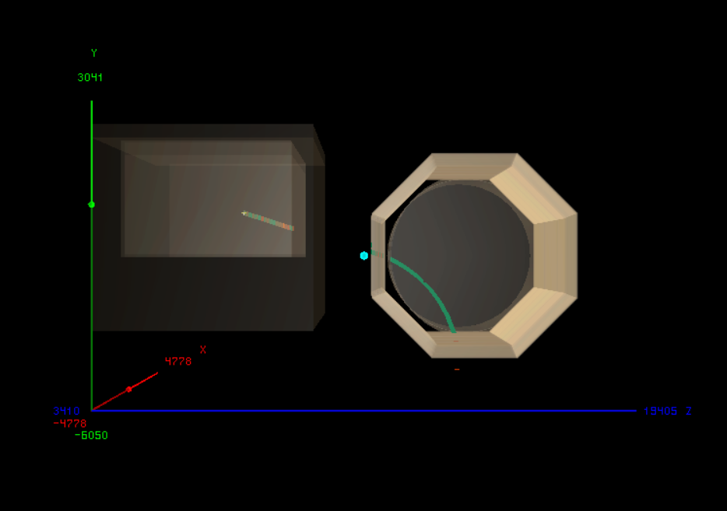
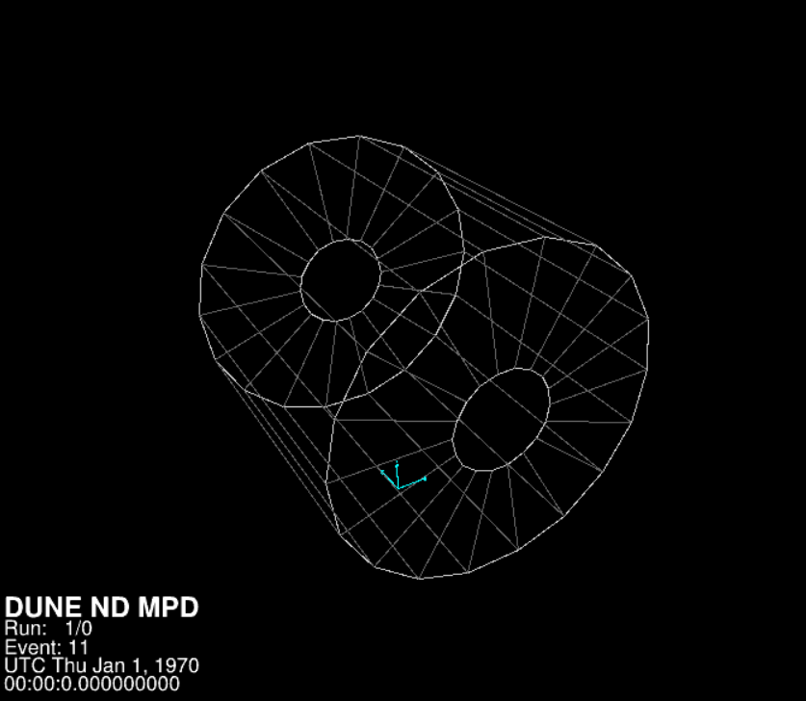
PROBLEMS WITH EDEP-SIM
Then tried to modify the geometry used by conversionedepjob.fcl to the corresponding NDGAr standalone (MPD_ECalOctagon_60l_SPY_v2_wMuID.gdml), but I get a mismatch in the events
Passing muon event from the Montecarlo simulation, visualized using edep-disp
Same passing muon event from the Montecarlo simulation, visualized using evd.fcl (used corresponding standalone geometry, get error when using hall geometry) after edep-sim conversion to art format has been applied

Slide 4
PROBLEMS WITH EDEP-SIM
There might be problems with conversionedepjob.fcl. Might try to fix them myself, but still don’t know how to modify GarSoft modules
Also need to be able to modify GArSoft modules, if I want to get informations about the Kalman filter process and produce state vector variables evolution graph

