Slide 1
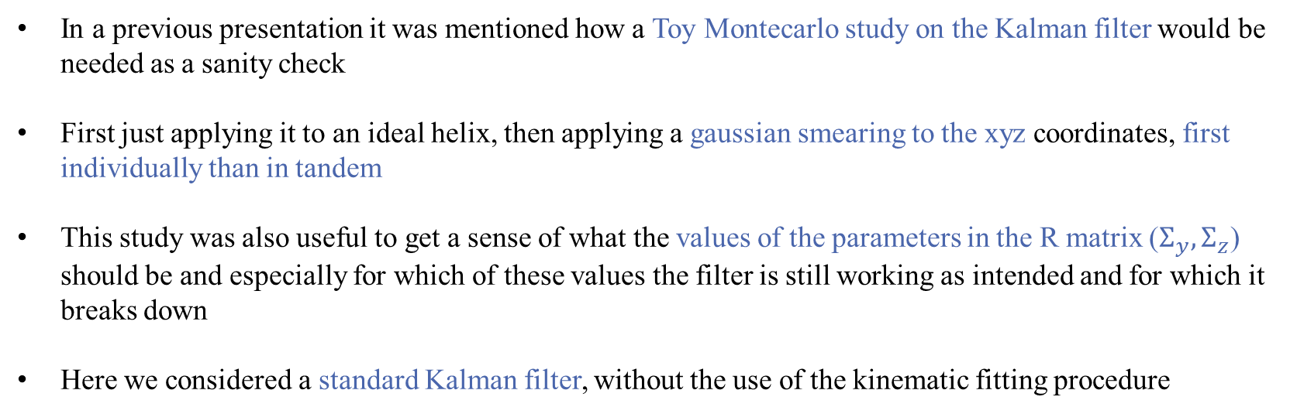
Toy monte carlo STUDY
In a previous presentation it was mentioned how a Toy Montecarlo study on the Kalman filter would be needed as a sanity check
First just applying it to an ideal helix, then applying a gaussian smearing to the xyz coordinates, first individually than in tandem
This study was also useful to get a sense of what the values of the parameters in the R matrix ($Σ_{y},Σ_{z}$) should be and especially for which of these values the filter is still working as intended and for which it breaks down
Here we considered a standard Kalman filter, without the use of the kinematic fitting procedure

Slide 2
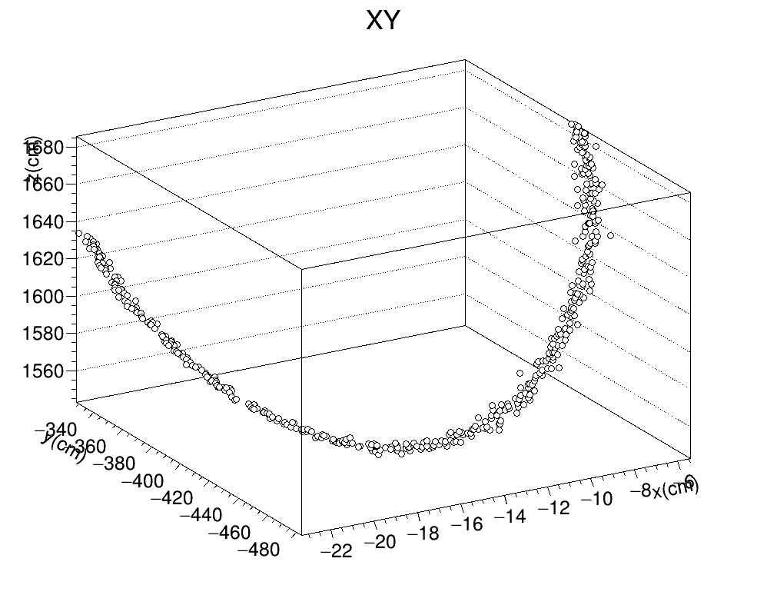
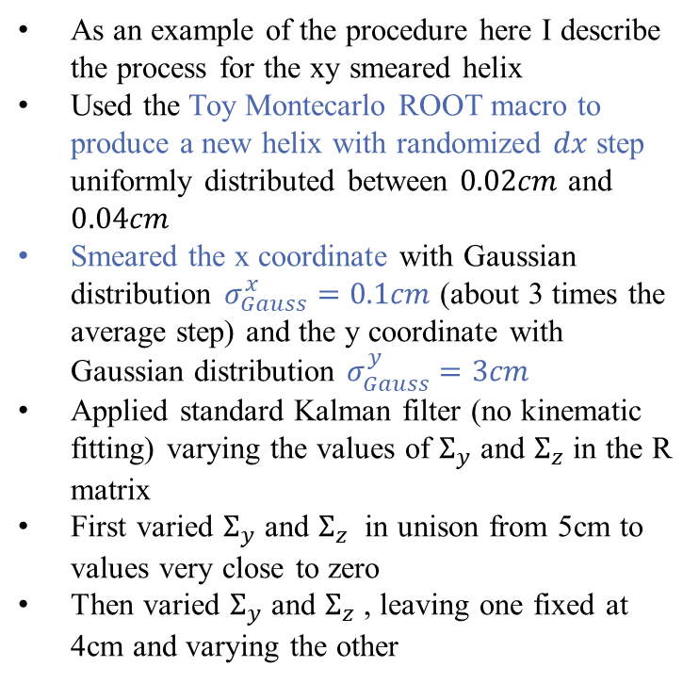
Toy monte carlo SMEARED XY
As an example of the procedure here I describe the process for the xy smeared helix
Used the Toy Montecarlo ROOT macro to produce a new helix with randomized $dx$ step uniformly distributed between $0.02cm$ and $0.04cm$
Smeared the x coordinate with Gaussian distribution $σ_{Gauss}^{x}=0.1cm$ (about 3 times the average step) and the y coordinate with Gaussian distribution $σ_{Gauss}^{y}=3cm$
Applied standard Kalman filter (no kinematic fitting) varying the values of $Σ_{y}$ and $Σ_{z}$ in the R matrix
First varied $Σ_{y}$ and $Σ_{z}$ in unison from 5cm to values very close to zero
Then varied $Σ_{y}$ and $Σ_{z}$ , leaving one fixed at 4cm and varying the other

Slide 3
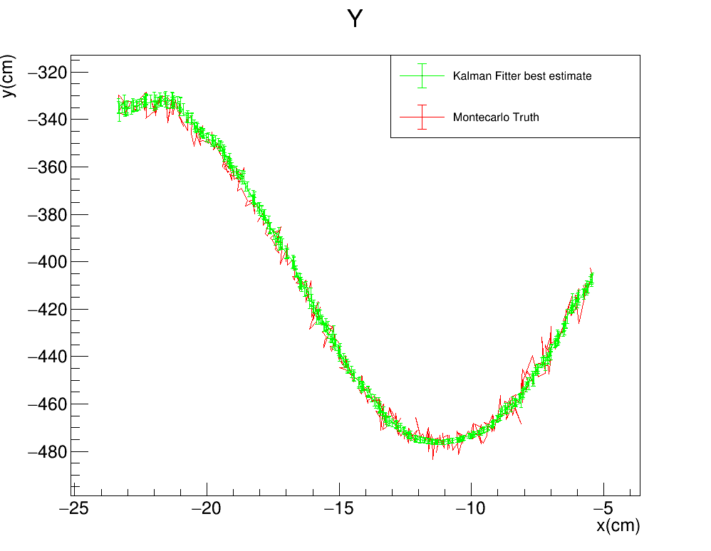
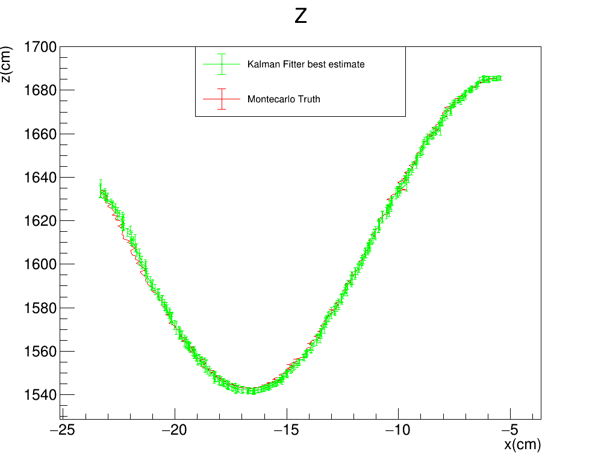



Toy monte carlo: SMEARED XY
Vary $Σ_{z}$ and $Σ_{y}$ from large to very small
STANDARD KALMAN FILTER
R$: \left(Σ_{y},Σ_{z}\right)=(5cm,5cm)$
Gauss$: {(σ}_{Gauss}^{x},σ_{Gauss}^{y})=(0.1 ,3)cm$
FILTER PROPAGATION DIRECTION

Slide 4
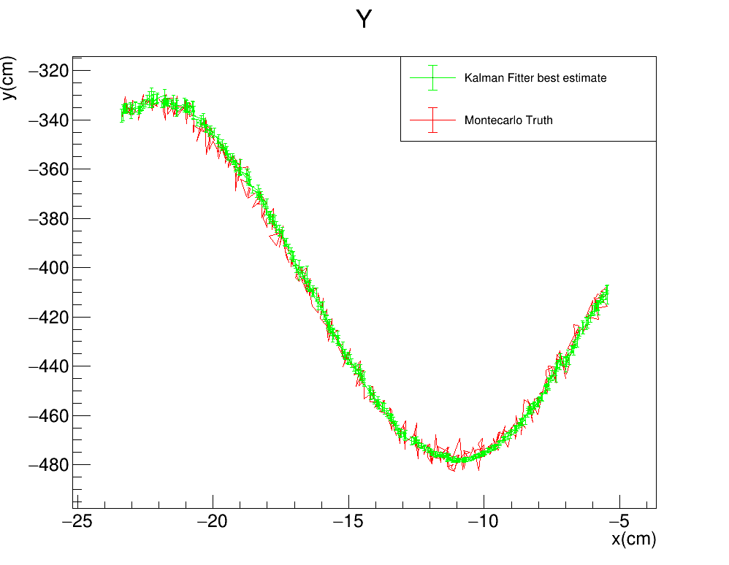
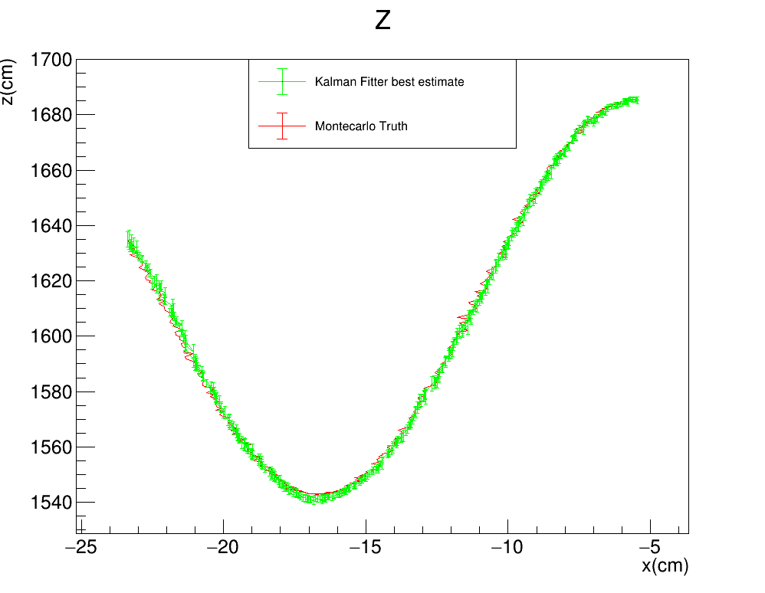

Toy monte carlo: SMEARED XY
STANDARD KALMAN FILTER
R$: \left(Σ_{y},Σ_{z}\right)=(4cm,4cm)$
Gauss$: {(σ}_{Gauss}^{x},σ_{Gauss}^{y})=(0.1 ,3)cm$
FILTER PROPAGATION DIRECTION

Slide 5
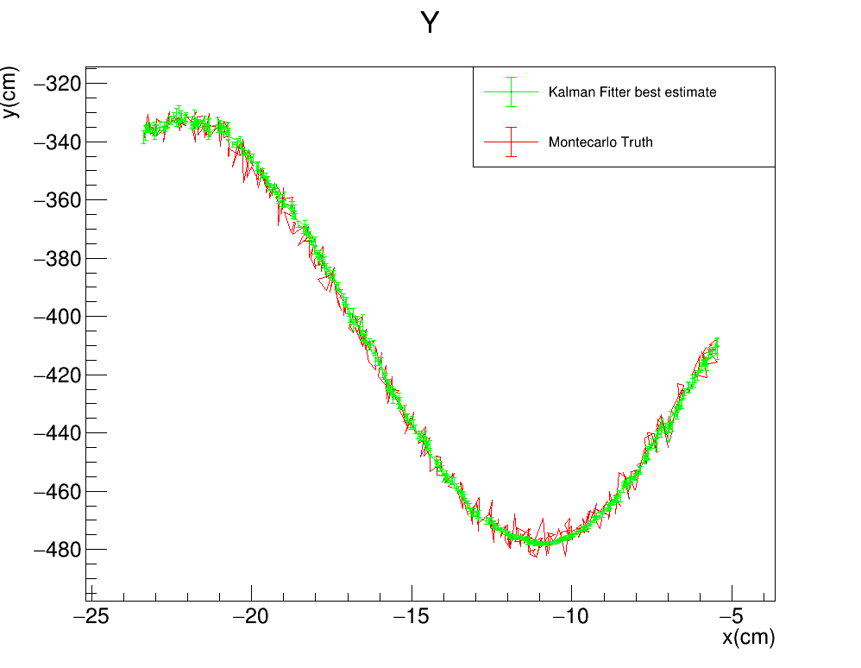
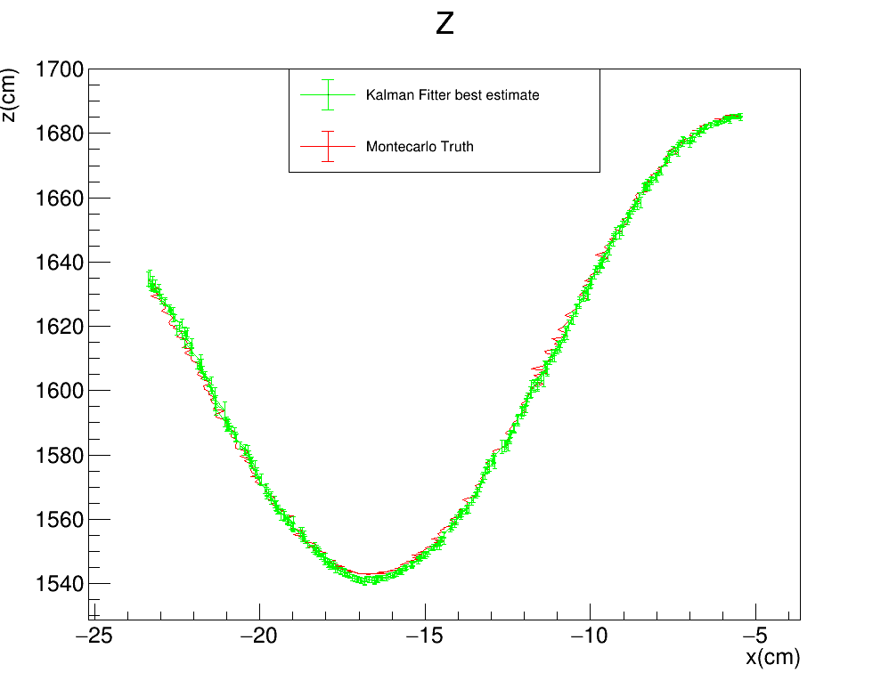

Toy monte carlo: SMEARED XY
STANDARD KALMAN FILTER
R$: \left(Σ_{y},Σ_{z}\right)=(3cm,3cm)$
Gauss$: {(σ}_{Gauss}^{x},σ_{Gauss}^{y})=(0.1 ,3)cm$
FILTER PROPAGATION DIRECTION

Slide 6
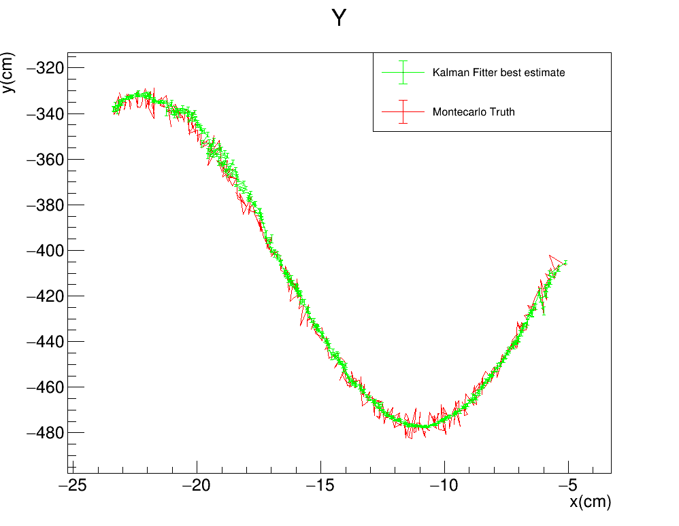


Toy monte carlo: SMEARED XY
STANDARD KALMAN FILTER
R$: \left(Σ_{y},Σ_{z}\right)=(2cm,2cm)$
Gauss$: {(σ}_{Gauss}^{x},σ_{Gauss}^{y})=(0.1 ,3)cm$
FILTER PROPAGATION DIRECTION

Slide 7
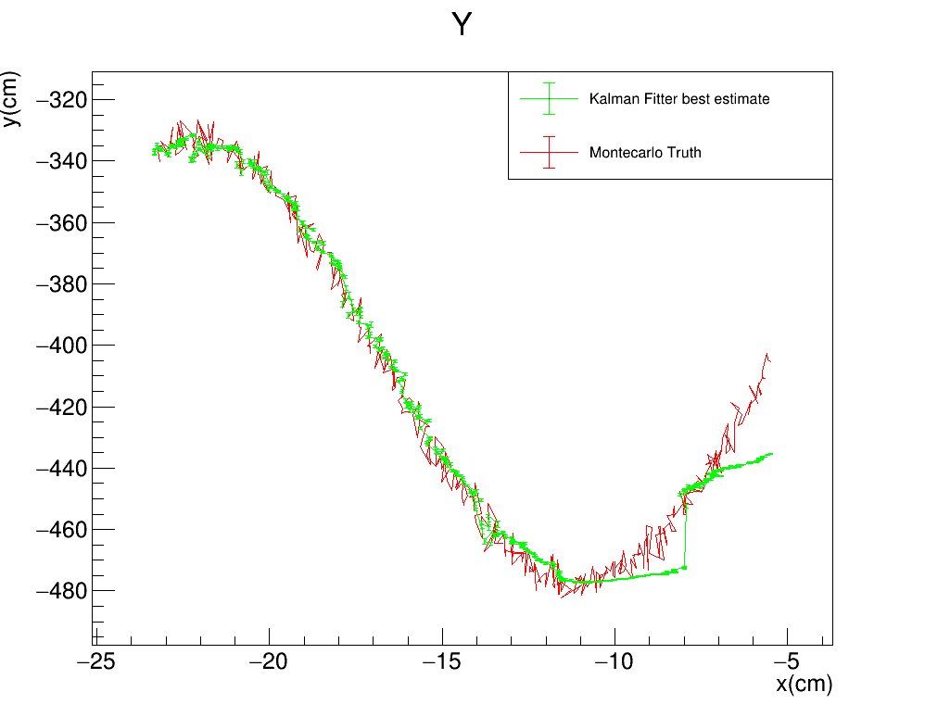
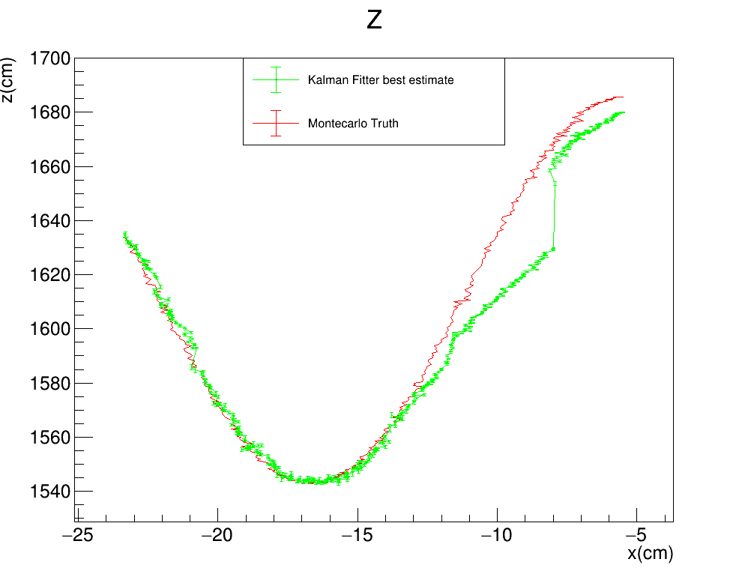

Toy monte carlo: SMEARED XY
STANDARD KALMAN FILTER
R$: \left(Σ_{y},Σ_{z}\right)=(1cm,1cm)$
Gauss$: {(σ}_{Gauss}^{x},σ_{Gauss}^{y})=(0.1 ,3)cm$
FILTER PROPAGATION DIRECTION

Slide 8
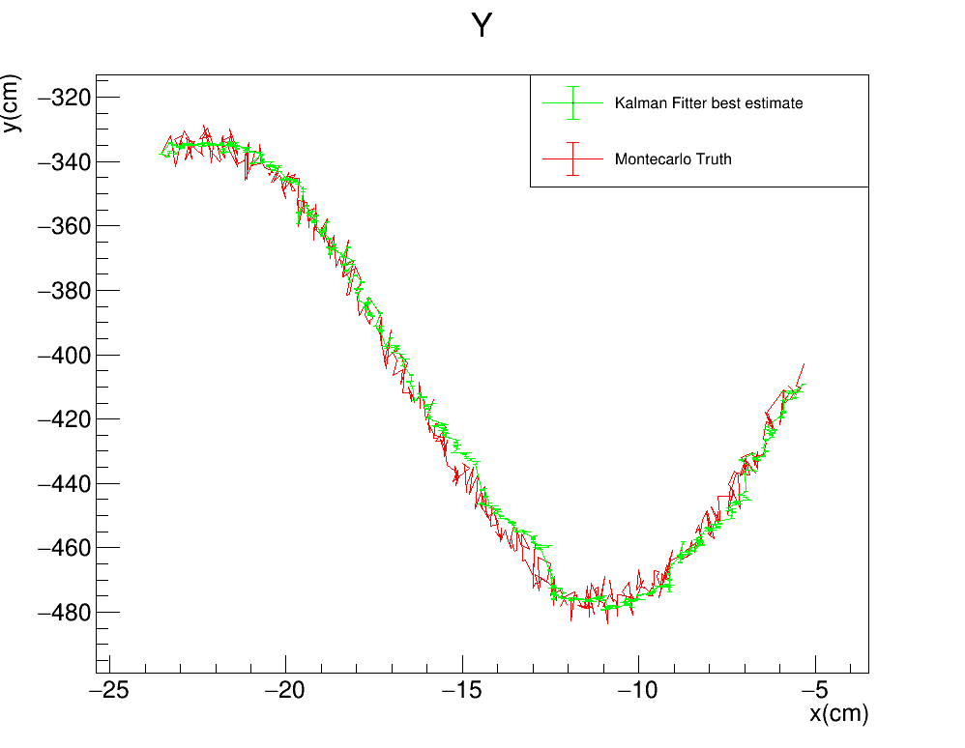
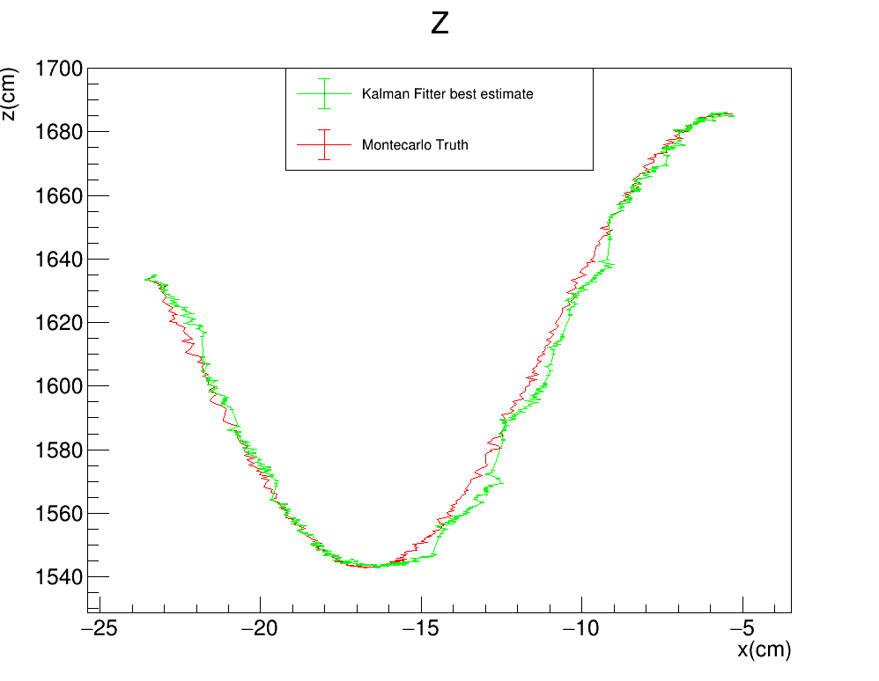

Toy monte carlo: SMEARED XY
STANDARD KALMAN FILTER
R$: \left(Σ_{y},Σ_{z}\right)=(0.1cm,0.1cm)$
Gauss$: {(σ}_{Gauss}^{x},σ_{Gauss}^{y})=(0.1 ,3)cm$
FILTER PROPAGATION DIRECTION

Slide 9
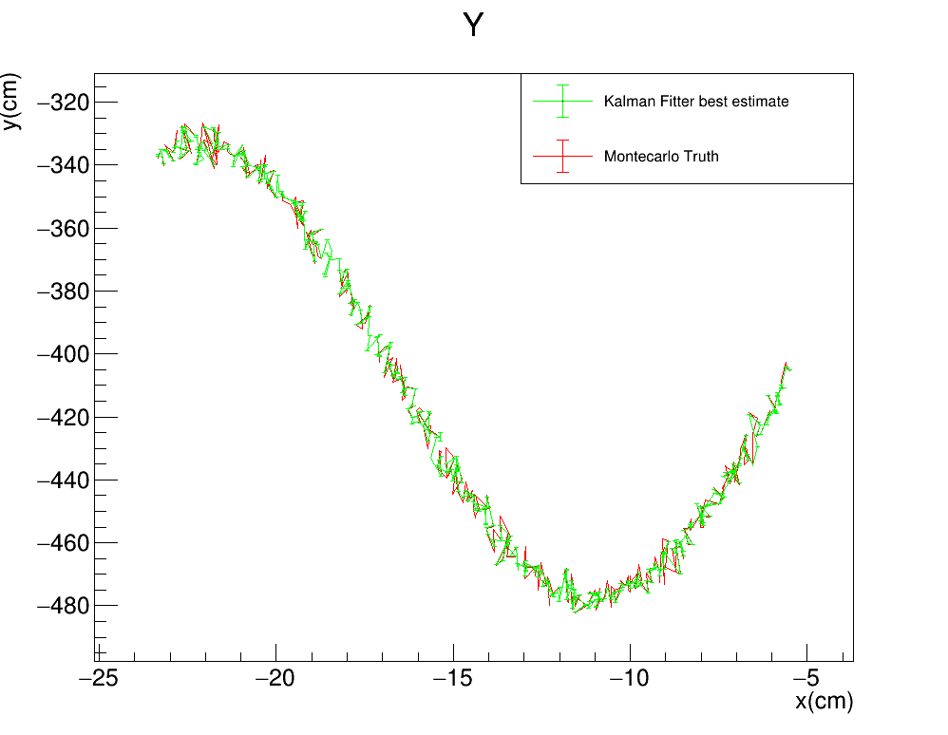
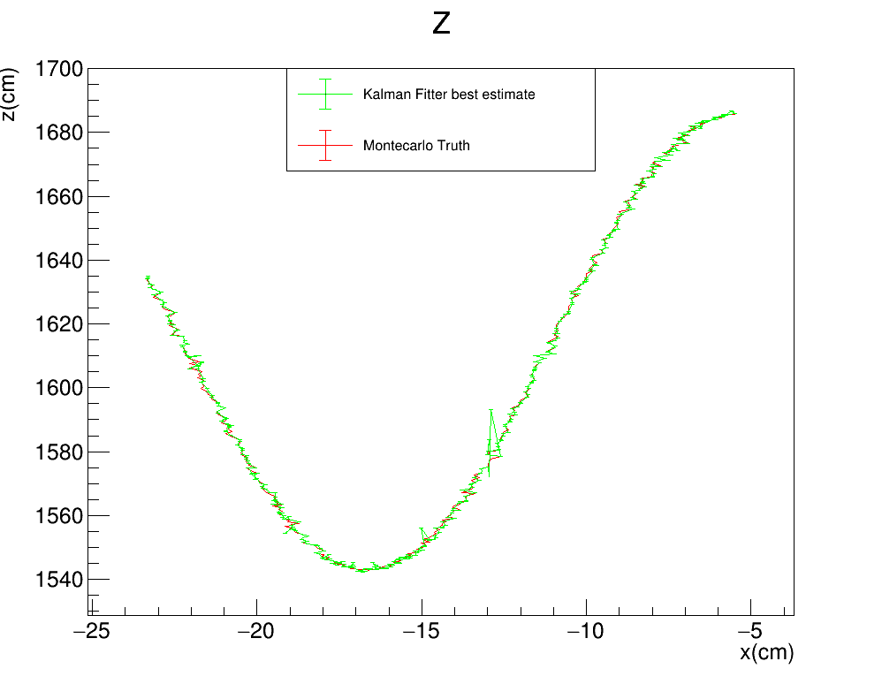

Toy monte carlo: SMEARED XY
STANDARD KALMAN FILTER
R$: \left(Σ_{y},Σ_{z}\right)=(0cm,0cm)$
Gauss$: {(σ}_{Gauss}^{x},σ_{Gauss}^{y})=(0.1 ,3)cm$
FILTER PROPAGATION DIRECTION

Slide 10
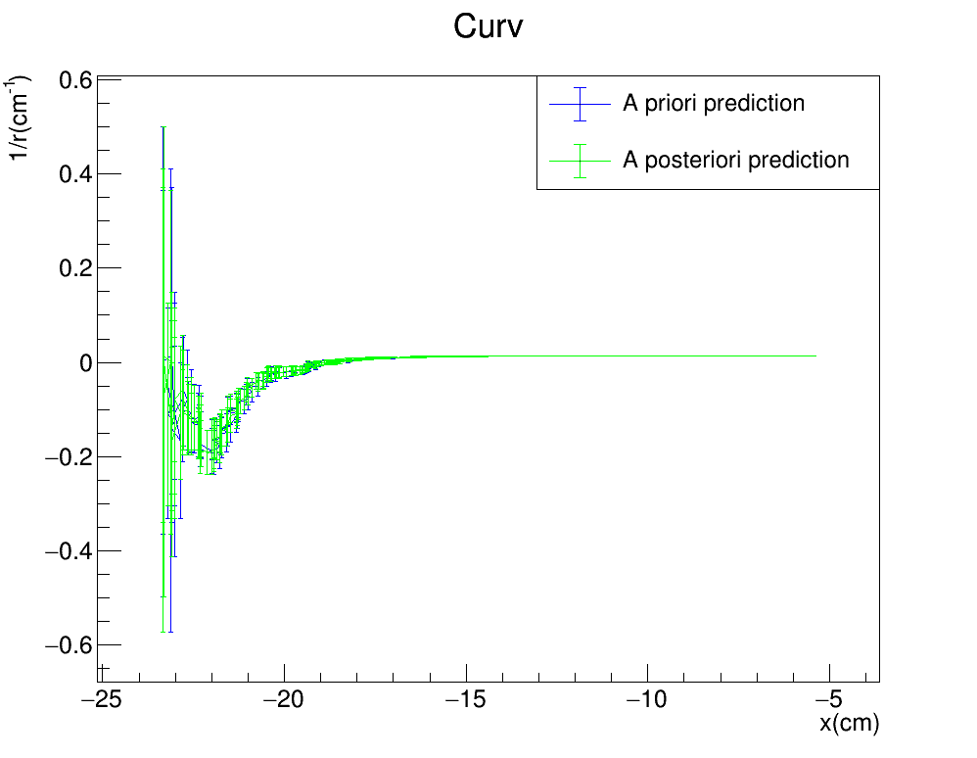
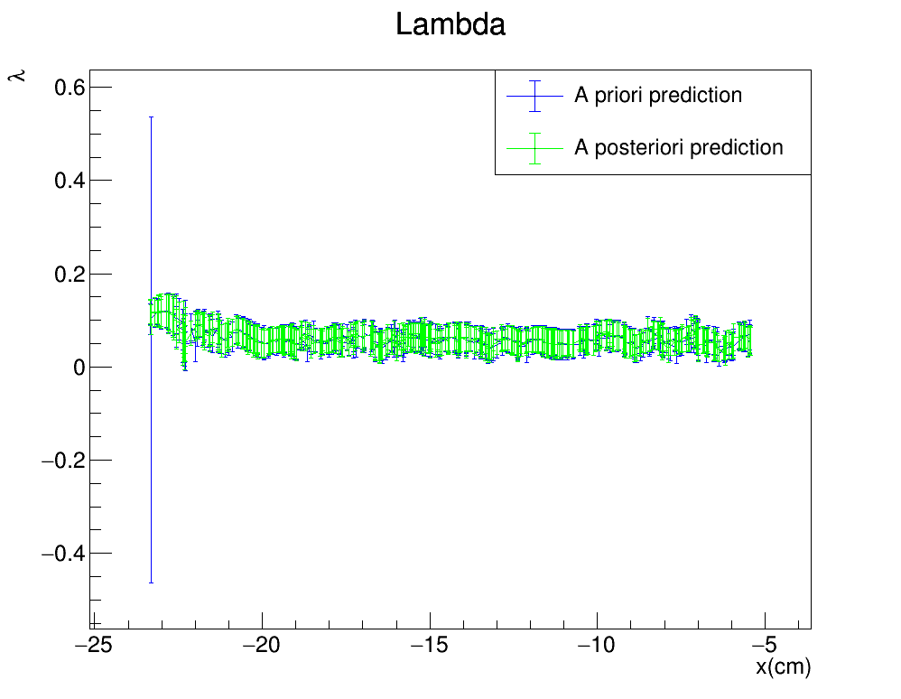
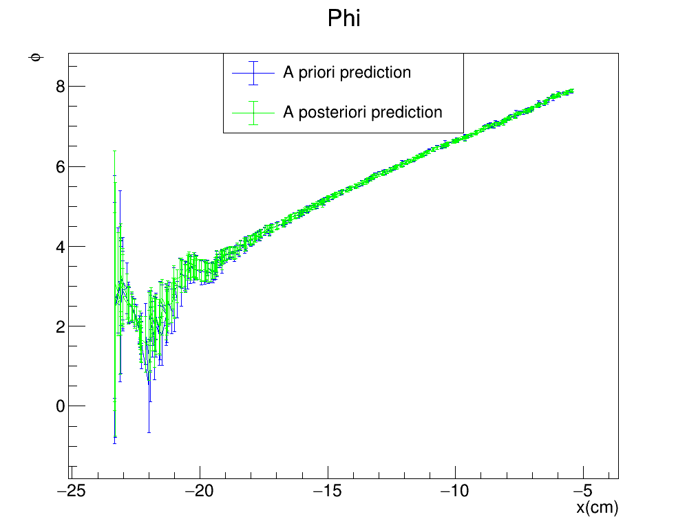
Toy monte carlo: SMEARED XY
Vary $Σ_{z}$ and $Σ_{y}$ from large to very small
R$: \left(Σ_{y},Σ_{z}\right)=(5cm,5cm)$
Gauss$: {(σ}_{Gauss}^{x},σ_{Gauss}^{y})=(0.1 ,3)cm$
FILTER PROPAGATION DIRECTION

Slide 11
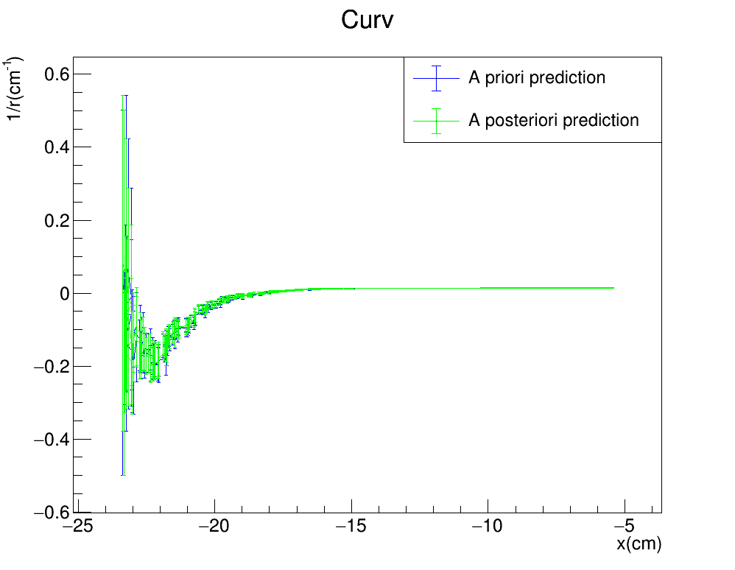
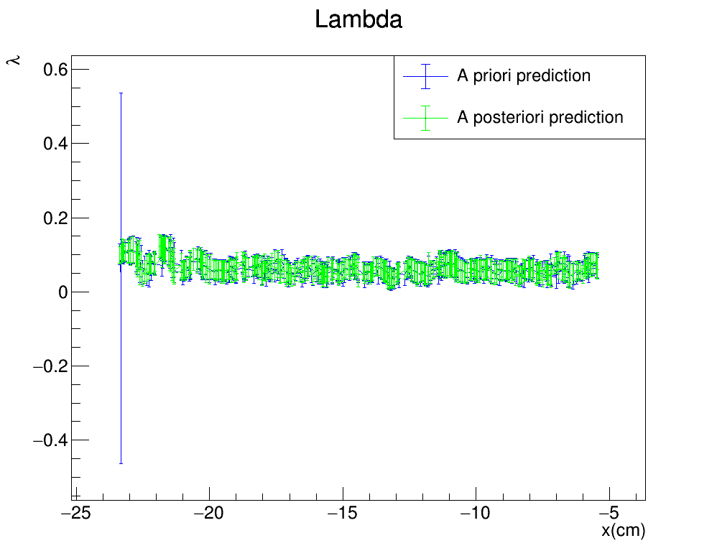
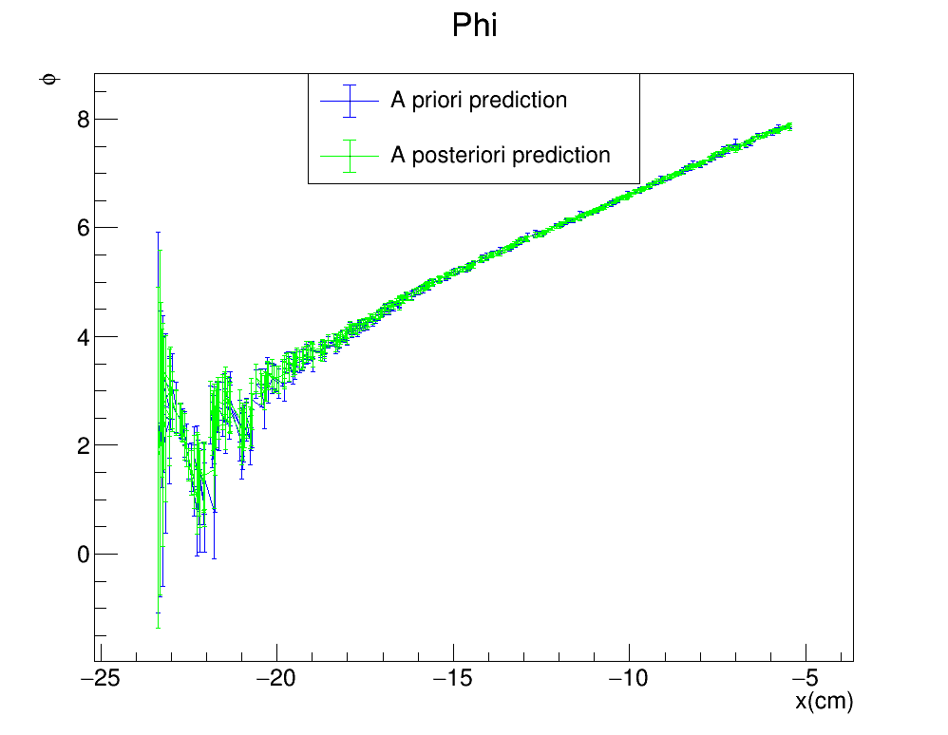
Toy monte carlo: SMEARED XY
R$: \left(Σ_{y},Σ_{z}\right)=(4cm,4cm)$
Gauss$: {(σ}_{Gauss}^{x},σ_{Gauss}^{y})=(0.1 ,3)cm$
FILTER PROPAGATION DIRECTION

Slide 12
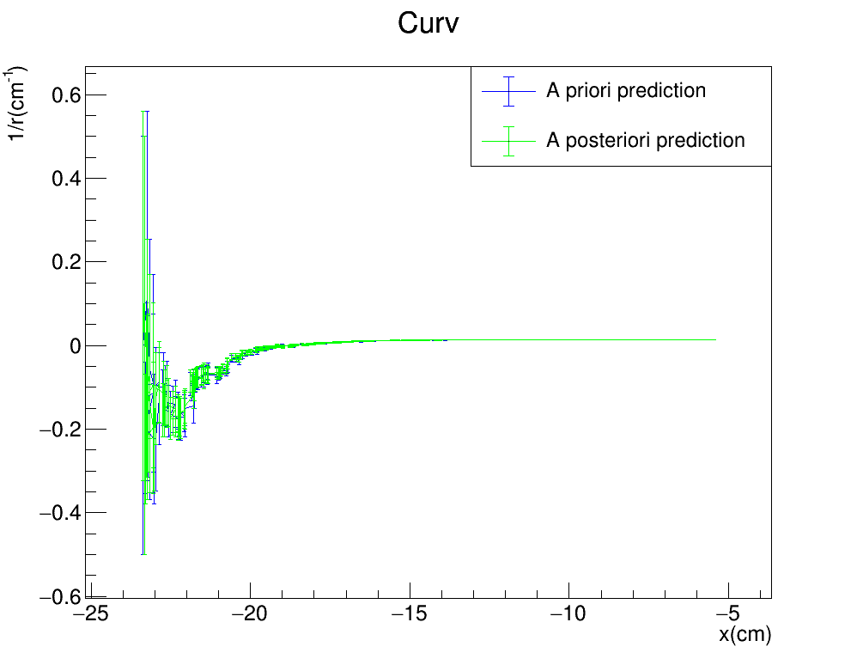
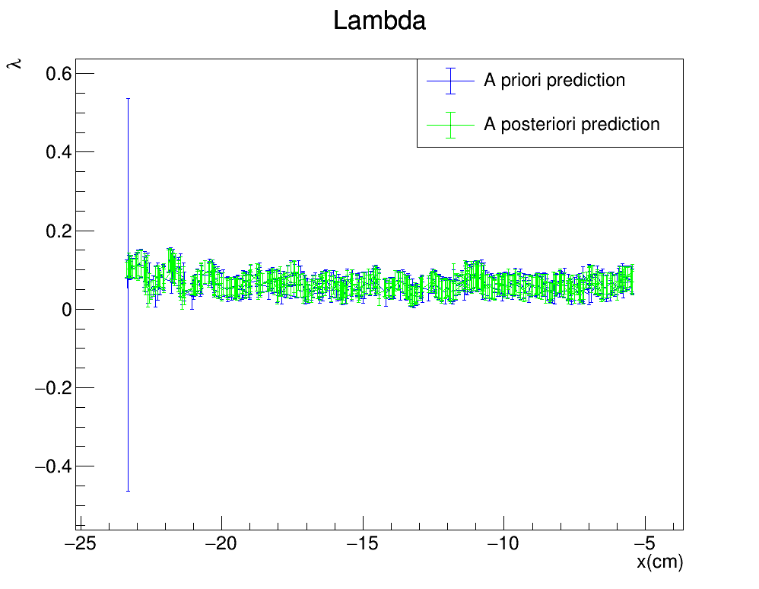
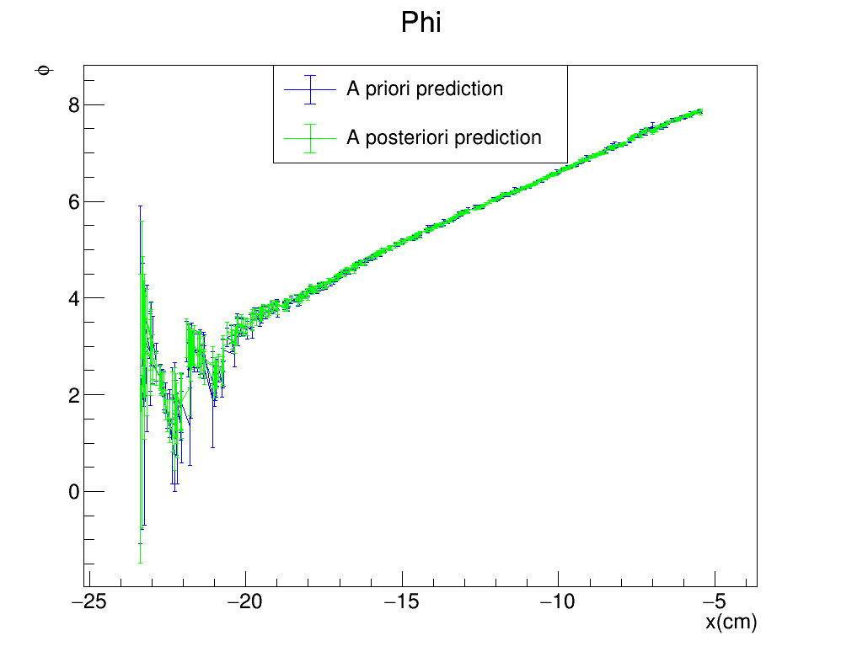
Toy monte carlo: SMEARED XY
R$: \left(Σ_{y},Σ_{z}\right)=(3cm,3cm)$
Gauss$: {(σ}_{Gauss}^{x},σ_{Gauss}^{y})=(0.1 ,3)cm$
FILTER PROPAGATION DIRECTION

Slide 13
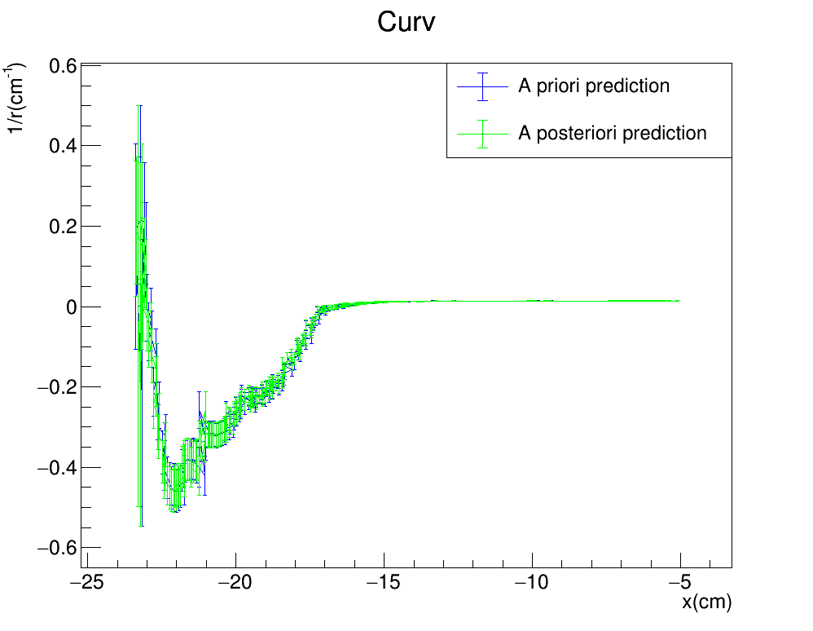
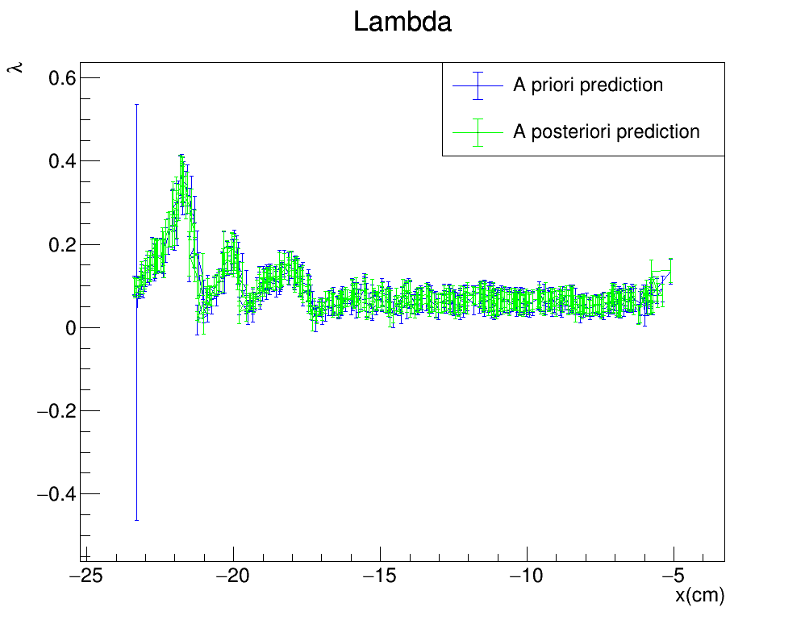
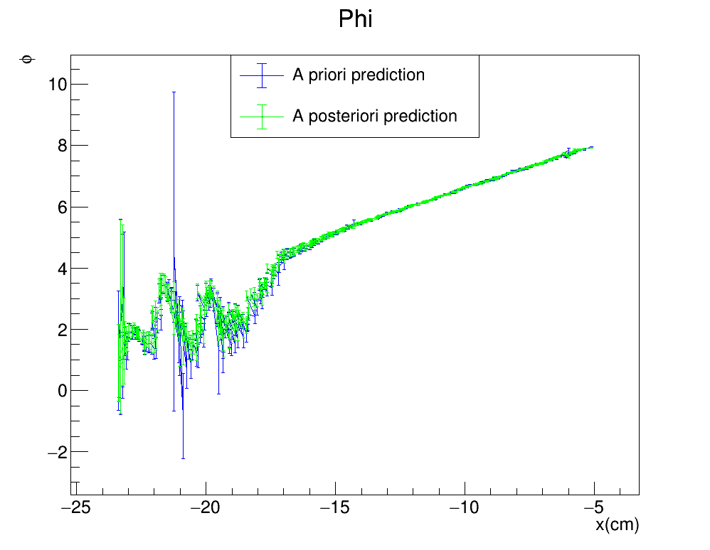
Toy monte carlo: SMEARED XY
R$: \left(Σ_{y},Σ_{z}\right)=(2cm,2cm)$
Gauss$: {(σ}_{Gauss}^{x},σ_{Gauss}^{y})=(0.1 ,3)cm$
FILTER PROPAGATION DIRECTION

Slide 14
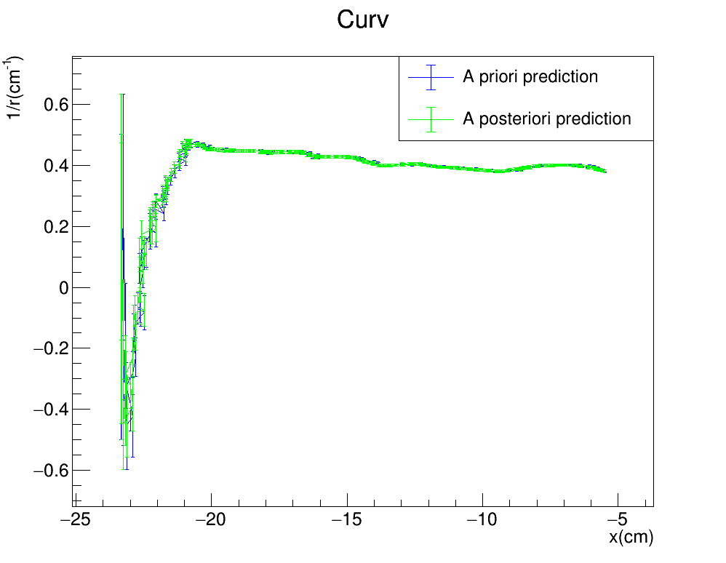
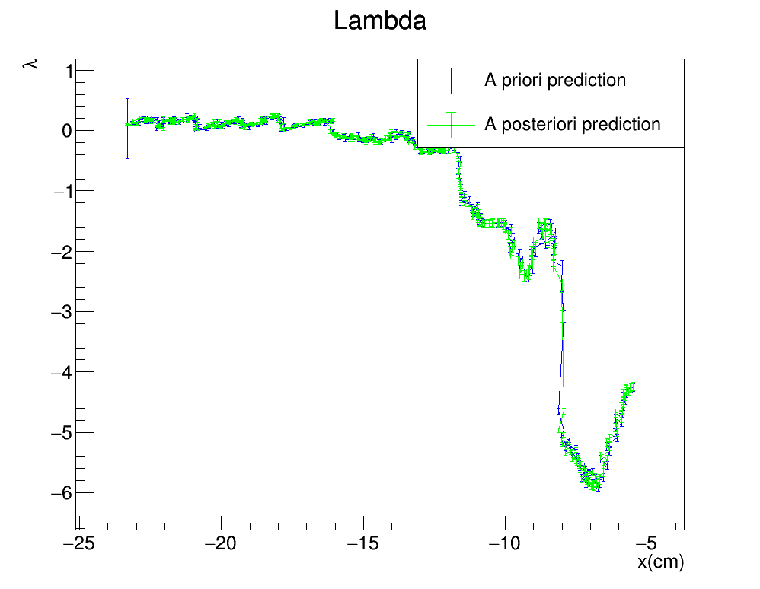
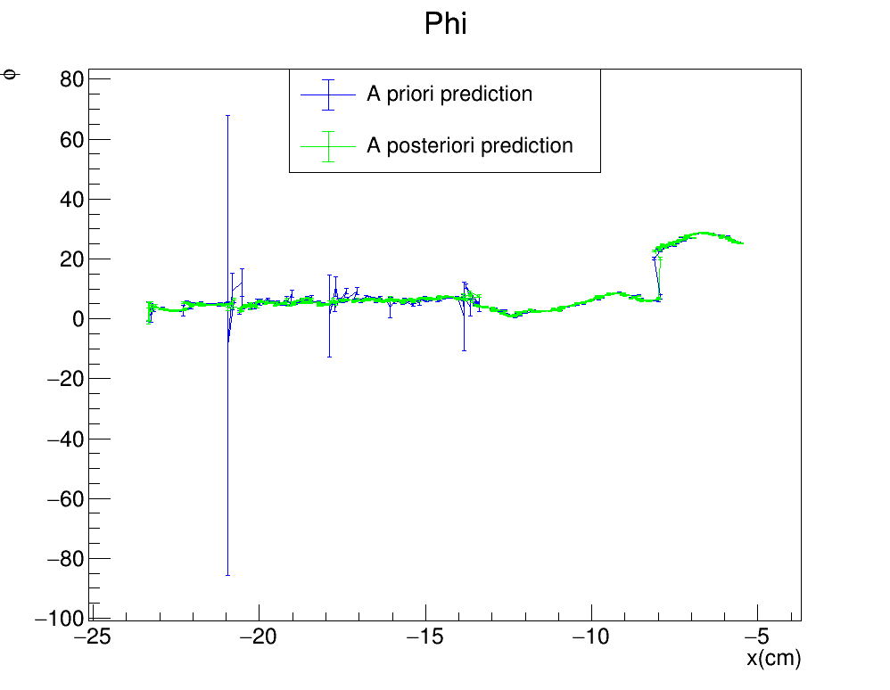
Toy monte carlo: SMEARED XY
R$: \left(Σ_{y},Σ_{z}\right)=(1cm,1cm)$
Gauss$: {(σ}_{Gauss}^{x},σ_{Gauss}^{y})=(0.1 ,3)cm$
FILTER PROPAGATION DIRECTION

Slide 15
Toy monte carlo: SMEARED XY
R$: \left(Σ_{y},Σ_{z}\right)=(0.1cm,0.1cm)$
Gauss$: {(σ}_{Gauss}^{x},σ_{Gauss}^{y})=(0.1 ,3)cm$
FILTER PROPAGATION DIRECTION

Slide 16
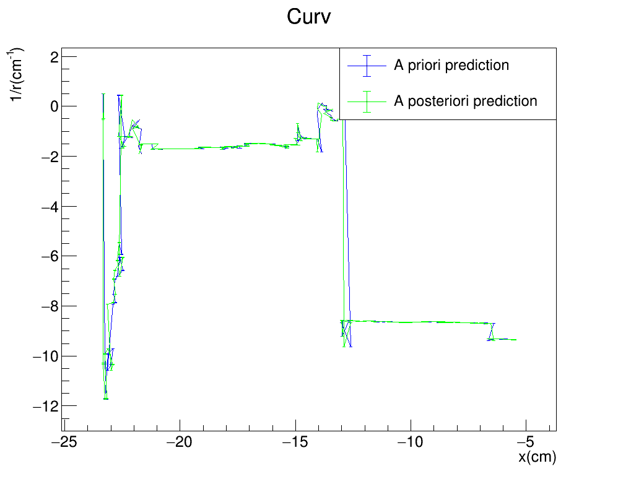
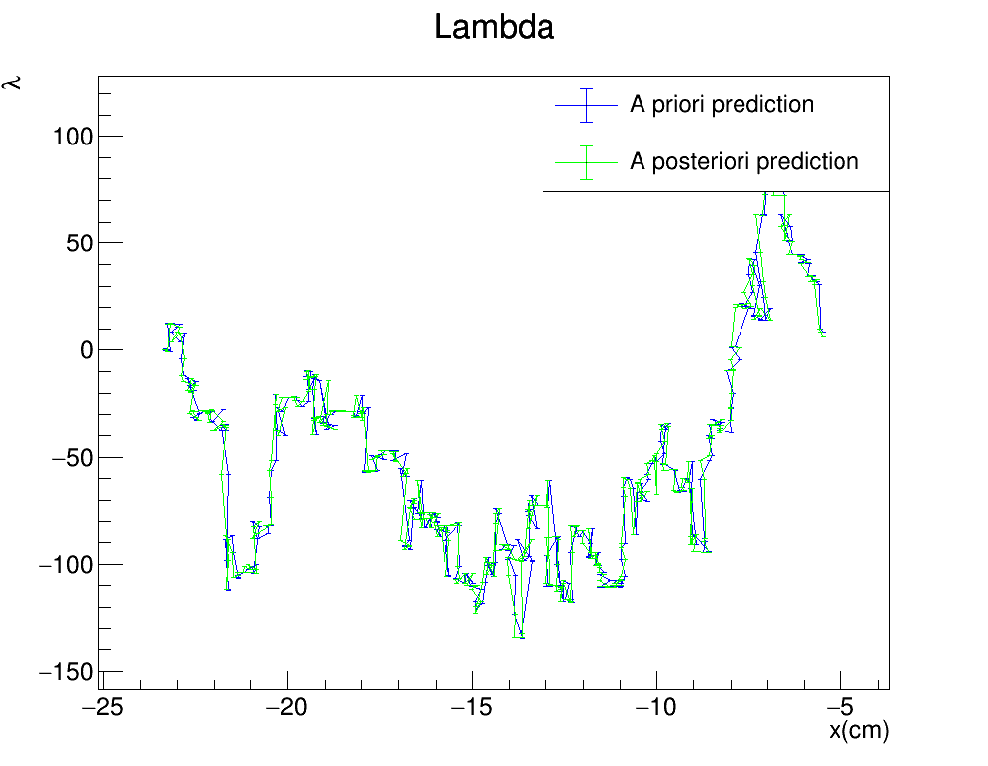
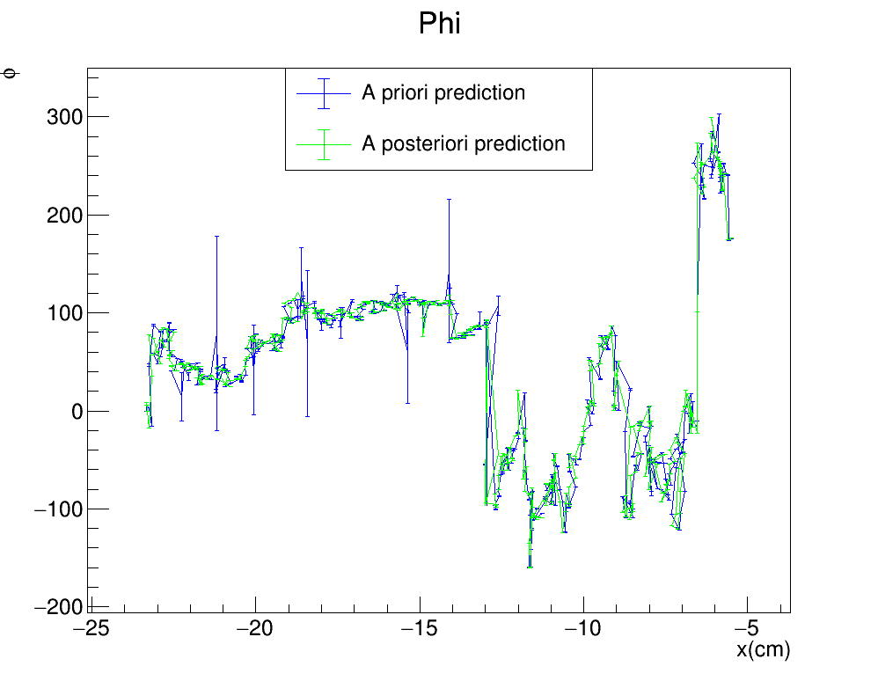
Toy monte carlo: SMEARED XY
R$: \left(Σ_{y},Σ_{z}\right)=(0cm,0cm)$
Gauss$: {(σ}_{Gauss}^{x},σ_{Gauss}^{y})=(0.1 ,3)cm$
FILTER PROPAGATION DIRECTION

Slide 17

Toy monte carlo: SMEARED XY
Kepp $Σ_{y}$ fixed at 4cm and go down with $Σ_{z}$
STANDARD KALMAN FILTER
R$: \left(Σ_{y},Σ_{z}\right)=(4cm,4cm)$
Gauss$: {(σ}_{Gauss}^{x},σ_{Gauss}^{y})=(0.1 ,3)cm$
FILTER PROPAGATION DIRECTION

Slide 18
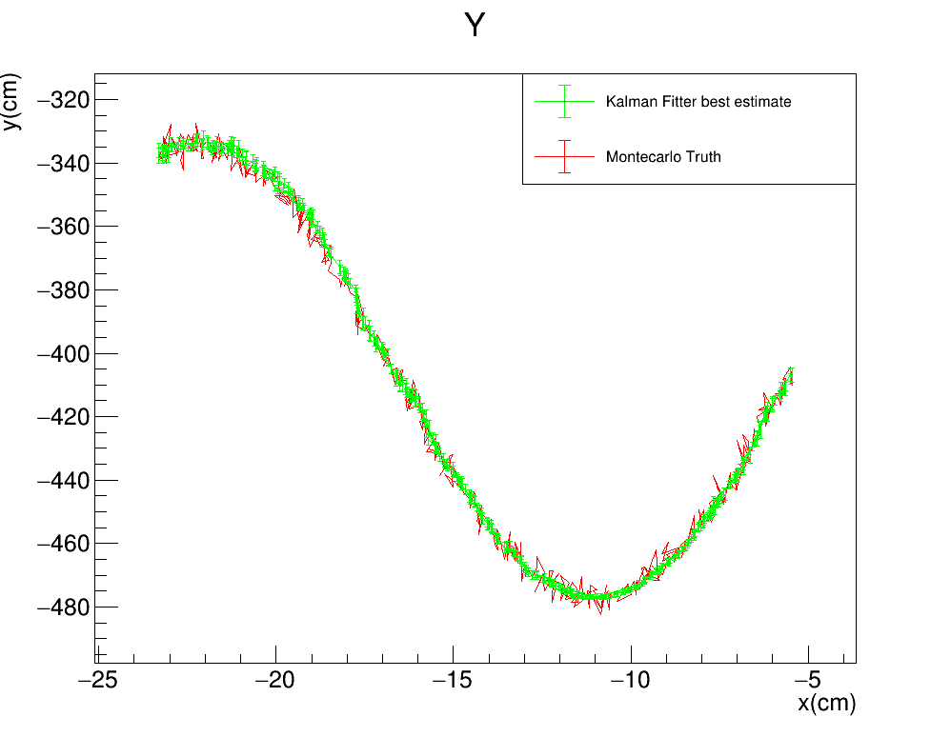


Toy monte carlo: SMEARED XY
STANDARD KALMAN FILTER
R$: \left(Σ_{y},Σ_{z}\right)=(4cm,3cm)$
Gauss$: {(σ}_{Gauss}^{x},σ_{Gauss}^{y})=(0.1 ,3)cm$
FILTER PROPAGATION DIRECTION

Slide 19
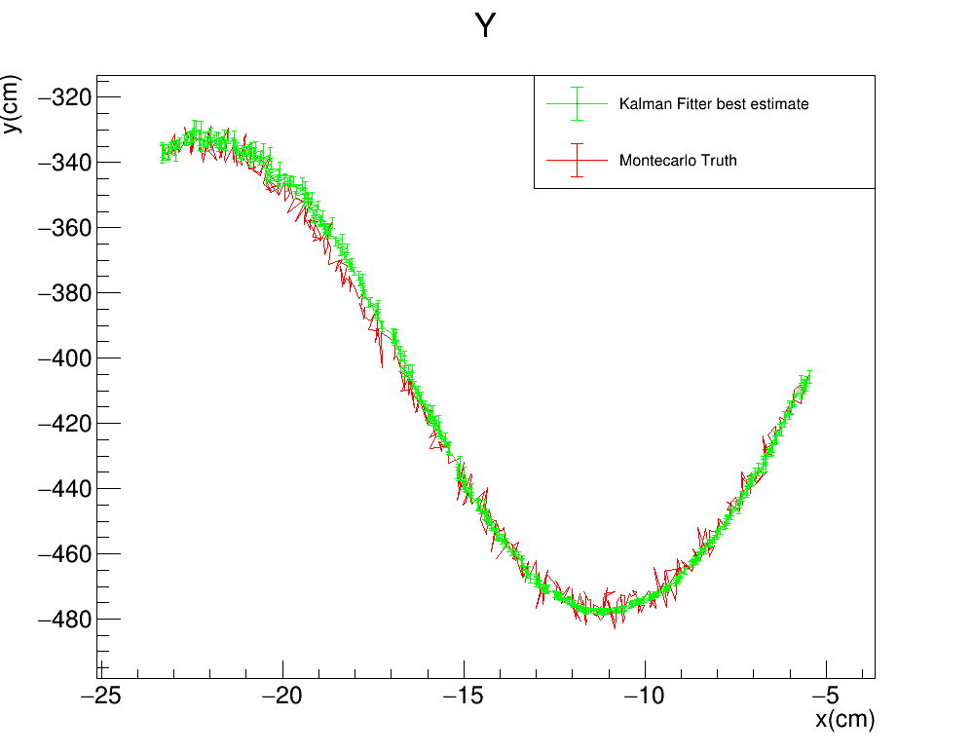
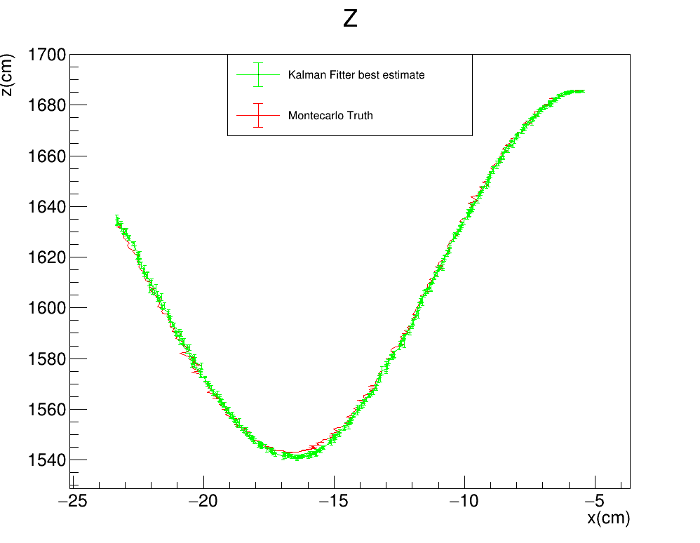

Toy monte carlo: SMEARED XY
STANDARD KALMAN FILTER
R$: \left(Σ_{y},Σ_{z}\right)=(4cm,2cm)$
Gauss$: {(σ}_{Gauss}^{x},σ_{Gauss}^{y})=(0.1 ,3)cm$
FILTER PROPAGATION DIRECTION

Slide 20
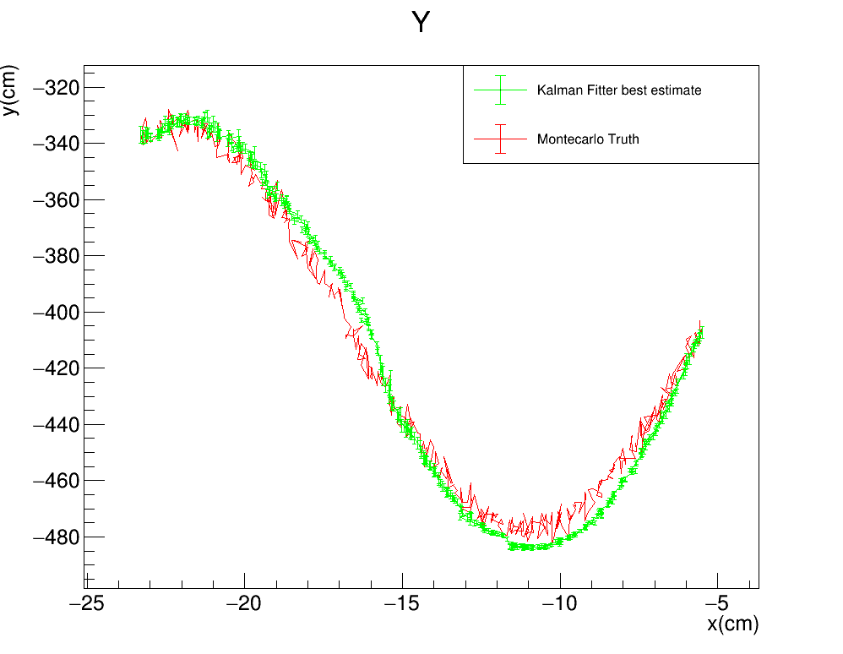
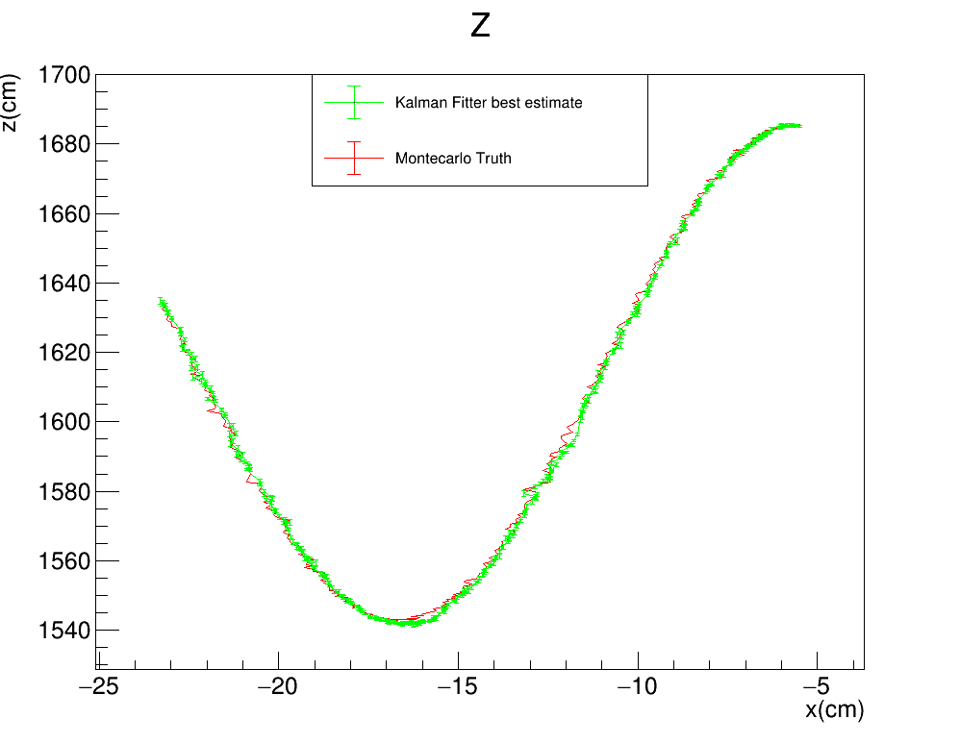

Toy monte carlo: SMEARED XY
STANDARD KALMAN FILTER
R$: \left(Σ_{y},Σ_{z}\right)=(4cm,1cm)$
Gauss$: {(σ}_{Gauss}^{x},σ_{Gauss}^{y})=(0.1 ,3)cm$
FILTER PROPAGATION DIRECTION

Slide 21
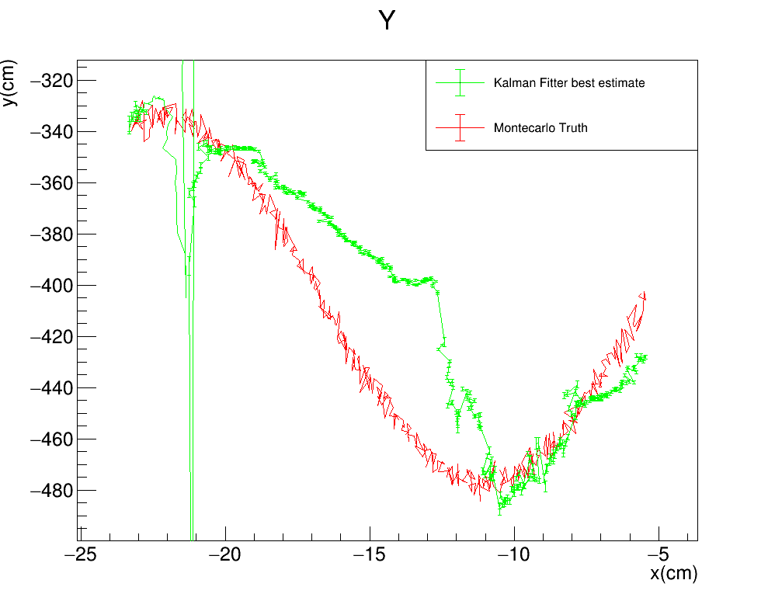
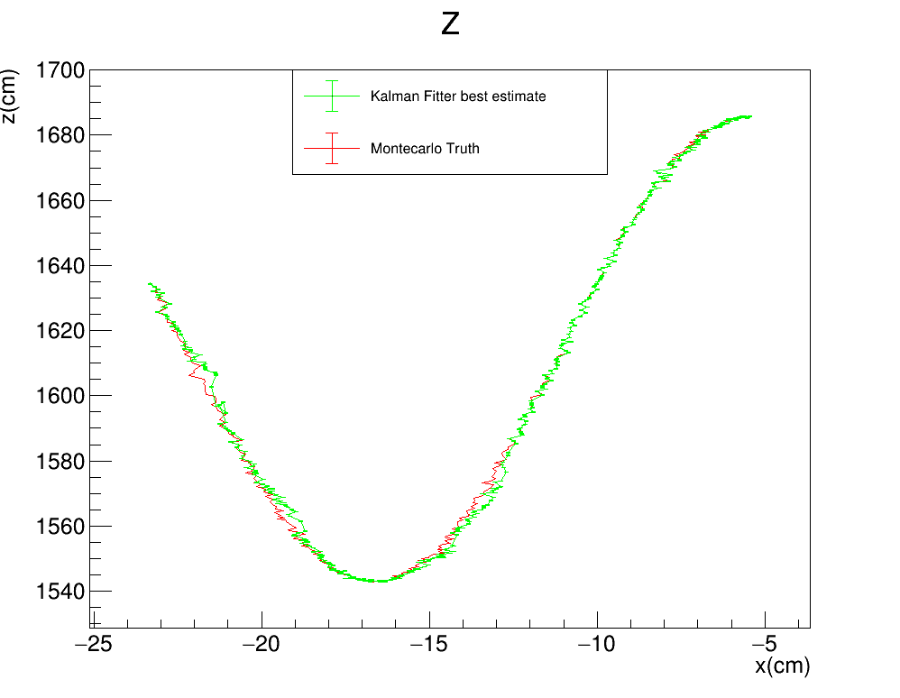

Toy monte carlo: SMEARED XY
STANDARD KALMAN FILTER
R$: \left(Σ_{y},Σ_{z}\right)=(4cm,0.1cm)$
Gauss$: {(σ}_{Gauss}^{x},σ_{Gauss}^{y})=(0.1 ,3)cm$
FILTER PROPAGATION DIRECTION

Slide 22
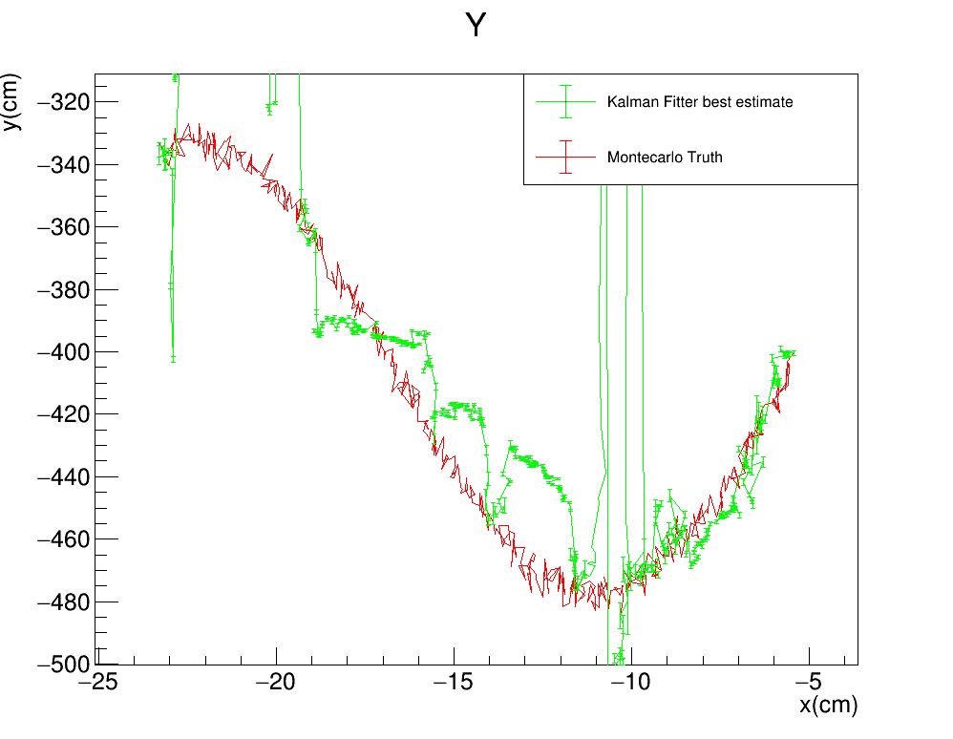
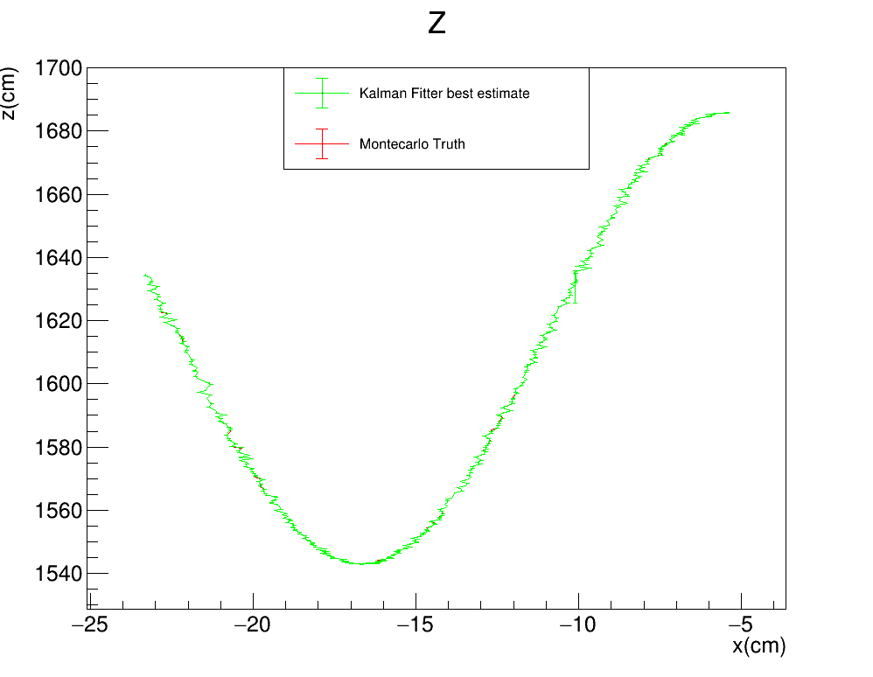

Toy monte carlo: SMEARED XY
STANDARD KALMAN FILTER
R$: \left(Σ_{y},Σ_{z}\right)=(4cm,0cm)$
Gauss$: {(σ}_{Gauss}^{x},σ_{Gauss}^{y})=(0.1 ,3)cm$
FILTER PROPAGATION DIRECTION

Slide 23
Toy monte carlo: SMEARED XY
Kepp $Σ_{y}$ fixed at 4cm and go down with $Σ_{z}$
STANDARD KALMAN FILTER
R$: \left(Σ_{y},Σ_{z}\right)=(4cm,4cm)$
Gauss$: {(σ}_{Gauss}^{x},σ_{Gauss}^{y})=(0.1 ,3)cm$
FILTER PROPAGATION DIRECTION

Slide 24
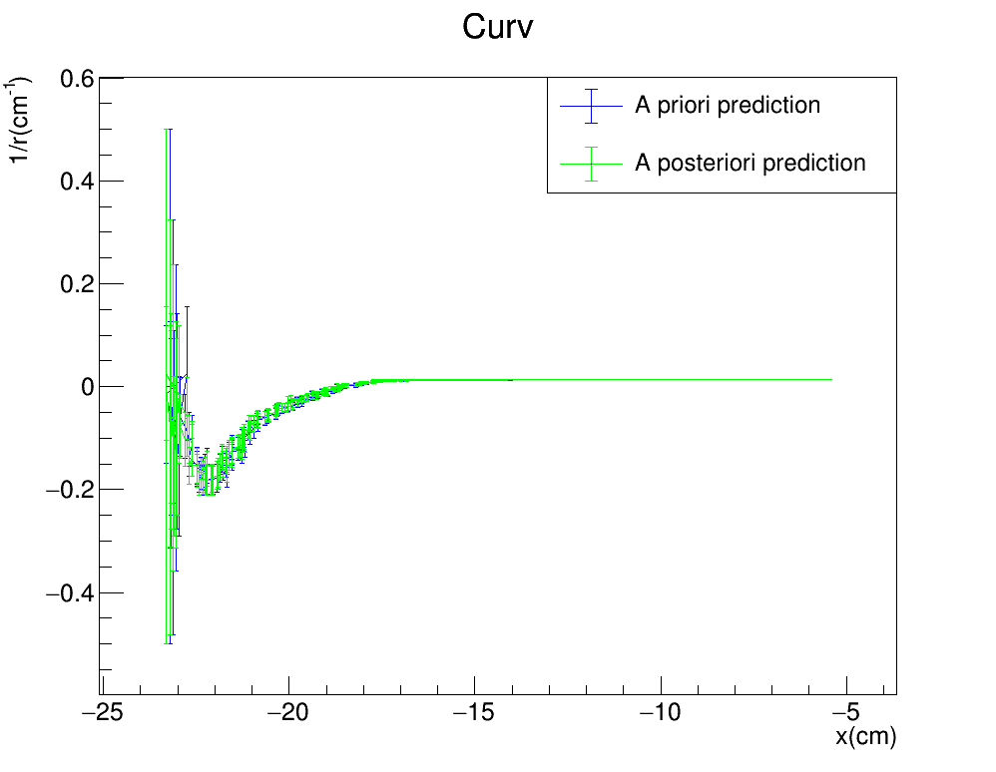
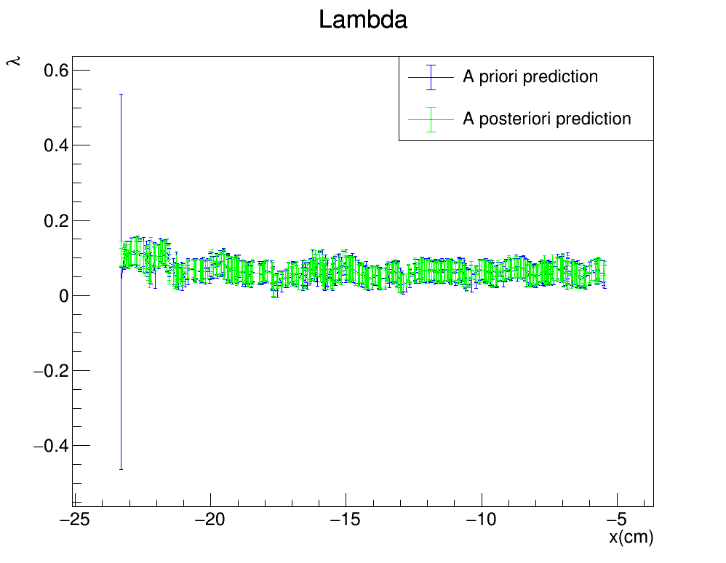
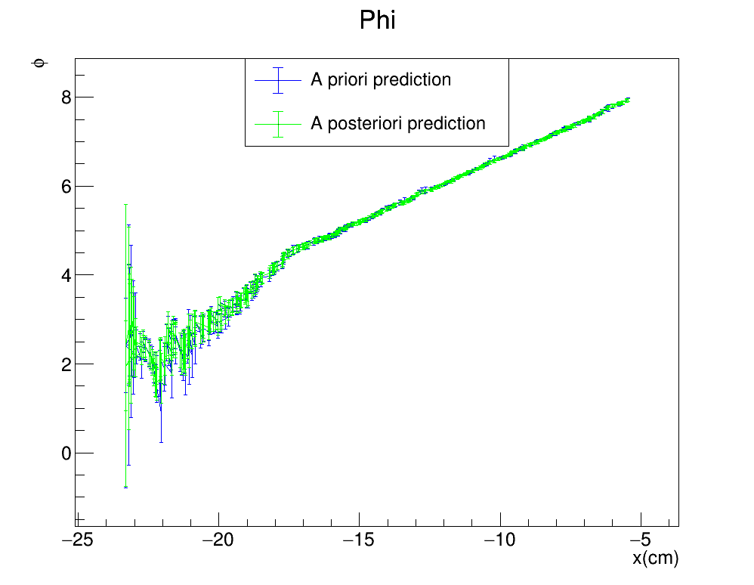
Toy monte carlo: SMEARED XY
STANDARD KALMAN FILTER
R$: \left(Σ_{y},Σ_{z}\right)=(4cm,3cm)$
Gauss$: {(σ}_{Gauss}^{x},σ_{Gauss}^{y})=(0.1 ,3)cm$
FILTER PROPAGATION DIRECTION

Slide 25
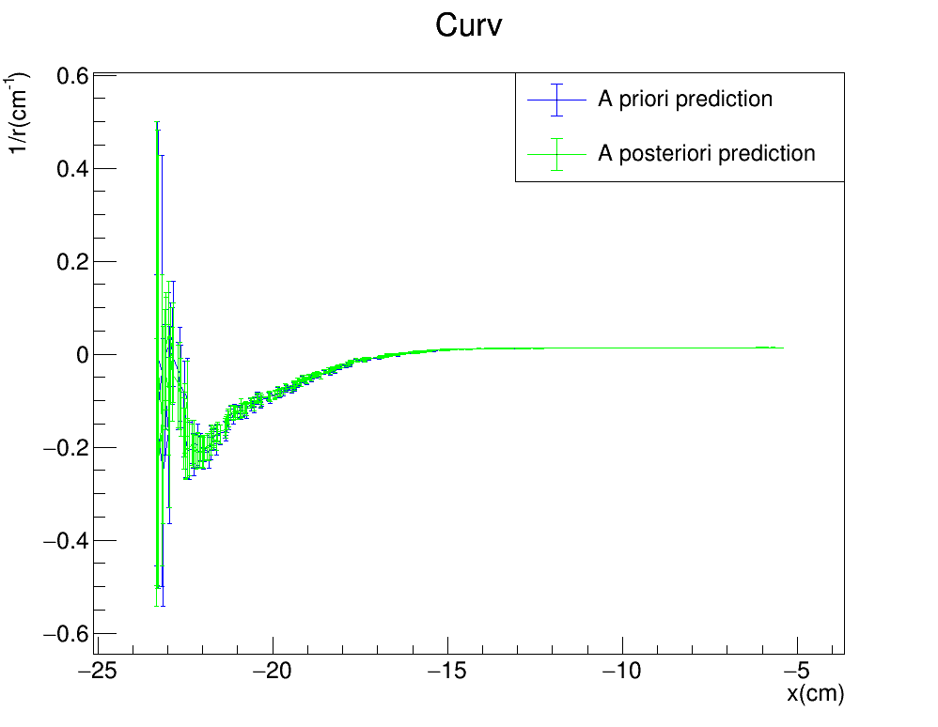
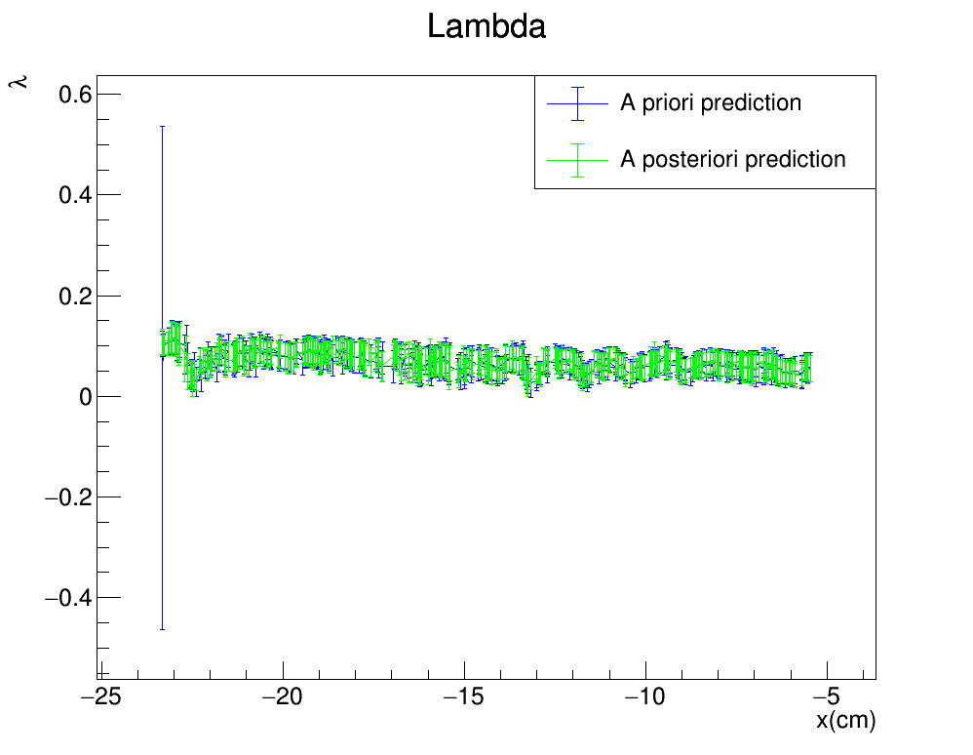
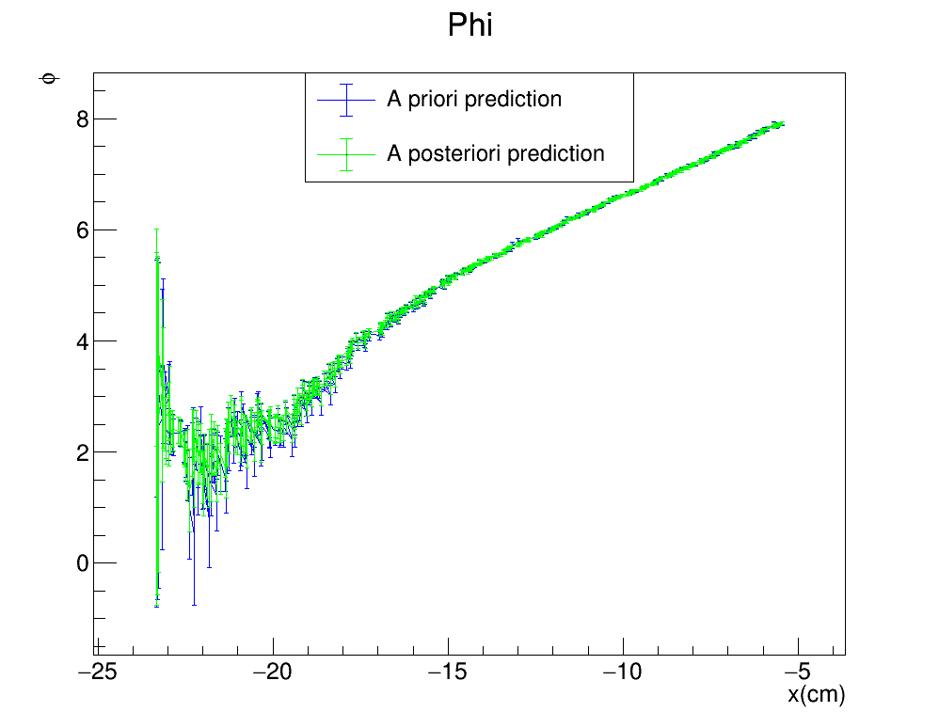
Toy monte carlo: SMEARED XY
STANDARD KALMAN FILTER
R$: \left(Σ_{y},Σ_{z}\right)=(4cm,2cm)$
Gauss$: {(σ}_{Gauss}^{x},σ_{Gauss}^{y})=(0.1 ,3)cm$
FILTER PROPAGATION DIRECTION

Slide 26
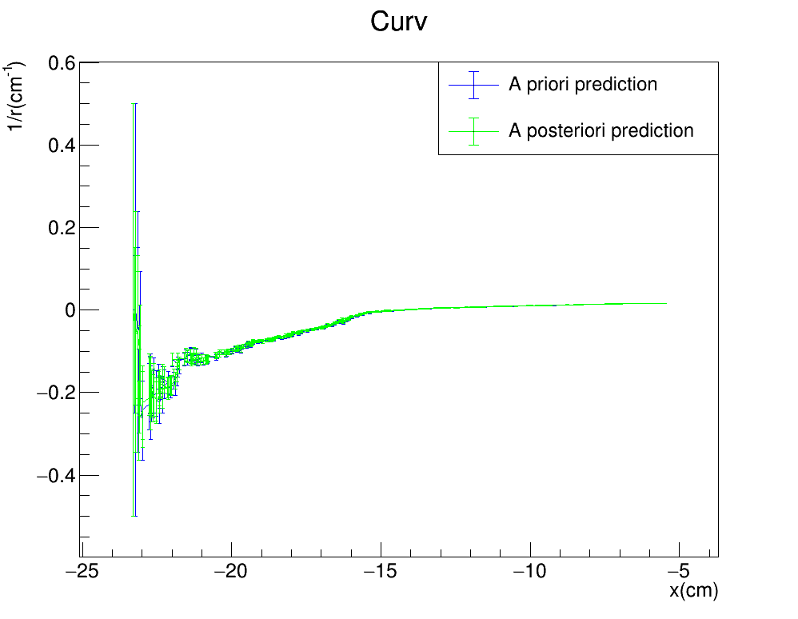


Toy monte carlo: SMEARED XY
STANDARD KALMAN FILTER
R$: \left(Σ_{y},Σ_{z}\right)=(4cm,1cm)$
Gauss$: {(σ}_{Gauss}^{x},σ_{Gauss}^{y})=(0.1 ,3)cm$
FILTER PROPAGATION DIRECTION

Slide 27



Toy monte carlo: SMEARED XY
STANDARD KALMAN FILTER
R$: \left(Σ_{y},Σ_{z}\right)=(4cm,0.1cm)$
Gauss$: {(σ}_{Gauss}^{x},σ_{Gauss}^{y})=(0.1 ,3)cm$
FILTER PROPAGATION DIRECTION

Slide 28



Toy monte carlo: SMEARED XY
STANDARD KALMAN FILTER
R$: \left(Σ_{y},Σ_{z}\right)=(4cm,0cm)$
Gauss$: {(σ}_{Gauss}^{x},σ_{Gauss}^{y})=(0.1 ,3)cm$
FILTER PROPAGATION DIRECTION

Slide 29

Toy monte carlo: SMEARED XY
Kepp $Σ_{z}$ fixed at 4cm and go down with $Σ_{y}$
STANDARD KALMAN FILTER
R$: \left(Σ_{y},Σ_{z}\right)=(4cm,4cm)$
Gauss$: {(σ}_{Gauss}^{x},σ_{Gauss}^{y})=(0.1 ,3)cm$
FILTER PROPAGATION DIRECTION

Slide 30



Toy monte carlo: SMEARED XY
STANDARD KALMAN FILTER
R$: \left(Σ_{y},Σ_{z}\right)=(3cm,4cm)$
Gauss$: {(σ}_{Gauss}^{x},σ_{Gauss}^{y})=(0.1 ,3)cm$
FILTER PROPAGATION DIRECTION

Slide 31



Toy monte carlo: SMEARED XY
STANDARD KALMAN FILTER
R$: \left(Σ_{y},Σ_{z}\right)=(2cm,4cm)$
Gauss$: {(σ}_{Gauss}^{x},σ_{Gauss}^{y})=(0.1 ,3)cm$
FILTER PROPAGATION DIRECTION

Slide 32



Toy monte carlo: SMEARED XY
STANDARD KALMAN FILTER
R$: \left(Σ_{y},Σ_{z}\right)=(1cm,4cm)$
Gauss$: {(σ}_{Gauss}^{x},σ_{Gauss}^{y})=(0.1 ,3)cm$
FILTER PROPAGATION DIRECTION

Slide 33



Toy monte carlo: SMEARED XY
STANDARD KALMAN FILTER
R$: \left(Σ_{y},Σ_{z}\right)=(0.1cm,4cm)$
Gauss$: {(σ}_{Gauss}^{x},σ_{Gauss}^{y})=(0.1 ,3)cm$
FILTER PROPAGATION DIRECTION

Slide 34



Toy monte carlo: SMEARED XY
STANDARD KALMAN FILTER
R$: \left(Σ_{y},Σ_{z}\right)=(0cm,4cm)$
Gauss$: {(σ}_{Gauss}^{x},σ_{Gauss}^{y})=(0.1 ,3)cm$
FILTER PROPAGATION DIRECTION

Slide 35
Toy monte carlo: SMEARED XY
Kepp $Σ_{z}$ fixed at 4cm and go down with $Σ_{y}$
STANDARD KALMAN FILTER
R$: \left(Σ_{y},Σ_{z}\right)=(4cm,4cm)$
Gauss$: {(σ}_{Gauss}^{x},σ_{Gauss}^{y})=(0.1 ,3)cm$
FILTER PROPAGATION DIRECTION

Slide 36



Toy monte carlo: SMEARED XY
STANDARD KALMAN FILTER
R$: \left(Σ_{y},Σ_{z}\right)=(3cm,4cm)$
Gauss$: {(σ}_{Gauss}^{x},σ_{Gauss}^{y})=(0.1 ,3)cm$
FILTER PROPAGATION DIRECTION

Slide 37



Toy monte carlo: SMEARED XY
STANDARD KALMAN FILTER
R$: \left(Σ_{y},Σ_{z}\right)=(2cm,4cm)$
Gauss$: {(σ}_{Gauss}^{x},σ_{Gauss}^{y})=(0.1 ,3)cm$
FILTER PROPAGATION DIRECTION

Slide 38



Toy monte carlo: SMEARED XY
STANDARD KALMAN FILTER
R$: \left(Σ_{y},Σ_{z}\right)=(1cm,4cm)$
Gauss$: {(σ}_{Gauss}^{x},σ_{Gauss}^{y})=(0.1 ,3)cm$
FILTER PROPAGATION DIRECTION

Slide 39



Toy monte carlo: SMEARED XY
STANDARD KALMAN FILTER
R$: \left(Σ_{y},Σ_{z}\right)=(0.1cm,4cm)$
Gauss$: {(σ}_{Gauss}^{x},σ_{Gauss}^{y})=(0.1 ,3)cm$
FILTER PROPAGATION DIRECTION

Slide 40



Toy monte carlo: SMEARED XY
STANDARD KALMAN FILTER
R$: \left(Σ_{y},Σ_{z}\right)=(0cm,4cm)$
Gauss$: {(σ}_{Gauss}^{x},σ_{Gauss}^{y})=(0.1 ,3)cm$
FILTER PROPAGATION DIRECTION

Slide 41

 | No smear [cm] | 1 Smeared [cm] |  |  | $$\text{2} \text{Smeared}\text{ [}\text{cm}\text{]}$$ |  |  | $$\text{3} \text{Smeared}\text{ [}\text{cm}\text{]}$$
 | $$\left(σ_{x},σ_{y},σ_{z}\right)=(0,0,0)$$ | $$σ_{x}=0.04$$ | $$σ_{y}=3$$ | $$σ_{z}=3$$ | $$\left(σ_{x},σ_{y}\right)=\left(0.1,3\right)$$ | $$\left(σ_{y},σ_{z}\right)=\left(3,3\right)$$ | $$\left(σ_{x},σ_{z}\right)=\left(0.1,3\right)$$ | $$\left(σ_{x},σ_{y},σ_{z}\right)=(0.,3,3)$$
$$Σ_{y}$$ | Have the data ready, need to check | Proceding downwards along with $Σ_{z}$ filter breaks at $Σ_{y}=1cm$, following measurement and loosing predictive power | With $Σ_{y}$ fixed at 3cm, proceeding downwards with $Σ_{z}$ the filter first improves then breaks at $Σ_{z}=0.1cm$ | With $Σ_{y}$ fixed at 3cm, proceeding downwards with $Σ_{z}$ the filter immediately breaks at $Σ_{z}=1cm$ | $Σ_{y}$ and $Σ_{z}$ moving down together filter breaks at 2cm. $Σ_{y}$ fixed at 4cm filter breaks at $Σ_{z}=1cm$ | Have the data ready, need to check
$$Σ_{z}$$ | Have the data ready, need to check | Proceding downwards along with $Σ_{y}$ filter breaks at $Σ_{z}=1$, following measurement and loosing predictive power | With $Σ_{z}$ fixed at 3cm, proceeding downwards with $Σ_{y}$ the filter immediately breaks at $Σ_{y}=1cm$ | With $Σ_{z}$ fixed at 3cm, proceeding downwards with $Σ_{y}$ the filter first improves then breaks at $Σ_{y}=0.1cm$ | $Σ_{y}$ and $Σ_{z}$ moving down together filter breaks at 2cm. $Σ_{z}$ fixed at 4cm filter breaks at $Σ_{y}=3cm$ | Have the data ready, need to check
$$Σ_{yz}$$
SUMMARY TABLE

Slide 42

SUMMARY
As considerable smearing is introduced, the standard Kalman filter seems to hold its predictive power
The variables in the R matrix seem to be working as expected:
Their ideal values seem to be proportional to the smearing experienced by the respective coordinate
Under a certain threashold the Kalman filter looses its predictive power and simply follows the measurement
The actual value of the sigmas seem to be significant, not just their ratio
A formula that relates the smearing experienced by the coordinates to the ideal values for the $Σ$’s needs to be found in the literature
The implementation of the Kalman filter used by ALICE should be tested on our Kalman filter

