Slide 1
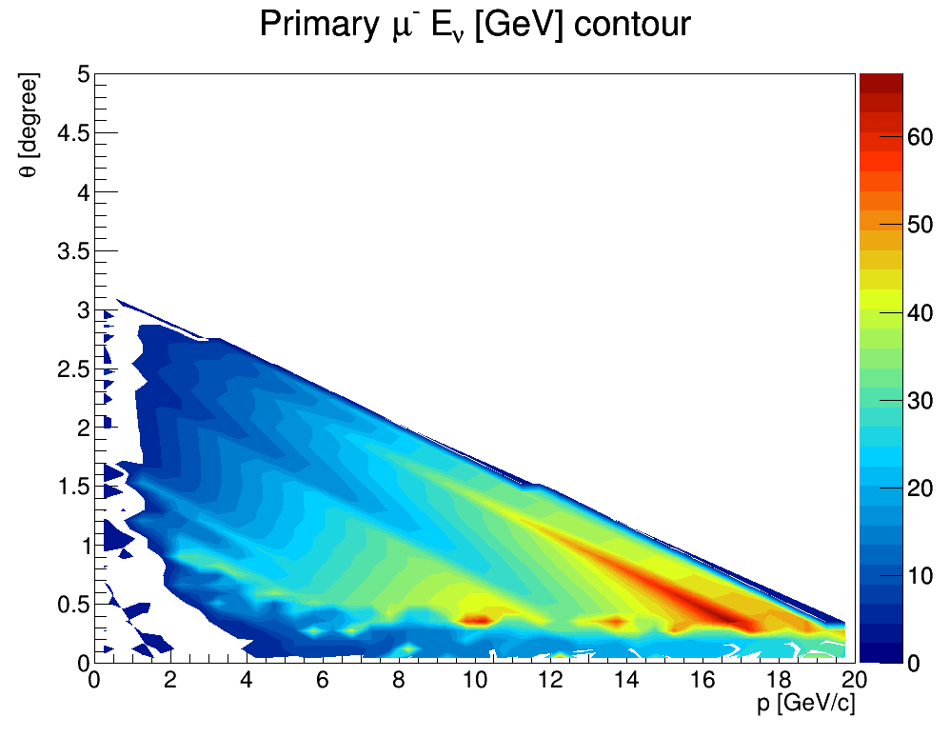
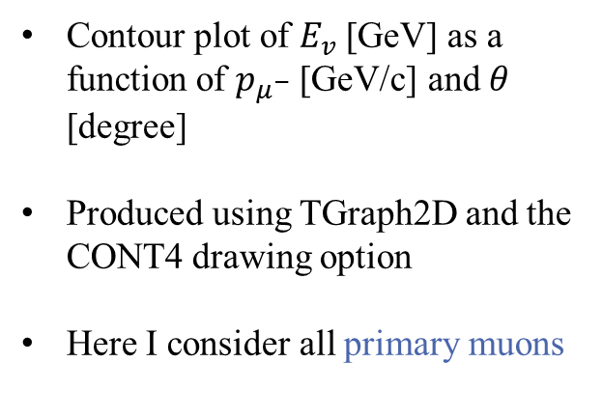
Neutrino energy Contour plot
Contour plot of $E_{v}$ [GeV] as a function of $p_{μ^{−}}$ [GeV/c] and $θ$ [degree]
Produced using TGraph2D and the CONT4 drawing option
Here I consider all primary muons

Slide 2
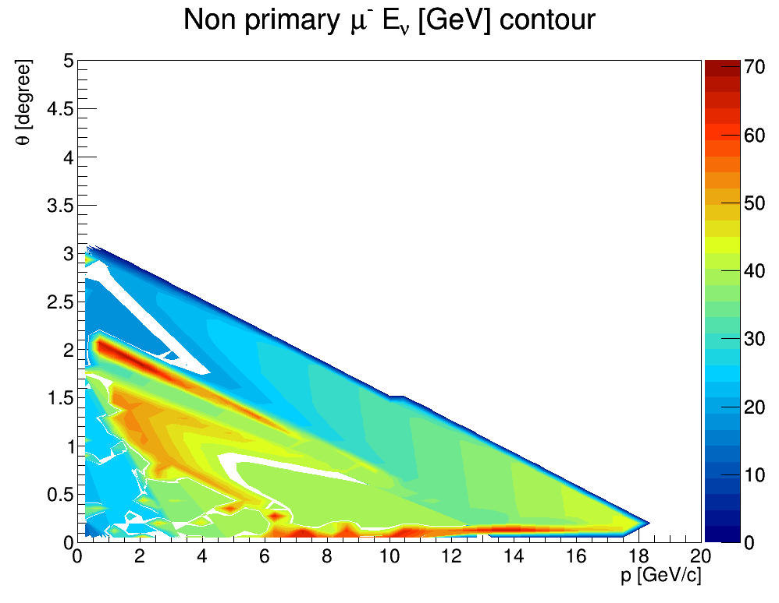
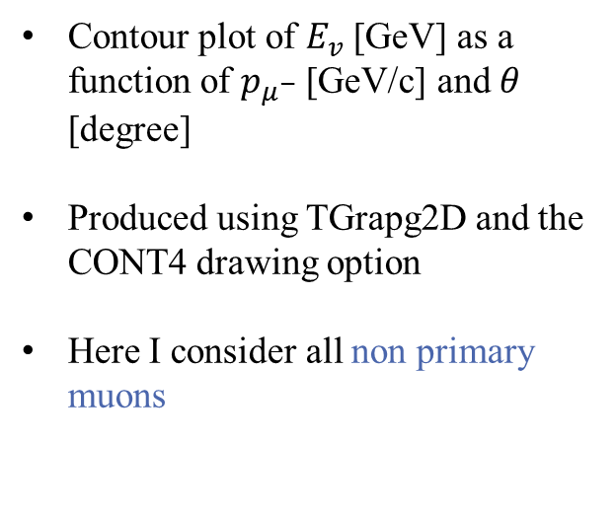
Neutrino energy Contour plot
Contour plot of $E_{v}$ [GeV] as a function of $p_{μ^{−}}$ [GeV/c] and $θ$ [degree]
Produced using TGrapg2D and the CONT4 drawing option
Here I consider all non primary muons

Slide 3
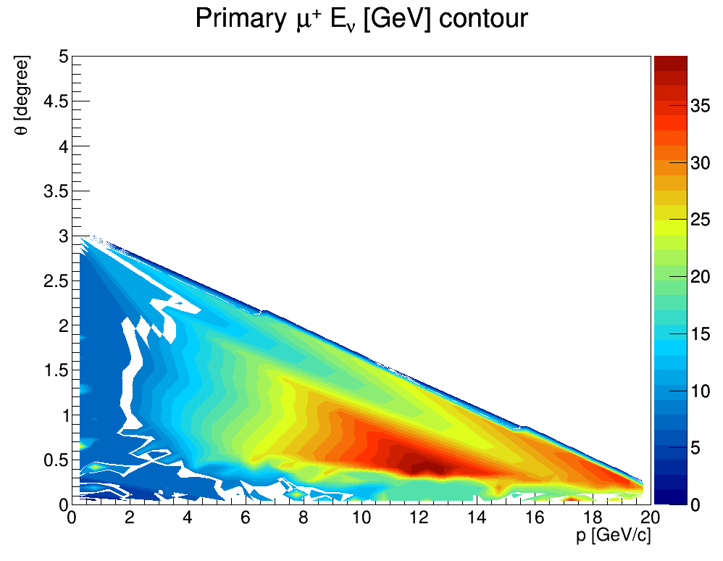
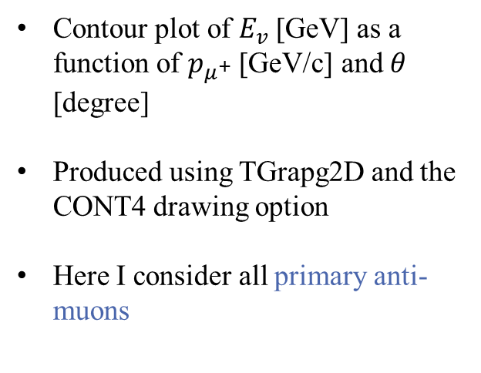
Neutrino energy Contour plot
Contour plot of $E_{v}$ [GeV] as a function of $p_{μ^{+}}$ [GeV/c] and $θ$ [degree]
Produced using TGrapg2D and the CONT4 drawing option
Here I consider all primary anti-muons

Slide 4
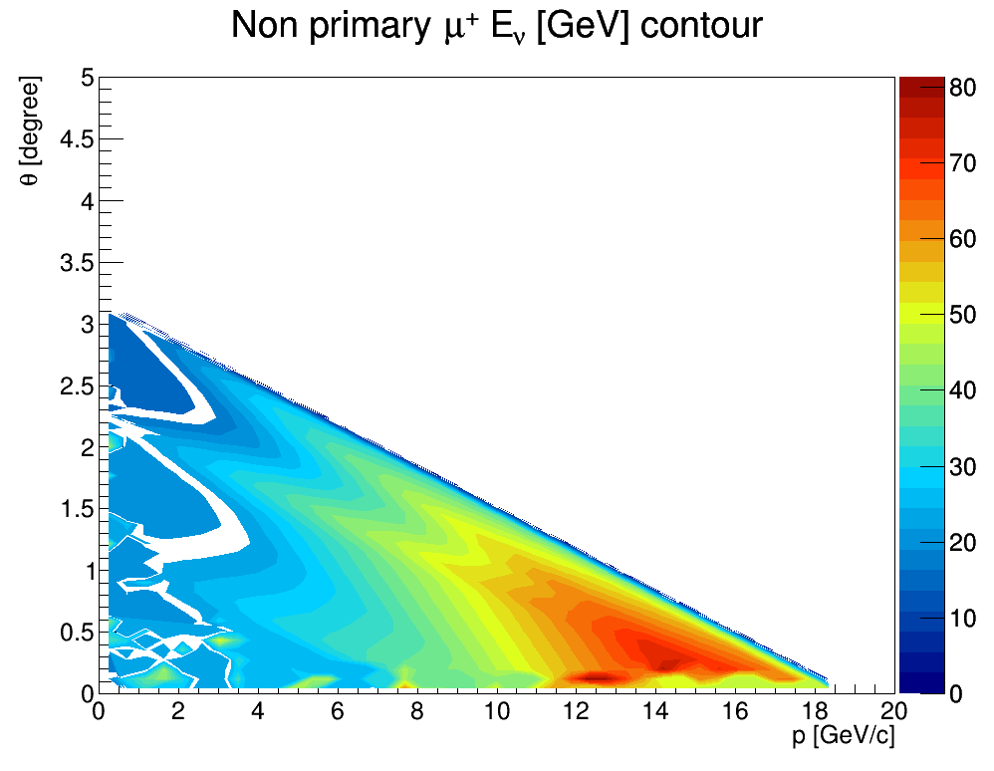
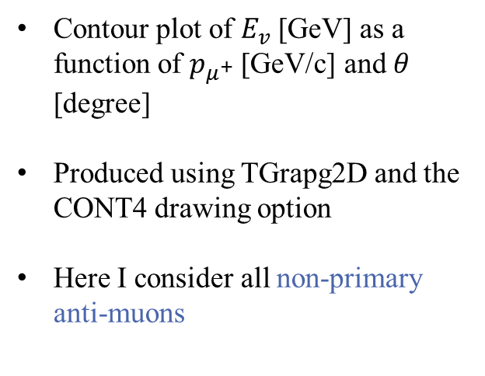
Neutrino energy Contour plot
Contour plot of $E_{v}$ [GeV] as a function of $p_{μ^{+}}$ [GeV/c] and $θ$ [degree]
Produced using TGrapg2D and the CONT4 drawing option
Here I consider all non-primary anti-muons

Slide 5
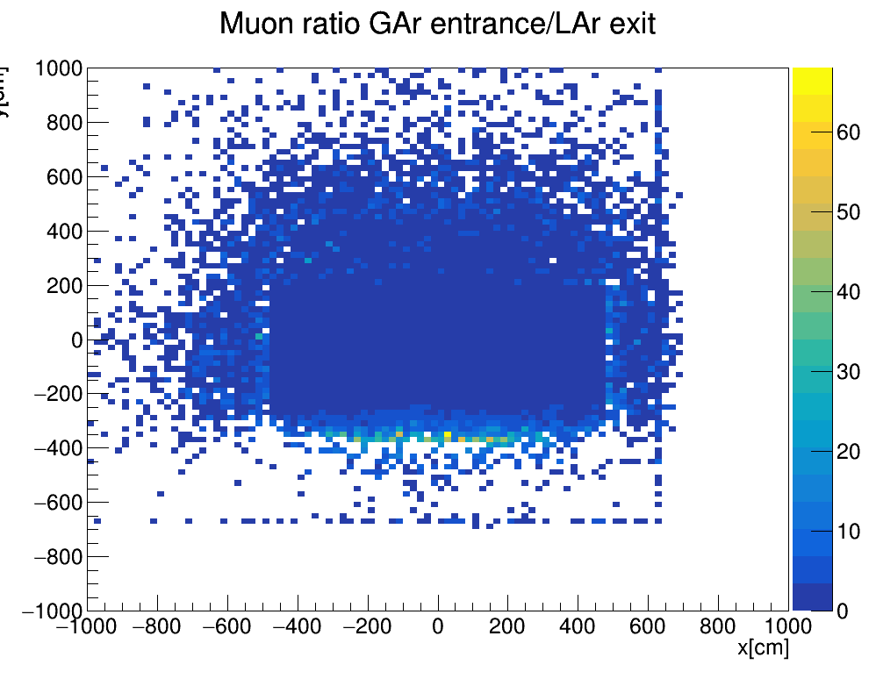
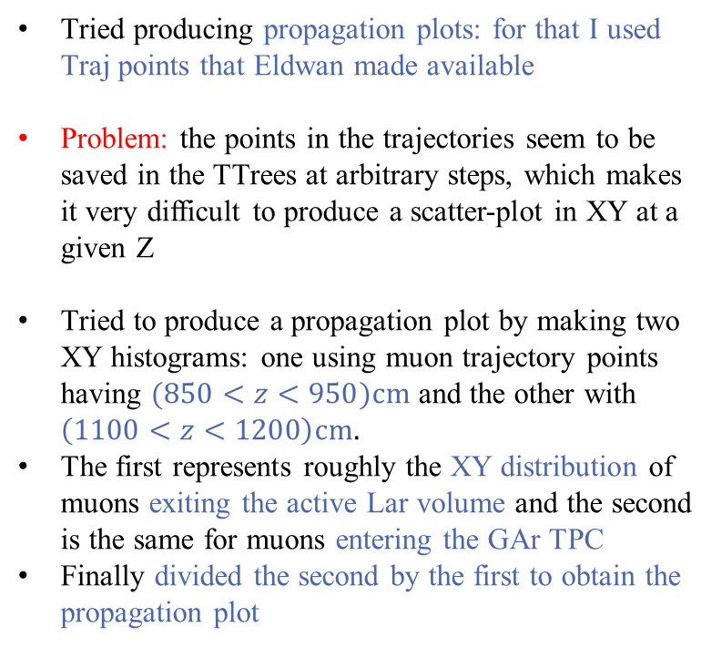
Propagation plots
Tried producing propagation plots: for that I used Traj points that Eldwan made available
Problem: the points in the trajectories seem to be saved in the TTrees at arbitrary steps, which makes it very difficult to produce a scatter-plot in XY at a given Z
Tried to produce a propagation plot by making two XY histograms: one using muon trajectory points having $(850<z<950)cm$ and the other with $\left(1100<z<1200\right)cm.$
The first represents roughly the XY distribution of muons exiting the active Lar volume and the second is the same for muons entering the GAr TPC
Finally divided the second by the first to obtain the propagation plot

Slide 6
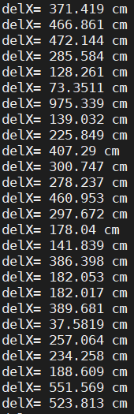
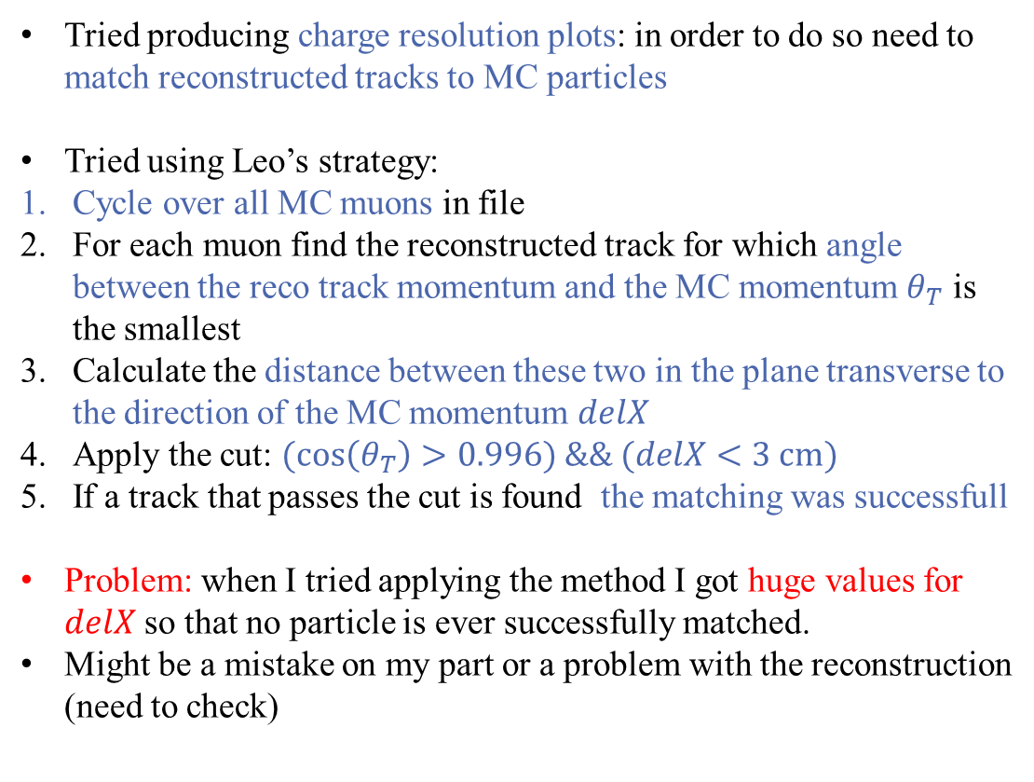
Track matching for resolution plots
Tried producing charge resolution plots: in order to do so need to match reconstructed tracks to MC particles
Tried using Leo’s strategy:
Cycle over all MC muons in file
For each muon find the reconstructed track for which angle between the reco track momentum and the MC momentum $θ_{T}$ is the smallest
Calculate the distance between these two in the plane transverse to the direction of the MC momentum $delX$
Apply the cut: $(cos\left(θ_{T}\right)>0.996) \&\& (delX<3 cm)$
If a track that passes the cut is found the matching was successfull
Problem: when I tried applying the method I got huge values for $delX$ so that no particle is ever successfully matched.
Might be a mistake on my part or a problem with the reconstruction (need to check)

Slide 7
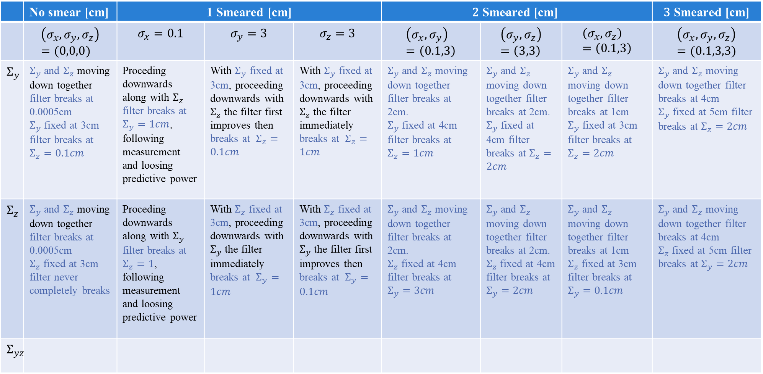
 | No smear [cm] | 1 Smeared [cm] |  |  | $$\text{2} \text{Smeared}\text{ [}\text{cm}\text{]}$$ |  |  | $$\text{3} \text{Smeared}\text{ [}\text{cm}\text{]}$$
 | $$\left(σ_{x},σ_{y},σ_{z}\right)=(0,0,0)$$ | $$σ_{x}=0.1$$ | $$σ_{y}=3$$ | $$σ_{z}=3$$ | $$\left(σ_{x},σ_{y}\right)=\left(0.1,3\right)$$ | $$\left(σ_{y},σ_{z}\right)=\left(3,3\right)$$ | $$\left(σ_{x},σ_{z}\right)=\left(0.1,3\right)$$ | $$\left(σ_{x},σ_{y},σ_{z}\right)=(0.1,3,3)$$
$$Σ_{y}$$ | $Σ_{y}$ and $Σ_{z}$ moving down together filter breaks at 0.0005cm $Σ_{y}$ fixed at 3cm filter breaks at $Σ_{z}=0.1cm$ | Proceding downwards along with $Σ_{z}$ filter breaks at $Σ_{y}=1cm$, following measurement and loosing predictive power | With $Σ_{y}$ fixed at 3cm, proceeding downwards with $Σ_{z}$ the filter first improves then breaks at $Σ_{z}=0.1cm$ | With $Σ_{y}$ fixed at 3cm, proceeding downwards with $Σ_{z}$ the filter immediately breaks at $Σ_{z}=1cm$ | $Σ_{y}$ and $Σ_{z}$ moving down together filter breaks at 2cm. $Σ_{y}$ fixed at 4cm filter breaks at $Σ_{z}=1cm$ | $Σ_{y}$ and $Σ_{z}$ moving down together filter breaks at 2cm. $Σ_{y}$ fixed at 4cm filter breaks at $Σ_{z}=2cm$ | $Σ_{y}$ and $Σ_{z}$ moving down together filter breaks at 1cm $Σ_{y}$ fixed at 3cm filter breaks at $Σ_{z}=2cm$ | $Σ_{y}$ and $Σ_{z}$ moving down together filter breaks at 4cm $Σ_{y}$ fixed at 5cm filter breaks at $Σ_{z}=2cm$
$$Σ_{z}$$ | $Σ_{y}$ and $Σ_{z}$ moving down together filter breaks at 0.0005cm $Σ_{z}$ fixed at 3cm filter never completely breaks | Proceding downwards along with $Σ_{y}$ filter breaks at $Σ_{z}=1$, following measurement and loosing predictive power | With $Σ_{z}$ fixed at 3cm, proceeding downwards with $Σ_{y}$ the filter immediately breaks at $Σ_{y}=1cm$ | With $Σ_{z}$ fixed at 3cm, proceeding downwards with $Σ_{y}$ the filter first improves then breaks at $Σ_{y}=0.1cm$ | $Σ_{y}$ and $Σ_{z}$ moving down together filter breaks at 2cm. $Σ_{z}$ fixed at 4cm filter breaks at $Σ_{y}=3cm$ | $Σ_{y}$ and $Σ_{z}$ moving down together filter breaks at 2cm. $Σ_{z}$ fixed at 4cm filter breaks at $Σ_{y}=2cm$ | $Σ_{y}$ and $Σ_{z}$ moving down together filter breaks at 1cm $Σ_{z}$ fixed at 3cm filter breaks at $Σ_{y}=0.1cm$ | $Σ_{y}$ and $Σ_{z}$ moving down together filter breaks at 4cm $Σ_{z}$ fixed at 5cm filter breaks at $Σ_{y}=2cm$
$$Σ_{yz}$$
SUMMARY TABLE

