Slide 1
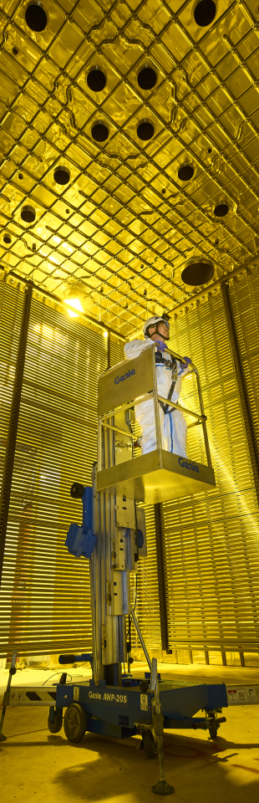

L2G : contained and crossing muons and multiple muon events
Authors: Federico Battisti Eldwan Brianne

Slide 2
Lar to gar sample: L2G
L2G: interface that takes outgoing LAr particles and feeds them to edep-sim with any TMS detector could simplify the sample simulation/reconstruction and standardize the procedure between detector designs (ND-GAr/TMS).
Progressed in our analysis of the LAr interacting sample produced by Eldwan, focusing on differences between the muons contained in the Liquid Argon and the ones produced in LAr that reach ND GAr.
We also started analysing events where multiple muons traversing the Liquid Argon are produced
To see previous analysis results see: https://indico.fnal.gov/event/47020/contributions/204949/attachments/138880/174374/l2g_Presentation_Gen13_2021.pdf
Simulated LAr sample
L2G
SSRI
ND-GAr lite
ND-GAr
https://indico.fnal.gov/event/44562/contributions/200915/attachments/136745/170170/DUNE_ND_Meeting_28.10.20.pdf

Slide 3
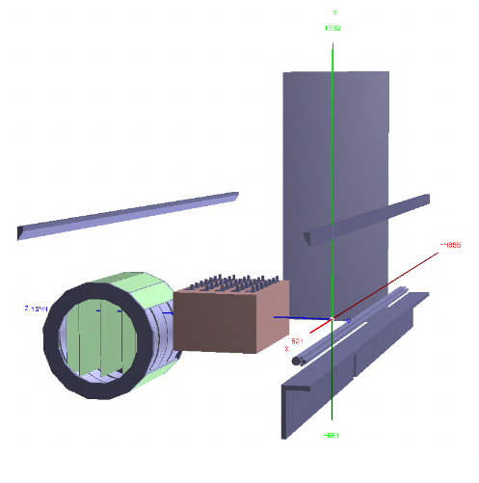
Generated sample: neutrino interactions in lar
y
Sample generated with GENIE v2
Gsimple flux in ND-Hall (from Tanaz)
1M single interaction events in ND-LAr (volArgonCubeActive)
Geometry used:
Baseline ND-LAr from dunendggd (apparently some updates are needed but not pushed yet...)
ND-GAr-Lite detector with SPY magnet (not the latest one acting as PV)
5 Scintillator planes (Minerva-like) of 6mx5mx4cm at (-240, -150, 0, 150, 240) //Not Optimized yet!
Segmented with triangular shapes strips in X/Y (2 cm triangle base)
Includes a muon detector (3 planes of Sc of 2 cm) with 2x7.5cm iron
Coordinate sytem: z roughly the flux direction, y is the vertical direction and x is the drift direction (i.e. the magnetic field direction)
LAr digi/reco to be done standalone and merged back
z
x

Slide 4
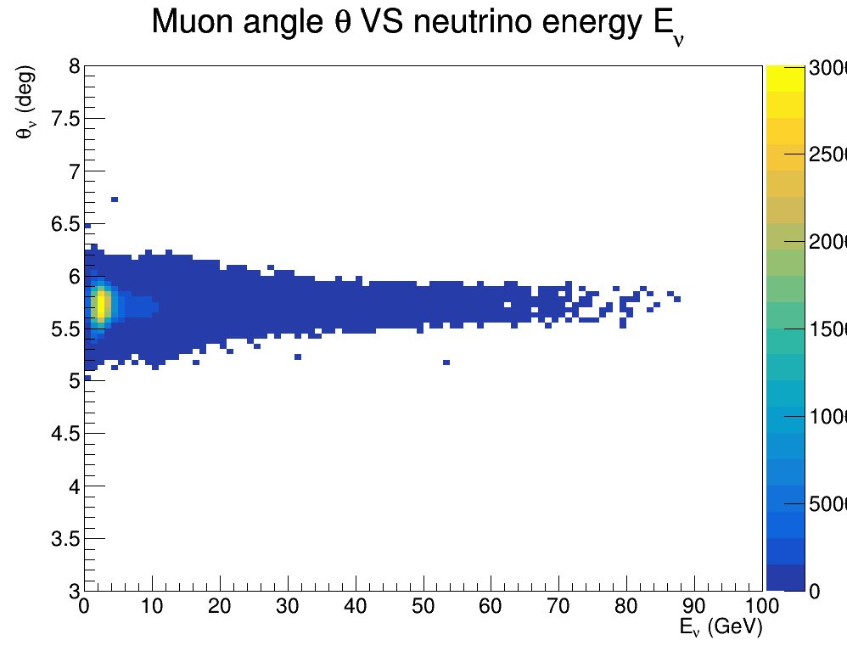
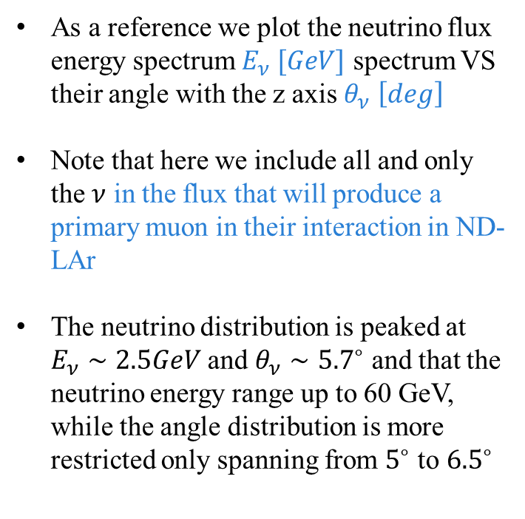
Interacting muon NEUTRINO SPECTRUM
30000
As a reference we plot the neutrino flux energy spectrum $E_{ν} [GeV]$ spectrum VS their angle with the z axis $θ_{ν} \left[deg\right]$
Note that here we include all and only the $ν$ in the flux that will produce a primary muon in their interaction in ND-LAr
The neutrino distribution is peaked at $E_{ν}∼2.5GeV$ and $θ_{ν}∼{5.7}^{∘}$ and that the neutrino energy range up to 60 GeV, while the angle distribution is more restricted only spanning from $5^{∘}$ to ${6.5}^{∘}$
25000
20000
15000
10000
5000

Slide 5
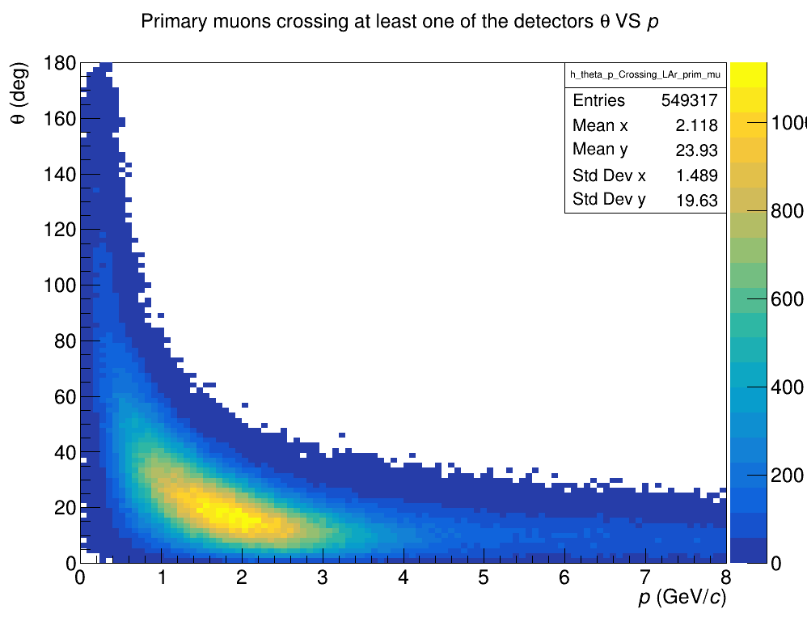
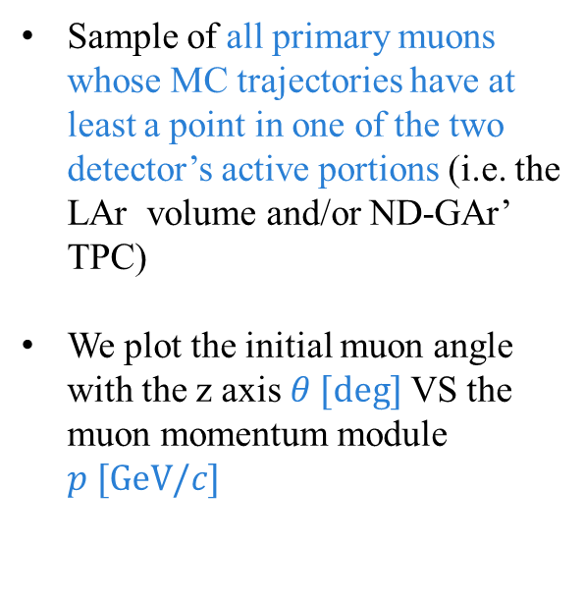
All muons traversing detectors
Sample of all primary muons whose MC trajectories have at least a point in one of the two detector’s active portions (i.e. the LAr volume and/or ND-GAr’ TPC)
We plot the initial muon angle with the z axis $θ [deg]$ VS the muon momentum module $p [GeV/c]$

Slide 6
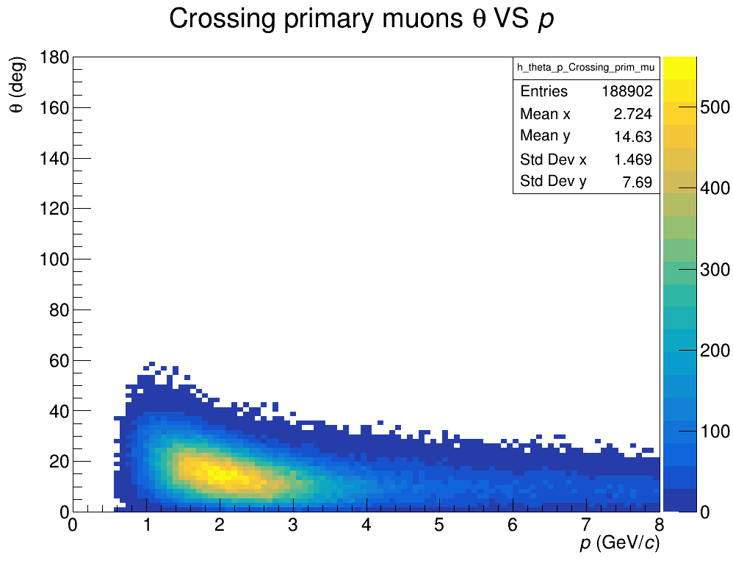
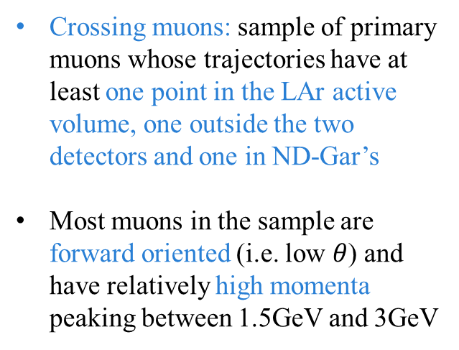
CROSSING muons p vs theta
Crossing muons: sample of primary muons whose trajectories have at least one point in the LAr active volume, one outside the two detectors and one in ND-Gar’s
Most muons in the sample are forward oriented (i.e. low $θ$) and have relatively high momenta peaking between 1.5GeV and 3GeV

Slide 7
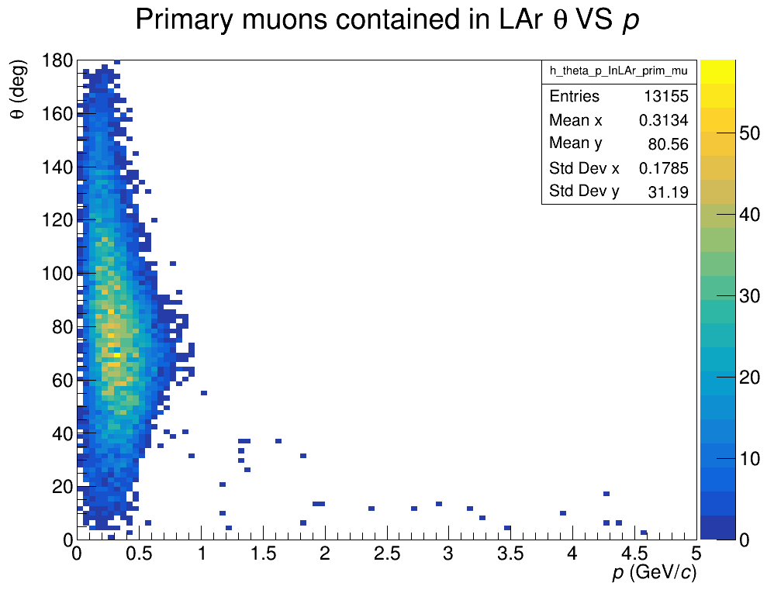
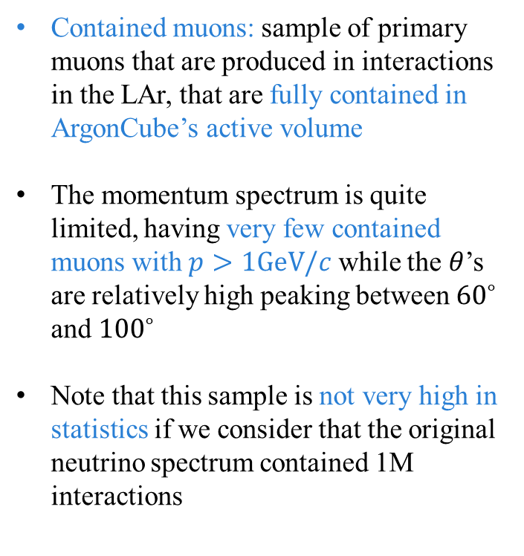
Contained muons p vs theta
Contained muons: sample of primary muons that are produced in interactions in the LAr, that are fully contained in ArgonCube’s active volume
The momentum spectrum is quite limited, having very few contained muons with $p>1GeV/c$ while the $θ$’s are relatively high peaking between ${60}^{∘}$ and ${100}^{∘}$
Note that this sample is not very high in statistics if we consider that the original neutrino spectrum contained 1M interactions

Slide 8
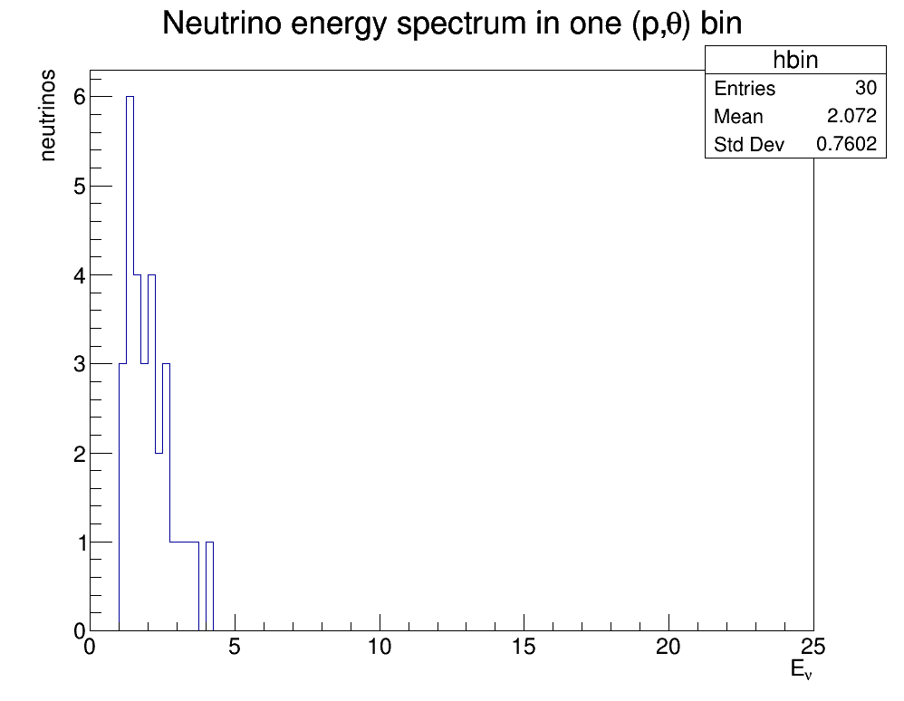
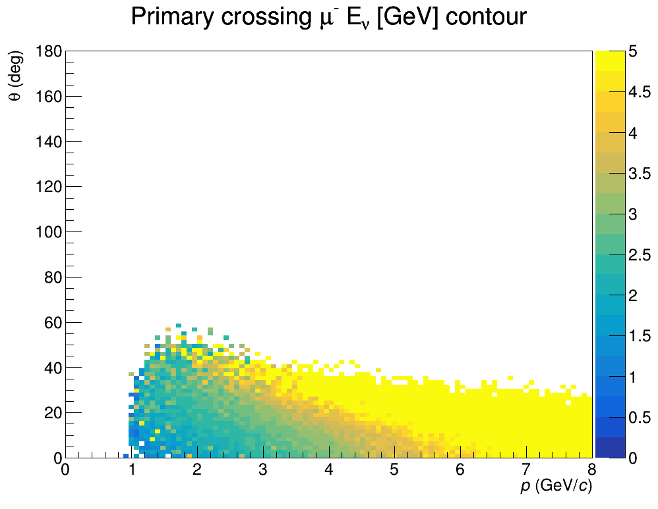
Neutrino energy distribution plotting
Evaluate average
Select bin by bin and look at the energy spectrum of the neutrinos producing the primary muons

Slide 9
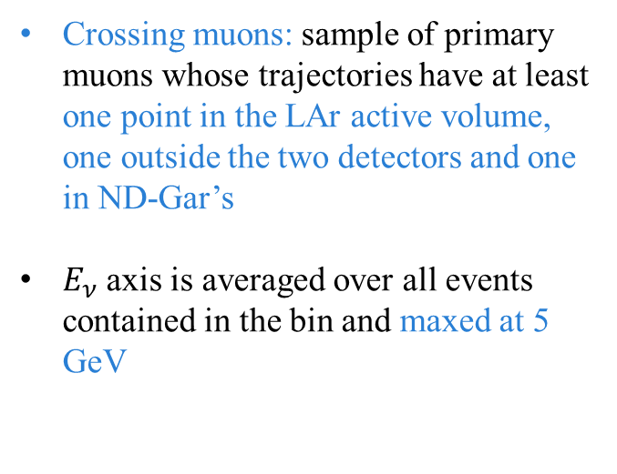
CROSSING muons p vs theta
Crossing muons: sample of primary muons whose trajectories have at least one point in the LAr active volume, one outside the two detectors and one in ND-Gar’s
$E_{ν}$ axis is averaged over all events contained in the bin and maxed at 5 GeV
9

Slide 10
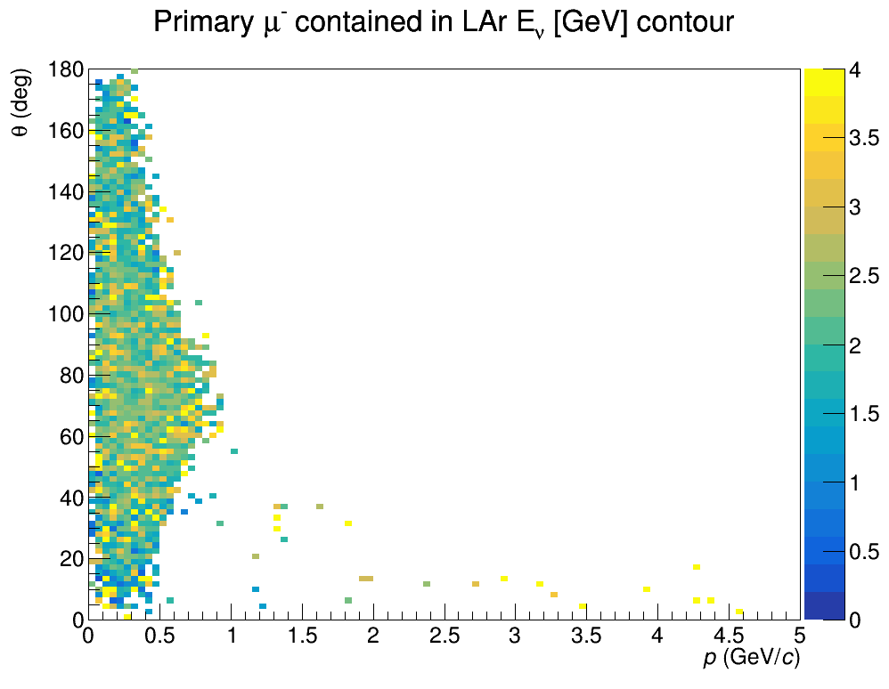
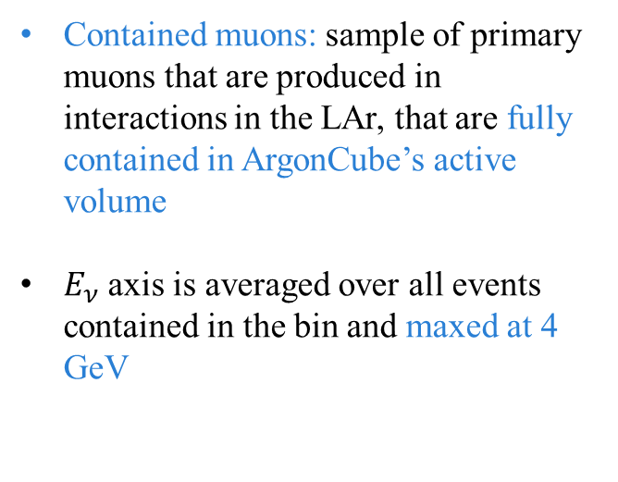
Contained muons p vs theta
Contained muons: sample of primary muons that are produced in interactions in the LAr, that are fully contained in ArgonCube’s active volume
$E_{ν}$ axis is averaged over all events contained in the bin and maxed at 4 GeV
10

Slide 11
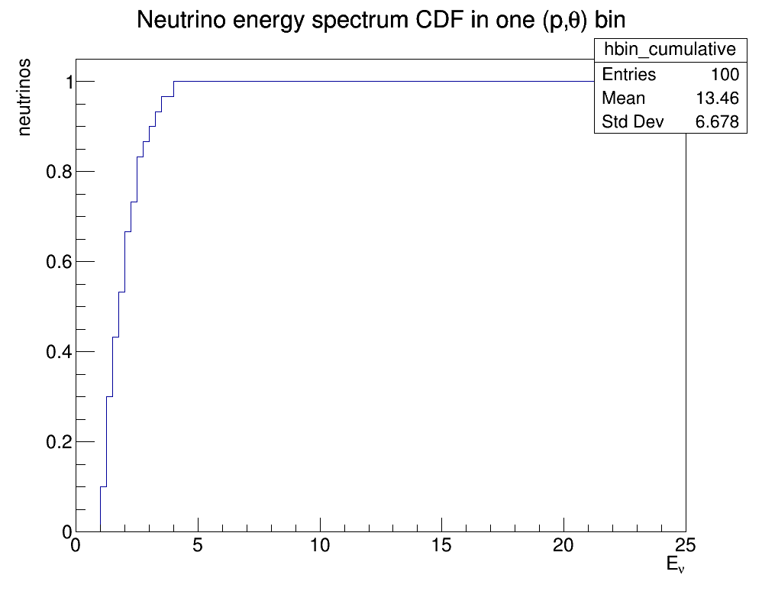
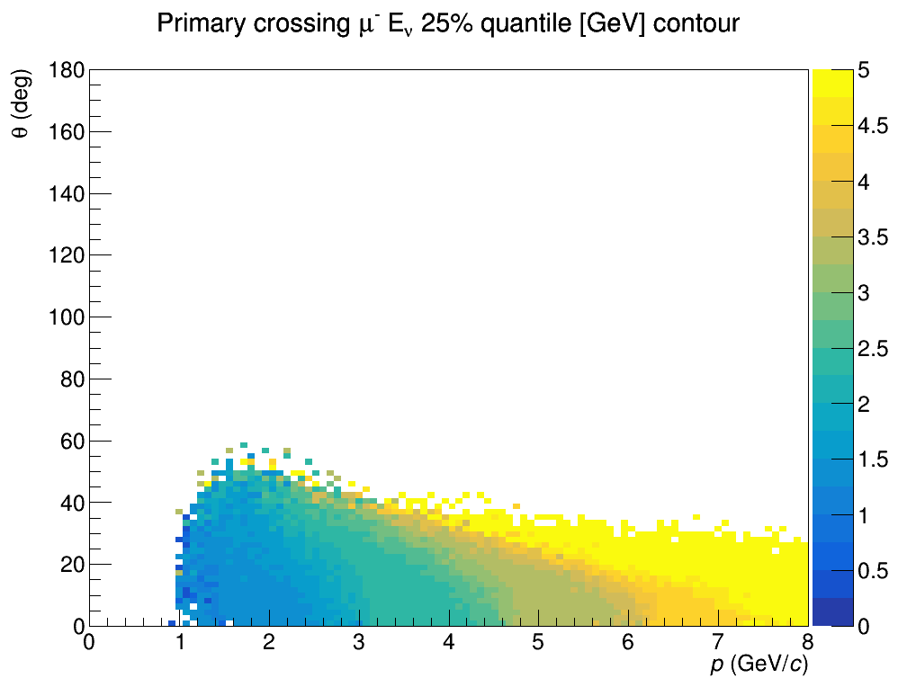
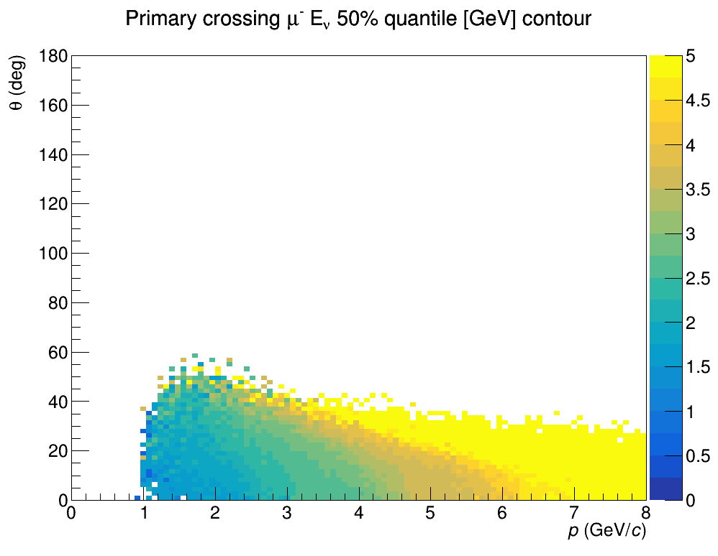
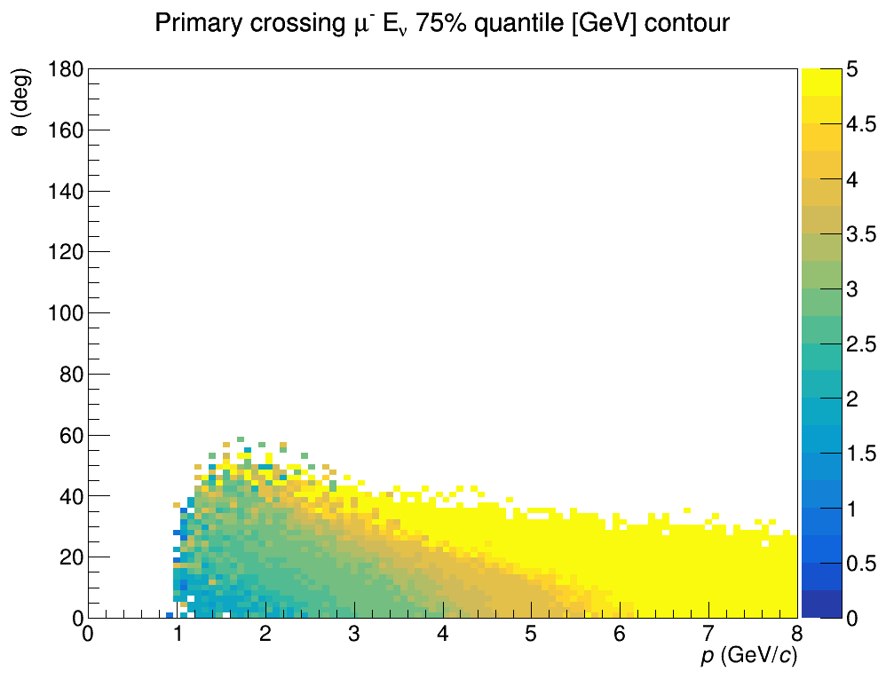
Neutrino energy distribution quantiles
CDF
25%, 50% and 75% quantiles
Select bin by bin and look at the energy spectrum of the neutrinos producing the primary muons

Slide 12
CROSSING muons neutrino energy quantiles
Crossing muons: 25%, 50% and 75% parent neutrino energy $E_{ν}$ quantiles plotted as a function of muon initial momentum $p [GeV/c]$ and $θ [deg]$ angle with the z axis

Slide 13
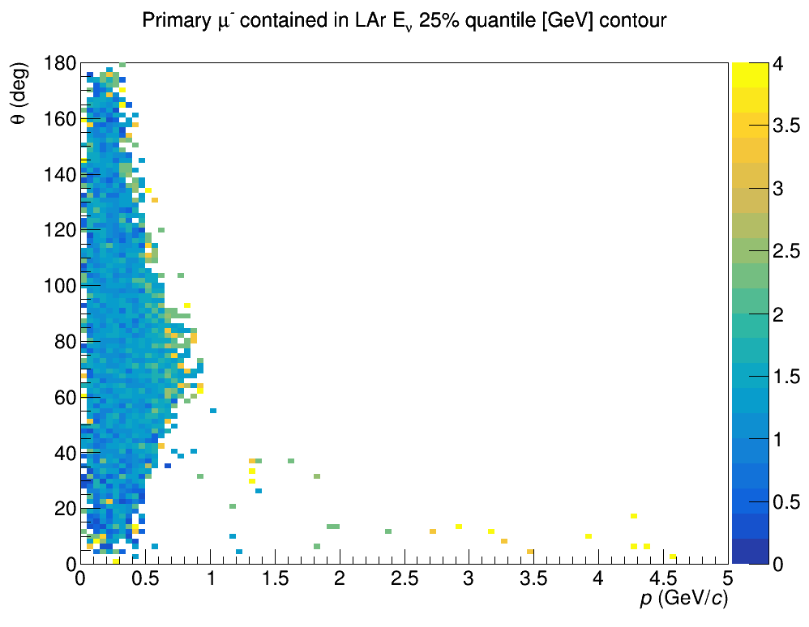
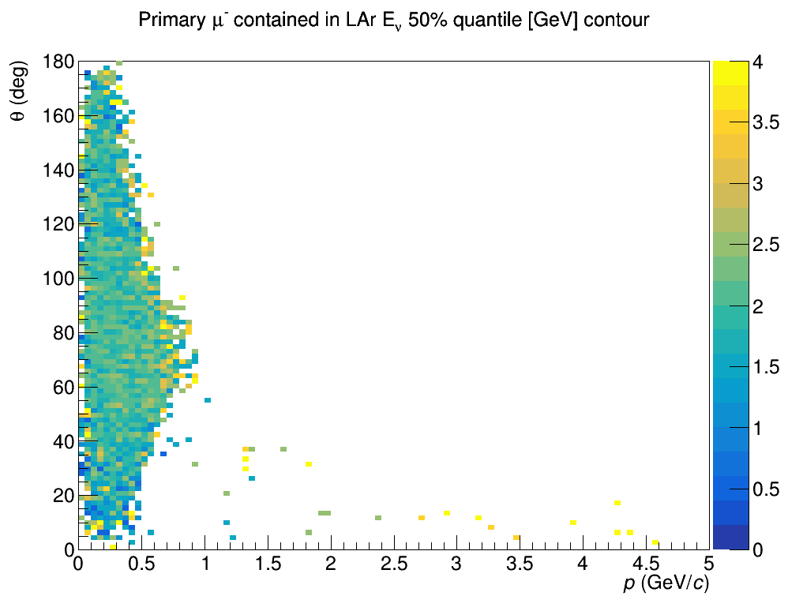
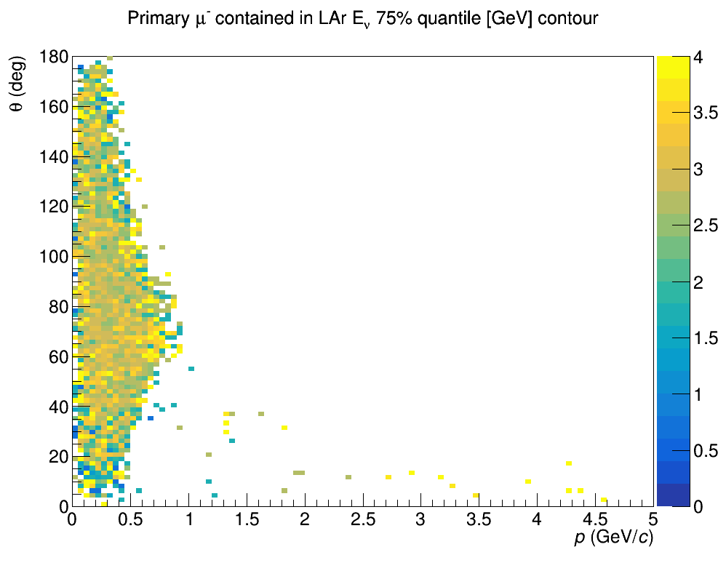
Contained muons neutrino energies quantiles
Contained muons: 25%, 50% and 75% parent neutrino energy $E_{ν}$ quantiles plotted as a function of muon initial momentum $p [GeV/c]$ and $θ [deg]$ angle with the z axis

Slide 14
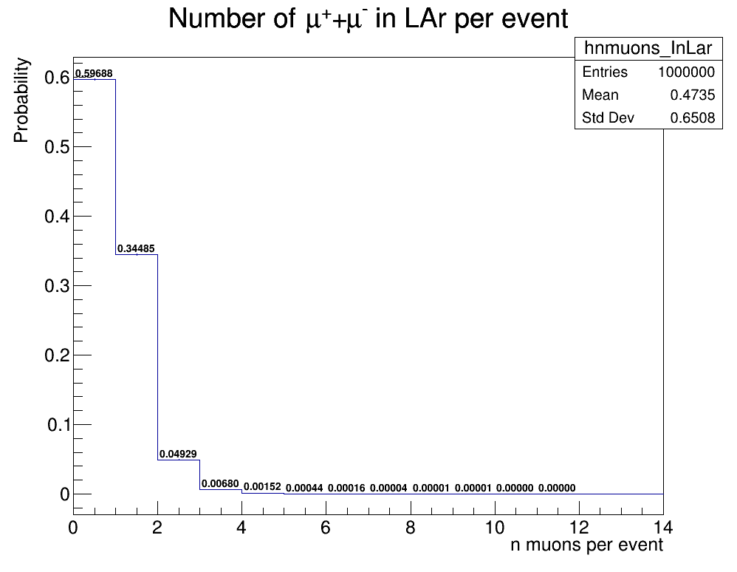
NUMBER OF MUONS
Number of negative and positive muons having at least one MC trajectory point inside the LAr volume per event
The histogram is normalized to 1 to rapresent a probability distribution
We can see that while the vast majority of the events produce either 1 or 0 muon trajectories in the LAr a bit more than 5% of the events produce two or more

Slide 15
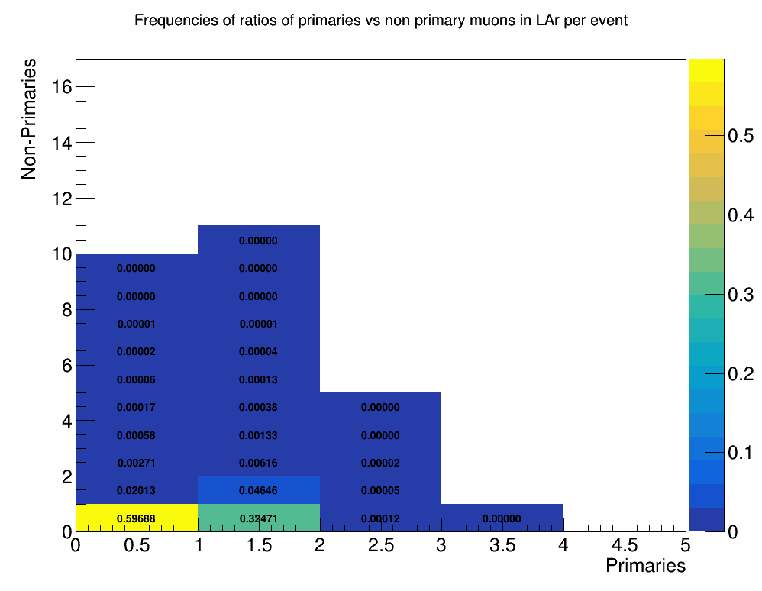
Primaries vs non primaries
Numer of primaries VS non-primary muons per event in the liquid Argon
The histogram is normalized to 1 on the z axis to rapresent a probability distribution

Slide 16
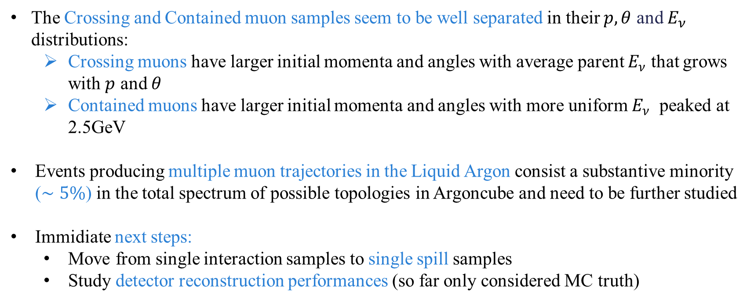
Summary and future steps
The Crossing and Contained muon samples seem to be well separated in their $p,θ$ and $E_{ν}$ distributions:
Crossing muons have larger initial momenta and angles with average parent $E_{ν}$ that grows with $p$ and $θ$
Contained muons have larger initial momenta and angles with more uniform $E_{ν}$ peaked at 2.5GeV
Events producing multiple muon trajectories in the Liquid Argon consist a substantive minority ($∼5\%$) in the total spectrum of possible topologies in Argoncube and need to be further studied
Immidiate next steps:
Move from single interaction samples to single spill samples
Study detector reconstruction performances (so far only considered MC truth)

