Slide 1
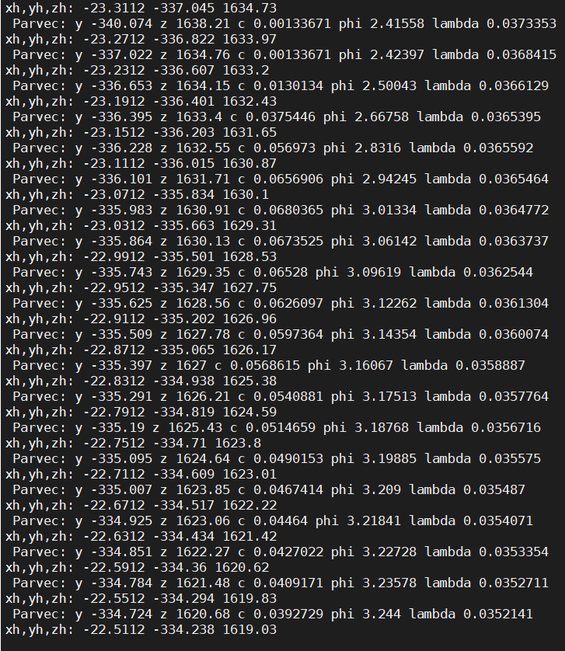
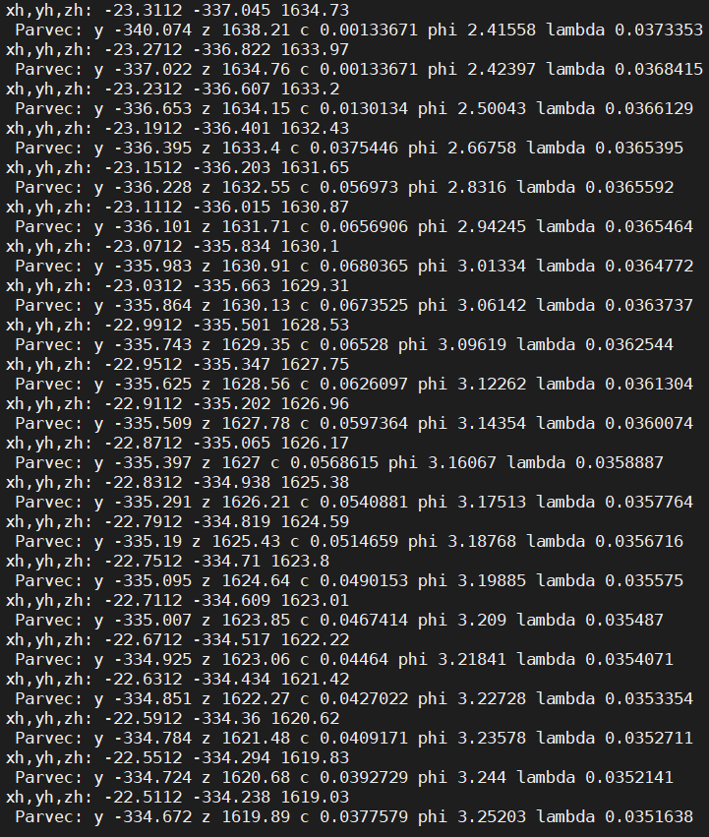
CAREFULL CHECK ON NEW MACRO
OLD METHOD
NEW MACRO

Slide 2
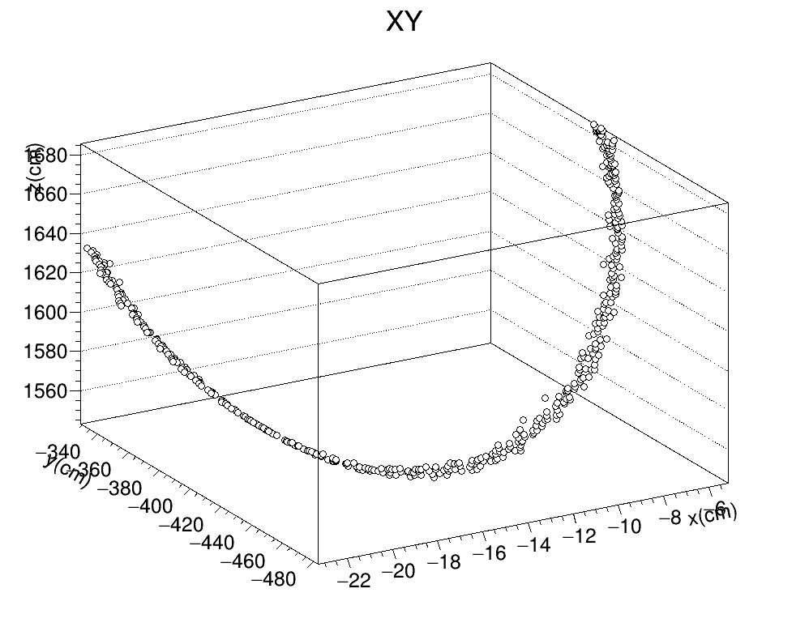
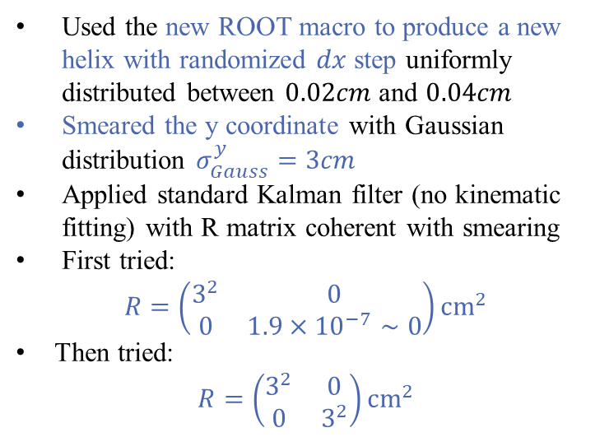
Toy monte carlo macro
Used the new ROOT macro to produce a new helix with randomized $dx$ step uniformly distributed between $0.02cm$ and $0.04cm$
Smeared the y coordinate with Gaussian distribution $σ_{Gauss}^{y}=3cm$
Applied standard Kalman filter (no kinematic fitting) with R matrix coherent with smearing
First tried:
$$R=\left(\begin{matrix}3^{2} & 0 \\ 0 & 1.9×{10}^{−7}∼0\end{matrix}\right){cm}^{2}$$
Then tried:
$$R=\left(\begin{matrix}3^{2} & 0 \\ 0 & 3^{2}\end{matrix}\right){cm}^{2}$$

