Slide 1
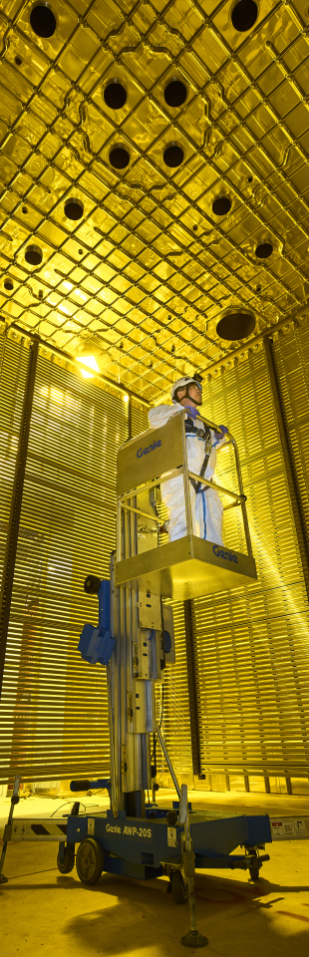

L2G first steps: sample production and analysis
Authors: Federico Battisti Eldwan Brianne

Slide 2
Lar to gar sample: L2G
Strong need for large LAr samples already propagated in edep-sim
L2G: interface that takes outgoing LAr particles and feeds them to edep-sim with any TMS detector could simplify the sample simulation/reconstruction and standardize the procedure between detector designs (ND-GAr/TMS).
As a first step Eldwan produced a large sample of LAr interactions, developed it up to reconstruction and anatree production and we started studying its properties focusing on the produced muons
Simulated LAr sample
L2G
SSRI
ND-GAr lite
ND-GAr
https://indico.fnal.gov/event/44562/contributions/200915/attachments/136745/170170/DUNE_ND_Meeting_28.10.20.pdf

Slide 3
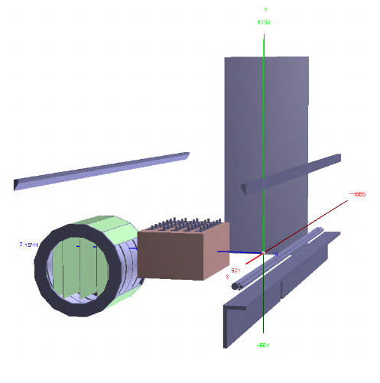
Generated sample: neutrino interactions in lar
Sample generated with GENIE v2
Gsimple flux in ND-Hall (from Tanaz)
• 1M events in ND-LAr (volArgonCubeActive)
• Geometry used
Baseline ND-LAr from dunendggd (apparently some updates are needed but not pushed yet...)
ND-GAr-Lite detector with SPY magnet (not the latest one acting as PV)
5 Scintillator planes (Minerva-like) of 6mx5mx4cm at (-240, -150, 0, 150, 240) //Not Optimized yet!
Segmented with triangular shapes strips in X/Y (2 cm triangle base)
Includes a muon detector (3 planes of Sc of 2 cm) with 2x7.5cm iron
Got to test the full chain gen/sim/reco for ND-GAr-Lite without major hickups with edep-sim and GArSoft
LAr digi/reco to be done standalone and merged back
Note that in our coordinate sytem z is the flux direction, y is the vertical direction and x is the drift direction (i.e. the magnetic field direction)
y
x
z

Slide 4
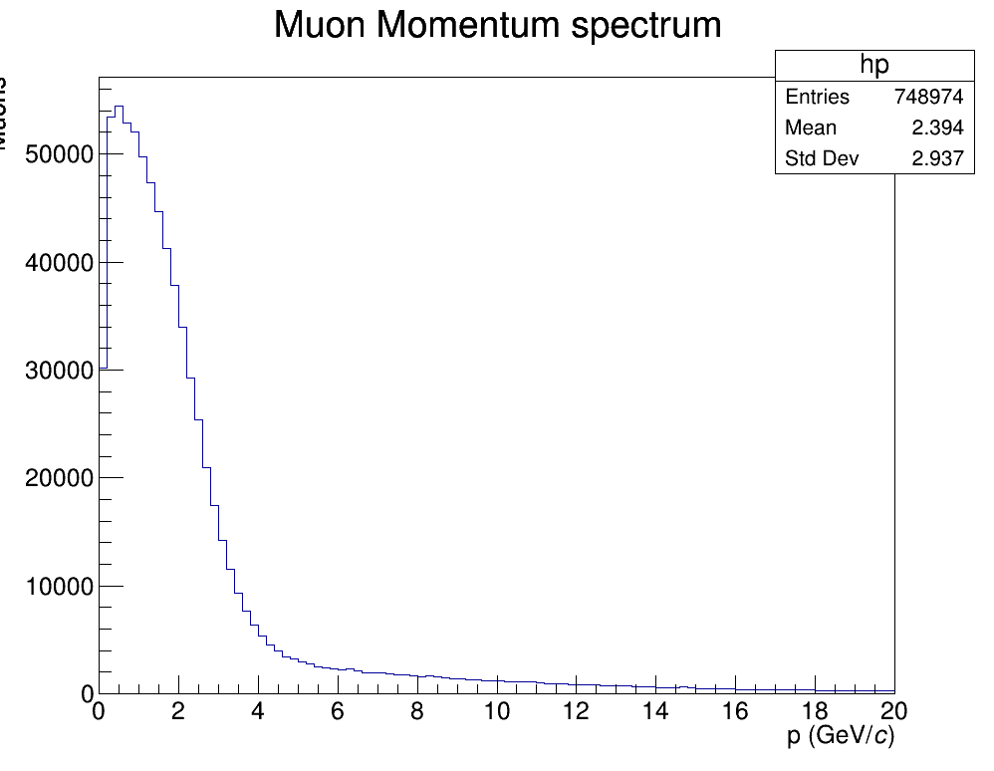
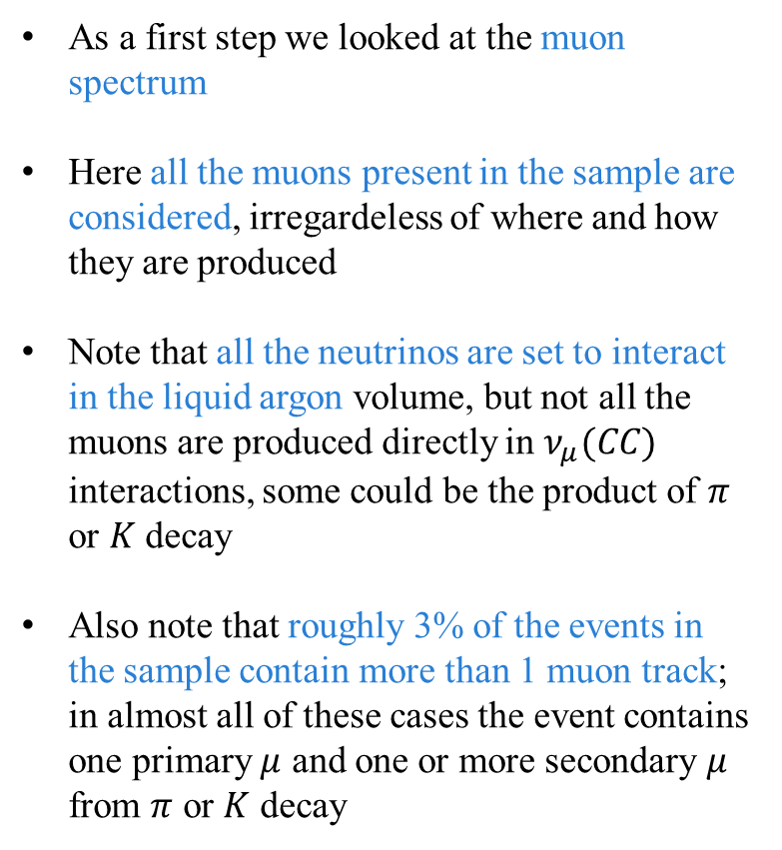
MUON SPECTRUM
As a first step we looked at the muon spectrum
Here all the muons present in the sample are considered, irregardeless of where and how they are produced
Note that all the neutrinos are set to interact in the liquid argon volume, but not all the muons are produced directly in $ν_{μ}(CC)$ interactions, some could be the product of $π$ or $K$ decay
Also note that roughly 3% of the events in the sample contain more than 1 muon track; in almost all of these cases the event contains one primary $μ$ and one or more secondary $μ$ from $π$ or $K$ decay
muons

Slide 5
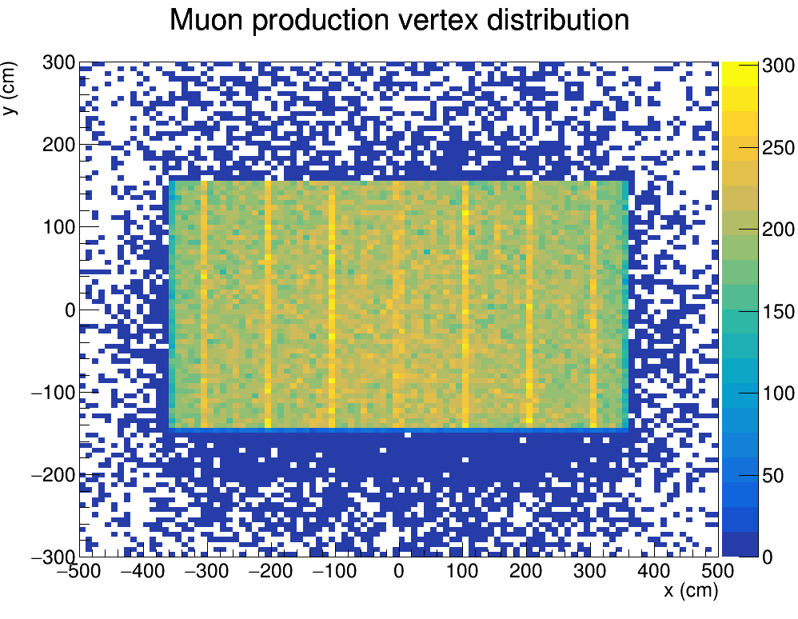
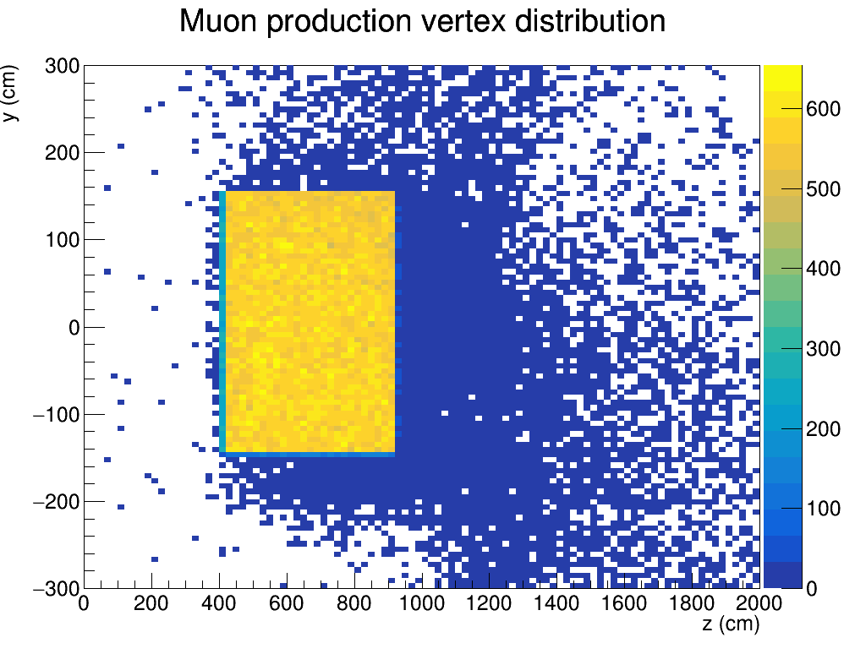
MUON PRODUCTION VERTEX
Here we plot the spatial distribution of the points of production of the muons i.e. The first points registered in the muon trajectories.

Slide 6
MUON PRODUCTION VERTEX
Here we plot the spatial distribution of the points of production of the muons i.e. The first points registered in the muon trajectories. The ND-GAr tracker volume is outlined in red

Slide 7
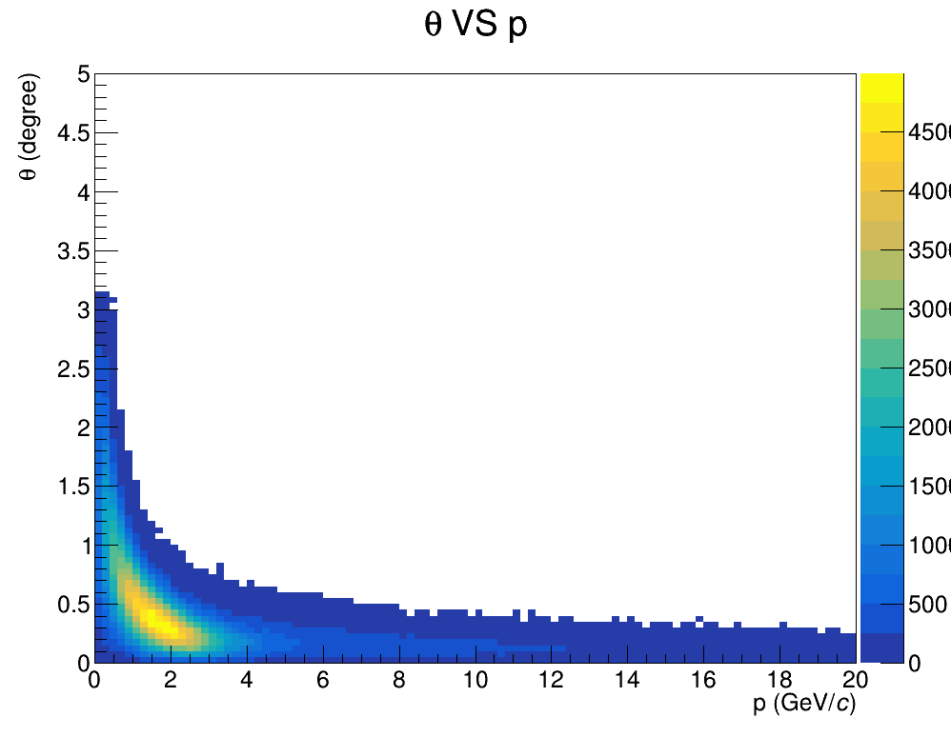
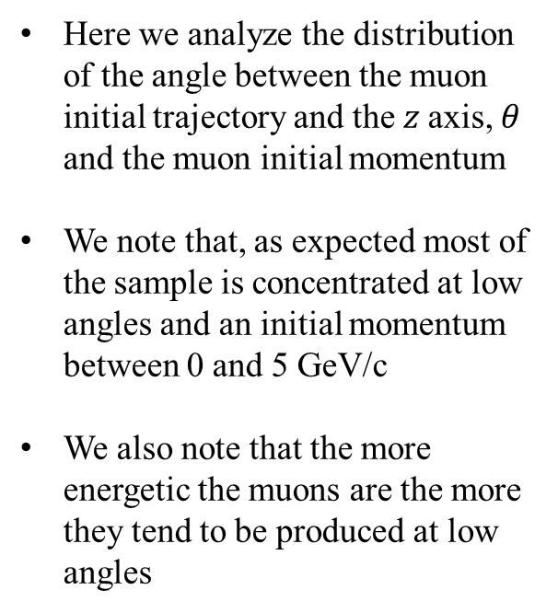
Theta vs p
Here we analyze the distribution of the angle between the muon initial trajectory and the $z$axis, $θ$ and the muon initial momentum
We note that, as expected most of the sample is concentrated at low angles and an initial momentum between 0 and 5 GeV/c
We also note that the more energetic the muons are the more they tend to be produced at low angles

Slide 8
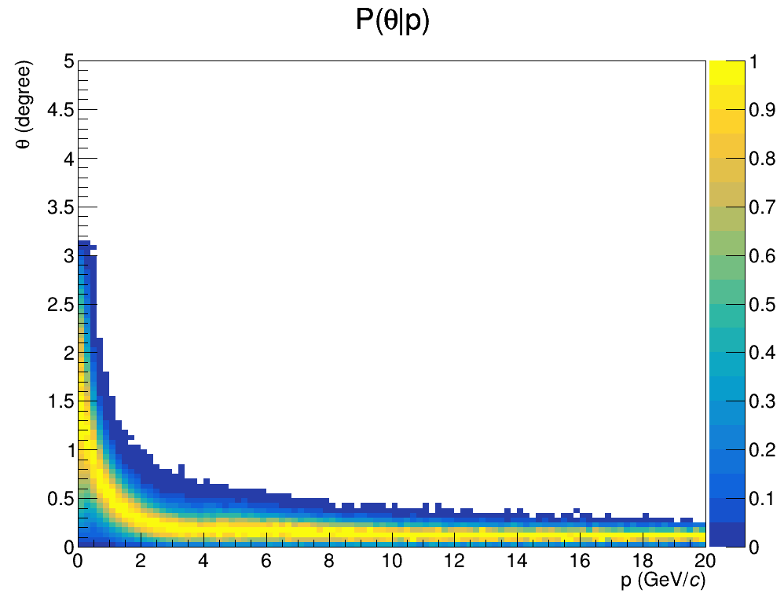
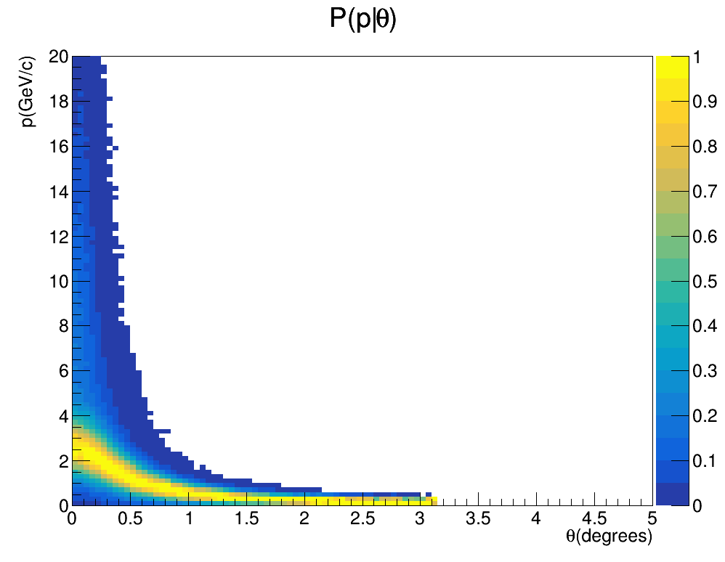
$P(θ|p)$ and $P(p|θ)$
Conditional probabilities $P(θ|p)$ and $P(p|θ)$ normalized so that the points with maximum probability in each slice are assigned the value 1

Slide 9
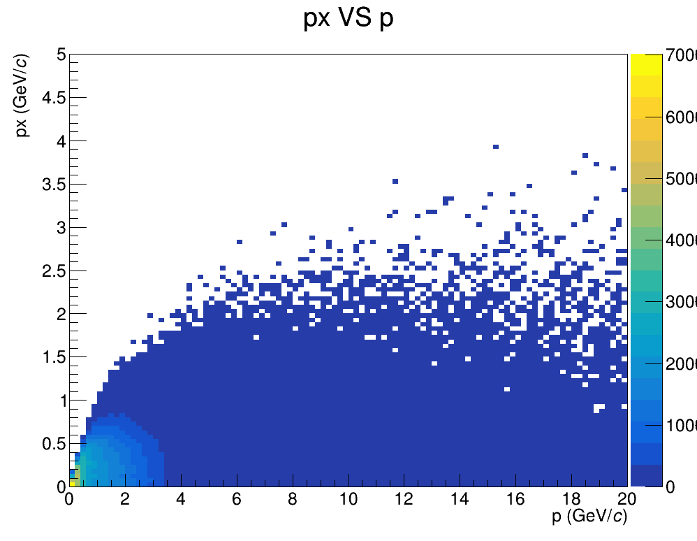
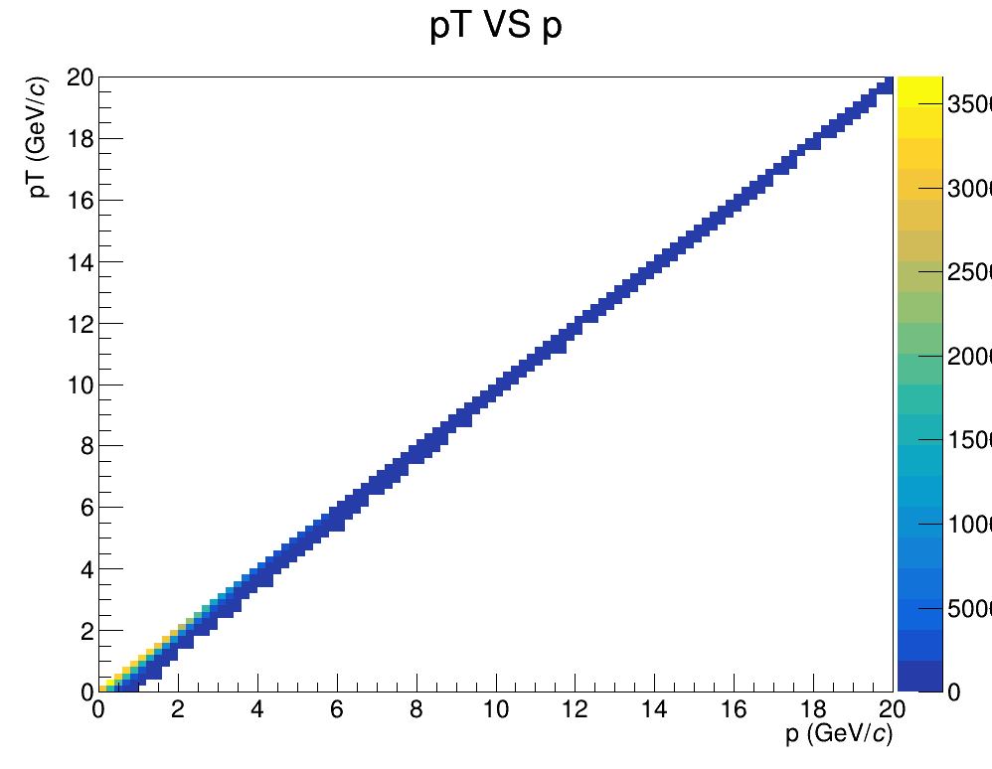
${(p}_{x} VS p$) and ${(p}_{T} VS p)$
Distributions of the momentum components along the drift direction $p_{x}$ and on the transverse plane $yz$ $p_{T}$ as a function of the total momentum $p$. The transverse momentum largely dominates, espectially at low momenta

Slide 10
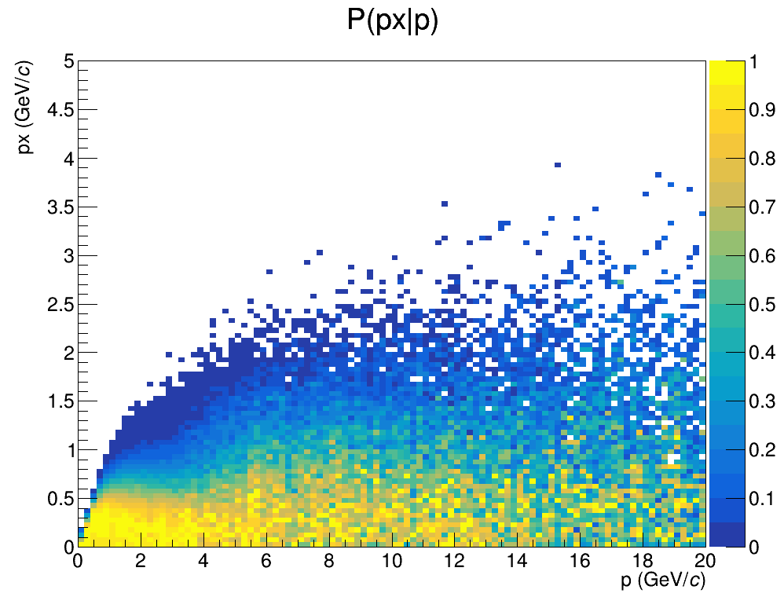
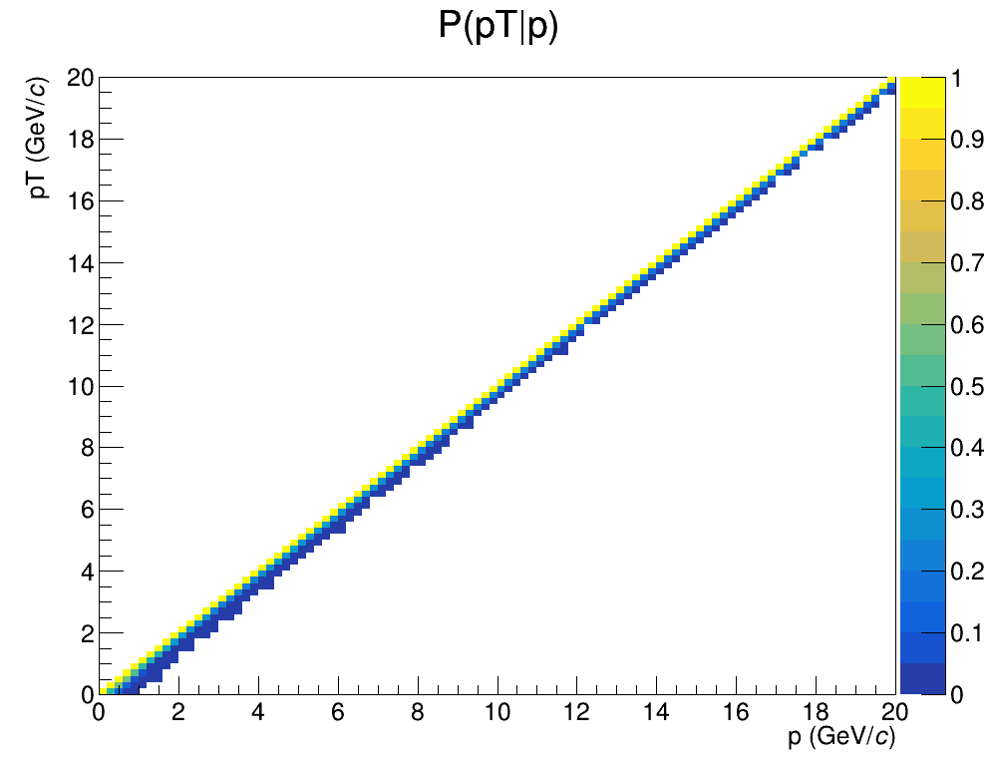
$P(p_{x}|p)$ and $P(p_{T}|p)$
Same information expressed in the form of conditional probabilities $P(p_{x}|p)$ and $P(p_{T}|p)$ once again normalized with the maxima at 1

Slide 11
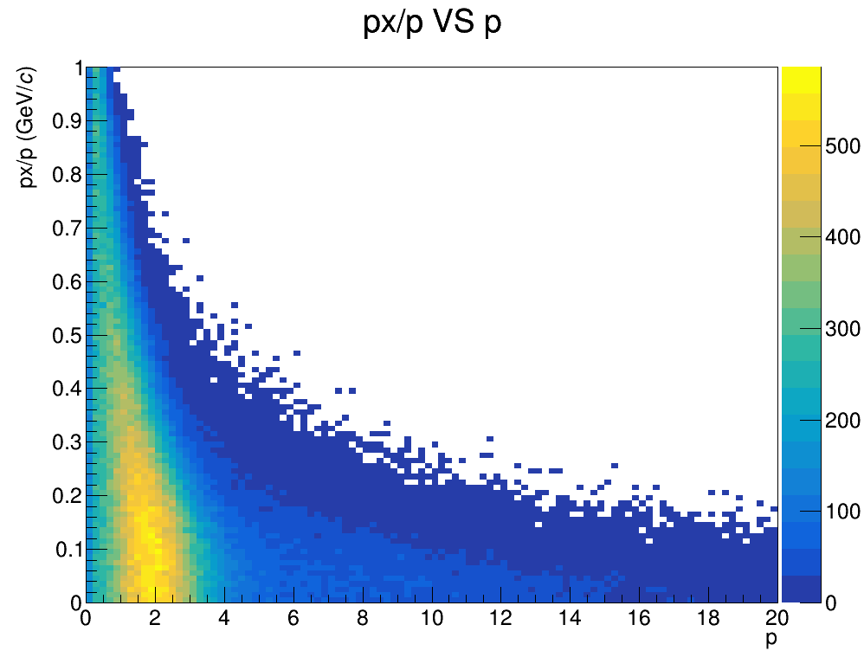
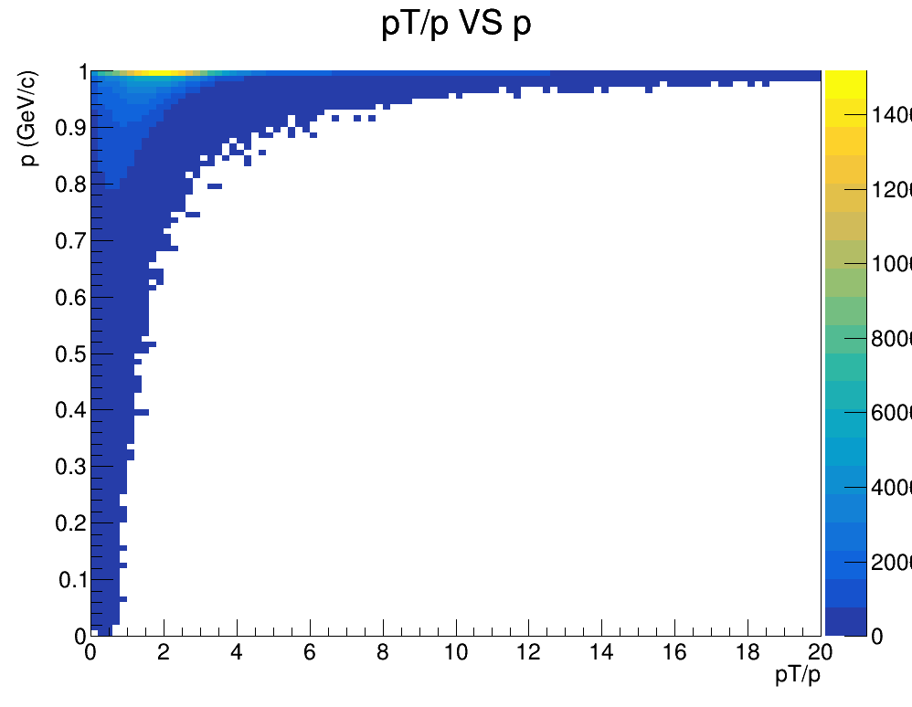
${(p}_{x}/p VS p$) and ${(p}_{T}/p VS p)$
Distributions of the momentum components fractions along the drift direction $p_{x}/p$ and on the transverse plane xy $p_{T}/p$ as a function of the total momentum $p$. Once again it is clear that the transverse momentum largely dominates, espectially at low momenta

Slide 12
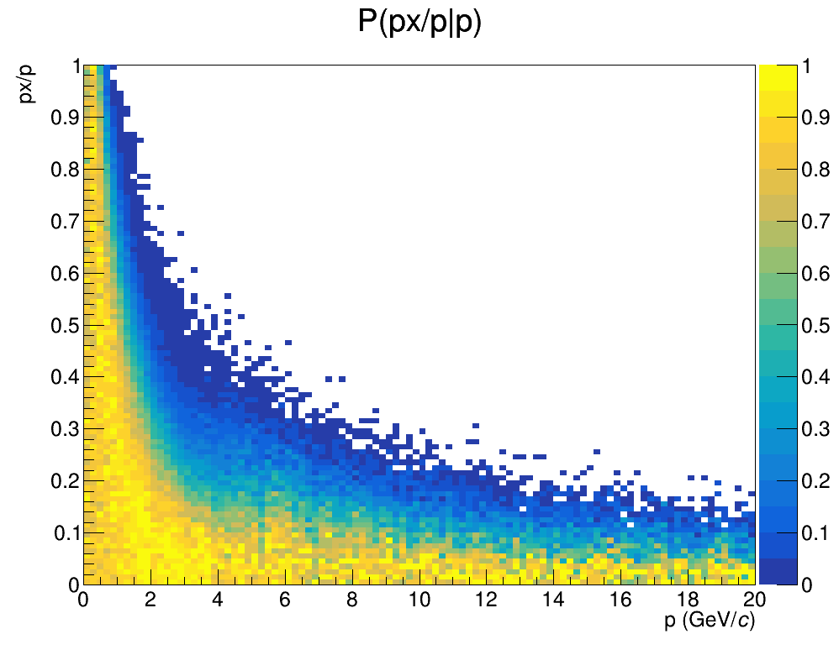
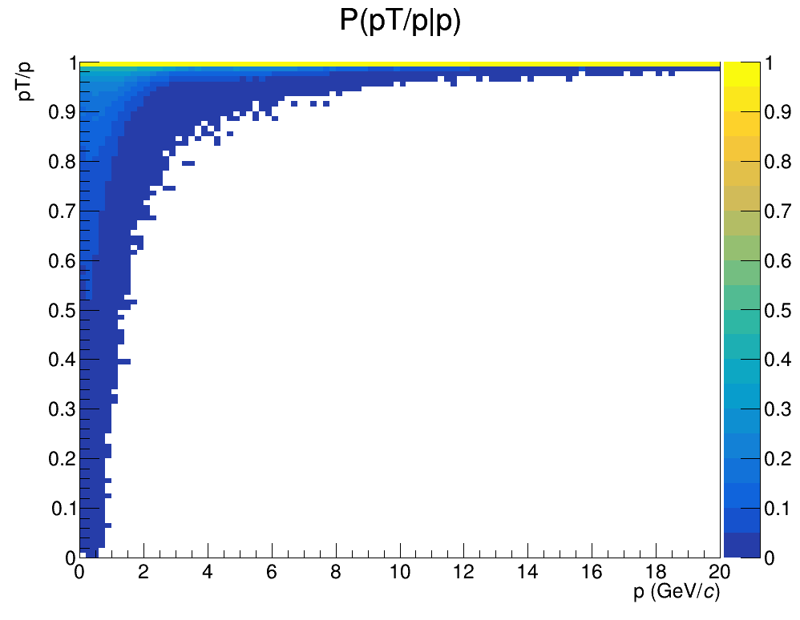
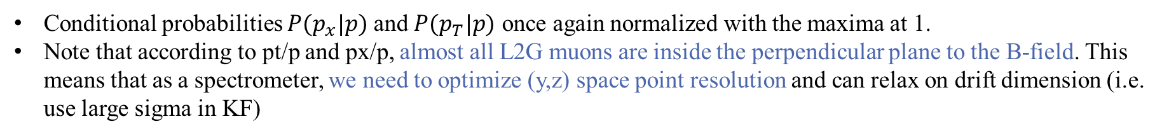
$P(p_{x}/p|p)$ and $P(p_{T}/p|p)$
Conditional probabilities $P(p_{x}|p)$ and $P(p_{T}|p)$ once again normalized with the maxima at 1.
Note that according to pt/p and px/p, almost all L2G muons are inside the perpendicular plane to the B-field. This means that as a spectrometer, we need to optimize (y,z) space point resolution and can relax on drift dimension (i.e. use large sigma in KF)

Slide 13
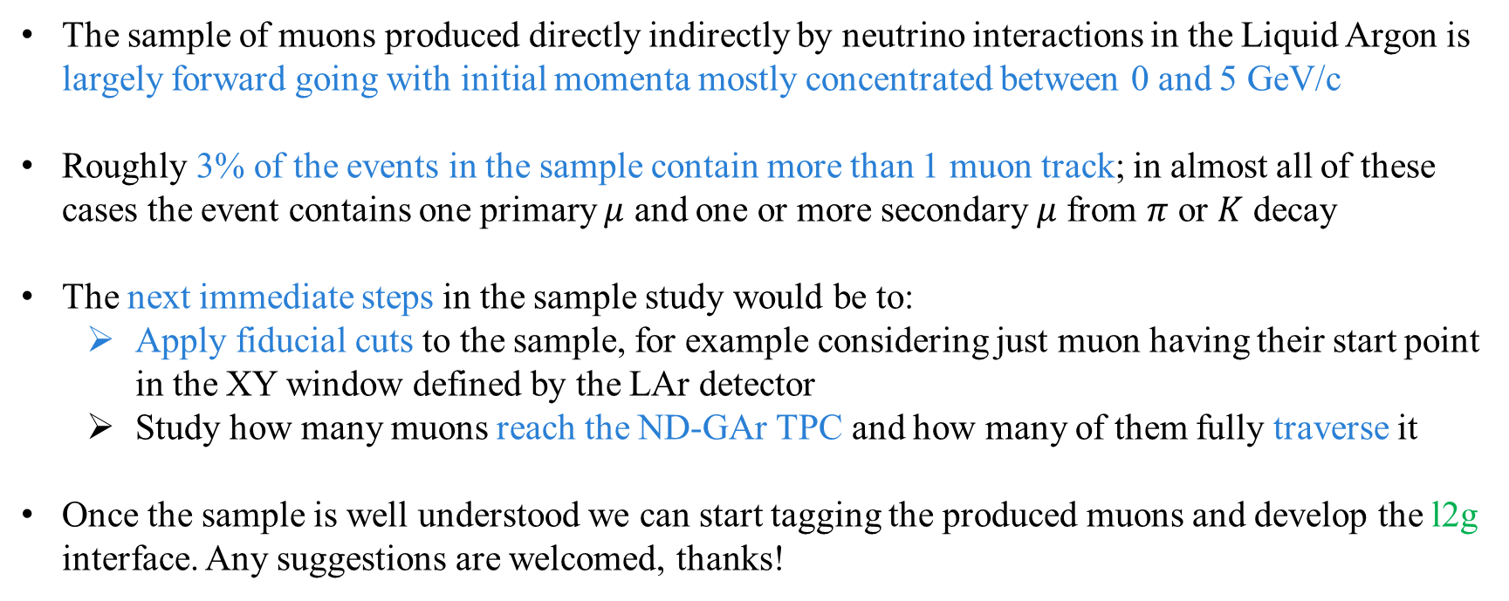
Summary and future steps
The sample of muons produced directly indirectly by neutrino interactions in the Liquid Argon is largely forward going with initial momenta mostly concentrated between 0 and 5 GeV/c
Roughly 3% of the events in the sample contain more than 1 muon track; in almost all of these cases the event contains one primary $μ$ and one or more secondary $μ$ from $π$ or $K$ decay
The next immediate steps in the sample study would be to:
Apply fiducial cuts to the sample, for example considering just muon having their start point in the XY window defined by the LAr detector
Study how many muons reach the ND-GAr TPC and how many of them fully traverse it
Once the sample is well understood we can start tagging the produced muons and develop the l2g interface. Any suggestions are welcomed, thanks!

Slide 14
Lar to gar ratio
Here we plot the ratio of muons at the exit of the Lar active volume with the number of muons at the entrance of the Gar as a function of x and y

