Slide 1
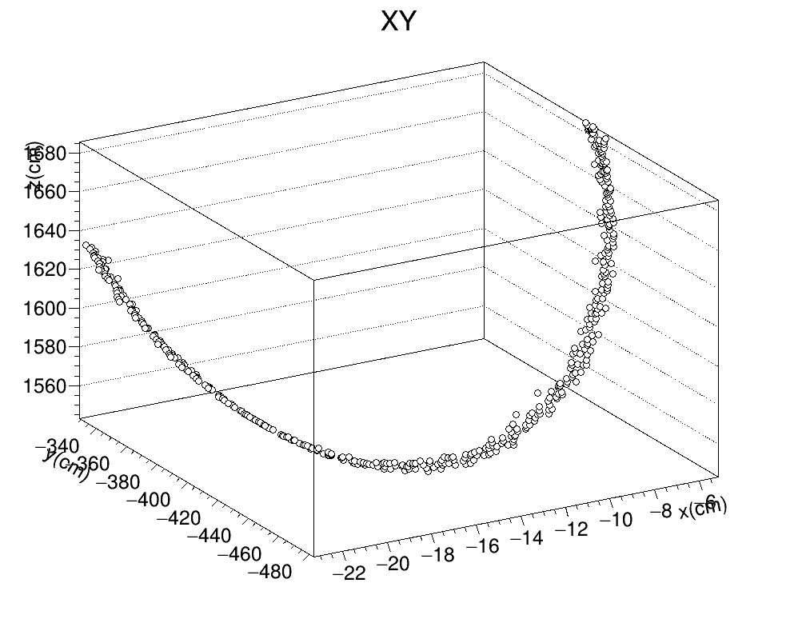
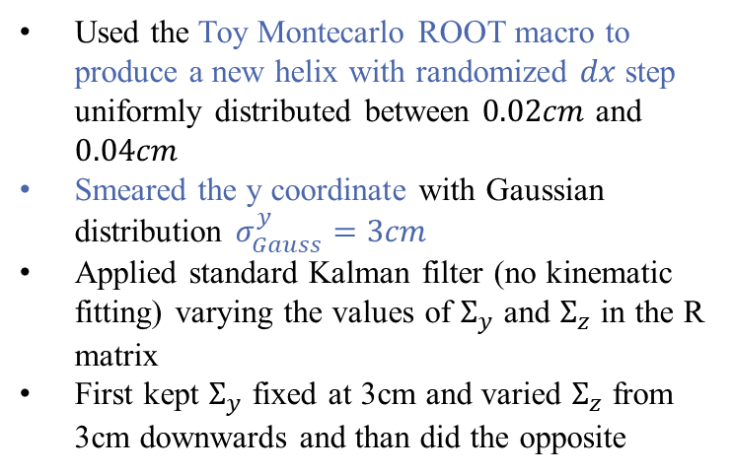
Toy monte carlo SMEARED y
Used the Toy Montecarlo ROOT macro to produce a new helix with randomized $dx$ step uniformly distributed between $0.02cm$ and $0.04cm$
Smeared the y coordinate with Gaussian distribution $σ_{Gauss}^{y}=3cm$
Applied standard Kalman filter (no kinematic fitting) varying the values of $Σ_{y}$ and $Σ_{z}$ in the R matrix
First kept $Σ_{y}$ fixed at 3cm and varied $Σ_{z}$ from 3cm downwards and than did the opposite

Slide 2
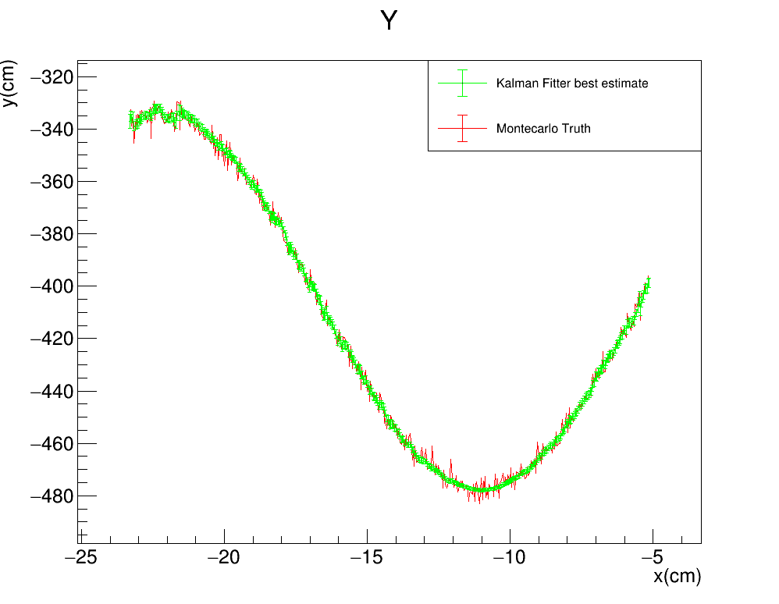
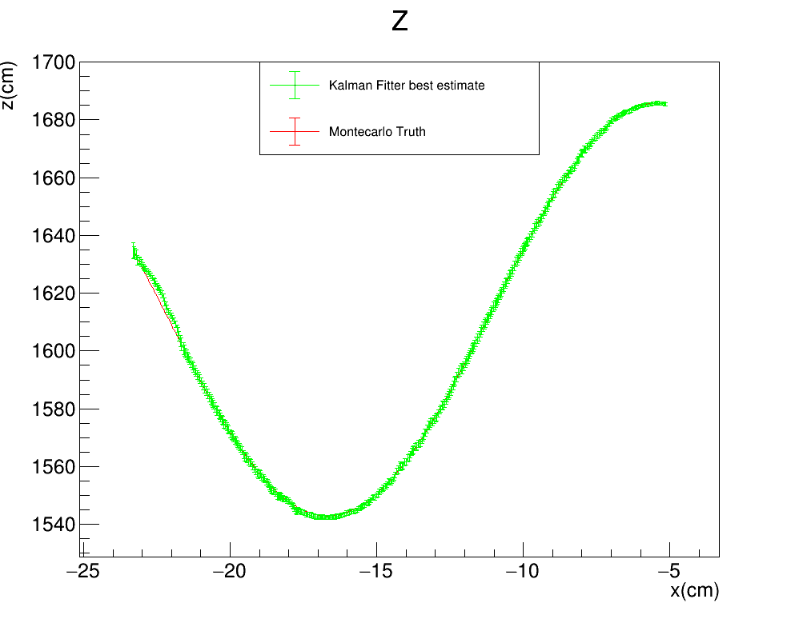



Toy monte carlo: SMEARED Y
Keep $Σ_{y}$ fixed at 3cm and vary $Σ_{z}$
STANDARD KALMAN FILTER
R$: \left(Σ_{y},Σ_{z}\right)=(3cm,3cm)$
Gauss$: σ_{Gauss}^{y}=3cm$
FILTER PROPAGATION DIRECTION

Slide 3
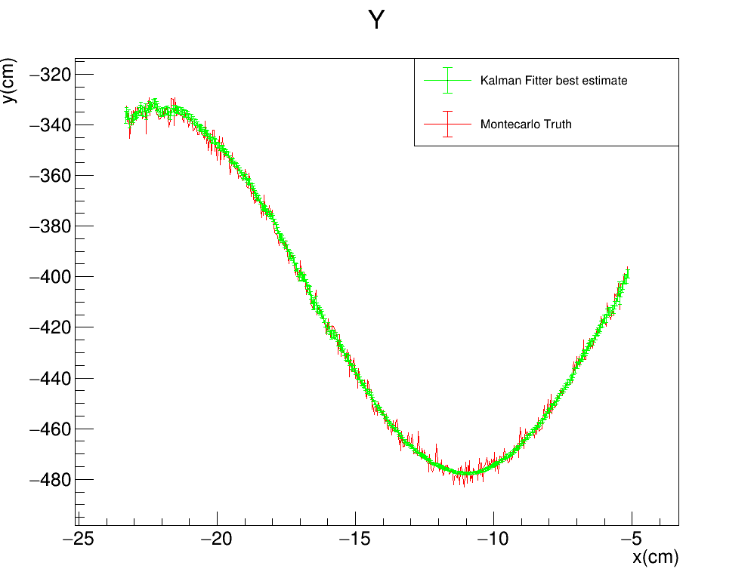
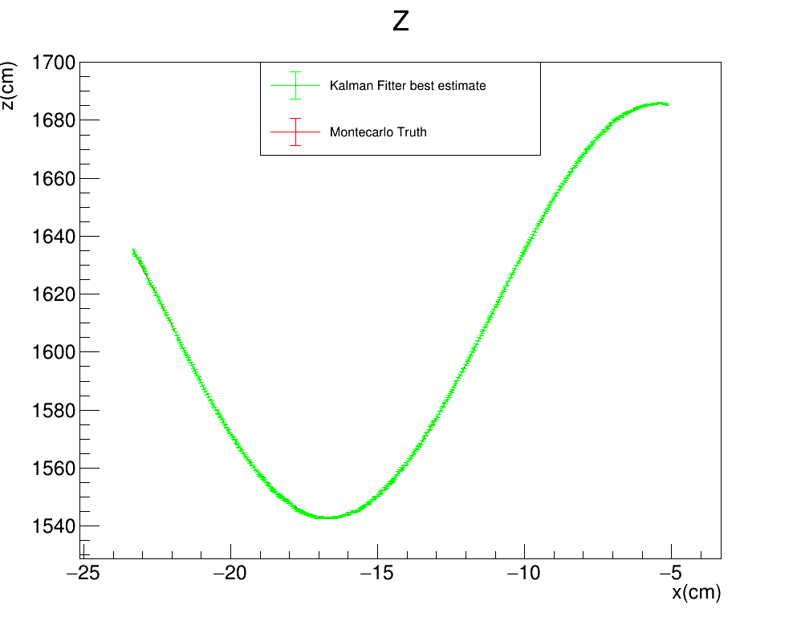

Toy monte carlo: SMEARED Y
STANDARD KALMAN FILTER
R$: \left(Σ_{y},Σ_{z}\right)=(3cm,1cm)$
Gauss$: σ_{Gauss}^{y}=3cm$
FILTER PROPAGATION DIRECTION

Slide 4
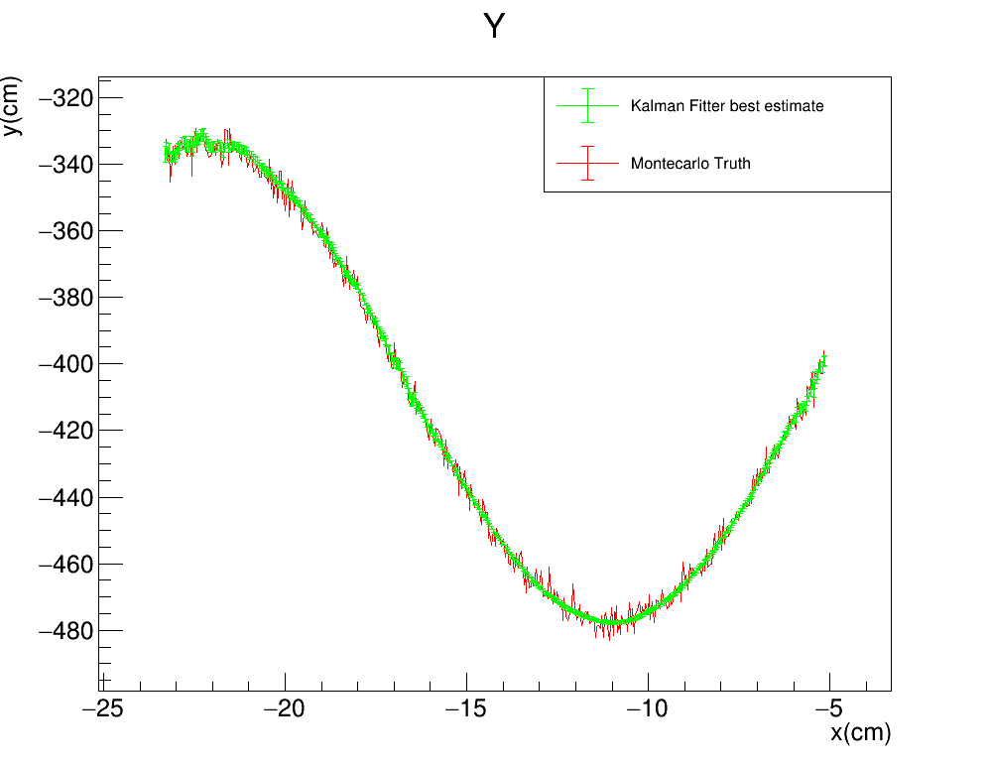
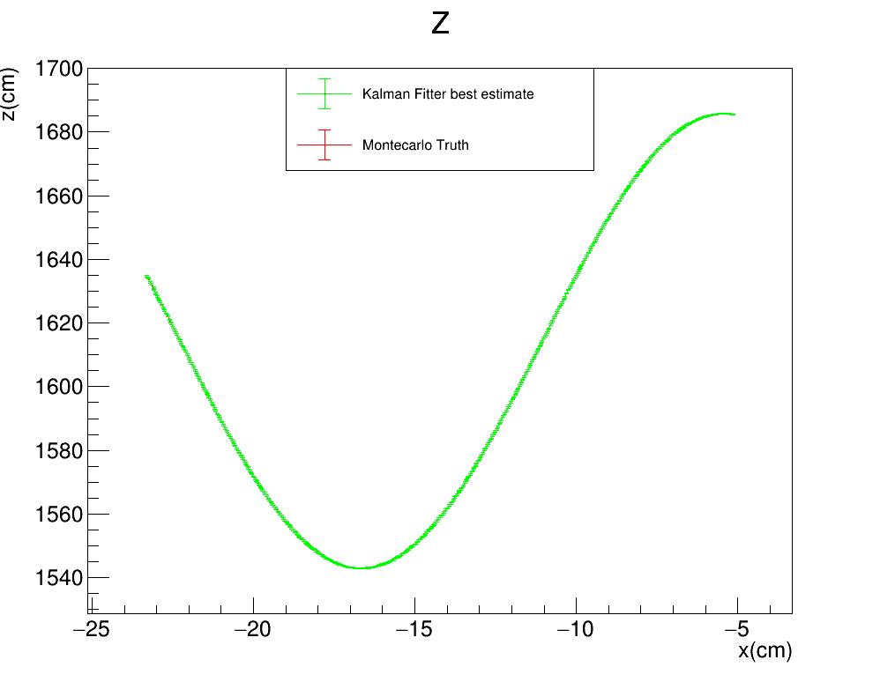

Toy monte carlo: SMEARED Y
STANDARD KALMAN FILTER
R$: \left(Σ_{y},Σ_{z}\right)=(3cm,0.3cm)$
Gauss$: σ_{Gauss}^{y}=3cm$
FILTER PROPAGATION DIRECTION

Slide 5
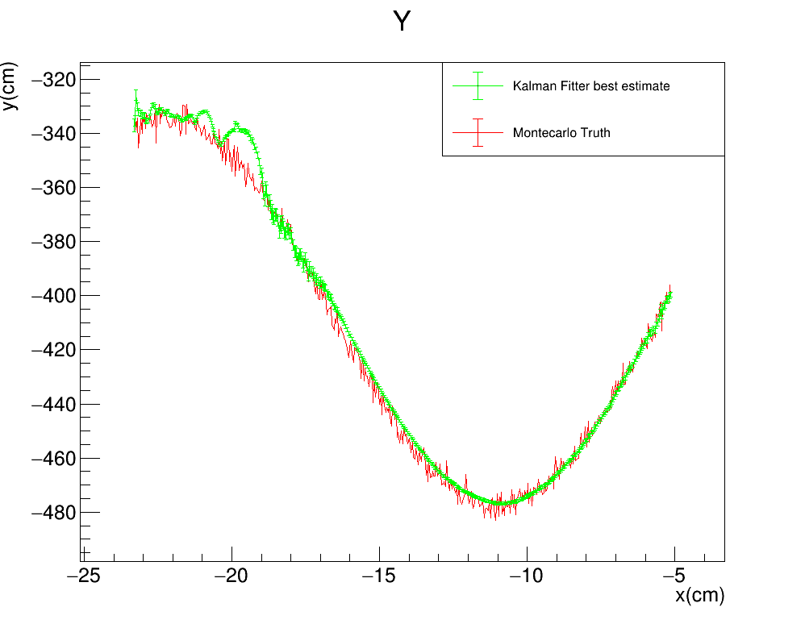


Toy monte carlo: SMEARED Y
STANDARD KALMAN FILTER
R$: \left(Σ_{y},Σ_{z}\right)=(3cm,0.1cm)$
Gauss$: σ_{Gauss}^{y}=3cm$
FILTER PROPAGATION DIRECTION

Slide 6
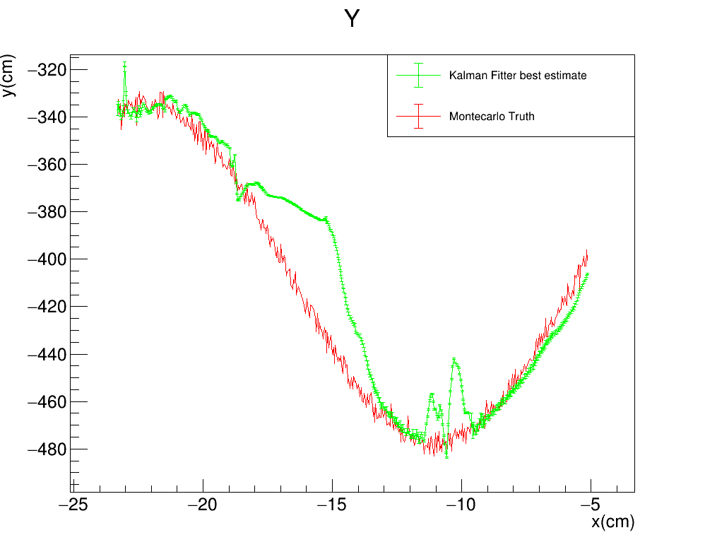
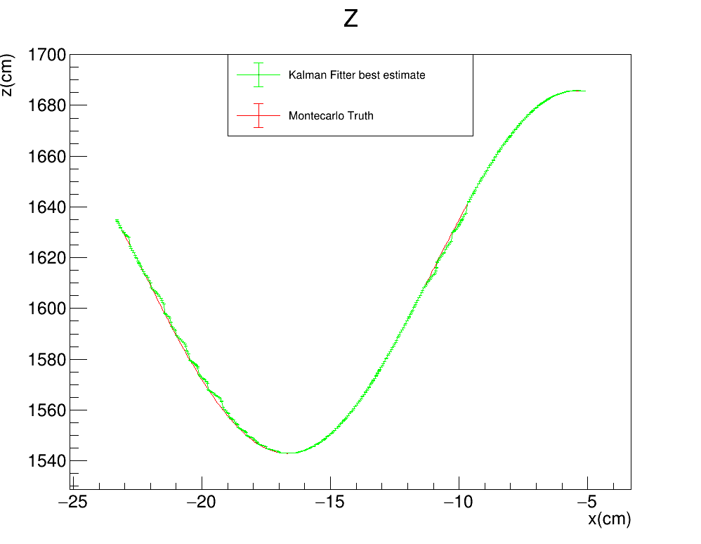

Toy monte carlo: SMEARED Y
STANDARD KALMAN FILTER
R$: \left(Σ_{y},Σ_{z}\right)=(3cm,0.01cm)$
Gauss$: σ_{Gauss}^{y}=3cm$
FILTER PROPAGATION DIRECTION

Slide 7
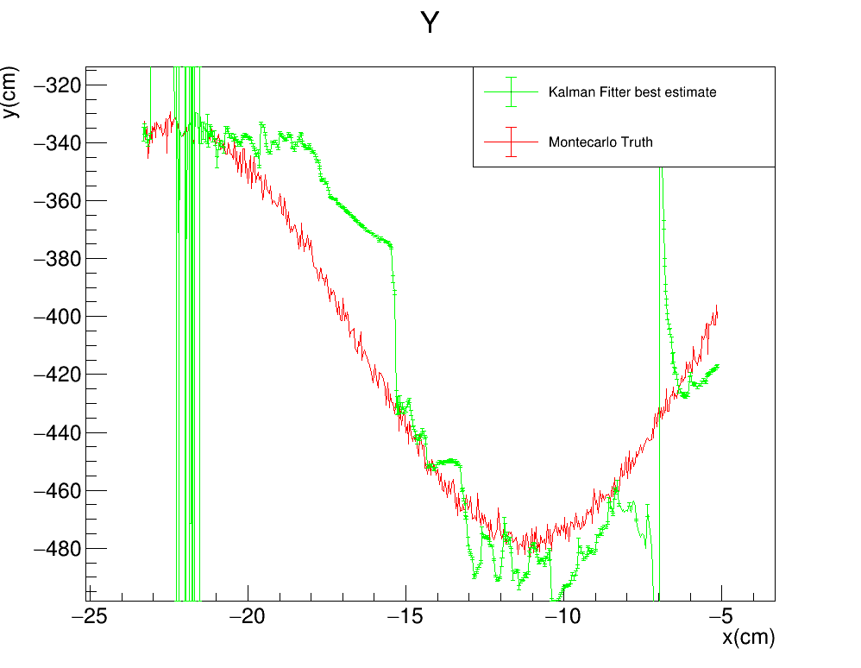
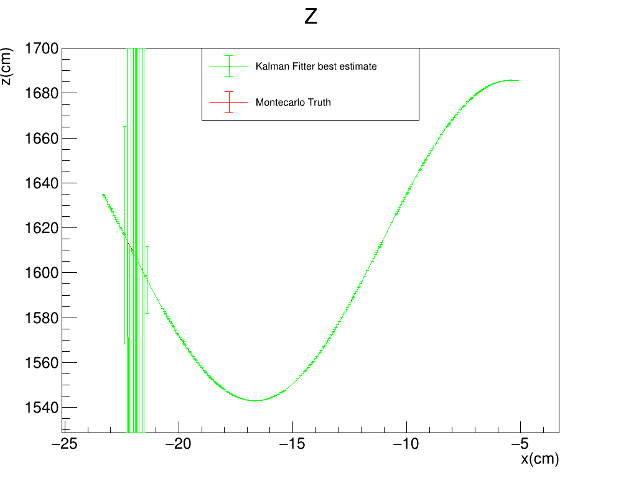

Toy monte carlo: SMEARED Y
STANDARD KALMAN FILTER
R$: \left(Σ_{y},Σ_{z}\right)=(3cm,∼0cm)$
Gauss$: σ_{Gauss}^{y}=3cm$
FILTER PROPAGATION DIRECTION

Slide 8

Toy monte carlo: SMEARED Y
Vary $Σ_{y}$ and keep $Σ_{z}$ fixed at 3cm
STANDARD KALMAN FILTER
R$: \left(Σ_{y},Σ_{z}\right)=(3cm,3cm)$
Gauss$: σ_{Gauss}^{y}=3cm$
FILTER PROPAGATION DIRECTION

Slide 9
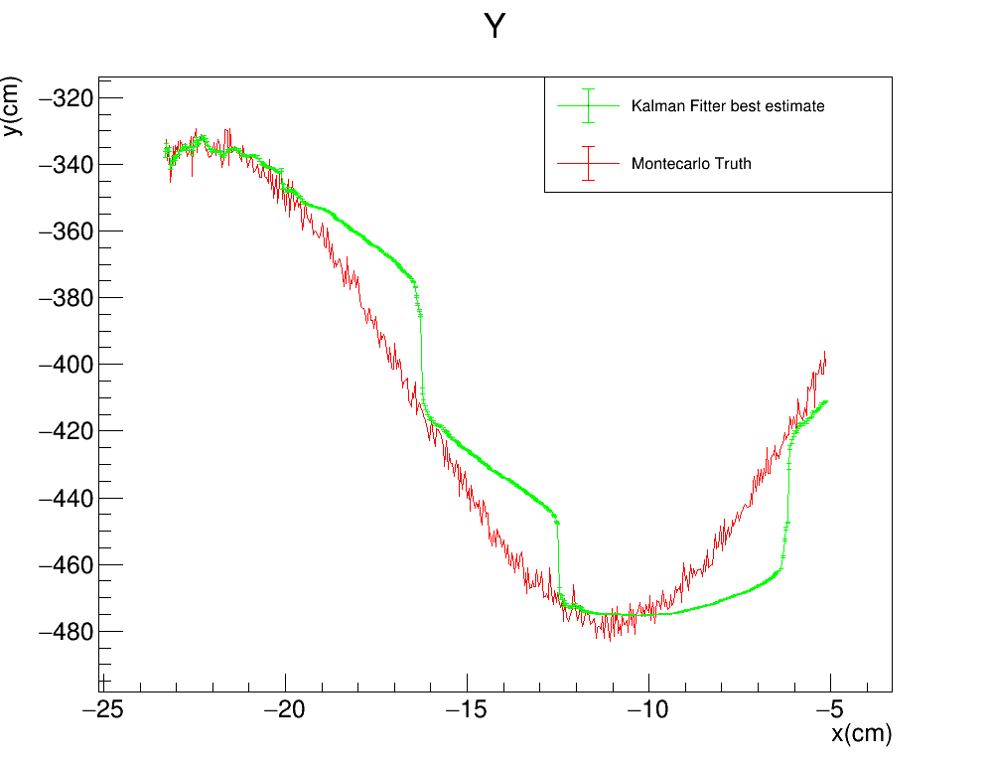
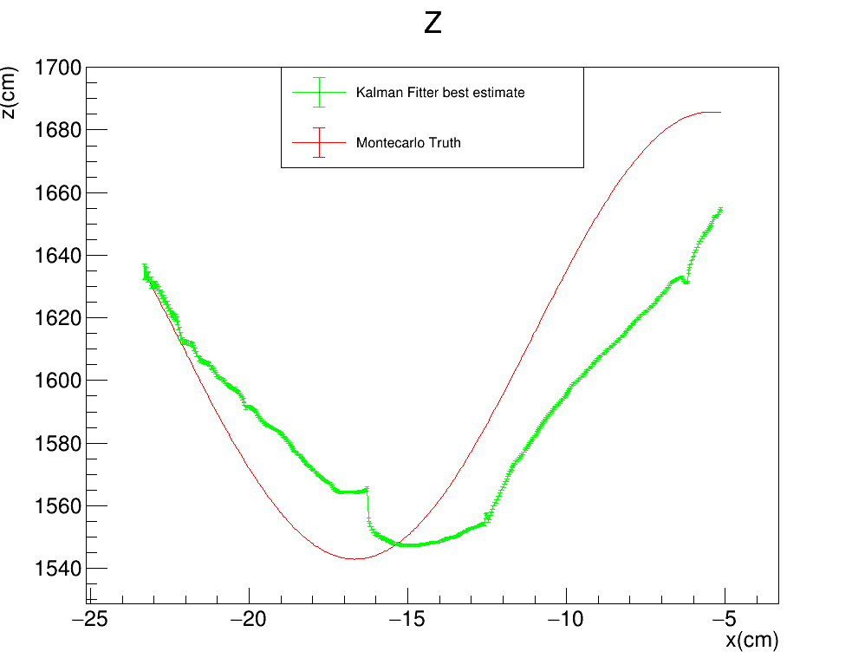

Toy monte carlo: SMEARED Y
STANDARD KALMAN FILTER
R$: \left(Σ_{y},Σ_{z}\right)=(1cm,3cm)$
Gauss$: σ_{Gauss}^{y}=3cm$
FILTER PROPAGATION DIRECTION

Slide 10
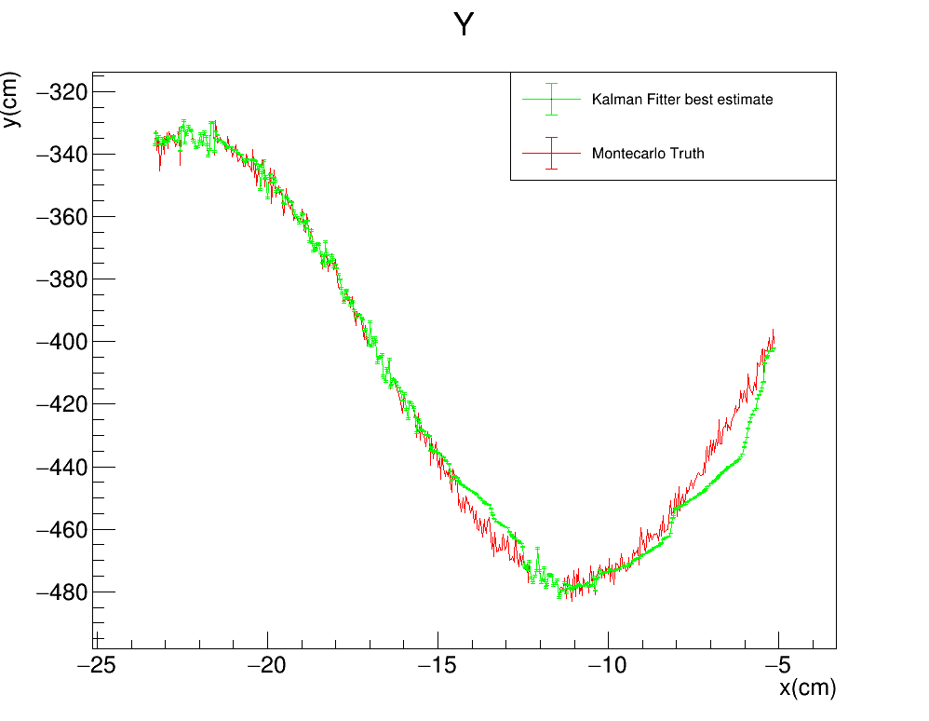
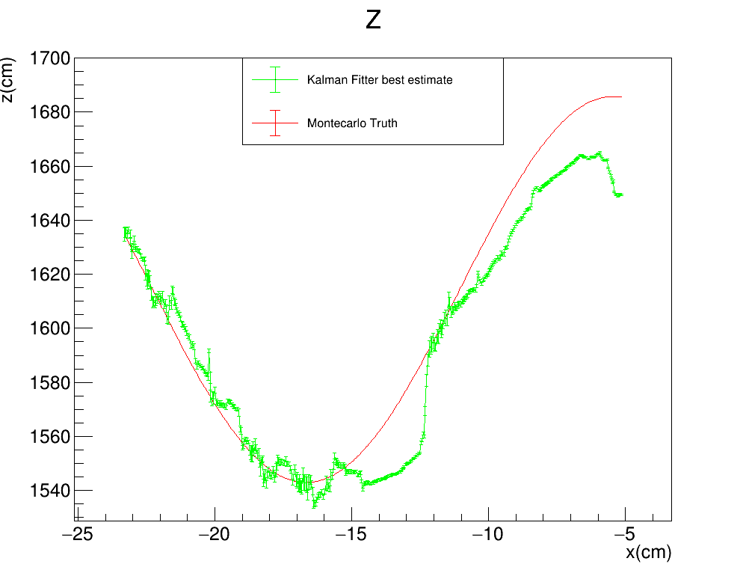

Toy monte carlo: SMEARED Y
STANDARD KALMAN FILTER
R$: \left(Σ_{y},Σ_{z}\right)=(0.3cm,3cm)$
Gauss$: σ_{Gauss}^{y}=3cm$
FILTER PROPAGATION DIRECTION

Slide 11
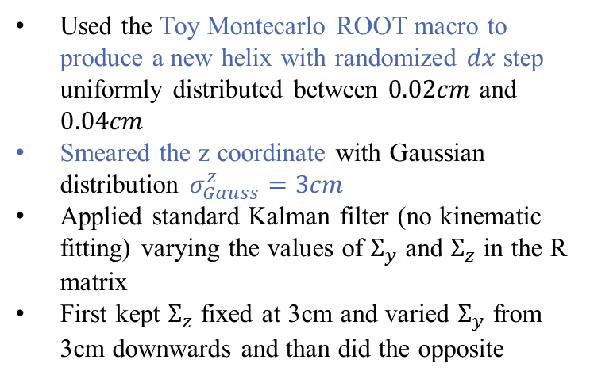
Toy monte carlo SMEARED Z
Used the Toy Montecarlo ROOT macro to produce a new helix with randomized $dx$ step uniformly distributed between $0.02cm$ and $0.04cm$
Smeared the z coordinate with Gaussian distribution $σ_{Gauss}^{z}=3cm$
Applied standard Kalman filter (no kinematic fitting) varying the values of $Σ_{y}$ and $Σ_{z}$ in the R matrix
First kept $Σ_{z}$ fixed at 3cm and varied $Σ_{y}$ from 3cm downwards and than did the opposite

Slide 12
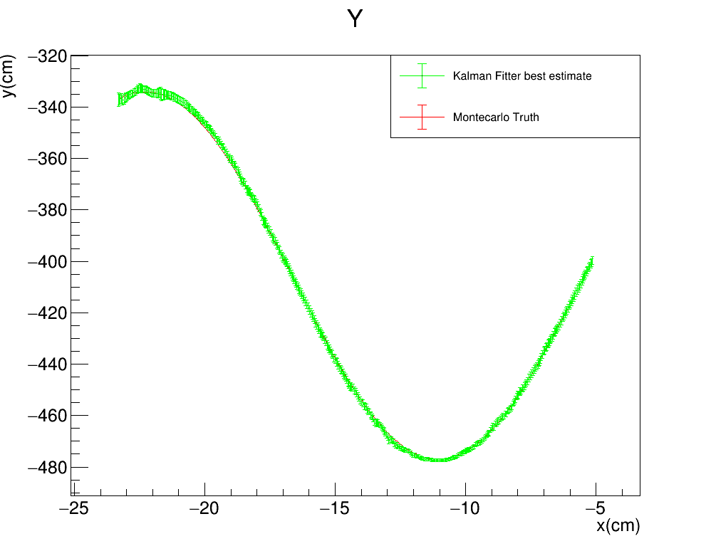
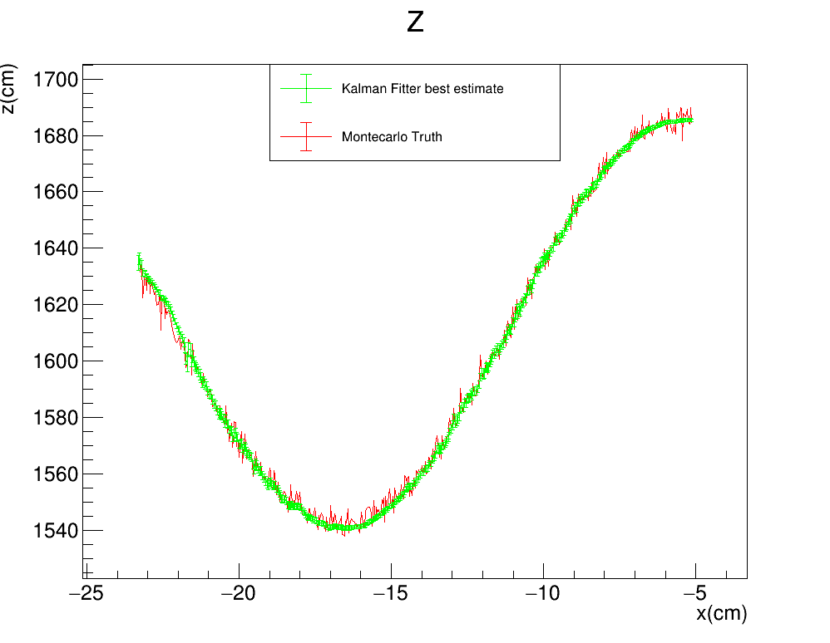


Toy monte carlo: SMEARED Z
Keep $Σ_{z}$ fixed at 3cm and vary $Σ_{y}$
STANDARD KALMAN FILTER
R$: \left(Σ_{y},Σ_{z}\right)=(3cm,3cm)$
Gauss$: σ_{Gauss}^{z}=3cm$
FILTER PROPAGATION DIRECTION

Slide 13
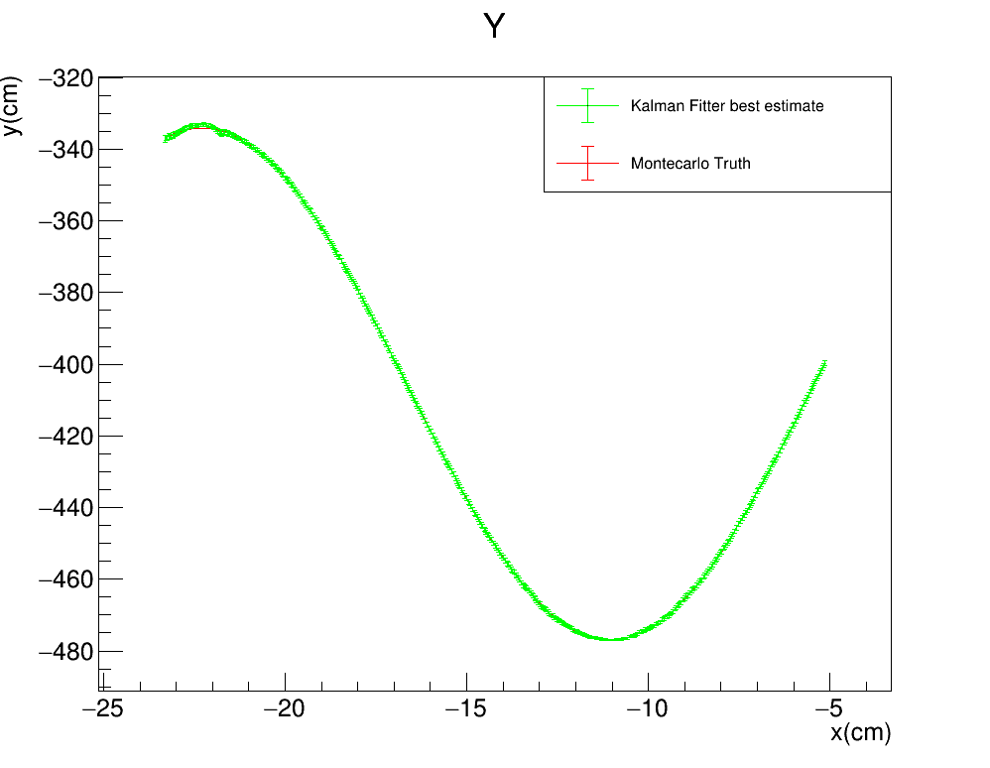

Toy monte carlo: SMEARED Z
STANDARD KALMAN FILTER
R$: \left(Σ_{y},Σ_{z}\right)=(1cm,3cm)$
Gauss$: σ_{Gauss}^{z}=3cm$
FILTER PROPAGATION DIRECTION

Slide 14
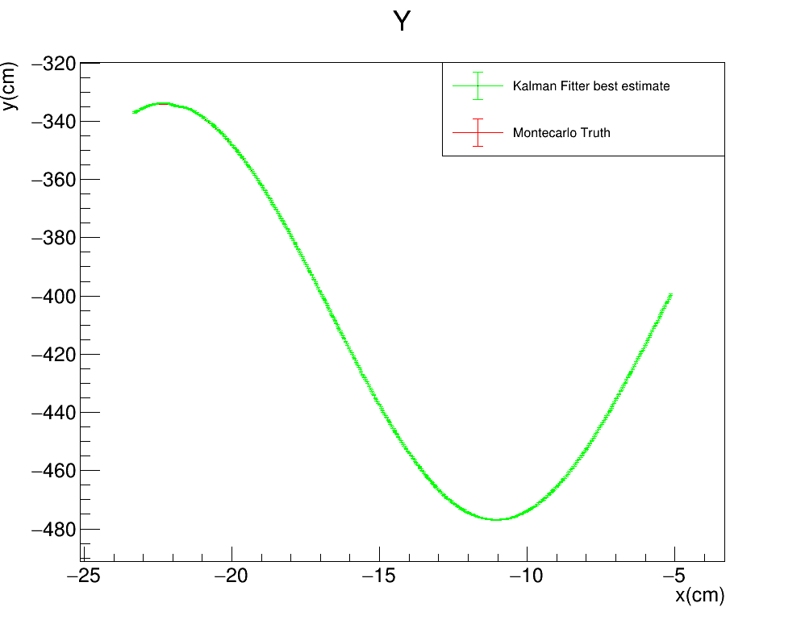
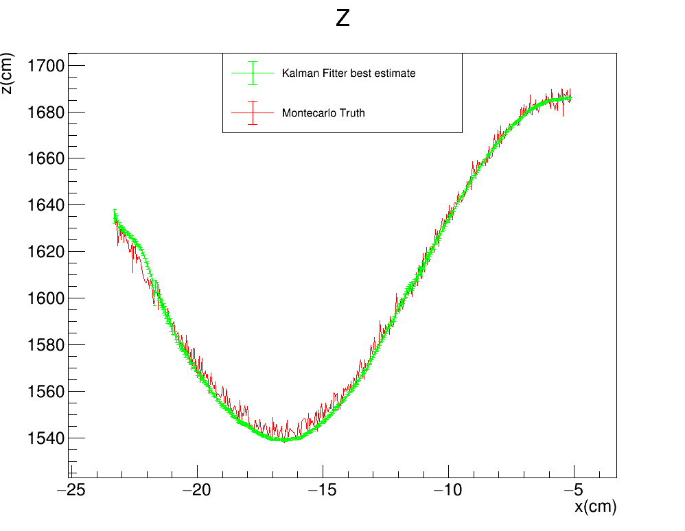
Toy monte carlo: SMEARED Z
STANDARD KALMAN FILTER
R$: \left(Σ_{y},Σ_{z}\right)=(0.3cm,3cm)$
Gauss$: σ_{Gauss}^{z}=3cm$
FILTER PROPAGATION DIRECTION

Slide 15
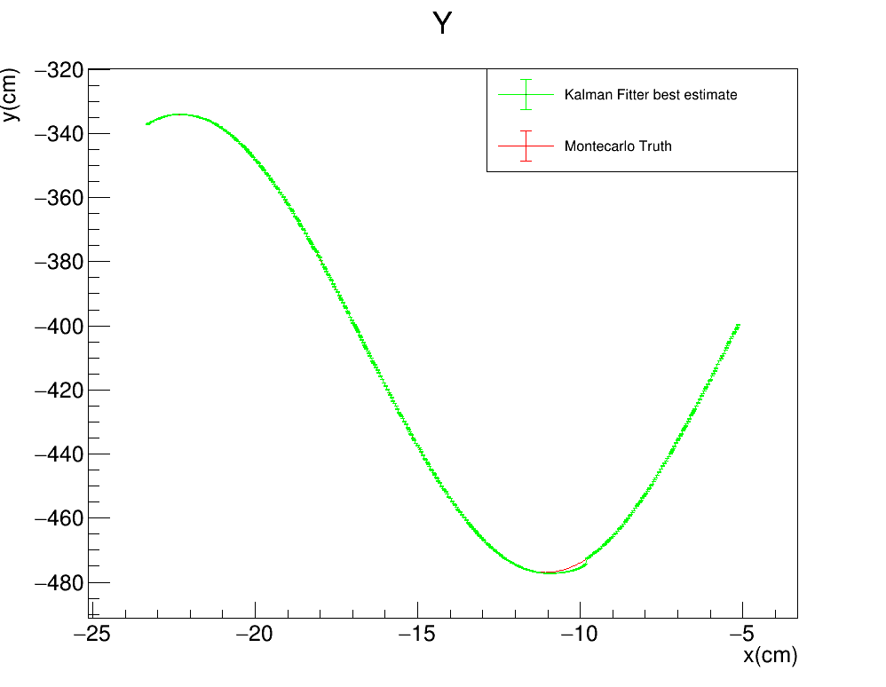
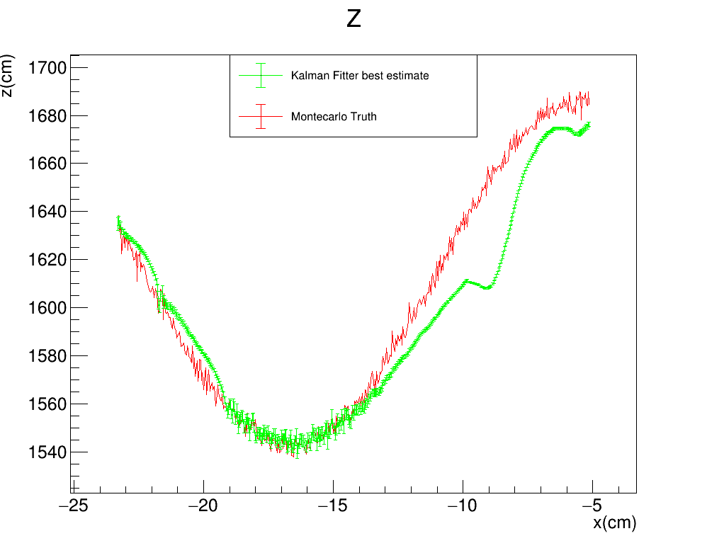

Toy monte carlo: SMEARED Z
STANDARD KALMAN FILTER
R$: \left(Σ_{y},Σ_{z}\right)=(0.1cm,3cm)$
Gauss$: σ_{Gauss}^{z}=3cm$
FILTER PROPAGATION DIRECTION

Slide 16
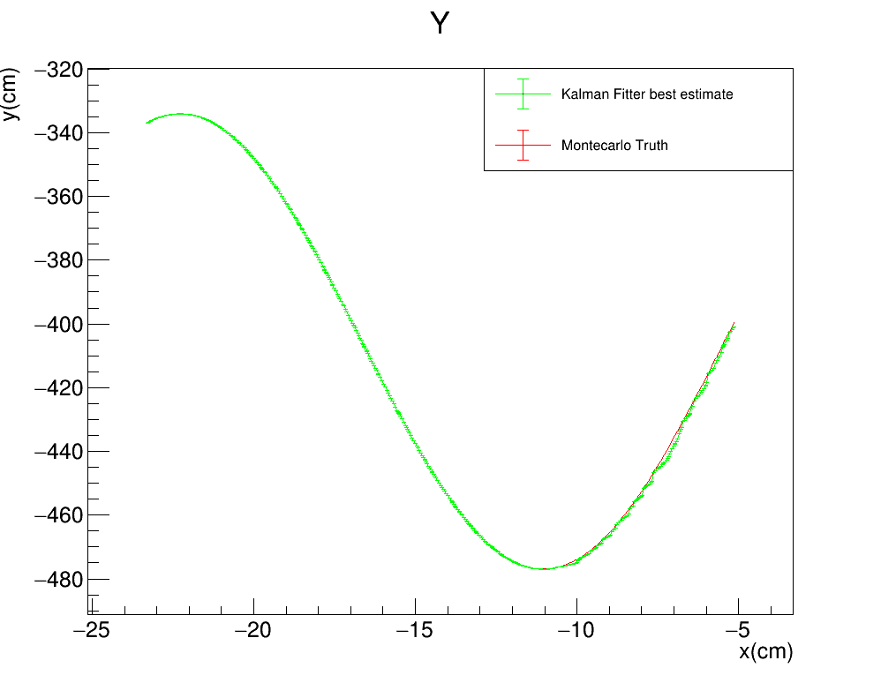
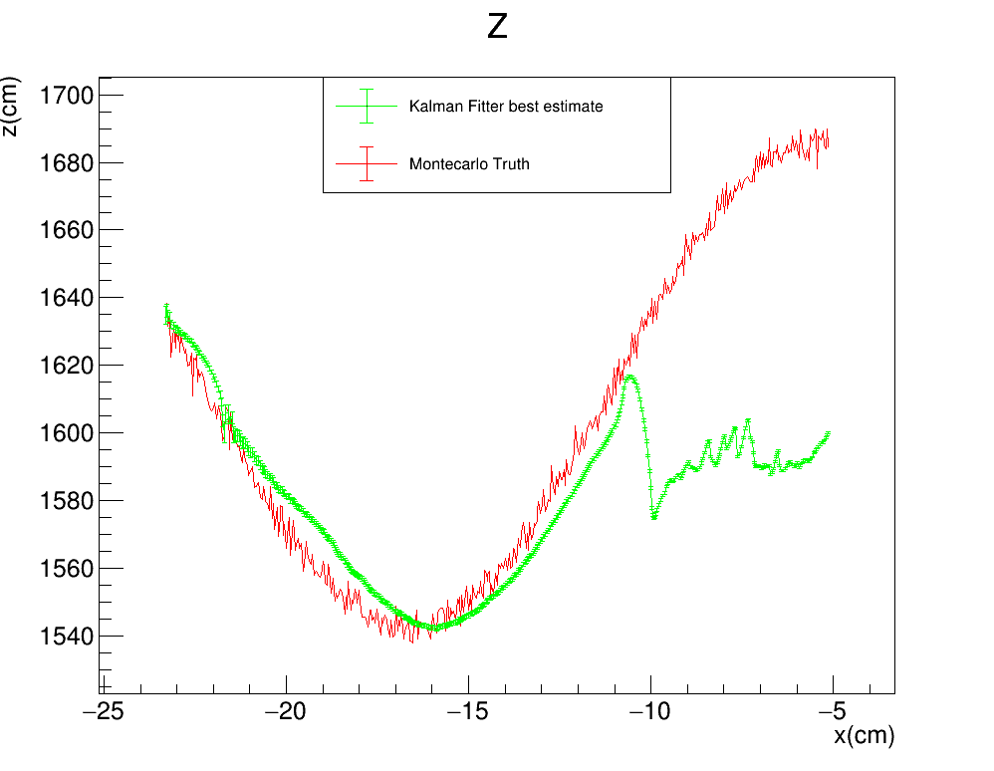

Toy monte carlo: SMEARED Z
STANDARD KALMAN FILTER
R$: \left(Σ_{y},Σ_{z}\right)=(0.01cm,3cm)$
Gauss$: σ_{Gauss}^{z}=3cm$
FILTER PROPAGATION DIRECTION

Slide 17
Toy monte carlo: SMEARED Z
STANDARD KALMAN FILTER
R$: \left(Σ_{y},Σ_{z}\right)=(0.01cm,3cm)$
Gauss$: σ_{Gauss}^{z}=3cm$
FILTER PROPAGATION DIRECTION

Slide 18

Toy monte carlo: SMEARED Z
Keep $Σ_{y}$ fixed at 3cm and vary $Σ_{z}$
STANDARD KALMAN FILTER
R$: \left(Σ_{y},Σ_{z}\right)=(3cm,3cm)$
Gauss$: σ_{Gauss}^{z}=3cm$
FILTER PROPAGATION DIRECTION

Slide 19
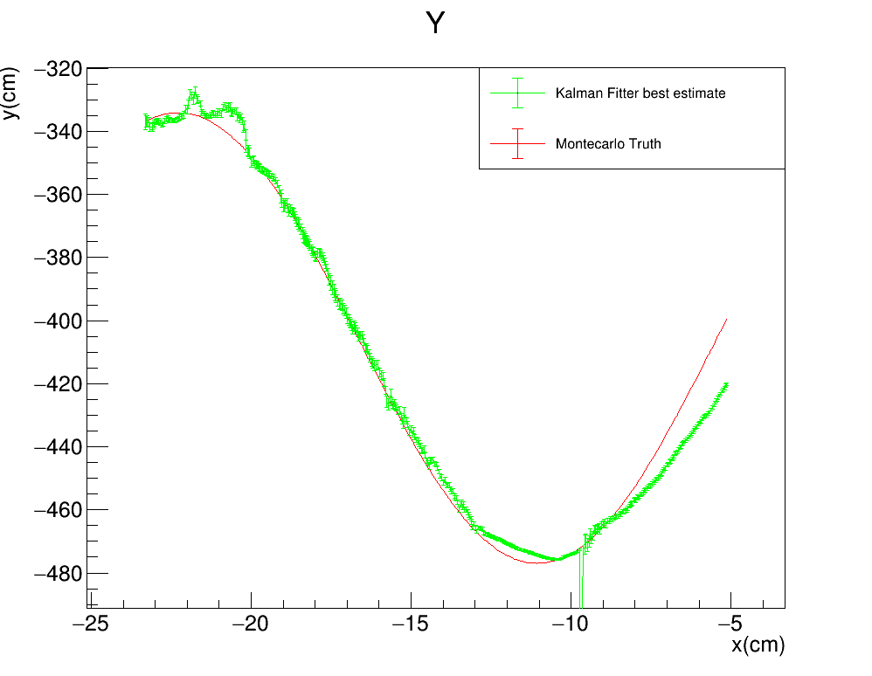
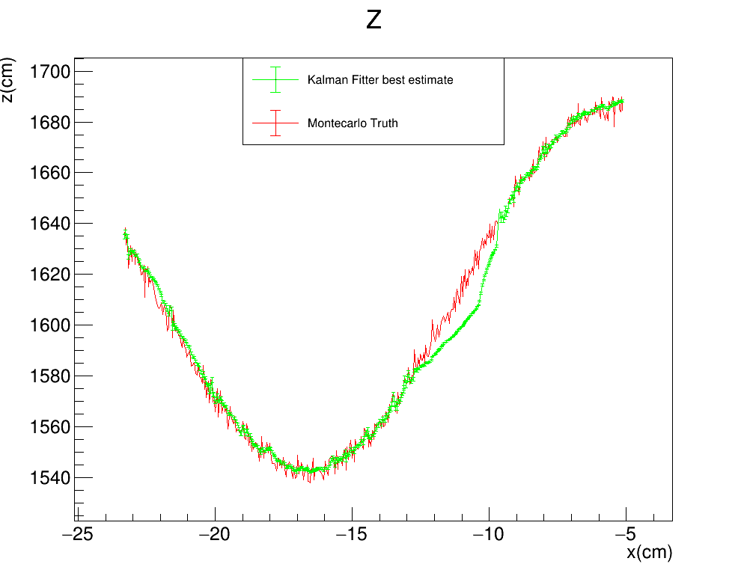
Toy monte carlo: SMEARED Z
STANDARD KALMAN FILTER
R$: \left(Σ_{y},Σ_{z}\right)=(3cm,1cm)$
Gauss$: σ_{Gauss}^{z}=3cm$
FILTER PROPAGATION DIRECTION

Slide 20
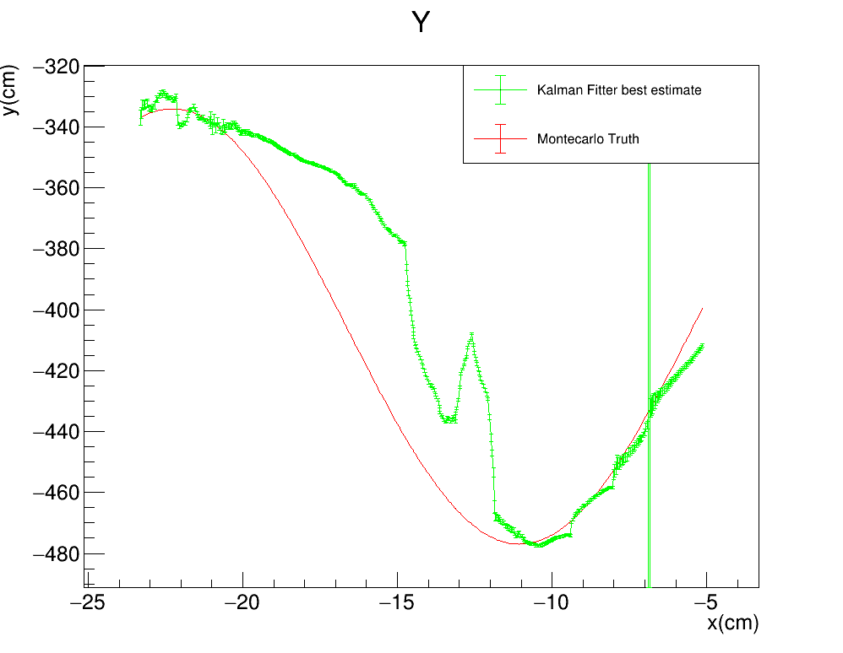
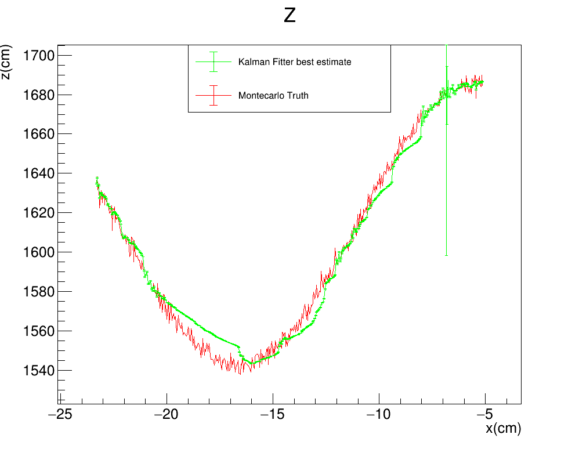
Toy monte carlo: SMEARED Z
STANDARD KALMAN FILTER
R$: \left(Σ_{y},Σ_{z}\right)=(3cm,0.3cm)$
Gauss$: σ_{Gauss}^{z}=3cm$
FILTER PROPAGATION DIRECTION

Slide 21
EXTRA SLIDES

Slide 22
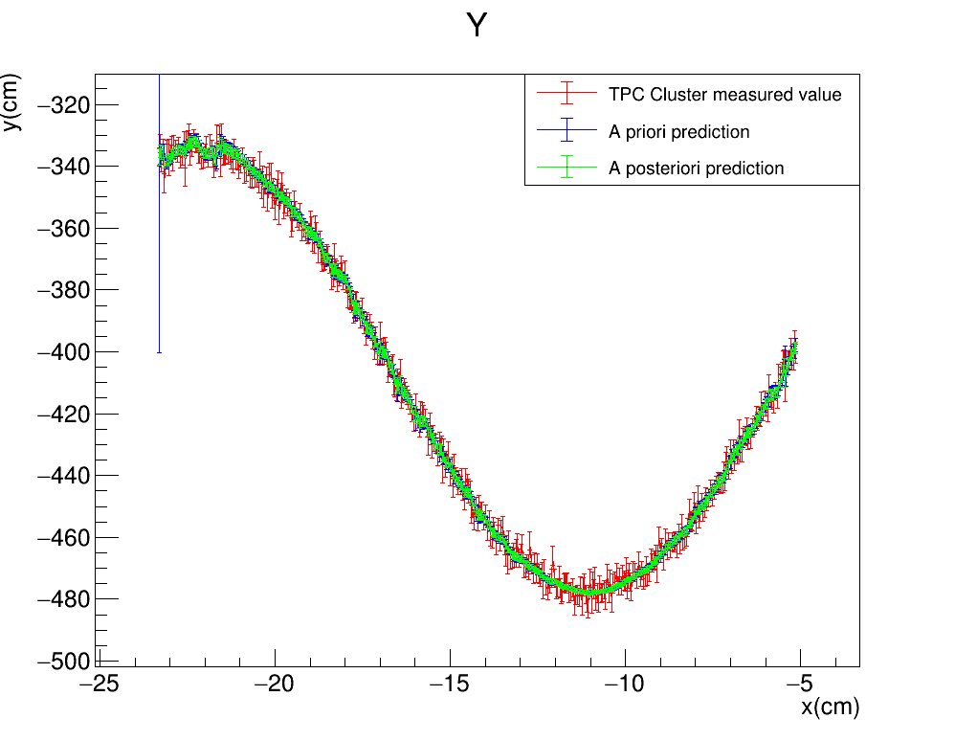
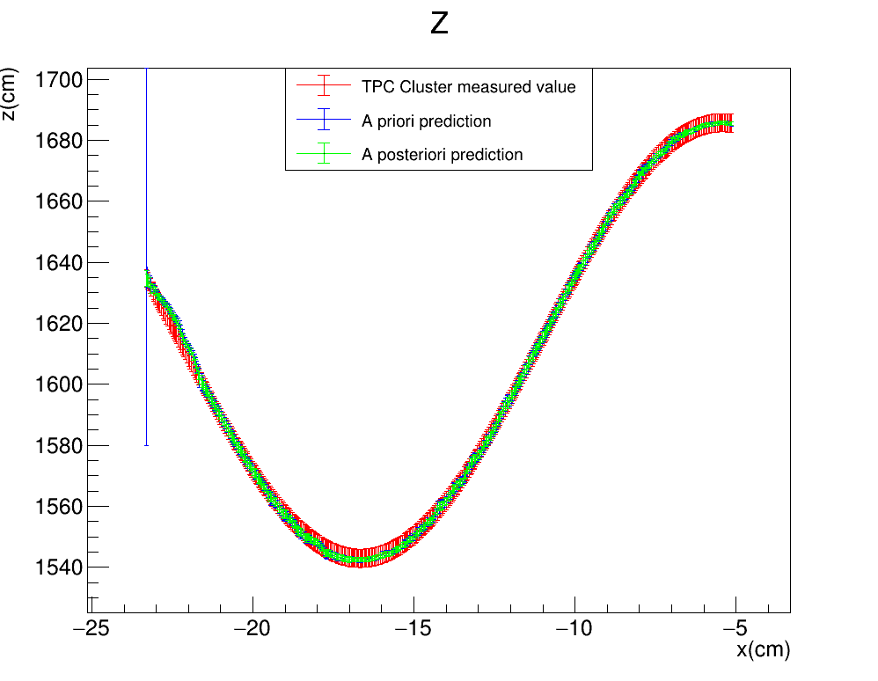
Toy monte carlo: SMEARED Y
Keep $Σ_{y}$ fixed at 3cm and vary $Σ_{z}$
STANDARD KALMAN FILTER
R$: \left(Σ_{y},Σ_{z}\right)=(3cm,3cm)$
Gauss$: σ_{Gauss}^{y}=3cm$
FILTER PROPAGATION DIRECTION

Slide 23

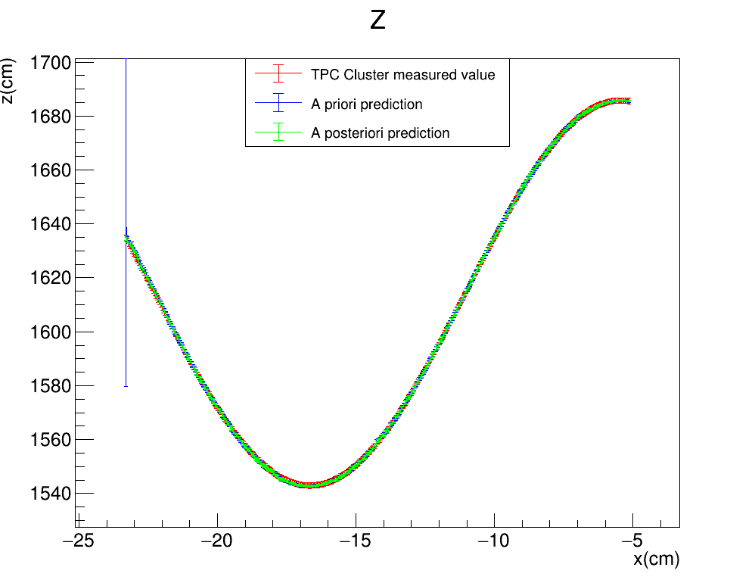
Toy monte carlo: SMEARED Y
STANDARD KALMAN FILTER
R$: \left(Σ_{y},Σ_{z}\right)=(3cm,1cm)$
Gauss$: σ_{Gauss}^{y}=3cm$
FILTER PROPAGATION DIRECTION

Slide 24
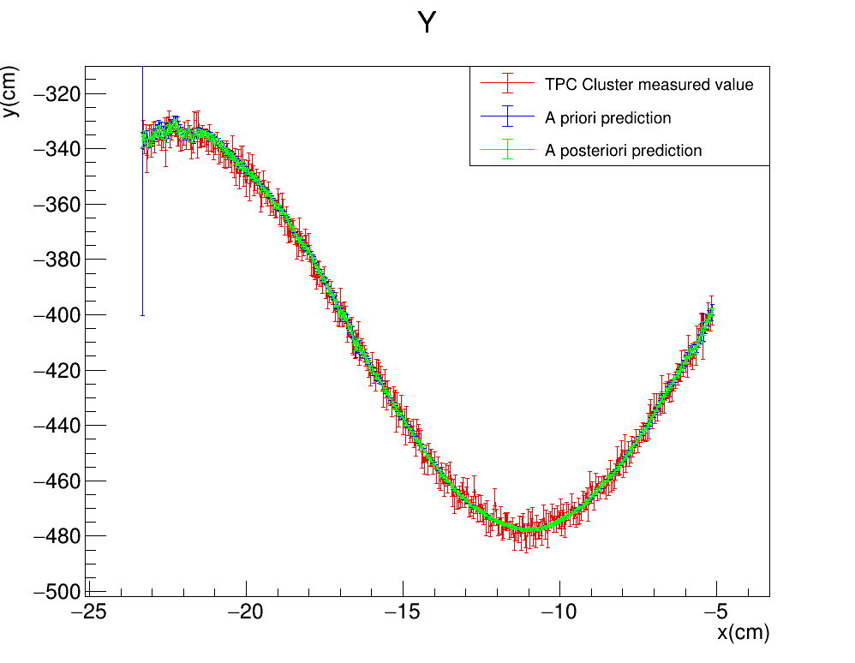
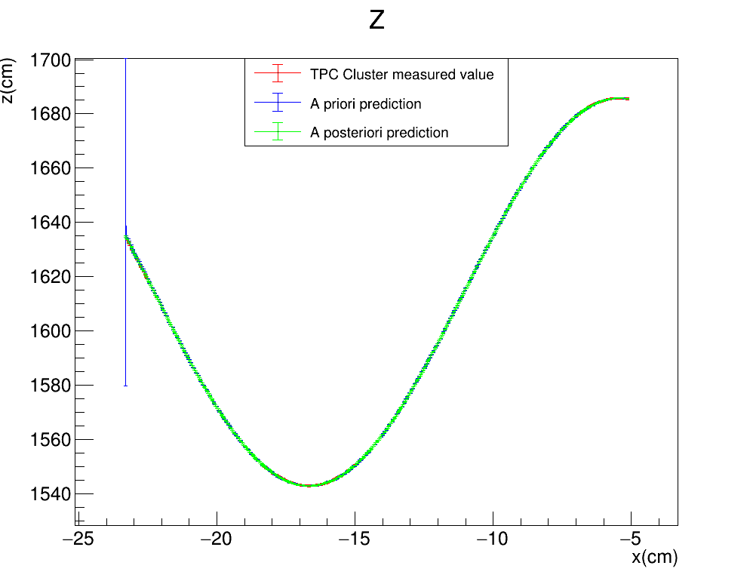
Toy monte carlo: SMEARED Y
STANDARD KALMAN FILTER
R$: \left(Σ_{y},Σ_{z}\right)=(3cm,0.3cm)$
Gauss$: σ_{Gauss}^{y}=3cm$
FILTER PROPAGATION DIRECTION

Slide 25
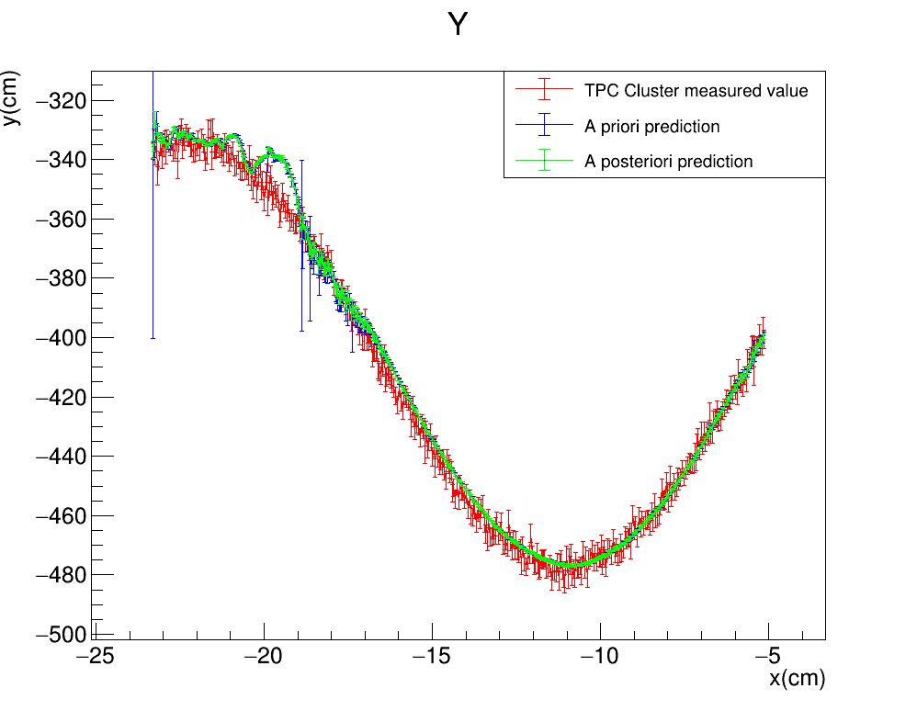
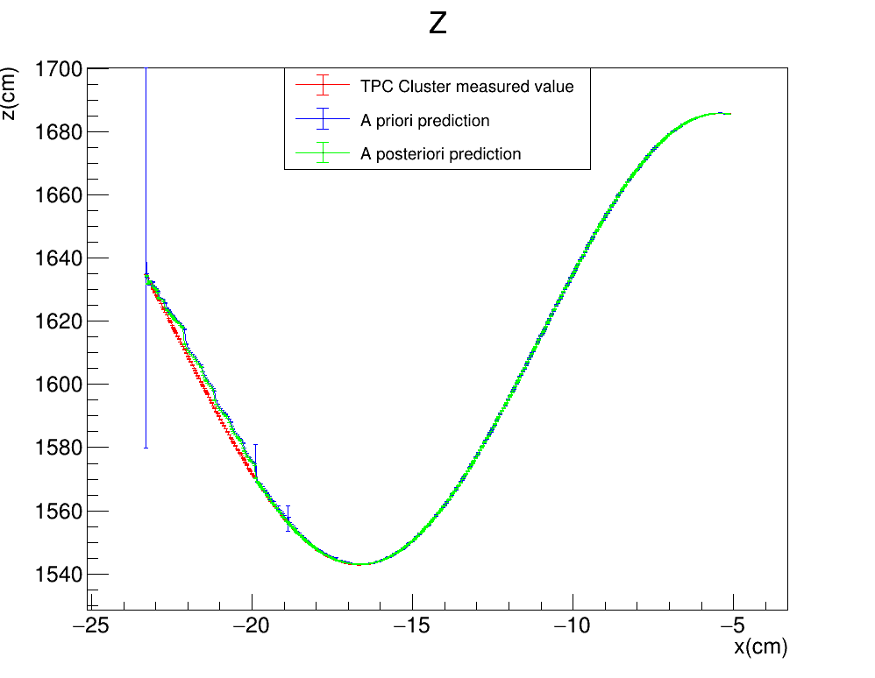
Toy monte carlo: SMEARED Y
STANDARD KALMAN FILTER
R$: \left(Σ_{y},Σ_{z}\right)=(3cm,0.1cm)$
Gauss$: σ_{Gauss}^{y}=3cm$
FILTER PROPAGATION DIRECTION

Slide 26
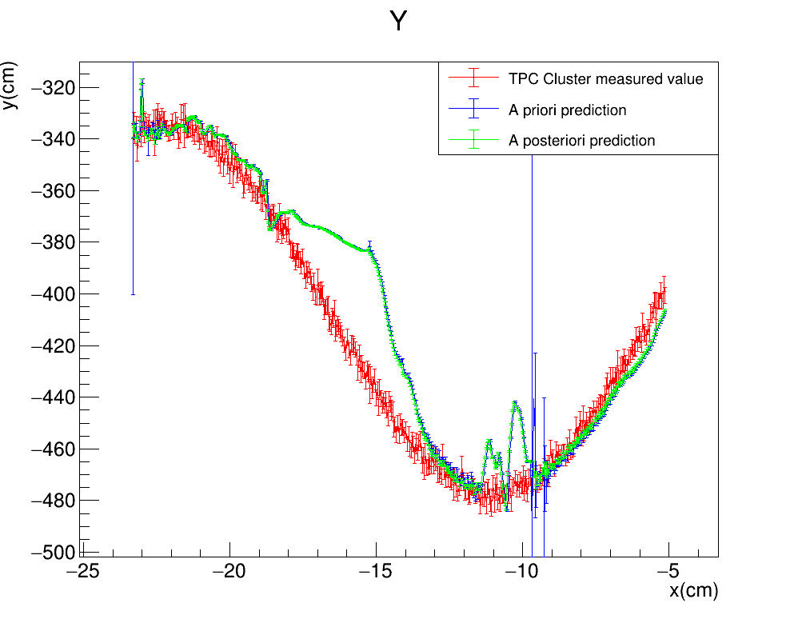
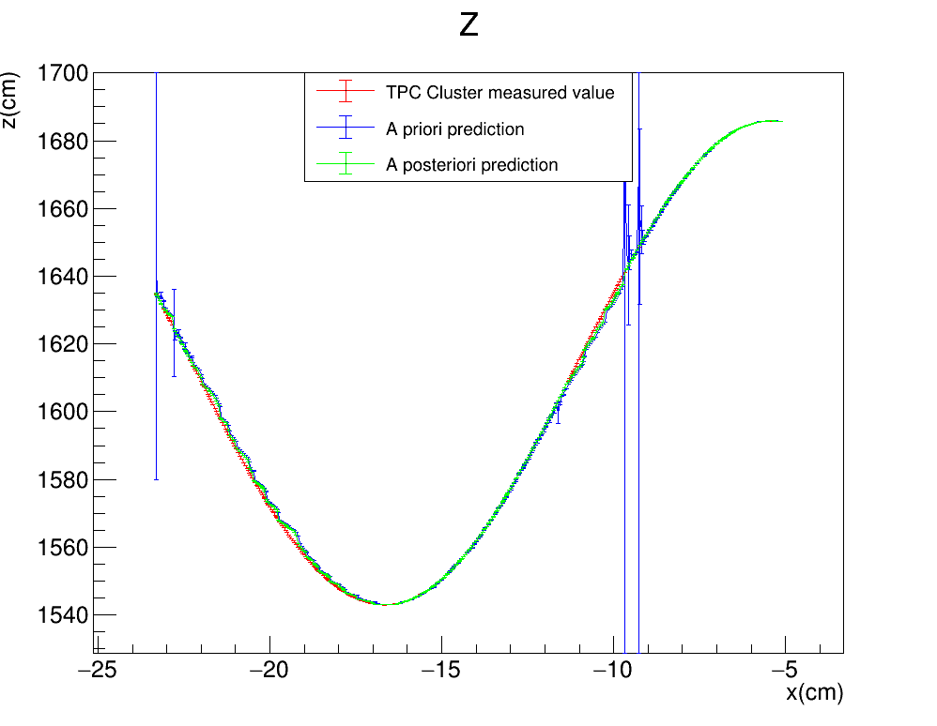
Toy monte carlo: SMEARED Y
STANDARD KALMAN FILTER
R$: \left(Σ_{y},Σ_{z}\right)=(3cm,0.01cm)$
Gauss$: σ_{Gauss}^{y}=3cm$
FILTER PROPAGATION DIRECTION

Slide 27
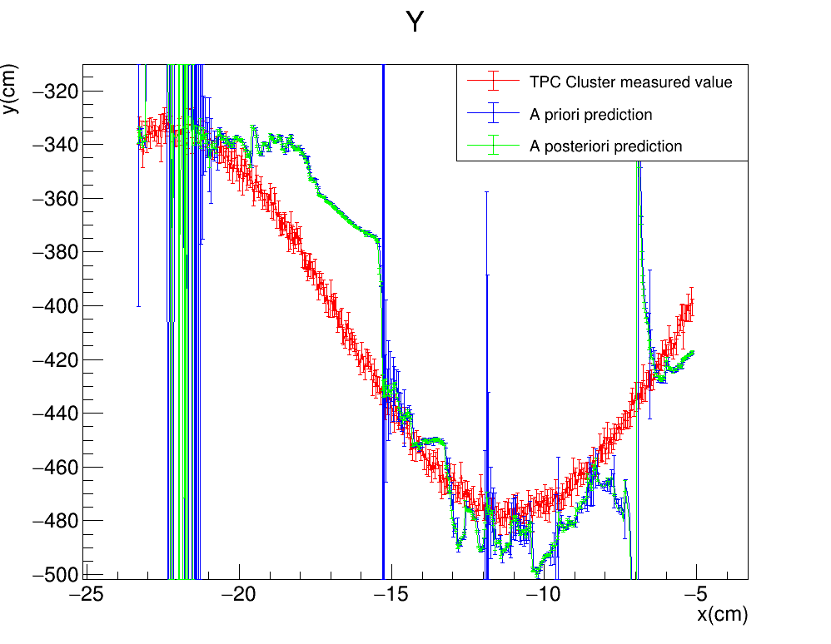
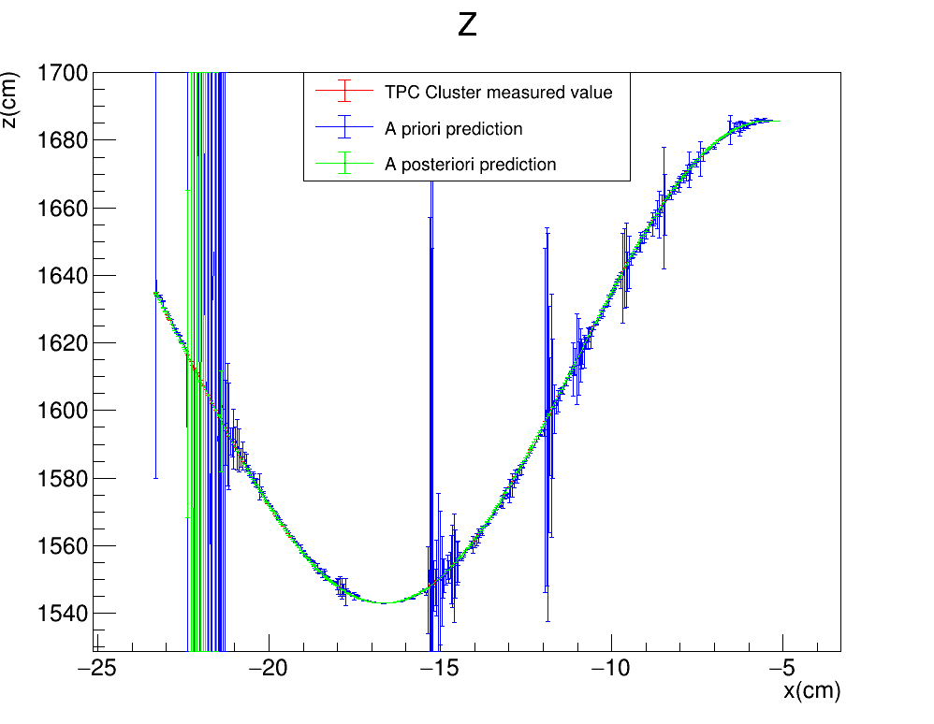
Toy monte carlo: SMEARED Y
STANDARD KALMAN FILTER
R$: \left(Σ_{y},Σ_{z}\right)=(3cm,∼0cm)$
Gauss$: σ_{Gauss}^{y}=3cm$
FILTER PROPAGATION DIRECTION

Slide 28
Toy monte carlo: SMEARED Y
Vary $Σ_{y}$ and keep $Σ_{z}$ fixed at 3cm
STANDARD KALMAN FILTER
R$: \left(Σ_{y},Σ_{z}\right)=(3cm,3cm)$
Gauss$: σ_{Gauss}^{y}=3cm$
FILTER PROPAGATION DIRECTION

Slide 29
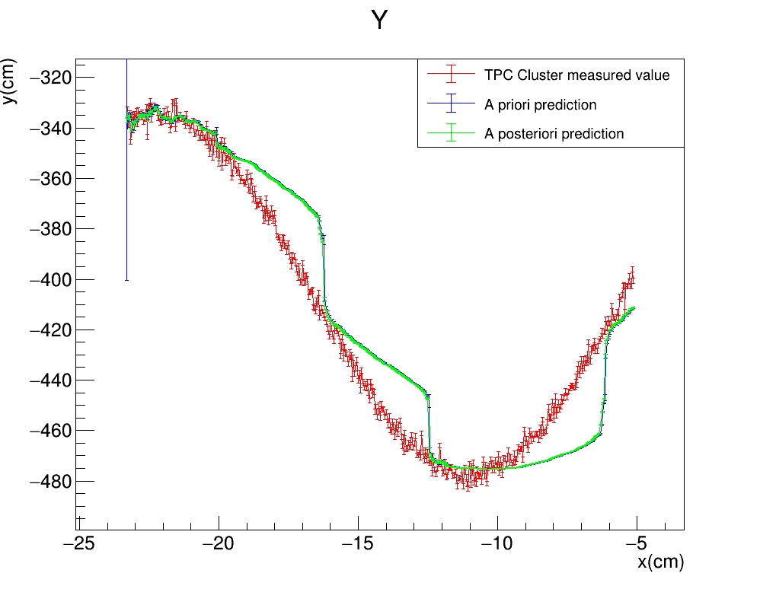
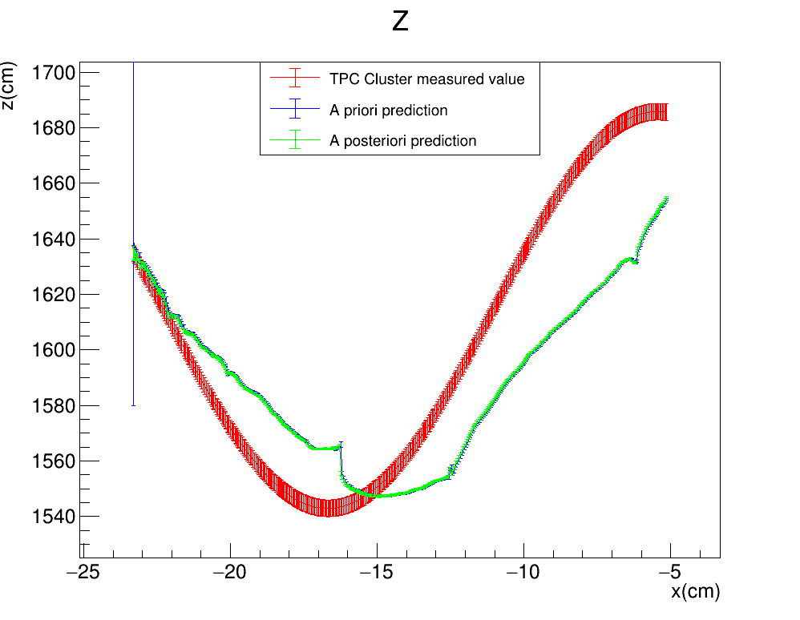
Toy monte carlo: SMEARED Y
STANDARD KALMAN FILTER
R$: \left(Σ_{y},Σ_{z}\right)=(1cm,3cm)$
Gauss$: σ_{Gauss}^{y}=3cm$
FILTER PROPAGATION DIRECTION

Slide 30
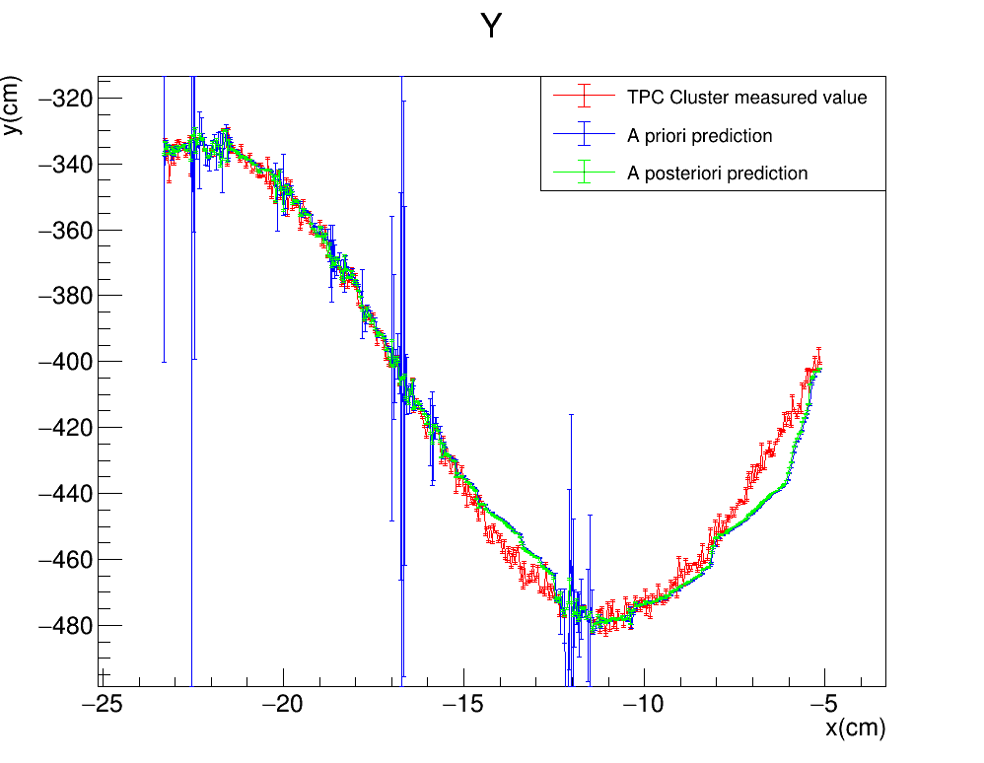
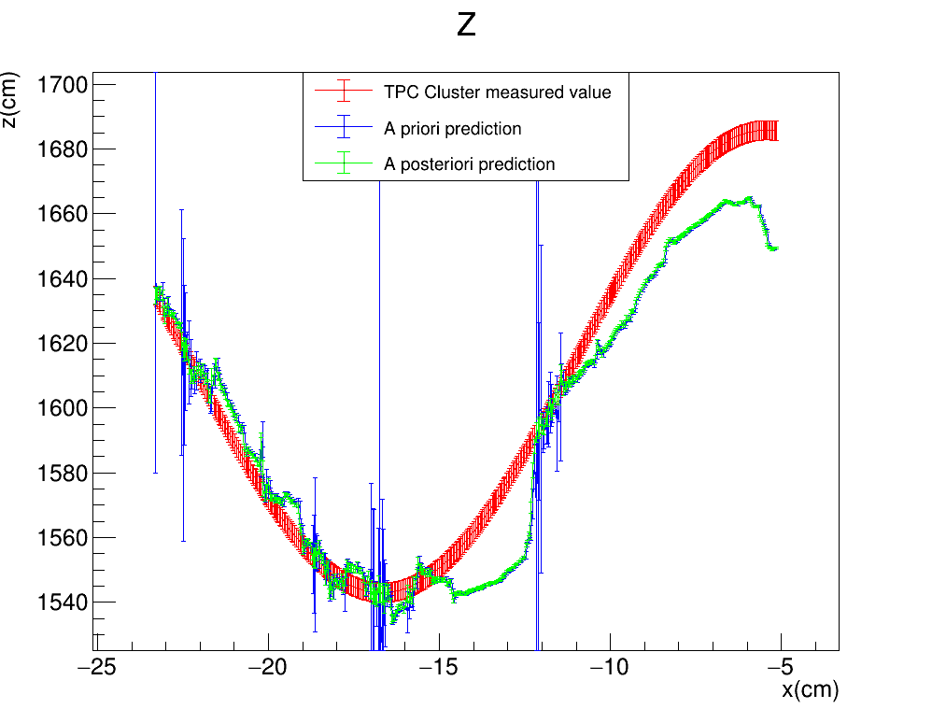
Toy monte carlo: SMEARED Y
STANDARD KALMAN FILTER
R$: \left(Σ_{y},Σ_{z}\right)=(0.3cm,3cm)$
Gauss$: σ_{Gauss}^{y}=3cm$
FILTER PROPAGATION DIRECTION

