Slide 1
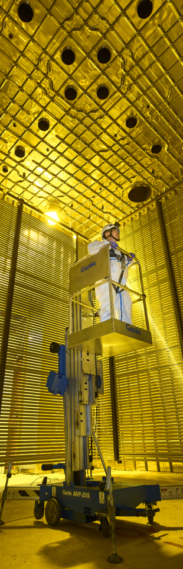

UNDERSTANDING THE KALMAN FILTER: TESTING ON A TOY MONTE CARLO MODEL
Presents: Federico Battisti

Slide 2
Outline
This presentation will cover a fairly complete description of our current Kalman Filter based reconstruction algorithm together with some early findings from a Toy Monte Carlo study developed to study the performance of said algorithm
The presentation will be divided into 4 main sections:
Description of what Kinematic Fitting is
Description of what a Kalman Filter is
Description of our own algorithm (T. Junk, DUNE-Doc-13933 https://docs.dunescience.org/cgi-bin/private/ShowDocument?docid=13933), which is a convolution of a Kalman Filter and a Kinematic Fitting algorithm
Early findings from my Toy Monte Carlo study

Slide 3
Kinematic fitting

Slide 4
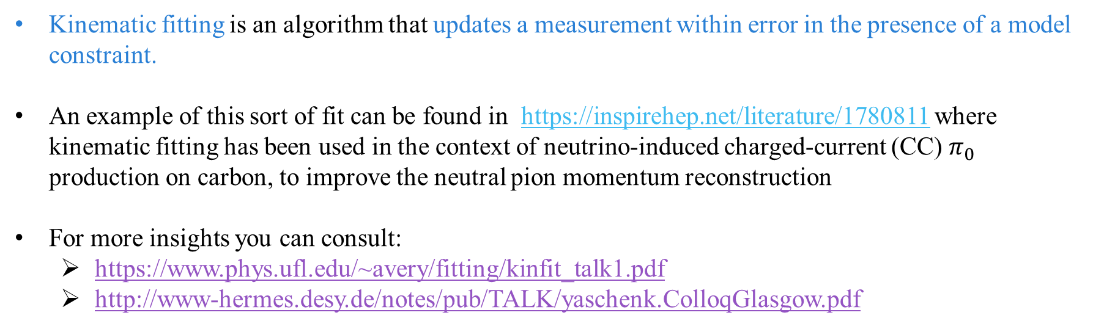
Kinematic fitting
Kinematic fitting is an algorithm that updates a measurement within error in the presence of a model constraint.
An example of this sort of fit can be found in https://inspirehep.net/literature/1780811 where kinematic fitting has been used in the context of neutrino-induced charged-current (CC) $π_{0}$ production on carbon, to improve the neutral pion momentum reconstruction
For more insights you can consult:
https://www.phys.ufl.edu/~avery/fitting/kinfit_talk1.pdf
http://www-hermes.desy.de/notes/pub/TALK/yaschenk.ColloqGlasgow.pdf

Slide 5









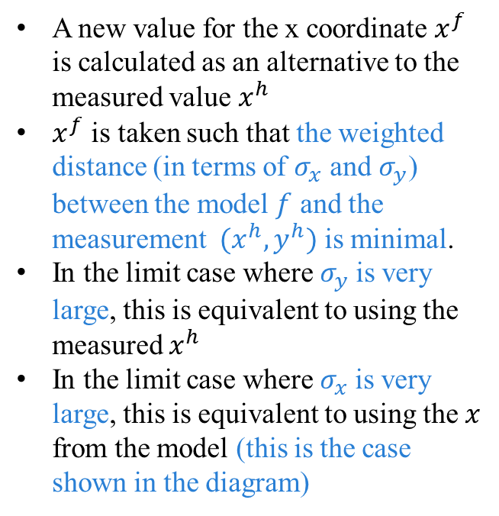
Kinematic fitTING
$$y$$
A new value for the x coordinate $x^{f}$ is calculated as an alternative to the measured value $x^{h}$
$x^{f}$ is taken such that the weighted distance (in terms of $σ_{x}$ and $σ_{y}$) between the model $f$ and the measurement $(x^{h},y^{h})$ is minimal.
In the limit case where $σ_{y}$is very large, this is equivalent to using the measured $x^{h}$
In the limit case where $σ_{x}$is very large, this is equivalent to using the $x$ from the model (this is the case shown in the diagram)
$$f$$
$$(x^{f},y^{h})$$
$$σ_{y}$$
$$(x^{h},y^{h})$$
$$σ_{x}$$
$$x^{f}$$
$$x^{h}$$
$$x$$

Slide 6
Kalman filter

Slide 7


KALMAN FILTER in general
A Kalman filter is an iterative algorithm which uses a system's physical laws of motion, known control inputs and multiple sequential measurements to form an estimate of the system's varying quantities
At each step of the iteration an estimate of the state of the system is produced as a weighted average of the system's predicted state and of the new measurement. The weights are calculated from the covariance.
The models for state transition and measurement can be written as:
STATE VECTOR
$$s_{k}=f\left(s_{k−1},X_{k−1}\right)$$
MEASUREMENT VECTOR
$$m_{k}^{h}$$
Where $f$ is the function of the previous state, $s_{k−1}$ , and the free parameter, $X_{k−1}$, that provides the current state $s_{k}$.
Note that the measurement vector $m_{k}^{h}$ and the state vector $s_{k}$ do not necessarily have the same number of components

Slide 8



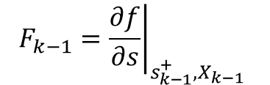
KALMAN FILTER IN GENERAL
Make a priori predictions for the current step’s state and covariance matrix using the a posteriori best estimate of the previous step (i.e. updated using measurement)
STATE VECTOR
$$s_{k}^{−}=f\left(s_{k−1}^{+},X_{k−1}\right)$$
COVARIANCE MATRIX
$$P_{k}^{−}=F_{k−1}P_{k−1}^{+}F_{k−1}^{T}+Q$$
$$F_{k−1}={\left.\frac{∂f}{∂s}\right|}_{s_{k−1}^{+},X_{k−1}}$$
$$Q$$
JACOBIAN
PROCESS NOISE COVARIANCE
Note: In the first iteration step we use step 0 estimates for the state vector and the covariance matrix ($s_{0},P_{0}$), which can be made very roughly

Slide 9
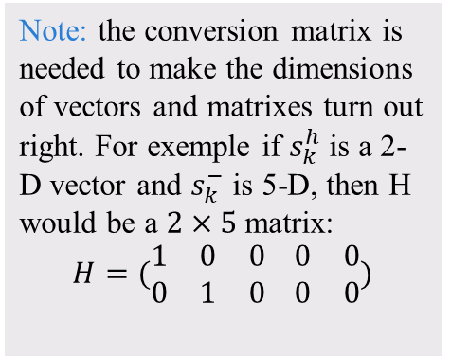






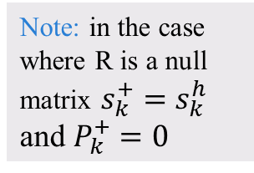
KALMAN FILTER IN GENERAL
Calculate the measurement residual and the Kalman Gain
$${\tilde{y}}_{k}=m_{k}^{h}−H(s_{k}^{−})$$
$$R$$
$$H$$
RESIDUAL
KALMAN GAIN
$$K_{k}=P_{k}^{−}H^{T}{\left(R+HP_{k}^{−}H^{T}\right)}^{−1}$$
MEASUREMENT NOISE COVARIANCE
CONVERSION MATRIX
Note: the conversion matrix is needed to make the dimensions of vectors and matrixes turn out right. For exemple if $s_{k}^{h}$ is a 2-D vector and $s_{k}^{−}$ is 5-D, then H would be a $2×5$ matrix:
$$H=(\begin{matrix}1 & 0 & 0 \\ 0 & 1 & 0\end{matrix} \begin{matrix}0 & 0 \\ 0 & 0\end{matrix})$$
Update the estimate
STATE VECTOR
$$s_{k}^{+}=s_{k}^{−}+K_{k}\tilde{y}$$
Note: in the case where R is a null matrix $s_{k}^{+}=s_{k}^{h}$ and $P_{k}^{+}=0$
COVARIANCE MATRIX
$$P_{k}^{+}=\left(1−K_{k}H\right)P_{k}^{−}$$

Slide 10



















KALMAN FILTER IN GENERAL
$$y$$
$$(x_{2}^{h},y_{2}^{h})$$
$$(x_{3}^{h},y_{3}^{−})$$
$$(x_{4}^{h},y_{4}^{−})$$
$$(x_{1}^{h},y_{1}^{−})$$
$$(x_{2}^{h},y_{2}^{+})$$
$$(x_{3}^{h},y_{3}^{+})$$
$$(x_{4}^{h},y_{4}^{+})$$
$$(x_{1}^{h},y_{1}^{+})$$
$$(x_{2}^{h},y_{2}^{−})$$
$$(x_{3}^{h},y_{3}^{h})$$
$$(x_{4}^{h},y_{4}^{h})$$
$$(x_{1}^{h},y_{1}^{h})$$
$$(x_{0}^{h},y_{0}^{h})$$
$$x_{1}^{h}$$
$$x_{2}^{h}$$
$$x_{3}^{h}$$
$$x_{4}^{h}$$
$$x$$

Slide 11
Our reconstruction algorithm™
T. Junk, DUNE-Doc-13933: https://docs.dunescience.org/cgi-bin/private/ShowDocument?docid=13933

Slide 12
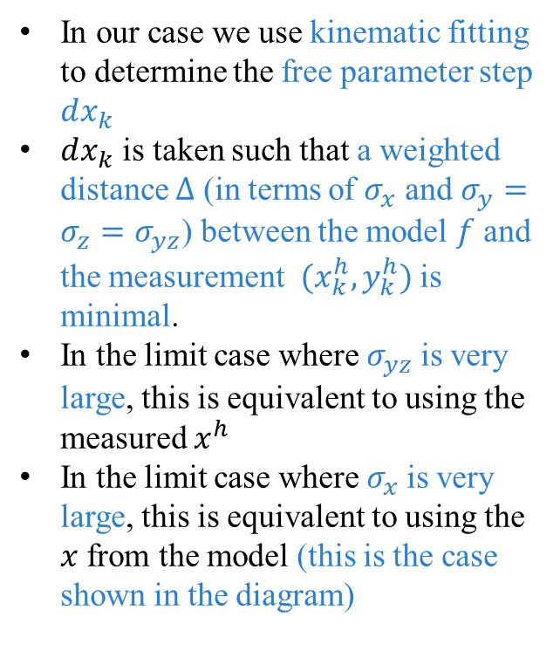







Kinematic fitTING
In our case we use kinematic fitting to determine the free parameter step $dx_{k}$
$dx_{k}$ is taken such that a weighted distance $Δ$ (in terms of $σ_{x}$ and $σ_{y}=σ_{z}=σ_{yz}$) between the model $f$ and the measurement $(x_{k}^{h},y_{k}^{h})$ is minimal.
In the limit case where $σ_{yz}$is very large, this is equivalent to using the measured $x^{h}$
In the limit case where $σ_{x}$is very large, this is equivalent to using the $x$ from the model (this is the case shown in the diagram)
$$f$$
$$(x_{1}^{f},y_{1}^{h})$$
$$σ_{y}$$
$$(x_{1}^{h},y_{1}^{h})$$
$$σ_{x}$$
$$(x_{0}^{f},y_{0}^{f})$$
$$dx_{1}$$
$$x_{1}^{f}$$
$$x_{1}^{h}$$

Slide 13
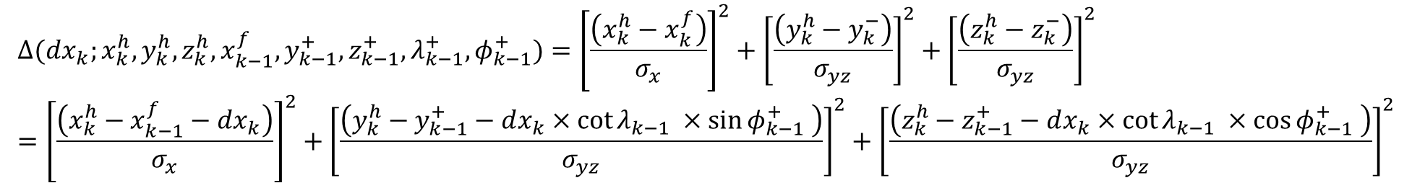

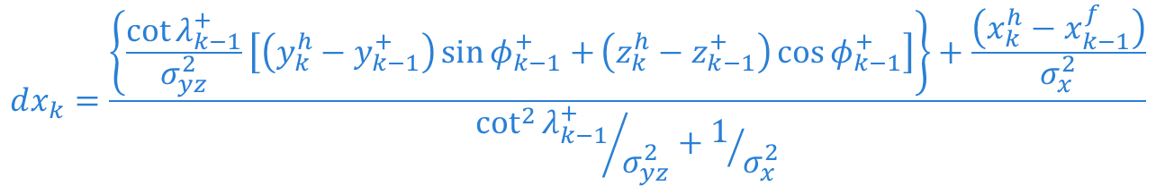
Kinematic fitTING
The quantity minimize in our kinematic fitting is the weighted distance $Δ$ with $\left(σ_{x},σ_{y}\right)=(0.5cm,1cm)$:
$$Δ(dx_{k};x_{k}^{h},y_{k}^{h},z_{k}^{h},x_{k−1}^{f},y_{k−1}^{+},z_{k−1}^{+},λ_{k−1}^{+},φ_{k−1}^{+})={\left[\frac{\left(x_{k}^{h}−x_{k}^{f}\right)}{σ_{x}}\right]}^{2}+{\left[\frac{\left(y_{k}^{h}−y_{k}^{−}\right)}{σ_{yz}}\right]}^{2}+{\left[\frac{\left(z_{k}^{h}−z_{k}^{−}\right)}{σ_{yz}}\right]}^{2}={\left[\frac{\left(x_{k}^{h}−x_{k−1}^{f}−dx_{k}\right)}{σ_{x}}\right]}^{2}+{\left[\frac{\left(y_{k}^{h}−y_{k−1}^{+}−dx_{k}×cot{λ_{k−1} ×\sin{φ_{k−1}^{+} }}\right)}{σ_{yz}}\right]}^{2}+{\left[\frac{\left(z_{k}^{h}−z_{k−1}^{+}−dx_{k}×cot{λ_{k−1} ×\cos{φ_{k−1}^{+} }}\right)}{σ_{yz}}\right]}^{2}$$
We determine $dx_{k}$ by imposing that the derivative of $Δ$ is equal to zero
$$dx_{k}=\frac{\left\{\frac{\cot{λ_{k−1}^{+}}}{σ_{yz}^{2}}\left[\left(y_{k}^{h}−y_{k−1}^{+}\right)\sin{φ_{k−1}^{+}+}\left(z_{k}^{h}−z_{k−1}^{+}\right)\cos{φ_{k−1}^{+}}\right]\right\}+\frac{\left(x_{k}^{h}−x_{k−1}^{f}\right)}{σ_{x}^{2}}}{{\cot^{2}{λ_{k−1}^{+}}}/{σ_{yz}^{2}}+1/{σ_{x}^{2}}}$$
$$\frac{dΔ}{d(dx_{k})}=0$$

Slide 14





















Our KALMAN FILTER: visualization
$$f(x_{k−1}^{f},y_{k−1}^{+})$$
$$Δ_{min}$$
$$y$$
$$(x_{k}^{h},y_{k}^{h})$$
$$(x_{k−1}^{f},y_{k−1}^{+})$$
$$dx_{k}$$
$$y_{1}^{−}$$
$$x_{k}^{f}$$
$$x_{k}^{h}$$
$$y_{1}^{+}$$
KINEMATIC FITTING
$$y_{1}^{h}$$
$$+$$
STANDARD KALMAN FILTER
$$y_{0}$$
$$=$$
OUR KALMAN FILTER™
$$x_{1}^{f}$$
$$x_{1}^{h}$$
$$x_{2}^{f}$$
$$x_{2}^{h}$$
$$x_{3}^{f}$$
$$x_{3}^{h}$$
$$x$$

Slide 15
Toy monte carlo study

Slide 16
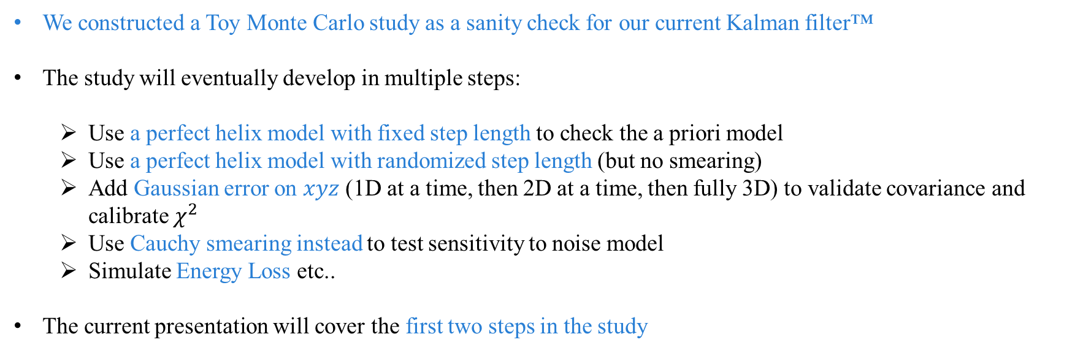
TOY MONTE CARLO OUTLINE
We constructed a Toy Monte Carlo study as a sanity check for our current Kalman filter™
The study will eventually develop in multiple steps:
Use a perfect helix model with fixed step length to check the a priori model
Use a perfect helix model with randomized step length (but no smearing)
Add Gaussian error on $xyz$ (1D at a time, then 2D at a time, then fully 3D) to validate covariance and calibrate $χ^{2}$
Use Cauchy smearing instead to test sensitivity to noise model
Simulate Energy Loss etc..
The current presentation will cover the first two steps in the study

Slide 17
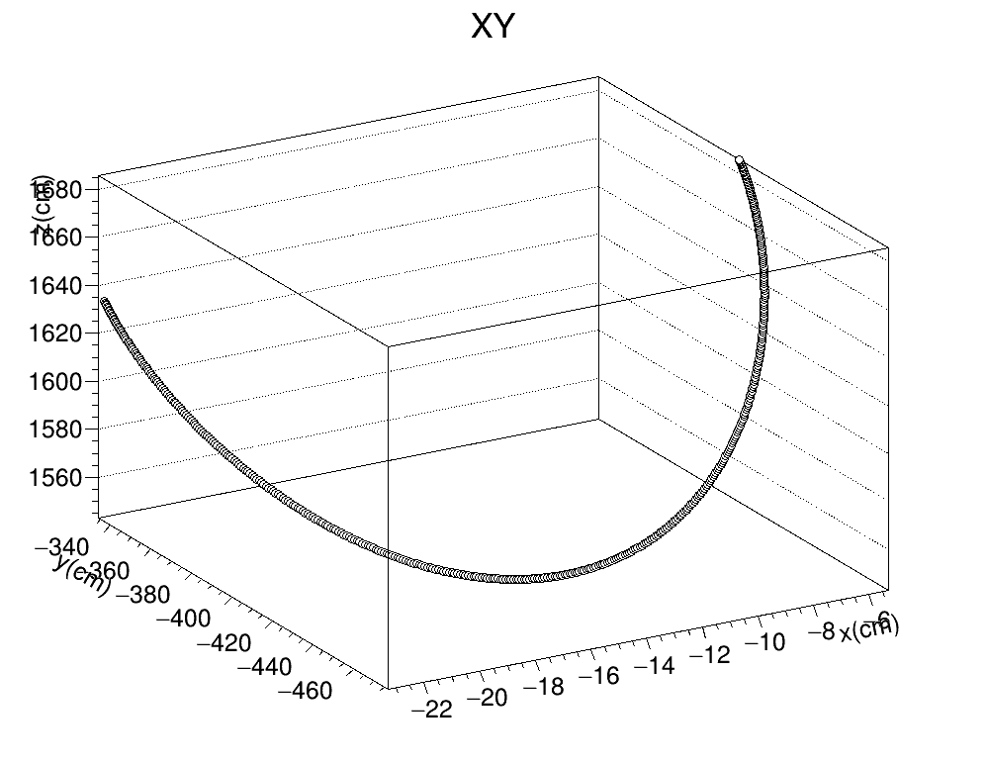
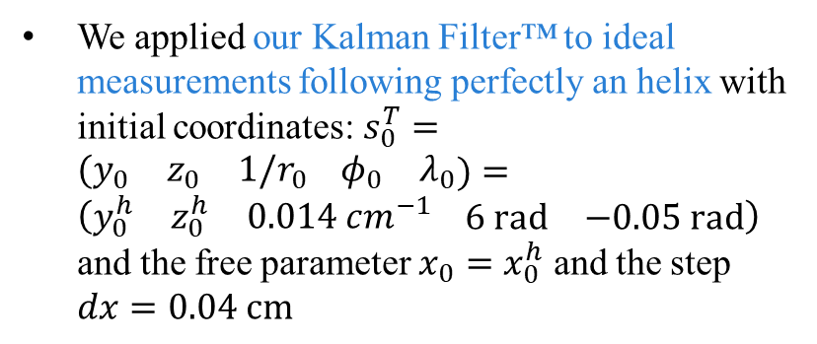
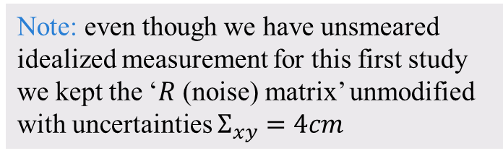
Toy monte carlo
We applied our Kalman Filter™ to ideal measurements following perfectly an helix with initial coordinates: $s_{0}^{T}=\begin{matrix}(y_{0} & z_{0} & 1/r_{0}\end{matrix} \begin{matrix}φ_{0} & λ_{0}\end{matrix})=\left(\begin{matrix}y_{0}^{h} & z_{0}^{h} & 0.014 cm^{−1}\end{matrix} \begin{matrix}6 rad & −0.05 rad\end{matrix}\right)$ and the free parameter $x_{0}=x_{0}^{h}$ and the step $dx=0.04 cm$
Note: even though we have unsmeared idealized measurement for this first study we kept the ‘$R$ (noise) matrix’ unmodified with uncertainties $Σ_{xy}=4cm$

Slide 18
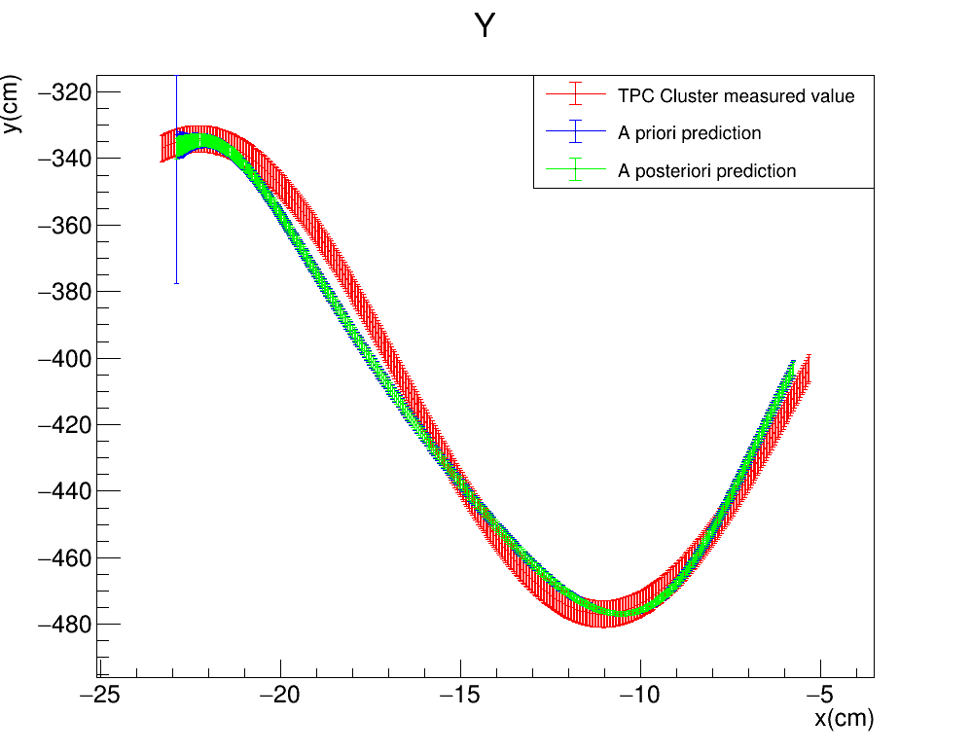
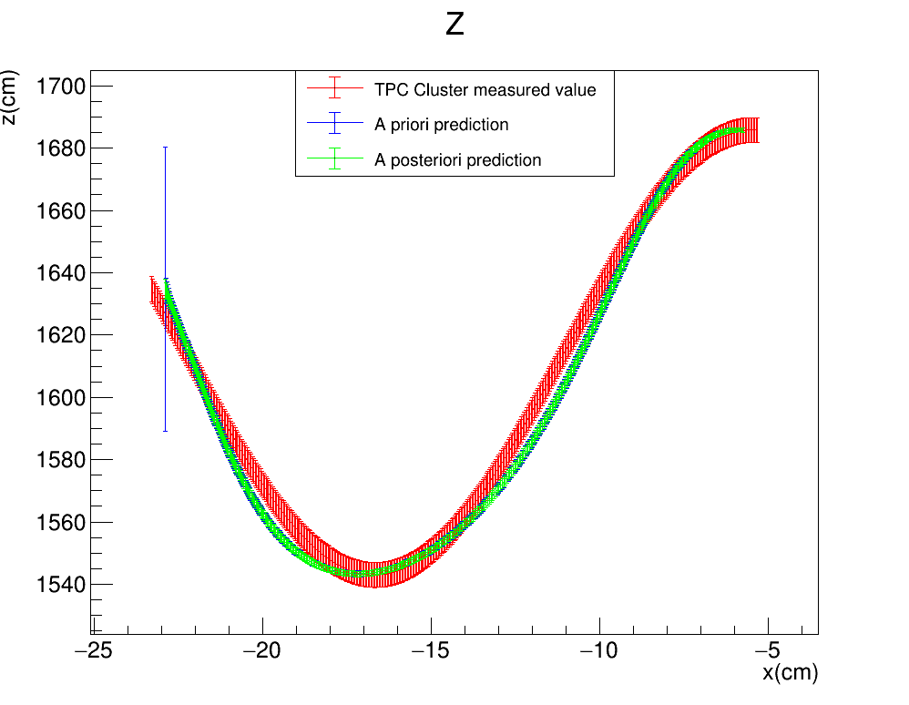

Toy monte carlo
Plots describing the evolution of the estimate of the measured quantities $(y,z)$ as a function of the free parameter $x$ for the perfect helix. Note that the TPC points have on the x coordinate the measured value, while for the estimates we use the estimated $x$ from the kinematic fitting (i.e. ${x_{k}=x}_{0}+k×dx_{k}$)
Note: the ‘TPC Cluster measured values’ are from a Toy MC, so the red error bars are the dummy values from the R matrix
KF™$: \left(σ_{x},σ_{yz}\right)=(0.5cm,1cm)$
FILTER PROPAGATION DIRECTION

Slide 19
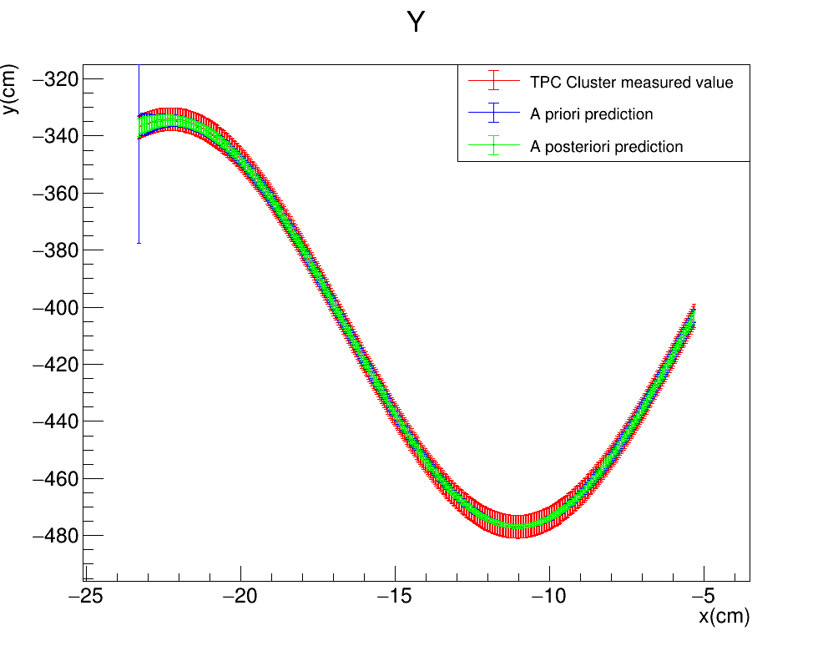
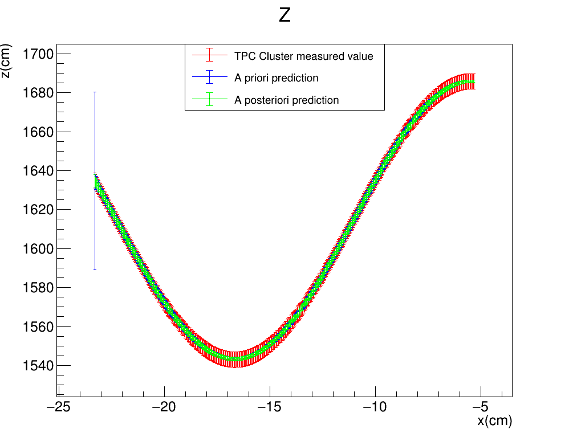

Toy monte carlo
We now replot the results from the previous slide, all identical except replacing the $x$ coordinate by $x^{h}$ instead of $x^{f}$. The plots show that the predicted $y$ and $z$ components coincide with the measured ones
Note: this is not the same as using the standard Kalman filter since y and z have been estimated using the x from kinematic fitting, as in the previous slide
KF™$: \left(σ_{x},σ_{yz}\right)=(0.5cm,1cm)$
FILTER PROPAGATION DIRECTION

Slide 20
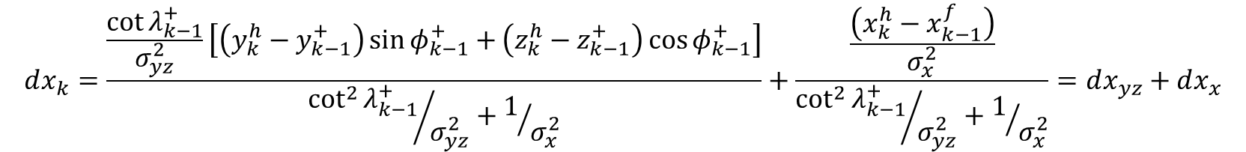
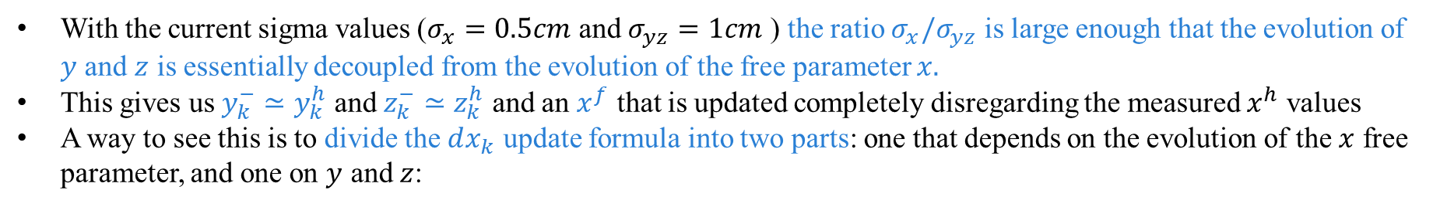
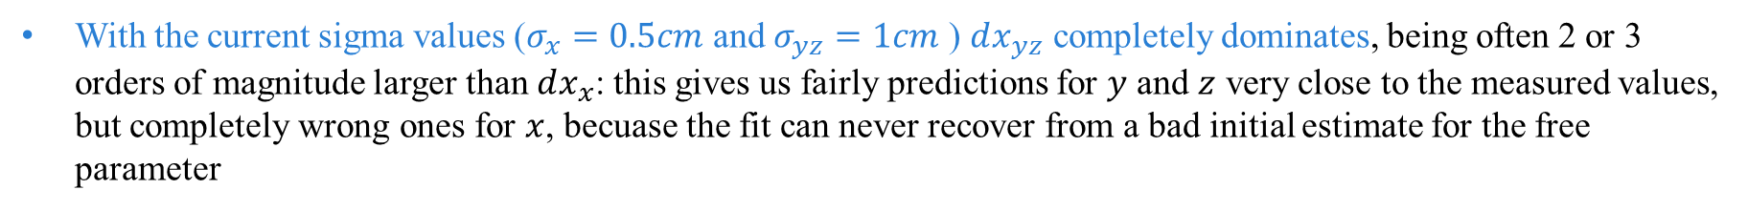
Toy monte carlo: UNDERSTANDING STEP DEtermination
With the current sigma values ($σ_{x}=0.5cm$ and $σ_{yz}=1cm$ ) the ratio $σ_{x}/σ_{yz}$ is large enough that the evolution of $y$ and $z$ is essentially decoupled from the evolution of the free parameter $x.$
This gives us $y_{k}^{−}≃y_{k}^{h}$ and $z_{k}^{−}≃z_{k}^{h}$ and an $x^{f}$ that is updated completely disregarding the measured $x^{h}$ values
A way to see this is to divide the $dx_{k}$ update formula into two parts: one that depends on the evolution of the $x$ free parameter, and one on $y$ and $z$:
$$dx_{k}=\frac{\frac{\cot{λ_{k−1}^{+}}}{σ_{yz}^{2}}\left[\left(y_{k}^{h}−y_{k−1}^{+}\right)\sin{φ_{k−1}^{+}+}\left(z_{k}^{h}−z_{k−1}^{+}\right)\cos{φ_{k−1}^{+}}\right]}{{\cot^{2}{λ_{k−1}^{+}}}/{σ_{yz}^{2}}+1/{σ_{x}^{2}}}+\frac{\frac{\left(x_{k}^{h}−x_{k−1}^{f}\right)}{σ_{x}^{2}}}{{\cot^{2}{λ_{k−1}^{+}}}/{σ_{yz}^{2}}+1/{σ_{x}^{2}}}=dx_{yz}+dx_{x}$$
With the current sigma values ($σ_{x}=0.5cm$ and $σ_{yz}=1cm$ ) $dx_{yz}$ completely dominates, being often 2 or 3 orders of magnitude larger than $dx_{x}$: this gives us fairly predictions for $y$ and $z$ very close to the measured values, but completely wrong ones for $x$, becuase the fit can never recover from a bad initial estimate for the free parameter

Slide 21
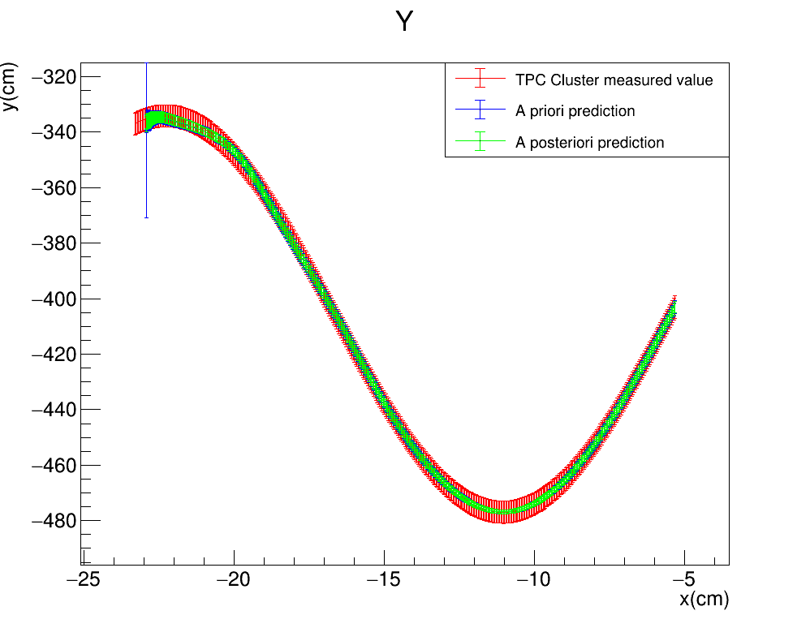
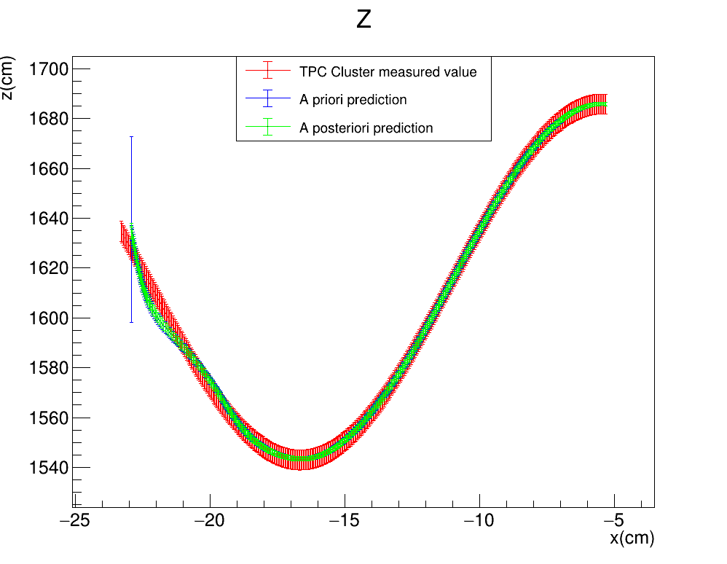

Toy monte carlo: UNDERSTANDING STEP DEtermination
In order for the x parameter to have more weight in the update of $dx_{k}$, changed the value of $σ_{yz}$ from 1cm to 4cm, leaving $σ_{x}=0.5cm$
The fit initially concentrates on fixing the $x$ prediction until that becomes accurate, and then it focuses on yz, reaching similar levels of precision by the end
KF™$: \left(σ_{x},σ_{yz}\right)=(0.5cm,4cm)$
FILTER PROPAGATION DIRECTION

Slide 22

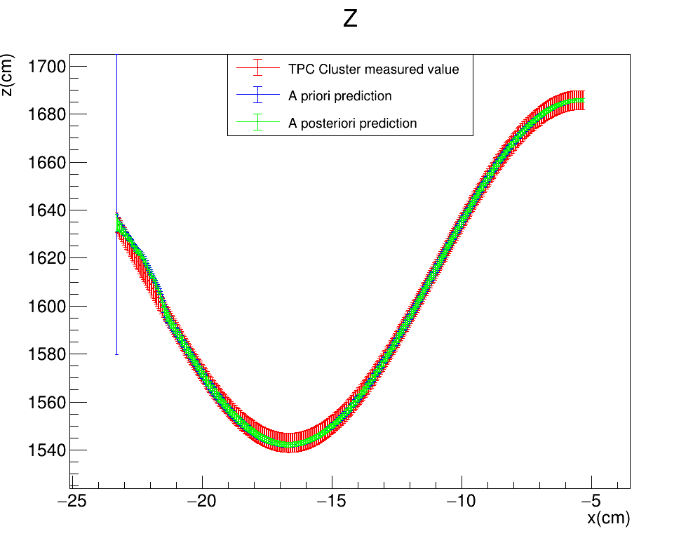

Toy monte carlo: UNDERSTANDING STEP DEtermination
We now test an extreme case were $σ_{yz}/σ_{x}$ is very large: $σ_{yz}$ is changed from 1cm to 1000cm, leaving $σ_{x}=0.5cm$
This becomes very close to be using $x^{h}$ instead of $x^{f}$
KF™$: \left(σ_{x},σ_{yz}\right)=(0.5cm,1000cm)$
FILTER PROPAGATION DIRECTION

Slide 23


Toy monte carlo: UNDERSTANDING STEP DEtermination
We try applying a standard Kalman Filter to our Toy Monte Carlo, such that it is identical to our Kalman Filter™ but it avoids the kinematic fitting algorithm completely
We get essentially the same result as in the last slide: having $σ_{yz}/σ_{x}$ very large is equivalent to a standard Kalman Filter
FILTER PROPAGATION DIRECTION

Slide 24

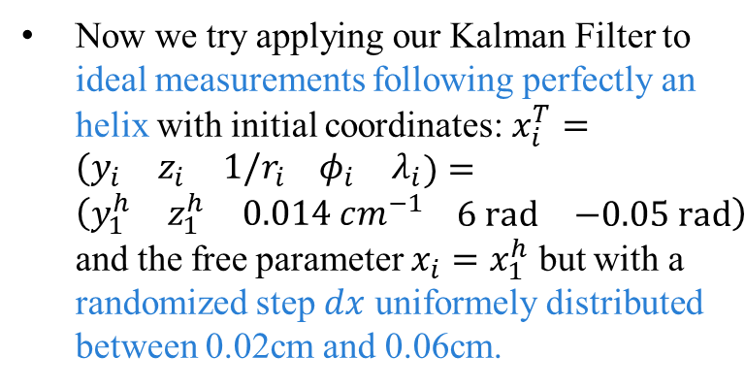
Randomized x step
Now we try applying our Kalman Filter to ideal measurements following perfectly an helix with initial coordinates: $x_{i}^{T}=\begin{matrix}(y_{i} & z_{i} & 1/r_{i}\end{matrix} \begin{matrix}φ_{i} & λ_{i}\end{matrix})=\left(\begin{matrix}y_{1}^{h} & z_{1}^{h} & 0.014 cm^{−1}\end{matrix} \begin{matrix}6 rad & −0.05 rad\end{matrix}\right)$ and the free parameter $x_{i}=x_{1}^{h}$ but with a randomized step $dx$ uniformely distributed between 0.02cm and 0.06cm.
Note: the step progression is randomized, but we are still following a perfect helix i.e. No smearing on the xyz coordinates is involved

Slide 25

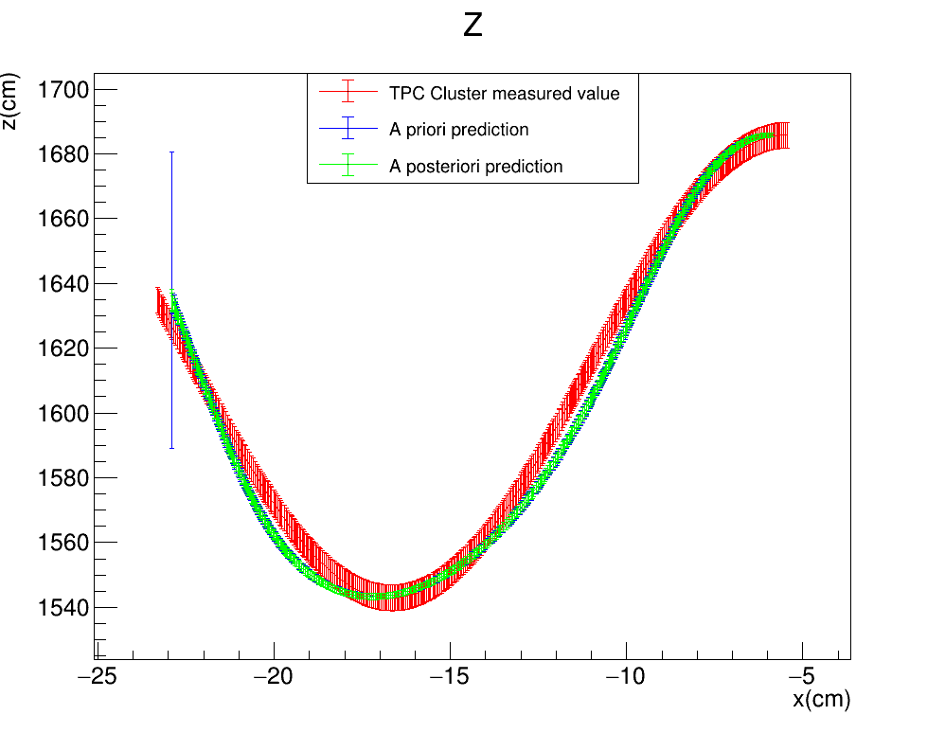
Randomized x step
Plots describing the evolution of the estimate of the measured quantities $(y,z)$ as a function of the free parameter $x$ for the perfect helix. Note that the the TPC points have on the x coordinate the measured value, while for the estimates we use the estimated x (i.e. ${x_{k}=x}_{0}+k×dx_{k}$)
KF™$: \left(σ_{x},σ_{yz}\right)=(0.5cm,1cm)$
FILTER PROPAGATION DIRECTION

Slide 26



Randomized x step
Reapplying the fit with the new $σ_{yz}=4cm$ we see that the 3D predictions are more in line with the Monte Carlo truth, past the first few steps
FILTER PROPAGATION DIRECTION
KF™$: \left(σ_{x},σ_{yz}\right)=(0.5cm,1cm)$
KF™$: \left(σ_{x},σ_{yz}\right)=(0.5cm,4cm)$

Slide 27

Randomized x step
Reapplying the fit with the new $σ_{yz}=4cm$ we see that the 3D predictions are more in line with the Monte Carlo truth, past the first few steps
FILTER PROPAGATION DIRECTION
KF™$: \left(σ_{x},σ_{yz}\right)=(0.5cm,1cm)$
KF™$: \left(σ_{x},σ_{yz}\right)=(0.5cm,4cm)$

Slide 28


Randomized x step: testing the ratio
Since $σ_{x}$ and $σ_{yz}$ are essentially weights, only their ratio $σ_{x}/σ_{yz}$ should matter. To test this we try the pair $\left(σ_{x},σ_{yz}\right)=(1cm,8cm)$ which has the same ratio as $\left(σ_{x},σ_{yz}\right)=(0.5cm,4cm)$
FILTER PROPAGATION DIRECTION
KF™$: \left(σ_{x},σ_{yz}\right)=(0.5cm,4cm)$
KF™$: \left(σ_{x},σ_{yz}\right)=(1cm,8cm)$

Slide 29
Randomized x step: testing the ratio
Since $σ_{x}$ and $σ_{yz}$ are essentially weights, only their ratio $σ_{x}/σ_{yz}$ should matter. To test this we try the pair $\left(σ_{x},σ_{yz}\right)=(1cm,8cm)$ which has the same ratio as $\left(σ_{x},σ_{yz}\right)=(0.5cm,4cm)$
FILTER PROPAGATION DIRECTION
KF™$: \left(σ_{x},σ_{yz}\right)=(0.5cm,4cm)$
KF™$: \left(σ_{x},σ_{yz}\right)=(1cm,8cm)$

Slide 30
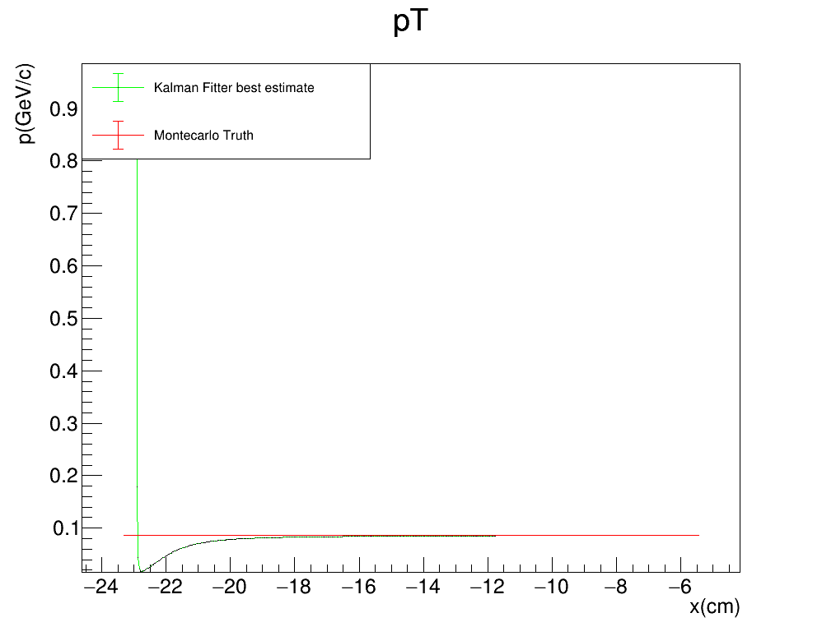
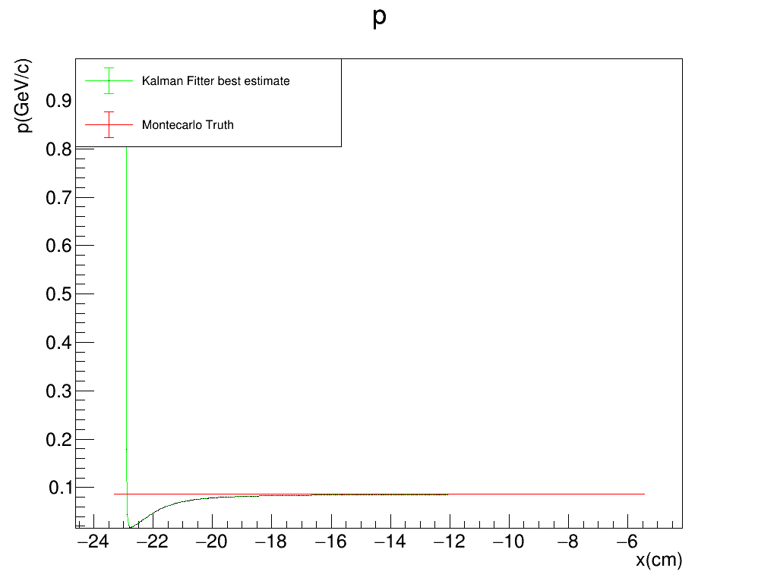
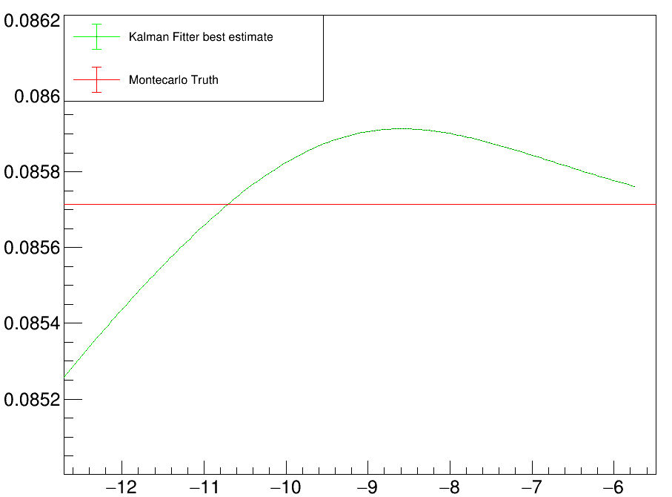
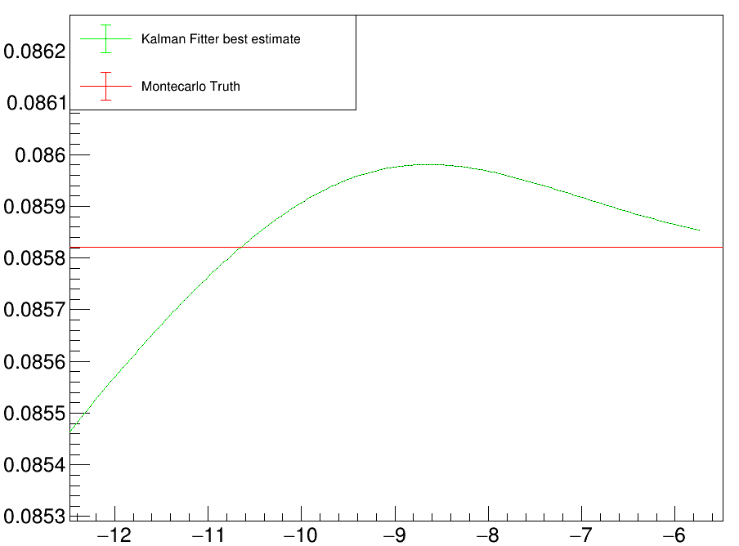

Randomized x step
Plots comparing the reconstructed tansverse momentum $p_{T}$ and the reconstructed total momentum $p_{T}$from our Kalman filter algorithm™ to the MC truth as a function of the free parameter $x$
KF™$: \left(σ_{x},σ_{yz}\right)=(0.5cm,1cm)$
FORWARD FIT

Slide 31
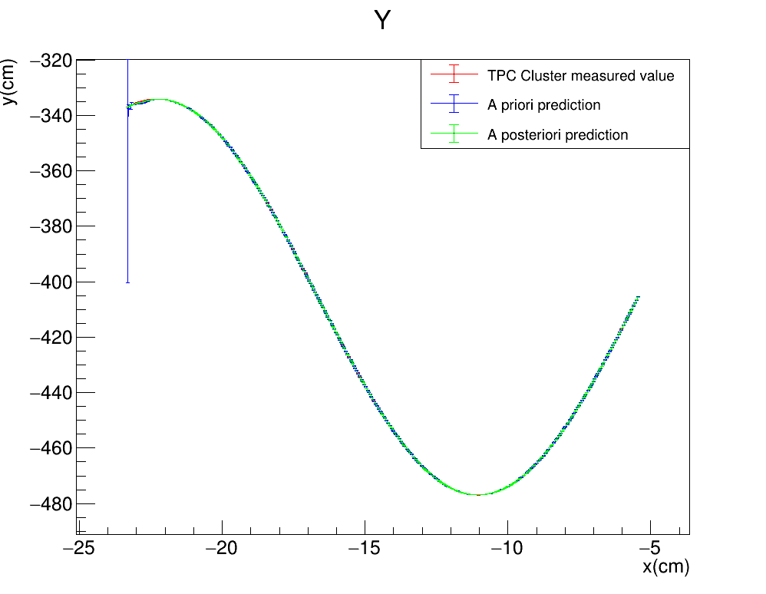
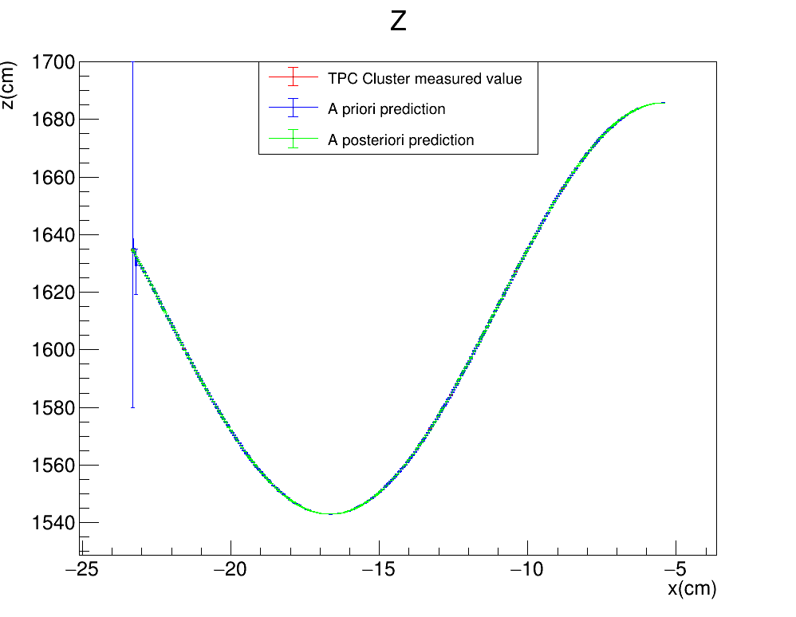
Applying a very small r a standard KALMAN FILTER
We try applying a standard Kalman Filter to our Toy Monte Carlo, substituting the values in the $R$ matrix with $Σ_{xy}={10}^{−6}$cm , where before we had $Σ_{xy}=4$cm: with such a small R the Kalman filter follows the measurements almost exactly
FITTER PROPAGATION DIRECTION

Slide 32
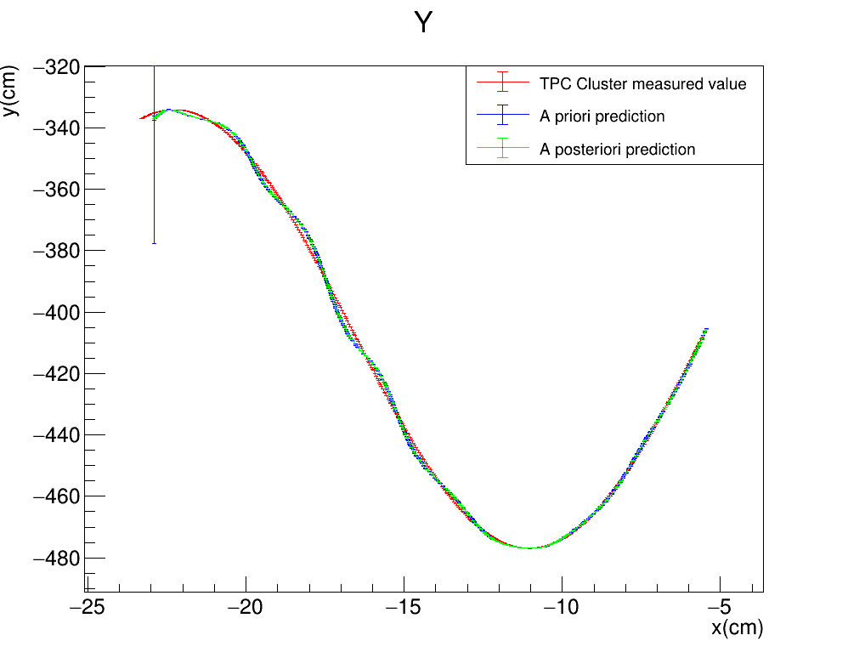
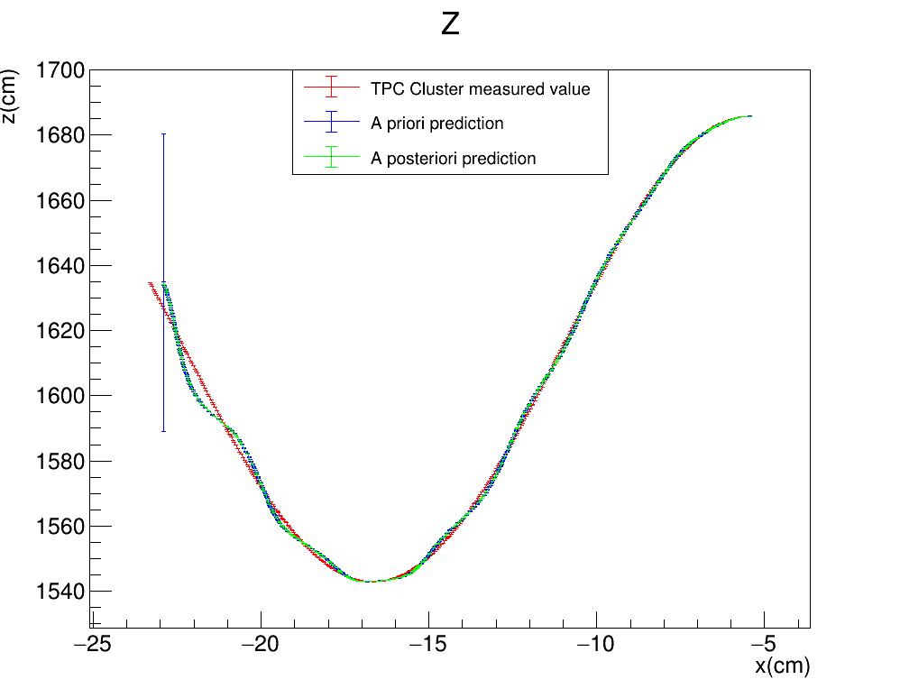

Applying a very small r to our KALMAN FILTER
We try applying our Kalman Filter™ to our Toy Monte Carlo, but substituting the values in the $R$ matrix with $Σ_{xy}={10}^{−6}$cm , where before we had $Σ_{xy}=4$cm: with such a small R the Kalman filter should converge with the measurement very quickly (this happens immediately with a Standard Kalman filter, as you can see in the previous slide)
KF™$: \left(σ_{x},σ_{yz}\right)=(0.5cm,4cm)$
FITTER PROPAGATION DIRECTION

Slide 33
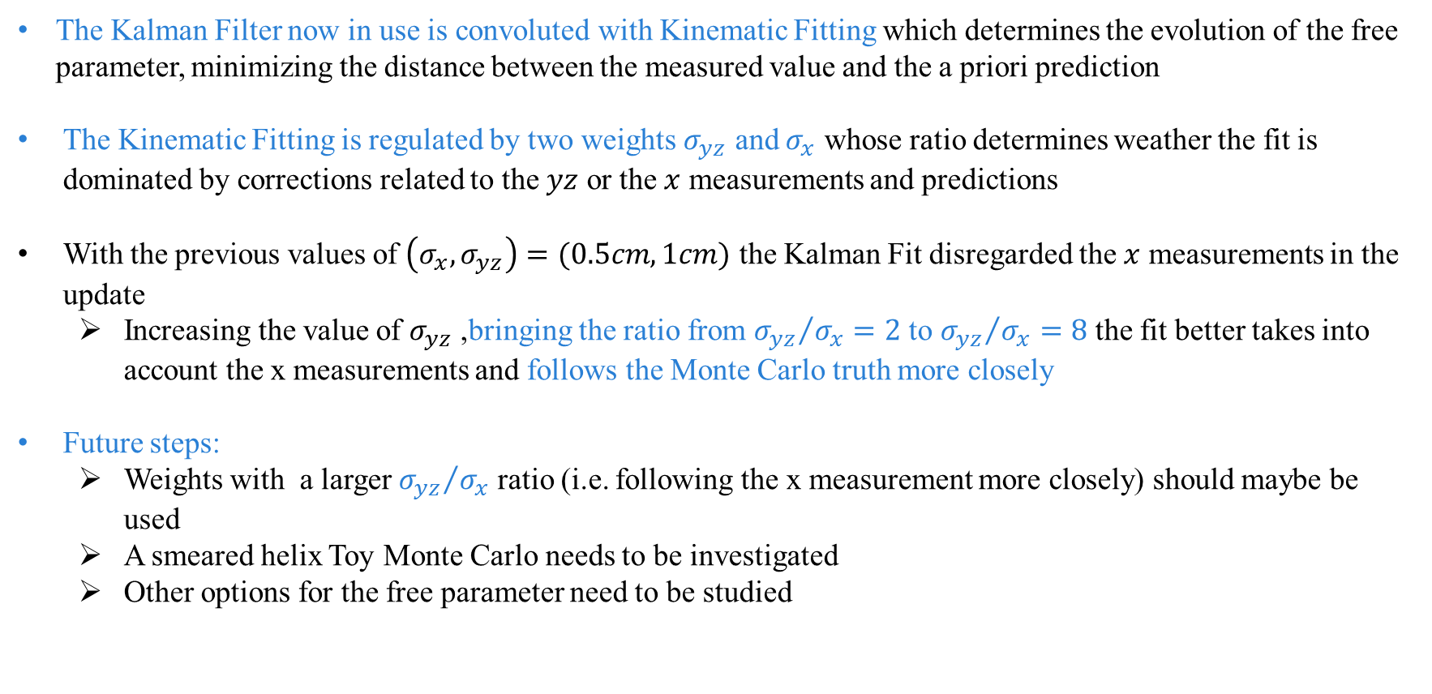
SUMMARY AND FUTURE STEPS
The Kalman Filter now in use is convoluted with Kinematic Fitting which determines the evolution of the free parameter, minimizing the distance between the measured value and the a priori prediction
The Kinematic Fitting is regulated by two weights $σ_{yz}$ and $σ_{x}$ whose ratio determines weather the fit is dominated by corrections related to the $yz$ or the $x$ measurements and predictions
With the previous values of $\left(σ_{x},σ_{yz}\right)=(0.5cm,1cm)$ the Kalman Fit disregarded the $x$ measurements in the update
Increasing the value of $σ_{yz}$ ,bringing the ratio from ${σ_{yz}}/{σ_{x}}=2$ to ${σ_{yz}}/{σ_{x}}=8$ the fit better takes into account the x measurements and follows the Monte Carlo truth more closely
Future steps:
Weights with a larger ${σ_{yz}}/{σ_{x}}$ ratio (i.e. following the x measurement more closely) should maybe be used
A smeared helix Toy Monte Carlo needs to be investigated
Other options for the free parameter need to be studied

Slide 34
BACKUP

Slide 35
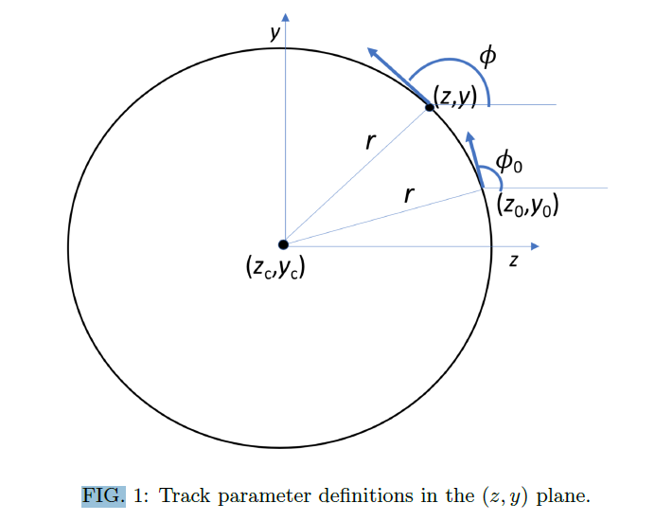
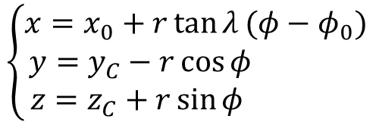
KALMAN FILTER APPLICATION
We apply a Kalman filter to the motion of a charged particle in the magnetic field
$$\left\{\begin{aligned}x=x_{0}+r\tan{λ}(φ−φ_{0}) \\ &y=y_{C}−r\cos{φ} \\ z=z_{C}+r\sin{φ} \end{aligned}\right.$$
TRACK PARAMETERS
We apply the Kalman filter to track candidates, consisting of groups of TPC clusters, which are identified and put together during the reconstruction process. Each step of the Kalman filter algorithm is identified by one of these TPC clusters
T. Junk, DUNE-Doc-13933
https://docs.dunescience.org/cgi-bin/private/ShowDocument?docid=13933

Slide 36
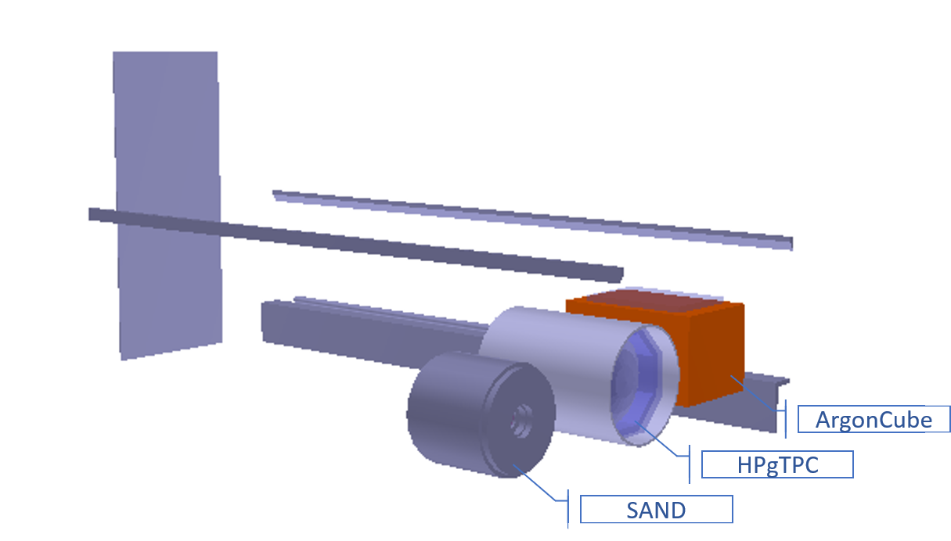
KALMAN FILTER: coordinate system
Note that in our coordinate sytem z is the flux direction, y is the vertical direction and x is the drift direction (i.e. the magnetic field direction)
y
x
z

Slide 37
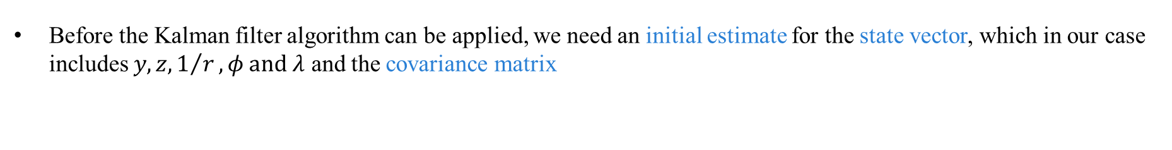
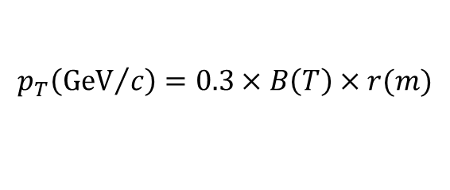


KALMAN FILTER APPLICATION: initial estimates
Before the Kalman filter algorithm can be applied, we need an initial estimate for the state vector, which in our case includes $y,z,1/r,φ and λ$ and the covariance matrix
STATE VECTOR
$$x_{0}^{T}=\begin{matrix}(y_{0} & z_{0} & 1/r_{0}\end{matrix} \begin{matrix}φ_{0} & λ_{0}\end{matrix})=\left(\begin{matrix}0 & 0 & 0.1\end{matrix} \begin{matrix}0 & 0\end{matrix}\right)$$
$$P_{0}=\left(\begin{matrix}1^{2} & 0 & 0 \\ 0 & 1^{2} & 0 \\ \begin{aligned}0 \\ 0 \\ 0\end{aligned} & \begin{aligned}0 \\ 0 \\ 0\end{aligned} & \begin{aligned}{0.5}^{2} \\ 0 \\ 0\end{aligned}\end{matrix} \begin{matrix}0 \\ 0 \\ \begin{aligned}0 \\ {0.5}^{2} \\ 0\end{aligned}\end{matrix} \begin{matrix}0 \\ 0 \\ \begin{aligned}0 \\ 0 \\ {0.5}^{2}\end{aligned}\end{matrix}\right)$$
COVARIANCE MATRIX
The estimated quantities from the state vector can be used to estimate the particle’s momentum
$$\left\{\begin{aligned}p_{x}=p_{T}\tan{λ} \\ p_{y}=p_{T}\sin{φ} \\ p_{z}=p_{T}\cos{φ}\end{aligned}\right.$$
$$p_{T}\left({GeV}/c\right)=0.3×B\left(T\right)×r(m)$$

Slide 38
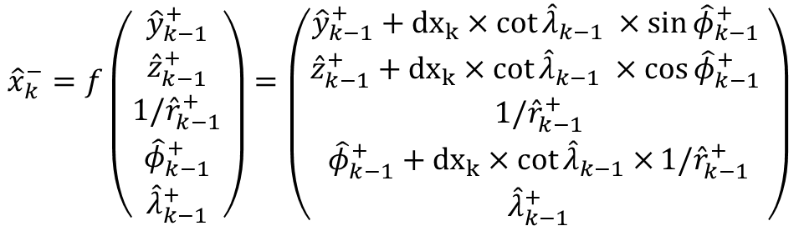
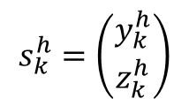
KALMAN FILTER APPLICATION: prediction AND MEASUREMENT
From the equation of motion we obtain the prediction function for our state vector. Note that the drift direction $x$ is used as our free parameter
$${\hat{x}}_{k}^{−}=f\left({{\hat{y}}_{k−1}^{+} \atop \begin{aligned}{\hat{z}}_{k−1}^{+} \\ {1/\hat{r}}_{k−1}^{+} \\ {\hat{φ}}_{k−1}^{+} \\ {\hat{λ}}_{k−1}^{+}\end{aligned}}\right)=\left({{\hat{y}}_{k−1}^{+}+{dx}_{k}×cot{{\hat{λ}}_{k−1} ×\sin{{\hat{φ}}_{k−1}^{+} }} \atop \begin{aligned}{\hat{z}}_{k−1}^{+}+{dx}_{k}×cot{{\hat{λ}}_{k−1} ×\cos{{\hat{φ}}_{k−1}^{+} }} \\ {1/\hat{r}}_{k−1}^{+} \\ {\hat{φ}}_{k−1}^{+}+{dx}_{k}×cot{{\hat{λ}}_{k−1}×}{1/\hat{r}}_{k−1}^{+} \\ {\hat{λ}}_{k−1}^{+}\end{aligned}}\right)$$
Note: the prediction model does not account for dE/dx energy loss
The only measured quantities in our case are $y$ and $z$, and are set at the center of the TPC cluster correspondent to the present step.
$$s_{k}^{h}=\left({y_{k}^{h} \atop z_{k}^{h}}\right)$$

Slide 39
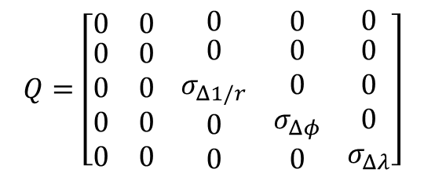
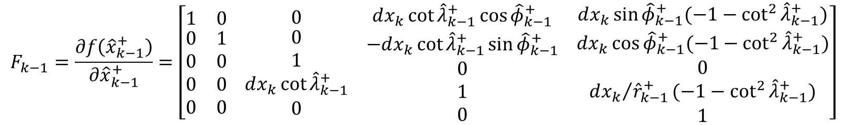

KALMAN FILTER APPLICATION: COVARIANCE MATRIX PREDICTION
First step to make the prediction for the covariance matrix is to calculate the Jacobian
$$F_{k−1}=\frac{∂f\left({\hat{x}}_{k−1}^{+}\right)}{∂{\hat{x}}_{k−1}^{+}}=\left[\begin{matrix}1 & 0 \\ \begin{aligned}0 \\ 0 \\ 0 \\ 0\end{aligned} & \begin{aligned}1 \\ 0 \\ 0 \\ 0\end{aligned}\end{matrix} \begin{matrix}0 \\ \begin{aligned}0 \\ 1 \\ dx_{k}\cot{{\hat{λ}}_{k−1}^{+}} \\ 0\end{aligned}\end{matrix} \begin{matrix}dx_{k}\cot{{\hat{λ}}_{k−1}^{+}\cos{{\hat{φ}}_{k−1}^{+}}} \\ \begin{aligned}−dx_{k}\cot{{\hat{λ}}_{k−1}^{+}\sin{{\hat{φ}}_{k−1}^{+}}} \\ 0 \\ 1 \\ 0\end{aligned}\end{matrix} \begin{matrix}dx_{k}\sin{{\hat{φ}}_{k−1}^{+}(−1−\cot^{2}{{\hat{λ}}_{k−1}^{+}})} \\ \begin{aligned}dx_{k}\cos{{\hat{φ}}_{k−1}^{+}(−1−\cot^{2}{{\hat{λ}}_{k−1}^{+}})} \\ 0 \\ {dx_{k}}/{{\hat{r}}_{k−1}^{+}}(−1−\cot^{2}{{\hat{λ}}_{k−1}^{+}}) \\ 1\end{aligned}\end{matrix}\right]$$
The step uncertainty matrix is also needed
$$Q=\left[\begin{matrix}0 & 0 \\ \begin{aligned}0 \\ 0 \\ 0 \\ 0\end{aligned} & \begin{aligned}0 \\ 0 \\ 0 \\ 0\end{aligned}\end{matrix} \begin{matrix}0 \\ \begin{aligned}0 \\ σ_{Δ1/r} \\ 0 \\ 0\end{aligned}\end{matrix} \begin{matrix}0 \\ \begin{aligned}0 \\ 0 \\ σ_{Δφ} \\ 0\end{aligned}\end{matrix} \begin{matrix}0 \\ \begin{aligned}0 \\ 0 \\ 0 \\ σ_{Δλ}\end{aligned}\end{matrix}\right]$$
The prediction is then:
$$P_{k}^{−}=F_{k−1}P_{k−1}F_{k−1}^{T}+Q$$

Slide 40

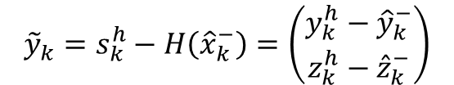


KALMAN FILTER APPLICATION: Evaluate the residual
We now evaluate the residual and Kalman Gain
RESIDUAL
With:
$${\tilde{y}}_{k}=s_{k}^{h}−H\left({\hat{x}}_{k}^{−}\right)=\left(\begin{matrix}y_{k}^{h}−{\hat{y}}_{k}^{−} \\ z_{k}^{h}−{\hat{z}}_{k}^{−}\end{matrix}\right)$$
$$R=\left(\begin{matrix}Σ_{yz}^{2} & 0 \\ 0 & Σ_{yz}^{2}\end{matrix}\right)$$
MEASUREMENT NOISE COVARIANCE
KALMAN GAIN
$$H=\left(\begin{matrix}1 & 0 & 0 \\ 0 & 1 & 0\end{matrix} \begin{matrix}0 \\ 0\end{matrix} \begin{matrix}0 \\ 0\end{matrix}\right)$$
$$K_{k}=P_{k}^{−}H{\left(R+HP_{k}^{−}H^{T}\right)}^{−1}$$
CONVERSION MATRIX
Note: The uncertainties in R are fixed, before the Kalman filter is applied, as external parameters: R is not updated.

Slide 41
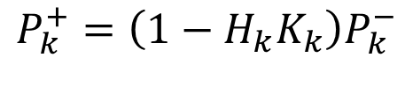

KALMAN FILTER APPLICATION: PREDICTION UPDATE
We are now finally able to update our estimates using both the a priori prediction and the measurement
STATE VECTOR
$${\hat{x}}_{k}^{+}={\hat{x}}_{k}^{−}+K_{k}{\tilde{y}}_{k}$$
COVARIANCE MATRIX
$$P_{k}^{+}=\left(1−H_{k}K_{k}\right)P_{k}^{−}$$

Slide 42
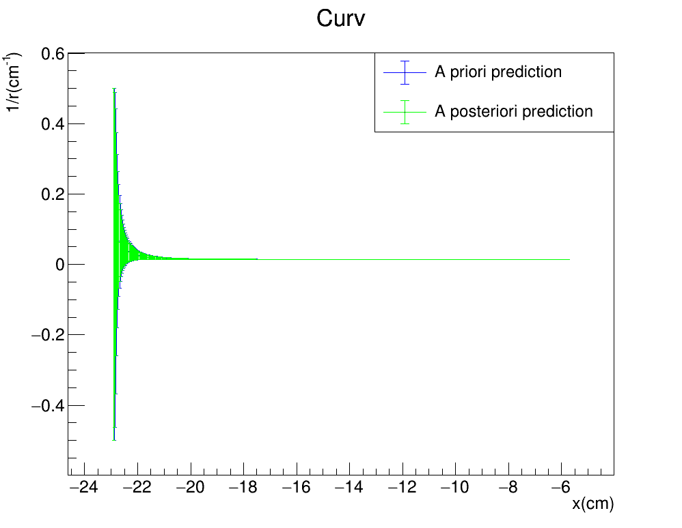
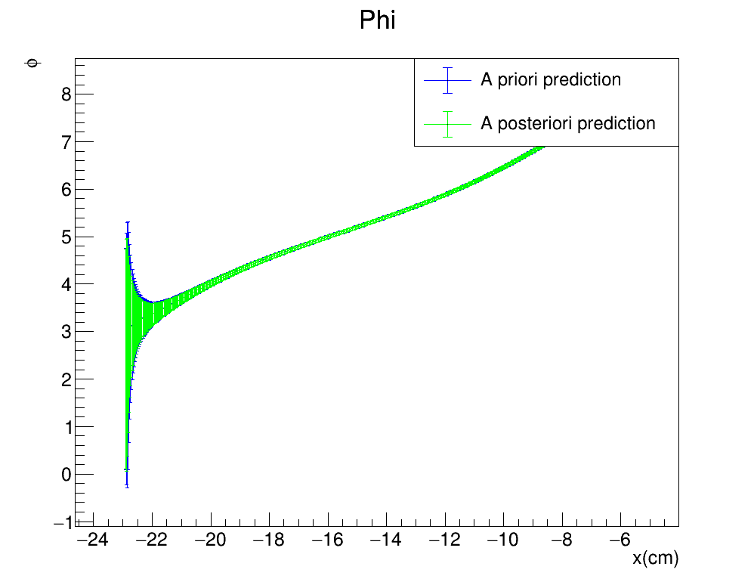


Toy monte carlo
Plots describing the evolution of the estimate of the non measured quantities $(\frac{1}{r},φ,λ)$ as a function of the free parameter $x$ for the perfect helix
$$\left(σ_{x},σ_{yz}\right)=(0.5cm,1cm)$$
FILTER PROPAGATION DIRECTION
42

Slide 43



Toy monte carlo
Plots comparing the reconstructed tansverse momentum $p_{T}$ and the reconstructed total momentum $p_{T}$from the Kalman fitter algorithm to the MC truth as a function of the free parameter $x$
$$\left(σ_{x},σ_{yz}\right)=(0.5cm,1cm)$$
FORWARD FIT

Slide 44



Randomized x step
Plots describing the evolution of the estimate of the non measured quantities $(\frac{1}{r},φ,λ)$ as a function of the free parameter $x$ for the perfect helix
$$\left(σ_{x},σ_{yz}\right)=(0.5cm,1cm)$$
FILTER PROPAGATION DIRECTION
44

Slide 45




UNDERSTANDING STEP DEtermination
Reapplying the fit with the new $σ_{yz}=4cm$ we see that the 3D predictions are more in line with the Montecarlo truth, past the first few steps
FITTER PROPAGATION DIRECTION
$$σ_{yz}=2cm$$
$$σ_{yz}=4cm$$

Slide 46



UNDERSTANDING STEP DEtermination
Reapplying the fit with the new $σ_{yz}=4cm$ we see that the 3D predictions are more in line with the Montecarlo truth, past the first few steps
FITTER PROPAGATION DIRECTION
$$σ_{yz}=2cm$$
$$σ_{yz}=4cm$$

Slide 47




UNDERSTANDING STEP DEtermination
The momentum reconstruction performance remains roughly the same
BACKWARD FIT

Slide 48


RESULTS FROM THE STANDARD KALMAN FILTER
We try applying a standard Kalman Filter to our Toy Monte Carlo, such that it is identical to our Kalman Filter™ but it avoids the kinematic fitting algorithm completely
This means that our free parameter coincides with the measured value of x for the TPC cluster
FITTER PROPAGATION DIRECTION

