Slide 1
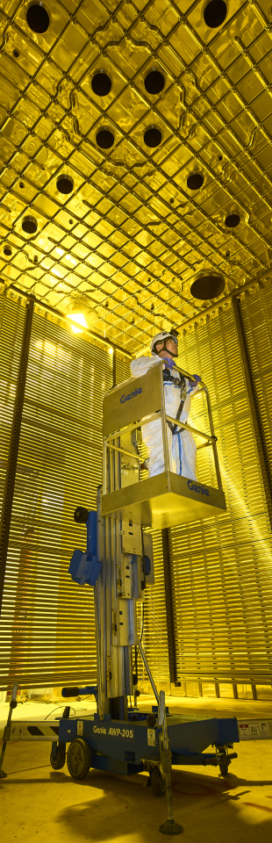

L2G : contained and crossing muons and multiple muon events
Author: Federico Battisti

Slide 2
Lar to gar sample: L2G
L2G: interface that takes outgoing LAr particles and feeds them to edep-sim with any TMS detector could simplify the sample simulation/reconstruction and standardize the procedure between detector designs (ND-GAr/TMS).
Progressed in our analysis of the LAr interacting sample produced by Eldwan, focusing on differences between the muons contained in the Liquid Argon and the ones produced in LAr that reach ND GAr.
We also started analysing events where multiple muons traversing the Liquid Argon are produced
To see previous analysis results see: https://indico.fnal.gov/event/47020/contributions/204949/attachments/138880/174374/l2g_Presentation_Gen13_2021.pdf
Simulated LAr sample
L2G
SSRI
ND-GAr lite
ND-GAr
https://indico.fnal.gov/event/44562/contributions/200915/attachments/136745/170170/DUNE_ND_Meeting_28.10.20.pdf

Slide 3
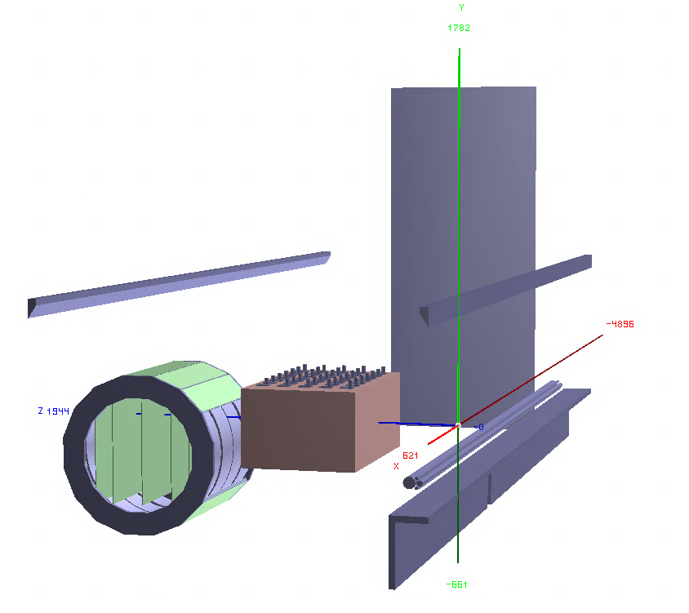
Generated sample: neutrino interactions in lar
Sample generated with GENIE v2
Gsimple flux in ND-Hall (from Tanaz)
1M single interaction events in ND-LAr (volArgonCubeActive)
Geometry used:
Baseline ND-LAr from dunendggd (apparently some updates are needed but not pushed yet...)
ND-GAr-Lite detector with SPY magnet (not the latest one acting as PV)
5 Scintillator planes (Minerva-like) of 6mx5mx4cm at (-240, -150, 0, 150, 240) //Not Optimized yet!
Segmented with triangular shapes strips in X/Y (2 cm triangle base)
Includes a muon detector (3 planes of Sc of 2 cm around the magnet yoke of the ND-GAr) with 2x7.5cm iron for mu/pi separation over 500 MeV/c
Coordinate sytem: z roughly the flux direction, y is the vertical direction and x is the drift direction (i.e. the magnetic field direction)
y
z
x

Slide 4
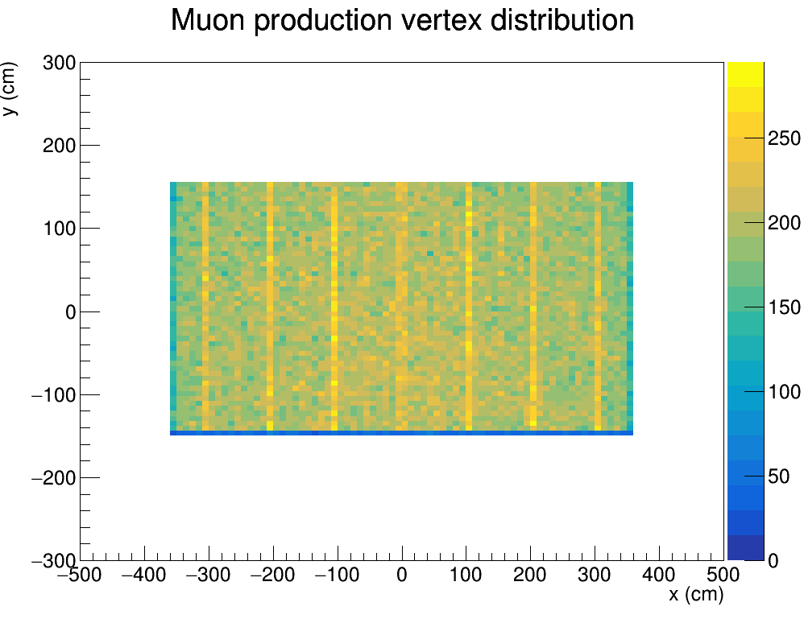
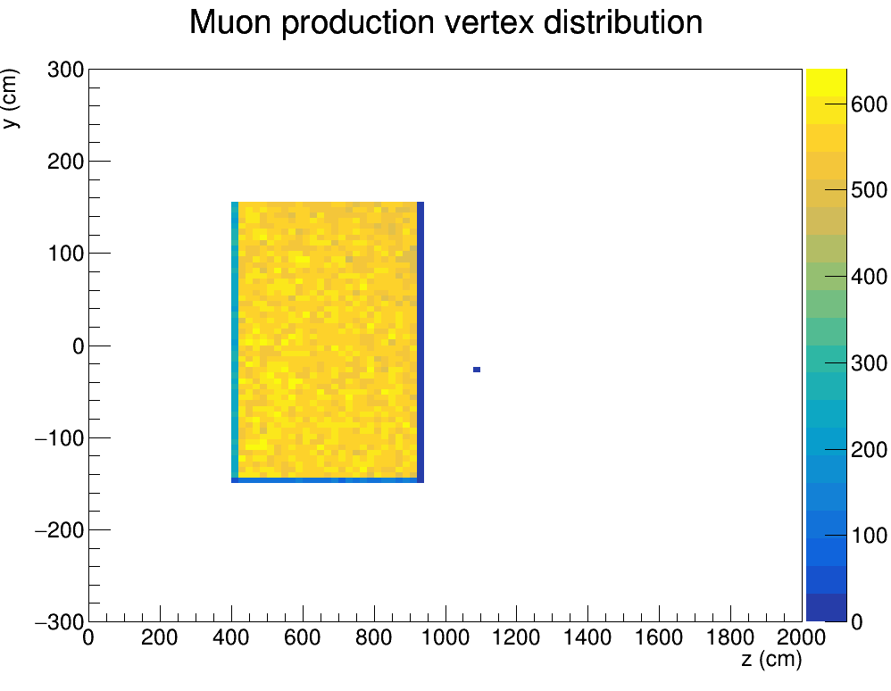
Lar fiducial volume
Here we plot all the primary muon production vertexes which are all contained in the Active LAr fiducial volume: $\left(−357.35<x<357.35\right) cm$ $\left(−127.275<y<127.275\right) cm$ $\left(411.5<z<920.5\right) cm$

Slide 5
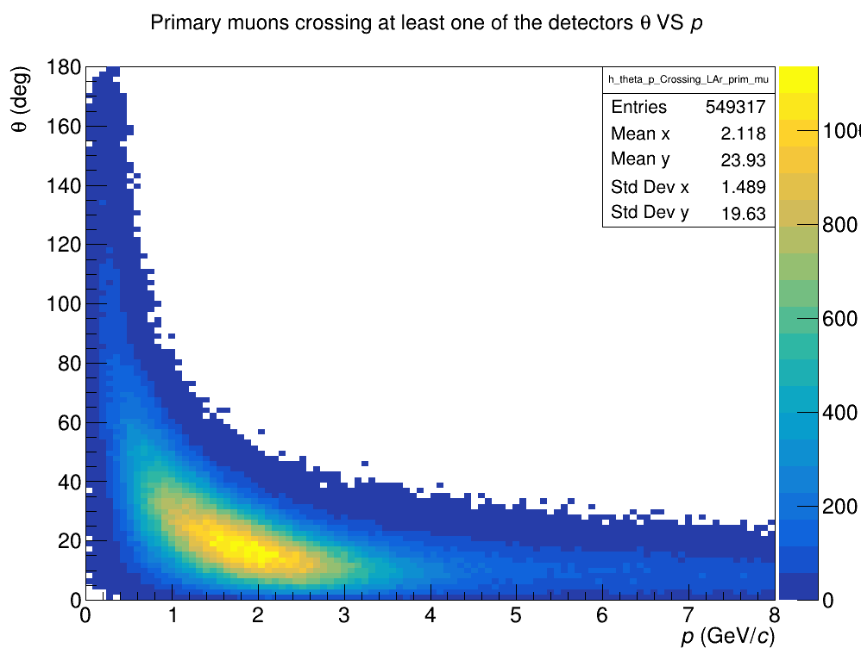
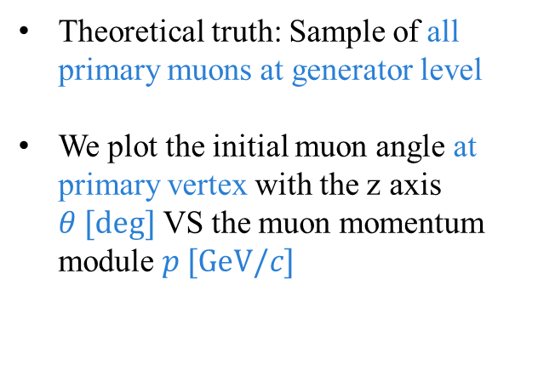
All PRIMARY muons AT GENERATOR LEVEL
Theoretical truth: Sample of all primary muons at generator level
We plot the initial muon angle at primary vertex with the z axis $θ [deg]$ VS the muon momentum module $p [GeV/c]$

Slide 6
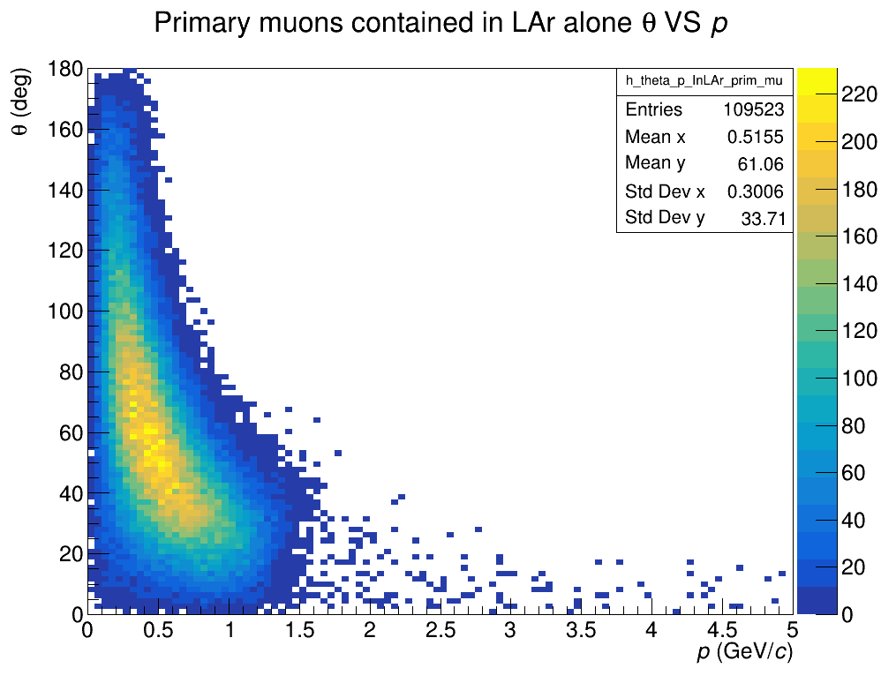
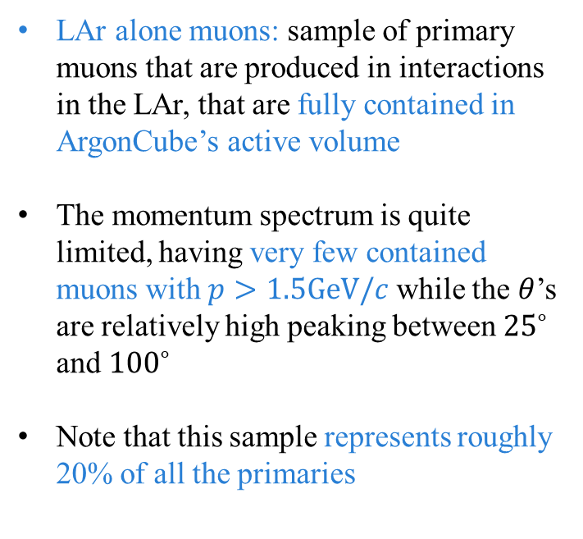
LAR alone muons p vs theta
LAr alone muons: sample of primary muons that are produced in interactions in the LAr, that are fully contained in ArgonCube’s active volume
The momentum spectrum is quite limited, having very few contained muons with $p>1.5GeV/c$ while the $θ$’s are relatively high peaking between ${25}^{∘}$ and ${100}^{∘}$
Note that this sample represents roughly 20% of all the primaries

Slide 7
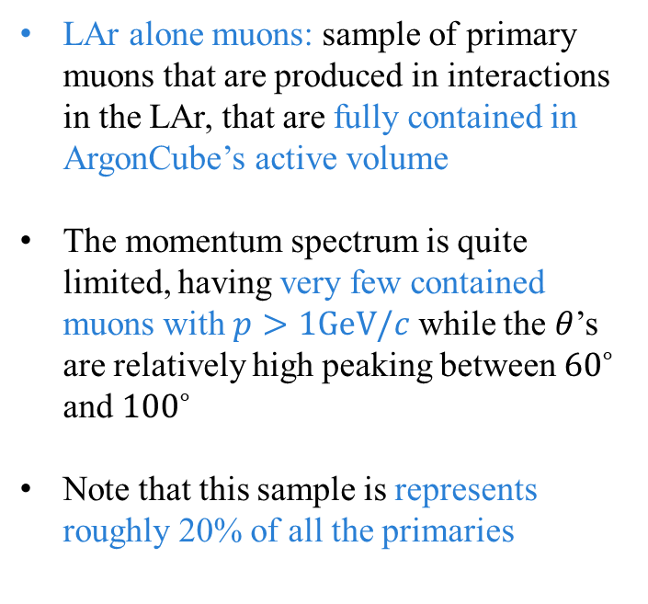
LAR alone muons p vs theta
LAr alone muons: sample of primary muons that are produced in interactions in the LAr, that are fully contained in ArgonCube’s active volume
The momentum spectrum is quite limited, having very few contained muons with $p>1GeV/c$ while the $θ$’s are relatively high peaking between ${60}^{∘}$ and ${100}^{∘}$
Note that this sample is represents roughly 20% of all the primaries
A clear slope can be noticed in the graph due to the cubic shape of the LAr detector: a more forward going muon (i.e. Smaller theta) will traverse less material and lose less energy, making it less likely for it to be stopped in the LAr

Slide 8
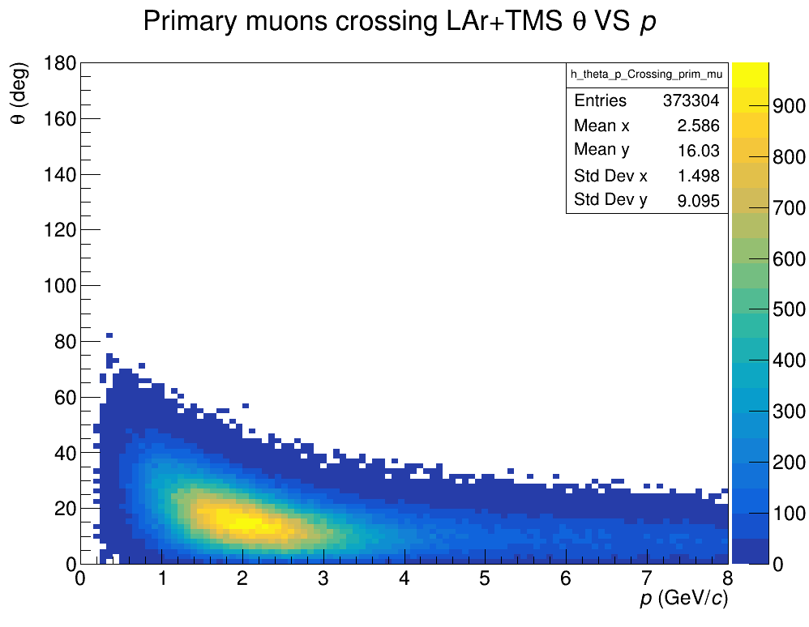
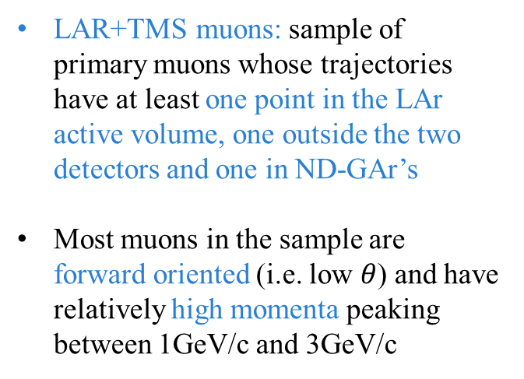
LAR+tms muons p vs theta
LAR+TMS muons: sample of primary muons whose trajectories have at least one point in the LAr active volume, one outside the two detectors and one in ND-GAr’s
Most muons in the sample are forward oriented (i.e. low $θ$) and have relatively high momenta peaking between 1GeV/c and 3GeV/c

Slide 9
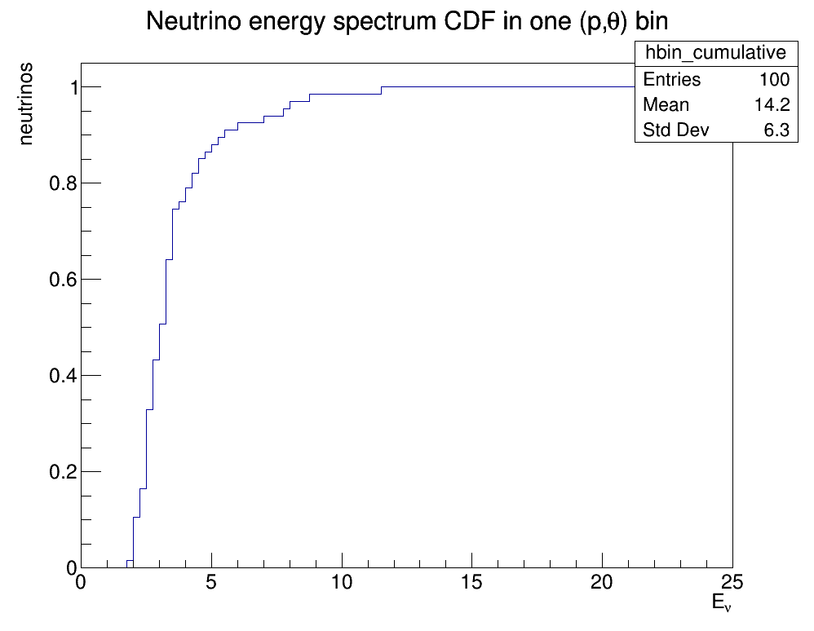
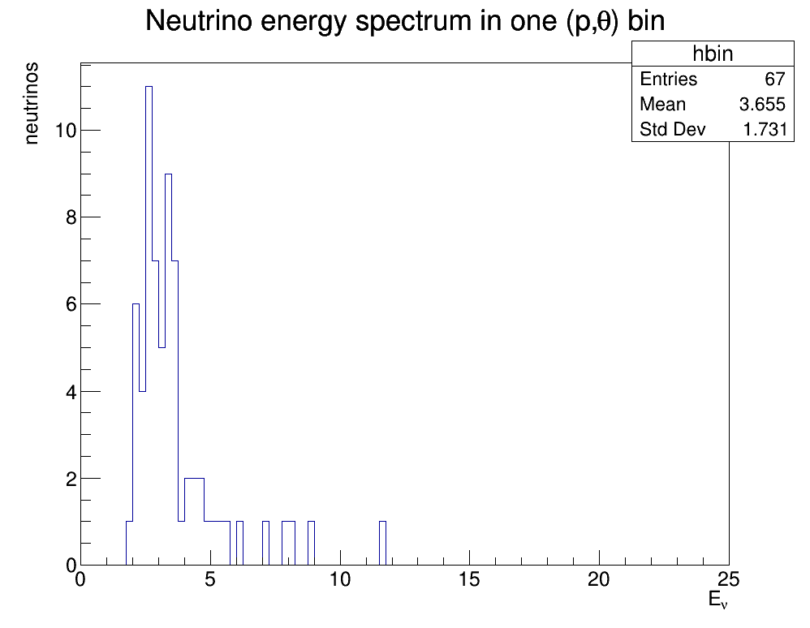
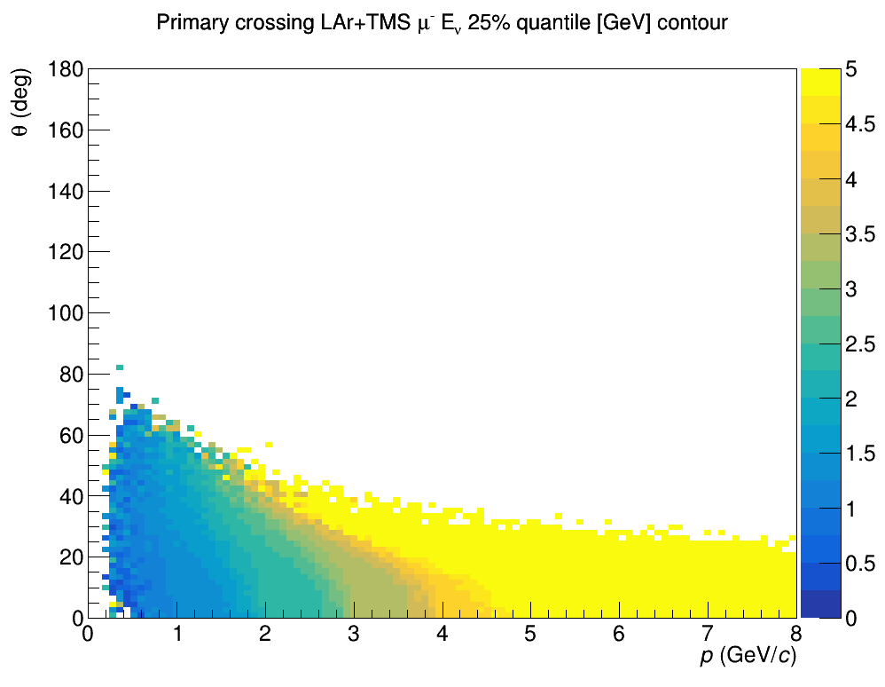

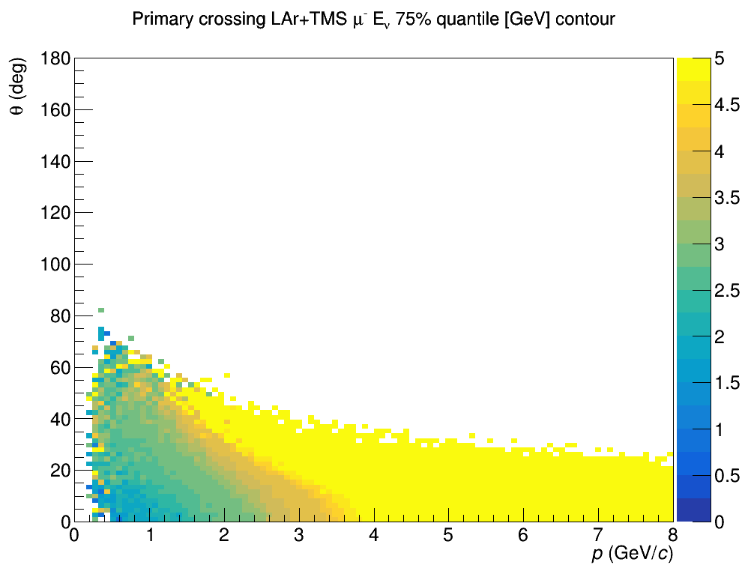
Neutrino energy distribution quantiles
CDF
25%, 50% and 75% quantiles
Select bin by bin and look at the energy spectrum of the neutrinos producing the primary muons

Slide 10
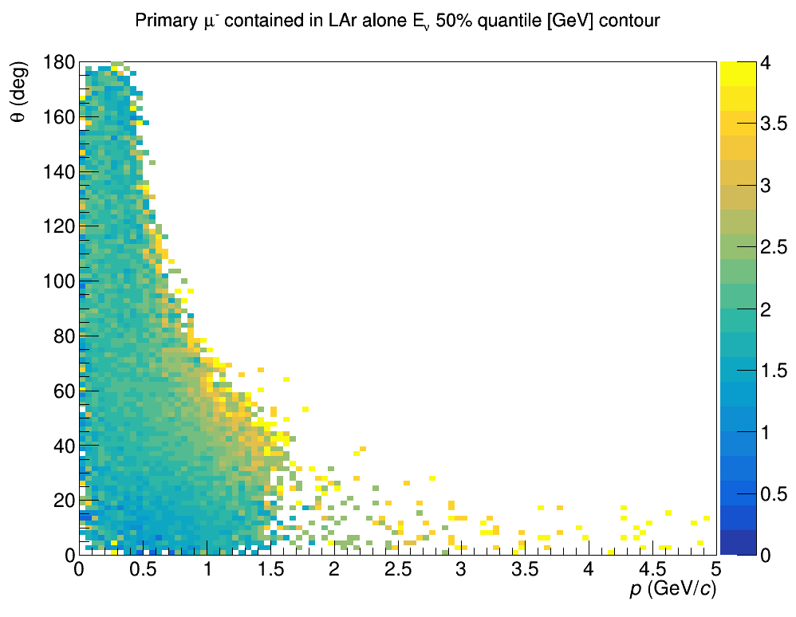
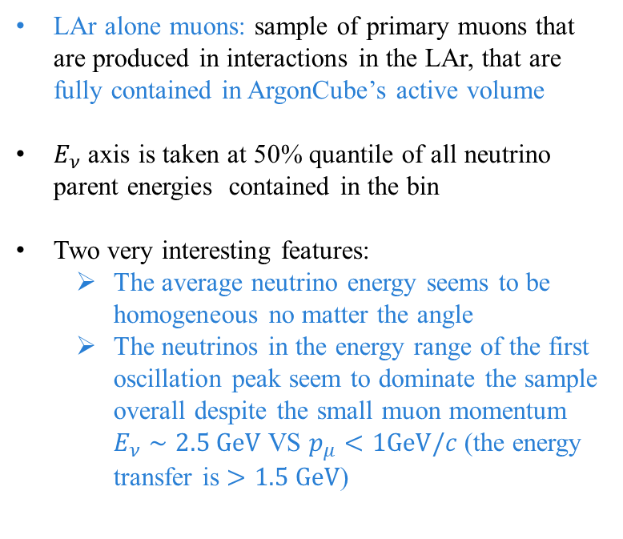
Lar alone muons p vs theta 50% quantile
LAr alone muons: sample of primary muons that are produced in interactions in the LAr, that are fully contained in ArgonCube’s active volume
$E_{ν}$ axis is taken at 50% quantile of all neutrino parent energies contained in the bin
Two very interesting features:
The average neutrino energy seems to be homogeneous no matter the angle
The neutrinos in the energy range of the first oscillation peak seem to dominate the sample overall despite the small muon momentum $E_{ν}∼2.5 GeV$ VS $p_{μ}<1GeV/c$ (the energy transfer is $>1.5 GeV$)
10

Slide 11
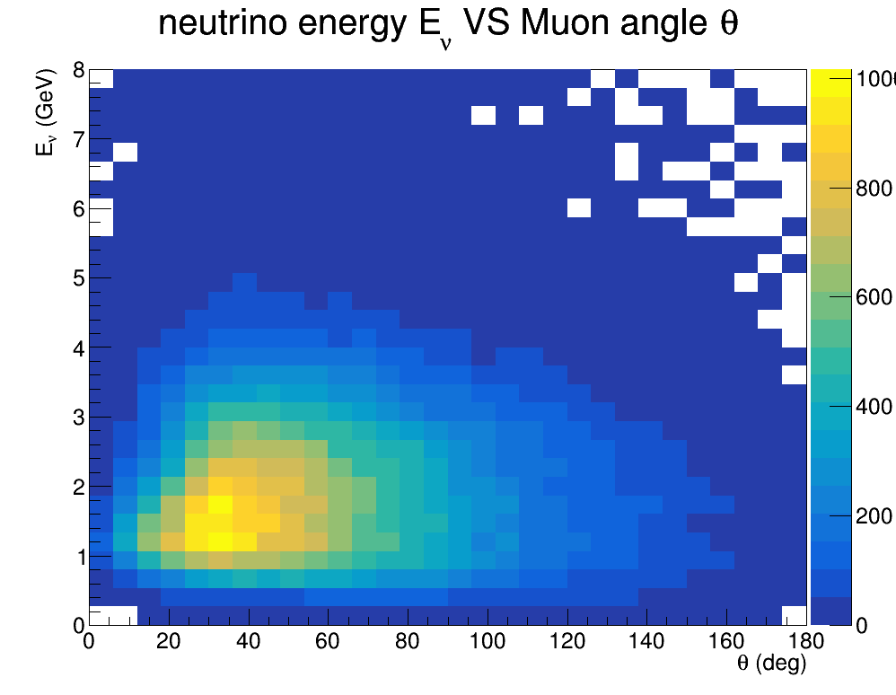
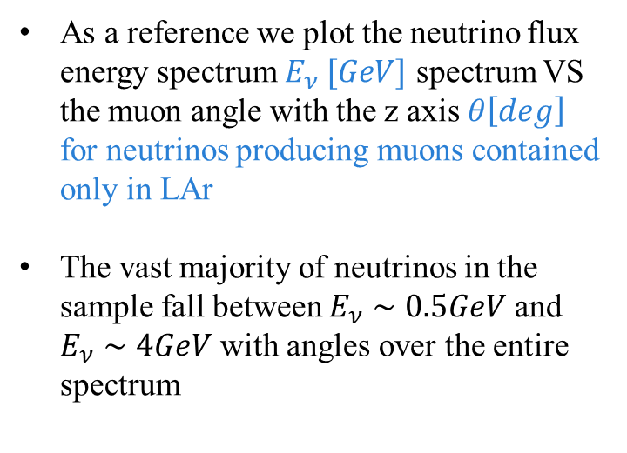
LAR alone NEUTRINO SPECTRUM
As a reference we plot the neutrino flux energy spectrum $E_{ν} [GeV]$ spectrum VS the muon angle with the z axis $θ\left[deg\right]$ for neutrinos producing muons contained only in LAr
The vast majority of neutrinos in the sample fall between $E_{ν}∼0.5GeV$ and $E_{ν}∼4GeV$ with angles over the entire spectrum

Slide 12
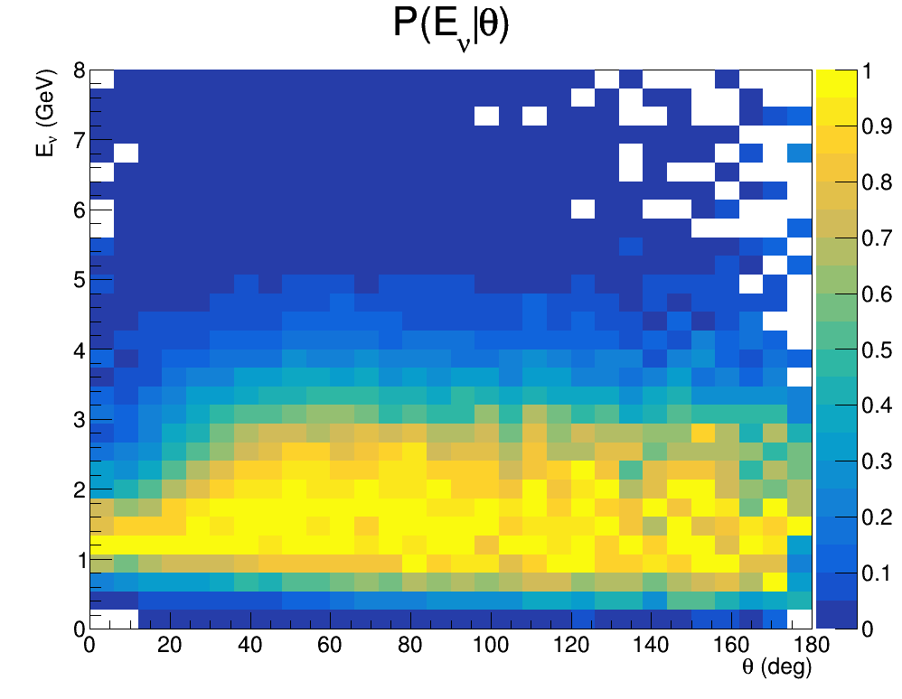
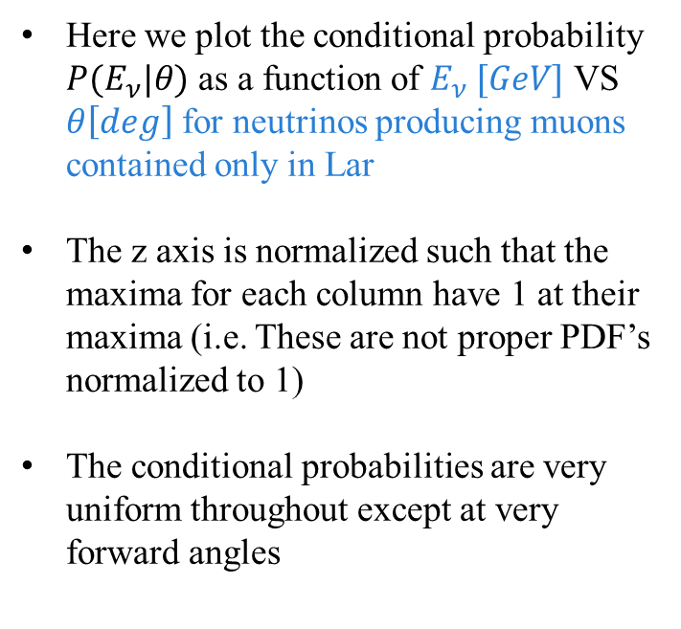
LAR alone NEUTRINO SPECTRUM
Here we plot the conditional probability $P(E_{ν}|θ)$ as a function of $E_{ν} [GeV]$ VS $θ\left[deg\right]$ for neutrinos producing muons contained only in Lar
The z axis is normalized such that the maxima for each column have 1 at their maxima (i.e. These are not proper PDF’s normalized to 1)
The conditional probabilities are very uniform throughout except at very forward angles

Slide 13
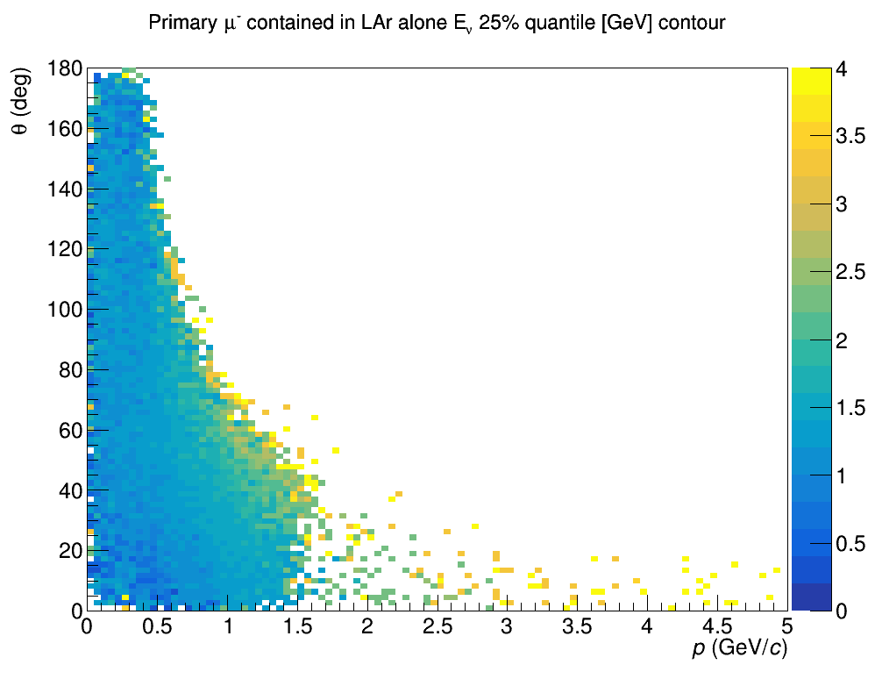
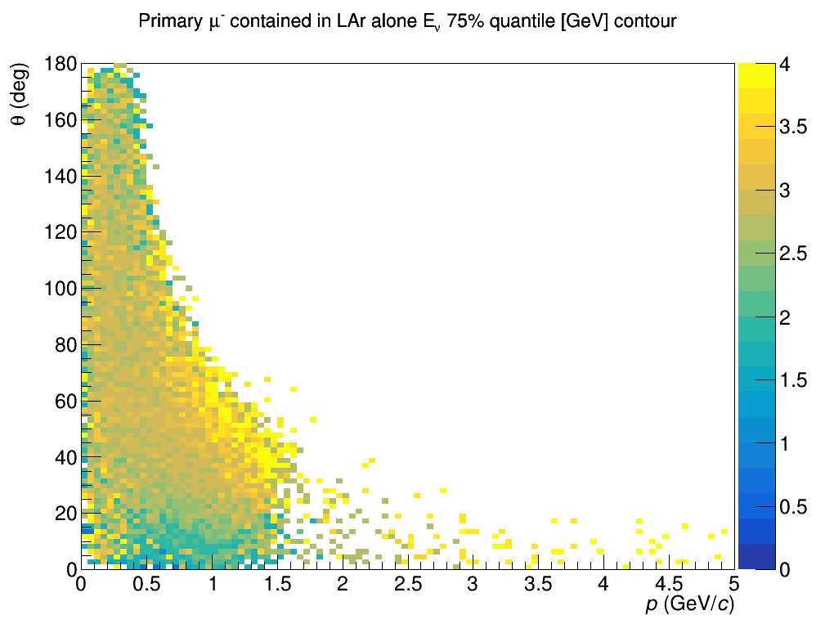
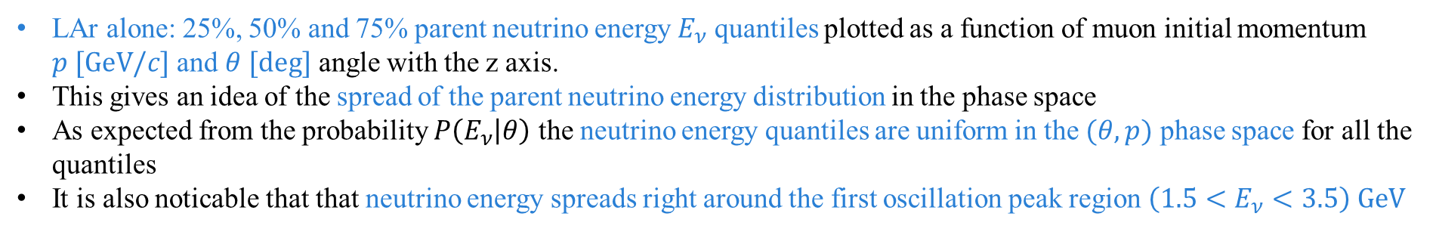
LAR Alone muons neutrino energies quantiles
LAr alone: 25%, 50% and 75% parent neutrino energy $E_{ν}$ quantiles plotted as a function of muon initial momentum $p [GeV/c]$ and $θ [deg]$ angle with the z axis.
This gives an idea of the spread of the parent neutrino energy distribution in the phase space
As expected from the probability $P\left(E_{ν} | θ\right)$ the neutrino energy quantiles are uniform in the $(θ,p)$ phase space for all the quantiles
It is also noticable that that neutrino energy spreads right around the first oscillation peak region $\left(1.5<E_{ν}<3.5\right) GeV$

Slide 14
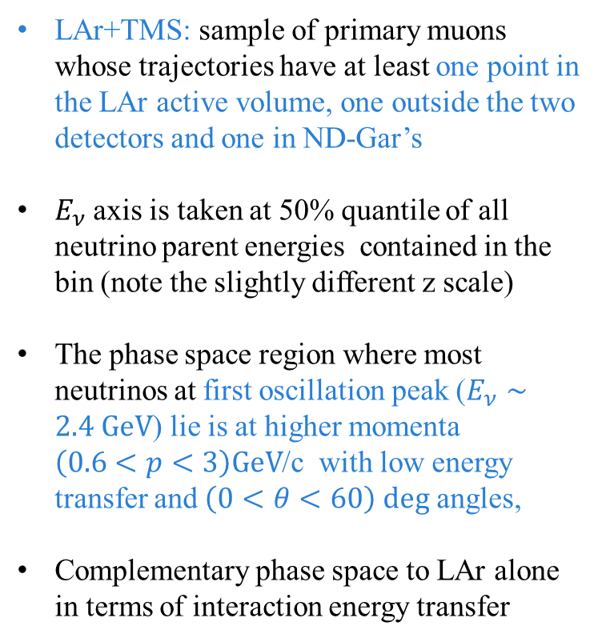
Lar+tms muons p vs theta 50% quantile
LAr+TMS: sample of primary muons whose trajectories have at least one point in the LAr active volume, one outside the two detectors and one in ND-Gar’s
$E_{ν}$ axis is taken at 50% quantile of all neutrino parent energies contained in the bin (note the slightly different z scale)
The phase space region where most neutrinos at first oscillation peak ($E_{ν}∼2.4 GeV$) lie is at higher momenta $\left(0.6<p<3\right)GeV$/c with low energy transfer and $\left(0<θ<60\right) deg$ angles,
Complementary phase space to LAr alone in terms of interaction energy transfer
14

Slide 15
LAR+TMS muons neutrino energy quantiles
LAr+TMS: 25%, 50% and 75% parent neutrino energy $E_{ν}$ quantiles plotted as a function of muon initial momentum $p [GeV/c]$ and $θ [deg]$ angle with the z axis.
This gives an idea of the spread of the parent neutrino energy distribution in the phase space

Slide 16
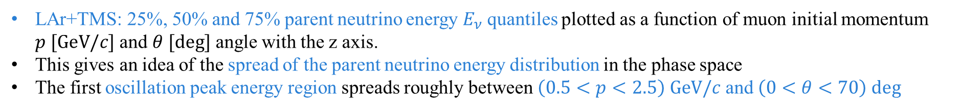
LAR+TMS muons neutrino energy quantiles
LAr+TMS: 25%, 50% and 75% parent neutrino energy $E_{ν}$ quantiles plotted as a function of muon initial momentum $p [GeV/c]$ and $θ [deg]$ angle with the z axis.
This gives an idea of the spread of the parent neutrino energy distribution in the phase space
The first oscillation peak energy region spreads roughly between $\left(0.5<p<2.5\right) GeV/c$ and $\left(0<θ<70\right) deg$

Slide 17
Events with MULTIple MUONs in lar
Events producing multiple muons in the LAr chamber could cause problems in the reconstruction, especially in cases where the trajectories are very close together
To study this topology we use MC truth data and we consider all events producing one or more muon or anti-muon tracks in the LAr irresgardless if they stop in it or not.
To set a baseline for this events sample we start by analyzing a single-interaction simulation (i.e. the same one used for the previous analysis) and we than repeat out analysis for a single-spill sample

Slide 18
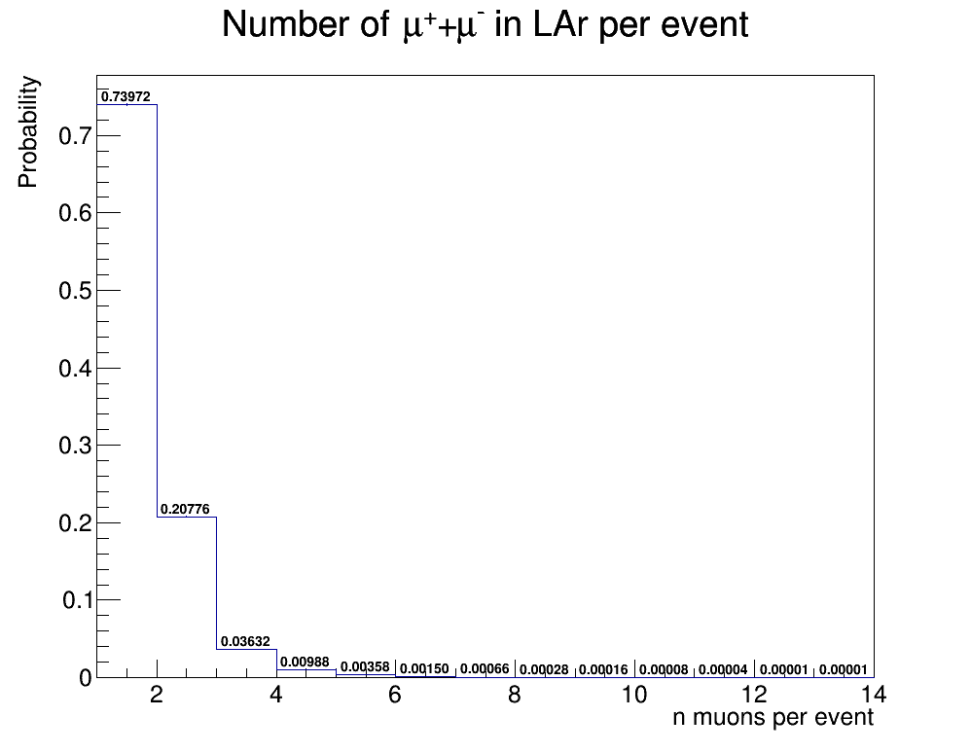
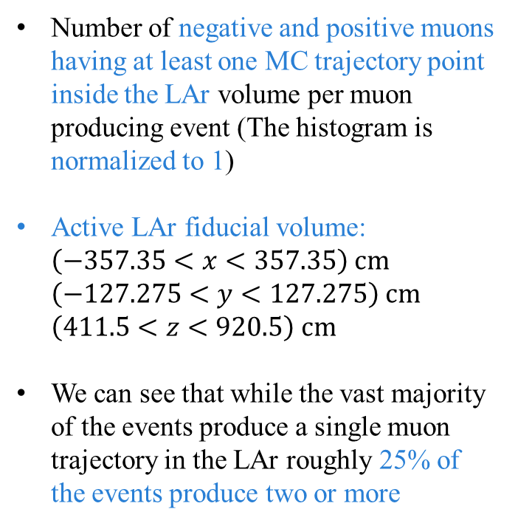
Single interaction: NUMBER OF MUONS in lar fiducial volume
Number of negative and positive muons having at least one MC trajectory point inside the LAr volume per muon producing event (The histogram is normalized to 1)
Active LAr fiducial volume: $\left(−357.35<x<357.35\right) cm$ $\left(−127.275<y<127.275\right) cm$ $\left(411.5<z<920.5\right) cm$
We can see that while the vast majority of the events produce a single muon trajectory in the LAr roughly 25% of the events produce two or more

Slide 19
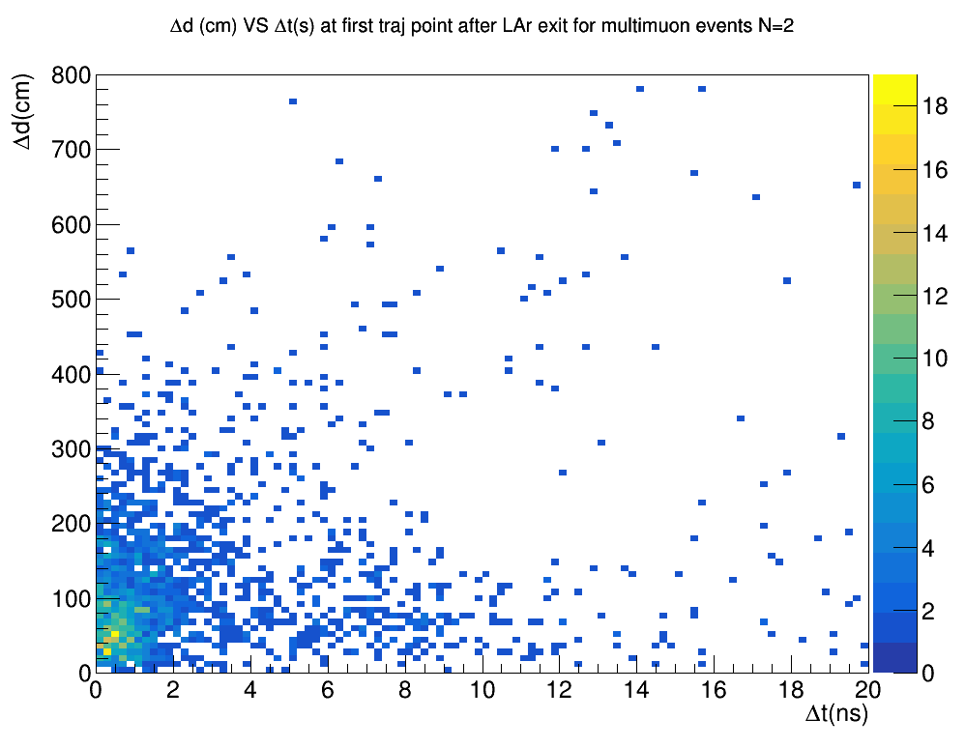
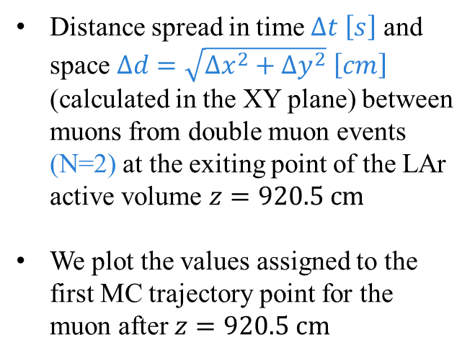
Single interaction: time-space spread
Distance spread in time $Δt \left[s\right]$ and space $Δd=\sqrt{Δx^{2}+{Δy}^{2}} \left[cm\right]$ (calculated in the XY plane) between muons from double muon events (N=2) at the exiting point of the LAr active volume $z=920.5 cm$
We plot the values assigned to the first MC trajectory point for the muon after $z=920.5 cm$

Slide 20
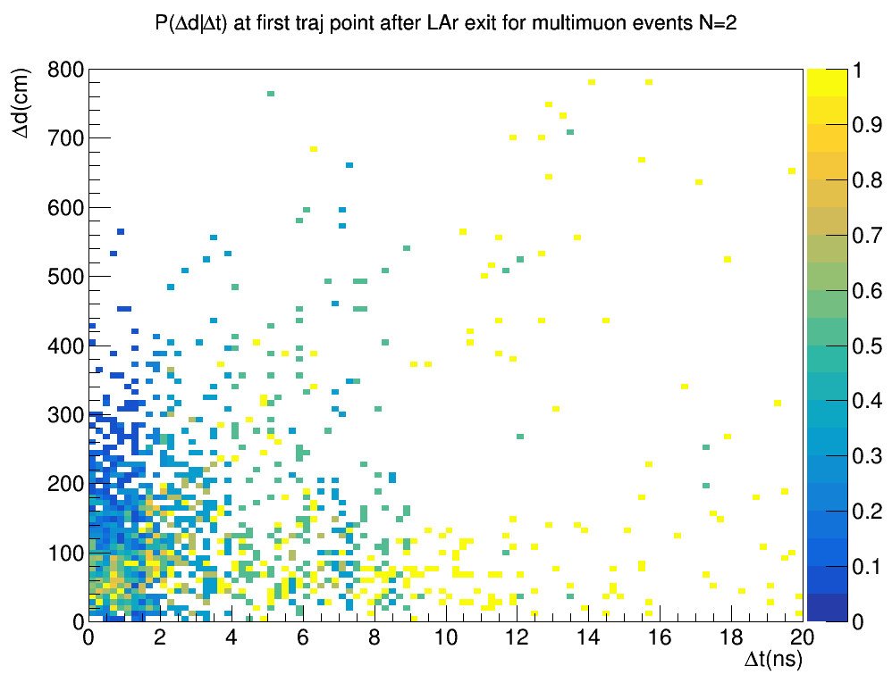
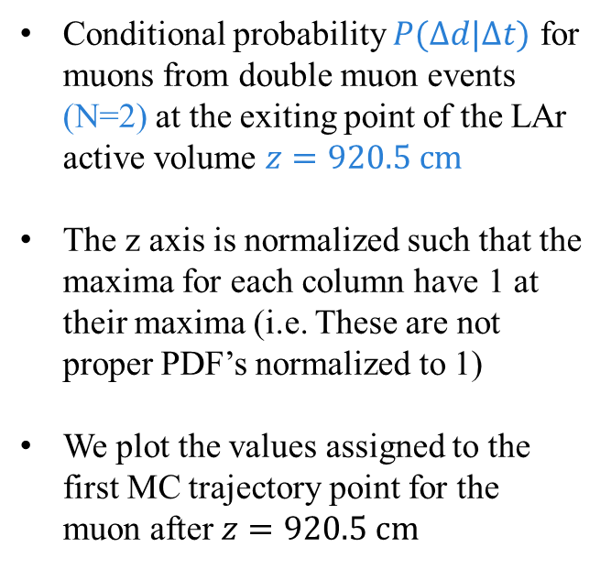
Single interaction: time-space spread
Conditional probability $P(Δd|Δt)$ for muons from double muon events (N=2) at the exiting point of the LAr active volume $z=920.5 cm$
The z axis is normalized such that the maxima for each column have 1 at their maxima (i.e. These are not proper PDF’s normalized to 1)
We plot the values assigned to the first MC trajectory point for the muon after $z=920.5 cm$

Slide 21
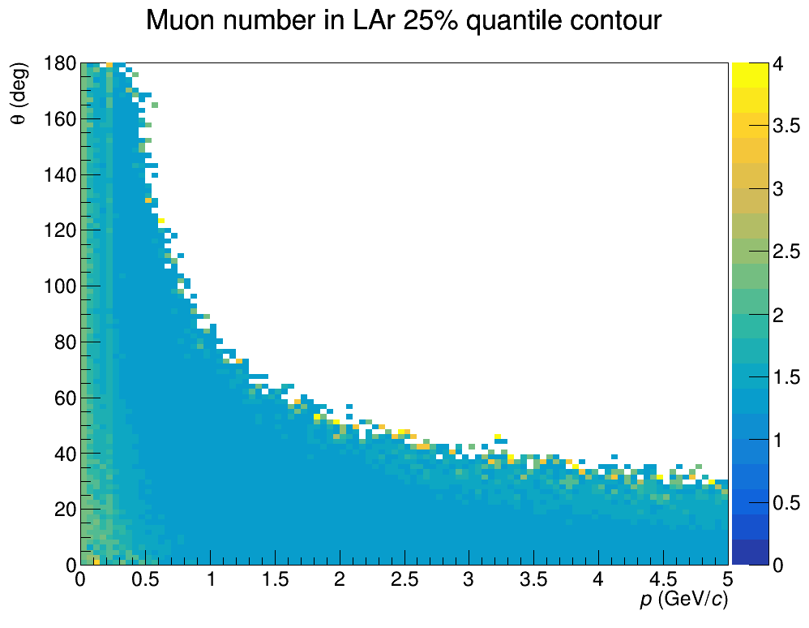
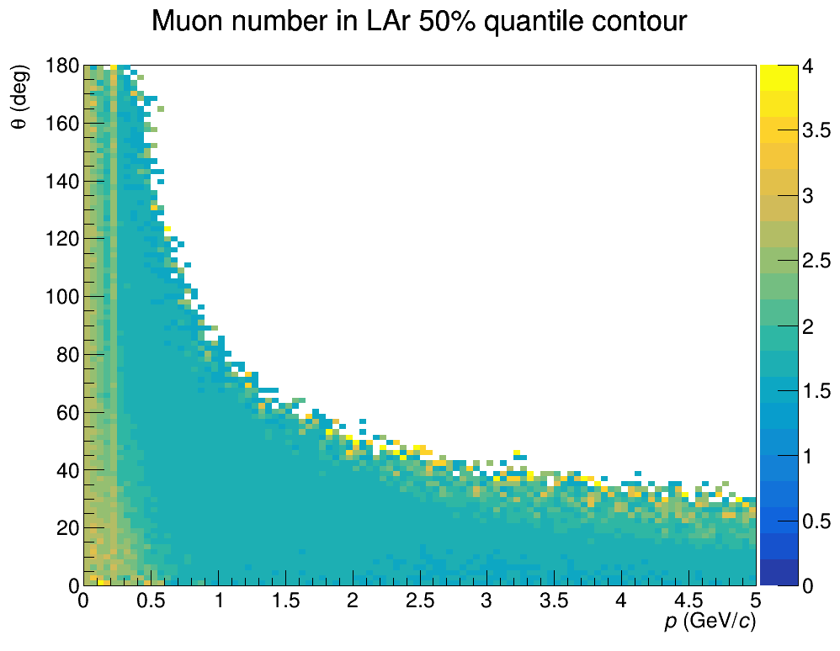
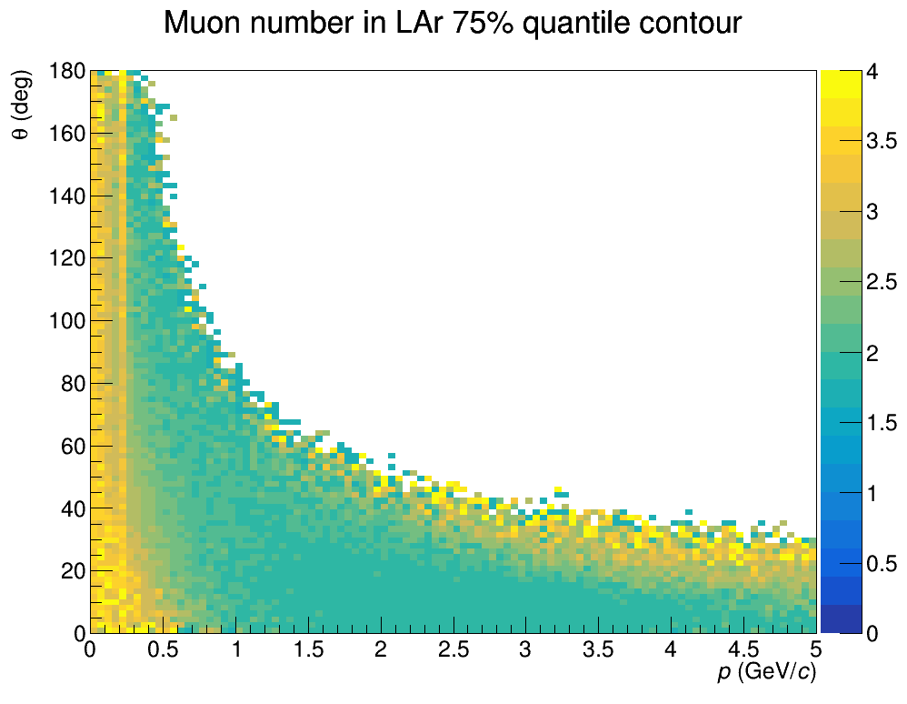
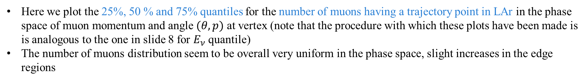
Single interaction: Number of muons in lar quantiles
Here we plot the 25%, 50 % and 75% quantiles for the number of muons having a trajectory point in LAr in the phase space of muon momentum and angle $(θ,p)$ at vertex (note that the procedure with which these plots have been made is is analogous to the one in slide 8 for $E_{ν}$ quantile)
The number of muons distribution seem to be overall very uniform in the phase space, slight increases in the edge regions

Slide 22
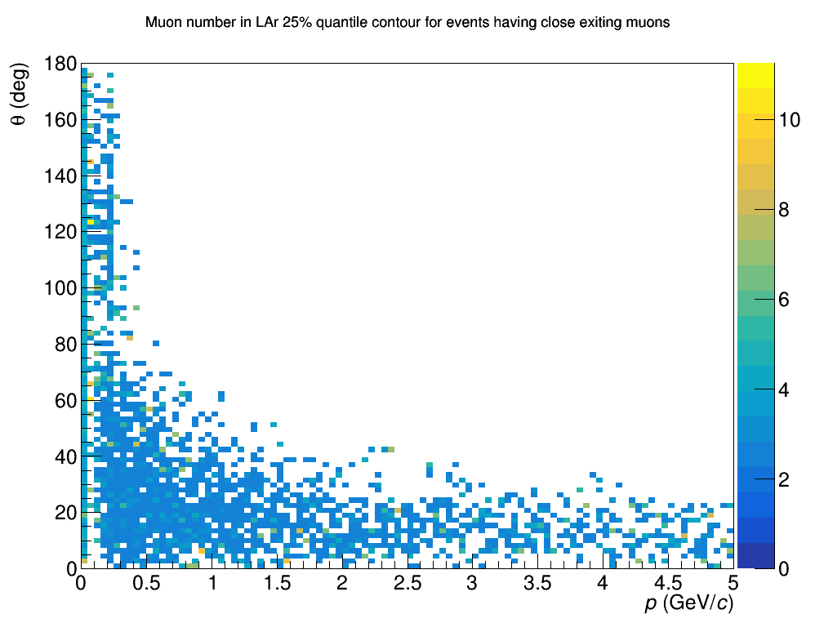

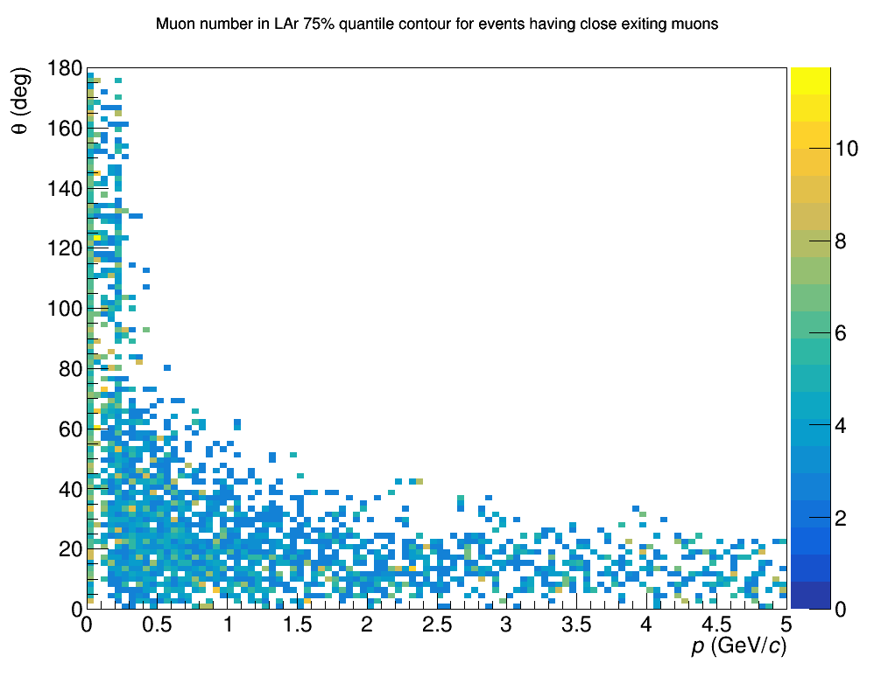
Single interaction: N of muons in lar quantiles; close muons
Here we plot the 25%, 50 % and 75% quantiles for all those events which have at least a couple of close exiting muons defined as $Δt<5ns$ and $Δd<$100cm
Here we see that a big number of events do not pass the selection

Slide 23
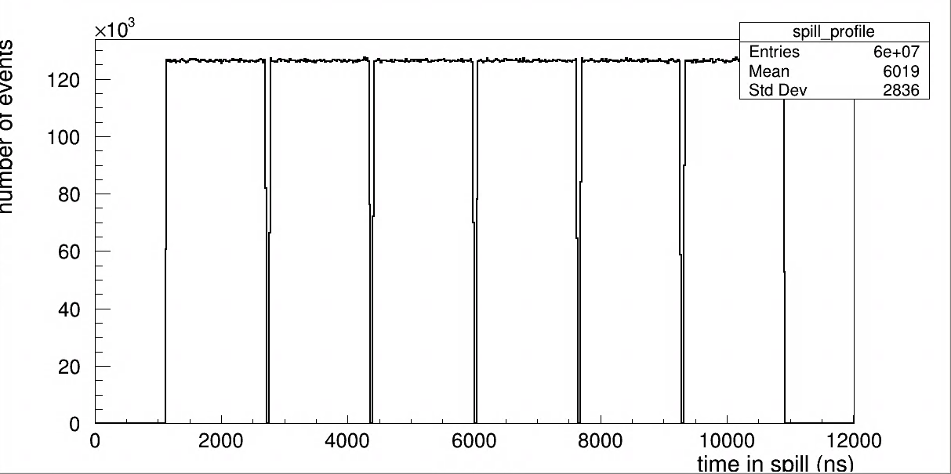
Single spill simulation
For the single spill analysis we use a sample containing MC truth for ${10}^{5}$single spills produced by Eldwan
Spills are generated simply by using the OverlayGENIE package with the parameters: Poisson distribution around 10 events/spill, 10 $μs$ spill using single GENIE events

Slide 24
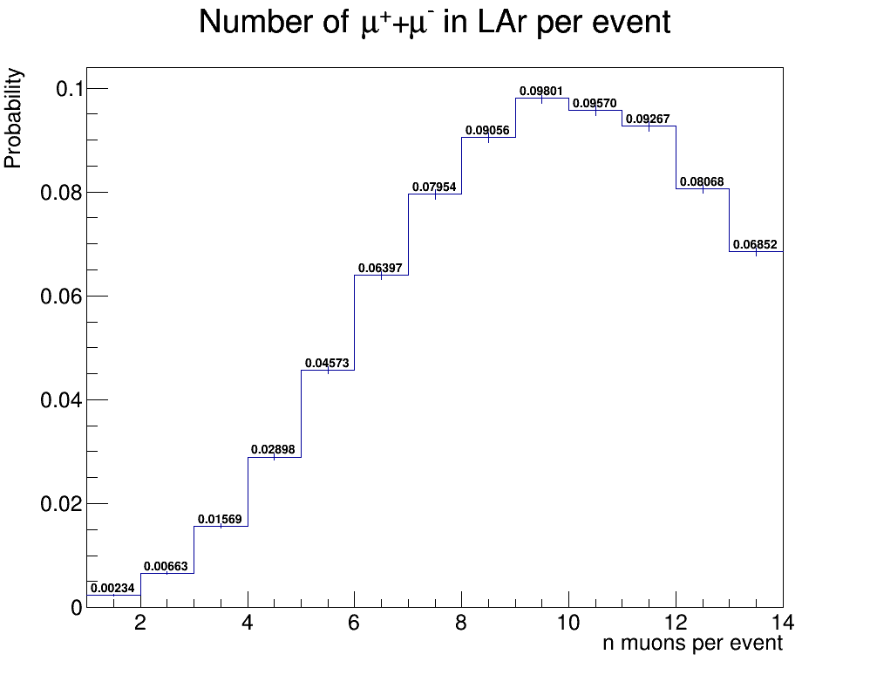
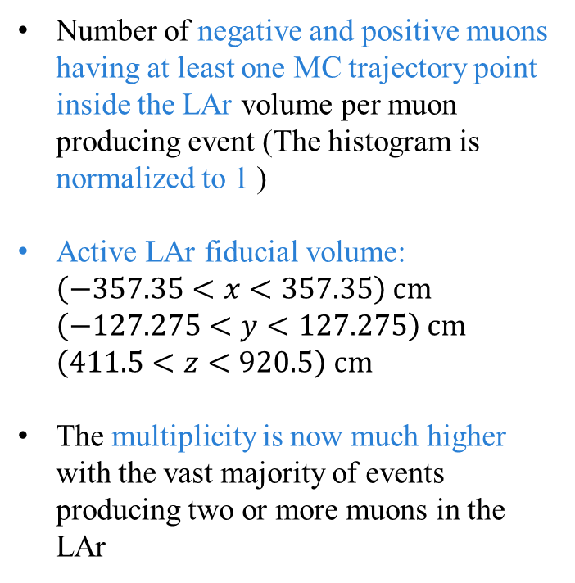
Single spill: NUMBER OF MUONS in lar fiducial volume
Number of negative and positive muons having at least one MC trajectory point inside the LAr volume per muon producing event (The histogram is normalized to 1 )
Active LAr fiducial volume: $\left(−357.35<x<357.35\right) cm$ $\left(−127.275<y<127.275\right) cm$ $\left(411.5<z<920.5\right) cm$
The multiplicity is now much higher with the vast majority of events producing two or more muons in the LAr

Slide 25
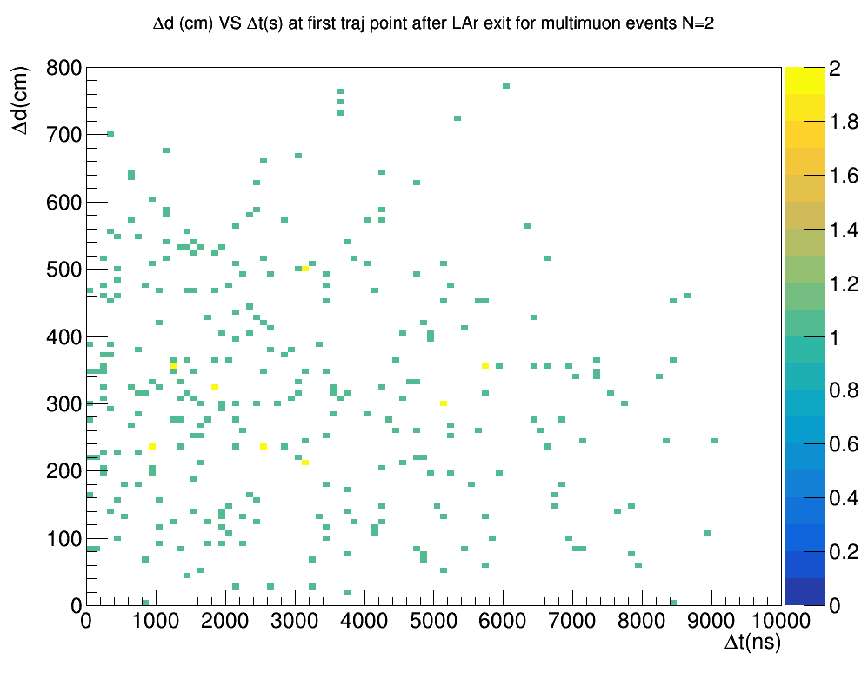
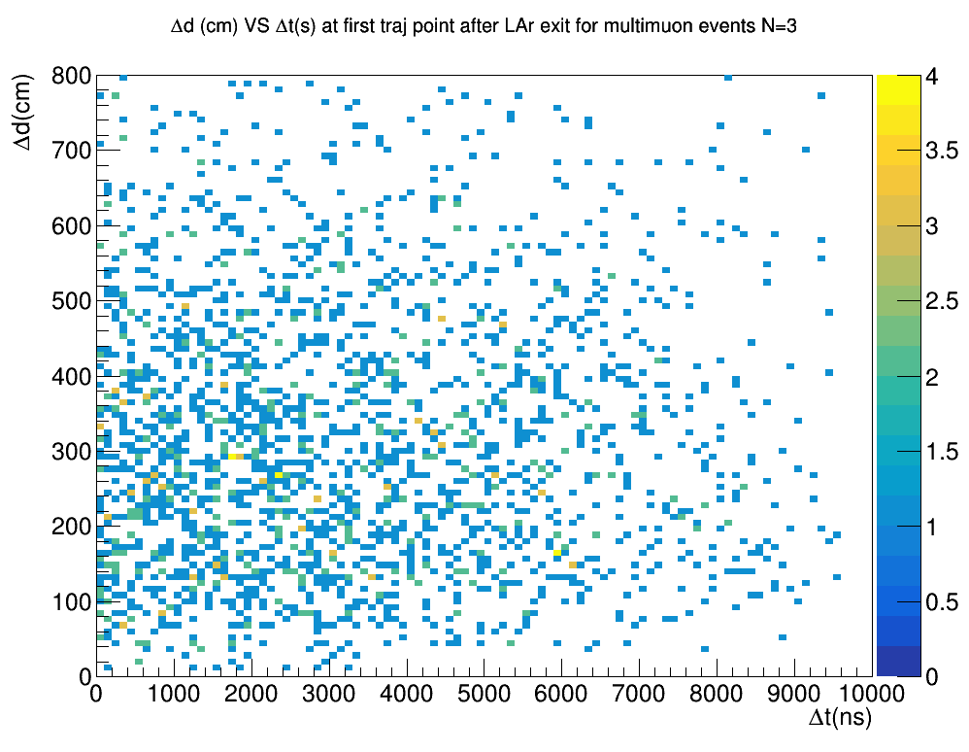
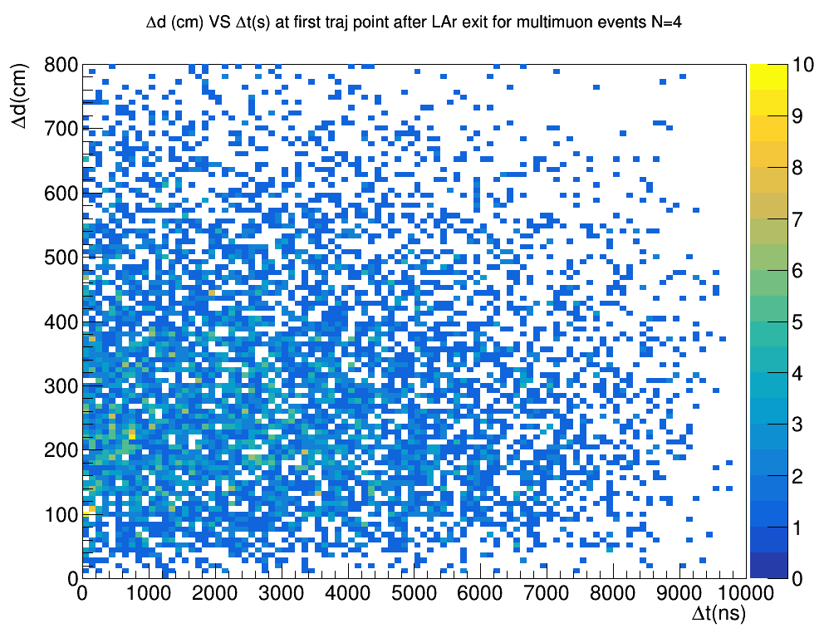
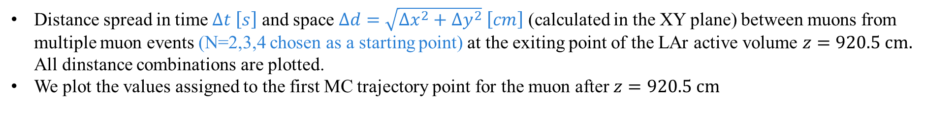
Single spill: time-space spread
Distance spread in time $Δt \left[s\right]$ and space $Δd=\sqrt{Δx^{2}+{Δy}^{2}} \left[cm\right]$ (calculated in the XY plane) between muons from multiple muon events (N=2,3,4 chosen as a starting point) at the exiting point of the LAr active volume $z=920.5 cm.$ All dinstance combinations are plotted.
We plot the values assigned to the first MC trajectory point for the muon after $z=920.5 cm$

Slide 26
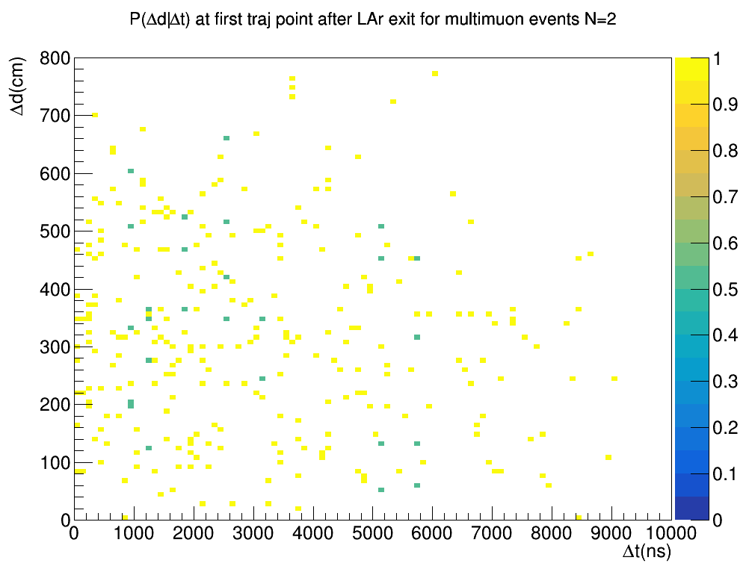
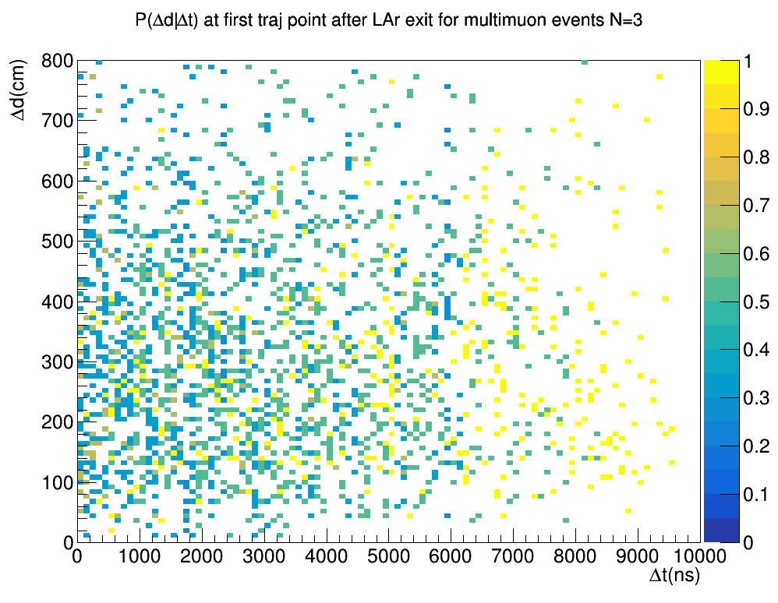
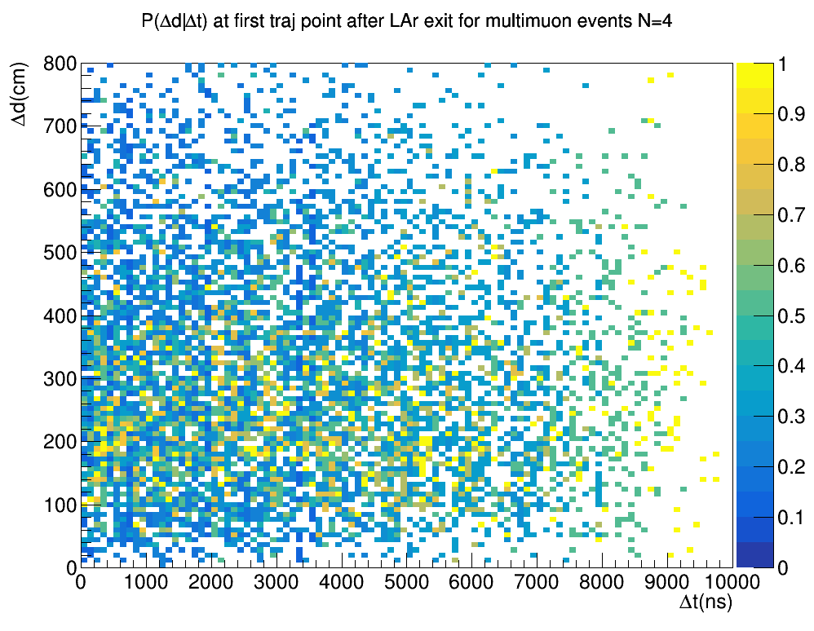
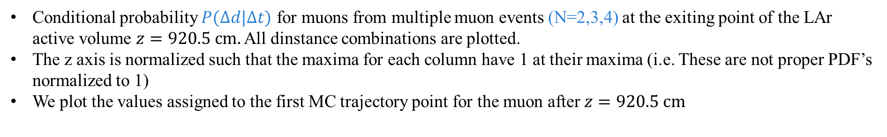
Single spill: time-space spread
Conditional probability $P(Δd|Δt)$ for muons from multiple muon events (N=2,3,4) at the exiting point of the LAr active volume $z=920.5 cm.$ All dinstance combinations are plotted.
The z axis is normalized such that the maxima for each column have 1 at their maxima (i.e. These are not proper PDF’s normalized to 1)
We plot the values assigned to the first MC trajectory point for the muon after $z=920.5 cm$

Slide 27
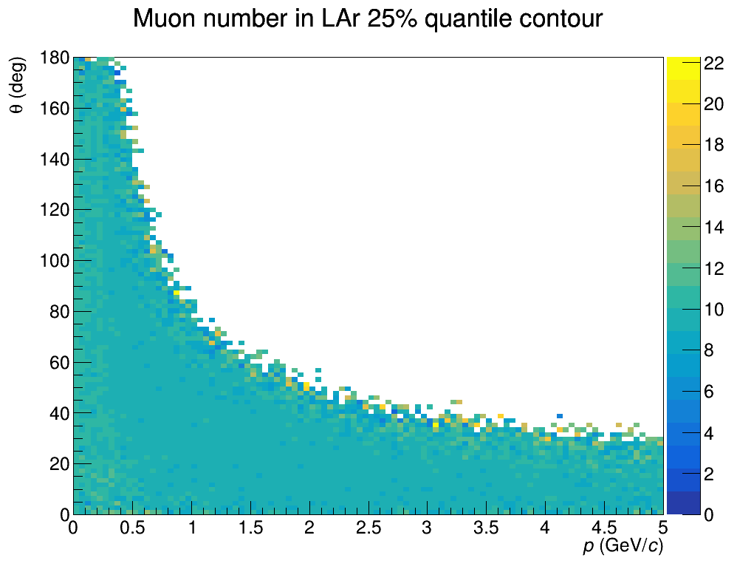



SINGLE SPILL: Number of muons in lar quantiles
Here we plot the 25%, 50 % and 75% quantiles for the number of muons having a trajectory point in Lar in the phase space of muon momentum and angle $(θ,p)$ at vertex (note that the procedure with which these plots have been made is is analogous to the one in slide 8 for $E_{ν}$ quantile)
The number of muons distribution seem to be even more uniform in the single-spill sample, but with higher multiplicities, as it is expected
Note that on average we have on average 10 events/spill across all phase space

Slide 28




SINGLE SPILL: N of muons in lar quantiles; events with close muons
Here we plot the 25%, 50 % and 75% quantiles for all those events which have at least a couple of close exiting muons defined as $Δt<5000ns$ and $Δd<5$00cm
The cut $Δt<5000ns$ is chosen somewhat arbitrarily at the moment but should depend on the timing precision of LAr and TMS: we might need to check different scenarios after this talk.
Here we see that most events do have at least a couple of close muons

Slide 29

Summary and future steps
We analyzed the LAr+GAr and LAr alone muon samples’ $(p,θ)$ distribution and relative parent $E_{ν}$ spread and found that:
LAr+GAr muons have larger initial momenta and smaller angles with average parent $E_{ν}$ that grows with $p$ and $θ$; the first oscillation peak energy region ($E_{ν}∼2.5GeV$) spreads roughly between $\left(0.5<p<2.5\right) GeV/c$ and $\left(0<θ<70\right) deg$
LAr alone have smaller initial momenta and larger angles, with neutrinos in the first oscillation peak region dominating the sample overall
We then looked at events producing muon trajectories in the Liquid Argon in terms of muon multiplicity, space-time distance spread for exiting muons and number of muons quantiles both for the all sample and specifically for events producing close exiting muons.
This analysis has been performed first over a single interaction sample, to set a baseline and then on a more realistic single spill sample
Immidiate next steps:
Study detector reconstruction performances (so far only considered MC truth)
Reconstruction seem to be very slow in single spill samples, around $24 s/ev$, which might indicate difficulties with multimuon events: need to investigate
Check $E_{ν}$and $N_{μ}$ at DUNE-PRISM off-axis angles

