Slide 1
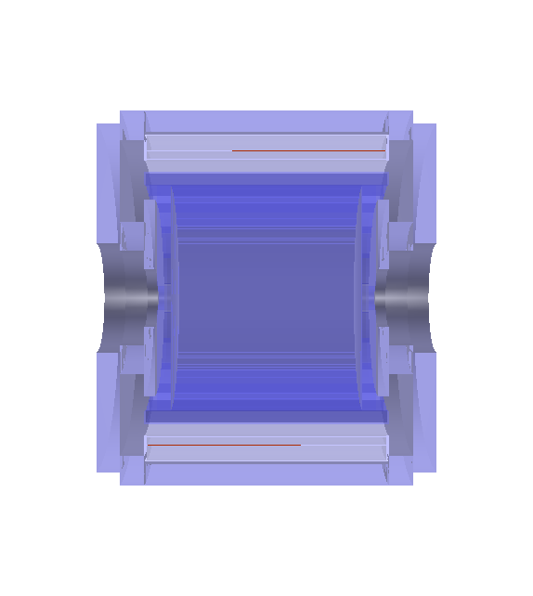
Iron Yoke
ECAL
STT
Super-conducting Magnet

Slide 2
0
1
2
3
4
5
6
7
8
9
10
11
5,4 cm
Layer 4
Layer 3
Layer 2
Layer 1
4,4 cm
Layer 0

Slide 4
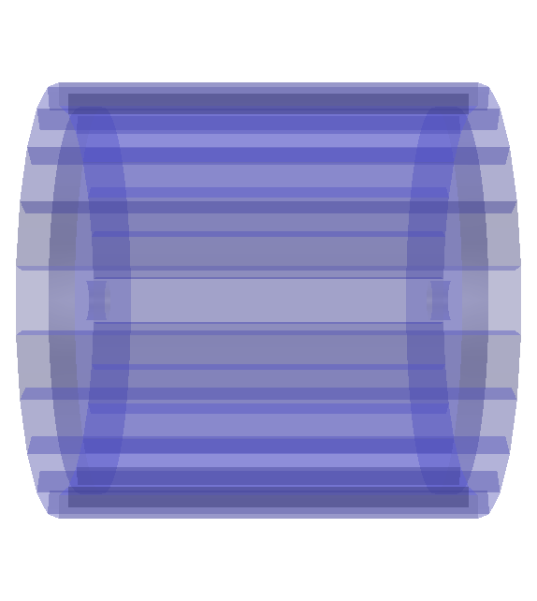
338 cm
430 cm
End-cap module
Barrel module

Slide 5


58.57 cm
52.51 cm
430 cm
23 cm

Slide 6
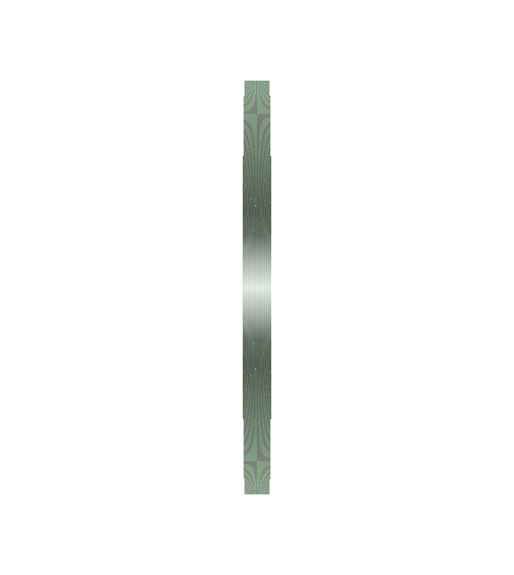
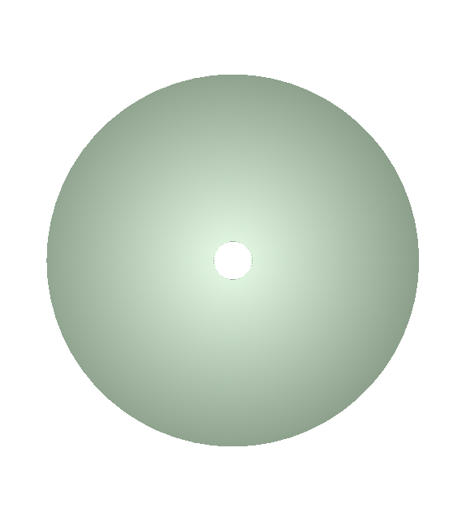
41.6 cm
23 cm
400 cm

Slide 7
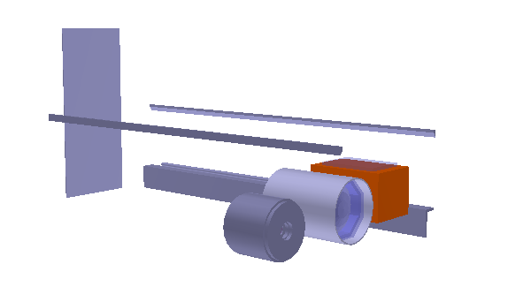
ArgonCube
HPgTPC
SAND

Slide 8
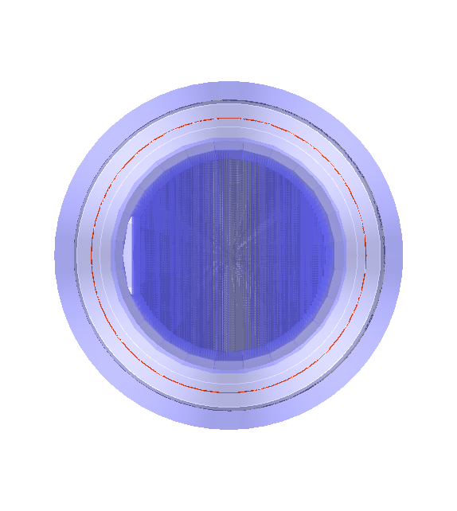
Iron Yoke
Super-conducting magnet
ECAL
LAr Meniscus
STT

