Slide 1
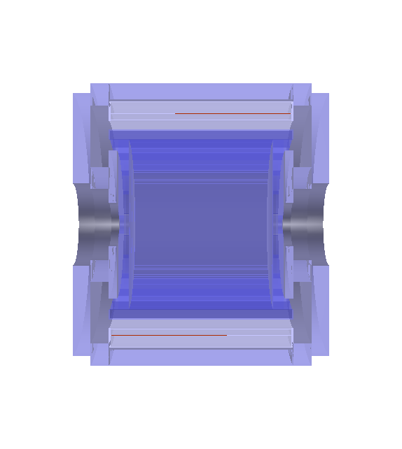
Iron Yoke
ECAL
STT
Super-conducting Magnet

Slide 2
0
1
2
3
4
5
6
7
8
9
10
11
5,4 cm
Layer 4
Layer 3
Layer 2
Layer 1
4,4 cm
Layer 0

Slide 3

(0.854; -0.384; 23.912) m
Particle Gun Centre

Slide 4
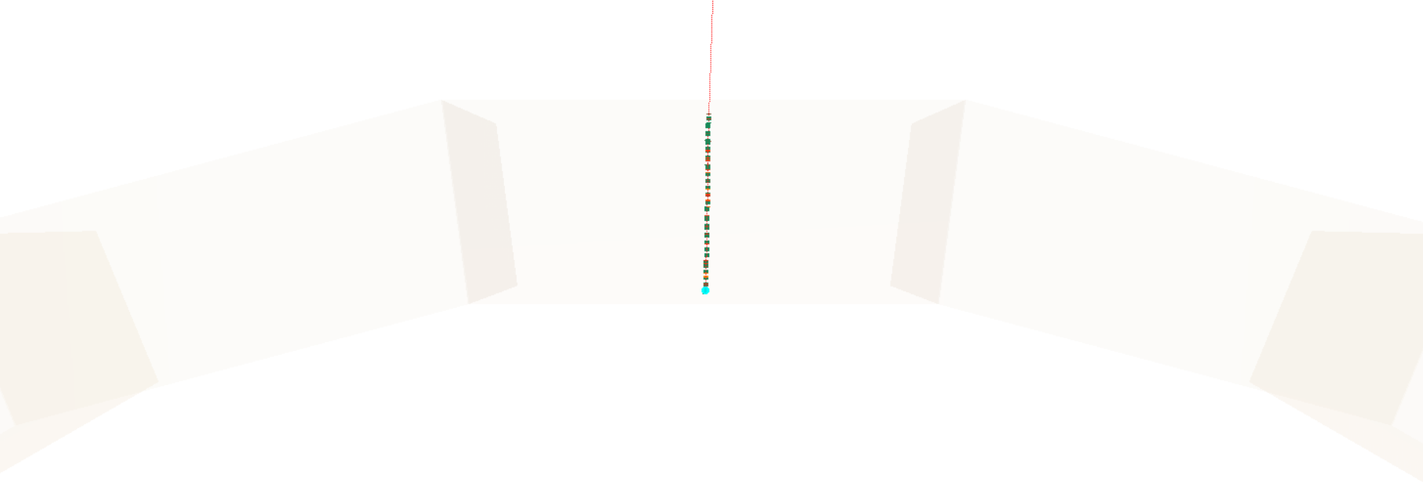
(0.854; -0.384; 23.912) m
Particle Gun Centre

Slide 5
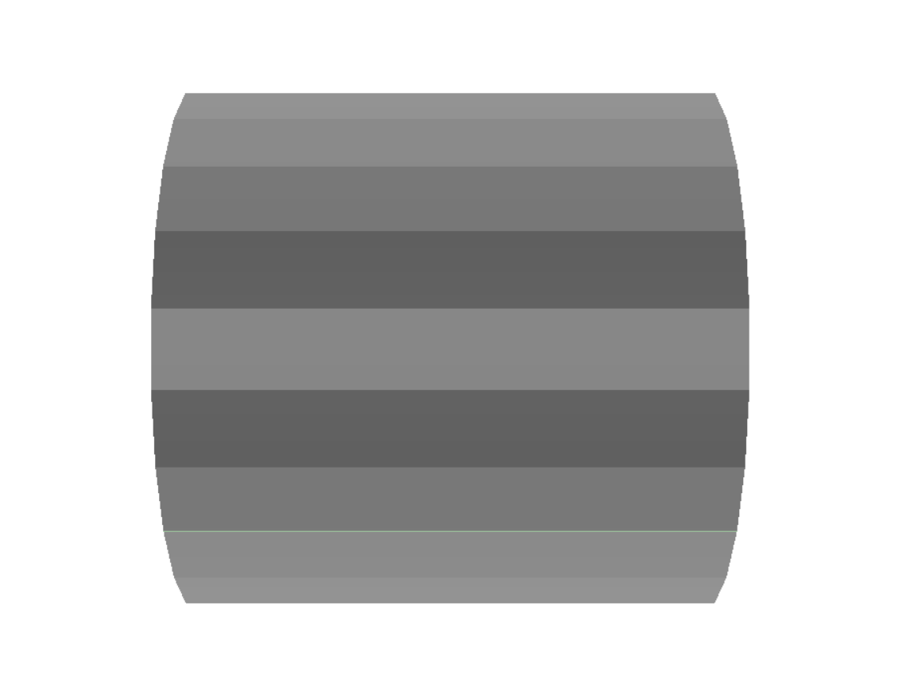
430 cm
185 cm

Slide 6
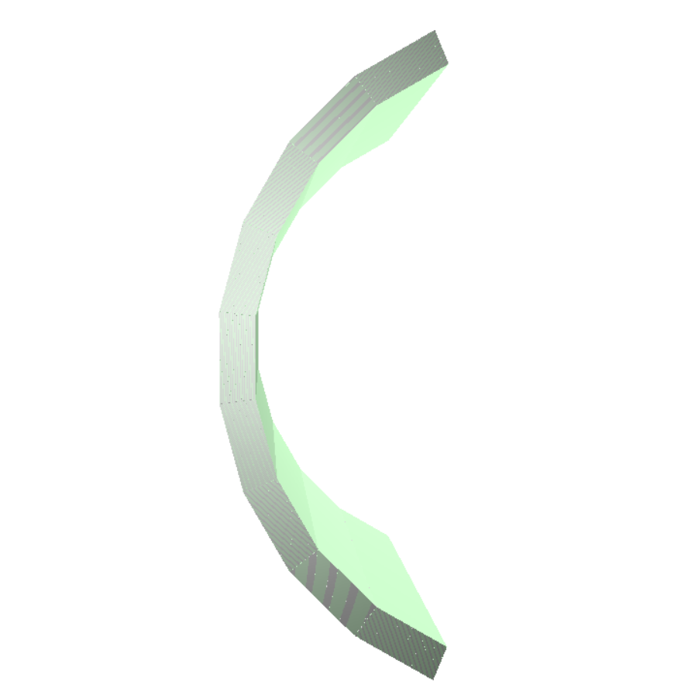
123.5 cm

Slide 7
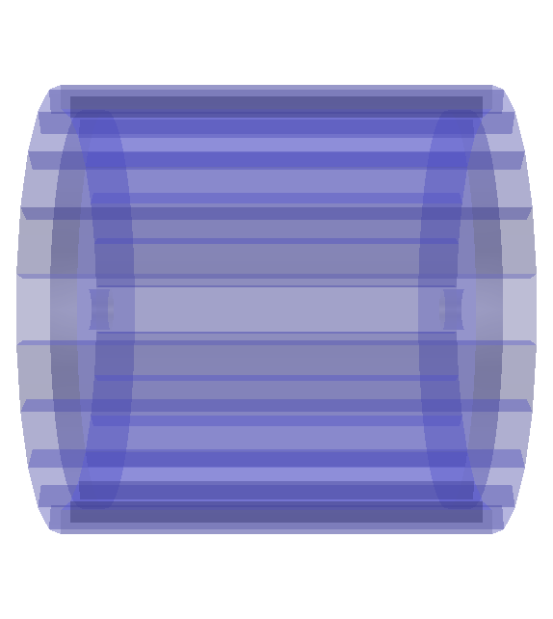
338 cm
430 cm
End-cap module
Barrel module

Slide 8


58.57 cm
52.51 cm
430 cm
23 cm

Slide 9
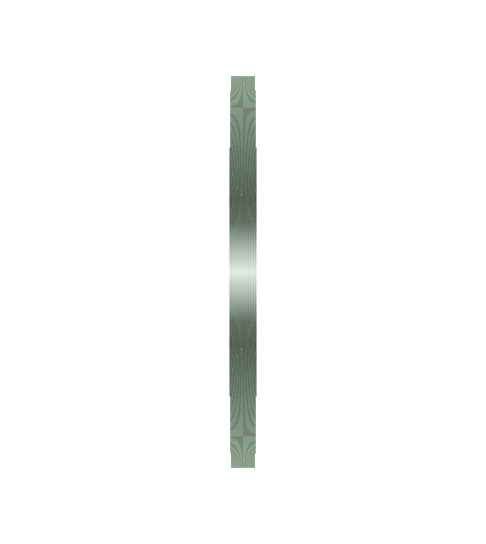
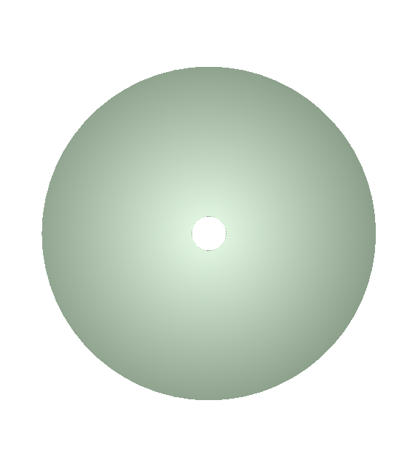
41.6 cm
23 cm
400 cm

Slide 10
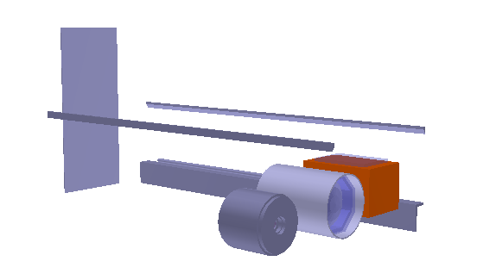
ArgonCube
HPgTPC
SAND

Slide 11
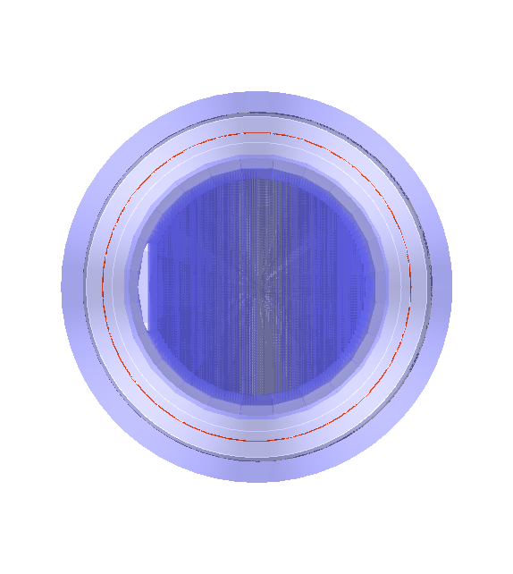
Iron Yoke
Super-conducting magnet
ECAL
LAr Meniscus
STT

