Slide 1
Boost.log
http://www.boost.org/doc/libs/1_55_0/libs/log/doc/html/index.html

Slide 2
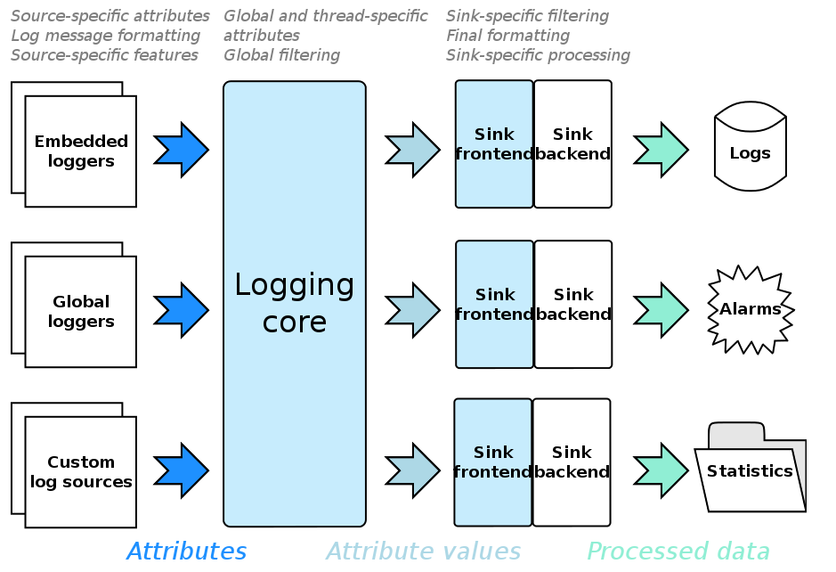
Notes:
The frontend (which is the synchronous_sink class template in the snippet above) is responsible for various common tasks for all sinks, such as thread synchronization model, filtering and, for text-based sinks, formatting. The backend (the text_ostream_backend class above) implements everything specific to the sink, such as writing to a file in this case.

Slide 3
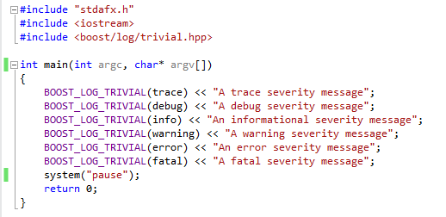
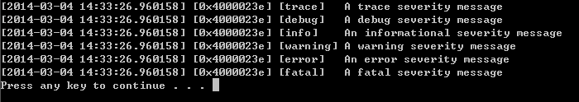
Trivial logging
BOOST_LOG_TRIVIAL
1.Default print message to console
2.multi-threads safe
3.Result contains a timestamp, the current thread identifier and severity level

Slide 4
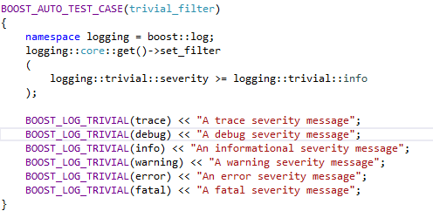

Trivial logging with filters
logging::core::get() returns a pointer to the core singleton.
set_filter() set the global filtering function.
severity keyword: type severity_level

Slide 5
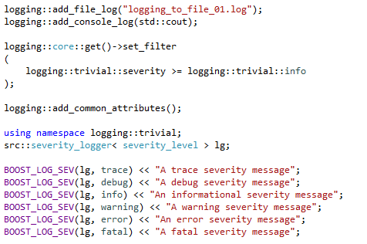
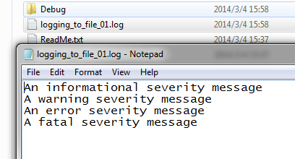
Setting up sinks
Add log to file:
BOOST_LOG_SEV
add_file_log()

Slide 6
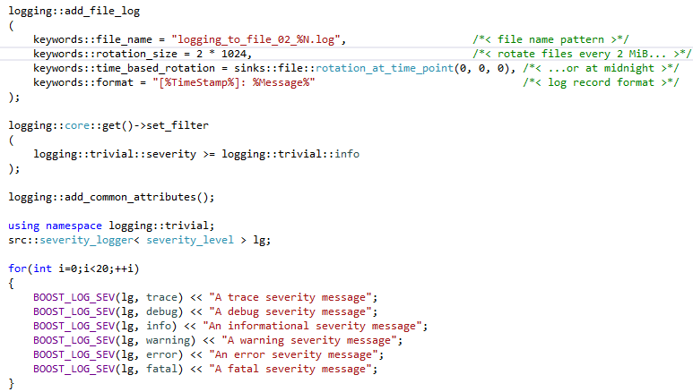
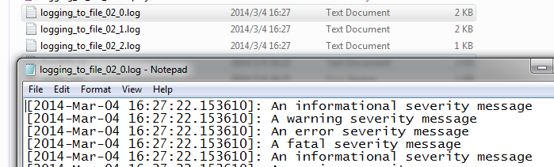
Setting up sinks
Notes:
file name pattern
rotate files every 2k...
...or at midnight
log record format

Slide 7
Creating loggers and writing logs
for dedicated logger objects:
create a logging source: src::logger lg;
sources need not be registered to log core
library provied two version logger:
thread-safe: have the _mt suffix in their name/involve locking and may slow things down
non-thread-safe: safe for different threads to write logs through different instancess
library provide default and copy-constructible and support swapping
can make a logger as a member of your class
Notes:
1.non-thread-safe: it is safe for different threads to write logs through different instances
2.thread-safe: counterparts can be accessed from different threads concurrently, but it involve locking and slow.
_mt suffix for thread-safe
3. open_record: record consumed by at least one sink.
Filtering is applied at this stage.

Slide 8
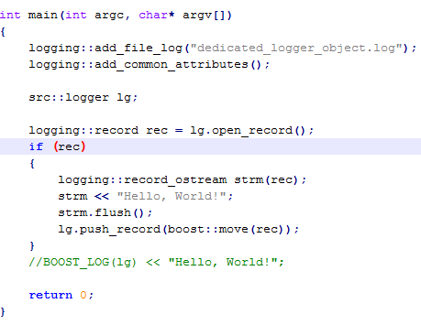
Creating loggers and writing logs
for dedicated logger objects:
Notes:
1.non-thread-safe: it is safe for different threads to write logs through different instances
2.thread-safe: counterparts can be accessed from different threads concurrently, but it involve locking and slow.
_mt suffix for thread-safe
3. open_record: record consumed by at least one sink.
Filtering is applied at this stage.

Slide 9
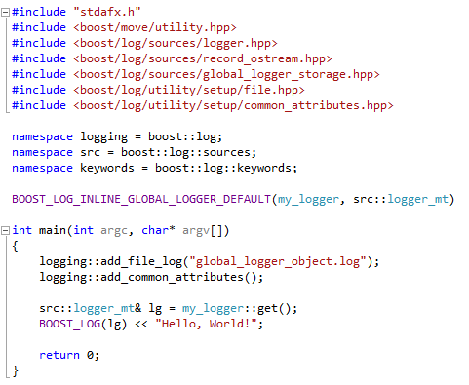
Creating loggers and writing logs
for global logger objects:
BOOST_LOG_INLINE_GLOBAL_LOGGER_DEFAULT(my_logger, src::logger_mt)
src::logger_mt& lg = my_logger::get();
cannot put a logger into your class
Notes:
src::logger_mt: use thread-safe loggers in a multithreaded application as global ones

Slide 10
Attributes
commonly use attributes
three scope: source-specific, thread-specific and global
can override global and thread-scoped attributes
logging::add_common_attributes();
"LineID", "TimeStamp", "ProcessID" ,"ThreadID" are registered globally
severity_logger auto registers a source-specific attribute "Severity"
Notes:
1.Attribute: position in the code, executable module name, current date and time, or any piece of data relevant to your particular application and execution environment,etc.
2.In single-threaded builds the "ThreadID" attribute is not registered.

Slide 11
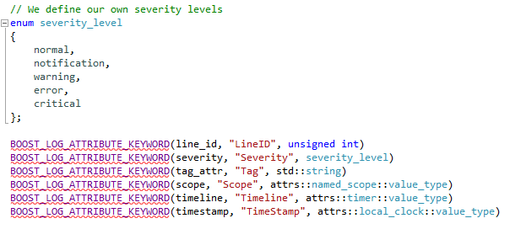
Attributes
more attributes
Defining attribute placeholders:
BOOST_LOG_ATTRBUTE_KEYWORD
Notes:
1. counter and local_clock components are attribute classes, they derive from the common attribute interface attribute.

Slide 12
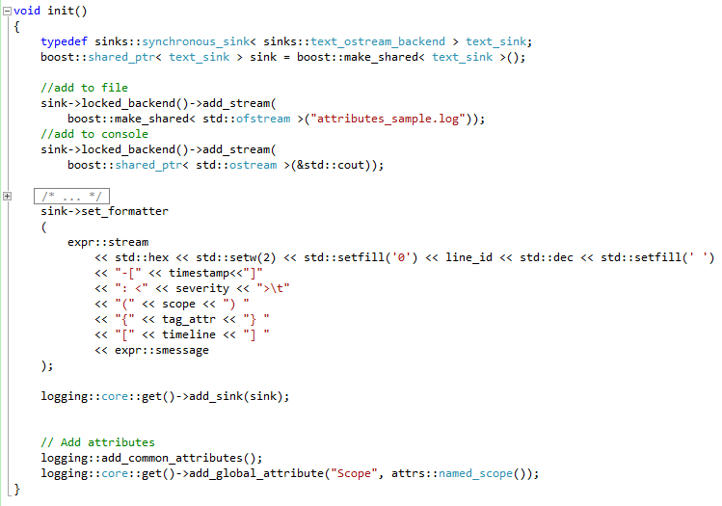
Attributes
Notes:
1. counter and local_clock components are attribute classes, they derive from the common attribute interface attribute.

Slide 13
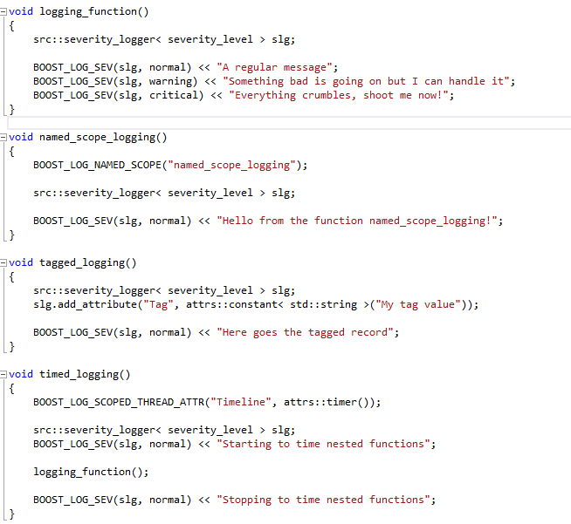
Attributes
Notes:
1. counter and local_clock components are attribute classes, they derive from the common attribute interface attribute.

Slide 14
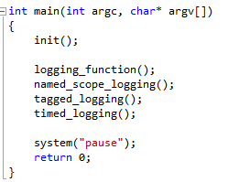
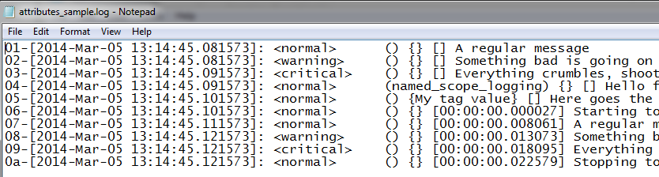
Attributes
Notes:
1. counter and local_clock components are attribute classes, they derive from the common attribute interface attribute.

Slide 15
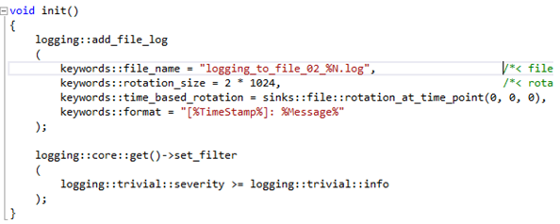
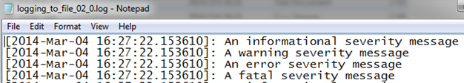
formatting
Even if you added attributes to the logging core or a logger, the attribute values will not reach the output unless you specify a formatter that will use these values.
add_file_log→keywords:format

Slide 16
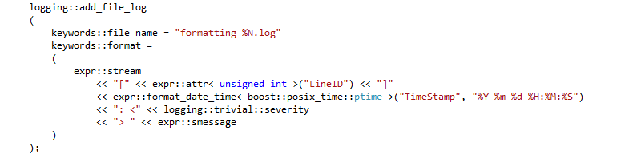

formatting
lambda-style expression
Lambda表达式是定义一个没有名称、也不需要显示类定义的函数对象用来将函数作为实参传递到另一个函数

Slide 17

formatting
Sink→set_format

Slide 18
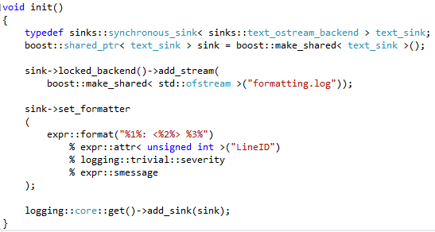
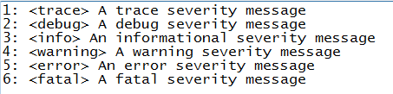
formatting
Format-style

Slide 19
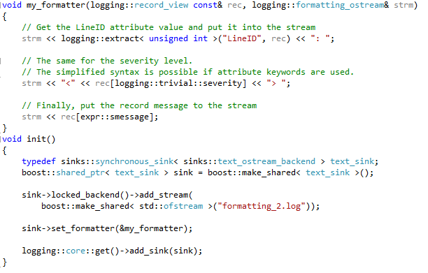

formatting
Custom formatting function
record_view is shallow copy. Formatters and sinks only operate on record views, not modify the origin recorde, so it can be still in use by other sinks in other threads.

Slide 20
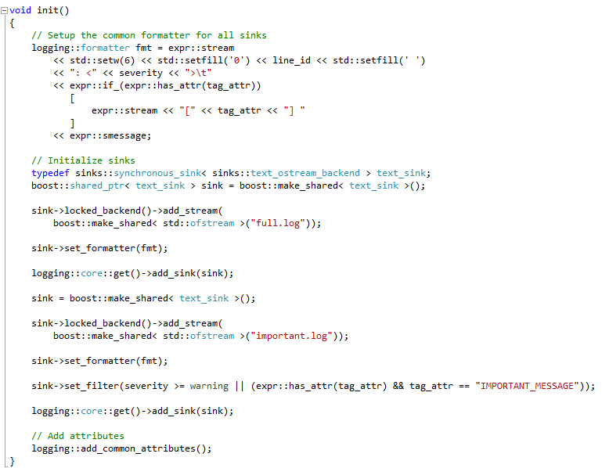
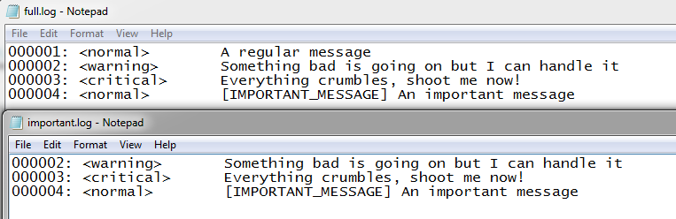
formatting
The formatter type is a type-erased function object with the formatter calling signature;

Slide 21

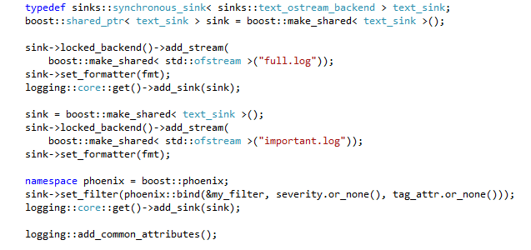
formatting
boost::phoenix: bind bind implementation with attribute placeholders compatible
attribute values wrapped into the value_ref template
or_none return an empty value_ref if the value is not found

Slide 22
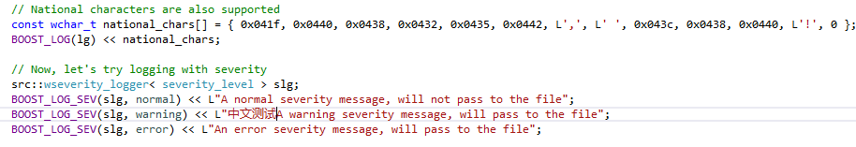
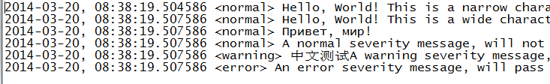
wide character logging
In this case the library can be used just the way it is used for plain ASCII logging, no additional setup is required.
forces the library to perform character code conversion when needed by the sink. To set up the library for this one has to imbue the sink with a locale with the appropriate codecvt facet. Boost.Locale can be used to generate such a locale.
Notes:
On Windows the common practice is to use wide strings to represent national characters. Also, most of the system API is wide character oriented, which requires Windows-specific sinks to also support wide strings. On the other hand, generic sinks, like the text file sink, are byte-oriented (because, well, you store bytes in files, not characters). This forces the library to perform character code conversion when needed by the sink. To set up the library for this one has to imbue the sink with a locale with the appropriate codecvt facet. Boost.Locale can be used to generate such a locale.

Slide 23
sink frontends
Every sink frontend receives log records from the logging core and then passes them along to the associated sink backend. The frontend does not define how to process records but rather in what way the core should interact with the backend

Slide 24
sink frontends
Basic sink frontend services
Filtering:
all sink frontends support filtering
set_filter/reset_filter/will_consume
is safe to call filters from multiple threads concurrently
Formatting:
For text-based sink backends: set_formatter/reset_formatter(lambda expressions)
Exception handling
set_exception_handler
An exception handler is not allowed to return a value.
is safe to call exception handlers from multiple threads concurrently.

Slide 25
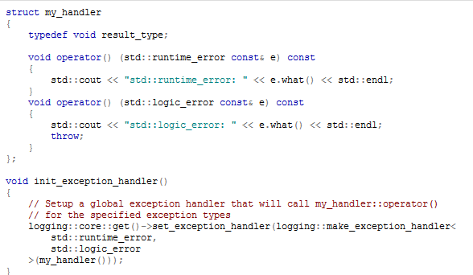
sink frontends
Notes:
to

Slide 26
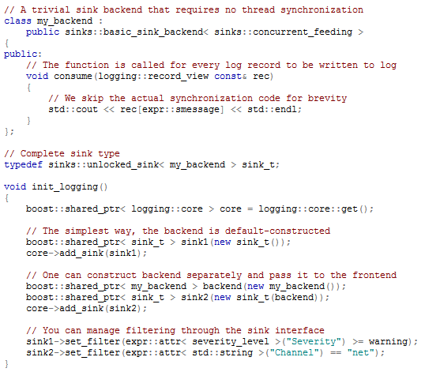
sink frontends
Unlocked sink frontend
not perform thread synchronization and simply passes logging records to the sink backend

Slide 27
sink frontends
Synchronous sink frontend
provides thread synchronization with a mutex
can acquire a pointer to the locked backend. As long as the pointer exists, the backend is guaranteed not to be accessed from other threads, unless the access is done through another frontend or a direct reference to the backend.

Slide 28
sink frontends
Asynchronous sink frontend
Like the synchronous one, asynchronous sink frontend provides a way of synchronizing access to the backend.
All log records are passed to the backend in a dedicated thread, which makes it suitable for backends that may block for a considerable amount of time

Slide 29
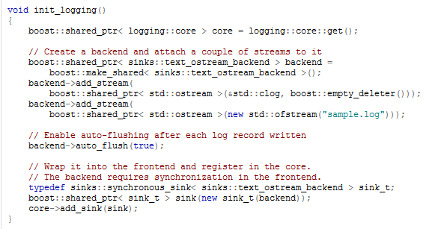
sink backends
Text stream backend
formatting log records into strings and putting into one or several streams
if need to format log records differently for different streams, should several sinks - each with its own formatter
Auto_flush

Slide 30
sink backends
Text file backend
Log file rotation based on file size and/or time
Flexible log file naming
Placing the rotated files into a special location in the file system
Deleting the oldest files in order to free more space on the file system
Also supports the auto-flush feature

Slide 31
sink backends
Text file backend
File rotation:The file size at rotation can be imprecise

Slide 32
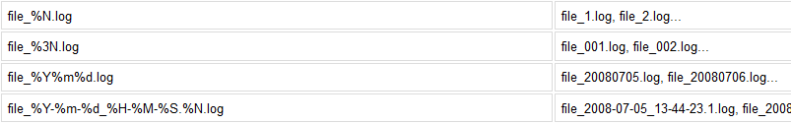
sink backends
Text file backend
Every day: sinks::file::rotation_at_time_point(12, 0, 0)
Every week : sinks::file::rotation_at_time_point(date_time::Tuesday, 0, 0, 0)/
sinks::file::rotation_at_time_point(date_time::Tuesday)
Every month: sinks::file::rotation_at_time_point(gregorian::greg_day(1), 0, 0, 0)
Every hour: sinks::file::rotation_at_time_interval(posix_time::hours(1))
one can specify his own predicate for time-based rotation: take no arguments and return bool

Slide 33
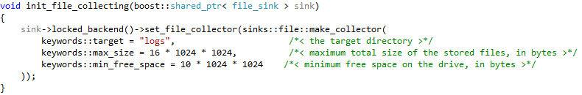
sink backends
Text file backend
the rotated files can be collected
collector not resolve log file name clashes between different sink backends

Slide 34
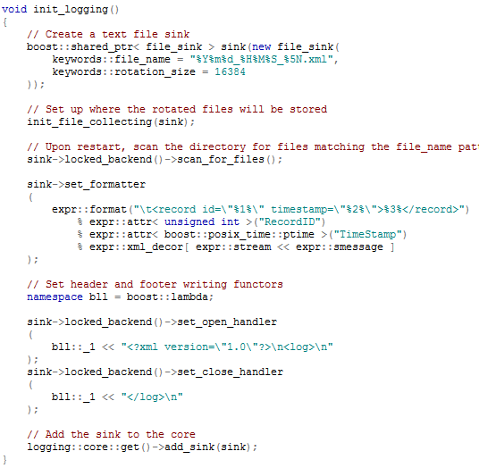
sink backends
Text file backend
scan_for_files:
scan the files matching the file_name pattern:
backend->scan_for_files();
scan all files in the target directory:
backend->scan_for_files(sinks::file::scan_all);

Slide 35
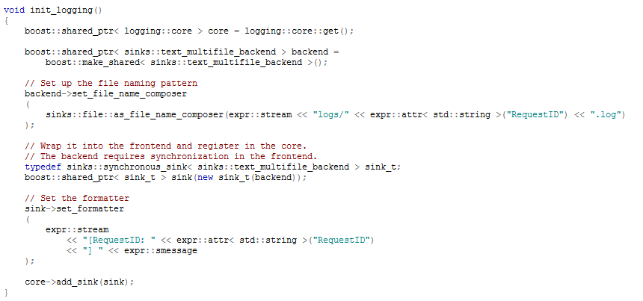
sink backends
Text multi-file backend
impossible to implement file rotation and removing unused files to free space. The user will have to implement such functionality himself.

