Slide 1
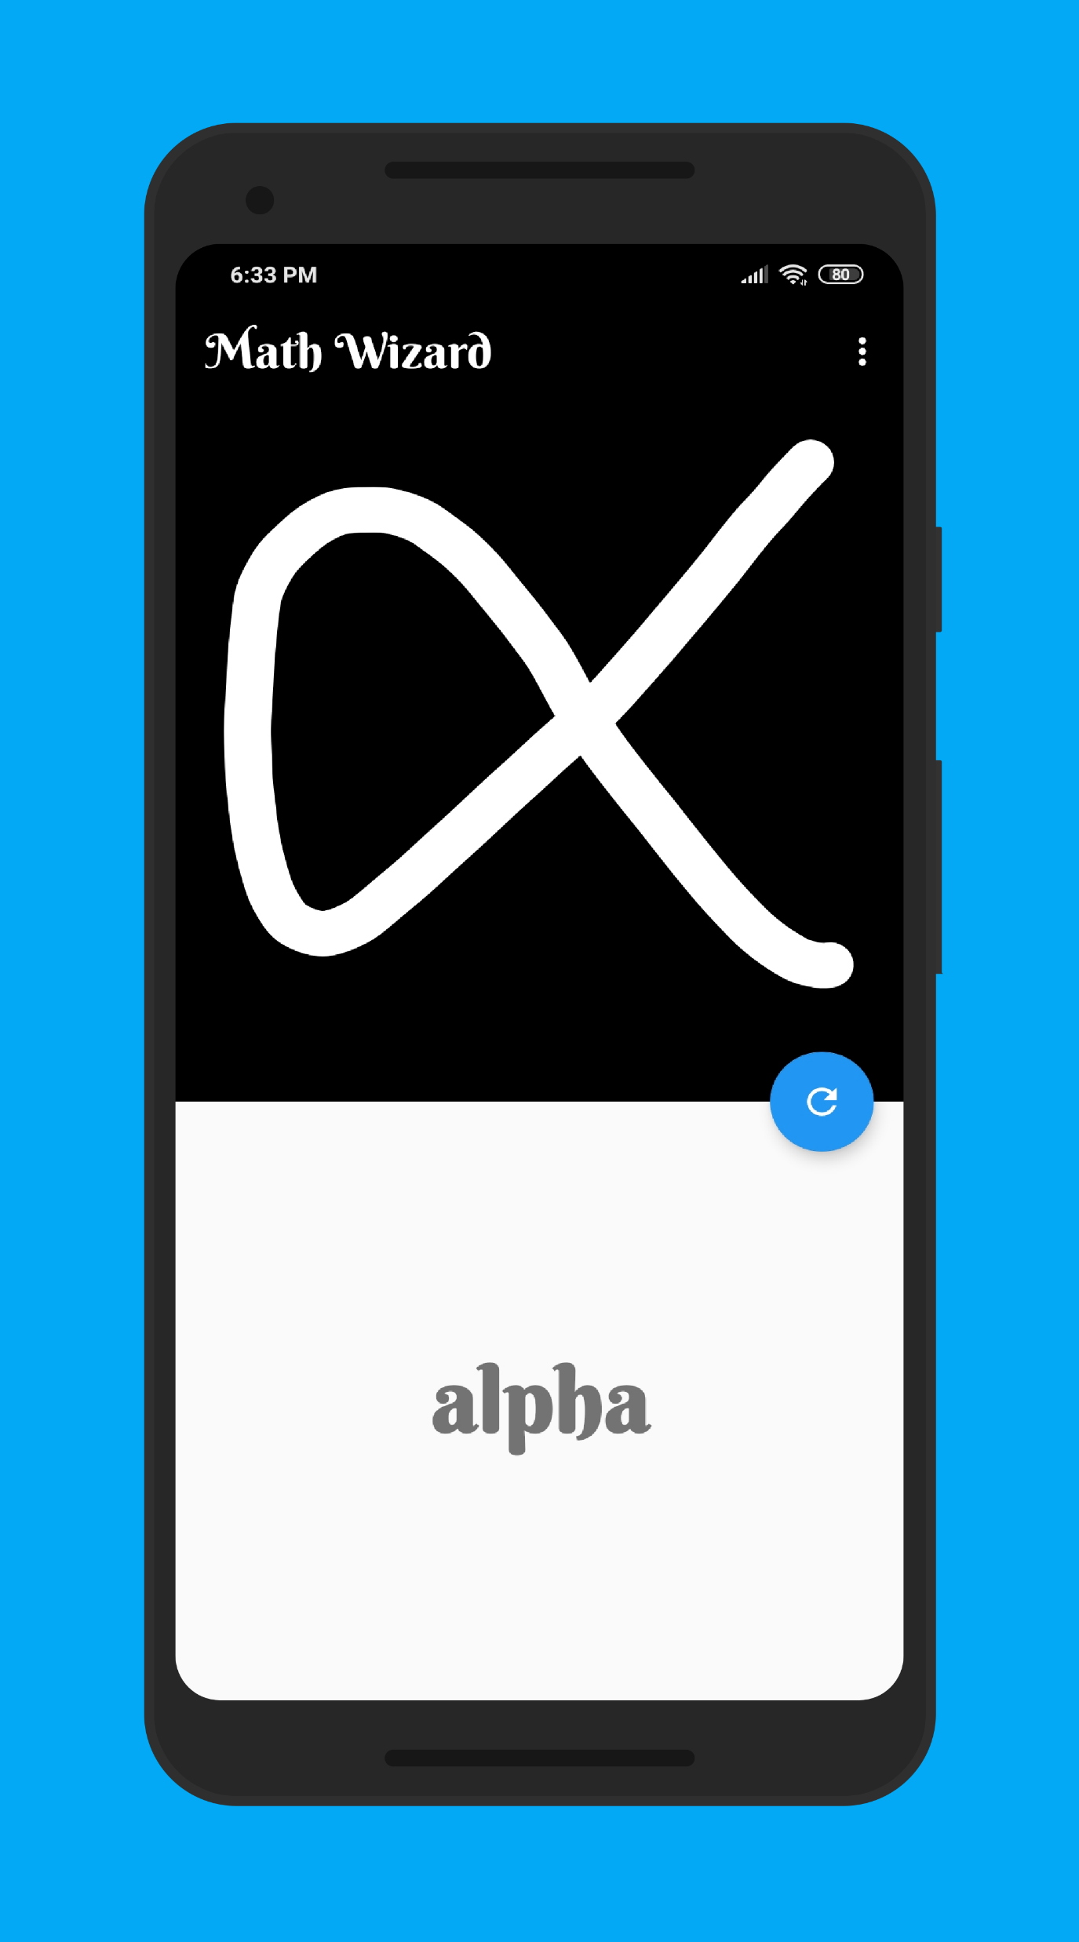

Math Wizard
Math Symbol Classifier using
On Device Machine Learning

