Slide 1

Microcontrollers
Workshop
With Arduino Nano
USU IEEE Student Branch
SPACK 2026
2/21/2026
For absolute beginners to learn the basics of Arduino and circuits,
Through a hands on workshop making a few simple projects.
Code and resources found in this github:
TrentChip38/ArduinoActivities

Slide 2
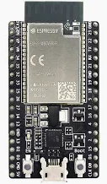
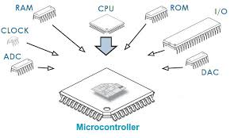
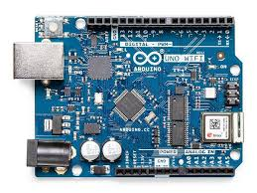
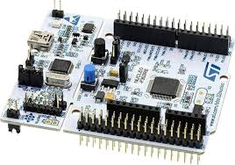
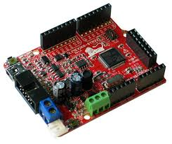
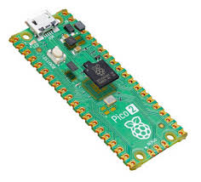
What is a Microcontroller?
Programmable device
Can read input pins, send on output pins, and communicate with sensors or control motors

Slide 3
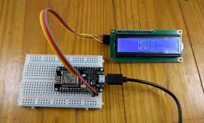
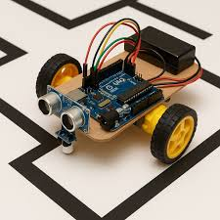
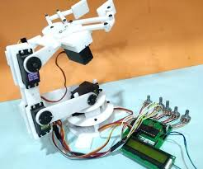
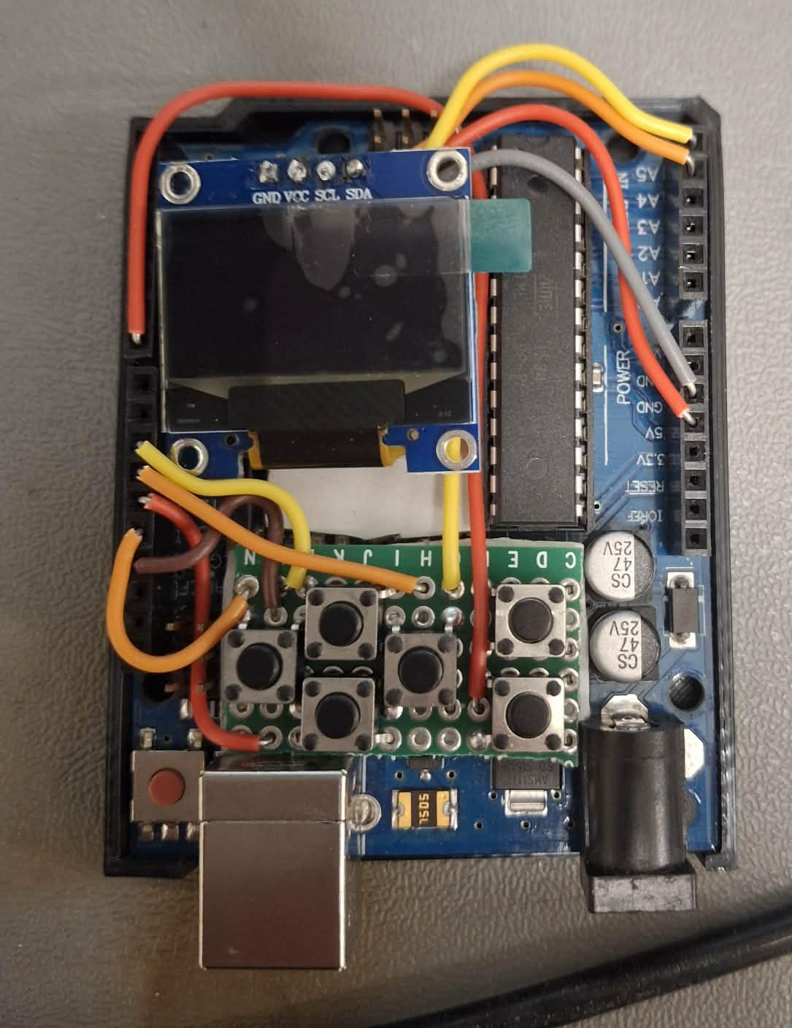
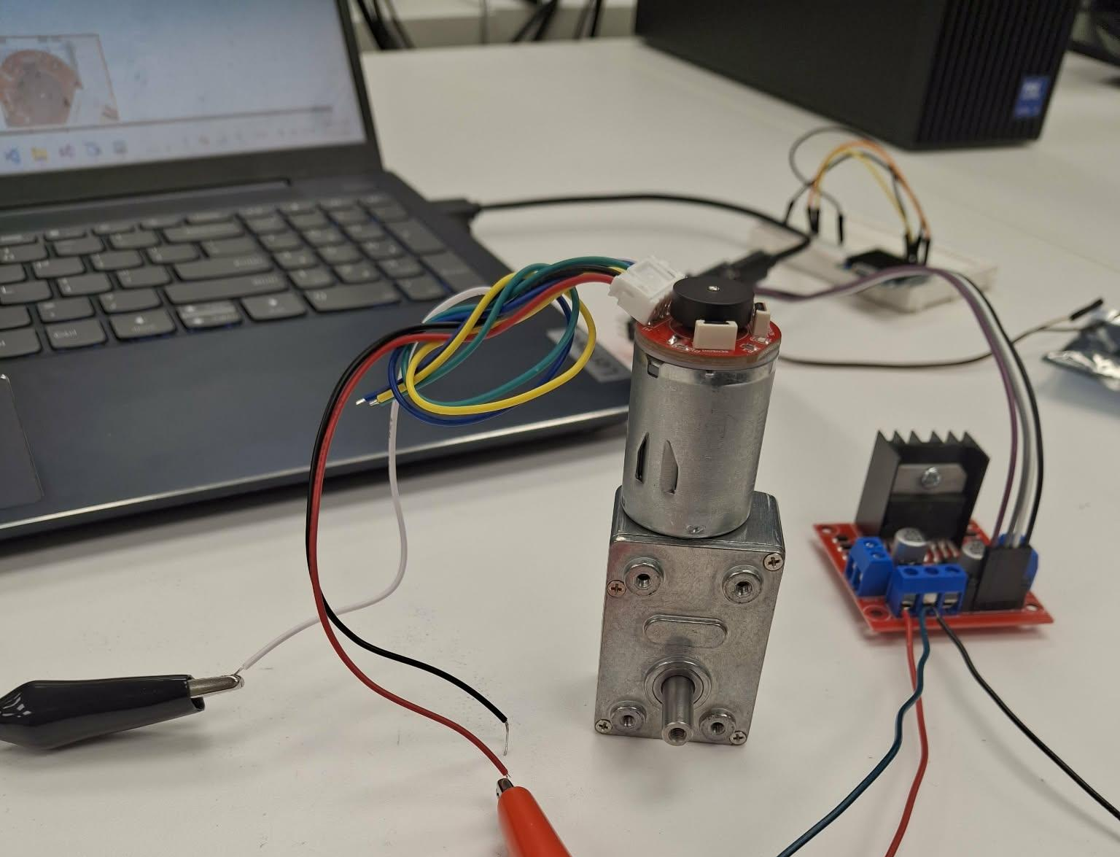
What they can do
Robotics, electronics, LCDs, motor controllers, sensors, and much more.

Slide 4
What we will do
Test upload
Output to LED
Read a button
Buzzer
Keyboard
Memory Game

Slide 5
Log into the computer
Download Arduino IDE 2
Hit windows
Search for “Arduino IDE 2”
Download
Open and start a new sketch
Save as
Plug in a board
Set the com port and type
Type is “Arduino Nano”

Slide 6
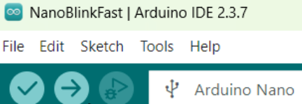
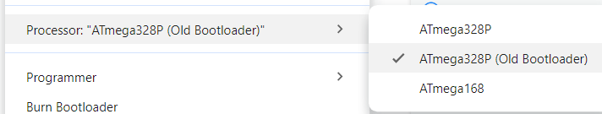
Test Upload: Blink
//Global variable to use
const int mDelay = 200;
//Setup runs once
void setup() {
//Initialize output pin
pinMode(LED_BUILTIN, OUTPUT);
}
//Loop runs over and over
void loop() {
//Turn the LED on (HIGH voltage)
digitalWrite(LED_BUILTIN, HIGH);
delay(mDelay); //Wait for 200 milis
//Turn the LED off with voltage LOW
digitalWrite(LED_BUILTIN, LOW);
delay(mDelay); //Wait for 200 milis
}
Compile & Upload
Select board
Most likely need to change to the old bootloader: Tools->Processor->Atmega328(Old Bootloader)
Notes:
Explain an Arduino sketch and have everyone test that they can upload a simple sketch to the board.

Slide 7
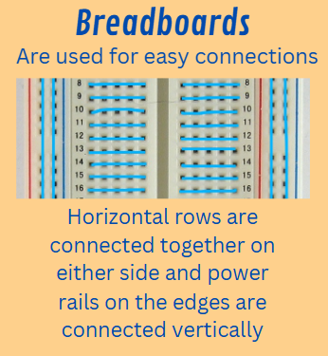
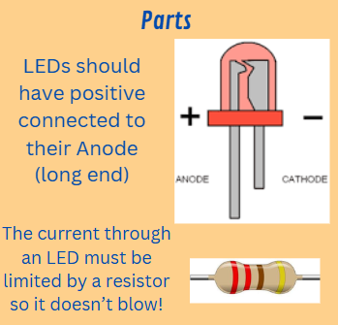

Slide 8
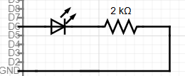
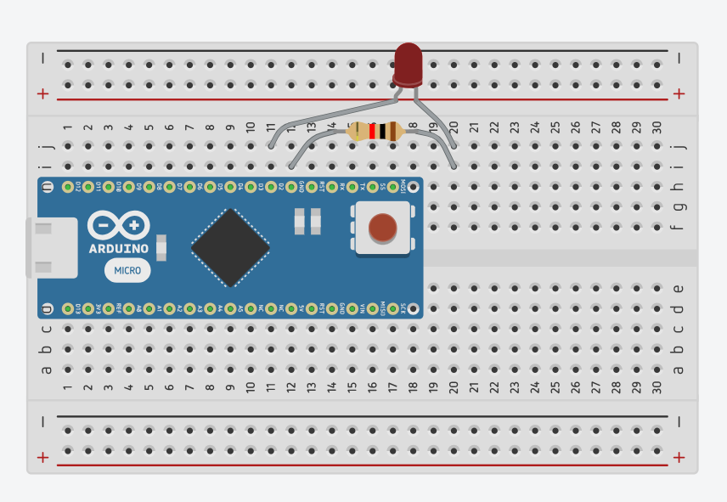
LED Output
const int mDelay = 500;
const int ledPin = 2;
//Setup function runs once
void setup() {
//Initialize output pin
pinMode(ledPin, OUTPUT);
}
//Loop function runs over and over after setup
void loop() {
//Turn the LED on (HIGH voltage)
digitalWrite(ledPin, HIGH);
//Wait for set delay time
delay(mDelay);
//Turn the LED off with voltage LOW
digitalWrite(ledPin, LOW);
//Wait for set delay time
delay(mDelay);
}

Slide 9
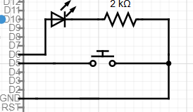
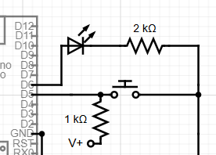
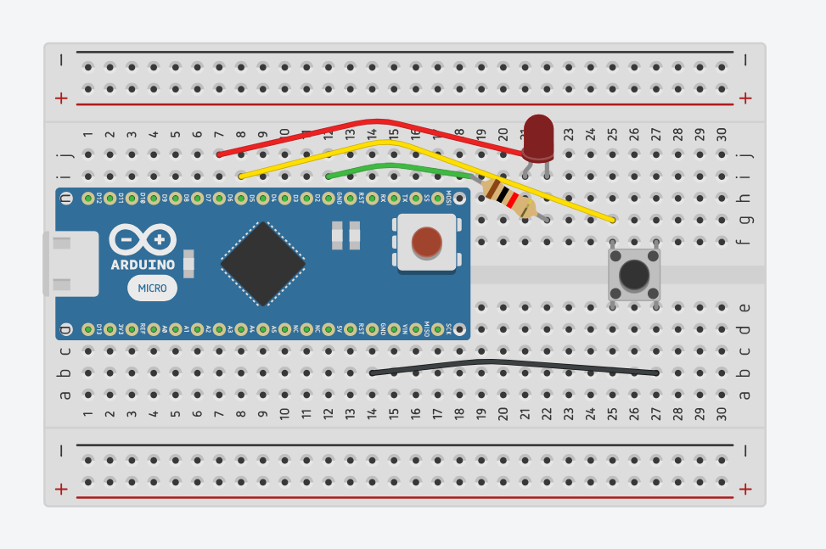
Button Input
//Definitions are similar to variables
#define LEDPin 6
#define btnPin 5
void setup() {
//Initialize output pin
pinMode(LEDPin, OUTPUT);
pinMode(btnPin, INPUT_PULLUP);
}
//Track on/off, start off
int LEDState = HIGH;
void loop() {
delay(200);//Check button every fith sec
int buttonState = digitalRead(btnPin);
//Statement executes if condition is true
if (buttonState == LOW){
//Switch LEDState from HIGH to LOW and vv
LEDState = ~LEDState;
digitalWrite(LEDPin, LEDState);
}
}
Notes:
I think I will skip this slide/project and the next one will teach buttons

Slide 10
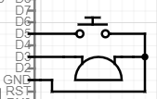
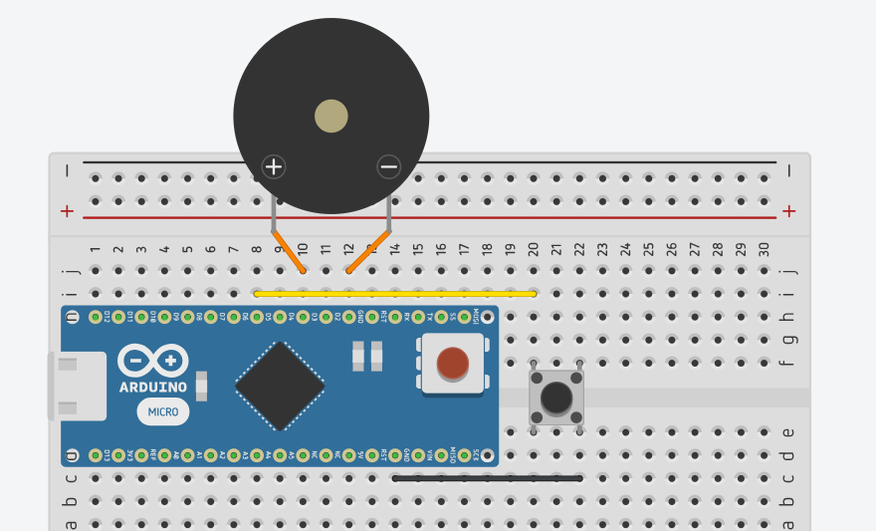
Button & Buzzer
//Pin definitions
#define btnPin 5
#define buzzerPin 3
//Setup function runs once
void setup() {
//Initialize pins
pinMode(buzzerPin, OUTPUT);
pinMode(btnPin, INPUT_PULLUP);
}
//Loop function runs over and over
void loop() {
delay(10);
if (digitalRead(btnPin) == LOW){
//Make tone at 440Hz, when pressed
tone(buzzerPin, 440, 20);
}
}

Slide 11
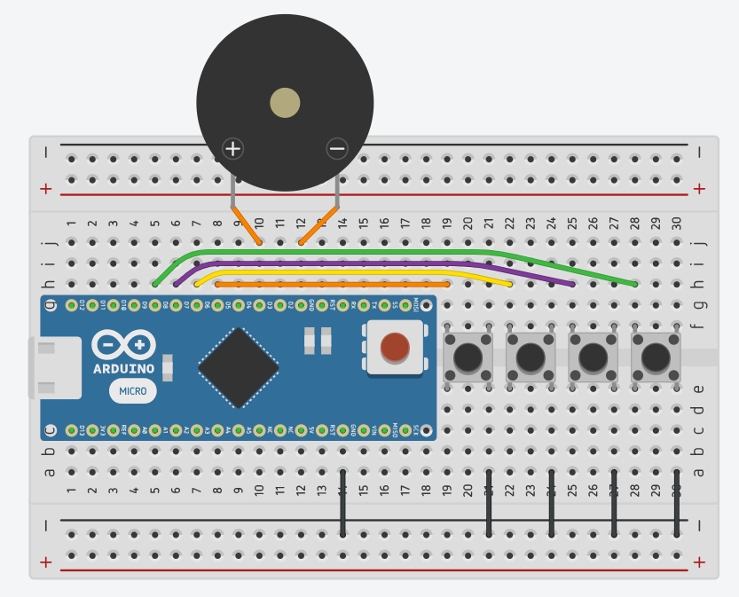
Keyboard
#include "pitches.h"
// Notes to play from the "pitches" library
int notes[] = { NOTE_C4, NOTE_D4, NOTE_E4, NOTE_F4 };
const int buttonPins[] = { 5, 6, 7, 8 };
const int buttonCount = 4;
const int speakerPin = 3;
void setup() {
//Using a for loop to set all the pins
for (int i = 0; i < buttonCount; i++) {
pinMode(buttonPins[i], INPUT_PULLUP);
}
}
void loop() {
bool buttonPressed = false;
for (int i = 0; i < buttonCount; i++) {
if (digitalRead(buttonPins[i]) == LOW) {
tone(speakerPin, notes[i]);
buttonPressed = true;
break; // Only play one tone at a time
}
}
if (!buttonPressed) {
noTone(speakerPin);
}
}
Notes:
Could skip this one too if need more time

Slide 12
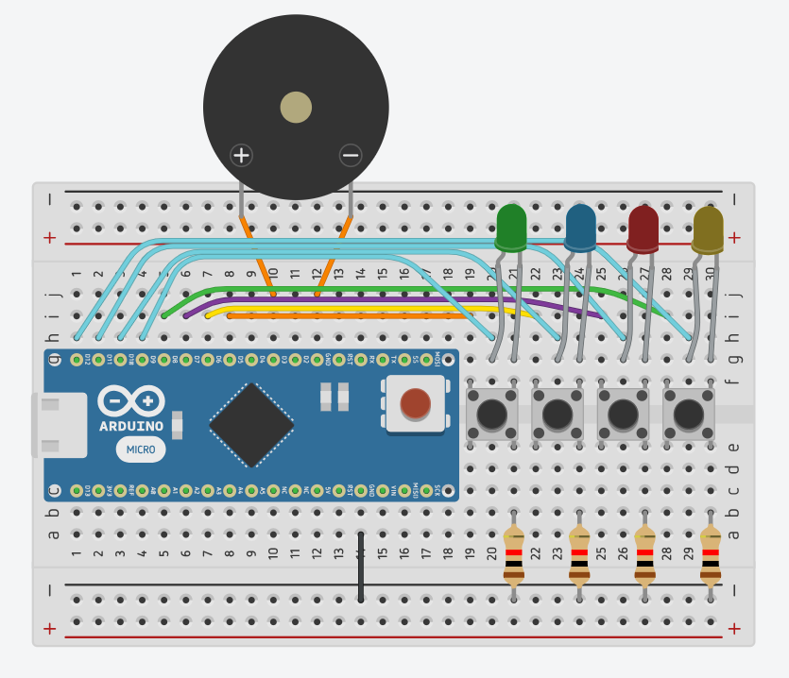
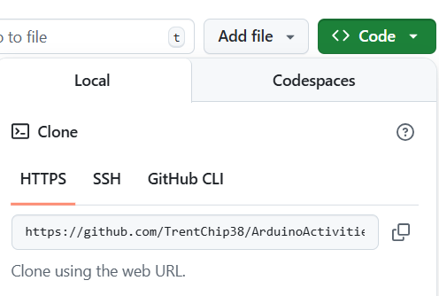
Memory Game
Go to this github:
https://github.com/TrentChip38/ArduinoActivities
And download the zip folder or “git clone” the repo
Then open the final project folder to use the code
Notes:
Building this will take at least 10-15 minutes. They need to get the repo and put together the whole circuit.
Help them find the github and download or show how to “git clone”.
Then let them build the circuit.
Show an actual picture of the circuit.
Put in the buzzer and buttons first.
Buzzer positive to D3 and ground to GND
Buttons across the bridge however you can fit them.
Use the bottom ground rail for negative to the buttons.
Then plug in 8 pins from D12-D5. Half are LEDs and other half are buttons.
Thats it!

Slide 13
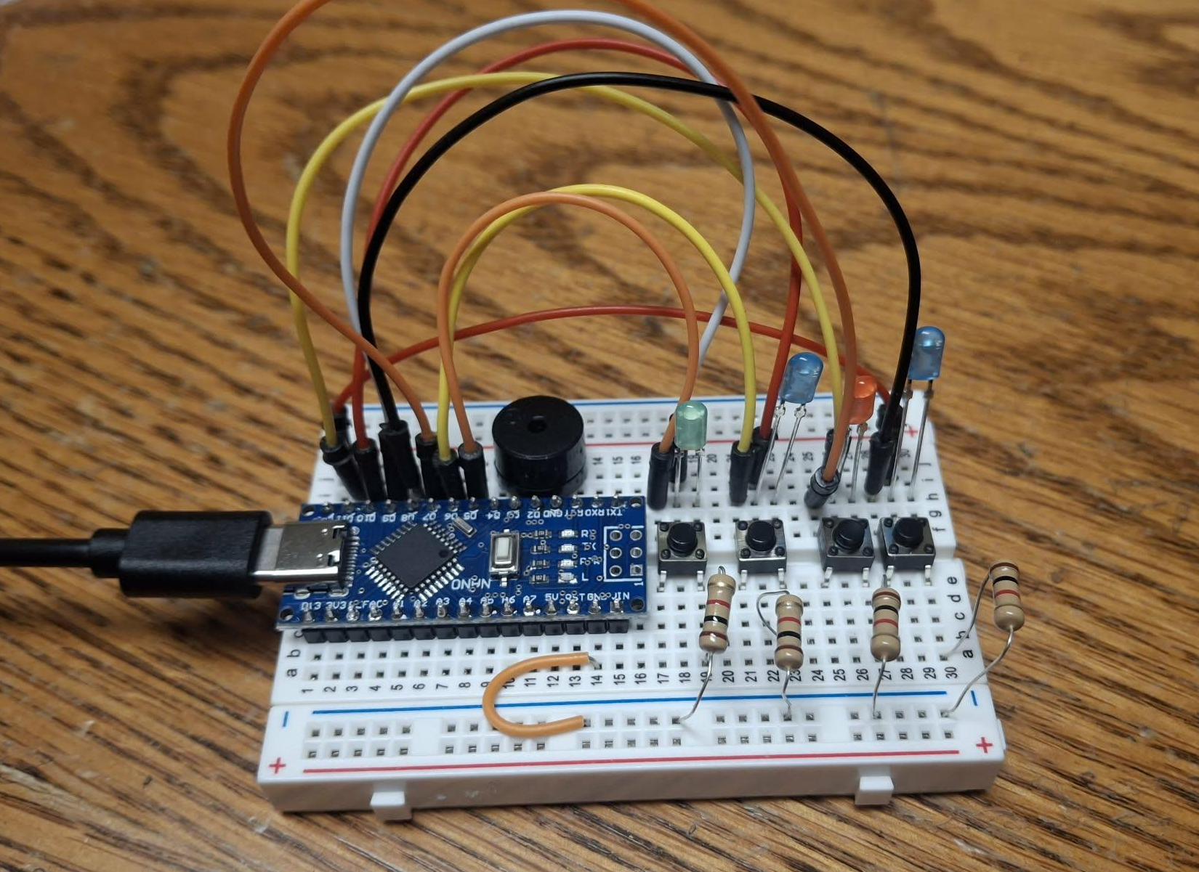
Memory Game
Put in the buzzer and buttons first.
Buzzer positive to D3 and ground to GND
Buttons across the bridge however you can fit them.
Use the bottom ground rail for negative to the buttons.
Then plug in 8 pins from D12-D5. Half are LEDs and other half are buttons.
LED above each button with the long positive end connected in between the button legs and gnd to the button ground
Program it and press the right button
Notes:
Building this will take at least 10-15 minutes. They need to get the repo and put together the whole circuit.
Help them find the github and download or show how to “git clone”.
Then let them build the circuit.
Show an actual picture of the circuit.
Put in the buzzer and buttons first.
Buzzer positive to D3 and ground to GND
Buttons across the bridge however you can fit them.
Use the bottom ground rail for negative to the buttons.
Then plug in 8 pins from D12-D5. Half are LEDs and other half are buttons.
Thats it!

Slide 14
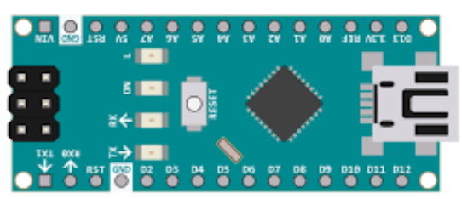
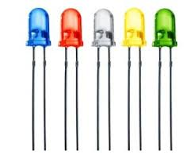
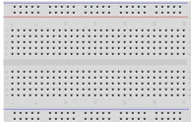
Parts we are using
Buzzer
Arduino Nano
Microcontroller
LEDs
1k ohm resistors
8+ cables
Half-size Breadboard
Buttons

