Slide 1

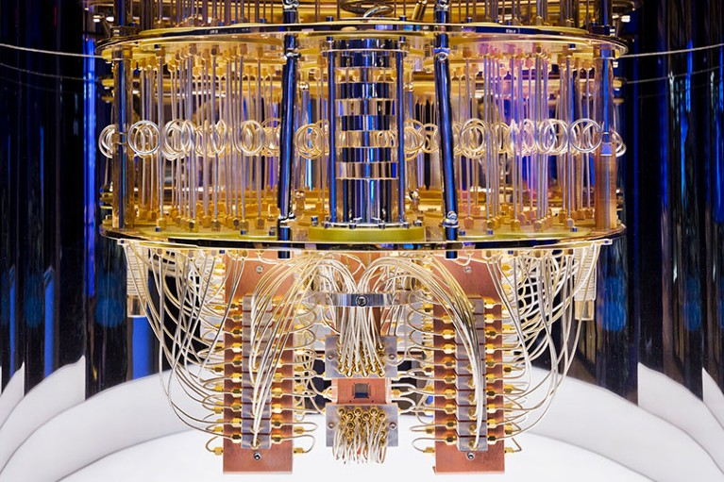
The Quantum Threat to Bitcoin
bitcoinbushbash.info
Notes:
30 min including questions. Bitcoin beginner-advanced, QC none-intermediate.
Frame as a migration race, not overnight collapse.

Slide 2
Is Bitcoin fucked?
No
*
bitcoinbushbash.info
Notes:
30 min including questions. Bitcoin beginner-advanced, QC none-intermediate.
Frame as a migration race, not overnight collapse.

Slide 3
What’s the threat → How we fix it → What you can do
bitcoinbushbash.info
Notes:
30 min including questions. Bitcoin beginner-advanced, QC none-intermediate.
Frame as a migration race, not overnight collapse.

Slide 4
Talk map
1. What is quantum computing
2. The QC threat to Bitcoin
3. Revision: sigs, hashes, mempool
4. When is it coming
5. Two big problems: tech & social
6. BIP360 as the first step
7. Legacy coins dilemma
8. What you can do
9. Myth-busters & perspective
bitcoinbushbash.info
Notes:
Anchor slide. BIP-360 gets 5 dedicated slides.

Slide 5
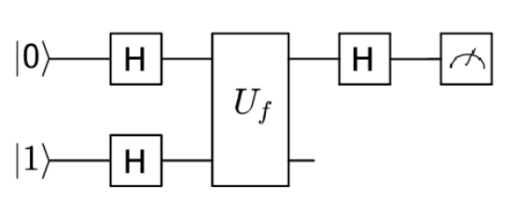
What is quantum computing?
Quantum mechanical phenomena
How they work
Superposition: many states at once
Entanglement: correlated states
Interference: amplify right answers
Qubit: 0 and 1 at the same time
Circuit: superposition & entanglement gates
Measure: interference amplifies right answer
Fault tolerance
Qubits are fragile and can’t be copied
Physical qubits vs Logical qubits
CRQC requires ~2300 logical qubits
bitcoinbushbash.info
Notes:
Superposition: A qubit can be 0 and 1 at the same time. With n qubits, 2ⁿ states are explored in parallel.
Entanglement: Qubits can be linked so that the state of one instantly reflects the state of another. This enables coordinated computation across qubits.
Interference: Correct answers are amplified (constructive interference) and wrong answers cancel out (destructive interference). It's how you get a useful result out of all those parallel possibilities.
This is Deutsch's algorithm — the simplest quantum algorithm that demonstrates quantum speedup over classical computation.
H gate (Hadamard): h qubits are put into superposition. Now both are exploring 0 and 1 simultaneously.
Uꜰ (Oracle): A black-box function that encodes some unknown function f(x). It acts on both qubits together — this is where entanglement and interference happen.
H gate on top qubit: Transforms the result so the answer can be read out.
Measurement (meter symbol): Measure the top qubit only.
CRQC = Cryptographically Relevant Quantum Computer.
[Quantum resource estimates for computing elliptic curve discrete logarithms](https://arxiv.org/abs/1706.06752)

Slide 6
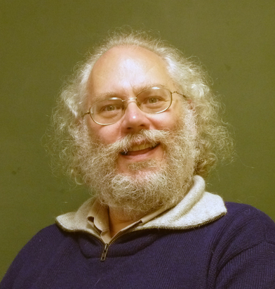
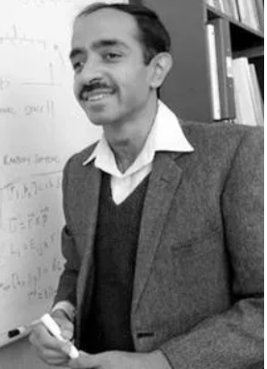
The QC threat to Bitcoin
Shor's algorithm (signatures)
Grover's algorithm (hashing)
Breaks ECC and RSA
Derives private key from public key
Exponential speedup
Targets SHA-256 / RIPEMD-160
Quadratic speedup only
256-bit -> ~128-bit effective
Quantum mining favors centralisation
bitcoinbushbash.info
Notes:
Shor: exponential advantage, breaks DLP. The real worry.
Grover: quadratic only. Not a collapse event, a cost-curve shift.

Slide 7
Long exposure
Short exposure
Two types of QC attack
bitcoinbushbash.info
Notes:
30 min including questions. Bitcoin beginner-advanced, QC none-intermediate.
Frame as a migration race, not overnight collapse.

Slide 8
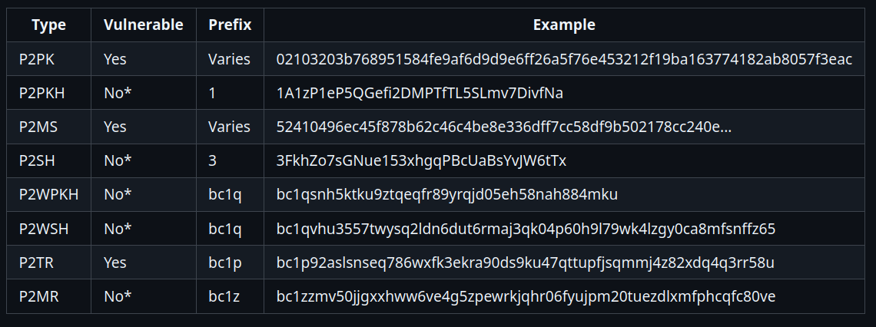
Long exposure attack vulnerability
bitcoinbushbash.info
Notes:
30 min including questions. Bitcoin beginner-advanced, QC none-intermediate.
Frame as a migration race, not overnight collapse.

Slide 9
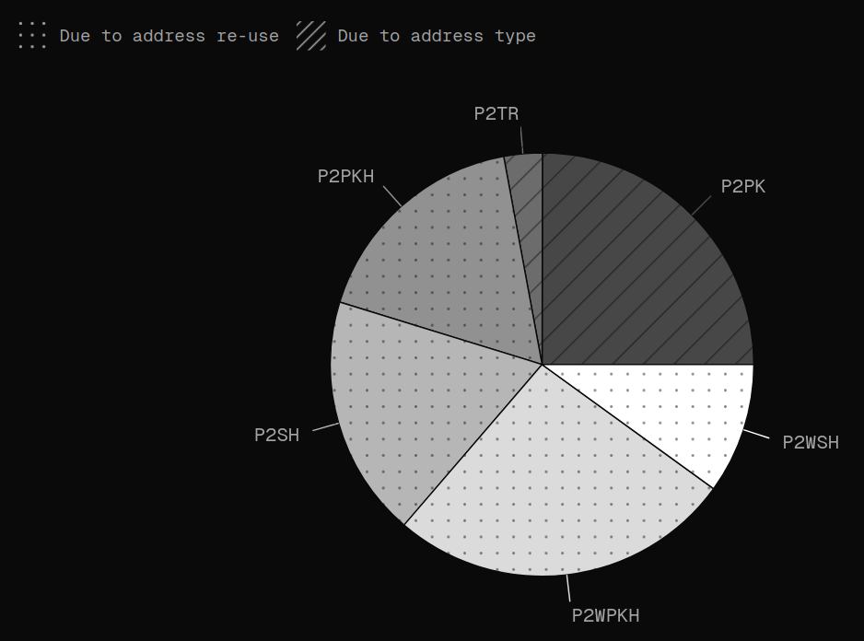
6,874,398 BTC
Long exposure attack vulnerability
bitcoinbushbash.info
Notes:
30 min including questions. Bitcoin beginner-advanced, QC none-intermediate.
Frame as a migration race, not overnight collapse.

Slide 10
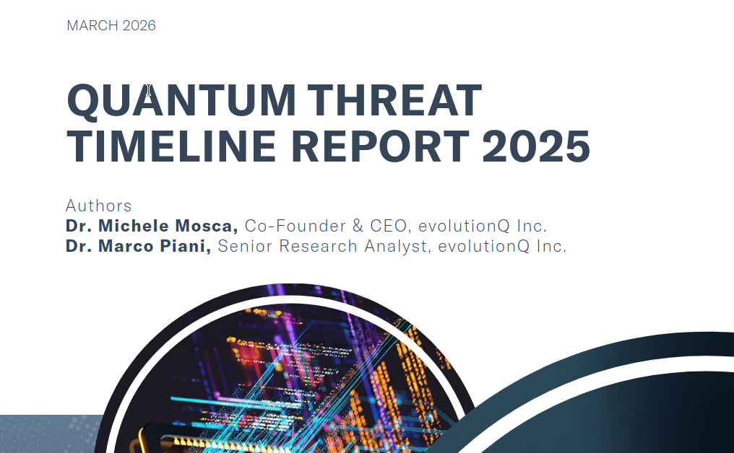
When is it coming?
bitcoinbushbash.info
Notes:
30 min including questions. Bitcoin beginner-advanced, QC none-intermediate.
Frame as a migration race, not overnight collapse.

Slide 11
When is it coming?
GRI Quantum Threat Timeline Report 2025 — 26 experts surveyed
~15%
~49%
~28%
Optimistic avg within 5 years
Optimistic avg within 10 years
Pessimistic avg within 10 years
Also look at Bitcoin Fundamentals 11 Nov 25 podcast with Charles Edwards
bitcoinbushbash.info
Notes:
Values from GRI 2024 key points. Weighted averages of 32 expert responses.

Slide 12
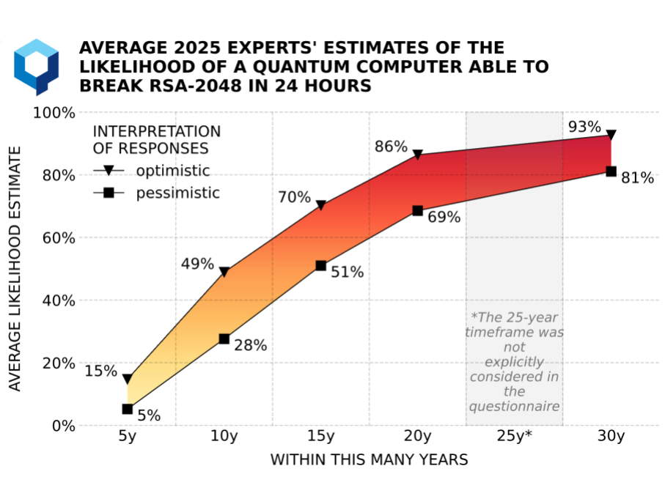
When is it coming?
bitcoinbushbash.info
Notes:
30 min including questions. Bitcoin beginner-advanced, QC none-intermediate.
Frame as a migration race, not overnight collapse.

Slide 13
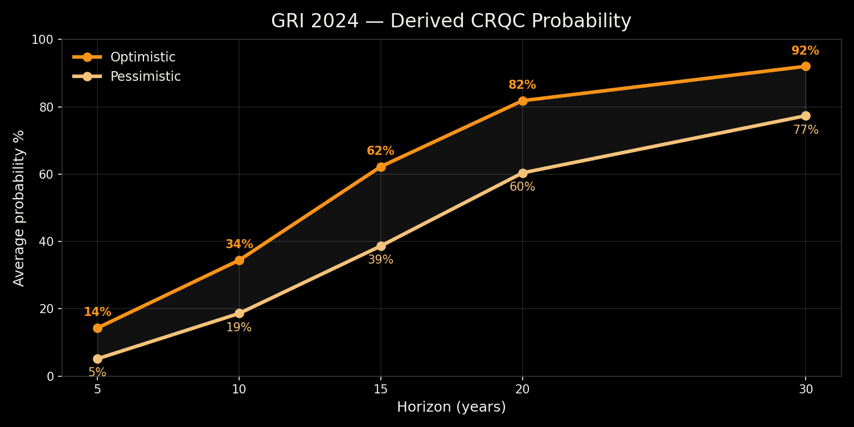
When is it coming?
Optimistic vs pessimistic probability assignments
bitcoinbushbash.info
Notes:
Derived from Appendix A.4 raw counts * probability bin assignments.
Key: ~34% optimistic at 10 yr, ~62% at 15 yr. The window is tightening.

Slide 14
Government policy timelines
2030
2033
2035
CNSA 2.0 PQC mandate begins
CNSA 2.0 full browser/OS PQC
NIST IR 8547 disallow ECC
Bitcoin doesn't answer to regulators — but enterprise/institutional users will demand PQC.
bitcoinbushbash.info
Notes:
CNSA 2.0: Commercial National Security Algorithm Suite.
NIST IR 8547 disallows ECC in US federal gov after 2035.
These drive enterprise Bitcoin infrastructure timelines.

Slide 15
Bitcoin Revision
Public key cryptography: ECC, signature algorithms
Hashing: mining, address compression, check sums, key derivation, Merkle trees
Public key hidden by hash until first spend (P2PKH/P2SH/P2WSH)
Public key exposed on receive (P2PK, P2TR key-path)
Mempool window: tx waits ~10 min before confirmation
When your public key is visible = your quantum exposure level
bitcoinbushbash.info
Notes:
Key insight: spending behaviour determines exposure.
Address reuse = key exposed on-chain forever.
P2TR key-path = key exposed at receive time (like 2010-era P2PK).

Slide 16
The two big Bitcoin problems
1. Technical: add post-quantum cryptography to Bitcoin
2. Social: what happens to legacy coins that don't upgrade
bitcoinbushbash.info
Notes:
Pivot into solution space. These are coupled problems.

Slide 17
Post-quantum signature options
NIST standardised
Other families
ML-DSA (Dilithium) — lattice-based
SLH-DSA (SPHINCS+) — hash-based
Conservative, well-studied
Compact sigs, larger public keys
Code-based (McEliece) — huge keys
Multivariate (Rainbow — broken)
Isogeny (SIKE — broken)
Active research, real risks
bitcoinbushbash.info
Notes:
ML-DSA and SLH-DSA are the NIST PQC standards (Aug 2024).
Some candidates already broken: SIKE, Rainbow. Caution warranted.

Slide 18
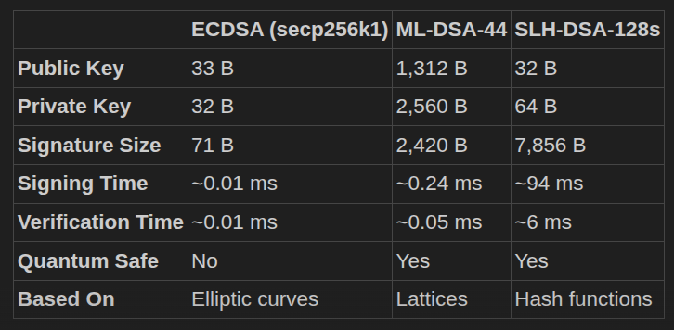
Signature Comparisons
bitcoinbushbash.info
Notes:
30 min including questions. Bitcoin beginner-advanced, QC none-intermediate.
Frame as a migration race, not overnight collapse.

Slide 19
BIP-360: Pay-to-Merkle-Root
P2MR
bc1z...
Soft fork
New output type SegWit version 2
New address prefix (Bech32m)
Backward compatible
Removes key-path spend — no public key exposed on-chain
Reuses battle-tested tapscript (BIPs 340/341/342)
Creates safe upgrade path for future PQC opcodes
bitcoinbushbash.info
Notes:
BIP-360 by Hunter Beast. Status: Draft.
Core idea: commit to Merkle root of script tree, not a tweaked public key.
Eliminates long-exposure quantum attack surface entirely.
BitMEX endorses this approach: removes Taproot key-path to match P2PKH quantum safety.

Slide 20
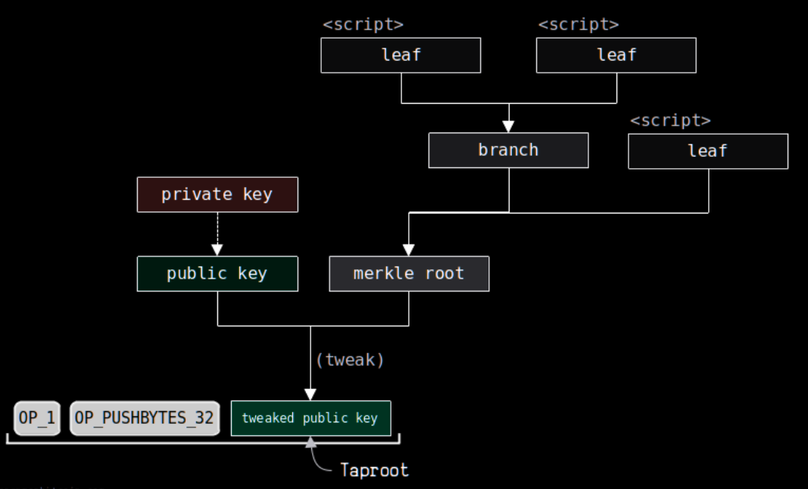
P2TR Structure
bitcoinbushbash.info
Notes:
30 min including questions. Bitcoin beginner-advanced, QC none-intermediate.
Frame as a migration race, not overnight collapse.

Slide 21
P2MR Structure
bitcoinbushbash.info
Notes:
30 min including questions. Bitcoin beginner-advanced, QC none-intermediate.
Frame as a migration race, not overnight collapse.

Slide 22
BIP-360: design principles
Rationale
Minimizes changes to the network
Supports tapscript which assists in implementing PQC required opcodes
Facilitates gradual integration of PQC without negative impacts before Q-Day.
Trade offs
Size: larger than key path spend, smaller than script path spend Privacy: can’t hide you have other script path spends (compared to key path spend)
bitcoinbushbash.info
Notes:
Verbatim from BIP-360: 'Minimize changes to the network.'
'Create the safest possible path for post-quantum signature integrations.'
'Facilitate gradual integration of quantum resistant features carried out iteratively.'
Future PQC via OP_SUCCESSx opcode updates for PQC OP_CHECKSIG.

Slide 23
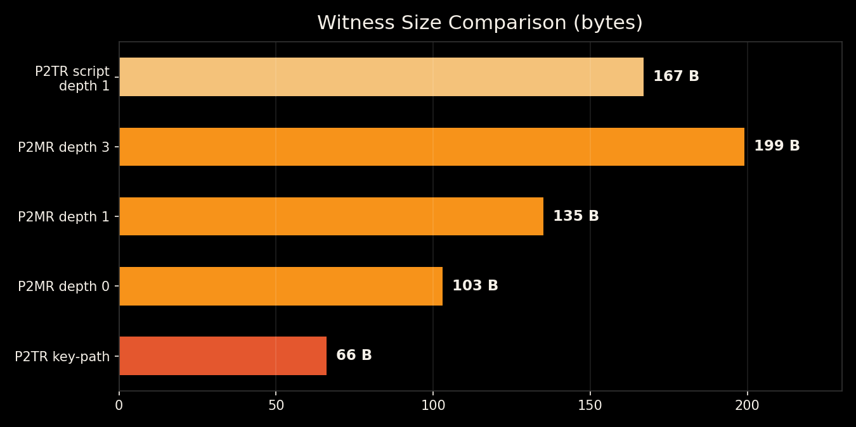
BIP-360: witness size tradeoffs
Larger than P2TR key-path — smaller than P2TR script-path
Depth 0 (single leaf): 103 B
vs P2TR key-path: 66 B
+37 B base overhead
+32 B per tree level
Always 32 B smaller than
equivalent P2TR script-path
(no internal key in control block)
bitcoinbushbash.info
Notes:
P2MR witness formula: 37 + 32*m bytes more than P2TR key-path.
But always 32 bytes LESS than equivalent P2TR script-path spend.
Because P2MR omits the internal public key from control block.
Depth 0: 103B. Depth 1: 135B. Depth 3: 199B.

Slide 24
BIP-360: what it protects
Protected: long exposure
Not yet protected: short exposure
Public keys hidden in the Merkle tree
Mempool window still uses ECDSA/Schnorr
Needs future PQC signature opcodes
P2MR creates the path for these
bitcoinbushbash.info
Notes:
From BIP-360: 'P2MR outputs are only resistant to long exposure attacks.'
'Protection against short exposure attacks may require future post-quantum signatures.'
BitMEX proposes dual tapleaf: quantum-safe AND quantum-vulnerable options per address.

Slide 25
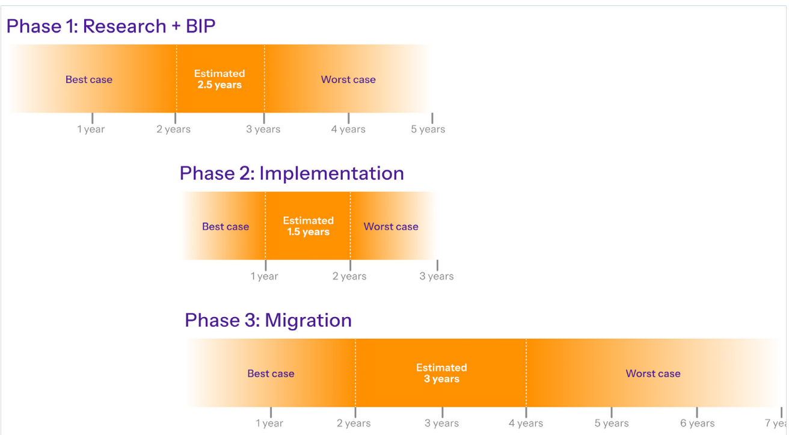
Implementation timeline
bitcoinbushbash.info
Notes:
Standard path: ~7 years for broad adoption (BIP co-author estimate).
Urgent path requires pre-work NOW: standards, wallet readiness, exchange coordination.
Side-by-side with GRI risk signal to visualise the race.

Slide 26
Problem 2: legacy coins
Options
Consequences
Status quo: let CRQC spend them, preserve neutrality
Freeze: lock vulnerable UTXOs preemptively
Hourglass: rate-limit movement of exposed coins
Steal: price shock, but censorship resistance intact
Freeze: market crash prevented, legitimacy damaged
Hourglass: middle path, still contentious
bitcoinbushbash.info
Notes:
This is governance territory, not just engineering.
Hourglass BIP: rate-limit quantum-exposed coin movement.
If freeze happens too early, legitimate users harmed.
If too late, market crash from quantum theft.

Slide 27
What can you do?
Today
When standards land
Don't reuse addresses
Avoid P2TR for large holdings
Don't share your XPUB unnecessarily
(SMSF auditing, public Electrum nodes)
Satoshi's shield: game-theory deterrent
Migrate when upgrades are made
Adopt tested PQC implementations
Run a node to support the upgrade
Fund dev grants and crypto research
Participate in the consensus direction
bitcoinbushbash.info
Notes:
Satoshi's shield: if Satoshi's coins are vulnerable, attackers face massive sell pressure.
Game-theoretic deterrent against quantum theft.
xpub exposure: SMSF auditing requirements and public Electrum nodes leak derivation paths.

Slide 28
Mythbusters
Myth
Reality
CRQC breaks all addresses instantly
Grover kills SHA-256
This is only a Bitcoin problem
Exposure type and time window matter
Quadratic speedup shifts cost curves, not instant break
ECDSA/RSA break is an internet-wide crisis
bitcoinbushbash.info
Notes:
Calibration slide. Staged threats, not a single catastrophic event.
Grover: 2^256 -> 2^128 search space. Still enormous.

Slide 29
CRQC most likely use cases
SIGINT: crack the 'store now, decrypt later' vault
Materials science and engineering simulation
Pharmaceutical drug discovery
Disease prevention and genomics research
Physics: push the boundary of QFT
bitcoinbushbash.info
Notes:
Nation-state drivers keep quantum investment high regardless of Bitcoin.
'Store now, decrypt later' is already happening — Bitcoin's pressure is real.

Slide 30
Questions?
Priority 1: stop exposing public keys
Priority 2: safe upgrade path (BIP-360)
Priority 3: social consensus on legacy coins
bitcoinbushbash.info
Notes:
Close with priorities. Invite involvement.
Key question: what ships early without fragmenting consensus?

Slide 31
References (1/10)
What is QC
1. IBM Quantum Learning: Bits, Gates, and Circuits
IBM's technical introduction to qubits, quantum gates, and circuits — aimed at people with a computing background, no physics degree required.
2. Classiq: The Deutsch-Jozsa Algorithm Explained
Step-by-step walkthrough of the Deutsch oracle problem and circuit — the simplest demonstration that a quantum computer can outperform a classical one.
3. Bitcoin Magazine: Quantum Bitcoin Summit
Summary of a summit bringing together quantum computing and Bitcoin experts to examine the real threats and separate hype from substance.
bitcoinbushbash.info

Slide 32
References (2/10)
What is the threat
4. Grover's Search Algorithm Overview
Microsoft's explanation of Grover's quantum search algorithm, which provides a quadratic speedup for unstructured search problems.
5. Quantum Resource Estimates for ECDLP
Roetteler et al. (2017) foundational paper estimating ~2,330 logical qubits and ~1.29 × 10¹¹ Toffoli gates to break 256-bit ECC using Shor's algorithm.
6. Ha, Lee & Heo (2024) — Resource analysis for ECDLP with noisy qubits
First comprehensive physical qubit estimate for ECDLP under surface codes: ~5.87 million physical qubits for P-256 at 10⁻³ error rate with 200 ns cycle time.
7. Ed25519 Optimisation (2025)
Achieves 97% reduction in T-count, 60% reduction in T-depth, and 16% fewer qubits for quantum attacks on Ed25519 by exploiting its specific finite field structure.
bitcoinbushbash.info

Slide 33
References (3/10)
Bitcoin revision
8. Elliptic Curve Cryptography
How Bitcoin uses the secp256k1 elliptic curve for key generation and digital signatures — the operation Shor's algorithm can reverse.
9. Digital Signatures
How ECDSA and Schnorr signatures work in Bitcoin to authorise spending without revealing the private key.
10. Hash Functions
Overview of SHA-256 and RIPEMD-160 as used in Bitcoin for mining, addresses, and data integrity — Grover's algorithm provides only a quadratic speedup against these.
11. Memory Pool
The mempool where unconfirmed transactions wait — the window during which a short exposure quantum attack could occur.
12. Taproot (P2TR)
Pay-to-Taproot: exposes a tweaked public key on-chain, making unspent P2TR outputs vulnerable to long exposure quantum attacks.
bitcoinbushbash.info

Slide 34
References (4/10)
QC timeline
13. GRI Quantum Threat Timeline Report 2025
Annual survey of 26 global quantum experts. Optimistic interpretation: ~49% chance of a CRQC within 10 years; pessimistic: ~28%. Notable upward shift from prior years.
14. Bitcoin Fundamentals: Quantum Computing and Bitcoin
Podcast episode discussing the quantum threat to Bitcoin with Charles Edwards, covering timelines, risk assessment, and what bitcoiners should know.
15. Cointelegraph: BIP-360 Upgrade Timeline
BIP-360 co-author estimates Bitcoin may take up to 7 years to fully upgrade to post-quantum signatures under a standard timeline.
bitcoinbushbash.info

Slide 35
References (5/10)
Technical problem and fixes
16. BIP360.org Overview
Overview of Pay-to-Merkle-Root (P2MR), a new output type that removes the quantum-vulnerable key path spend from Taproot while preserving script tree functionality.
17. BIP-360 Draft: Pay-to-Merkle-Root
The formal BIP specification for P2MR, detailing address format (bc1z...), witness structure, and security rationale against long exposure quantum attacks.
18. BitMEX Research: Taproot Quantum Spend Paths
Proposes dual-path Taproot wallets with both quantum-safe and classical spend paths, arguing these wallets should be exempt from any future coin freeze.
19. Cointelegraph: Six Quantum Security Challenges
Outlines six major hurdles Bitcoin faces in becoming quantum-resistant, including signature size bloat, consensus changes, and migration logistics.
20. Bitcoin Magazine: Bitcoin Advances Toward Quantum Resistance
Reports on recent development progress toward quantum-resistant Bitcoin, including BIP-360 and related proposals.
bitcoinbushbash.info

Slide 36
References (6/10)
21. NIST FIPS 204: ML-DSA
NIST's finalised standard for ML-DSA (derived from CRYSTALS-Dilithium), a lattice-based post-quantum digital signature algorithm.
22. NIST FIPS 205: SLH-DSA
NIST's finalised standard for SLH-DSA (derived from SPHINCS+), a stateless hash-based post-quantum digital signature algorithm.
23. Post-Quantum Digital Signatures Benchmark: ML-DSA vs ECDSA
Side-by-side performance benchmarks comparing ML-DSA signature sizes, signing times, and verification times against classical ECDSA.
24. ASecuritySite: Digital Signature Benchmark
Interactive benchmarking tool for post-quantum signature schemes including Dilithium/ML-DSA across different security levels.
25. Making SLH-DSA 10x-100x Faster
Research by SLH-DSA co-designer Andreas Huelsing on optimisation techniques to dramatically improve SLH-DSA signing and verification performance.
bitcoinbushbash.info

Slide 37
References (7/10)
26. SLotH GitHub: SLH-DSA Performance
Reference implementation and benchmarks for optimised SLH-DSA, targeting hardware acceleration to close the performance gap with lattice-based schemes.
27. Chaincode: Bitcoin Post-Quantum
Chaincode Labs research paper analysing post-quantum migration strategies for Bitcoin, including signature scheme selection and upgrade paths.
bitcoinbushbash.info

Slide 38
References (8/10)
Social problem and fixes
28. Hourglass v2 Draft
Proposes a middle-ground approach to quantum-vulnerable coins: rate-limiting their movement rather than freezing or ignoring them entirely.
29. Lopp: Against Quantum Recovery of Bitcoin
Jameson Lopp argues Bitcoin should permanently burn funds in quantum-vulnerable addresses rather than allow quantum-capable entities to steal them.
30. CoinDesk: To Freeze or Not to Freeze — Satoshi and the $440B in Bitcoin Threatened by Quantum Computing
Examines the debate over ~7 million BTC in quantum-vulnerable addresses including Satoshi's ~1 million coins, weighing immutability against market stability.
31. Cointelegraph Magazine: Bitcoin may face hard fork over any attempt to freeze Satoshi's coins
Argues that freezing quantum-vulnerable coins would violate Bitcoin's core property rights, potentially splitting the network in a contentious hard fork.
bitcoinbushbash.info

Slide 39
References (9/10)
Other uses of QC
32. Frontiers: Quantum Computing — Foundations, Algorithms, and Emerging Applications (2025)
Comprehensive review covering quantum algorithms and their emerging applications across materials science, chemistry, optimisation, and physics simulation.
33. Wikipedia: Harvest Now, Decrypt Later
Overview of the HNDL strategy where adversaries intercept and store encrypted communications today for decryption once quantum computers become available.
bitcoinbushbash.info

Slide 40
References (10/10)
34. Federal Reserve: HNDL and Post-Quantum Cryptography Risks for Distributed Ledger Networks
Federal Reserve research examining how harvest-now-decrypt-later attacks pose data privacy risks specifically for blockchain and distributed ledger networks.
35. McKinsey: The Quantum Revolution in Pharma (2025)
McKinsey analysis of how quantum computing is accelerating drug discovery by simulating molecular interactions at the quantum level, compressing timelines from years to weeks.
36. Nature: Quantum-Machine-Assisted Drug Discovery (2025)
Nature paper on combining quantum computing with machine learning for biomarker discovery, genomic data processing, and cancer detection via liquid biopsy.
bitcoinbushbash.info

