Slide 1

The Quantum Threat to Bitcoin
What's at risk, what's being built, and what you can do
Overview the threat
What we can do
What you can do
bitcoinbushbash.info
Notes:
30 min including questions. Bitcoin beginner-advanced, QC none-intermediate.
Frame as a migration race, not overnight collapse.

Slide 2
Talk map
1. What is quantum computing
2. The QC threat to Bitcoin
3. Revision: sigs, hashes, mempool
4. When is it coming (GRI 2024)
5. Two big problems
6. BIP-360 deep dive (the big mitigation)
7. Legacy coins dilemma
8. What you can do
9. Mythbusters & perspective
bitcoinbushbash.info
Notes:
Anchor slide. BIP-360 gets 5 dedicated slides.

Slide 3
What is quantum computing?
Only what matters for Bitcoin's security model
Core ideas
Road to a CRQC
Superposition: 0 and 1 at once
Entanglement: correlated states
Interference: amplify right answers
Physical qubits are noisy
Error correction burns many physical qubits per logical qubit
Logical qubits + runtime = can it run Shor fast enough?
bitcoinbushbash.info
Notes:
CRQC = Cryptographically Relevant Quantum Computer.
Current largest factored number by QC is 15. Far away, but trajectory matters.

Slide 4
The QC threat to Bitcoin
Two algorithms, two threat profiles
Shor's algorithm (signatures)
Grover's algorithm (hashing)
Breaks ECDSA and Schnorr
Derives private key from public key
Exponential speedup
Primary Bitcoin threat
Targets SHA-256 / RIPEMD-160
Quadratic speedup only
256-bit -> ~128-bit effective
Changes mining economics, not collapse
bitcoinbushbash.info
Notes:
Shor: exponential advantage, breaks DLP. The real worry.
Grover: quadratic only. Not a collapse event, a cost-curve shift.

Slide 5
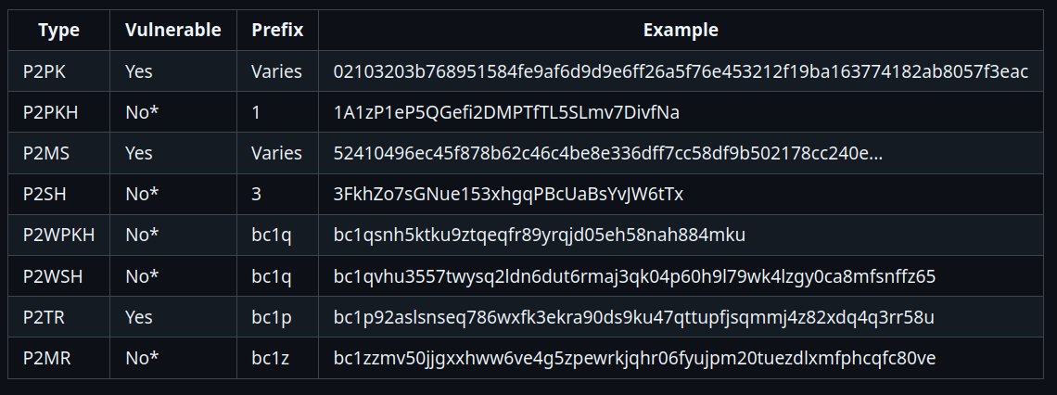
Long exposure attack vulnerability
What's at risk, what's being built, and what you can do
bitcoinbushbash.info
Notes:
30 min including questions. Bitcoin beginner-advanced, QC none-intermediate.
Frame as a migration race, not overnight collapse.

Slide 6
Revision
Digital signatures, hashing, and the mempool
Signatures: prove you own the coins, authorize spend
Hashing: mining proof-of-work + compress/conceal public keys
Public key hidden by hash until first spend (P2PKH/P2SH/P2WSH)
Public key exposed on receive (P2PK, P2TR key-path)
Mempool window: tx waits ~10 min before confirmation
When your public key is visible = your quantum risk window
bitcoinbushbash.info
Notes:
Key insight: spending behaviour determines exposure.
Address reuse = key exposed on-chain forever.
P2TR key-path = key exposed at receive time (like 2010-era P2PK).

Slide 7
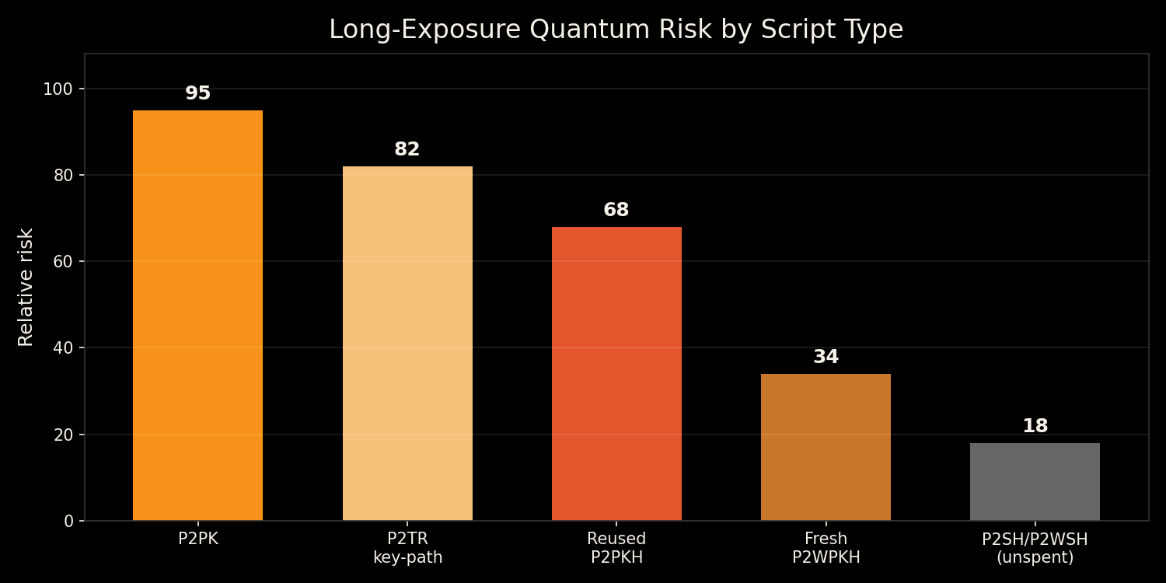
Attack types: long vs short exposure
bitcoinbushbash.info
Notes:
Long exposure: key visible on-chain indefinitely. Attacker has unlimited time.
P2PK/P2TR key-path: exposed at receive.
Reused P2PKH: exposed after first spend.
Short exposure: mempool race after key reveal. Needs faster QC. Secondary threat.

Slide 8
When is it coming?
GRI Quantum Threat Timeline Report 2024 — 32 experts surveyed
~14%
~34%
~19%
Optimistic avg
within 5 years
Optimistic avg
within 10 years
Pessimistic avg
within 10 years
Planning signal, not prediction. Uncertainty concentrates in the 10-15 year window.
bitcoinbushbash.info
Notes:
Values from GRI 2024 key points. Weighted averages of 32 expert responses.

Slide 9
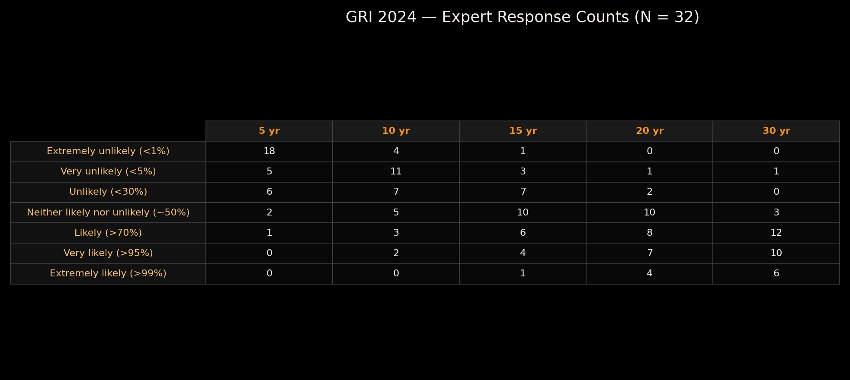
GRI expert response distribution
Raw counts — Appendix A.4
bitcoinbushbash.info
Notes:
Each column sums to 32. Shows how spread the expert opinion really is.
18 of 32 say extremely unlikely within 5 years. But 3 say likely or above.

Slide 10
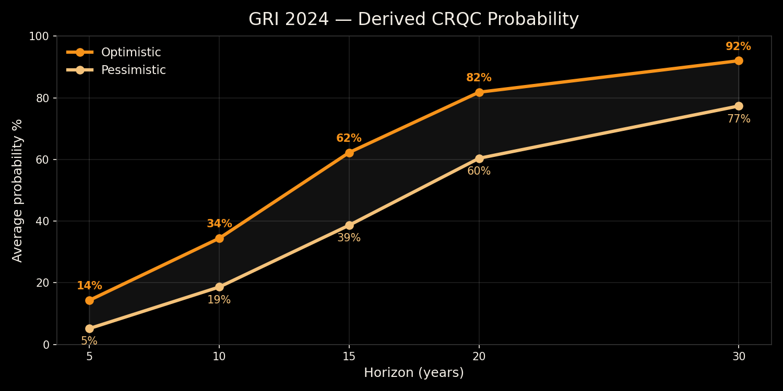
GRI derived probability curve
Optimistic vs pessimistic probability assignments
bitcoinbushbash.info
Notes:
Derived from Appendix A.4 raw counts * probability bin assignments.
Key: ~34% optimistic at 10 yr, ~62% at 15 yr. The window is tightening.

Slide 11
Government policy timelines
Regulatory pressure already moving
2030
2033
2035
CNSA 2.0
PQC mandate begins
CNSA 2.0
full browser/OS PQC
NIST IR 8547
disallow ECC
Bitcoin doesn't answer to regulators — but enterprise/institutional users will demand PQC.
bitcoinbushbash.info
Notes:
CNSA 2.0: Commercial National Security Algorithm Suite.
NIST IR 8547 disallows ECC in US federal gov after 2035.
These drive enterprise Bitcoin infrastructure timelines.

Slide 12
The two big Bitcoin problems
1. Technical: add post-quantum cryptography to Bitcoin
2. Social: what happens to legacy coins that don't upgrade
Both must be solved together. Technical alone is not enough.
bitcoinbushbash.info
Notes:
Pivot into solution space. These are coupled problems.

Slide 13
Post-quantum signature options
5 families, different tradeoffs
NIST standardised
Other families
ML-DSA (Dilithium) — lattice-based
SLH-DSA (SPHINCS+) — hash-based
Conservative, well-studied
Compact sigs, larger public keys
Code-based (McEliece) — huge keys
Multivariate (Rainbow — broken)
Isogeny (SIKE — broken)
Active research, real risks
BIP-360 does NOT commit to any PQC algorithm — it builds the infrastructure for them.
bitcoinbushbash.info
Notes:
ML-DSA and SLH-DSA are the NIST PQC standards (Aug 2024).
Some candidates already broken: SIKE, Rainbow. Caution warranted.

Slide 14
PQC operational impacts
Bigger signatures ripple through the entire stack
Transaction size and fee increases
Block space pressure and mempool dynamics
Verification and signing time changes
Lightning channel updates: every state = PQC signature
Multisig: N signatures * PQC size
Exchanges and custody: key management overhaul
bitcoinbushbash.info
Notes:
PQC sigs are much larger than ECDSA/Schnorr (64B -> potentially kilobytes).
Affects on-chain, Lightning, custody, hardware wallets.

Slide 15
BIP-360: Pay-to-Merkle-Root
The key quantum mitigation path for Bitcoin
P2MR
bc1z...
Soft fork
New output type
SegWit version 2
New address
prefix (Bech32m)
Backward
compatible
Removes key-path spend — no public key exposed on-chain
Reuses battle-tested tapscript (BIPs 340/341/342)
Creates safe upgrade path for future PQC opcodes
bitcoinbushbash.info
Notes:
BIP-360 by Hunter Beast. Status: Draft.
Core idea: commit to Merkle root of script tree, not a tweaked public key.
Eliminates long-exposure quantum attack surface entirely.
BitMEX endorses this approach: removes Taproot key-path to match P2PKH quantum safety.

Slide 16
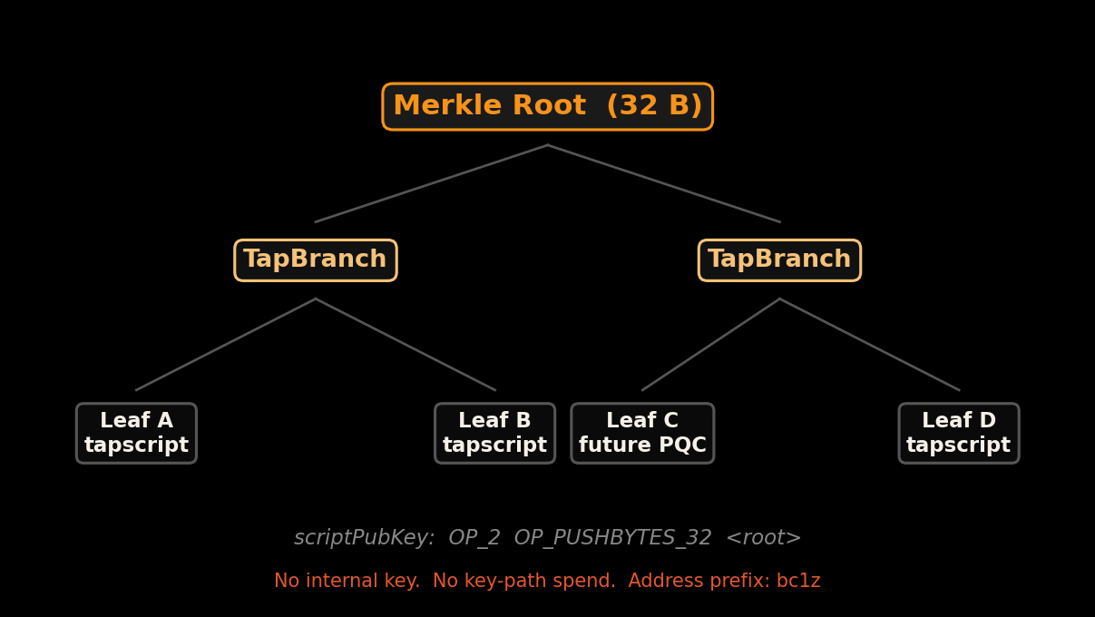
BIP-360: Merkle tree structure
How P2MR commits to scripts without exposing keys
bitcoinbushbash.info
Notes:
Output: OP_2 OP_PUSHBYTES_32 <merkle_root>
Unlike P2TR: no internal key, no key tweak. Commits only to TapBranch hash.
Witness: stack elements + leaf script + control block (NO public key in control block).
Control block: 1 + 32*m bytes (m = tree depth, max 128).
Parity bit always 1 (no key to compute parity from).
Unused script paths remain private. Tapscript compatible.

Slide 17
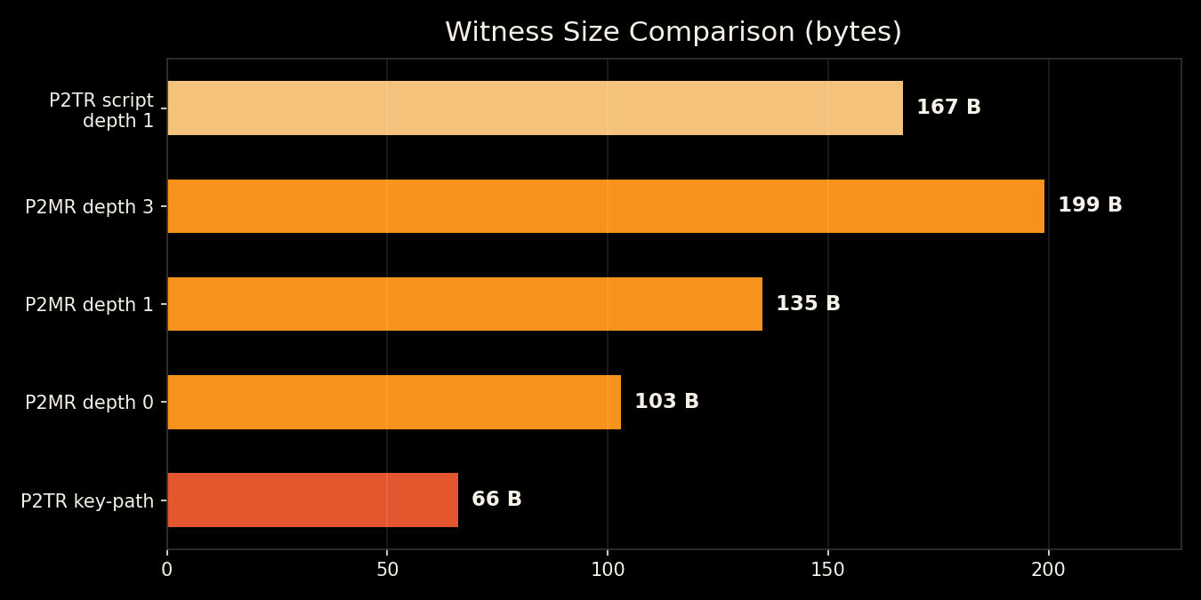
BIP-360: witness size tradeoffs
Larger than P2TR key-path — smaller than P2TR script-path
Depth 0 (single leaf): 103 B
vs P2TR key-path: 66 B
+37 B base overhead
+32 B per tree level
Always 32 B smaller than
equivalent P2TR script-path
(no internal key in control block)
bitcoinbushbash.info
Notes:
P2MR witness formula: 37 + 32*m bytes more than P2TR key-path.
But always 32 bytes LESS than equivalent P2TR script-path spend.
Because P2MR omits the internal public key from control block.
Depth 0: 103B. Depth 1: 135B. Depth 3: 199B.

Slide 18
BIP-360: design principles
Minimum change, maximum future optionality
Design goals (from BIP text)
Key technical decisions
Minimize changes to the network
Reuse existing Bitcoin code and workflows
Preserve compatibility where possible
Safest path for PQC signature integration
Enable gradual, iterative upgrades
No key-path spend (eliminates ECC surface)
No internal key tweak (Merkle root only)
OP_SUCCESSx path for future PQC opcodes
No specific PQC algorithm mandated
Multiple PQC sigs possible for redundancy
bitcoinbushbash.info
Notes:
Verbatim from BIP-360: 'Minimize changes to the network.'
'Create the safest possible path for post-quantum signature integrations.'
'Facilitate gradual integration of quantum resistant features carried out iteratively.'
Future PQC via OP_SUCCESSx opcode updates for PQC OP_CHECKSIG.

Slide 19
BIP-360: what it protects (and doesn't)
Long-exposure resistance now — short-exposure resistance later
Protected: long exposure
Not yet protected: short exposure
Public keys never appear on-chain
Funds at rest are quantum-safe
Unused script paths stay private
Existing tapscript programs work as-is
Mempool window still uses ECDSA/Schnorr
Key revealed during broadcast-to-confirm
Needs future PQC signature opcodes
P2MR creates the path for these
P2MR is stage 1. PQC signatures via OP_SUCCESSx are stage 2.
bitcoinbushbash.info
Notes:
From BIP-360: 'P2MR outputs are only resistant to long exposure attacks.'
'Protection against short exposure attacks may require future post-quantum signatures.'
BitMEX proposes dual tapleaf: quantum-safe AND quantum-vulnerable options per address.

Slide 20
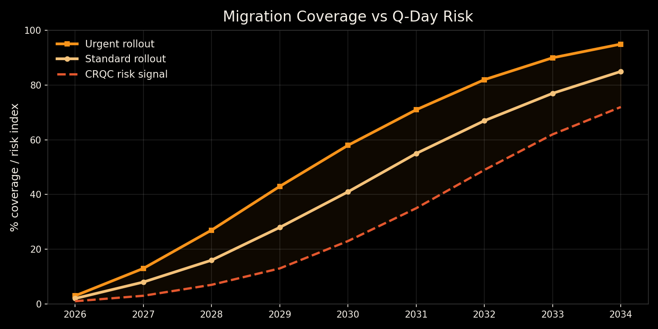
Implementation timeline
We win if migration finishes before Q-Day
bitcoinbushbash.info
Notes:
Standard path: ~7 years for broad adoption (BIP co-author estimate).
Urgent path requires pre-work NOW: standards, wallet readiness, exchange coordination.
Side-by-side with GRI risk signal to visualise the race.

Slide 21
Problem 2: legacy coins
Do nothing = stolen. Restrict = censorship. Both bad.
Options
Consequences
Steal: let CRQC spend them, preserve neutrality
Freeze: lock vulnerable UTXOs preemptively
Hourglass: rate-limit movement of exposed coins
Steal: price shock, but censorship resistance intact
Freeze: market crash prevented, legitimacy damaged
Hourglass: middle path, still contentious
Likely outcome: chain split risk. External forces will exploit the division.
bitcoinbushbash.info
Notes:
This is governance territory, not just engineering.
Hourglass BIP: rate-limit quantum-exposed coin movement.
If freeze happens too early, legitimate users harmed.
If too late, market crash from quantum theft.

Slide 22
What can you do?
Today
When standards land
Don't reuse addresses
Avoid P2TR/P2PK for large holdings
Don't share your xpub unnecessarily
(SMSF auditing, public Electrum nodes)
Satoshi's shield: game-theory deterrent
Migrate to P2MR when wallets support it
Adopt tested PQC implementations
Run a node to support the upgrade
Fund dev grants and crypto research
Participate in the consensus direction
bitcoinbushbash.info
Notes:
Satoshi's shield: if Satoshi's coins are vulnerable, attackers face massive sell pressure.
Game-theoretic deterrent against quantum theft.
xpub exposure: SMSF auditing requirements and public Electrum nodes leak derivation paths.

Slide 23
Mythbusters
Myth
Reality
CRQC breaks all addresses instantly
Grover kills SHA-256
This is only a Bitcoin problem
Exposure type and time window matter
Quadratic speedup shifts cost curves, not instant break
ECDSA/RSA break is an internet-wide crisis
bitcoinbushbash.info
Notes:
Calibration slide. Staged threats, not a single catastrophic event.
Grover: 2^256 -> 2^128 search space. Still enormous.

Slide 24
CRQC most likely use cases
Bitcoin is one target among many
SIGINT: crack the 'store now, decrypt later' vault
Materials science and engineering simulation
Pharmaceutical drug discovery
Disease prevention and genomics research
Physics: push the boundary of QFT
bitcoinbushbash.info
Notes:
Nation-state drivers keep quantum investment high regardless of Bitcoin.
'Store now, decrypt later' is already happening — Bitcoin's pressure is real.

Slide 25
References
Key references
Additional sources
BIP-360 (P2MR)
github.com/bitcoin/bips/blob/master/bip-0360.mediawiki
bip360.org
bip360.org/bip360.html
GRI Quantum Threat 2024
globalriskinstitute.org
BitMEX Taproot Quantum
bitmex.com/blog/Taproot-Quantum-Spend-Paths
BTC Mag: Quantum Summit
bitcoinmagazine.com/technical/the-quantum-bitcoin-summit
NIST PQC project
csrc.nist.gov/projects/post-quantum-cryptography
Hourglass BIP (legacy coin rate-limiting)
Lopp: Against Quantum Recovery of Bitcoin
CNSA 2.0 / NIST IR 8547 timelines
TradingView: 7-year upgrade estimate
bitcoinbushbash.info
Notes:
All major sources listed with URLs.

Slide 26
Questions?
Where should Bitcoin move first?
Priority 1: stop exposing public keys
Priority 2: safe upgrade path (BIP-360)
Priority 3: social consensus on legacy coins
bitcoinbushbash.info
Notes:
Close with priorities. Invite involvement.
Key question: what ships early without fragmenting consensus?

