Slide 1
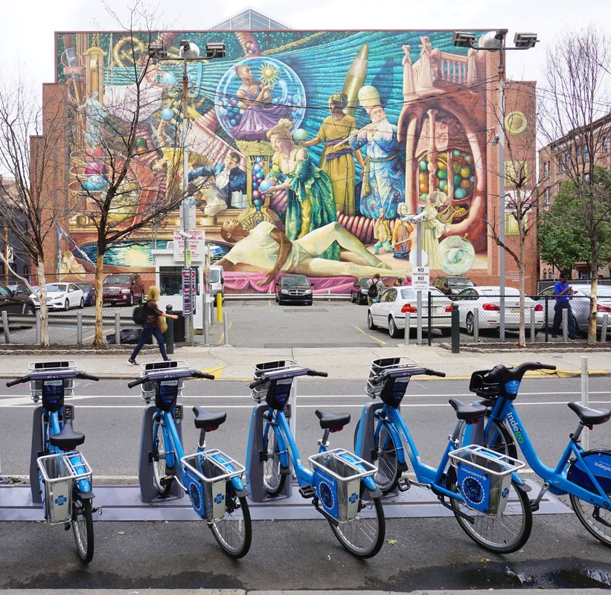
Improvements To Worker Assignment Problem
Trent Johnson
Georgia Institute of Technology
Jie Wu
Temple University

Slide 2
What is Bike Sharing
Systems of publically available bikes for rent
Usuall

