Slide 1
Simple Comment System using PHP, JQUERY and AJAX

Slide 2
DATABASE
Database Name: simple_comment
Table Name: comments
Fields (3) : id, name, comment, date
The field ‘ id ’ – set as Primary key and Auto increment.
The field ‘ date ’ – Default value is set as CURRENT_TIMESTAMP
CURRENT_TIMESTAMP - Returns the current time (based on current time zone ) in 'HH:MM:SS' or HHMMSS format.
FIELD | DATA TYPE | LENGTH
id | int | 11
name | varchar | 40
comment | text | -
date | timestamp | -

Slide 3
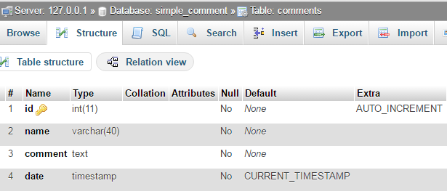
Database created in localhost – phpMyAdmin

Slide 4
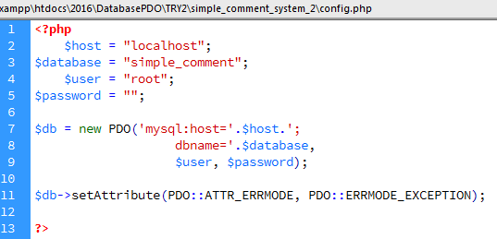
config.php
Database connectivity

Slide 5
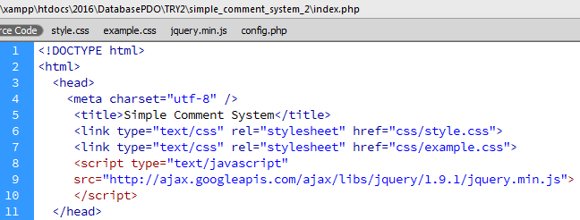
index.php
Part 1 - <head> section : Load CSS and JQuery library

Slide 6
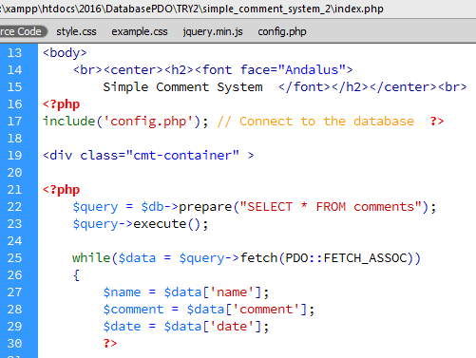
index.php
Part 2 - <body> section : Connect database;
Query the database, and retrieve the existing data

Slide 7
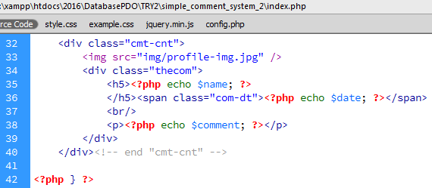
index.php
Part 3 – Display the fetched comment with profile image, name and date of post.

Slide 8
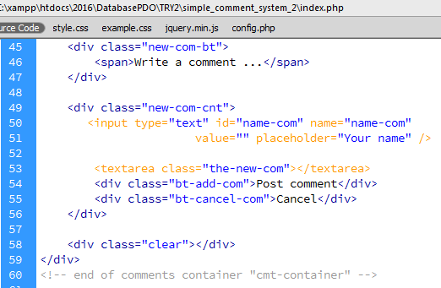
index.php
Part 4 – Display new comment container with ‘Text area’ ,
‘Post comment’ and ‘Cancel’ buttons

Slide 9

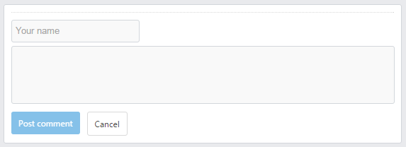
Output of index.php - Part 4
<div class="new-com-bt">
<div class="new-com-cnt">

Slide 10
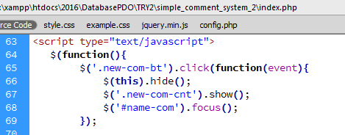
index.php
Part 5 - <script> section begins.
On clicking 'Write a comment' box <div class="new-com-bt">
Hide the (new-com-bt ) box
Show the new comment input box ( class="new-com-cnt"> )
Focus the cursor at 'name' field

Slide 11
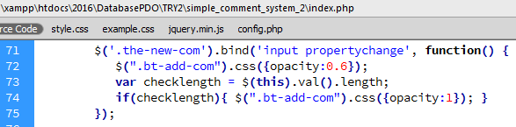
index.php - Part 5
When start writing the comment activate the 'Post comment’ button.
'Post comment' button appears in low opacity until the user starts writing the comment.
Once the user starts writing the comment, the 'Post comment' button gets brighter.
bind( ) - attaches one or more event handlers for selected elements,
and specifies a function to run when the event occurs.
input and propertychange – Event handlers
length – returns the length of the selected data

Slide 12
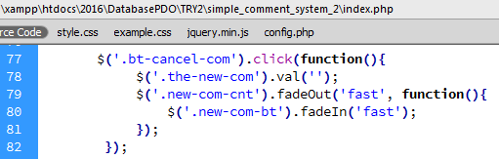
index.php
Part 6 - On clicking on the cancel button
Set the new comment input box ( <class="new-com-cnt"> ) value as 'empty‘
fade out the section; and fade in the 'Write a comment' box ( <class="new-com-bt"> )

Slide 13
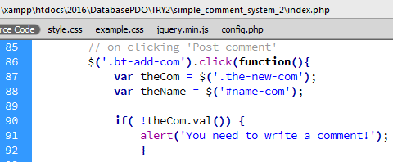
index.php
Part 7 - On clicking 'Post comment' :
If the comment input box does not contain any value,
display an alert box, prompting to write a comment.

Slide 14
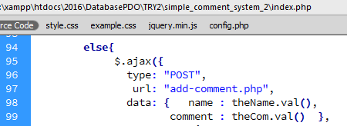
index.php
Part 8 – Else, if the comment contain any value:
using Ajax function, post the data to add-comment.php
add-comment.php – explained in fore coming slides

Slide 15
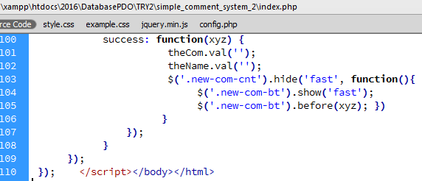
index.php
Part 9 – On success: - empty the name and comment box.
- hide the 'new comment' section
- Again, show the 'write a comment' box
Before displaying the 'write a comment’ box, insert the content called back from add-comment.php
before( ) - inserts specified content in front of (before) the selected elements.

Slide 16
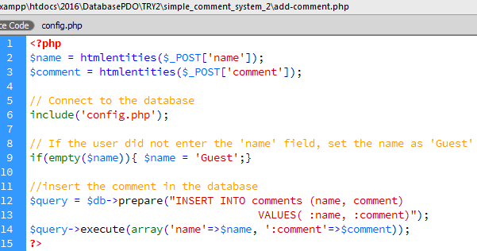
add-comment.php
Part 1 – Retrieve the name and comment from URL
- If name is empty, set it as ‘Guest’; and insert the data to database.
htmlentities( ) - converts characters to HTML entities.
(example: &nbsp; for space)

Slide 17
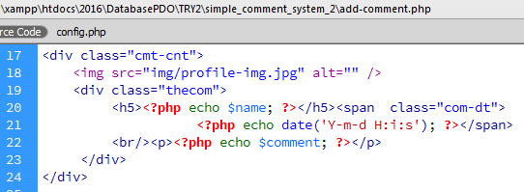
add-comment.php
Part 2– < class="cmt-cnt"> to display the entered comment
date ( ) - formats a local date and time, and returns the formatted date string.
Y - A four digit representation of a year
m - A numeric representation of a month (from 01 to 12)
d - The day of the month (from 01 to 31)
H - 24-hour format of an hour (00 to 23) ;
i - Minutes with leading zeros (00 to 59)
s - Seconds, with leading zeros (00 to 59)

Slide 18
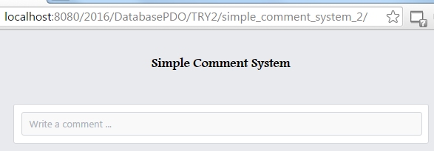
OUTPUT
Simple Comment System – Home page

Slide 19
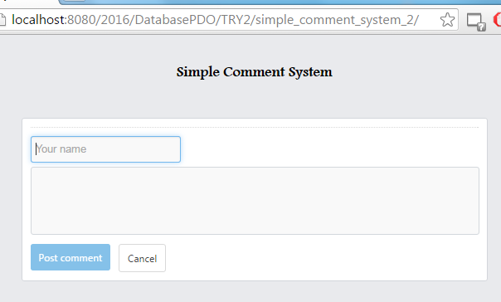
OUTPUT
On Clicking ‘Write a Comment’ box:
Cursor focused on ‘Name’ field
‘Post comment’ button appears in lower opacity.

Slide 20
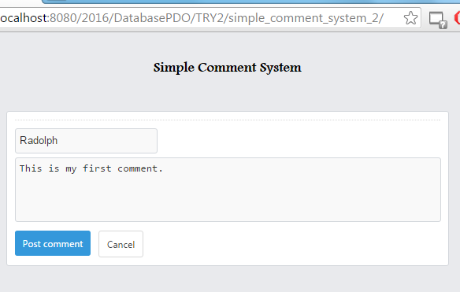
OUTPUT
On entering some data in the comment text box,
‘Post comment’ button appears to be brighter!

Slide 21
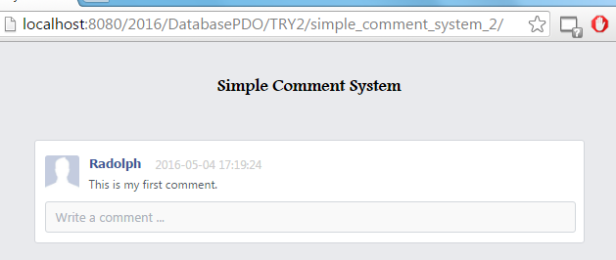

OUTPUT
On Posting the comment:
Database updated:

Slide 22
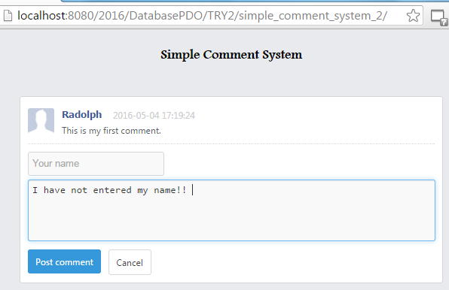
OUTPUT
Writing comment without name:

Slide 23
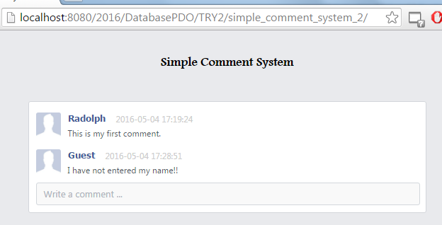

OUTPUT
Comment posted without name; as Guest:
Database updated:

Slide 24
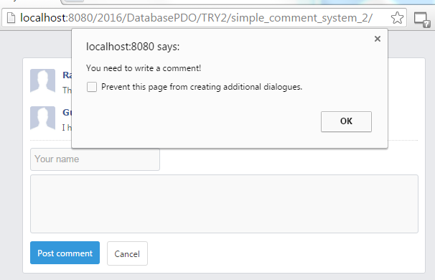
OUTPUT
Alert displayed if attempt to post comment with empty value:

