Slide 1
Intelligent Robotics Fall 2022
Simulated Airplane

Slide 2
ROSflight
ROS
  Robot Control
Hardware
  Flight Controller vs Main Computer
Gazebo
  Simulation
Notes:
Framework for building robots, messagas, subscriptions, publications, actions.

Slide 3
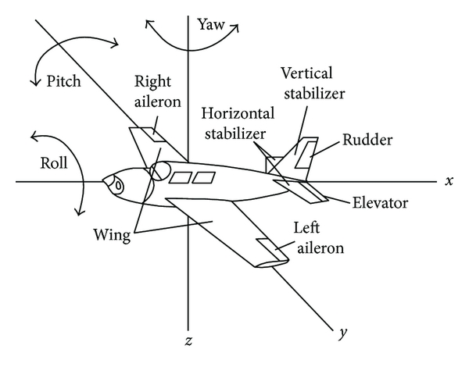
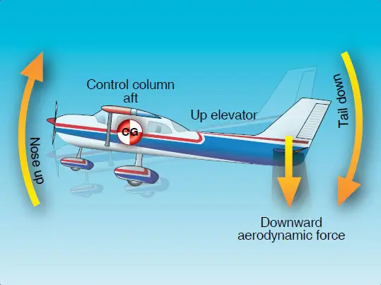
Altitude Hold PID
What controls Altitude in a plane?

Slide 4
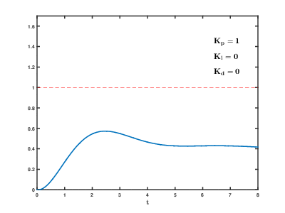
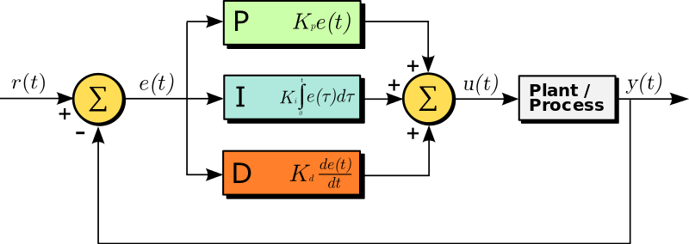
Altitude Hold PID
What is a PID controller?

Slide 5
Fuzzy PID?

