Slide 1
Quaternion Control

Slide 2
Changes to last term code
Custom Messages
  Turn controllers On / Off
  Change controller set-points
Service Server
  Instead of topic publisher/Subcriber

Slide 3
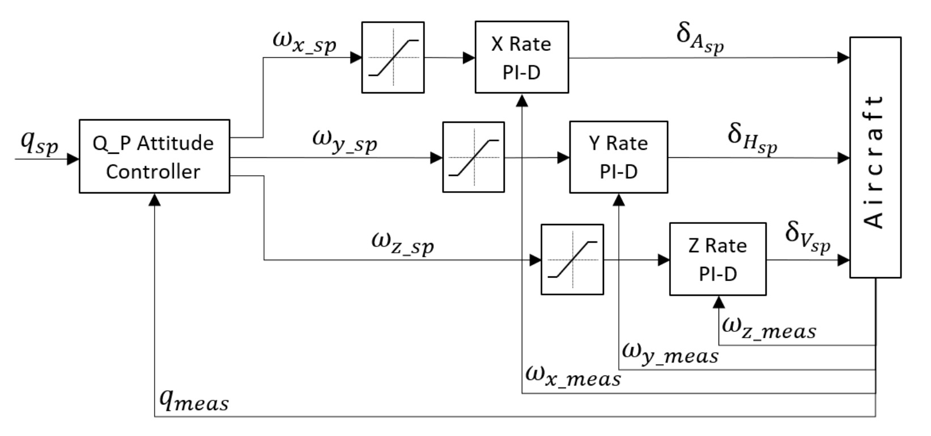

Slide 4
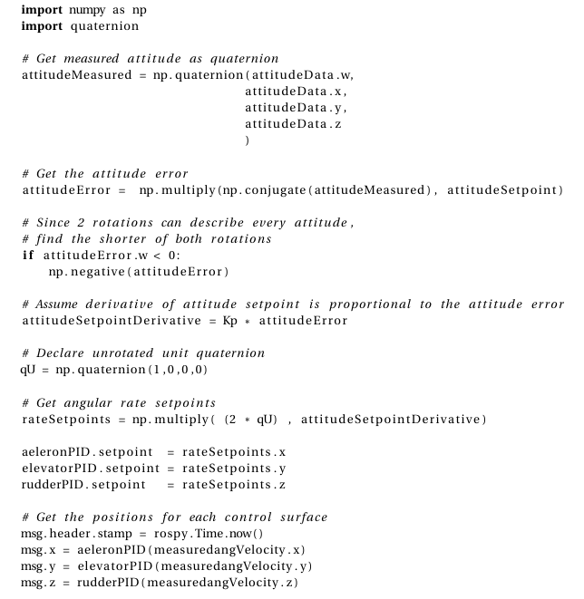

Slide 5
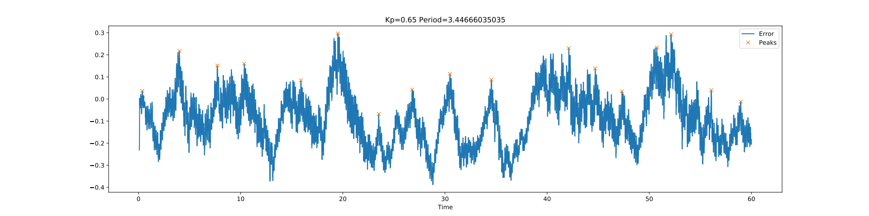
Noise?

Slide 6
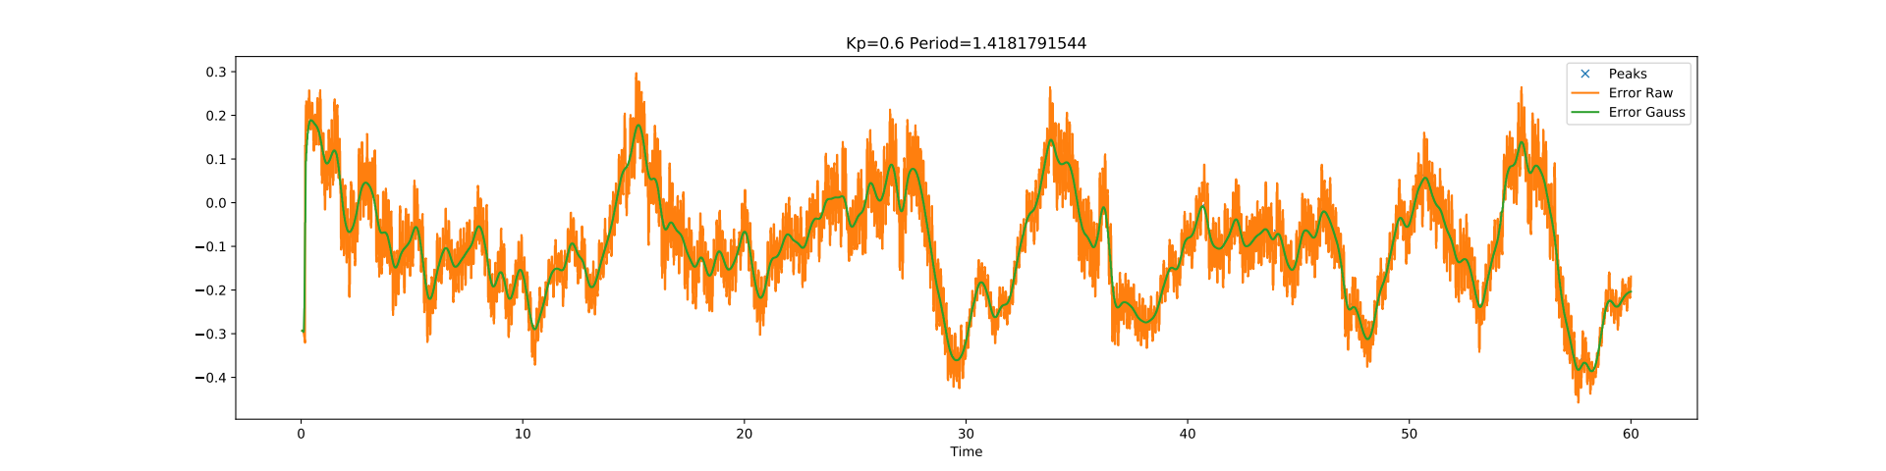
Filter It?

Slide 7
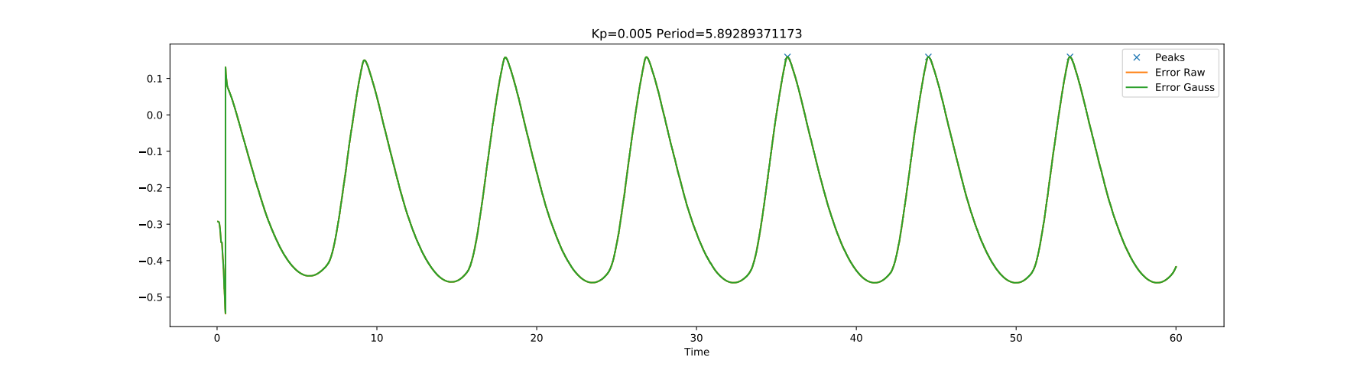
Better, not quite.

Slide 8
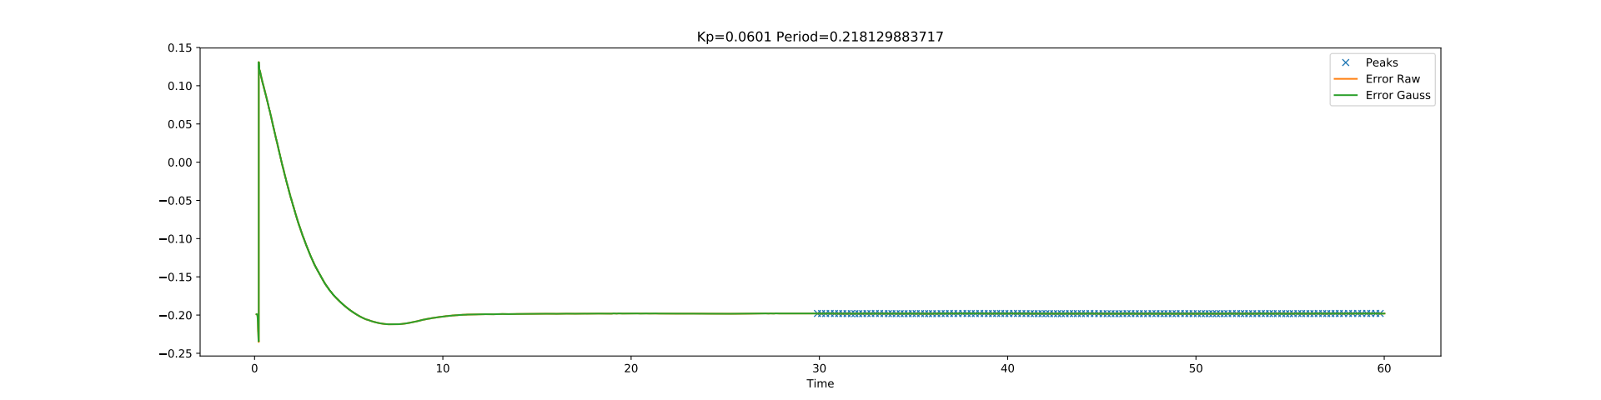
THATS IT!

Slide 9
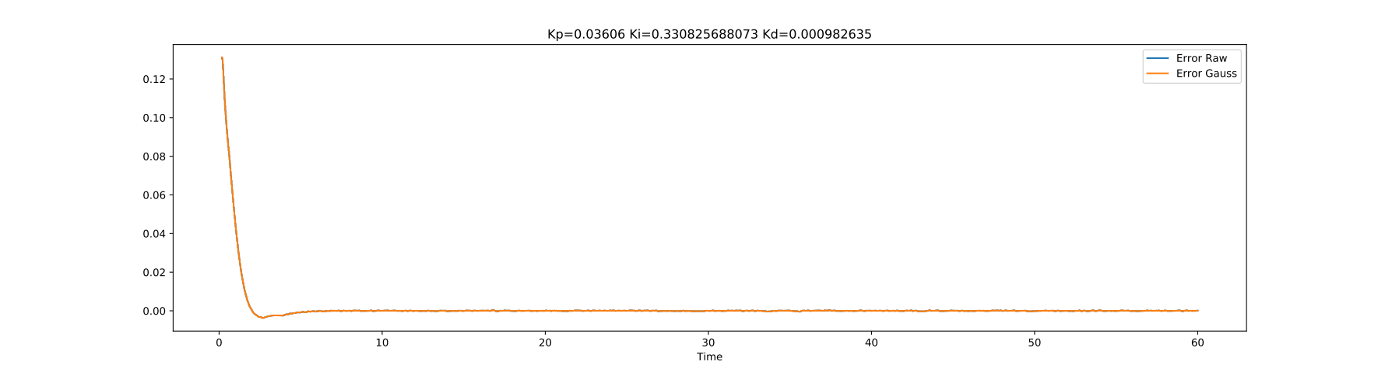
Y axis PID Tuned!

Slide 10
Plane Controllers
Attitude Controller
  Pitch up/down
    Eyebrow state: Up / Down
  Bank left/right
    Eyebrow state: Left / Right
  Quaternion Rotations P’=pqp^-1
Altitude Controller
  Eyebrow state: Neutral
    Left / Right?

