Slide 1
TE0600 platform
reference project creation sequence
PLB bus based

Slide 2
Special Note:
Make sure BSB files are copied into
\Xilinx\14.2\ISE_DS\EDK\data\board
Make sure private pcores are copied into
\Xilinx\14.2\ISE_DS\EDK\data\wizards\BsbCores\pcores
Before running this manual

Slide 3
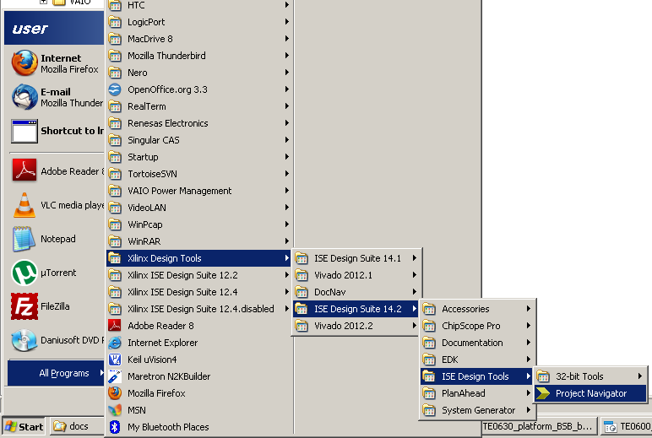
start Xilinx ISE 14 Project Navigator

Slide 4
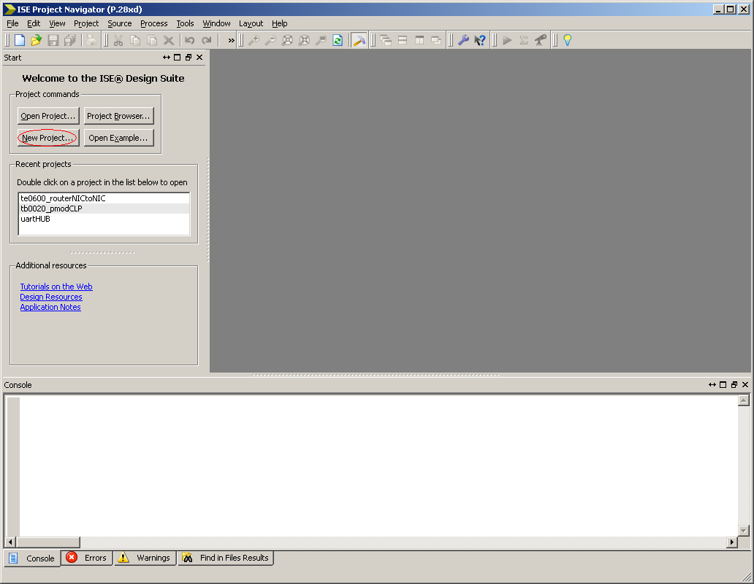
click button to create a new project

Slide 5
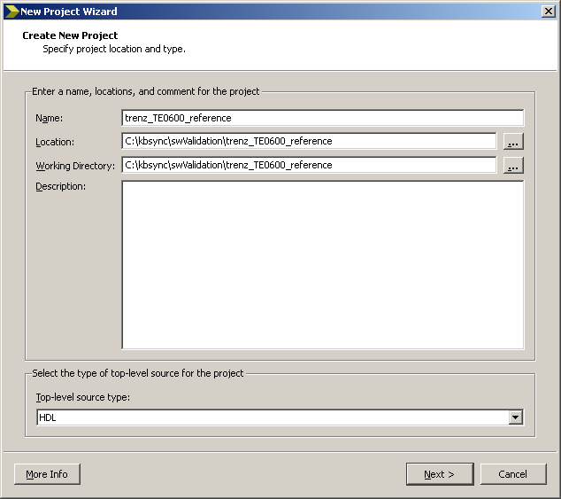
choose project name, then click Next

Slide 6
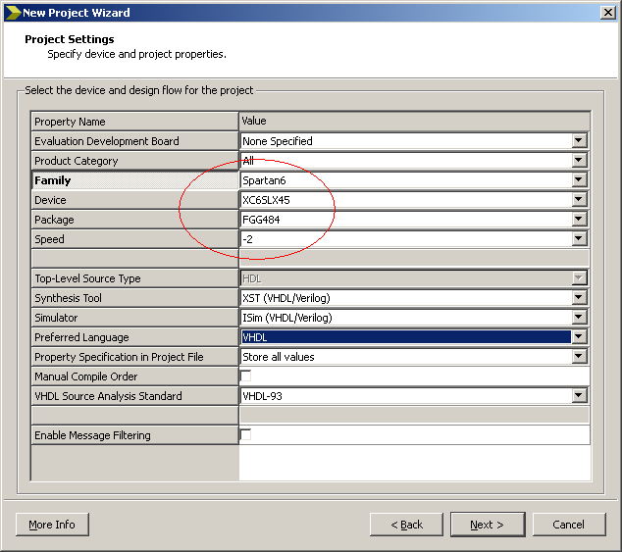
provide correct Family, Device, Package and Speed, then click Next

Slide 7
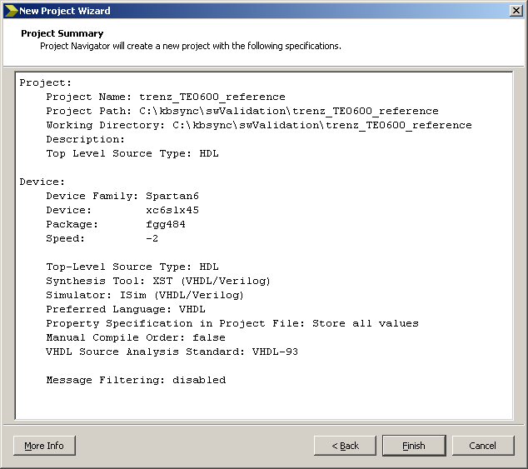
verify configuration and click Finish

Slide 8
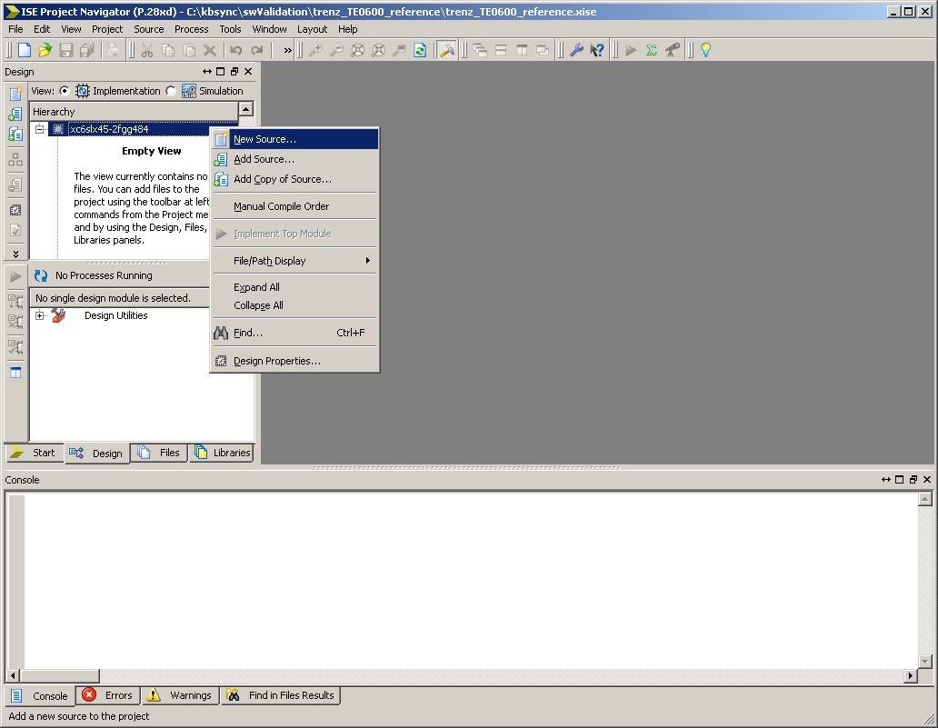
right button menu to add New Source

Slide 9
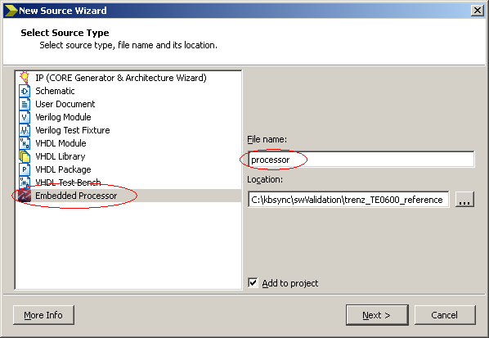
choose Embedded Processor, provide File name then click Next

Slide 10
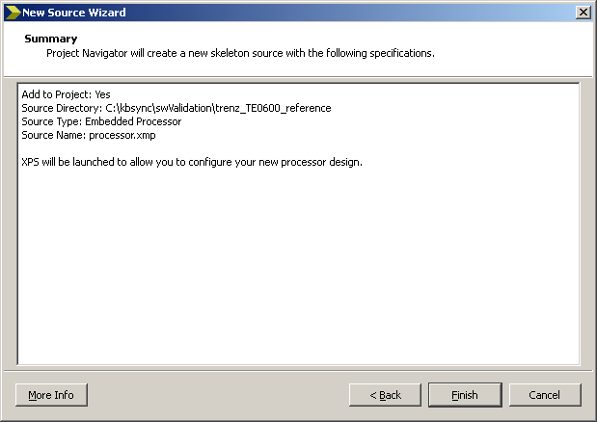
verify configuration then click Finish

Slide 11
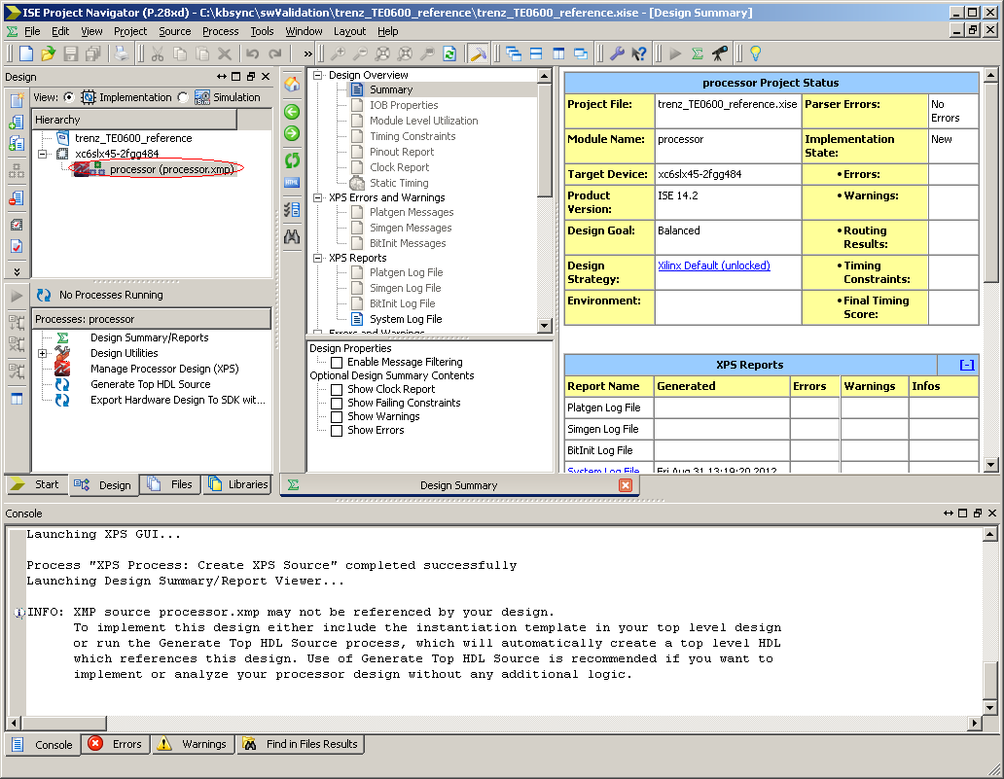
Double click on processor.xmp

Slide 12
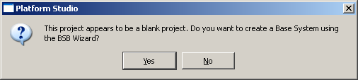
confirm Yes to launch BSB Wizard

Slide 13
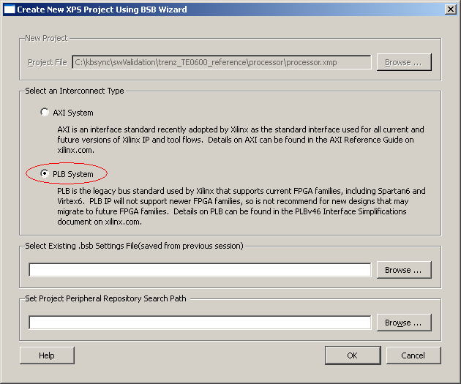
choose PLB system

Slide 14
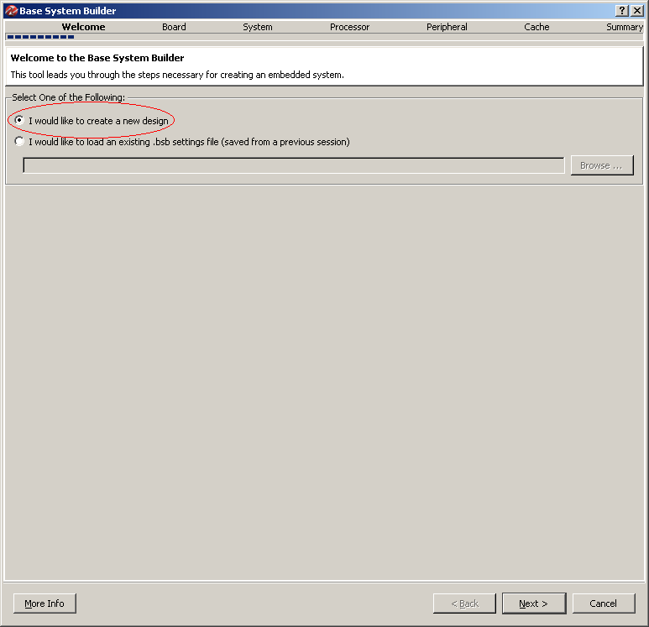
choose create new design then click Next

Slide 15
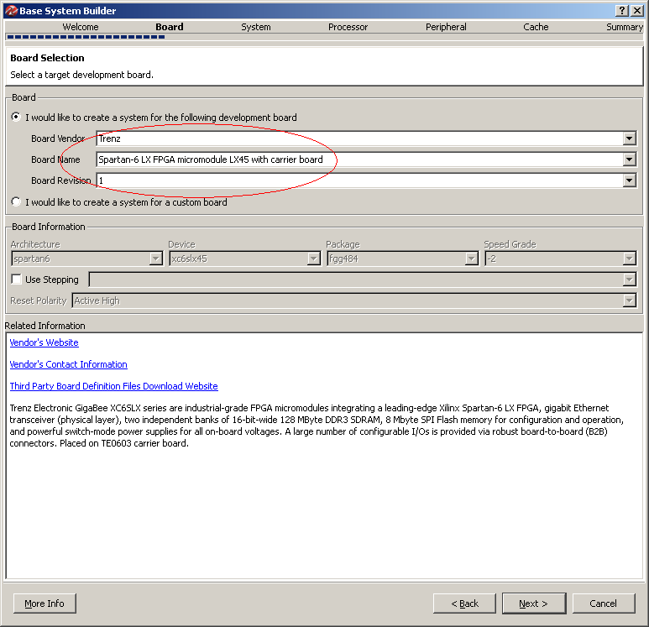
choose correct Vendor, Name and Revision then click Next

Slide 16
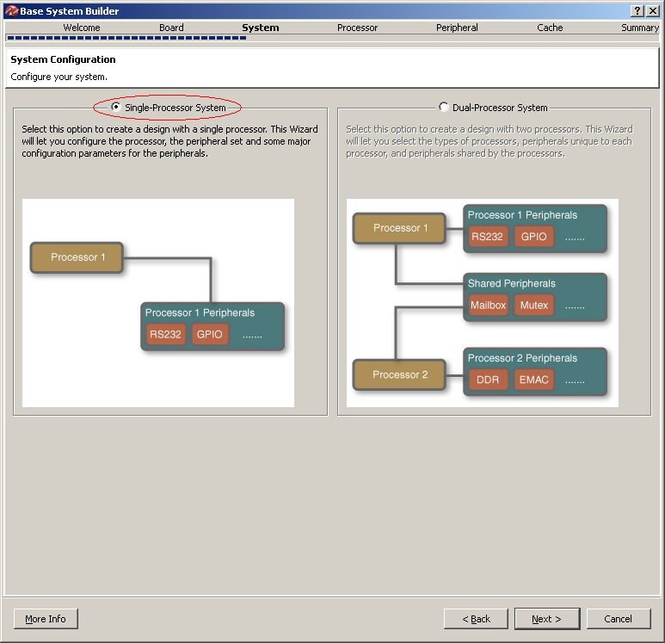
choose Single-Processor System then click Next

Slide 17
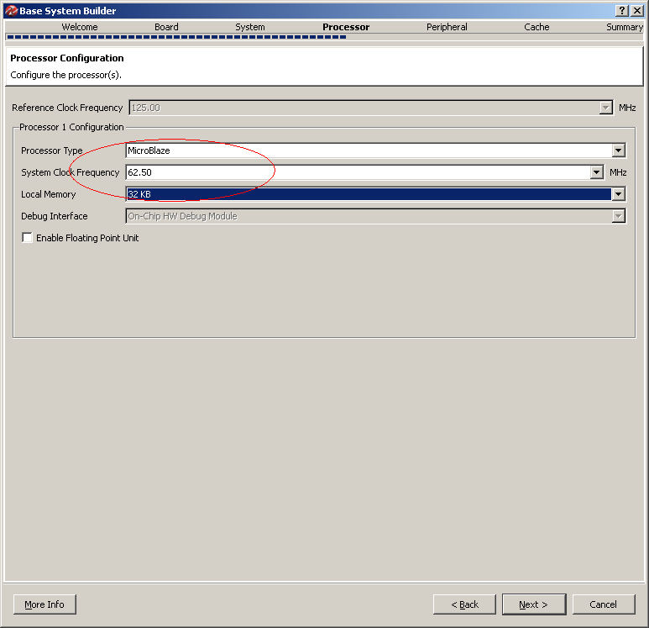
choose default Processor Type, System Clock
Frequency (half of the reference) and Local Memory size (32 Kb) then click Next

Slide 18
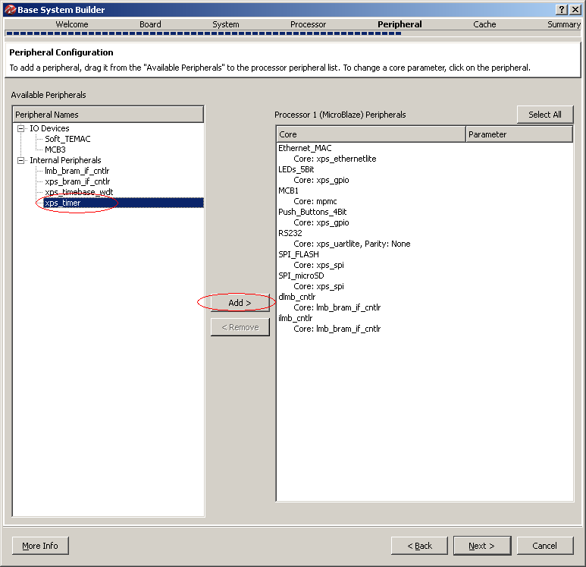
add xps_timer (XilKernel required), then click Next

Slide 19
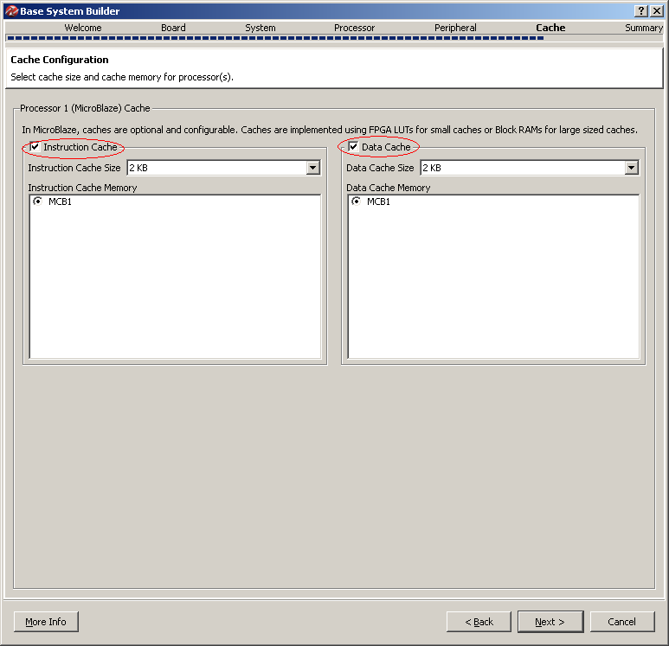
enable Instruction and Data Caches then click Next

Slide 20
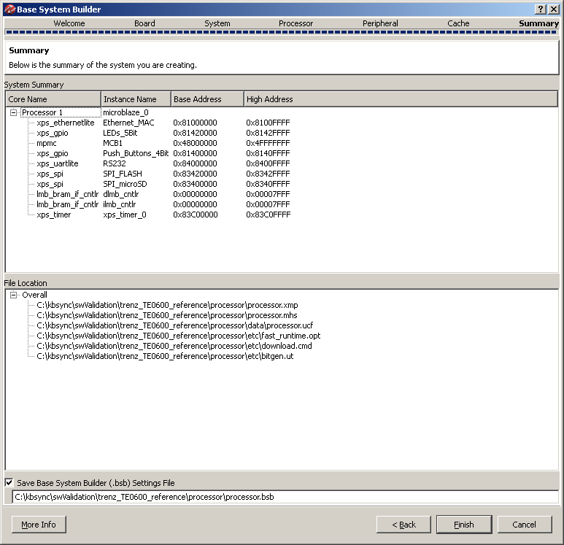
verify created configuration then click Finish

Slide 21
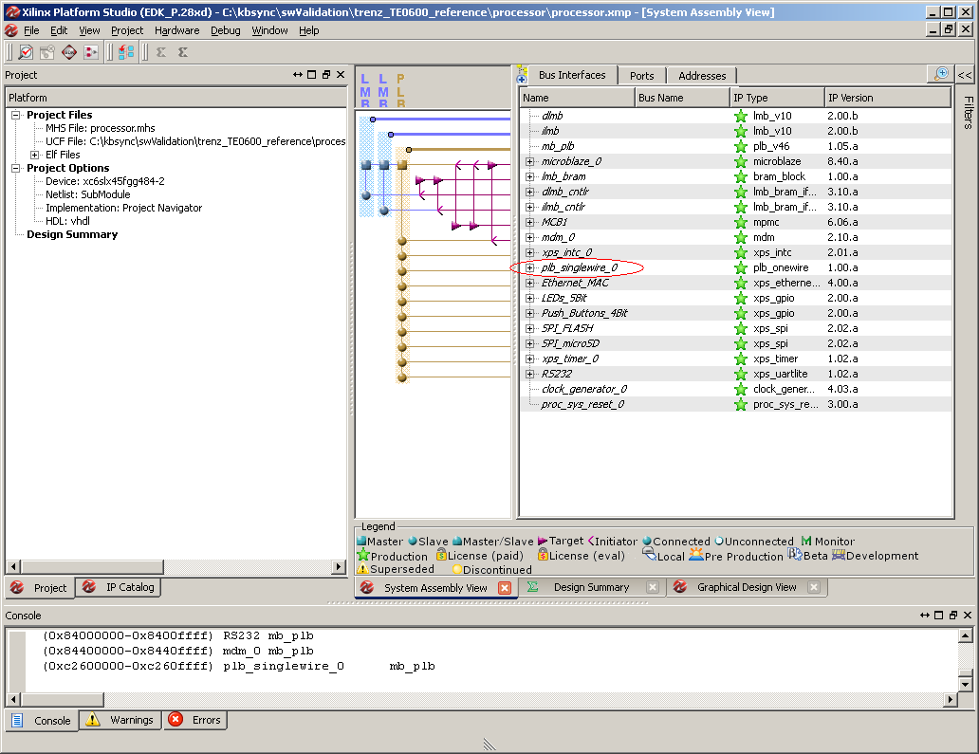
Verify singlewire pcore availability

Slide 22
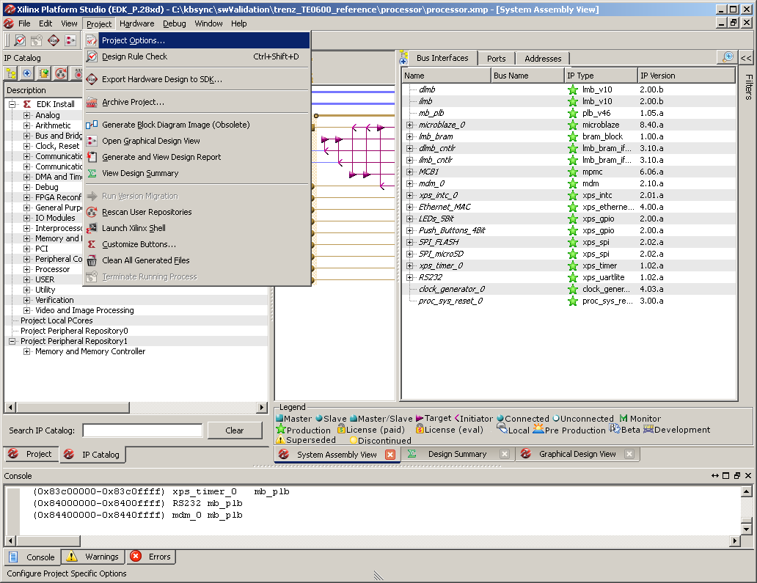
launch Project Options

Slide 23
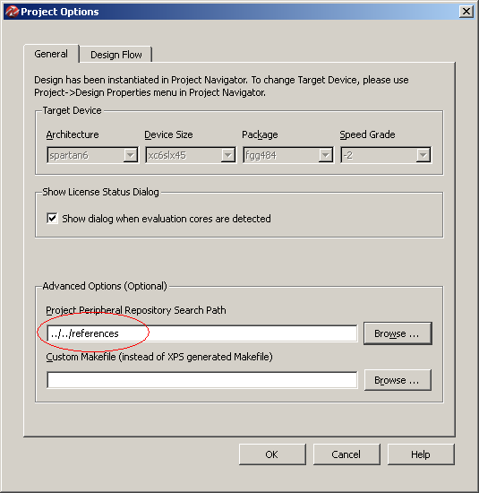
provide path to the private pcores (singlewire) then click OK

Slide 24
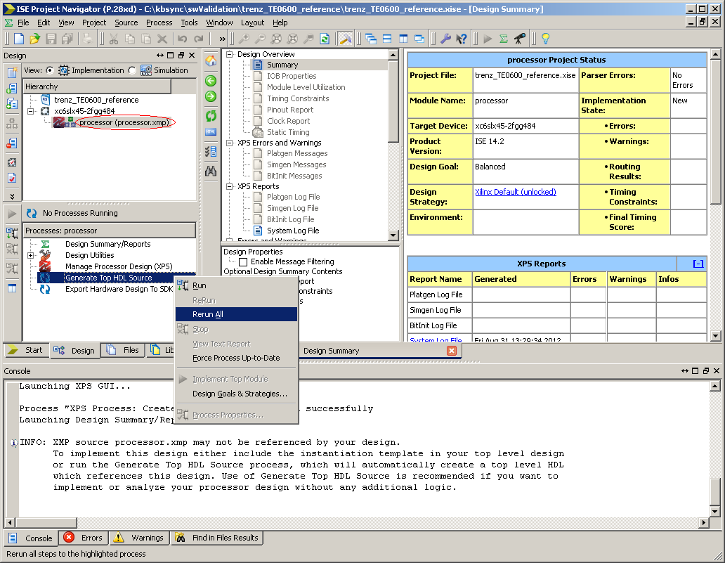
return to ISE Project Navigator, step on processor.xmp and generate TOP HDL Source

Slide 25
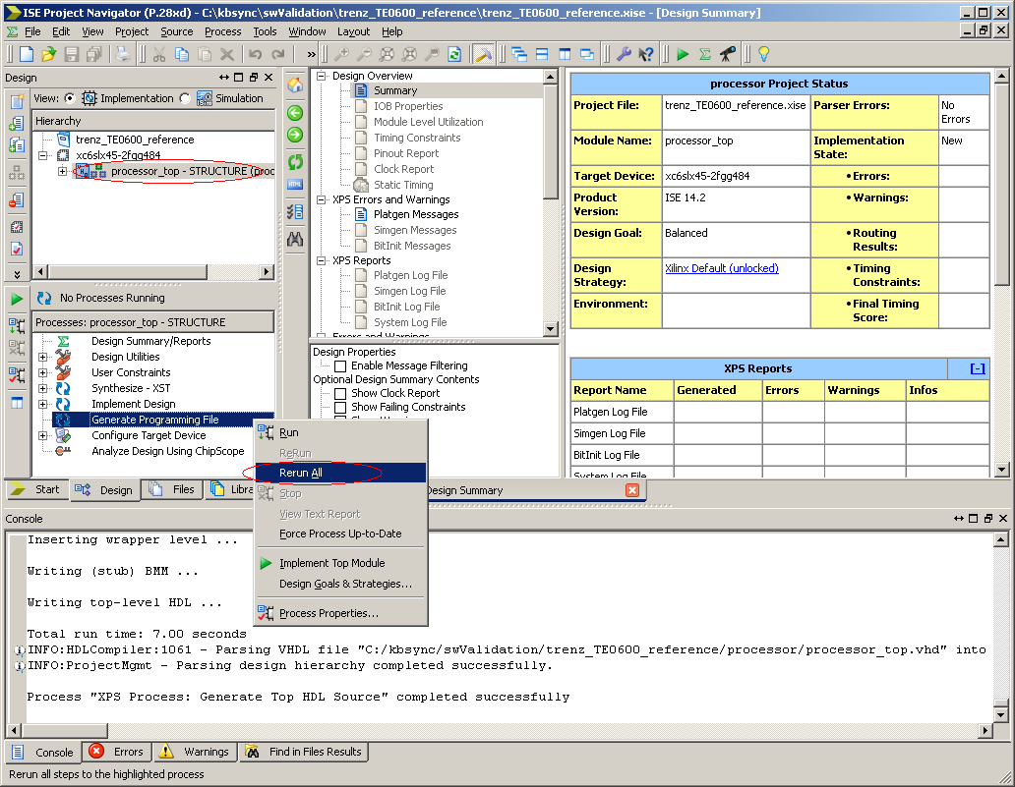
step on processor.xmp, choose Generate
Programming File and click Rerun All

Slide 26
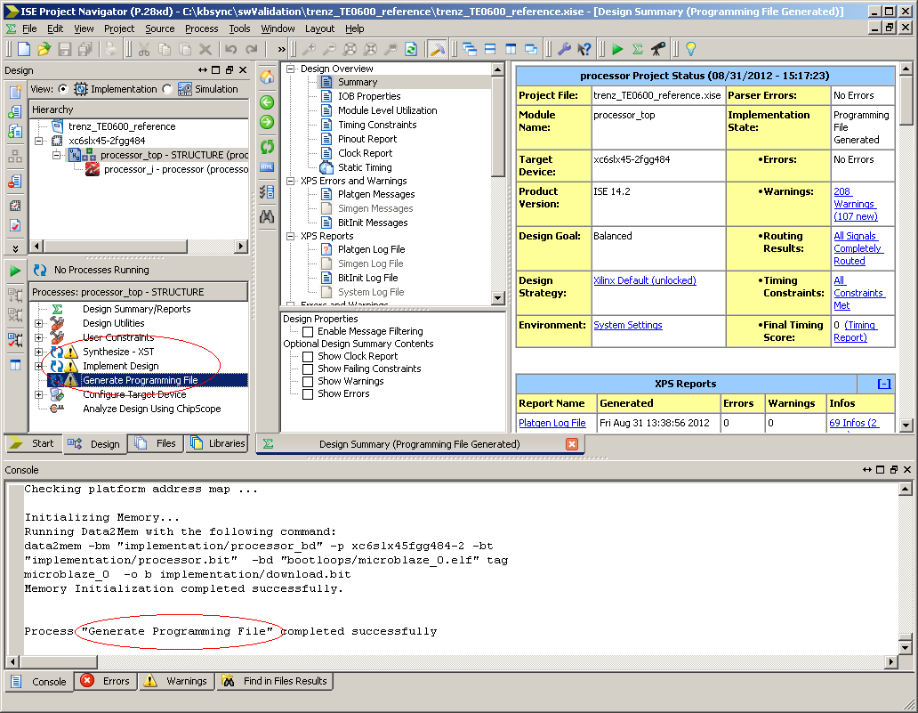
confirm generation success and return to Xilinx
Platform Studio

Slide 27
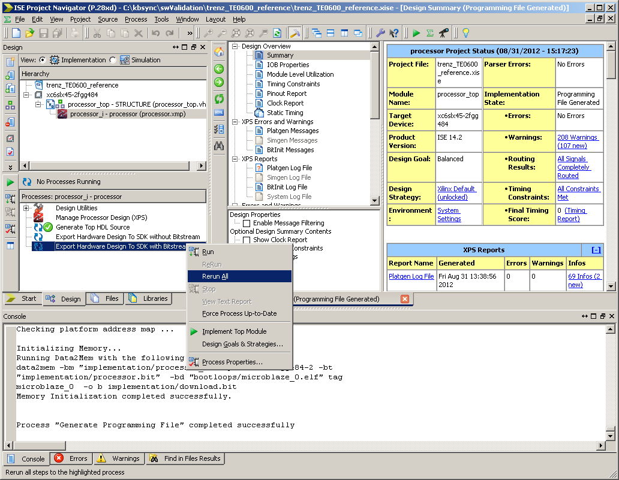
choose from menu Export Hardware Design to SDK with bitstream

Slide 28
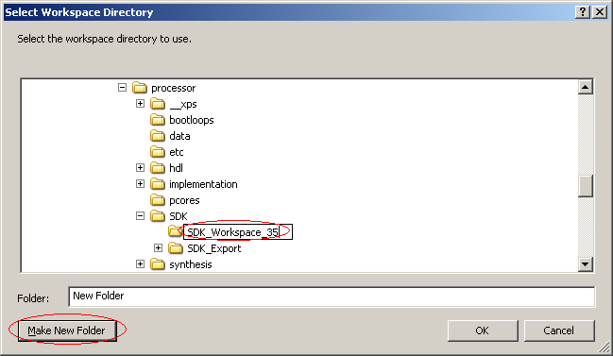
Create workspace working folder

Slide 29
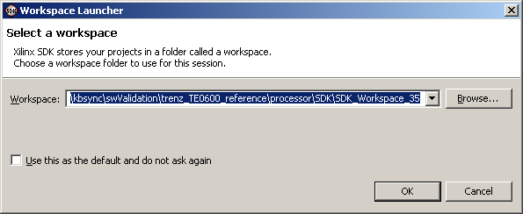
Confirm worspace location

Slide 30
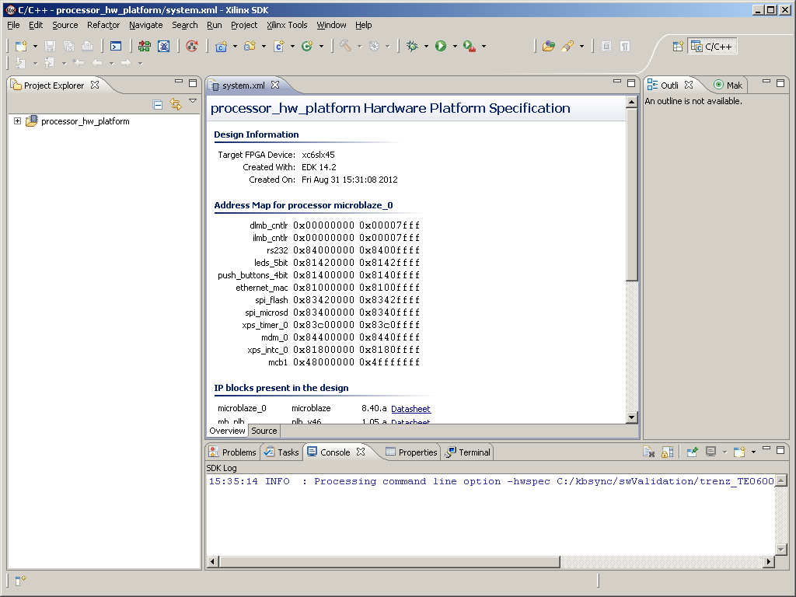
Obtain empty SDK configuration

Slide 31
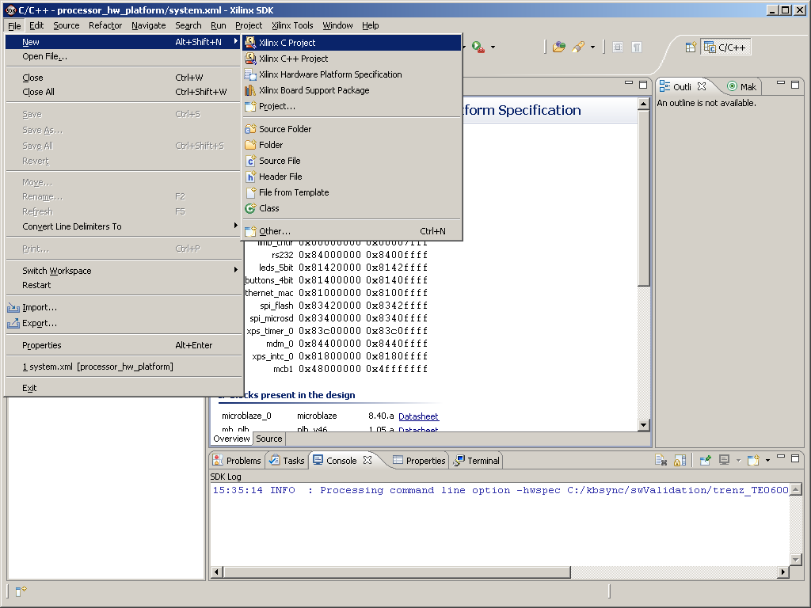
from SDK menu choose to create New Xilinx C
Project

Slide 32
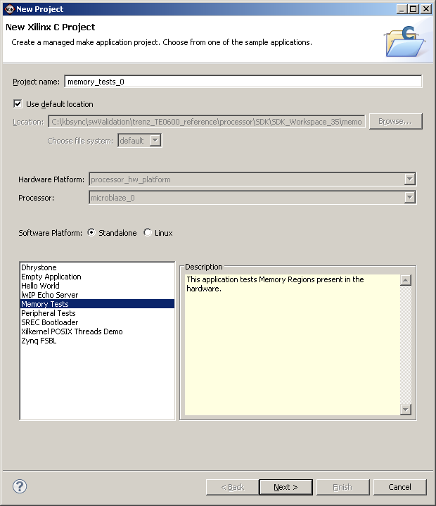
choose Memory Tests template and click Next

Slide 33
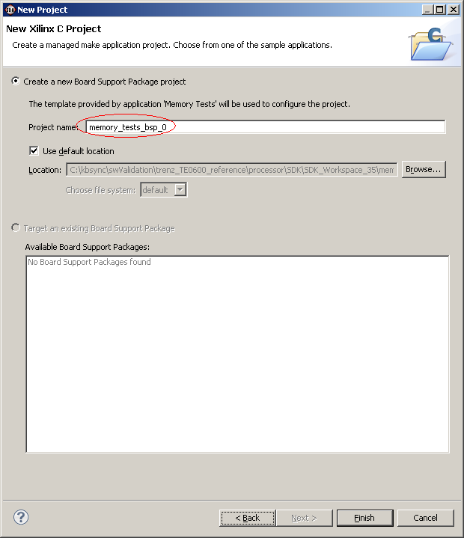
keep default BSP project name memory_tests_bsp_0 and click Finish

Slide 34
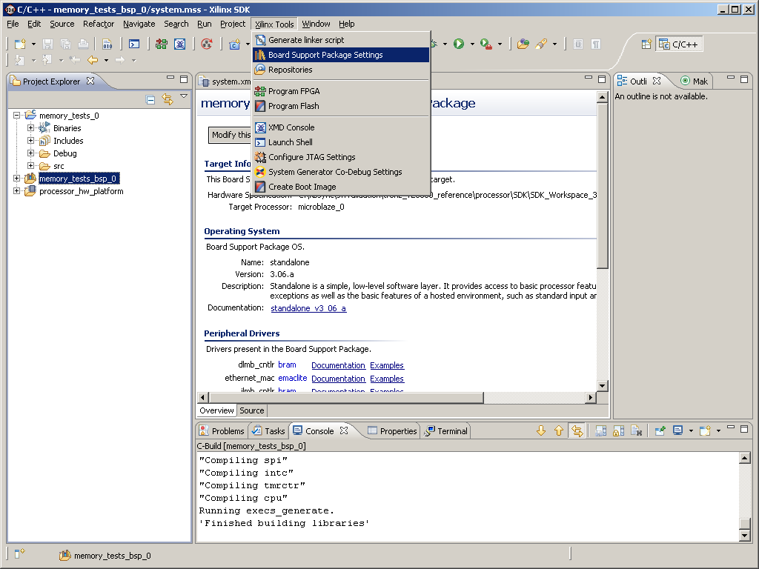
step on memory_tests_bsp_0 and choose Board
Support Package Settings menu

Slide 35
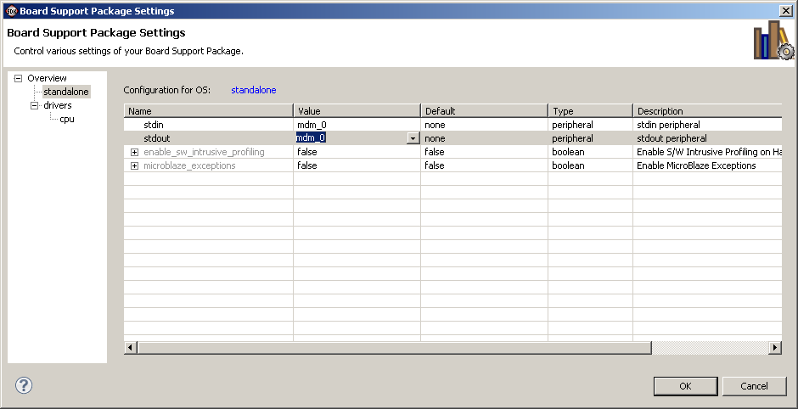
from standalone section apply mdm_0 to stdin and stdout then click OK

Slide 36
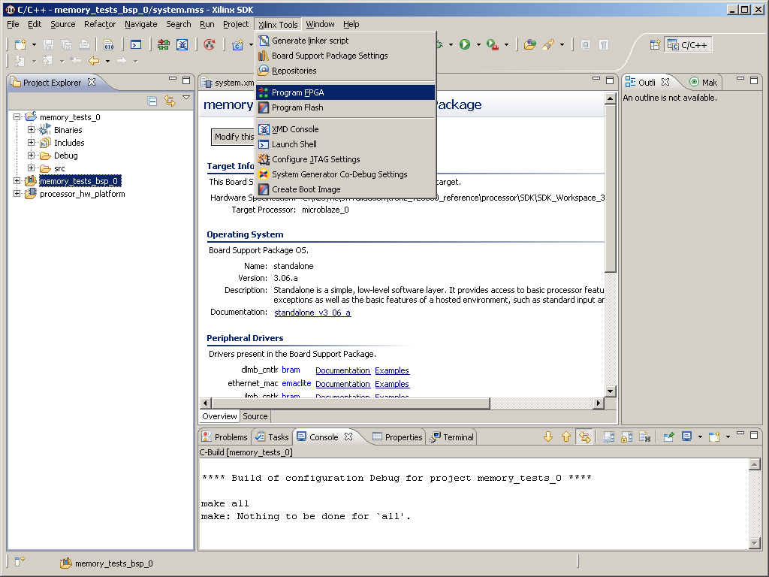
connect the prototype board TE0600 and choose
Program FPGA from menu

Slide 37
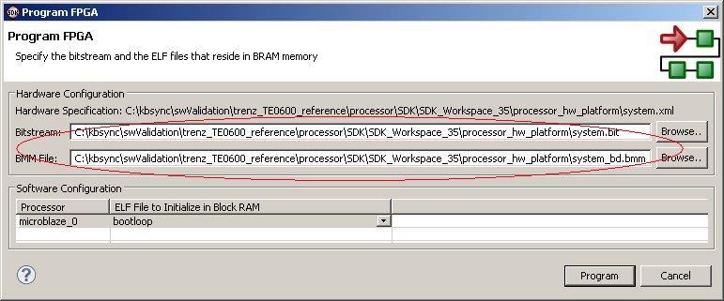
provide correct Bistream and BMM files then click
Program

Slide 38
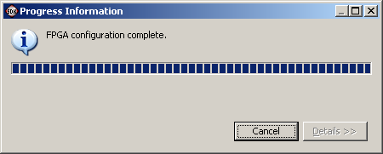
wait for FPGA programming completion

Slide 39
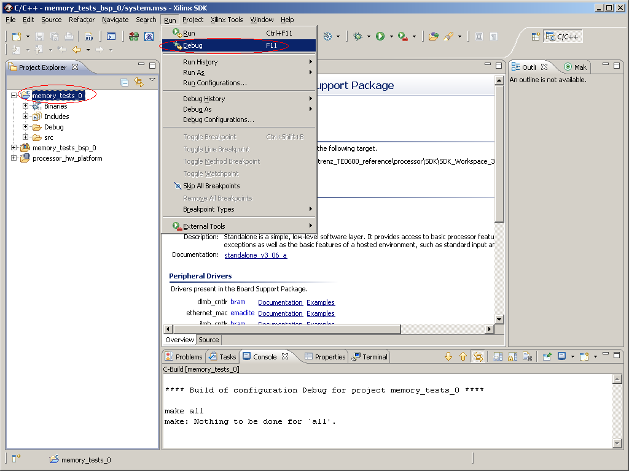
step on memory_tests_0 application and choose
Debug menu

Slide 40
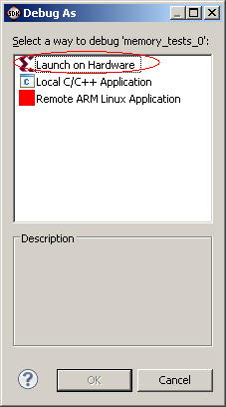
Confirm launch on a hardware

Slide 41
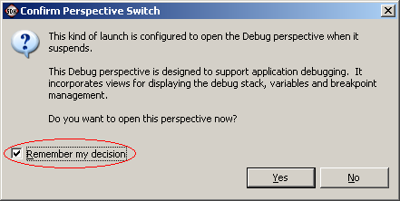
choose remember decision and confirm switching to
Debug design by clicking Yes button

Slide 42
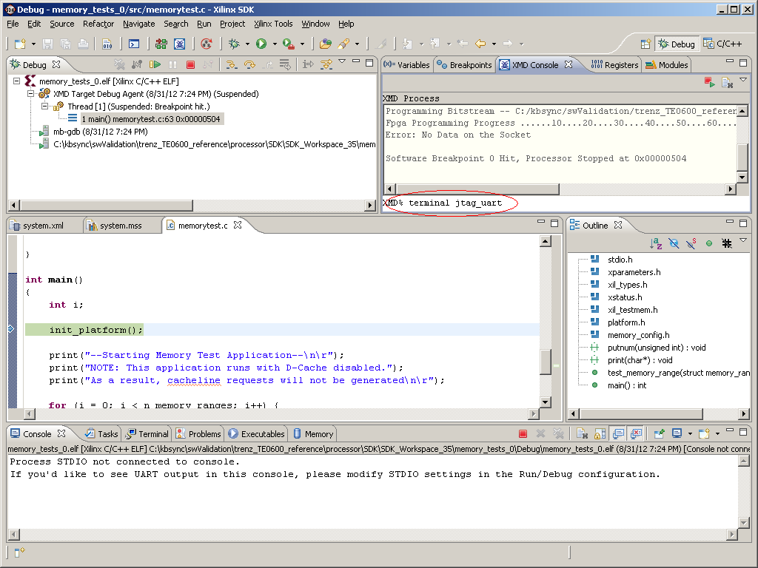
switch to XMD Console tab and type command
"terminal jtag_uart

Slide 43
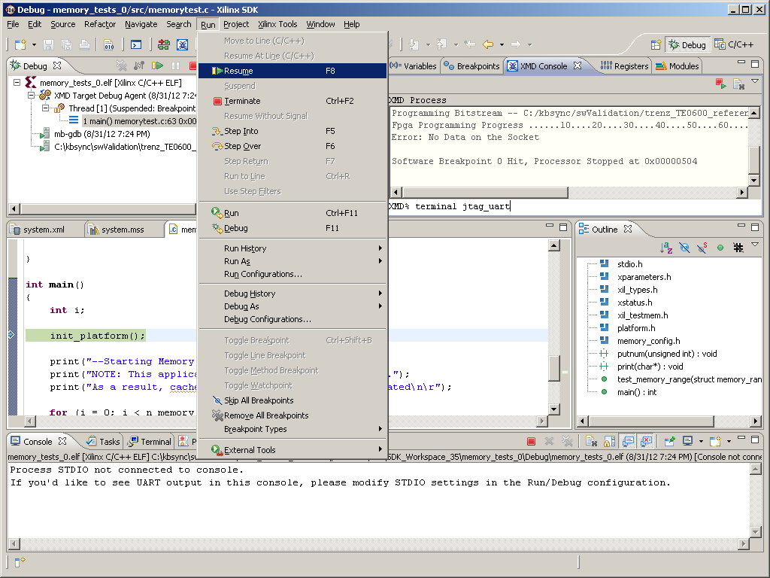
resume test application execution from Resume menu

Slide 44
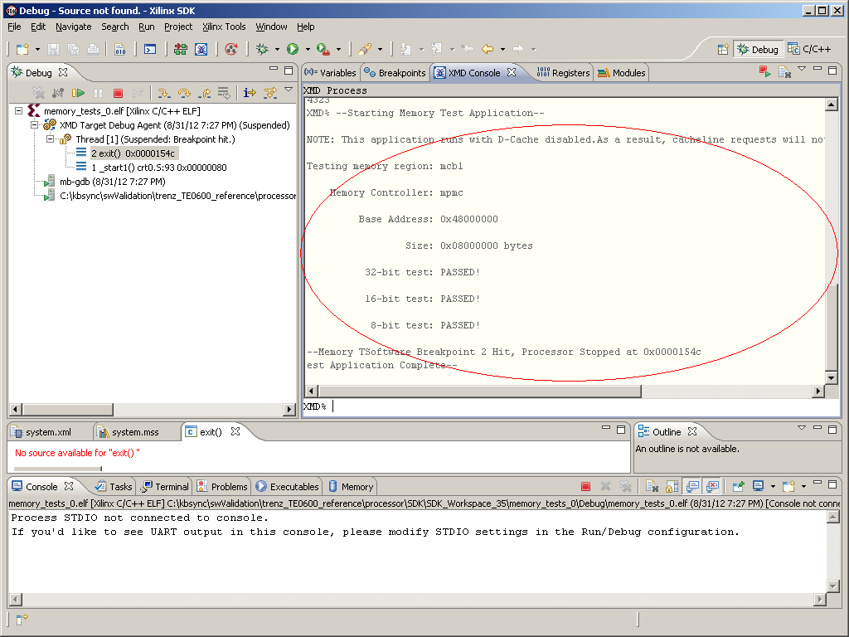
observe memory test execution and report messages

Slide 45
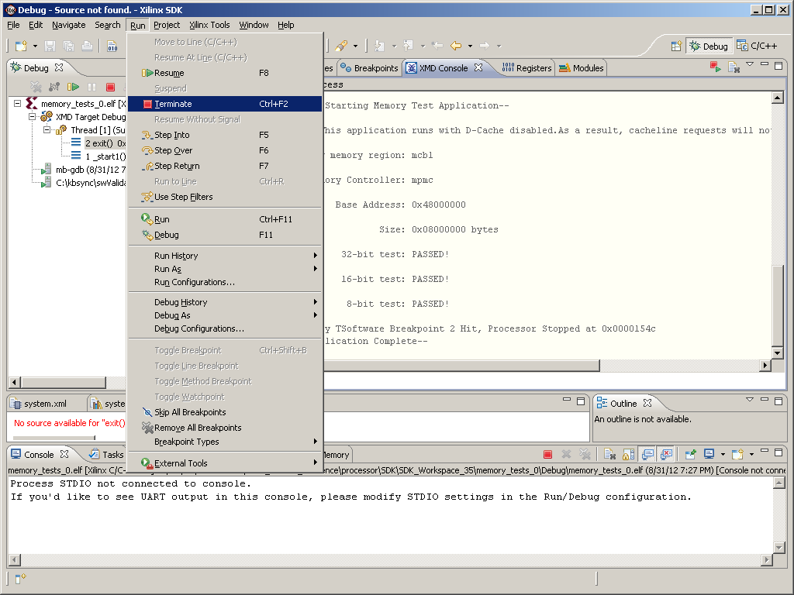
terminate successfully executed application

Slide 46
TE0600 board configuration
complete
external memory configuration
confirmed with test application

