Slide 1
TE0300 platform
reference project creation sequence

Slide 2
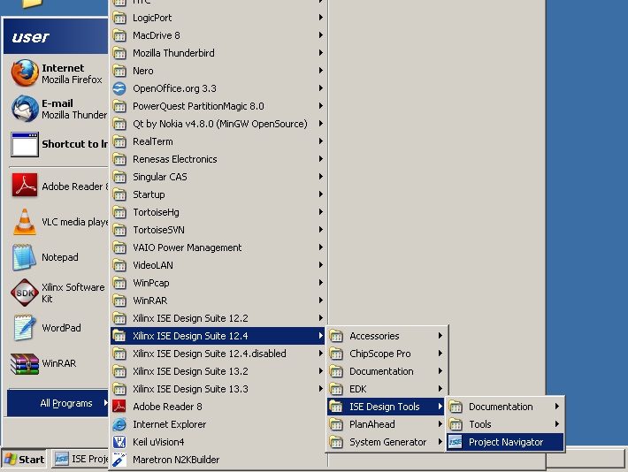
start Xilinx ISE Project Navigator

Slide 3
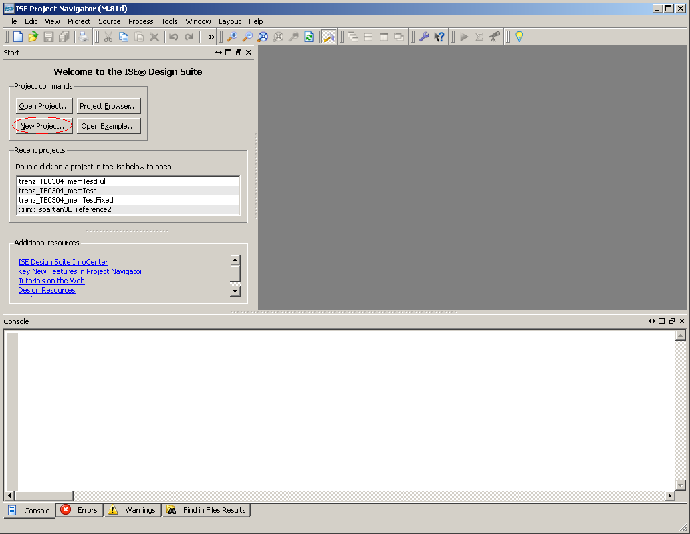
click button to create a new project

Slide 4
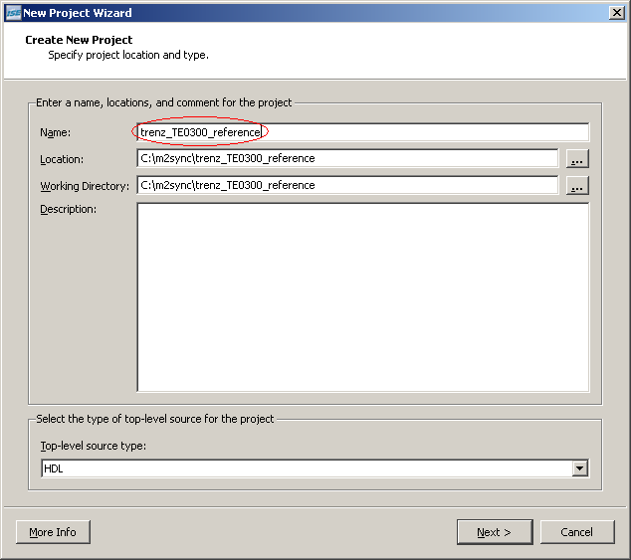
choose project name, then click Next

Slide 5
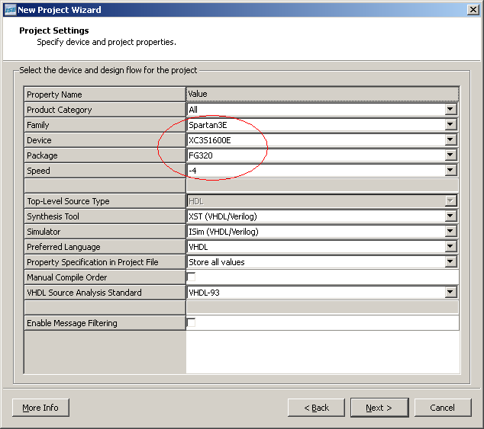
provide correct Family, Device, Package and Speed, then click Next

Slide 6
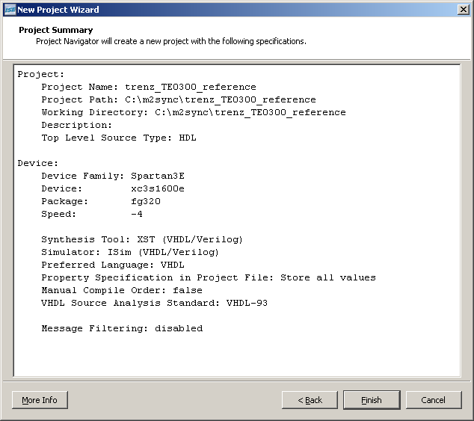
verify configuration and click Finish

Slide 7
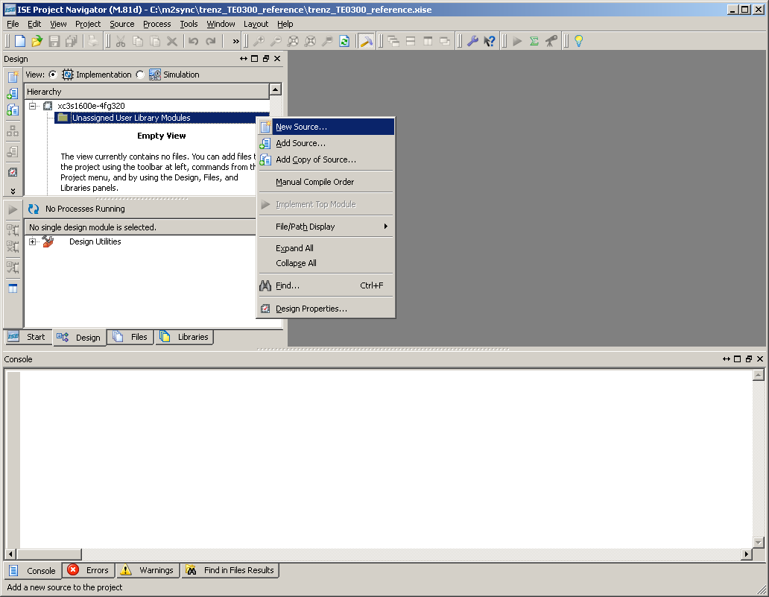
right button menu to add New Source

Slide 8
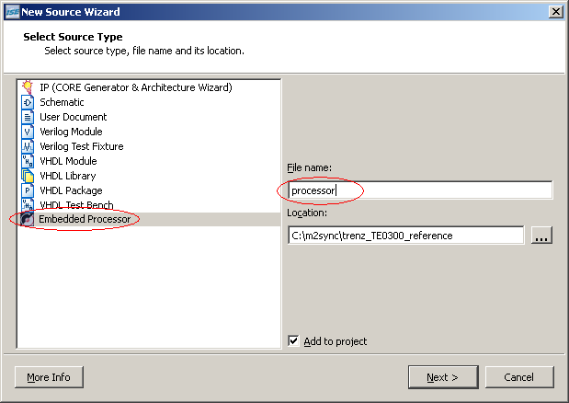
choose Embedded Processor, provide File name then click Next

Slide 9
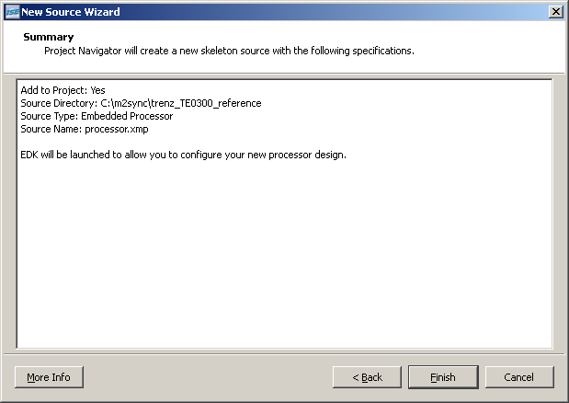
verify configuration then click Finish

Slide 10
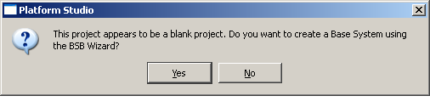
confirm Yes to launch BSB Wizard

Slide 11
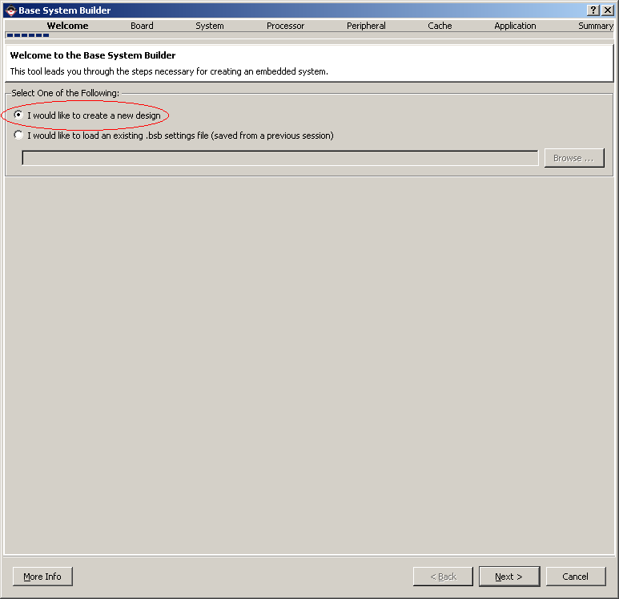
choose create new design then click Next

Slide 12
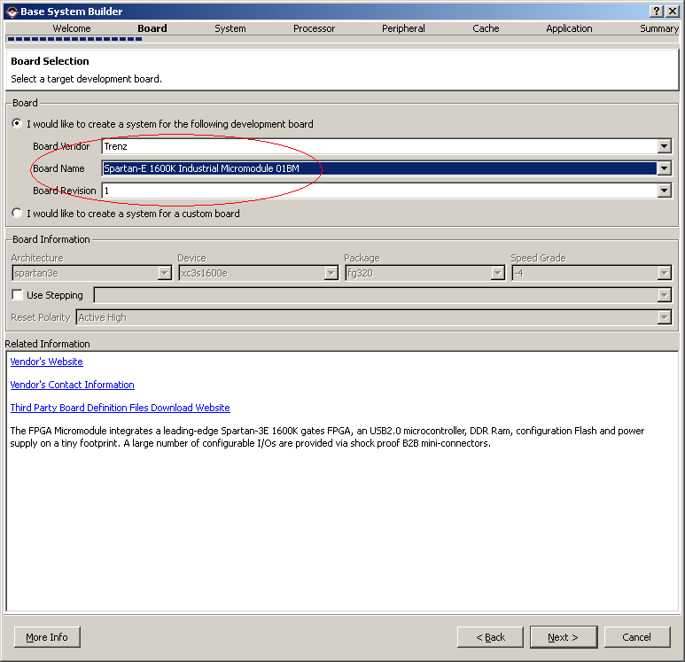
choose correct Vendor, Name and Revision then click Next

Slide 13
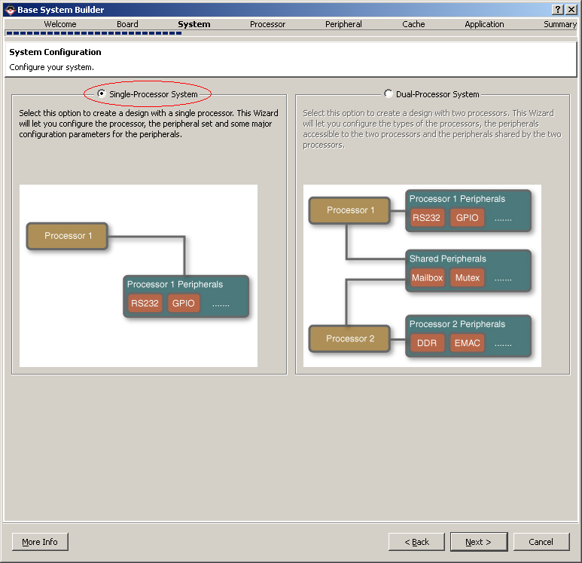
choose Single-Processor System then click Next

Slide 14
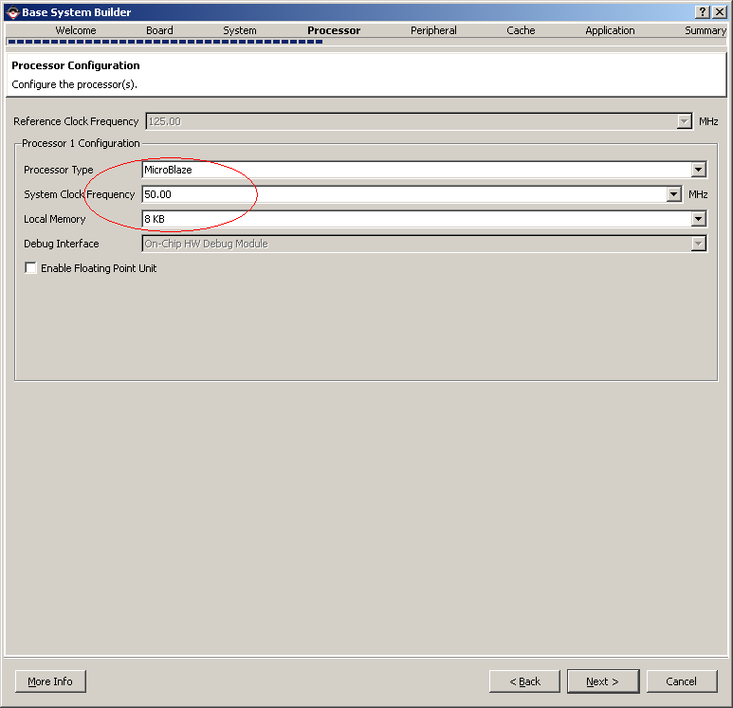
choose default Processor Type, System Clock Frequency (it will be fixed later) and Local Memory size then click Next

Slide 15
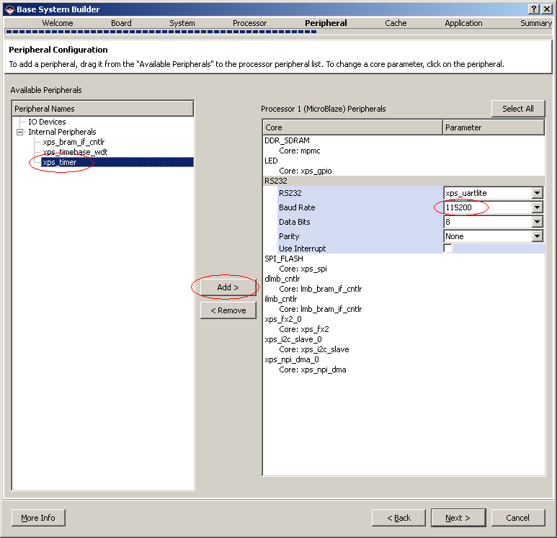
add xps_timer (XilKernel required), correct default UART speed then click Next

Slide 16
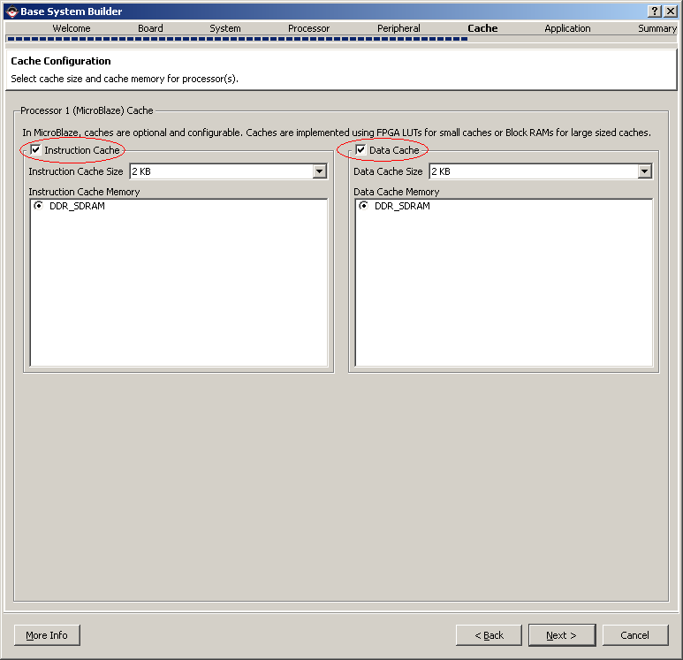
enable Instruction and Data Caches then click Next

Slide 17
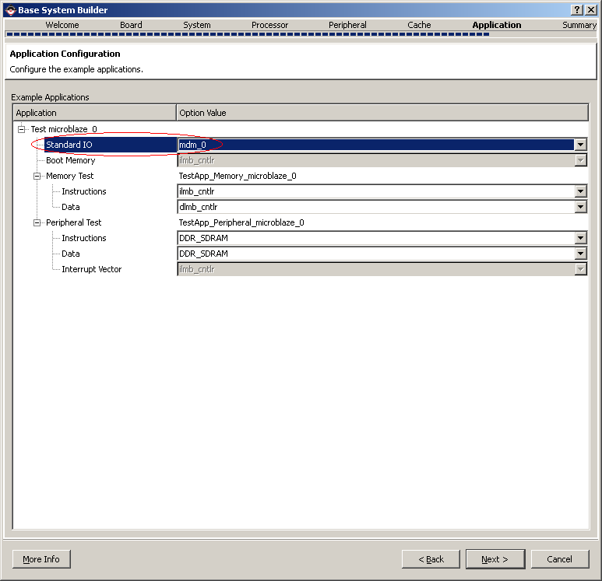
choose mdm_0 as Standard IO then click Next

Slide 18
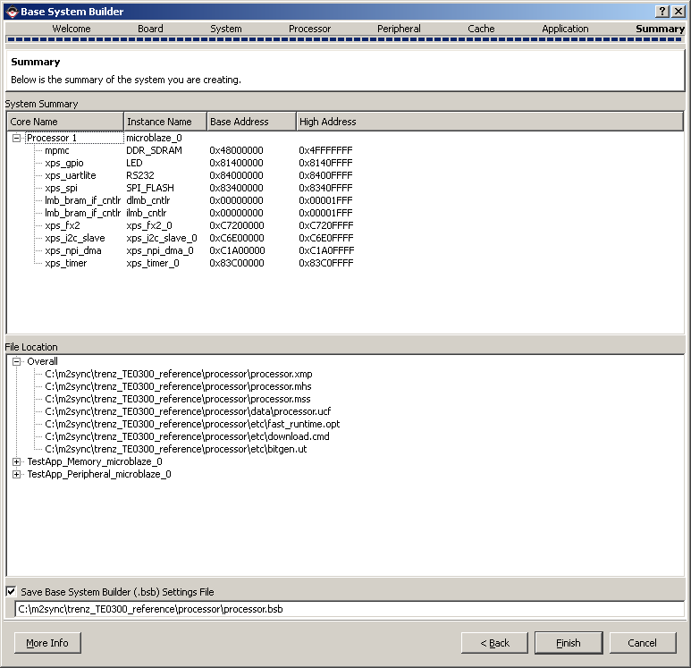
verify created configuration then click Finish

Slide 19
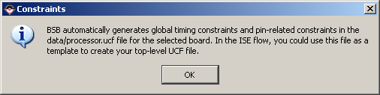
confirm UCF file creation

Slide 20
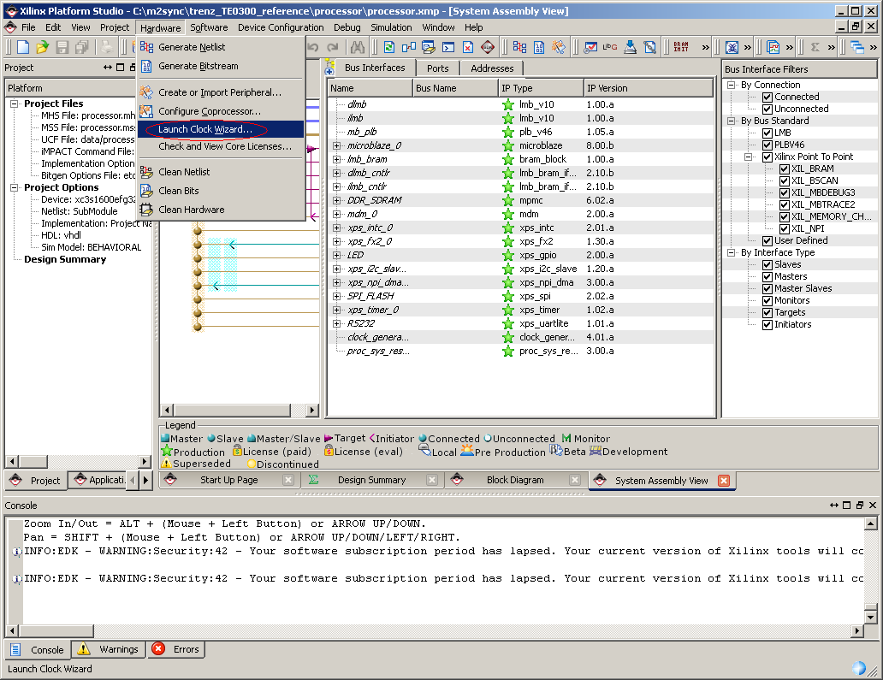
launch Clock Wizard

Slide 21
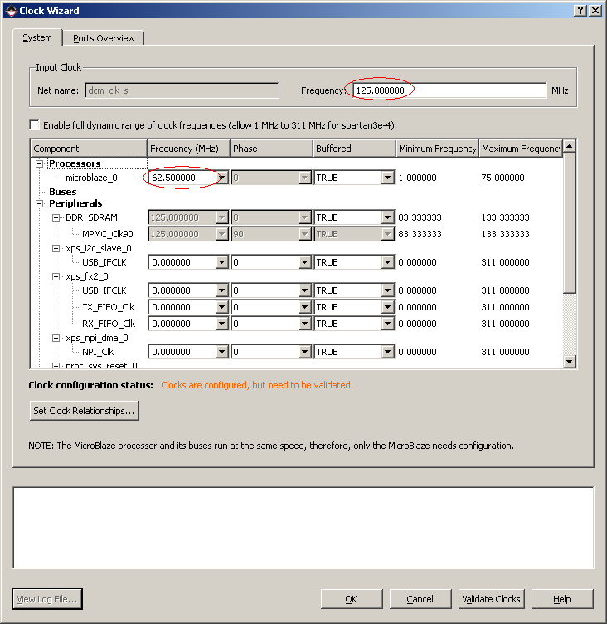
identify Input Clock frequency and choose exactly 1/2 for microblaze_0 then Validate Clocks and OK

Slide 22
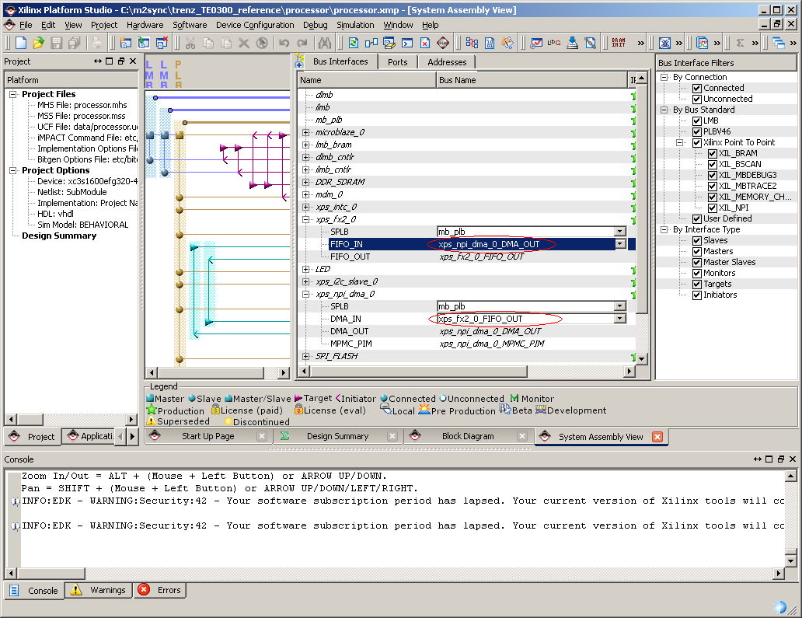
connect npi_dma and fx2 pcores to each other

Slide 23
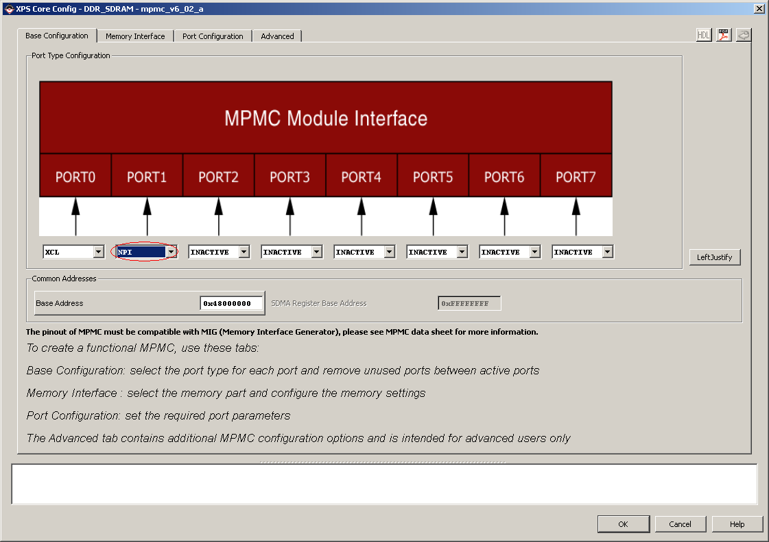
double click on DDR_SDRAM pcore and configure NPI port

Slide 24
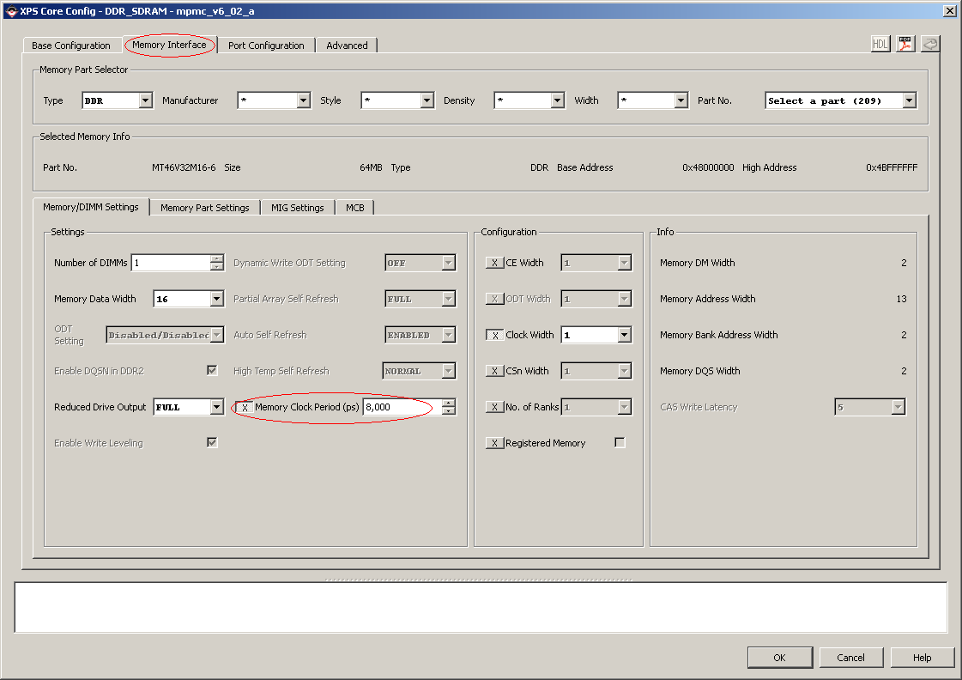
switch to Memory Interface tab and activate Clock Period (8000 ps for 125Mhz, 10000 ps for 100Mhz)

Slide 25
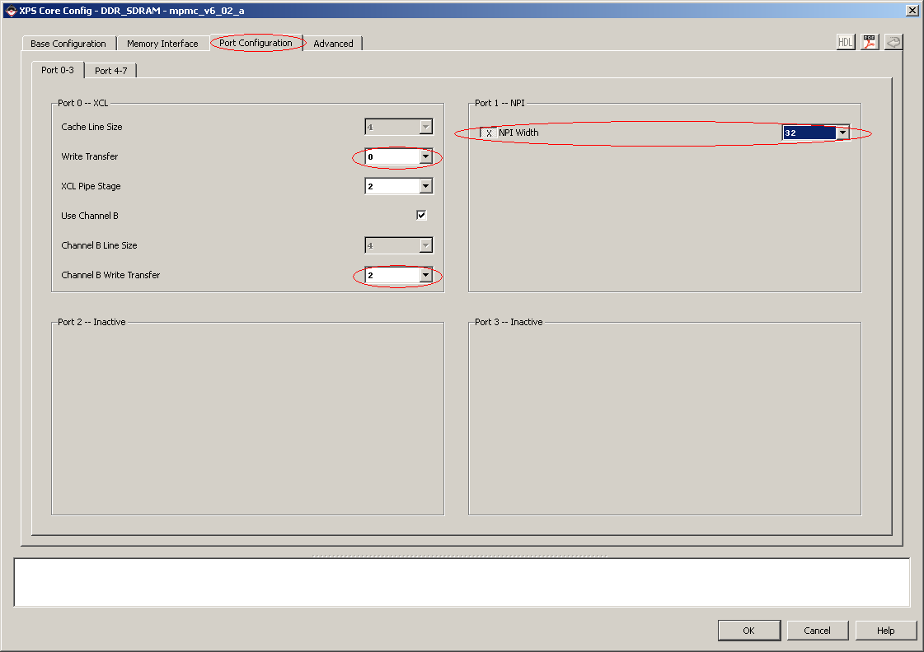
switch to Port Configuration tab, correct Write Transfers and NPI Width then click OK

Slide 26
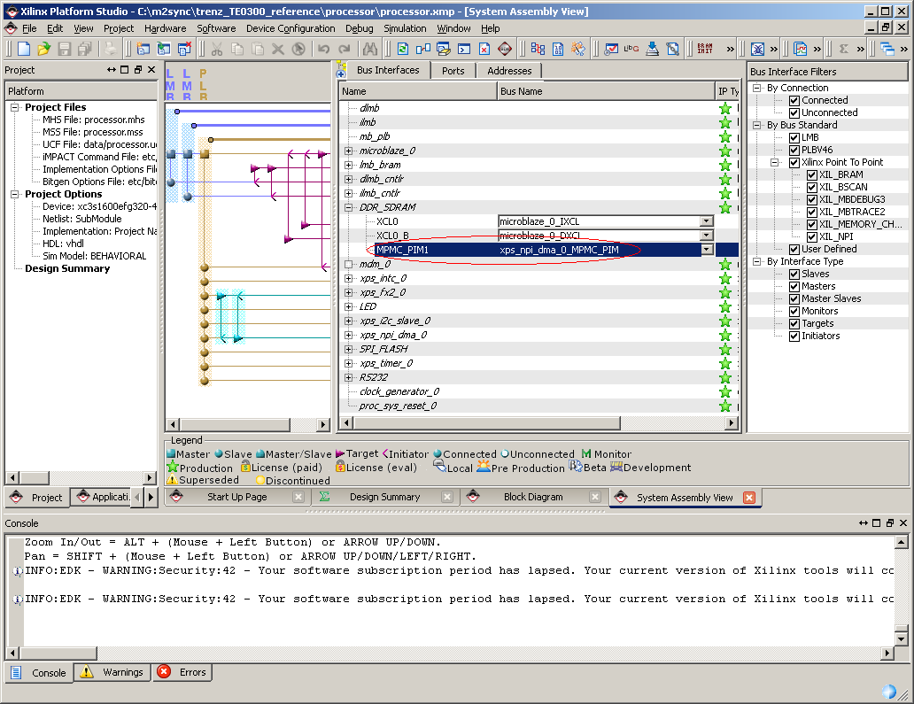
connect mpmc and npi_dma pcores

Slide 27
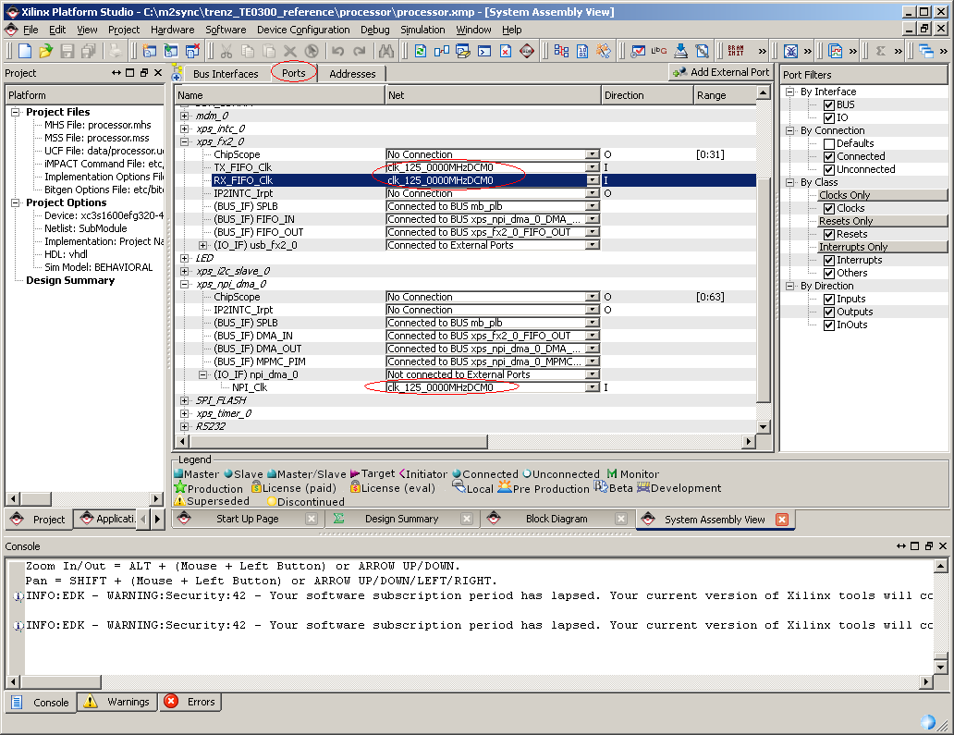
switch to Ports tab and assign npi_dma and fx2 clocks

Slide 28
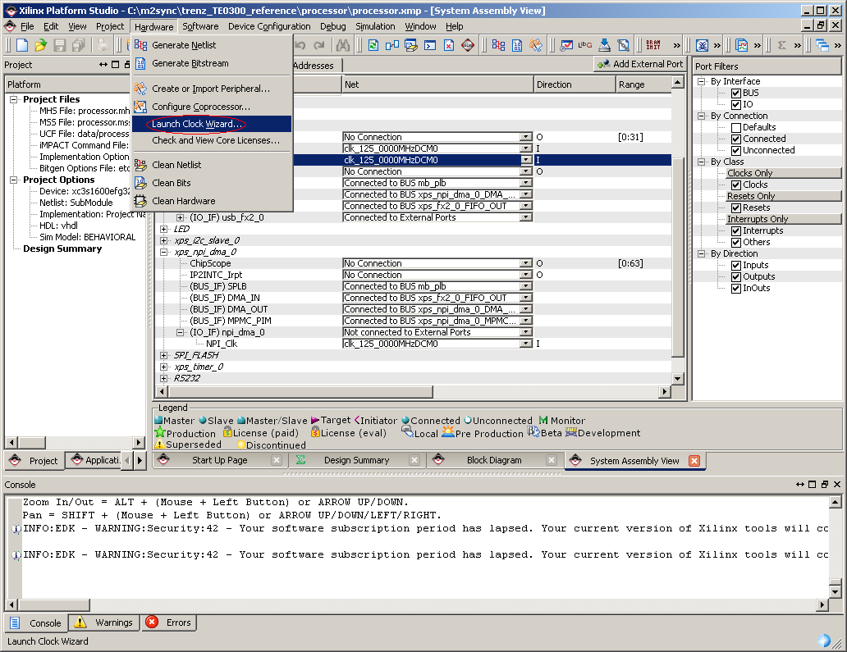
re-launch Clock Wizard

Slide 29
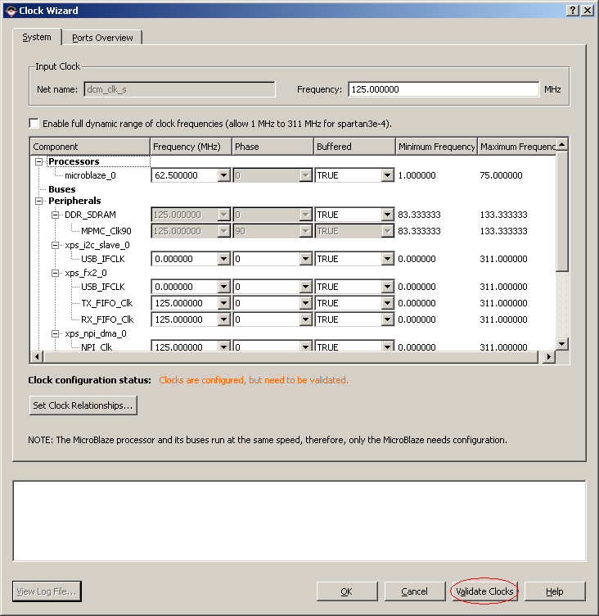
re-validate clocks then click OK

Slide 30
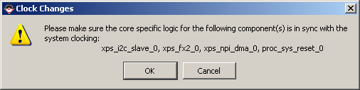
confirm Clock Changes

Slide 31
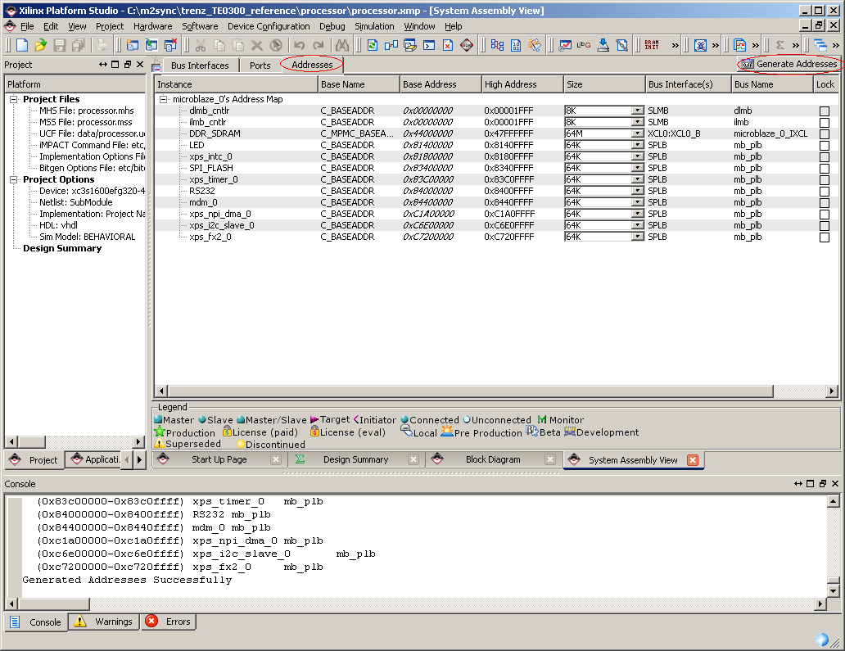
switch to Addresses tab and re-generate addresses

Slide 32
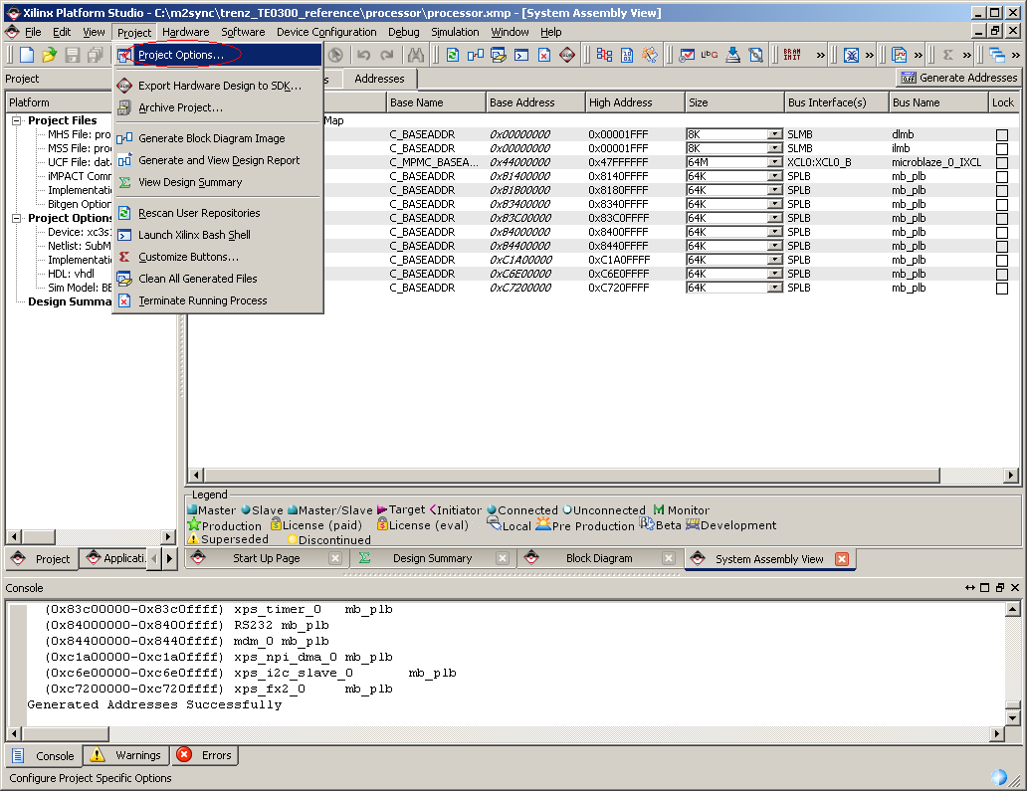
launch Project Options

Slide 33
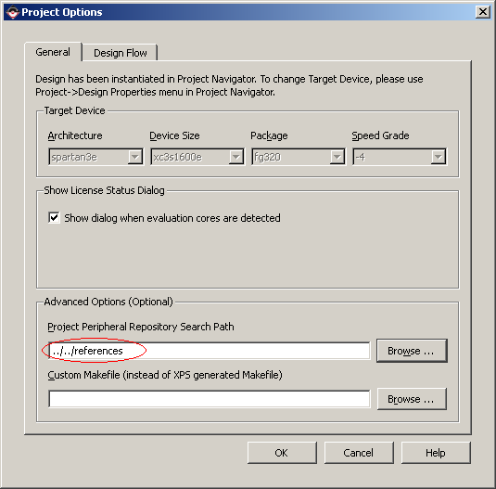
provide path to the private pcores (npi_dma, fx2, i2c_slave) then click OK

Slide 34
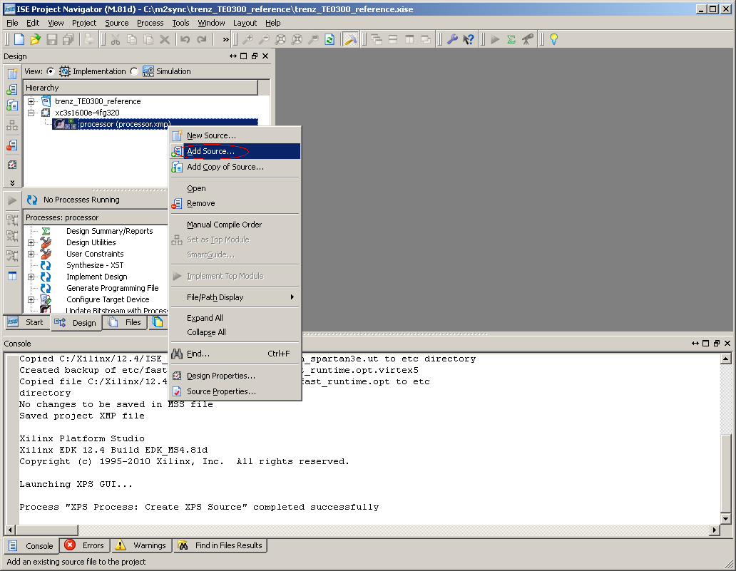
return to ISE Project Navigator and add Source

Slide 35
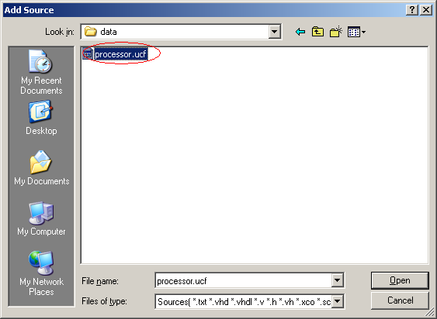
choose processor.ucf from processor/data/ subfolder then click Open

Slide 36
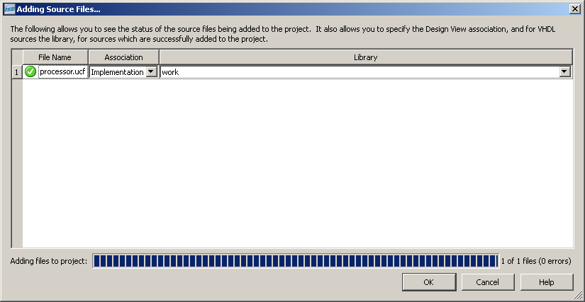
confirm adding Source File by clicking OK

Slide 37
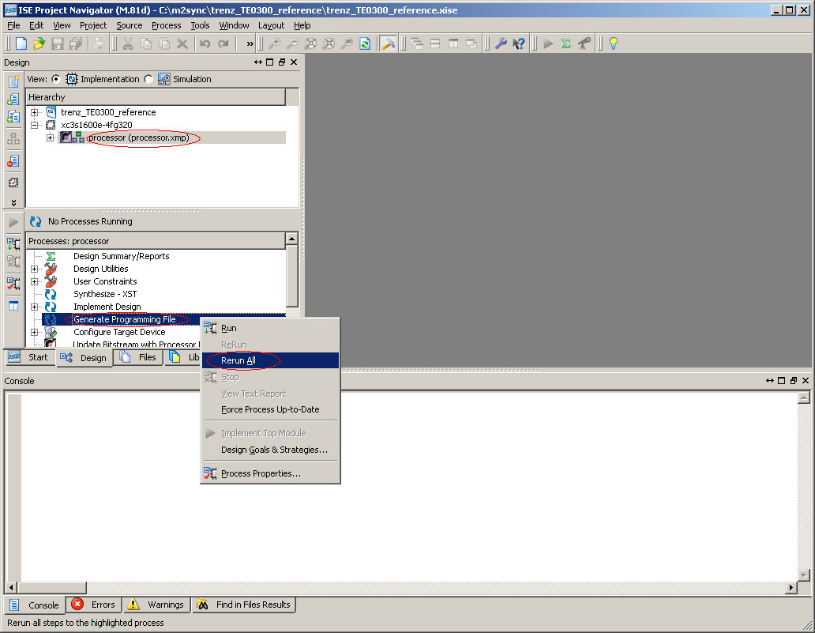
step on processor.xmp, choose Generate Programming File and click Rerun All

Slide 38
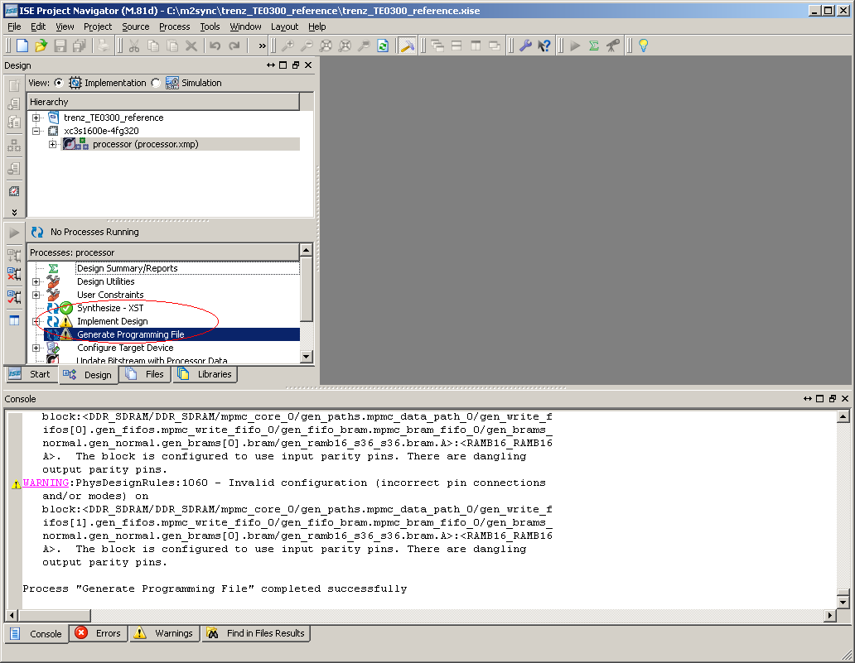
confirm generation success and return to Xilinx Platform Studio

Slide 39
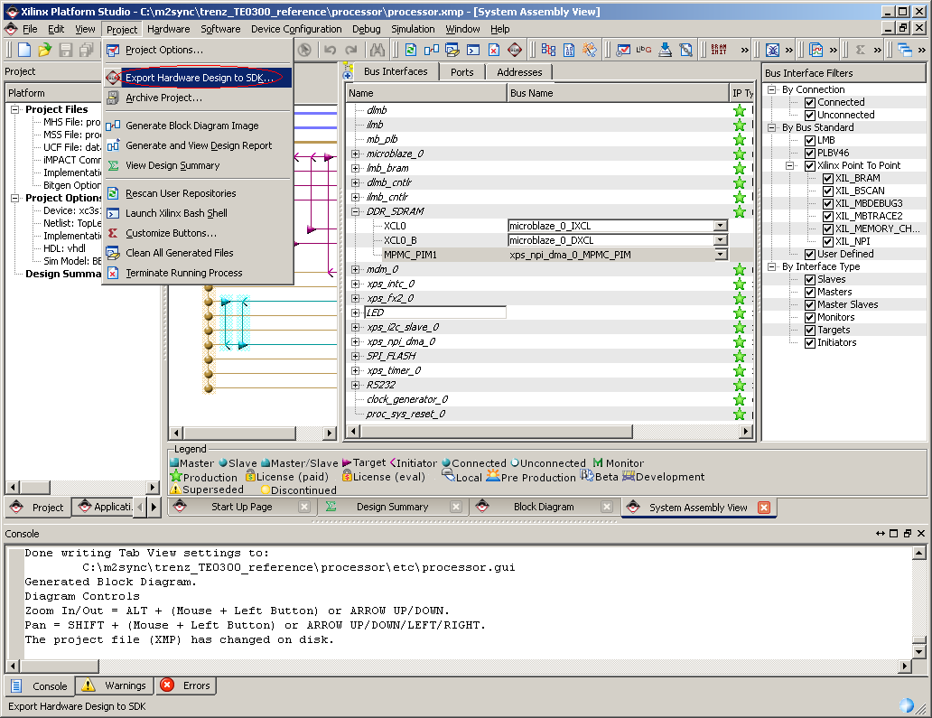
choose from menu Export Hardware Design to SDK

Slide 40
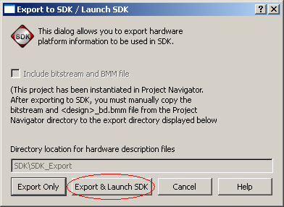
because Xilinx SDK isn't running yet, choose Export & Launch SDK button

Slide 41
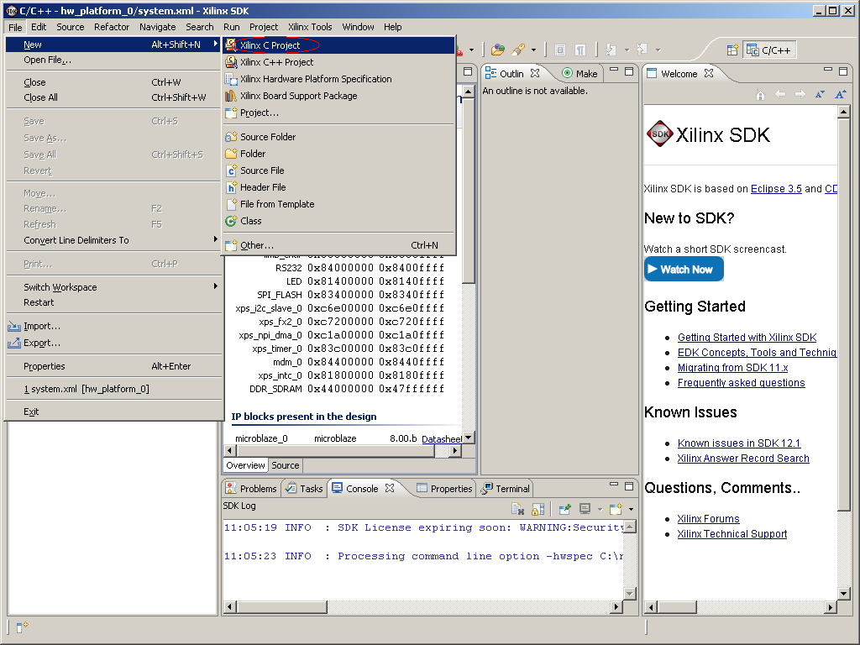
from SDK menu choose to create New Xilinx C Project

Slide 42
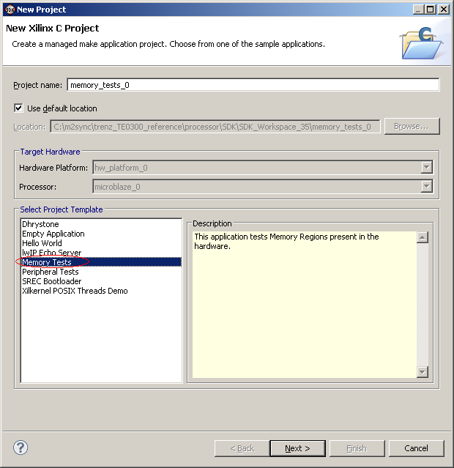
choose Memory Tests template and click Next

Slide 43
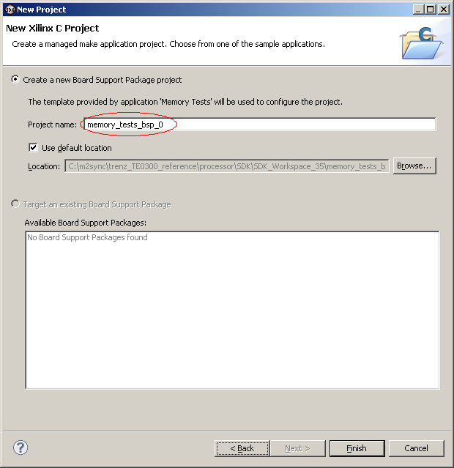
keep default BSP project name memory_tests_bsp_0 and click Finish

Slide 44
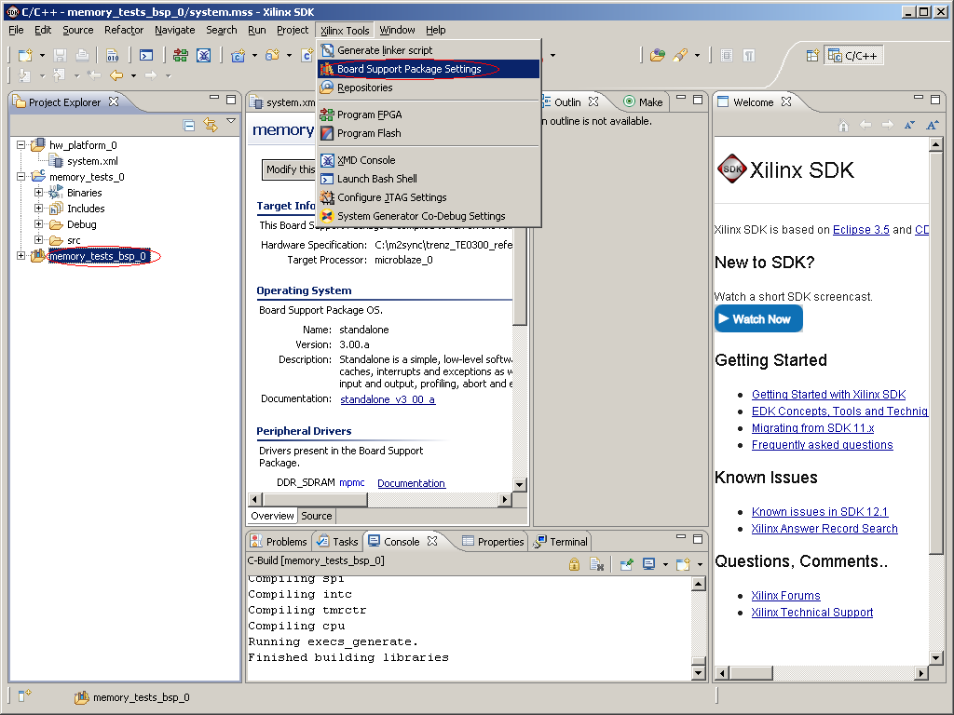
step on memory_tests_bsp_0 and choose Board Support Package Settings menu

Slide 45
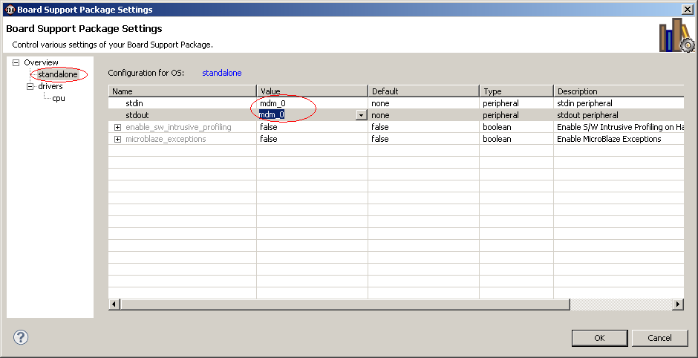
from standalone section apply mdm_0 to stdin and stdout then click OK

Slide 46
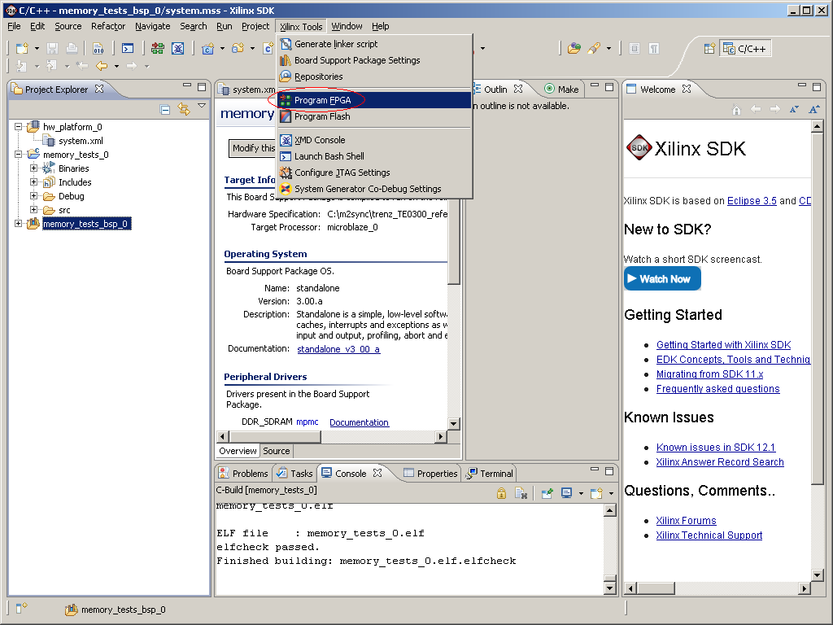
connect the prototype board TE0300 and choose Program FPGA from menu

Slide 47
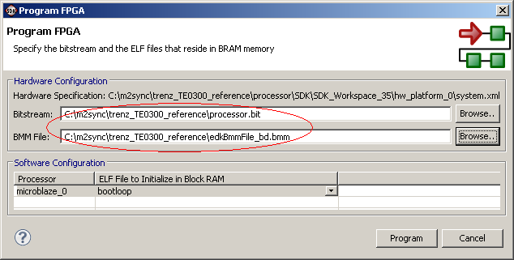
provide correct Bistream and BMM files then click Program

Slide 48
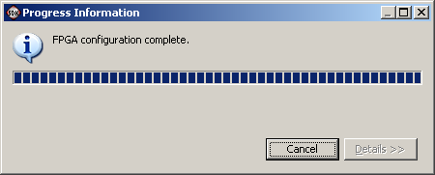
wait for FPGA programming completion

Slide 49
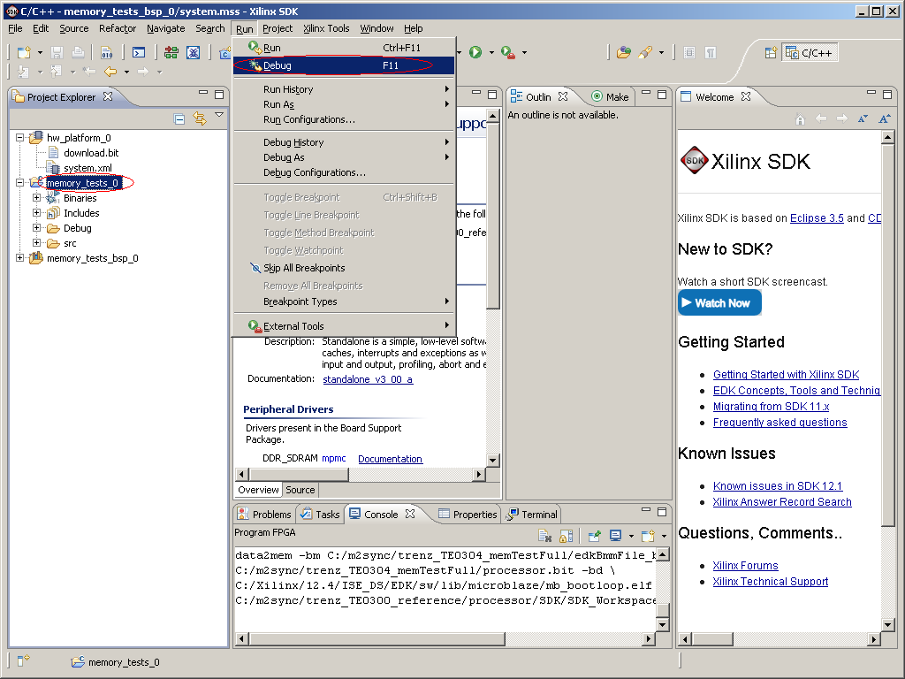
step on memory_tests_0 application and choose Debug menu

Slide 50
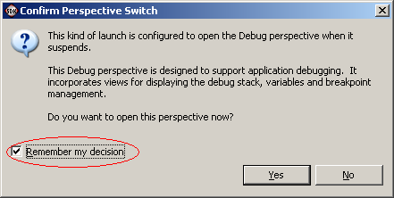
choose remember decision and confirm switching to Debug design by clicking Yes button

Slide 51
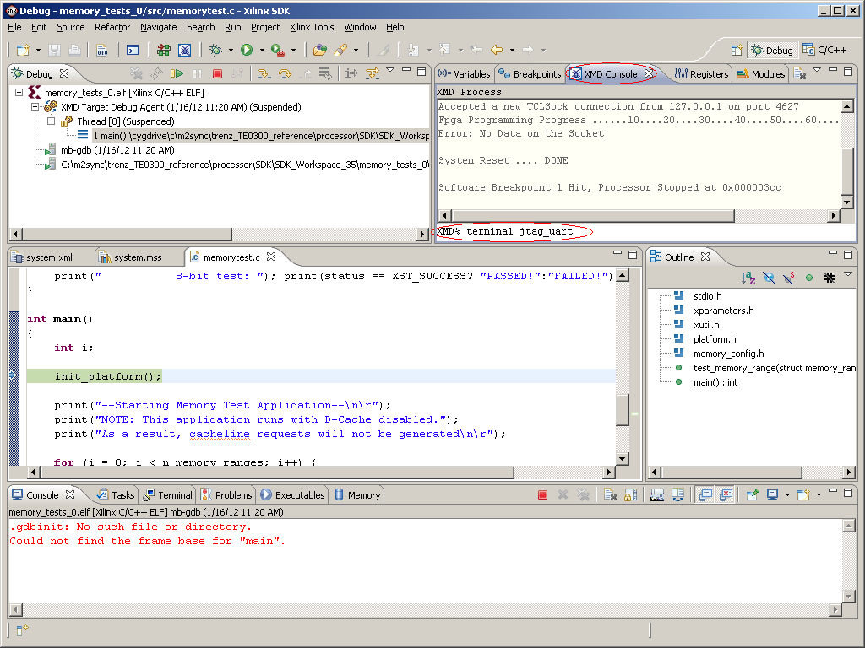
switch to XMD Console tab and type command "terminal jtag_uart"

Slide 52

resume test application execution from Resume menu

Slide 53

observe memory test execution and report messages

Slide 54

terminate successfully executed application

Slide 55
TE0300 board configuration complete
external memory configuration confirmed with test application

