Slide 1
TE0630 platform
reference project creation sequence

Slide 2
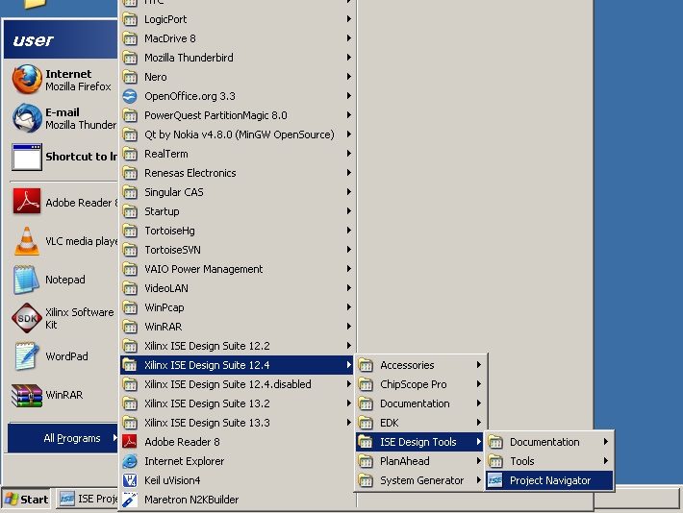
start Xilinx ISE Project Navigator

Slide 3
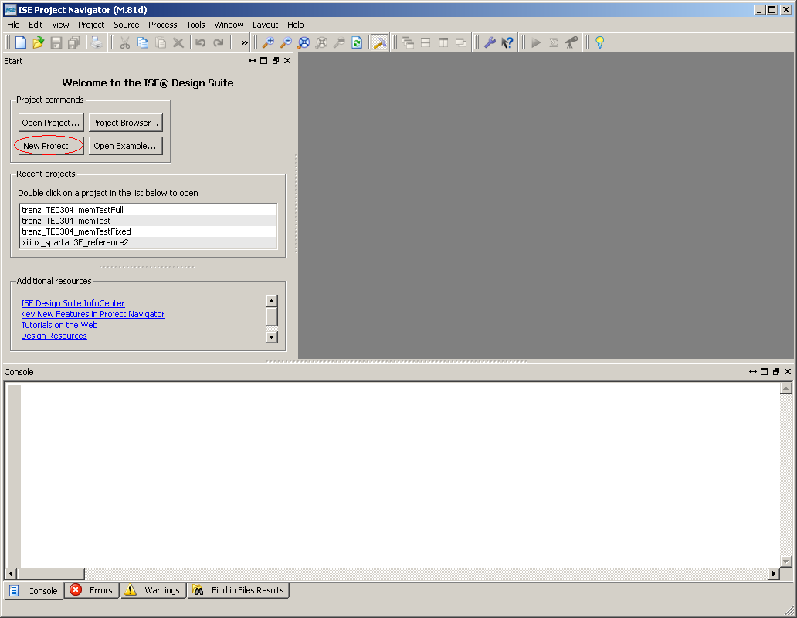
click button to create a new project

Slide 4
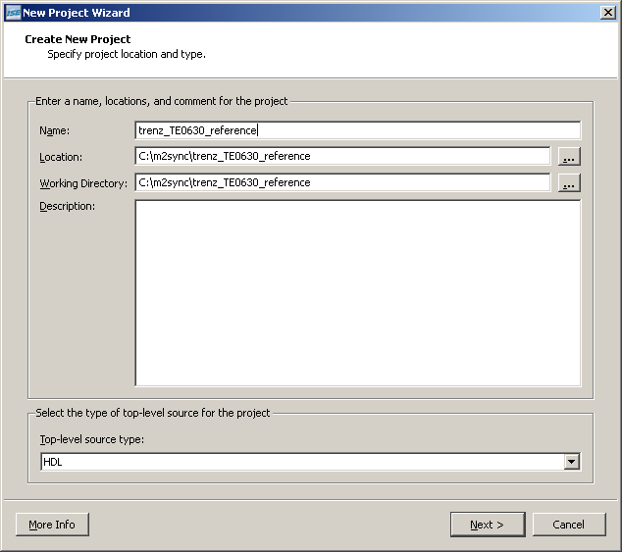
choose project name, then click Next

Slide 5
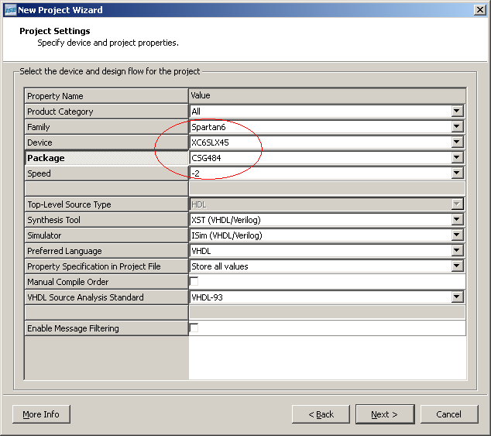
provide correct Family, Device, Package and Speed, then click Next

Slide 6
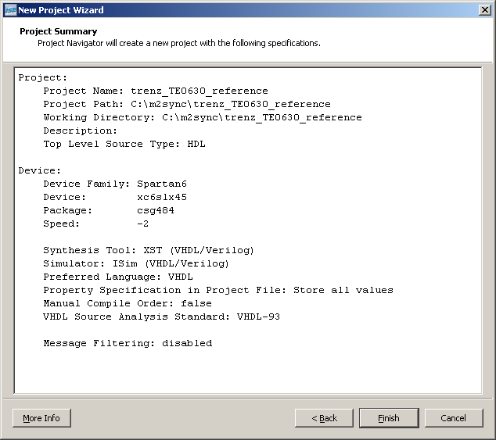
verify configuration and click Finish

Slide 7
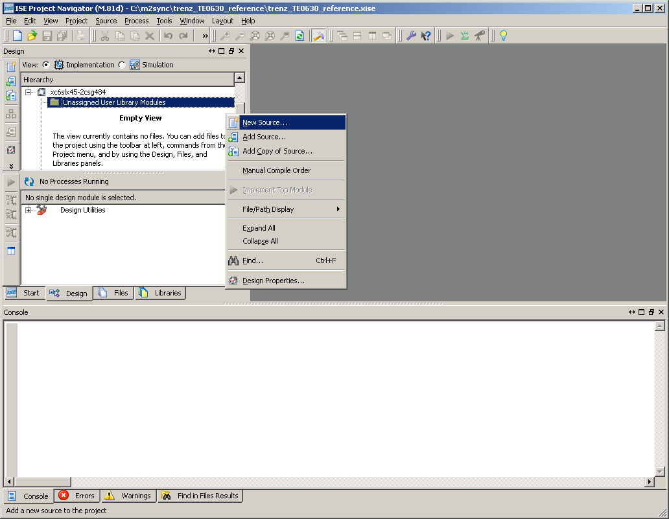
right button menu to add New Source

Slide 8
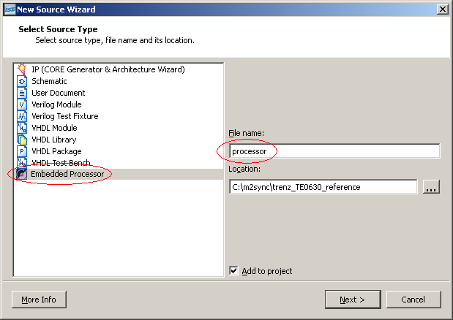
choose Embedded Processor, provide File name then click Next

Slide 9
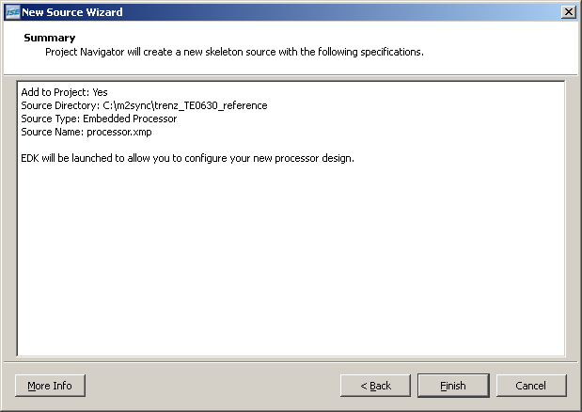
verify configuration then click Finish

Slide 10
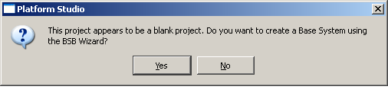
confirm Yes to launch BSB Wizard

Slide 11
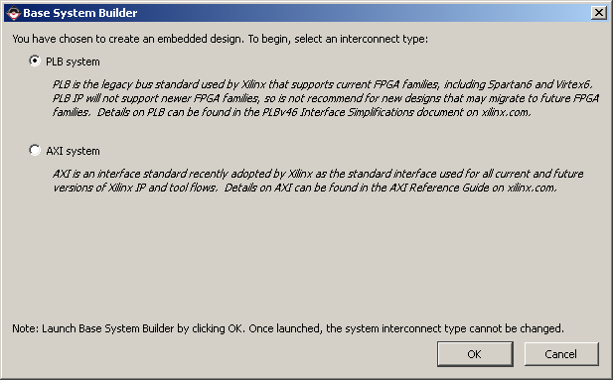
choose PLB system

Slide 12
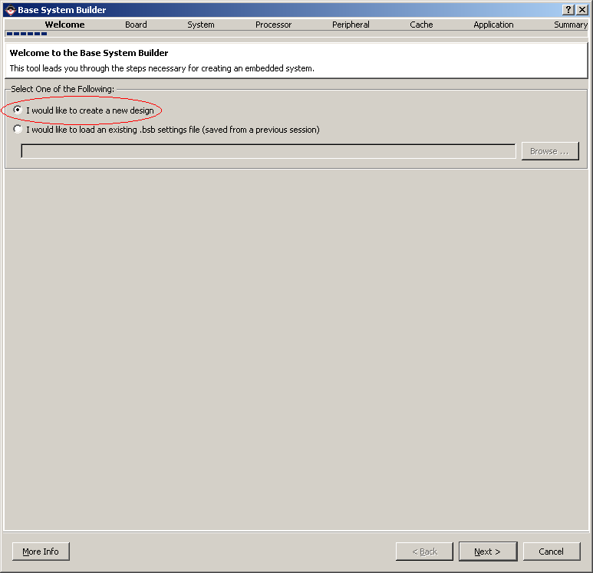
choose create new design then click Next

Slide 13
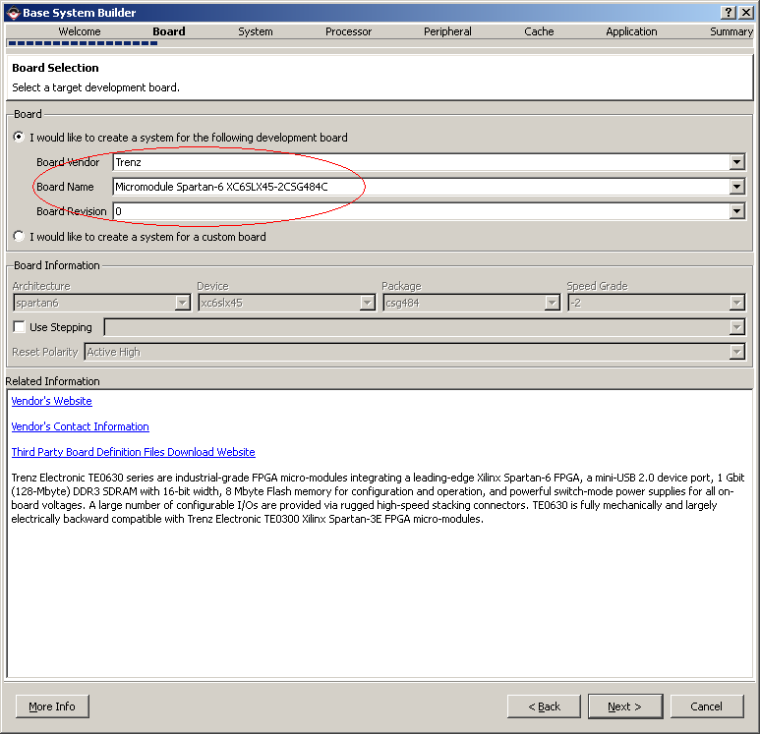
choose correct Vendor, Name and Revision then click Next

Slide 14
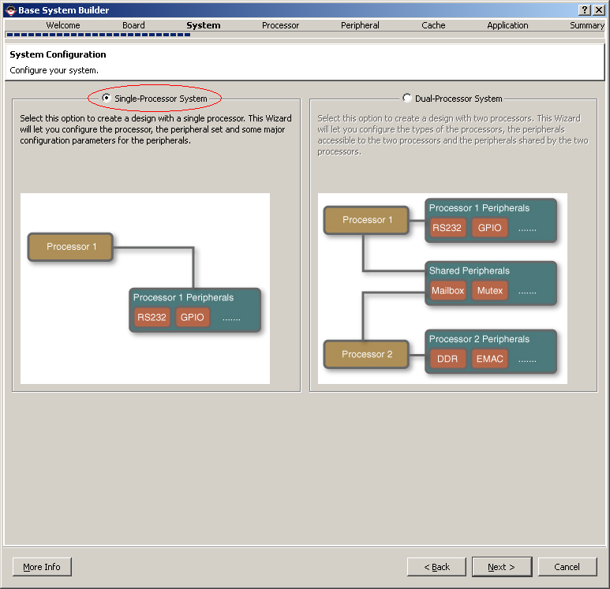
choose Single-Processor System then click Next

Slide 15
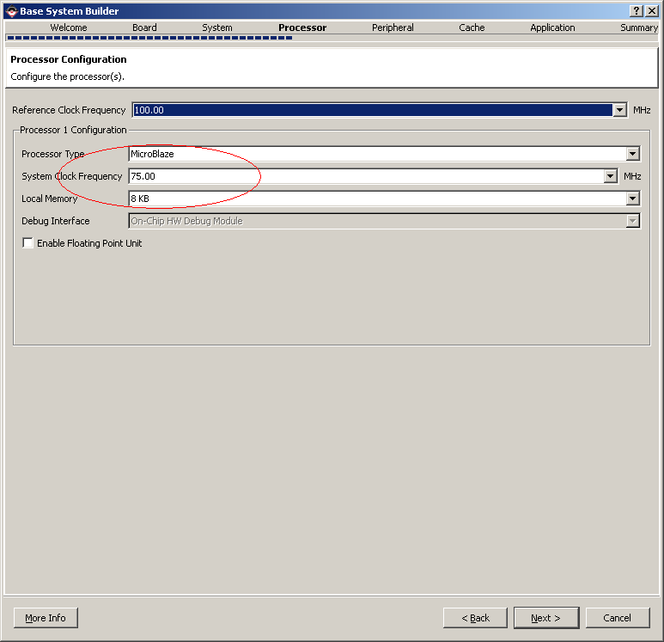
choose default Processor Type, System Clock Frequency (it will be fixed later) and Local Memory size then click Next

Slide 16
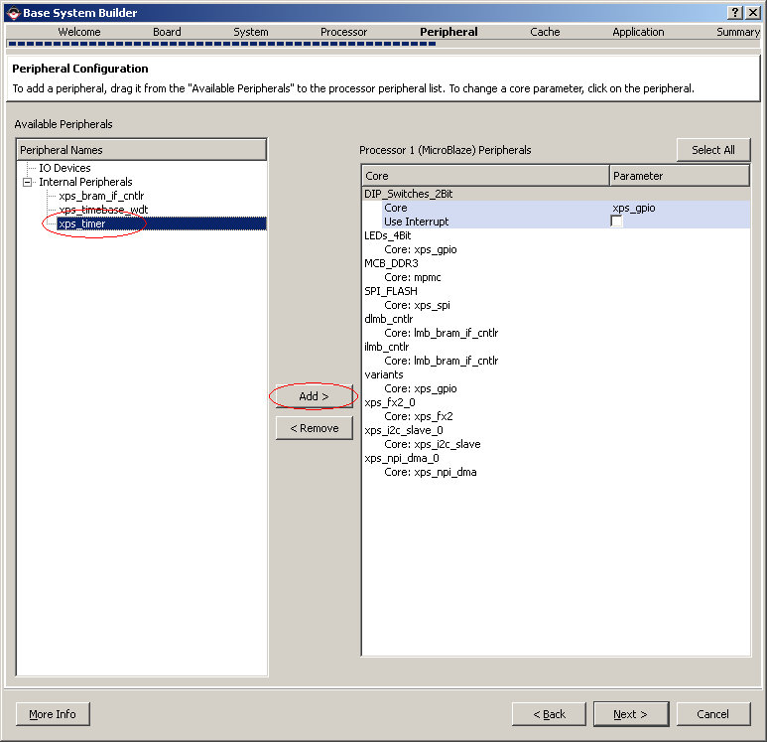
add xps_timer (XilKernel required), then click Next

Slide 17
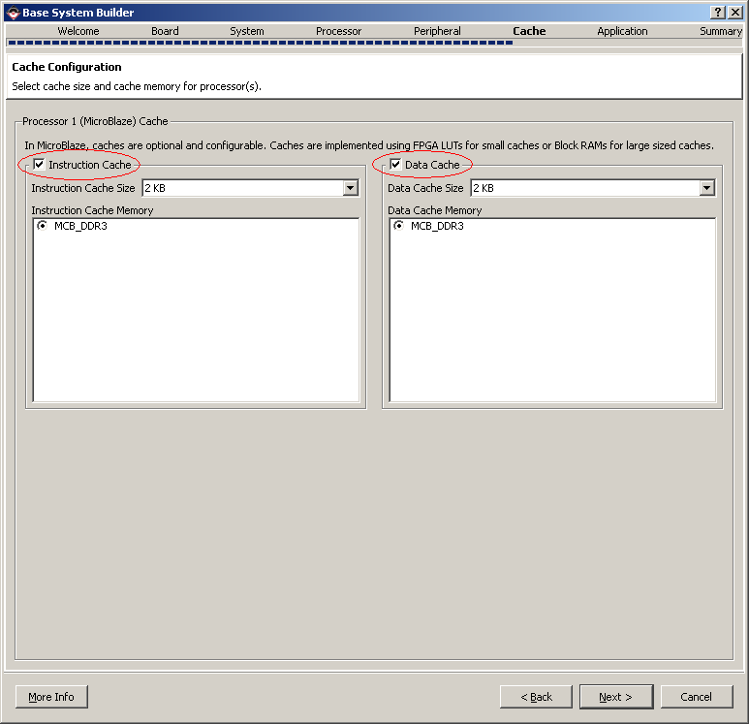
enable Instruction and Data Caches then click Next

Slide 18
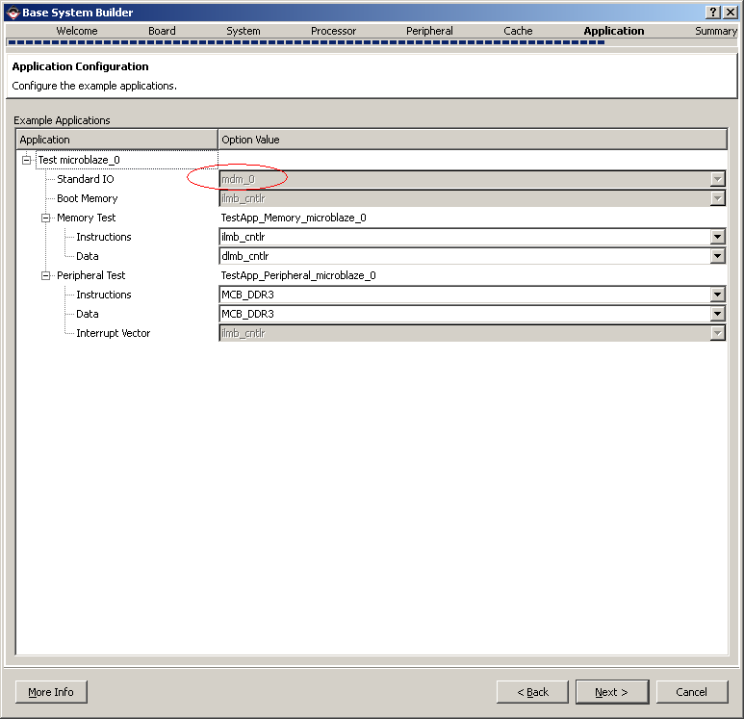
verify if mdm_0 choosen as Standard IO then click Next

Slide 19
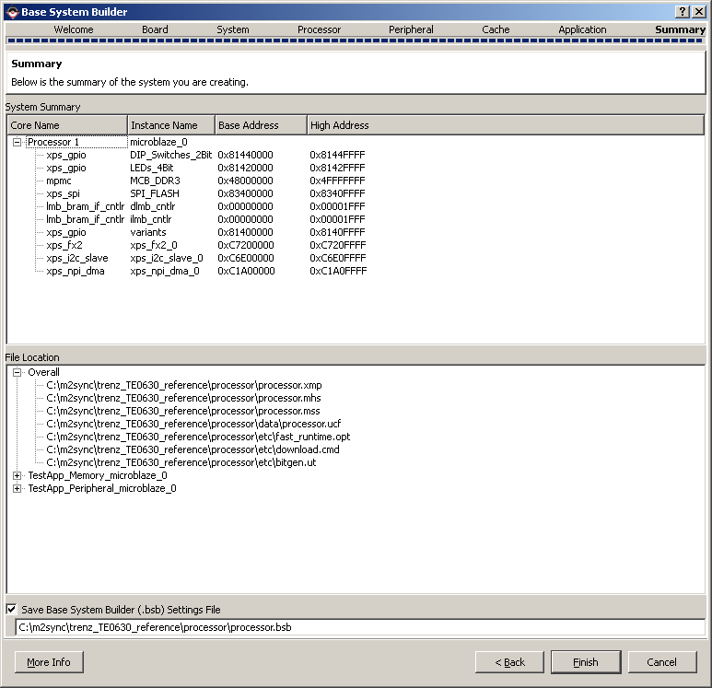
verify created configuration then click Finish

Slide 20
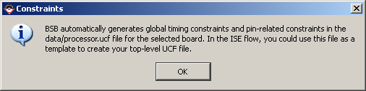
confirm UCF file creation

Slide 21
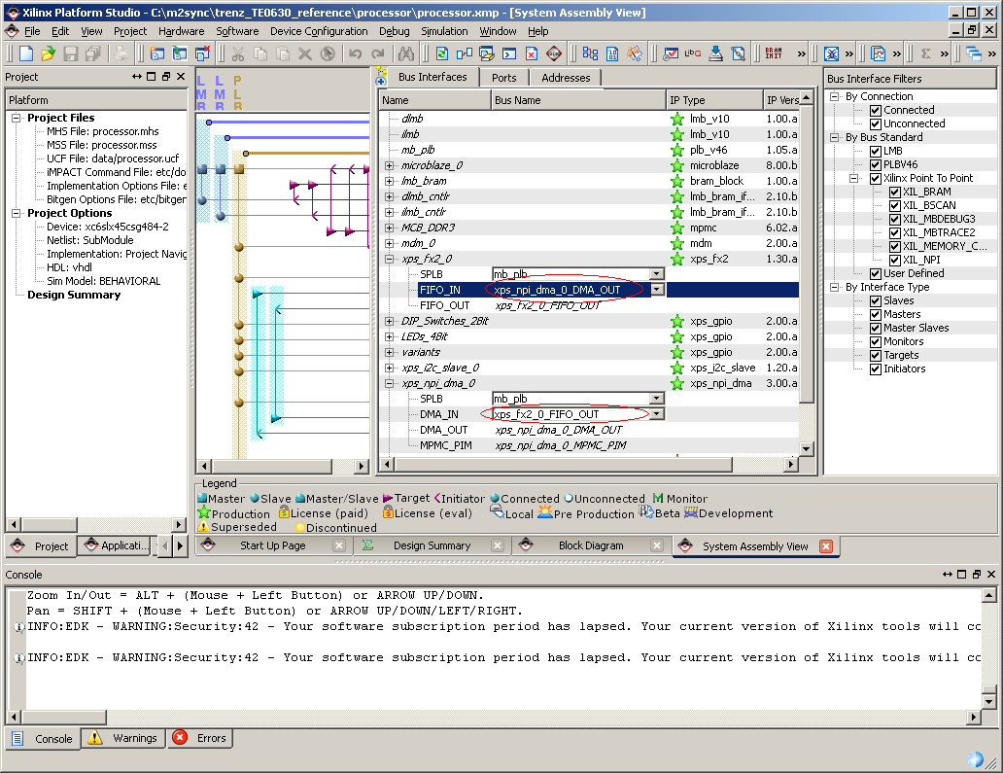
connect npi_dma and fx2 pcores to each other

Slide 22
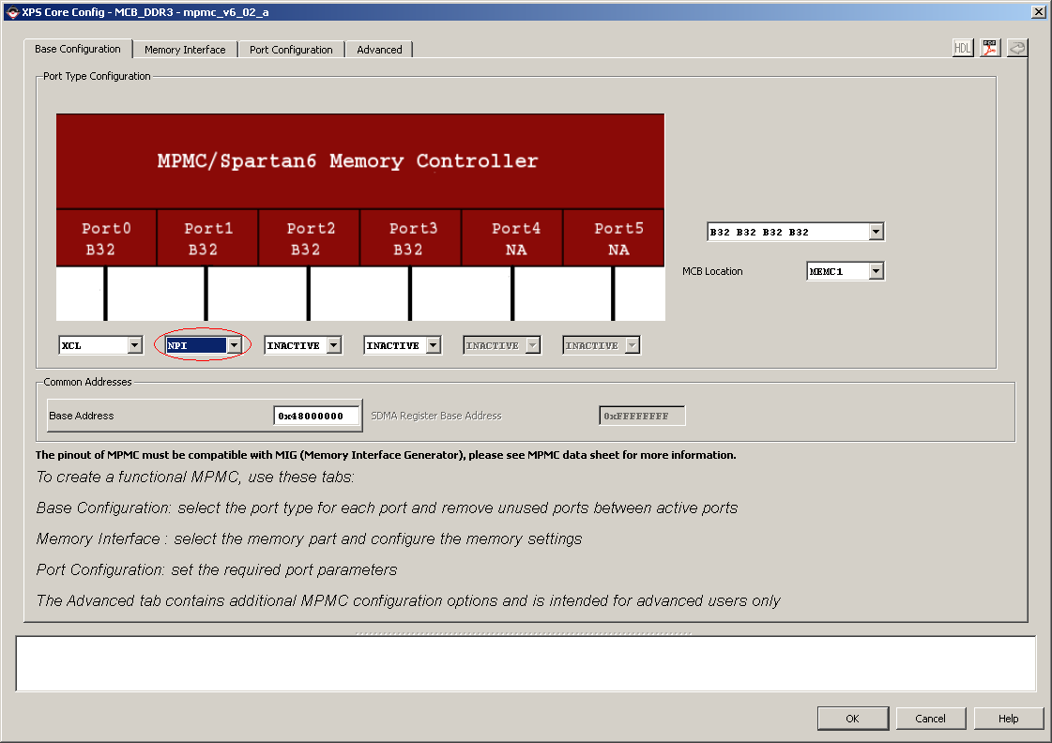
double click on MCB_DDR3 pcore and configure NPI port

Slide 23
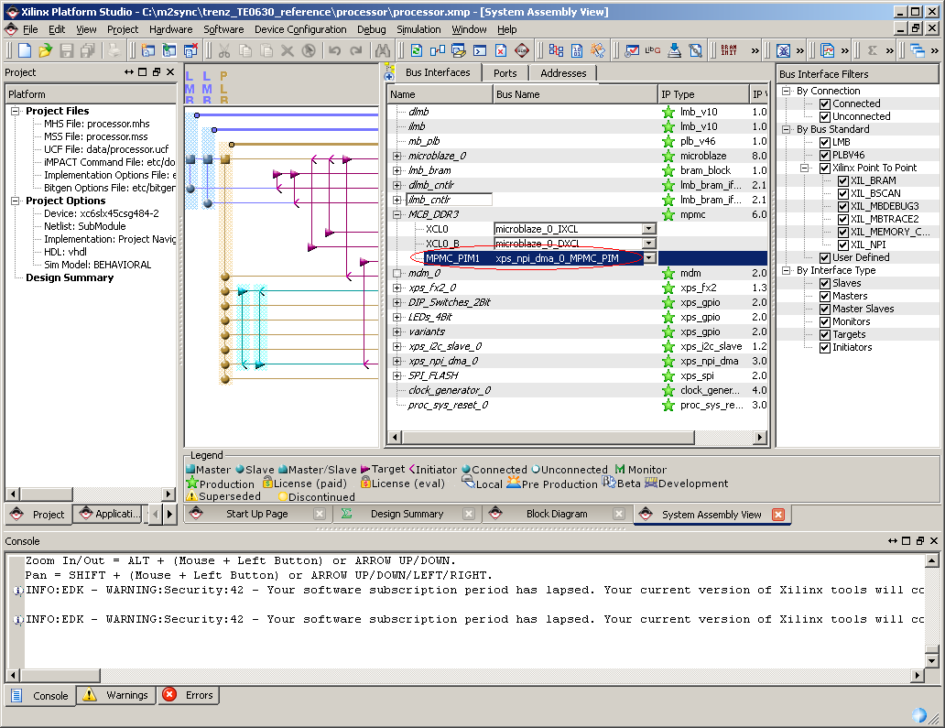
connect mpmc and npi_dma pcores

Slide 24
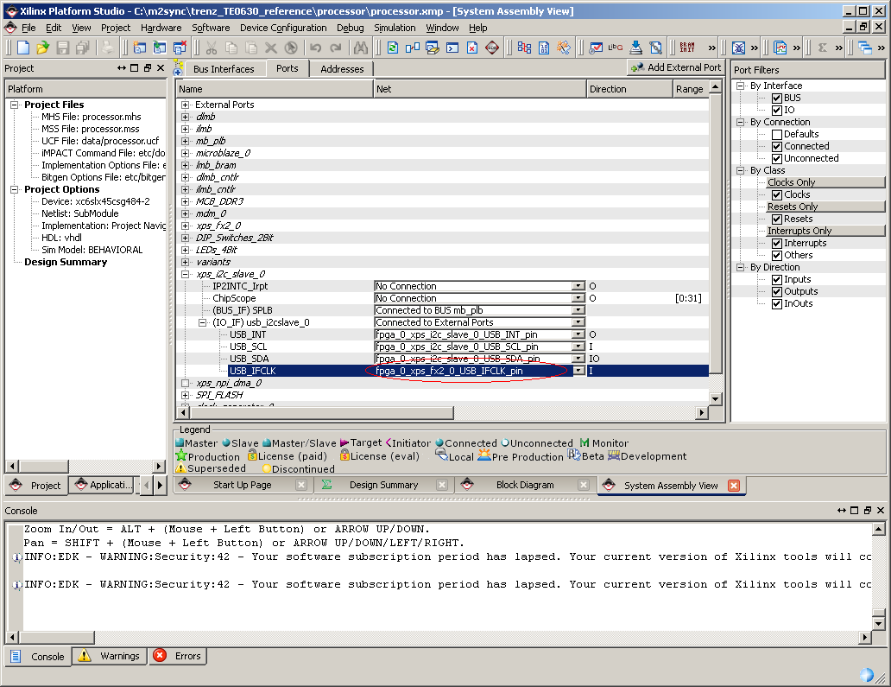
switch to Ports tab and connect xps_i2c clock signal

Slide 25
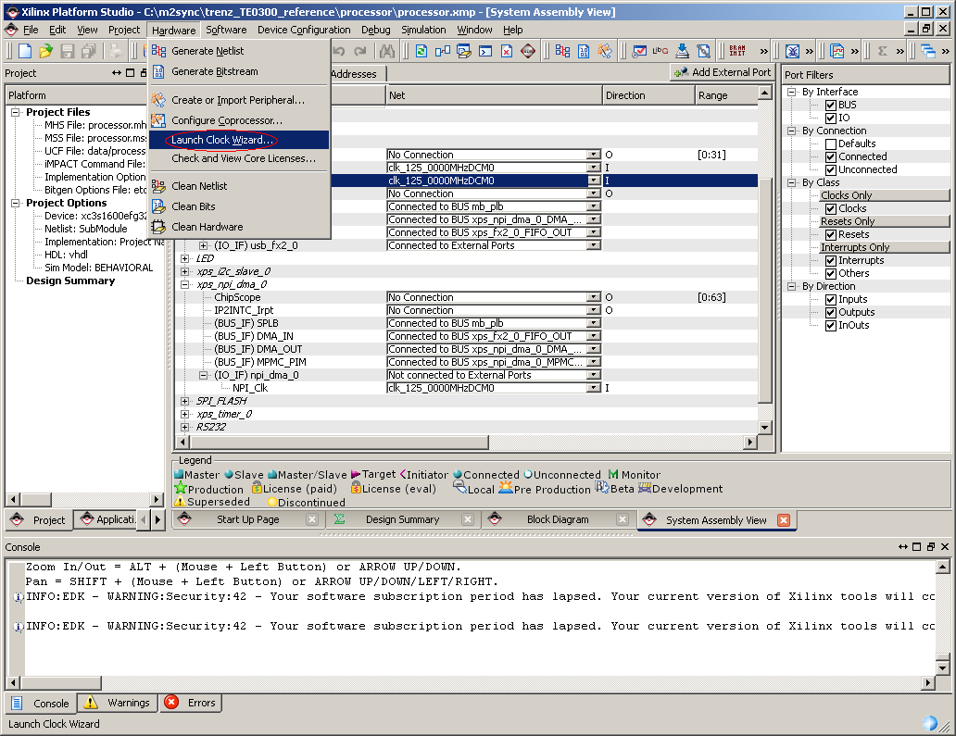
launch Clock Wizard

Slide 26
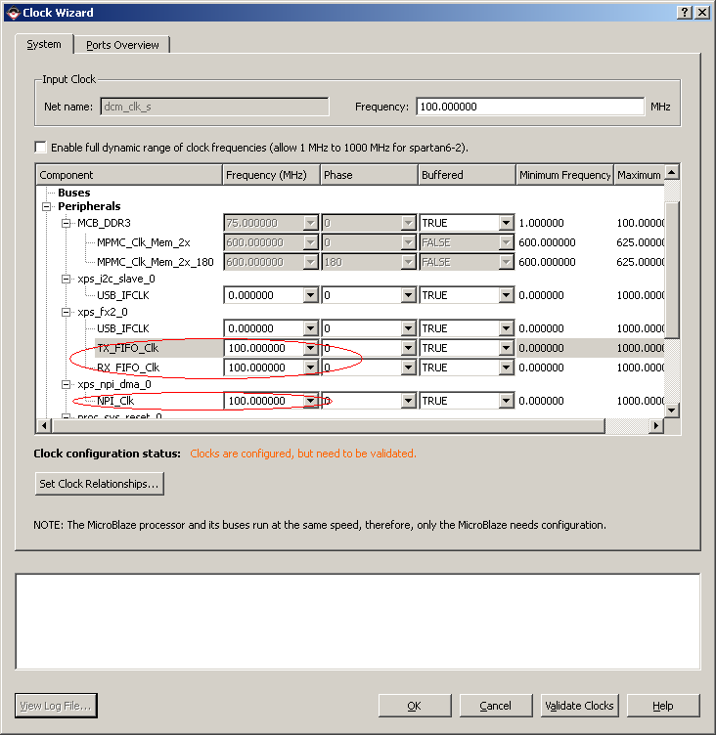
specify clocks for xps_fx2 and xps_npi_dma pcores, validate them, then click OK

Slide 27
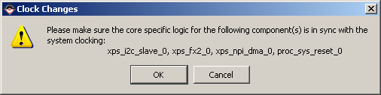
confirm Clock Changes

Slide 28
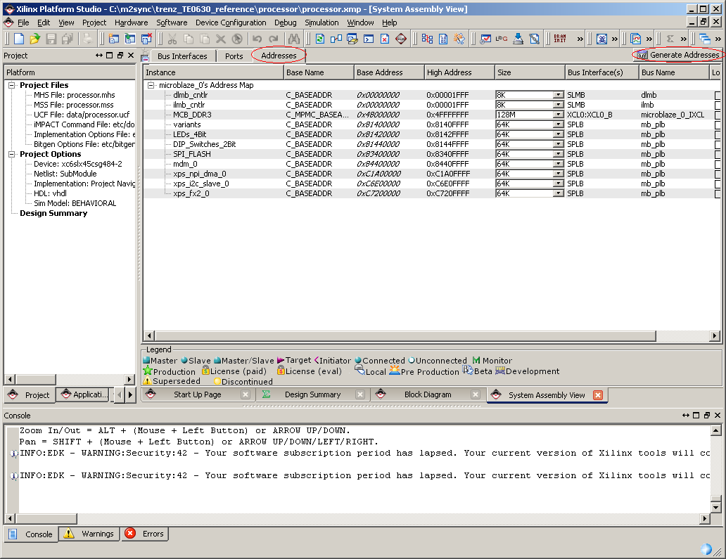
switch to Addresses tab and re-generate addresses

Slide 29
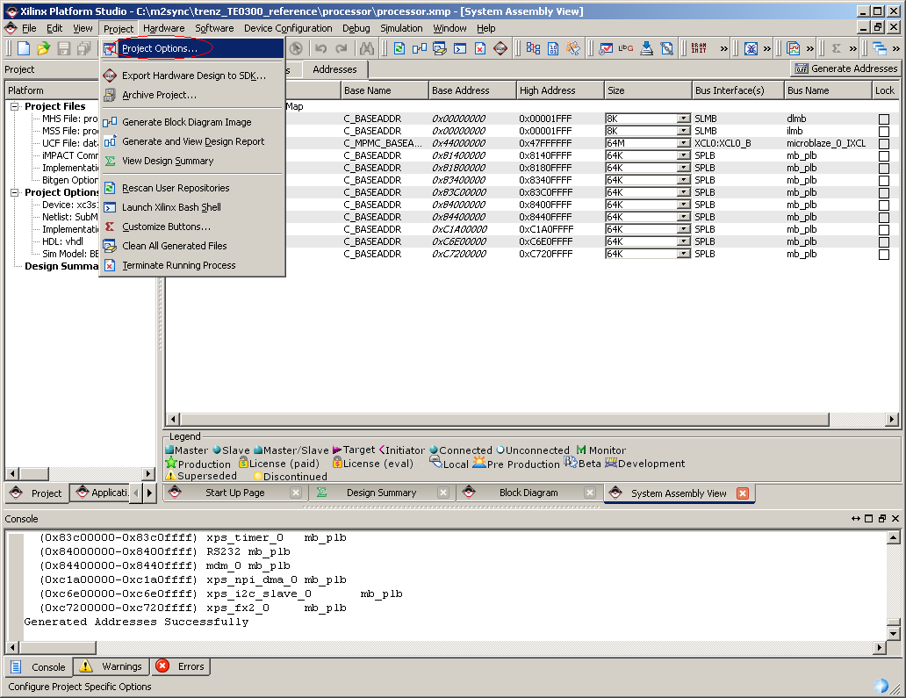
launch Project Options

Slide 30
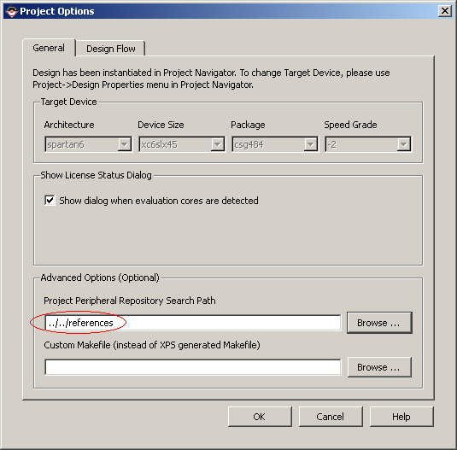
provide path to the private pcores (npi_dma, fx2, i2c_slave) then click OK

Slide 31
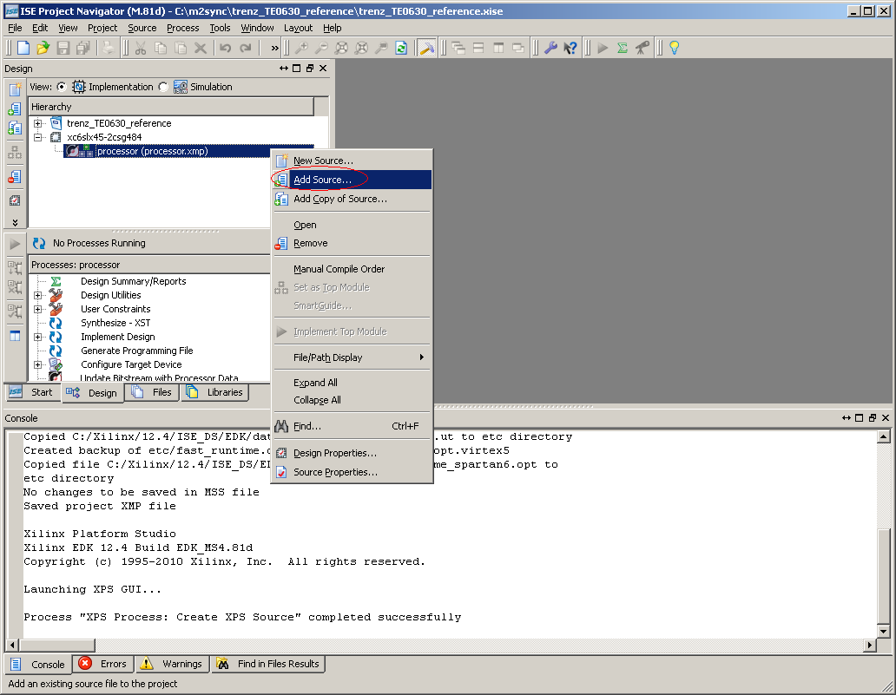
return to ISE Project Navigator and add Source

Slide 32
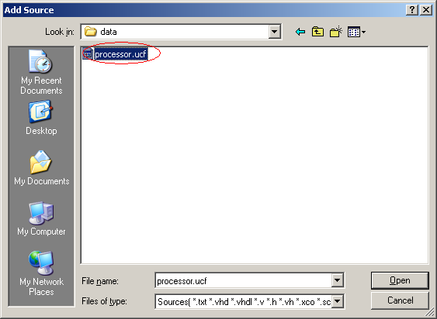
choose processor.ucf from processor/data/ subfolder then click Open

Slide 33
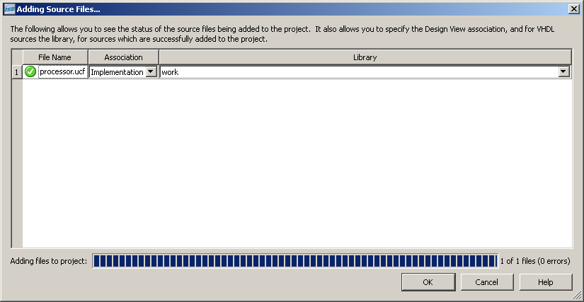
confirm adding Source File by clicking OK

Slide 34
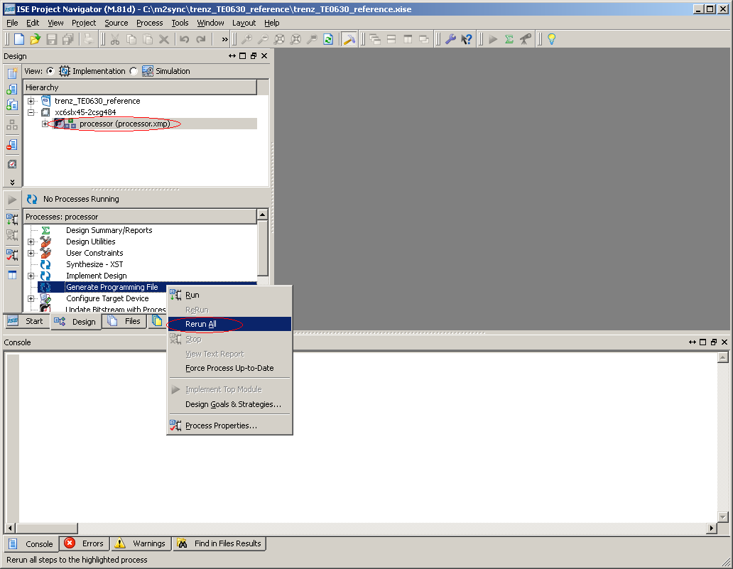
step on processor.xmp, choose Generate Programming File and click Rerun All

Slide 35
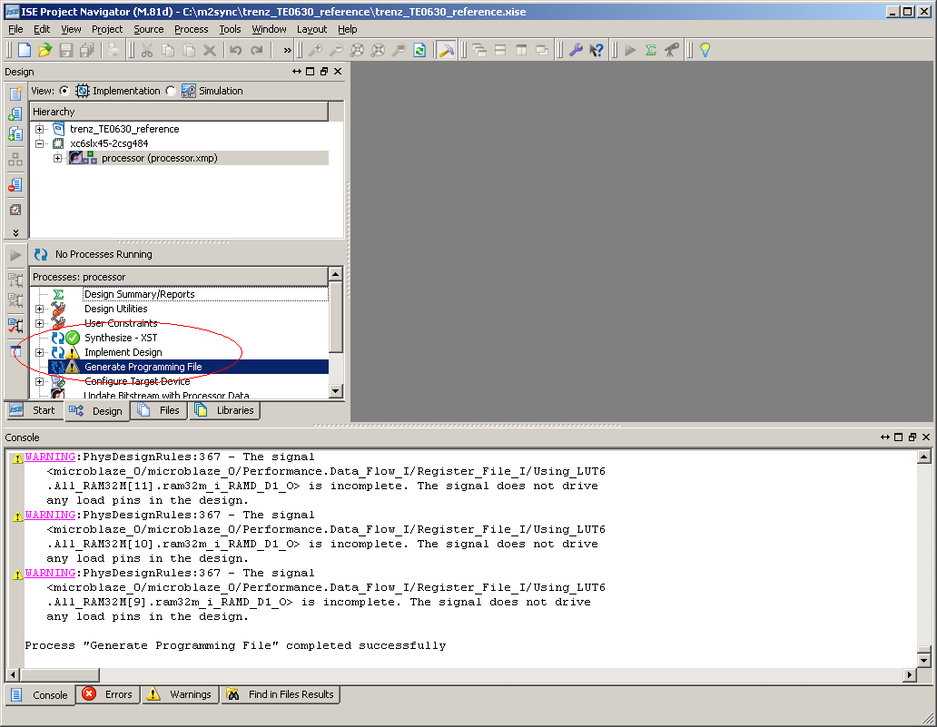
confirm generation success and return to Xilinx Platform Studio

Slide 36
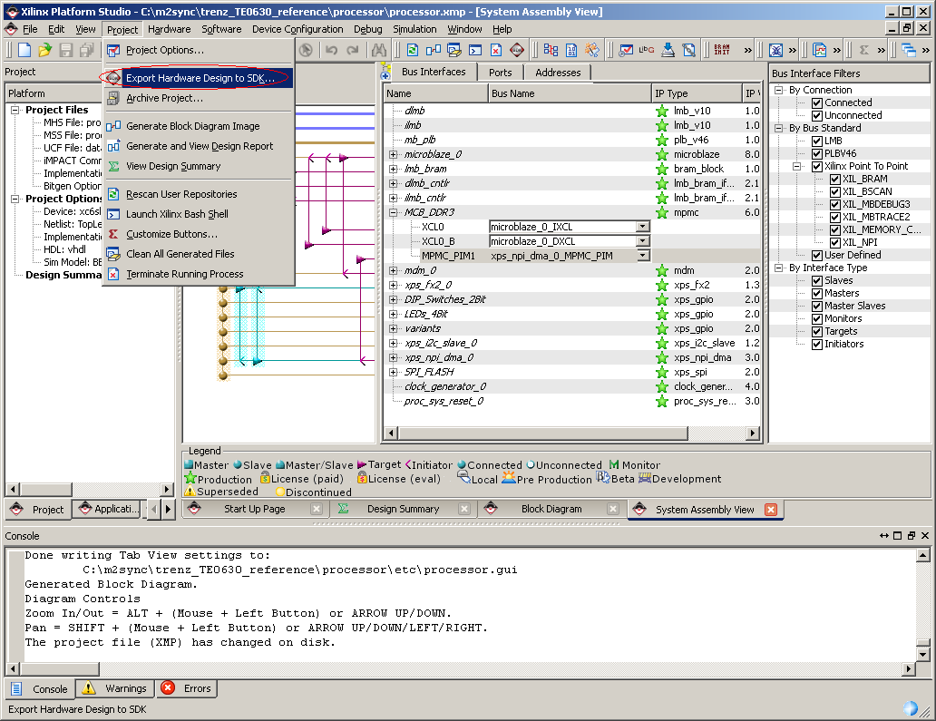
choose from menu Export Hardware Design to SDK

Slide 37
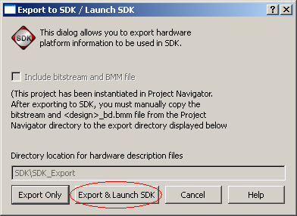
because Xilinx SDK isn't running yet, choose Export & Launch SDK button

Slide 38
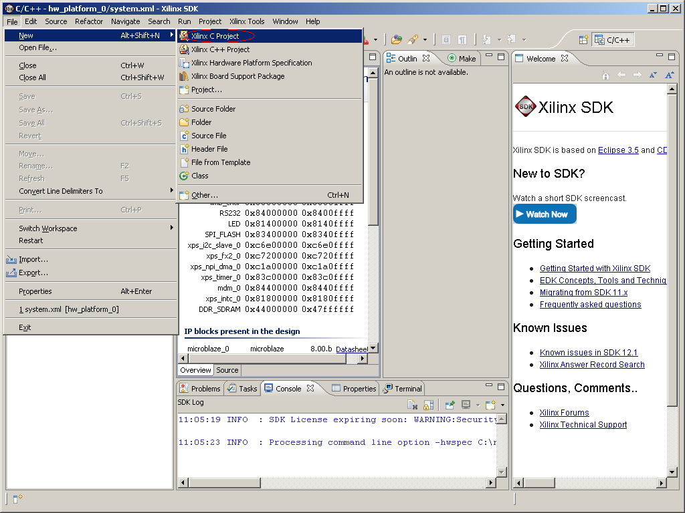
from SDK menu choose to create New Xilinx C Project

Slide 39
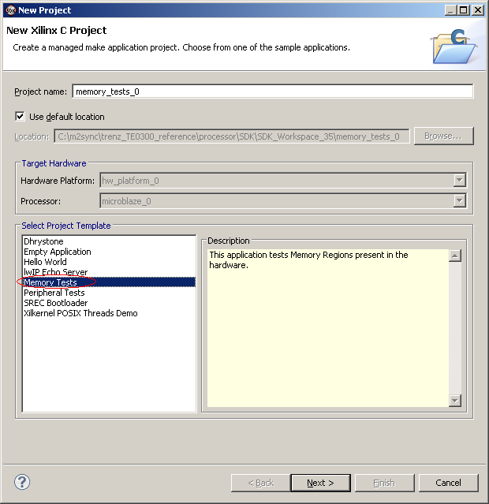
choose Memory Tests template and click Next

Slide 40
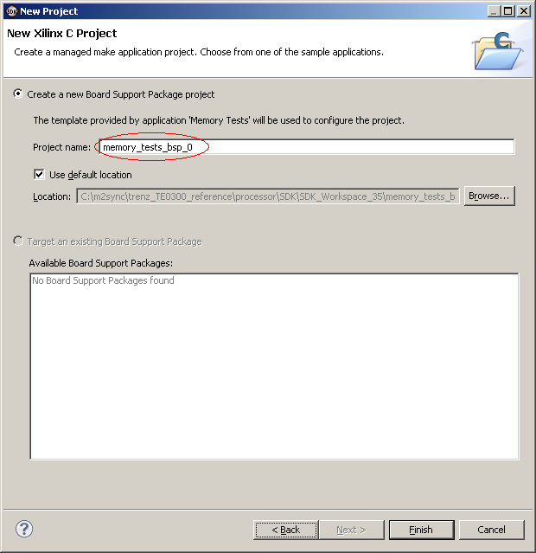
keep default BSP project name memory_tests_bsp_0 and click Finish

Slide 41
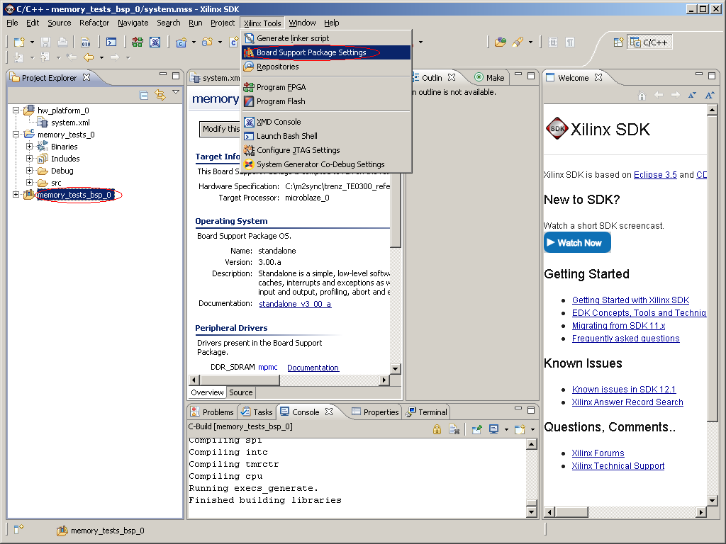
step on memory_tests_bsp_0 and choose Board Support Package Settings menu

Slide 42
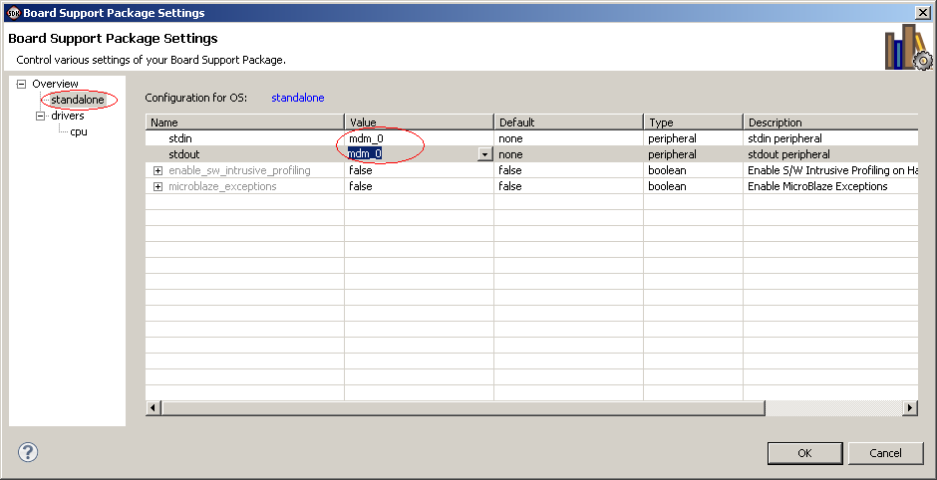
from standalone section apply mdm_0 to stdin and stdout then click OK

Slide 43
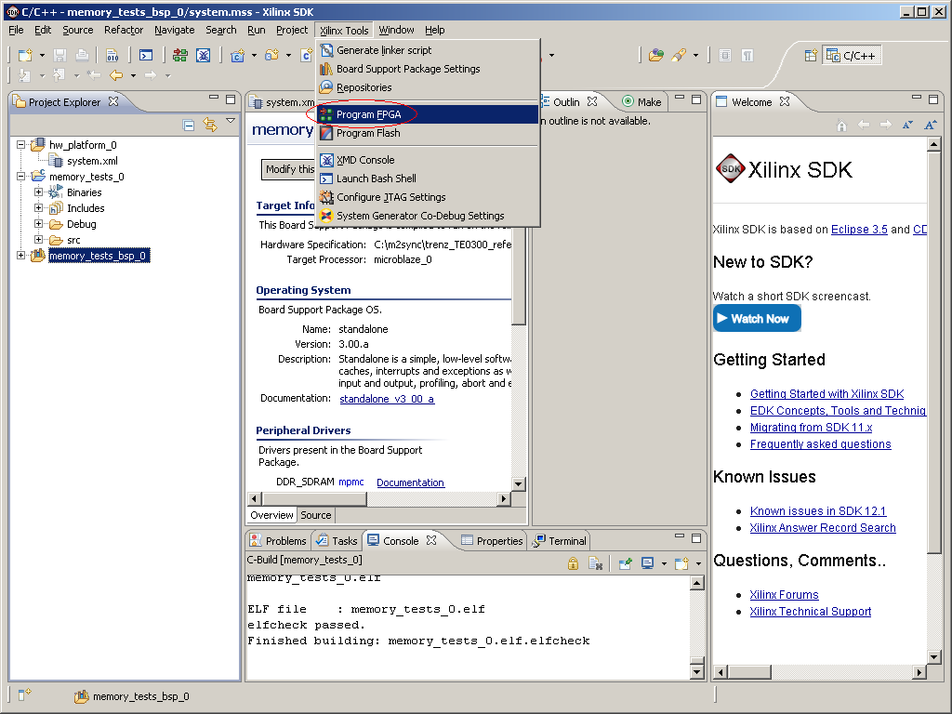
connect the prototype board TE0300 and choose Program FPGA from menu

Slide 44
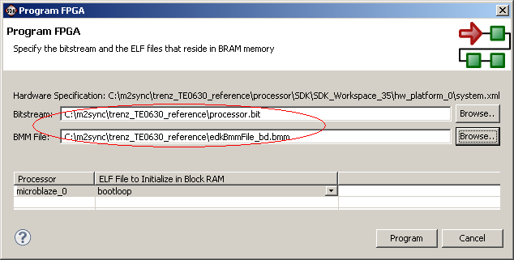
provide correct Bistream and BMM files then click Program

Slide 45
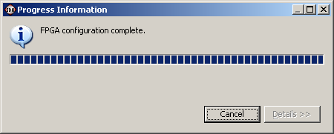
wait for FPGA programming completion

Slide 46
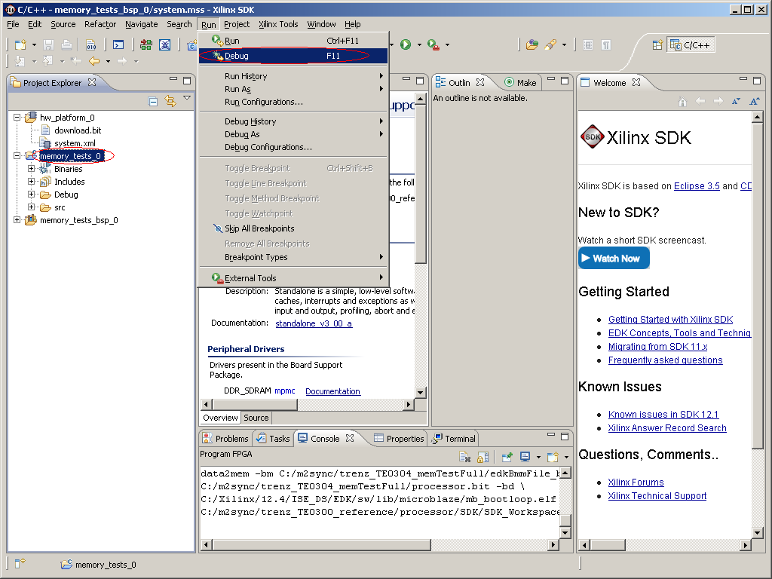
step on memory_tests_0 application and choose Debug menu

Slide 47
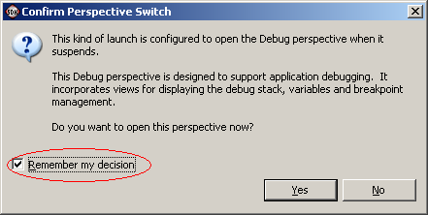
choose remember decision and confirm switching to Debug design by clicking Yes button

Slide 48
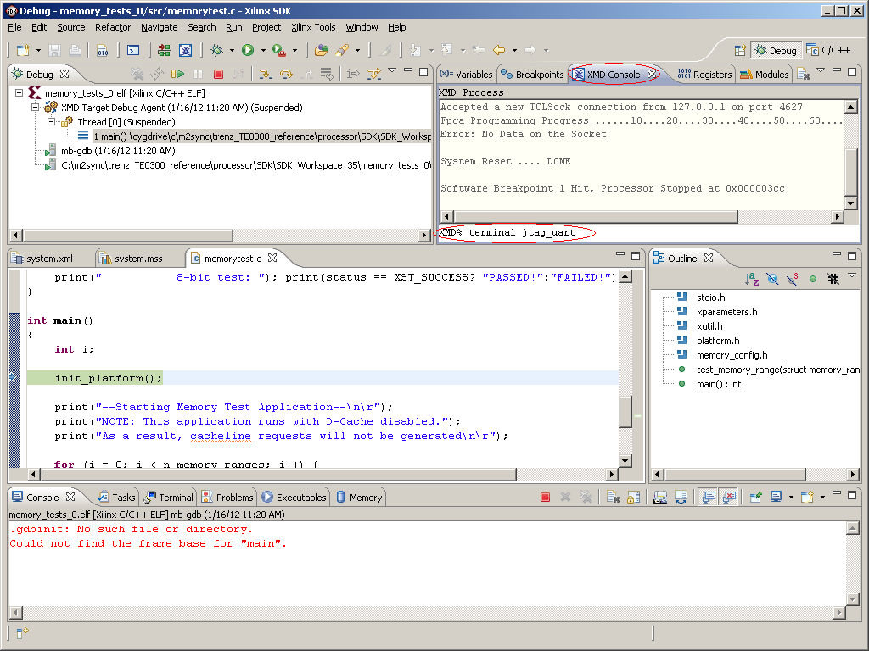
switch to XMD Console tab and type command "terminal jtag_uart"

Slide 49
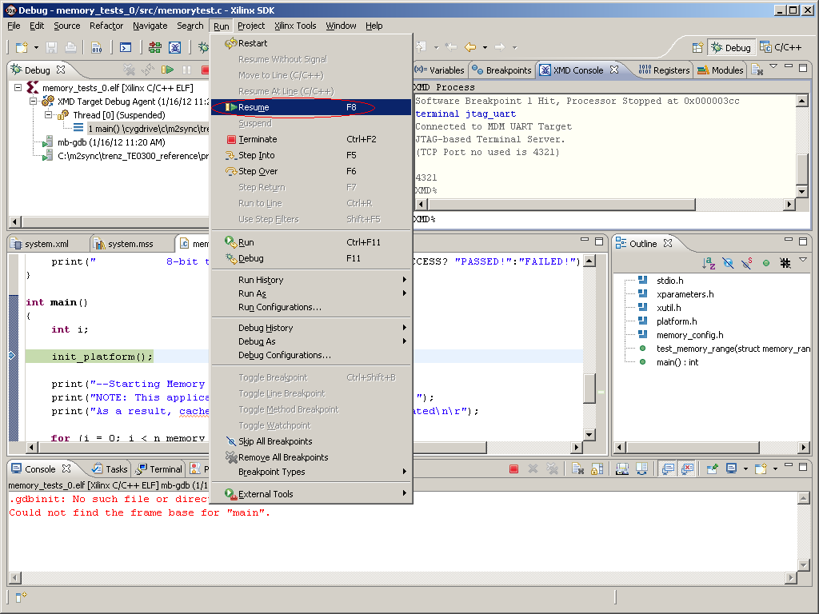
resume test application execution from Resume menu

Slide 50
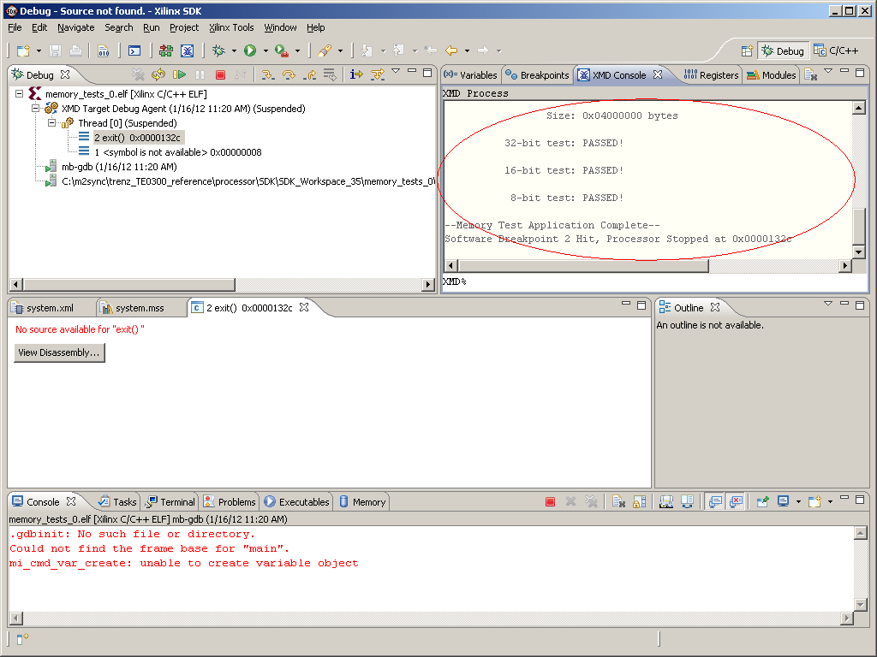
observe memory test execution and report messages

Slide 51
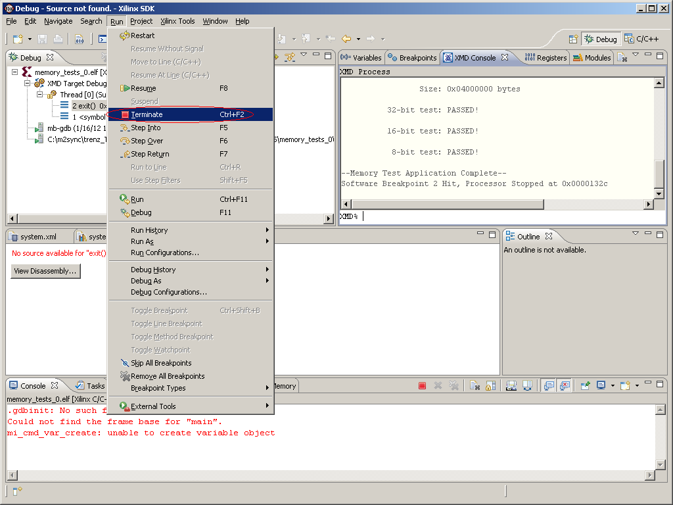
terminate successfully executed application

Slide 52
TE0630 board configuration complete
external memory configuration confirmed with test application

