Slide 1
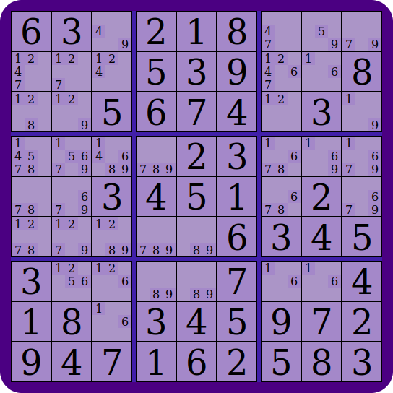
Rank-3 Board
Groups:
Box: 2
Row: 0
Col: 8
Option: 6
Cell: {1,6}
Solved Cell: {9}

