Slide 1
Theme-based Sentiment Analysis
HITSZ ICRC
Reporter：Leng Jia
Members : Gong XiaoChang
Yan HongYu
2017/12/19

Slide 2
CONTENTS
1
Introduction
2
Analysis and implement
3
Conclusion
4
Future Work

Slide 3
01
Introduction

Slide 4
Introduction
This competition is based on e-commerce review data. We need to analyze the users’ preference for these themes according to the statement of subject characteristics and emotional information. Finally, we should output the pairs of themes, sentiment words and sentiment polarity.

Slide 5
Analysis and implement
02

Slide 6
Analysis and implement
Ruled-based approach
Data processing
Segmenting Words
Identificating themes and sentiment words
Matching Themes and sentiment words and polarities
CRF
based approach

Slide 7
Analysis and implement
Data processing
1.Remove all useless information
2.“?、？、!、！,、，、.、。” comma
3.Lower all upper cases.
4.Convert traditional Chinese into simple Chinese with the tool opencc.
5.Remove all numbers.
Category | Instance
Expressions | &hellip;&hellip;&hellip;
Additional review | [追评]
URLs | http://www.amazon.cn
@tags | @小桀
Titles | 【PSV国行游戏】
Newline symbol | </br>
The hashtag # # | #疾速性能#

Slide 8
Analysis and implement
Segmenting Words
Split the sentence
Segment the words
Remove the stopwords
Comma
User_dict
啊 的 呢 很 太 再

Slide 9
Analysis and implement
Identificating Themes and Sentiment Words---CRF
Features:
Basic Features 01: word w_{i} 02: w_{i-1}: the first left word of w_{i} 03: w_{i+1}: the first right word of w_{i} 04: w_{i-2}: the second left word of w_{i} 05: w_{i+2}: the second right word of w_{i} 06: p_{i}: the pos of word w_{i} 07: p_{i-1}: the first left pos of w_{i} 08: p_{i+1}: the first left pos of w_{i} 09: p_{i-2}: the second left pos of w_{i} : p_{i+2}: the second left pos of w_{i}
Syntactic Features 11: dependency_{i}: the dependency parsing of w_{i} 12: dependency_parent_{i}: the dependency parsing of w_{i} parent 13: pos_parent_{i}: the pos of w_{i}’s parent

Slide 10
Analysis and implement
Identificating Themes and Sentiment Words---CRF
Set Labels:
Themes
sentiment words
comma
others
T
S
,
O

Slide 11
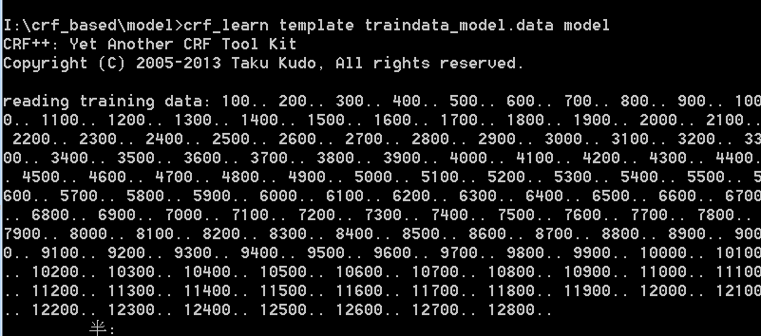
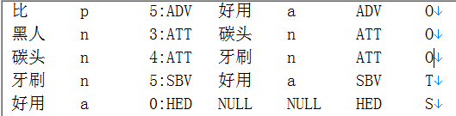
Analysis and implement
Identificating Themes and Sentiment Words---CRF
Model training

Slide 12
Analysis and implement
Identificating Themes and Sentiment Words---Rule Based
construct
themes dictionary
sentiment words dictionary(f>50)
set labels
themes ->T
sentiment words ->S

Slide 13
Analysis and implement
Matching Themes and sentiment words and polarities
Mode one : “TO*S”, pair ‘T’ and ‘S’
黑人/O 碳头/O 牙刷/T 好用/S -> (牙刷, 好用)
Mode two : “O*SO*”, pair ‘null’ and ‘S’
方便/S , 可挂/O 脖上/O , 当/O 项链/O -> (null, 方便)
Mode three : “T1O*T2O*S”, pair ‘T2’ and ‘S’
纱布/T 材质/T 不错/S -> (材质, 不错)
Mode four : “TO*S1O*S2” , pair ‘T’ and ‘S1’ , pair ‘null’ and ‘S2’
味道/T 清新/S 淡雅/S -> (味道, 清新), (null, 淡雅)
Mode five : “SO*T”, pair ‘T’ and ‘S’
不方便/S 冲洗/T -> (冲洗, 不方便)

Slide 14
Analysis and implement
Matching Themes and sentiment words and polarities
Combine negative word and sentiment word to be a new sentiment word
不/O 喜欢/S -> 不喜欢/S
Set the new sentiment word’s polarity be the negation of the original sentiment word
Polarity(不喜欢) = - Polarity(喜欢)

Slide 15
03
Conclusion

Slide 16
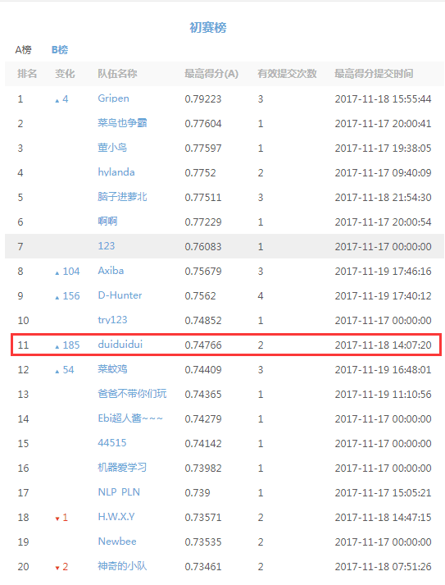
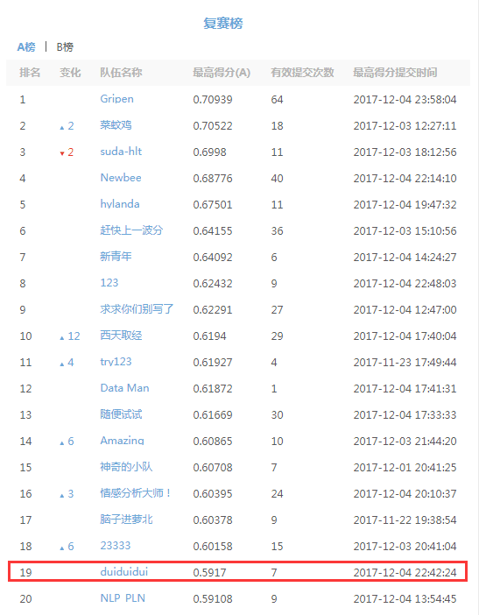
Conclusion

Slide 17
Conclusion

Slide 18
Future
Work
04

Slide 19
Future Work
Xgboost match the pair of theme and sentiment word.
Input
Output
Features of training data
Model training
(binary classification)
Theme and sentiment word pairs with labels whether the pairs are correct.
Features:
CRF sequence
Word2vec
The distance of T and S
Pos
The length of sentence

Slide 20
THANKS

