Slide 1
Search in Pacman
HITSZ ICRC
2017/10/30

Slide 2
CONTENTS
1
Introduction
2
Analysis and implement
3
Conclusion
4
Task Assignment

Slide 3
01
Introduction

Slide 4
Introduction
A Pacman agent needs to efficiently find paths through a maze, either to reach a particular location or collect remaining food quickly.
There are two parts of algorithms in the project, which are the search algorithms and food collecting algorithms.
The first part only has one dot which includes Question 1, Question 2, Question 3, Question 4. The second part has many dots which includes Question 5, Question 6.

Slide 5
Analysis and implement
02

Slide 6
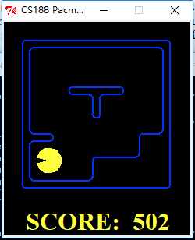
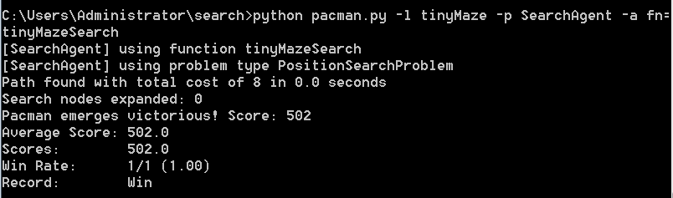
Analysis and implement
Question 0
Question 0 is initializing the Pacman game.

Slide 7
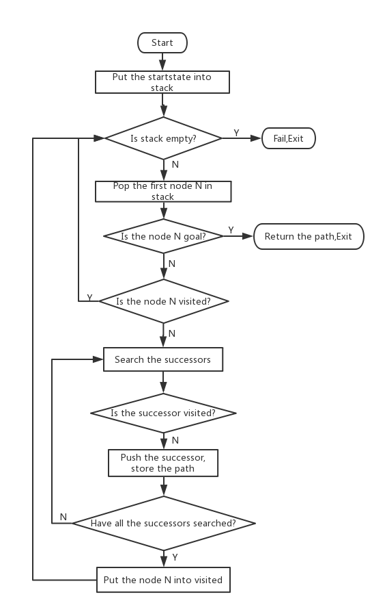
Analysis and implement
Question 1
Question 1 is implementing the depth-first search (DFS) algorithm. DFS is not unfit for search the shortest path, which is better in traversing all of the node of tree. We use a stack as the basic storage structure.

Slide 8
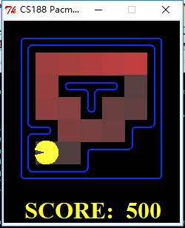
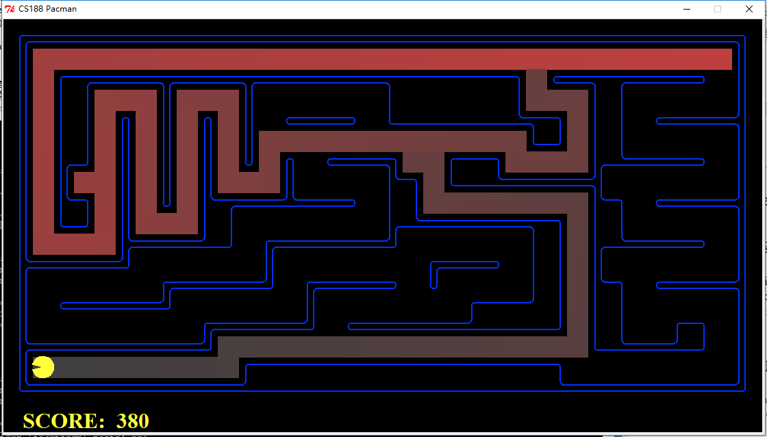
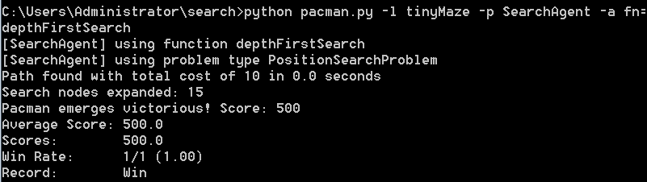
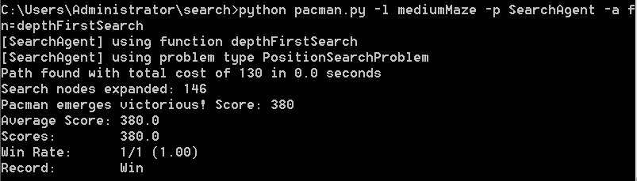
Analysis and implement
Question 1
tinyMaze mediumMaze

Slide 9
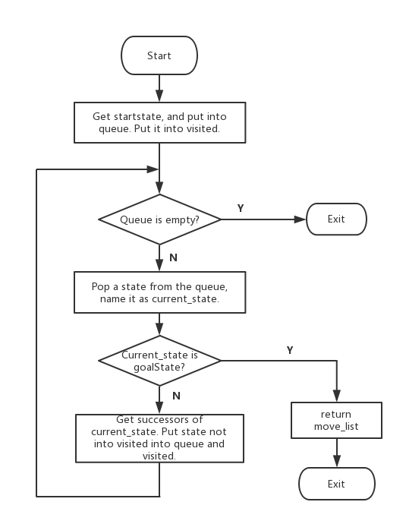
Analysis and implement
Question 2
Question 2 is implementing the Breadth-first search(BFS) algorithm. BFS is good at search the shortest path in a tree. We use a queue as the basic storage structure.

Slide 10
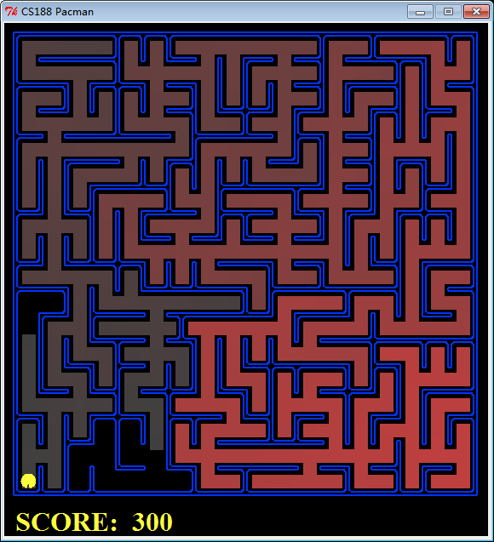
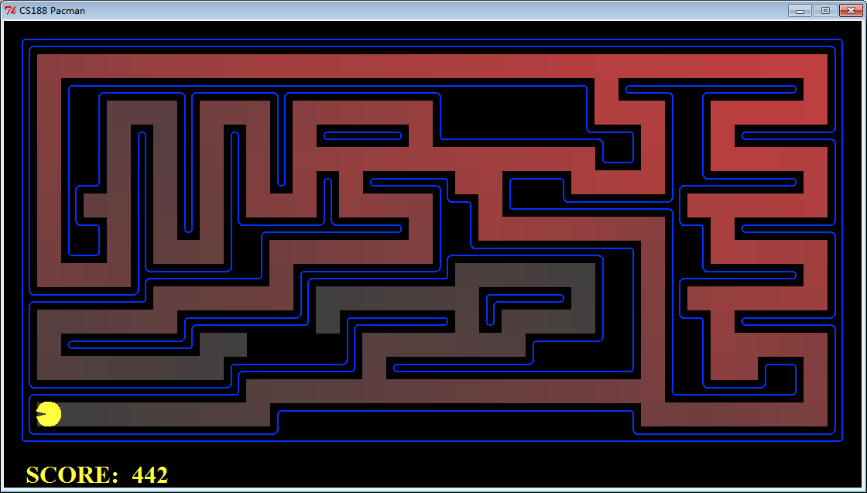
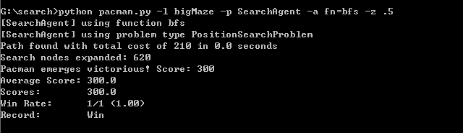
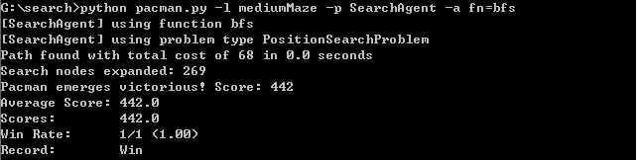
Analysis and implement
Question 2
mediumMaze bigMaze

Slide 11
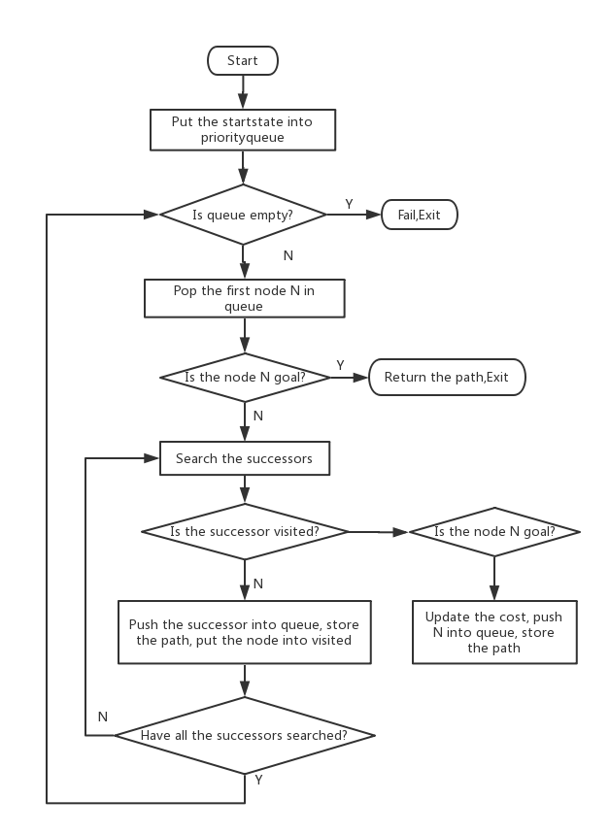
Analysis and implement
Question 3
Question 3 is implementing the uniform-cost graph search algorithm (UCS) algorithm. UCS is only decided by the cost of every step, not the depth of the tree.But if all of the cost are equal, It's the same as breadth first search. We use a priority-queue as the basic storage structure.

Slide 12
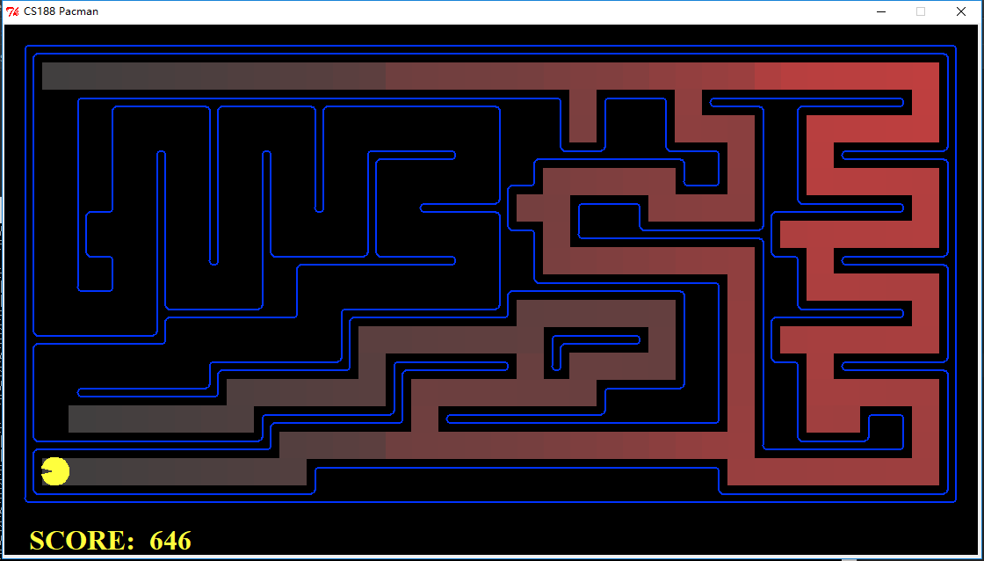
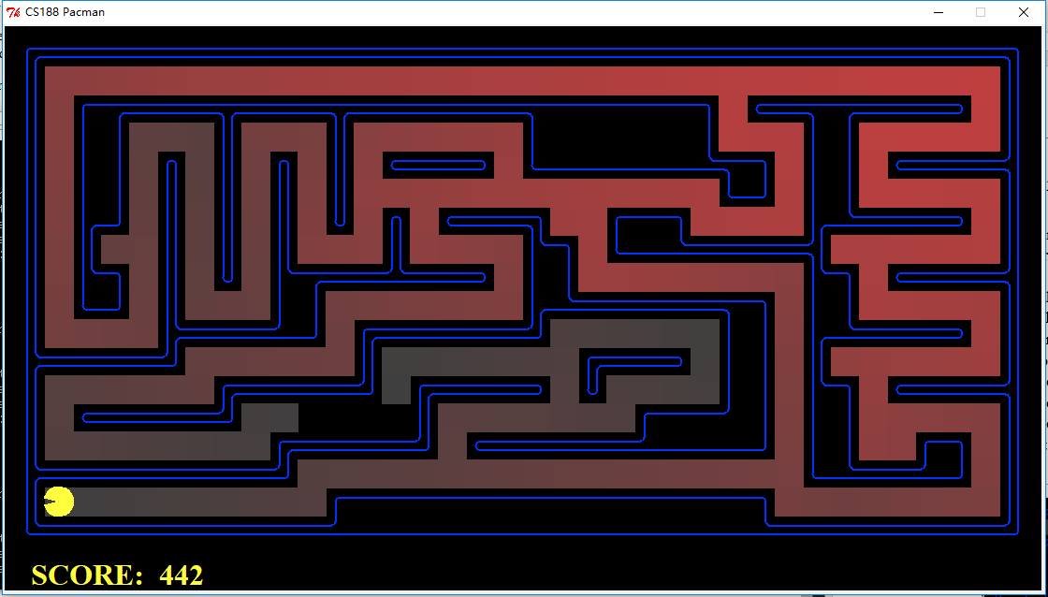
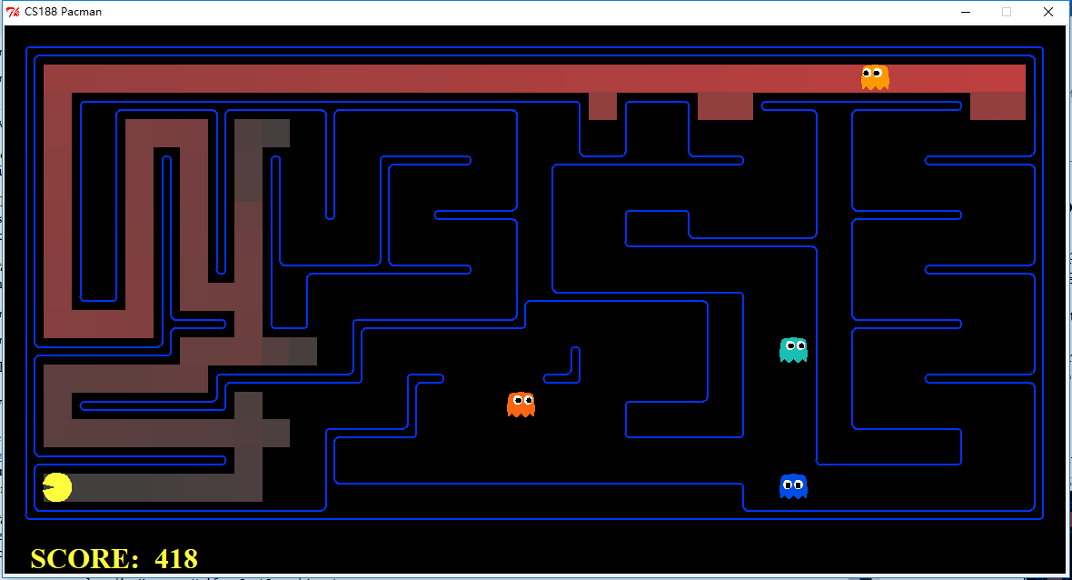
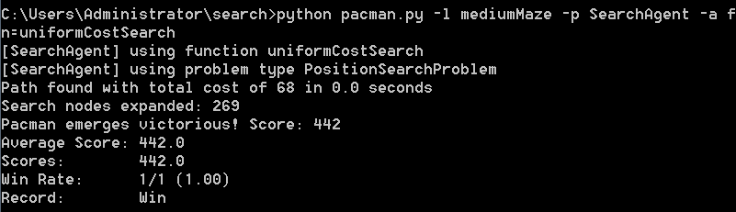
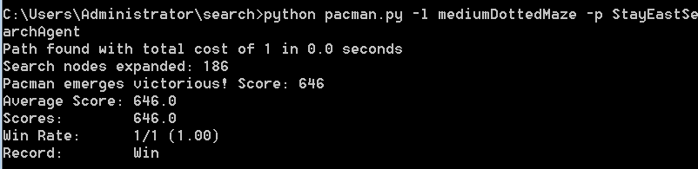
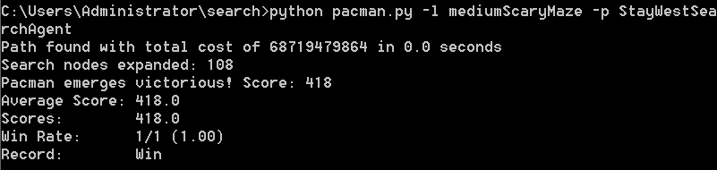
Analysis and implement
Question 3
mediumMaze mediumDottedMaze mediumScaryMaze

Slide 13
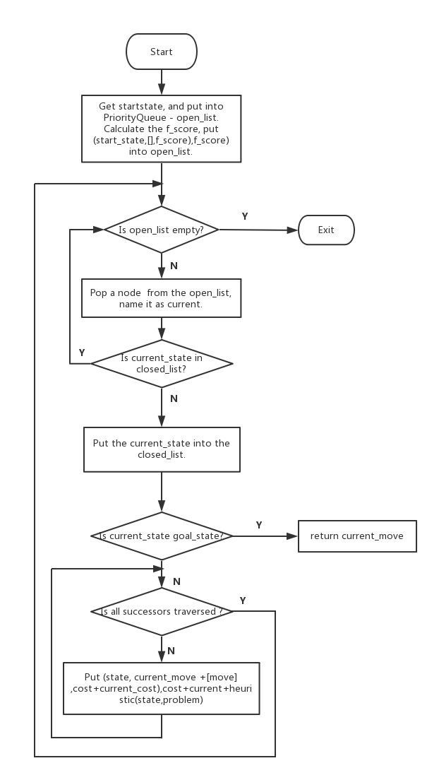
Analysis and implement
Question 4
Question 4 is implementing the A* graph search in the aStarSearch. The information was given by cost funtion f(n)=g(n)+h(n). It choose the manhatun distance as heuristic function.

Slide 14
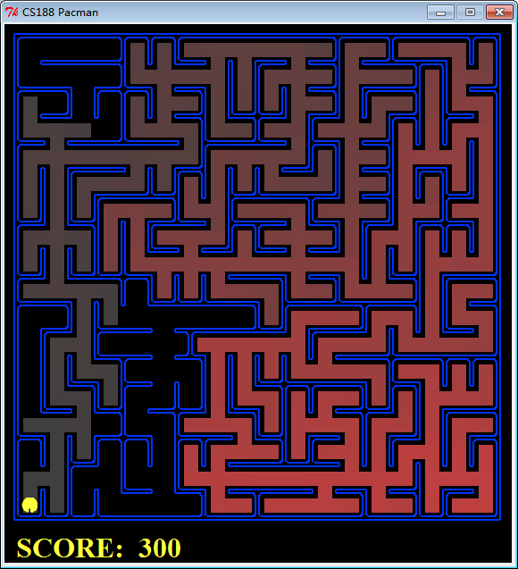
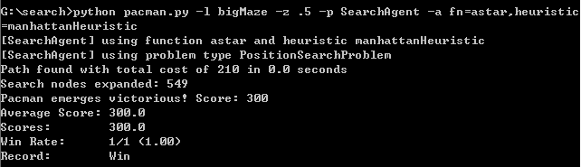
Analysis and implement
Question 4
bigMaze

Slide 15
Analysis and implement
Question 5
Question 5 is eat all the beans with as little steps as possible. We define the function foodHeuristic and construct the appropriate heuristic function to complete the bean searching problem.

Slide 16
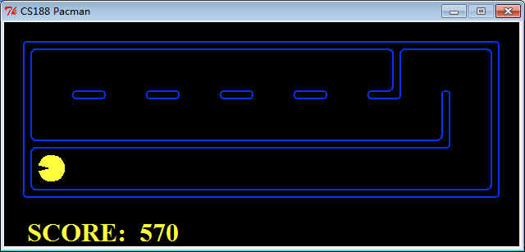
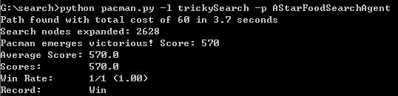
Analysis and implement
Question 5

Slide 17
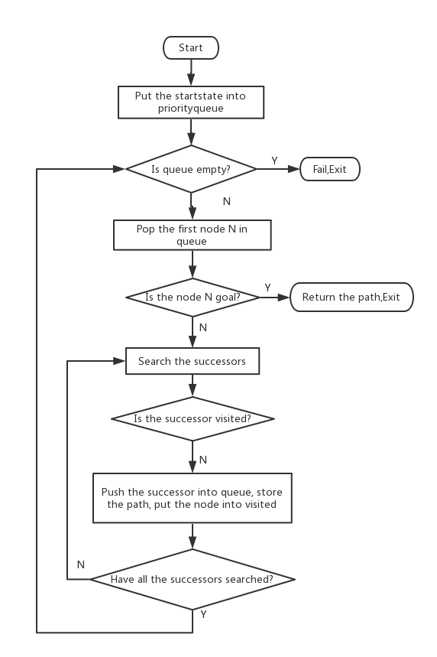
Analysis and implement
Question 6
Question 6 is implementing greedy graph search. The solution is that implement the agent ClosestDotSearchAgent and the function findPathToClosestDot by using BFS.

Slide 18
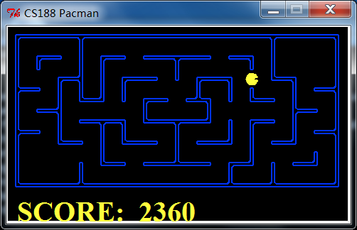
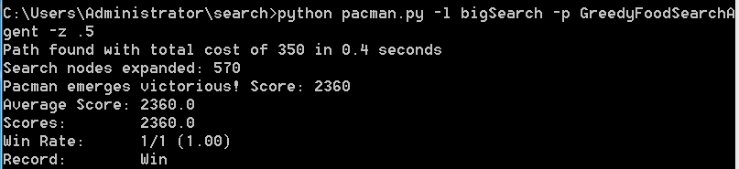
Analysis and implement
Question 6

Slide 19
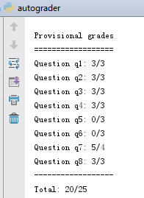
Analysis and implement

Slide 20
03
Conclusion

Slide 21
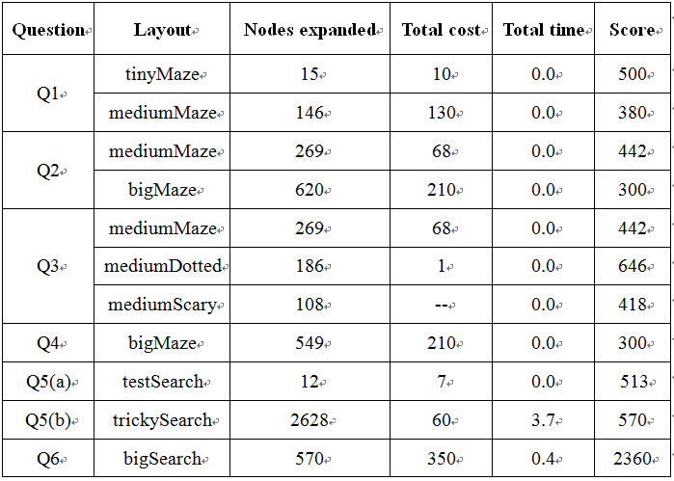
Conclusion
The comparison of several algorithms performance

Slide 22
THANKS

