Slide 1
Temperature Forecasting with Nixtla
Trevon Woods
ITAI-3377-IoT at the Edge
Sitaram Ayyagari
03/25/202

Slide 2
Contents
1.
8.
Overview
Impact of Generative Models
2.
9.
Data Prep
Challenges, Insights, Takeaways
3.
Model Selection & Training
4.
Feature Engineering
5 & 6.
Model Evaluation and Validation
7.
Generative Modeling

Slide 3
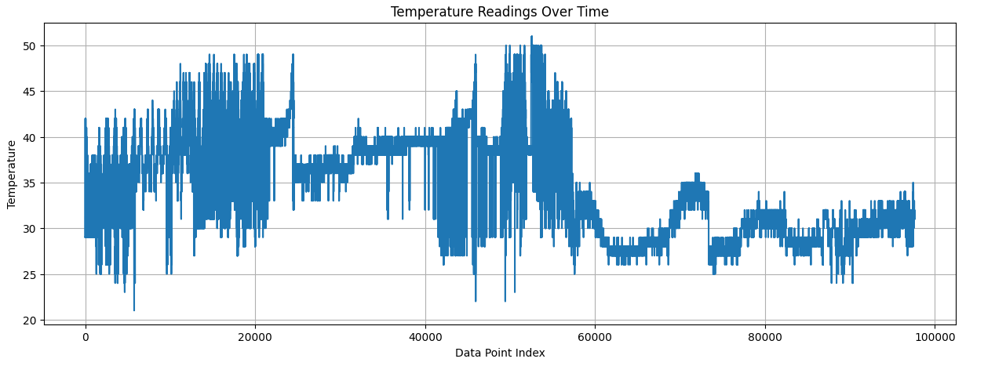
Overview
Temperature forecasting using Nixtla TimeGPT
Goal: Predict IoT sensor temperatures
Dataset: Kaggle IoT temperature readings

Slide 4
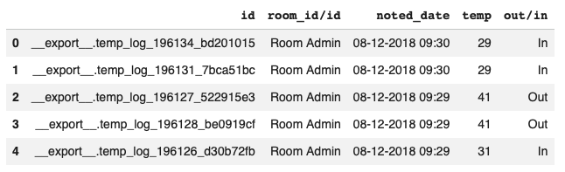
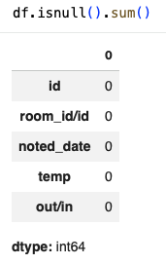
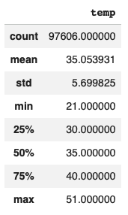
Data Prep
Loaded & explored dataset
Converted datetime, indexed, sorted
Resampled to hourly frequency
No missing values

Slide 5
Model Selection and Training
Used TimeGPT (Nixtla)
Forecast horizon: 639 hours
Confidence intervals: 80%, 90%
Baseline model without engineered features

Slide 6
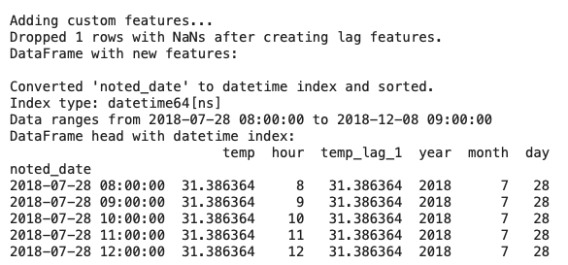
Feature Engineering
Added features: Hour, Lag temp, Year, Month, Day
Captured seasonality & trends
Improved model performance

Slide 7
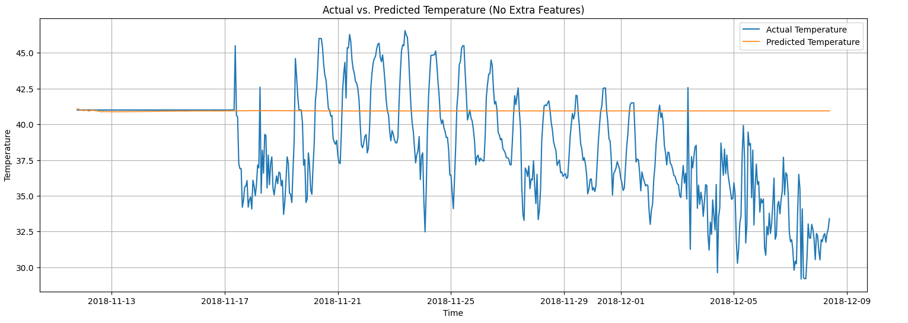
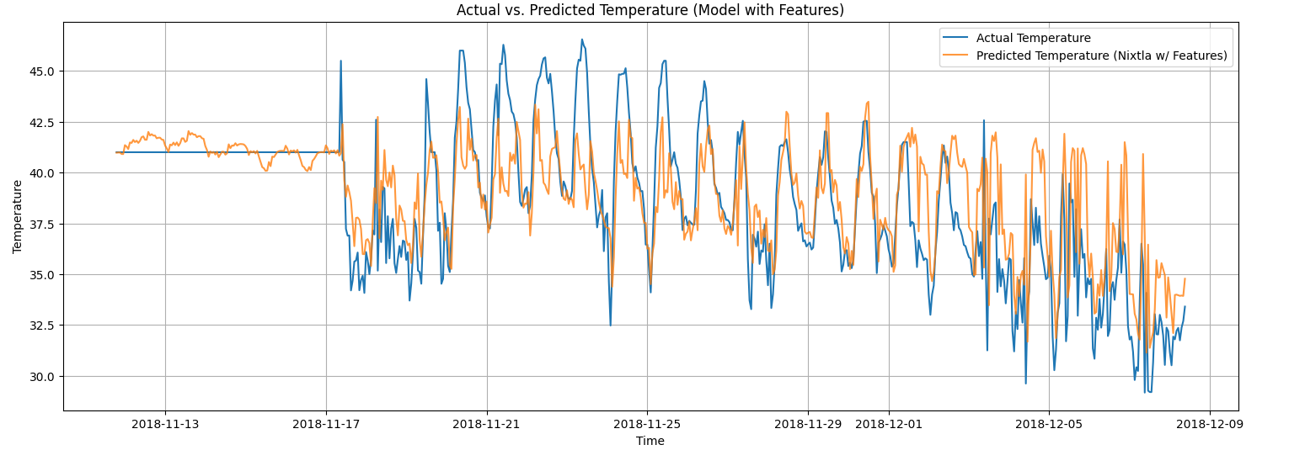
Model Evaluation
Without Features:
MAE: 3.2330
RMSE: 4.2958
Predictions were not great
Needed more robust features
With Features:
MAE: 1.75
RMSE: 2.52
Predictions closely followed actual trends
Acceptable for IoT use cases

Slide 8
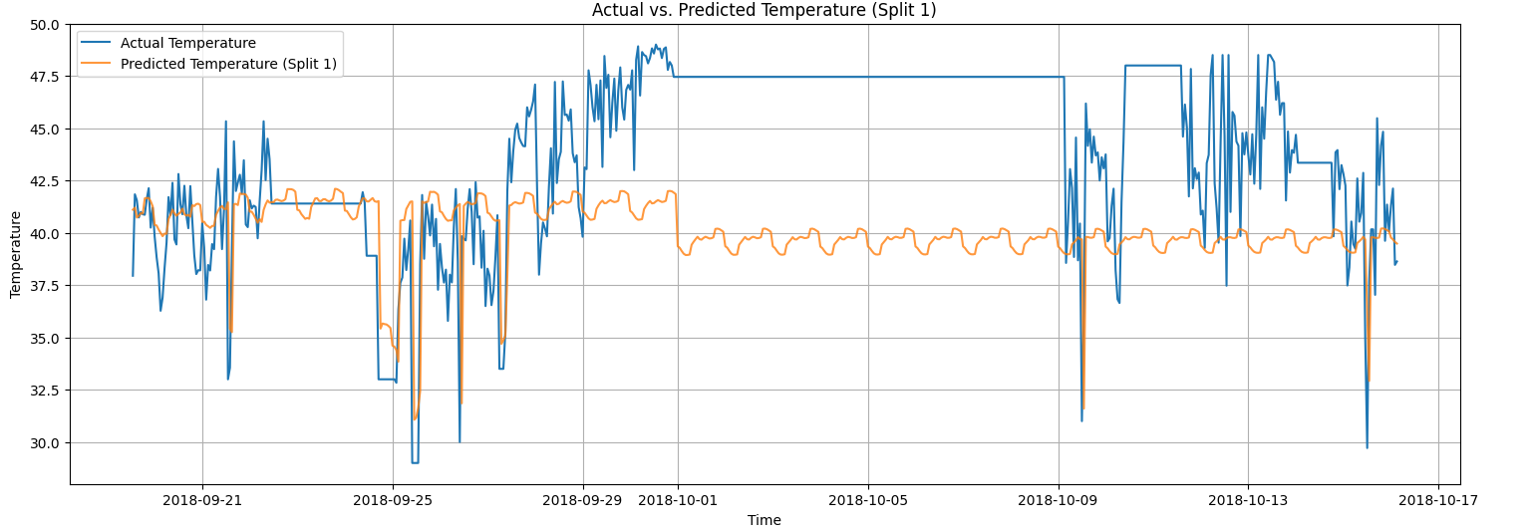
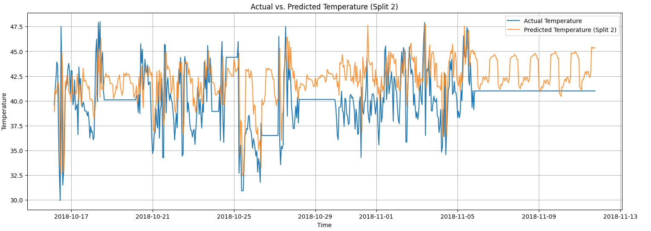
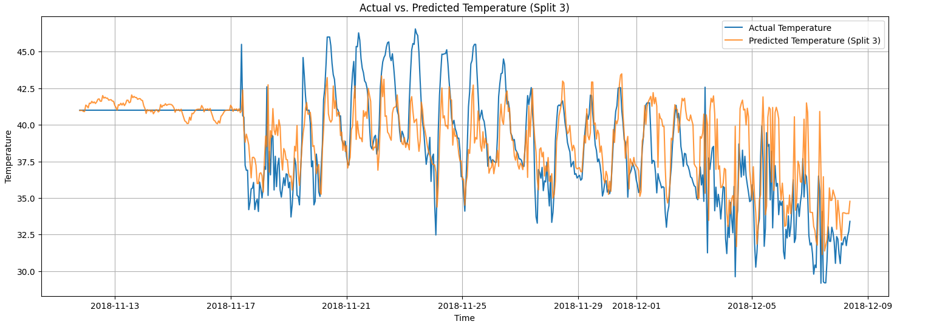
Validation Strategy
Rolling-Origin Cross Validation
3 splits
Performance improved with more data
Simulates real-world deployment

Slide 9
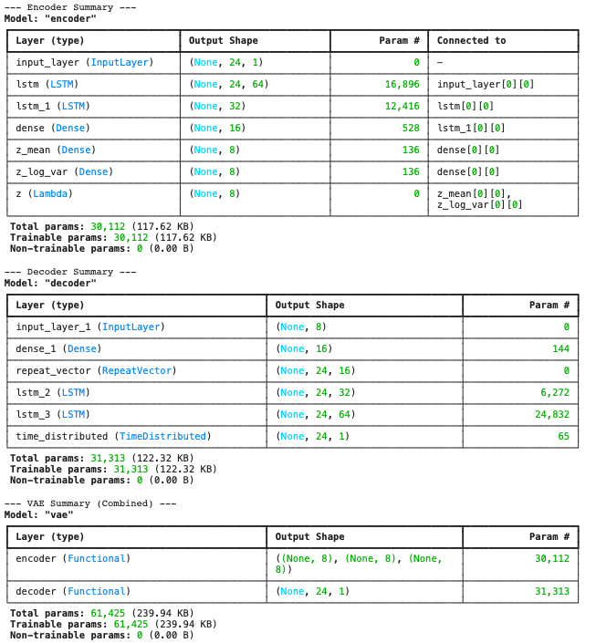
Generative Modeling
Used VAE to generate synthetic data
LSTM-based encoder/decoder
Generated ~60k data points
Goal: augment training data

Slide 10
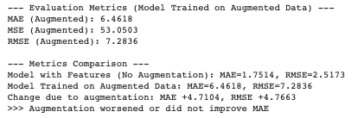
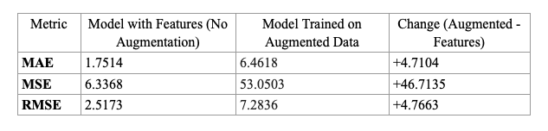
Impact of Generative Models
Augmentation worsened performance
MAE increased to 6.46
Likely due to missing engineered features
Synthetic data quality matters

Slide 11
Challenges, Insights, & Takeaways
Debugging TimeGPT input issues
Handling frequency & feature mismatches
Learned VAE for time series
Future: better features, tuning, GANs

Slide 12
Thank you

