Slide 1
PLEASE READ
There are notes in red boxes, these are meant for guidance, DELETE before presenting to customer.
This presentation was generated by extracting data from an RVTools file, all information should be reviewed w/ customer for accuracy.
The RVTools File Used was;
RVTools_export_2024-02-26_21.00.57.xlsx

Slide 2
Azure VMware Solution

Slide 3




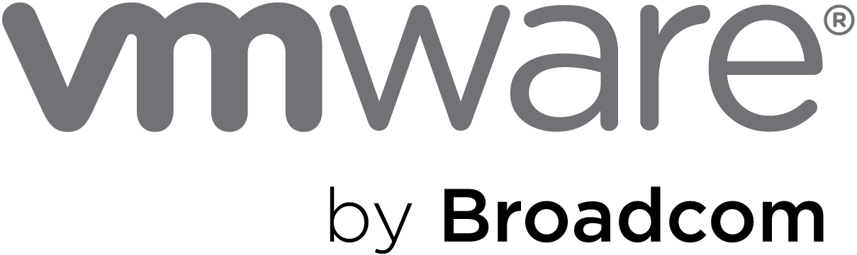
Azure VMware Solution
Microsoft Investments
Microsoft License Reduction
Extended Support Cost Avoidance
Broadcom License Reduction
AVS Hosts
138
$2,606,070
$606,824
$3,143,862
$5,464,200
Azure VMware Solution (3 Year Total):
$4,752,845
120
Avoiding Refresh of On-Premises vSphere Hosts
Microsoft Funding (in whole or part) Architecture, Implementation and Migration
VMware Technology Cost Stability
Overall Microsoft Windows and SQL License Optimization

Slide 4
Azure VMware Solution
The chart provides the detailed calculations of the numbers shown on the previous slide.
 | Year 1 | Year 2 | Year 3 | Total
AVS Host Pricing
Azure NetApp Files
Windows License Savings
SQL License Savings
ESU Avoidance (Windows)
Field Empowerment Discount
AVS Credit Offer (ACO)
VMware Renewal Savings

Slide 5
Azure VMware Solution – Sizing
VM Workload Breakout | Windows VMs | SQL VMs | Non-Win & Non-SQL VMs
Virtual Machine
Average vCPU Per VM
Average vMemory Per VM (GB)
Average Storage Consumed Per VM (GB)
This is a breakdown of the total VMs by workload type, identified by evaluating the RVTools File and uses “best guess” based on evaluating the various fields. These values should be verified
AV36P
138
Azure VMware Solution Hosts

Slide 6
Azure VMware Solution – Microsoft Investments
 | 3 Year Total
Field Empowerment Discount
AVS Credit Offer
Field Empowerment Discount
Additional 15% discount for 3-Year Reserved Instances
AVS Credit Offer
One-time Azure Credit Offer towards 3 Year RI
Notes:
Eligibility: ONLY net new migrations
What is the offer?: New customer migrations to AVS on a 1 or 3 YR RI will get a one-time ACO incentive. ACO can be used towards AVS consumption. Minimum of 6 node deployment in any region. Summary of how ACO will be awarded:

Slide 7

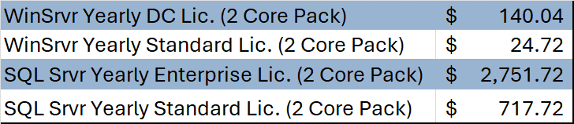
Azure VMware Solution – Microsoft License Reduction
Windows Datacenter On-Premises License Consumption
Windows Datacenter Licenses Optimized for Azure VMware Solution
By licensing the Azure VMware Solution as shown above there will be an estimated Microsoft license savings of
$606,824
Assumed Microsoft License Pricing

Slide 8

Azure VMware Solution – Extended Support Cost Avoidance
Windows Server 2012 Virtual Machines:
67
Windows Server 2012 Cores:
67
On-Premises Licensing Model (Assumed):
Windows Datacenter
If Windows Datacenter is being used all vSphere cores must be licensed for ESU
ESU Licenses:
2494
Extended Support Savings (3 Years):
$3,143,862

Slide 9
Azure VMware Solution – Broadcom License Reduction
VMware Cores On-Premises:
5204
Estimated Renewal Cost:
$5,464,200
VMware Cloud Foundation (v. 5) - Commitment Plan (3 years) - 1 core

Slide 10
Azure VMware Solution – How We Get There
Architecture Design
Migration Assessment & Planning
Implementation
Migration
Microsoft Fast Track (Microsoft Investment)
Azure VMware Solution Global Black Belt (Microsoft Investment)
Azure Cloud Migration Factory (Microsoft Investment)
Microsoft Partner (Funding Available)
The Global Blackbelt option is for IAP customers, or if an exception was approved.

