Slide 1
Azure VMware Solution

Slide 2




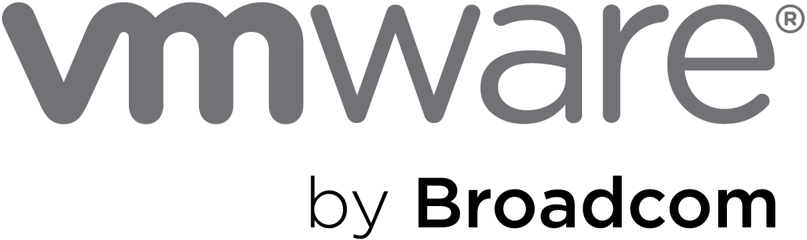
Azure VMware Solution
Microsoft Investments
Microsoft License Reduction
Extended Support Cost Avoidance
Broadcom License Reduction
AVS Hosts
36
$738,540
$297,442
$1,174,851
$1,957,200
Azure VMware Solution (3 Year Total):
$155,565
75
Avoiding Refresh of On-Premises vSphere Hosts
Microsoft Funding (in whole or part) Architecture, Implementation and Migration
VMware Technology Cost Stability
Overall Microsoft Windows and SQL License Optimization

Slide 3
Azure VMware Solution
 | Year 1 | Year 2 | Year 3 | Total
AVS Host Pricing | $1,441,200 | $1,441,200 | $1,441,200 | $4,323,600
Windows License Savings | -$99,147 | -$99,147 | -$99,147 | -$297,442
SQL License Savings
ESU Avoidance (Windows) | -$391,617 | -$391,617 | -$391,617 | -$1,174,851
Field Empowerment Discount | -$216,180 | -$216,180 | -$216,180 | -$648,540
AVS Credit Offer (ACO) | -$90,000 |  |  | -$90,000
VMware Renewal Savings | -$652,400 | -$652,400 | -$652,400 | -$1,957,200
 | -$8,144 | $81,855 | 81,855 | $155,565
Detailed explanation of each of these line items are detailed on slide 6 and forward.

Slide 4
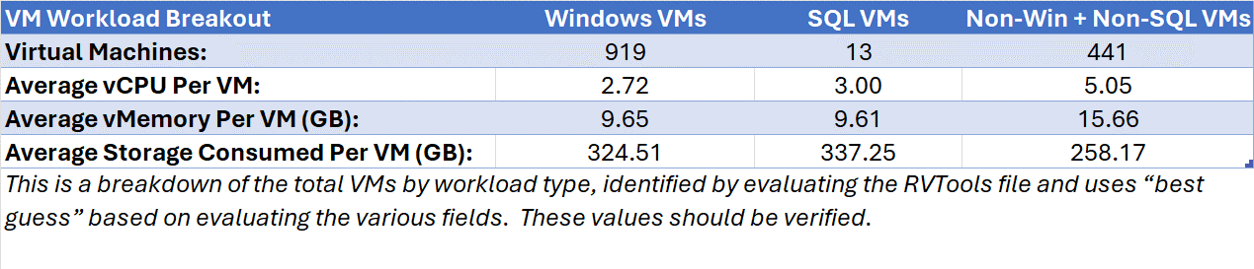
Azure VMware Solution – Sizing
36
AV36P
Azure VMware Solution Hosts

Slide 5
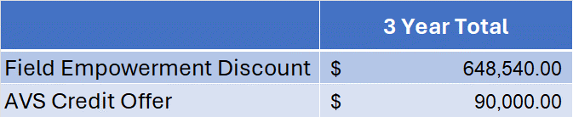
Azure VMware Solution – Microsoft Investments
Field Empowerment Discount
Additional 15% discount for 3-Year Reserved Instances
AVS Credit Offer
One-time Azure Credit Offer towards 3 Year RI
Notes:
Eligibility: ONLY net new migrations
What is the offer?: New customer migrations to AVS on a 1 or 3 YR RI will get a one-time ACO incentive. ACO can be used towards AVS consumption. Minimum of 6 node deployment in any region. Summary of how ACO will be awarded:

Slide 6
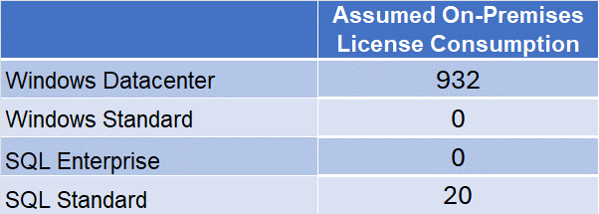
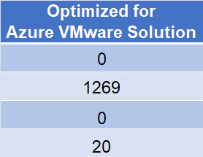

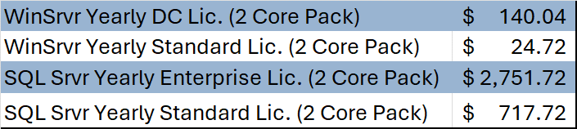
Azure VMware Solution – Microsoft License Reduction
By licensing the Azure VMware Solution as shown above there will be an estimated Microsoft license savings of
$297,442
Assumed Microsoft License Pricing

Slide 7

Azure VMware Solution – Extended Support Cost Avoidance
Windows Server 2012 Virtual Machines:
596
On-Premises Licensing Model (Assumed):
Windows Datacenter
Extended Support Savings (3 Years):
$1,174,851

Slide 8
Azure VMware Solution – Broadcom License Reduction
VMware Cores On-Premises:
1864
Estimated Renewal Cost:
$1,957,200
VMware Cloud Foundation (v. 5) - Commitment Plan (3 years) - 1 core

Slide 9
Azure VMware Solution – How We Get There
Architecture Design
Migration Assessment & Planning
Implementation
Migration
Microsoft Fast Track (No Cost to Customer)
Azure VMware Solution Global BlackBelt* (No Cost to Customer)
Azure Cloud Migration Factory (No Cost)
Microsoft Partner (Funding Available)

