Slide 1
PLEASE READ
You will see all dollar amounts formatted like xxxxxxxx.xx, you will need to reformat to $xxx,xxx.xx
This presentation was generated by extracting data from an RVTools file, all information should be reviewed w/ customer for accuracy.
It shows ALL potential discounts / investments Microsoft could make to incent the customer to migrate to Azure VMware Solution. As such you should modify to align with the offers you wish to extend to the customer.
On Slide 3 “Azure VMware Solution Overview” DELETE/MODIFY what is shown to reflect only what you wish to offer to the customer
On Slide 4 “Azure VMware Solution Cost Summary” DELETE/MODIFY the rows so it aligns with what is represented on slide 3.
For the remainder of the slides, DELETE/MODIFY as appropriate.
There are notes in red boxes, these are meant for guidance, DELETE before presenting to customer.
The RVTools File Used was;
Copy of RVTools_export_all_2024-02-01 for Teleflex.xlsx

Slide 2
Azure VMware Solution

Slide 3





Azure VMware Solution
Microsoft Investments
Microsoft License Reduction
Extended Support Cost Avoidance
Broadcom License Reduction
AVS Hosts
Please format the numbers as currency
36
$738,540
$297,442
$1,174,851
$1,957,200
Azure VMware Solution (3 Year Total):
$155,565
75
Avoiding Refresh of On-Premises vSphere Hosts
Microsoft Funding (in whole or part) Architecture, Implementation and Migration
VMware Technology Cost Stability
Overall Microsoft Windows and SQL License Optimization

Slide 4
Azure VMware Solution
 | Year 1 | Year 2 | Year 3 | Total
AVS Host Pricing | $1,441,200 | $1,441,200 | $1,441,200 | $4,323,600
Windows License Savings | -$99,147 | -$99,147 | -$99,147 | -$297,442
SQL License Savings
ESU Avoidance (Windows) | -$391,617 | -$391,617 | -$391,617 | -$1,174,851
Field Empowerment Discount | -$216,180 | -$216,180 | -$216,180 | -$648,540
AVS Credit Offer (ACO) | -$90,000 |  |  | -$90,000
VMware Renewal Savings | -$652,400 | -$652,400 | -$652,400 | -$1,957,200
 | -$8,144 | $81,855 | 81,855 | $155,565
The chart provides the detailed calculations of the numbers shown on the previous slide.
Please format the numbers in the form of currency
Detailed explanation of each of these line items are detailed on slide 6 and forward.

Slide 5
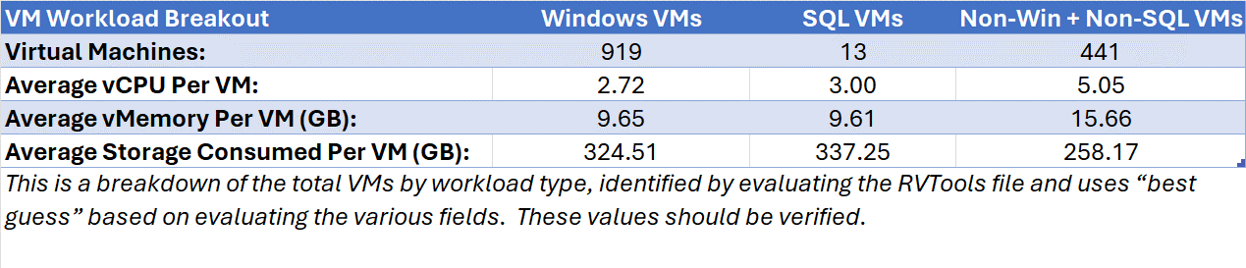
Azure VMware Solution – Sizing
36
AV36P
Azure VMware Solution Hosts

Slide 6
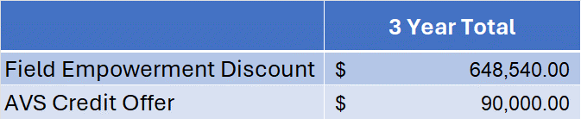
Azure VMware Solution – Microsoft Investments
Field Empowerment Discount
Additional 15% discount for 3-Year Reserved Instances
AVS Credit Offer
One-time Azure Credit Offer towards 3 Year RI
Notes:
Eligibility: ONLY net new migrations
What is the offer?: New customer migrations to AVS on a 1 or 3 YR RI will get a one-time ACO incentive. ACO can be used towards AVS consumption. Minimum of 6 node deployment in any region. Summary of how ACO will be awarded:

Slide 7
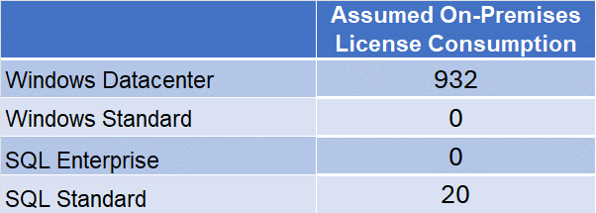
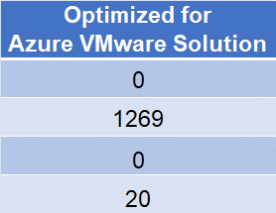

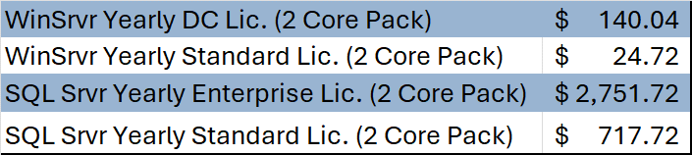
Azure VMware Solution – Microsoft License Reduction
By licensing the Azure VMware Solution as shown above there will be an estimated Microsoft license savings of
$297,442
Please format the number as currency
Assumed Microsoft License Pricing

Slide 8

Azure VMware Solution – Extended Support Cost Avoidance
Windows Server 2012 Virtual Machines:
596
On-Premises Licensing Model (Assumed):
Windows Datacenter
Extended Support Savings (3 Years):
$1,174,851
Please format the number as currency

Slide 9
Azure VMware Solution – Broadcom License Reduction
VMware Cores On-Premises:
1864
Please format the number as currency
Estimated Renewal Cost:
$1,957,200
VMware Cloud Foundation (v. 5) - Commitment Plan (3 years) - 1 core

Slide 10
Azure VMware Solution – How We Get There
Architecture Design
Migration Assessment & Planning
Implementation
Migration
Microsoft Fast Track (No Cost to Customer)
Azure VMware Solution Global BlackBelt* (No Cost to Customer)
The Global Blackbelt offer is only applicable to IAP customers, delete this item if this customer is not an IAP account.
Azure Cloud Migration Factory (No Cost)
Microsoft Partner (Funding Available)

