Slide 1
PLEASE READ
You will see all dollar amounts formatted like xxxxxxxx.xx, you will need to reformat to $xxx,xxx.xx
This presentation was generated by extracting data from an RVTools file, all information should be reviewed w/ customer for accuracy.
There are notes on the slides which may want to be removed before showing the customer, please review and delete / modify notations as necessary.
The RVTools File Used was;
Copy of RVTools_export_all_2024-02-01 for Teleflex.xlsx

Slide 2
Azure VMware Solution

Slide 3




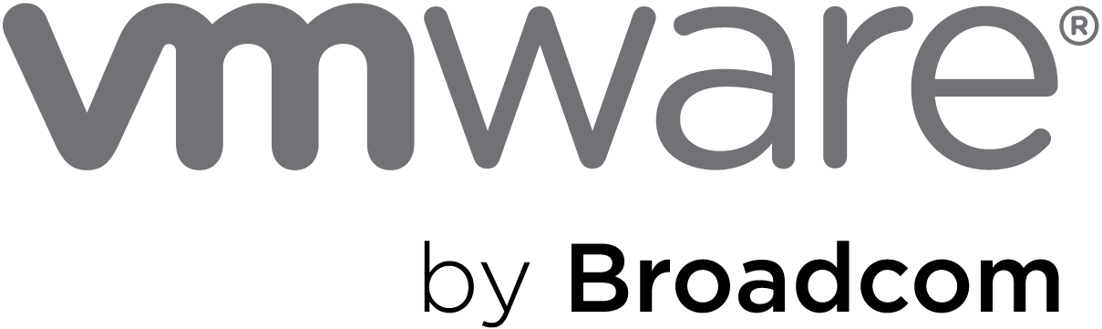
Azure VMware Solution
Microsoft Investments
Microsoft License Reduction
Extended Support Cost Avoidance
Broadcom License Reduction
AVS Hosts
36
$738,540
$297,442
$1,174,85
$1,957,200
Azure VMware Solution (3 Year Total):
$155,565
75
Avoiding Refresh of On-Premises vSphere Hosts
Microsoft Funding (in whole or part) Architecture, Implementation and Migration
VMware Technology Cost Stability
Overall Microsoft Windows and SQL License Optimization

Slide 4
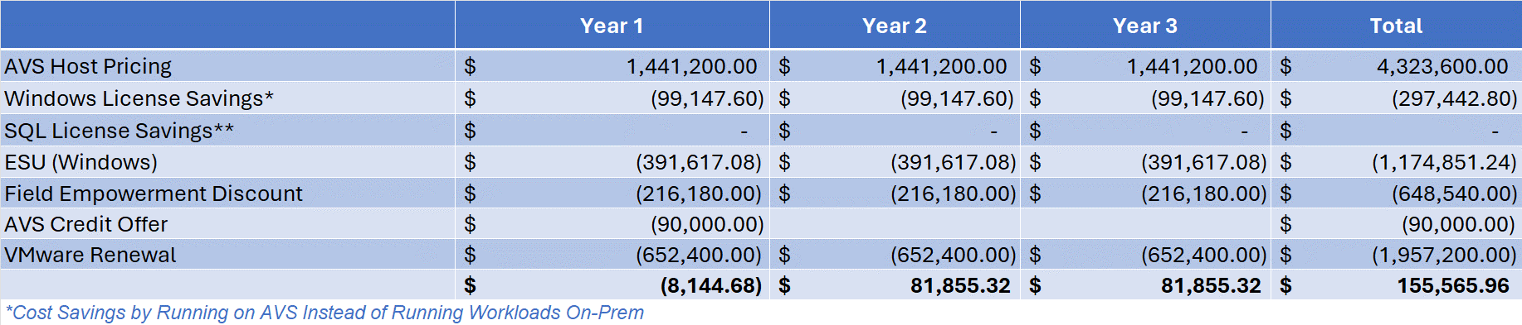
Azure VMware Solution
The chart provides the detailed calculations of the numbers shown on the previous slide.
Detailed explanation of each of these line items are detailed on slide 6 and forward.

Slide 5
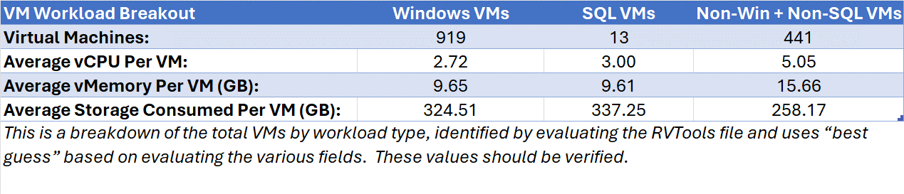
Azure VMware Solution – Sizing
36
AV36P
Azure VMware Solution Hosts

Slide 6
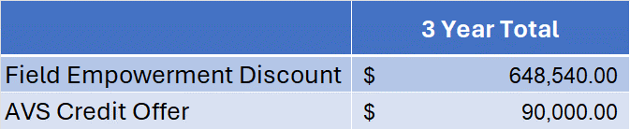
Azure VMware Solution – Microsoft Investments
Field Empowerment Discount
Additional 15% discount for 3-Year Reserved Instances
AVS Credit Offer
One-time Azure Credit Offer towards 3 Year RI
Notes:
Eligibility: ONLY net new migrations
What is the offer?: New customer migrations to AVS on a 1 or 3 YR RI will get a one-time ACO incentive. ACO can be used towards AVS consumption. Minimum of 6 node deployment in any region. Summary of how ACO will be awarded:

Slide 7
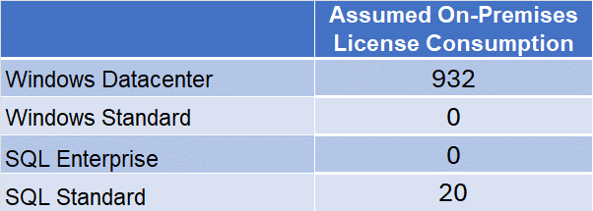
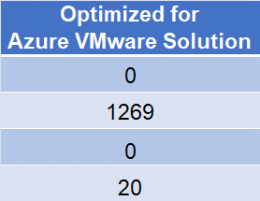

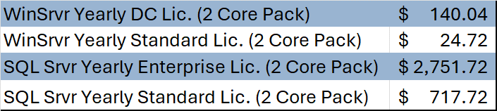
Azure VMware Solution – Microsoft License Reduction
By licensing the Azure VMware Solution as shown above there will be an estimated Microsoft license savings of
297442.8
Assumed Microsoft License Pricing

Slide 8

Azure VMware Solution – Extended Support Cost Avoidance
Windows Server 2012 Virtual Machines:
596
On-Premises Licensing Model (Assumed):
Windows Datacenter
Extended Support Savings (3 Years):
1174851.24

Slide 9
Azure VMware Solution – Broadcom License Reduction
VMware Cores On-Premises:
1864
Estimated Renewal Cost:
1957200
VMware Cloud Foundation (v. 5) - Commitment Plan (3 years) - 1 core

Slide 10
Azure VMware Solution – How We Get There
Architecture Design
Migration Assessment & Planning
Implementation
Migration
Microsoft Fast Track (No Cost to Customer)
Azure VMware Solution Global BlackBelt* (No Cost to Customer)
Azure Cloud Migration Factory (No Cost)
Microsoft Partner (Funding Available)
*IAP Customers

Slide 11
Azure VMware Solution
Microsoft Investments
Microsoft License Reduction
Extended Support Cost Avoidance
Broadcom License Reduction
AVS Hosts
36
$738,540
$297,442
$1,174,851
$1,957,200
Azure VMware Solution (3 Year Total):
$155,565
Avoiding Refresh of On-Premises vSphere Hosts
75
Eases and Accelerates Migration to Azure Native When Needed
Microsoft to Fund (in whole or part) of Architecture, Implementation and Migration
VMware Technology Cost Stability
Dedicated Microsoft Global Blackbelt

