Slide 1
World Class Proposal Example
Winning the VMware Base
AVS Business Architect – Dawn Decker

Slide 2





Azure VMware Solution
Microsoft Investments
Microsoft License Reduction
Extended Support Cost Avoidance
Broadcom License Reduction
AVS Hosts
36
738540
297442.8
1174851.24
1957200
Azure VMware Solution (3 Year Total):
155565.96
Avoiding Refresh of On-Premises vSphere Hosts
75
Eases and Accelerates Migration to Azure Native When Needed
Microsoft to Fund (in whole or part) of Architecture, Implementation and Migration
VMware Technology Cost Stability
Dedicated Microsoft Global Blackbelt
Overall Microsoft Windows and SQL License Optimization

Slide 3
Azure VMware Solution
The chart provides the detailed calculations of the numbers shown on the previous slide

Slide 4
Azure VMware Solution – Sizing
36
AV36p
Azure VMware Solution Hosts

Slide 5
Azure VMware Solution – Microsoft Investments
Field Empowerment Discount
Additional 15% discount for 3-Year Reserved Instances
AVS Credit Offer
One-time Azure Credit Offer towards 3 Year RI
Notes:
Eligibility: ONLY net new migrations
What is the offer?: New customer migrations to AVS on a 1 or 3 YR RI will get a one-time ACO incentive. ACO can be used towards AVS consumption. Minimum of 6 node deployment in any region. Summary of how ACO will be awarded:

Slide 6

Azure VMware Solution – Microsoft License Reduction
By licensing the Azure VMware Solution as shown above there will be a Microsoft license savings of

Slide 7
Azure VMware Solution
Microsoft Investments
Microsoft License Reduction
Extended Support Cost Avoidance
Broadcom License Reduction
AVS Hosts
36
$738,540
$297,442
$1,174,851
$1,957,200
Azure VMware Solution (3 Year Total):
$155,565
Avoiding Refresh of On-Premises vSphere Hosts
75
Eases and Accelerates Migration to Azure Native When Needed
Microsoft to Fund (in whole or part) of Architecture, Implementation and Migration
VMware Technology Cost Stability
Dedicated Microsoft Global Blackbelt

Slide 8
Cloud Migration Factory
https://microsoft.sharepoint.com/:p:/r/sites/CSUMigrationFactory/_layouts/15/Doc.aspx?sourcedoc=%7Bb7295cb2-2aa9-4f27-b412-4373bb8d5481%7D&action=view&wdSlideId=256&wdModeSwitchTime=1708964298628&isSPOFile=1&clickparams=eyJBcHBOYW1lIjoiVGVhbXMtRGVza3RvcCIsIkFwcFZlcnNpb24iOiI0OS8yNDAyMDIwNTUxMSIsIkhhc0ZlZGVyYXRlZFVzZXIiOnRydWV9

Slide 9
Summary

Slide 10



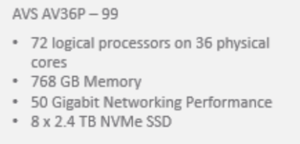
AVS Commercial Offer
VM’s
Servers
RAM
Total Cores
Total Storage
1928
89
72 TB
6451
1901 TB
Excl. backup
Contract Year | Year 1 | Year 2 | Year 3 | Total
AVS Hosts 3 Year AV36P US East Pricing | 330,275.35 | 330,275.35 | 330,275.35 | 990826.05
Empowerment | -49,541.30 | -49,541.30 | -49,541.30 | -148,623.90
Go Big Offer | -120,000.00 | 0 | 0 | -120,000.00
Commercial offer |  |  |  | $722,202.15

Slide 11
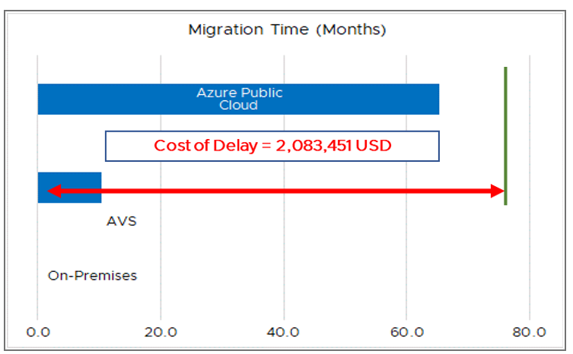
World Class Proposal- Value Proposal
Contract Year | Year 1 | Year 2 | Year 3 | Total
AVS Hosts 3 Year AV36P US East Pricing | 330,275.35 | 330,275.35 | 330,275.35 | 990826.05
Empowerment | -49,541.30 | -49,541.30 | -49,541.30 | -148,623.90
Go Big Offer | -120,000.00 | 0 | 0 | -120,000.00
Commercial offer |  |  |  | $722,201.15
MSFT Investments ($968.6K) include:
$148.6K - Additional 15% discount for 3-Year Reserved Instances, already discounted at 50% off Pay As You Go pricing
$120K – ACO Offer
$250K - ECIF Funding for Microsoft Consulting Services –
ECIF Funding dedicated to Azure VMware Solution migration work and is available only to Microsoft Consulting Services
Migration Factory FREE Migration- Estimated $450K value
Azure Cost benefits vs. on Prem or AWS/Google:​
SQL 2012 ESU Costs - $10.07M​
Windows Server 2012 ESU Costs – $653K​
Combined advantage of running in Azure: $10.72M
Shared under NDA. This is a draft proposal for discussion only and is subject to change.

Slide 12
World Class Proposal- Value Proposal
Contract Year | Year 1 | Year 2 | Year 3 | Total
AVS Hosts 3 Year AV36P US East Pricing | 330,275.35 | 330,275.35 | 330,275.35 | 990826.05
Empowerment | -49,541.30 | -49,541.30 | -49,541.30 | -148,623.90
Go Big Offer | -120,000.00 | 0 | 0 | -120,000.00
Commercial offer |  |  |  | $722,201.15
MSFT Investments ($968.6K) include:
$148.6K - Additional 15% discount for 3-Year Reserved Instances, already discounted at 50% off Pay As You Go pricing
$120K – ACO Offer
$250K - ECIF Funding for Microsoft Consulting Services –
ECIF Funding dedicated to Azure VMware Solution migration work and is available only to Microsoft Consulting Services
Migration Factory FREE Migration- Estimated $450K value
Azure Cost benefits vs. on Prem or AWS/Google:​
SQL 2012 ESU Costs - $10.07M​
Windows Server 2012 ESU Costs – $653K​
Combined advantage of running in Azure: $10.72M
Shared under NDA. This is a draft proposal for discussion only and is subject to change.

