Slide 1
Azure Migrate Interpreted
Discovery and assessment summary

Slide 2
Consolidated Infrastructure Summary
VM Power State Chart
VM Utilization Summary
Powered On
On-premises total
On-premises utilization
Recommended Azure sizing
1,398 (95.0%)
Assessed VMs
1,472
Powered Off
Storage
3.03 PB
48.8% Consumed
1.56 PB (48.5% decrease)
74 (5.0%)
Cores
8,821
48.9% CPU Utilization
6,758 (23.4% decrease)
Memory
44.4 TB
32.9% Memory Utilization
37.3 TB (16.0% decrease)
Fileshare count by host OS
Database count by type
Webapp count by type
Fileshares
Share
Count
Share
Webapps
Share
Windows
743
99.6%
SQL Server
252
87.2%
IIS
866
99.5%
Linux
3
0.4%
MongoDB
19
6.6%
MySQL
11
3.8%
Tomcat
4
0.5%
Total
746
100.0%
PostgreSQL
7
2.4%
Total
870
100.0%
Total
289
100.0%

Slide 3
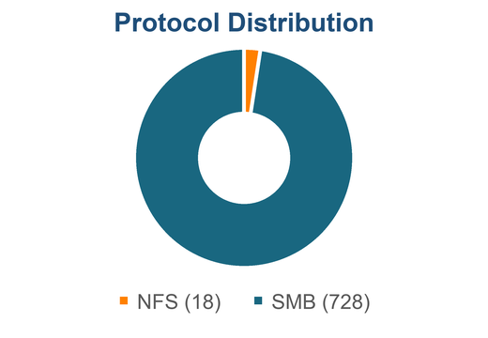
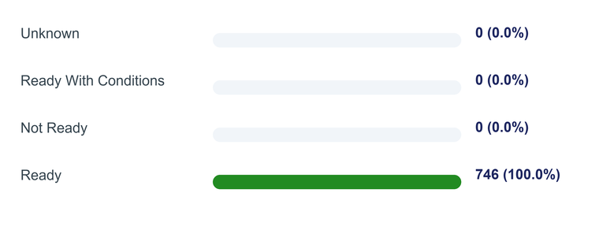
Fileshare Readiness
Discovery-derived fileshare-only server scope with Azure Files readiness, sizing, and monthly cost comparison.
Fileshare-only Azure sizing and cost
68
275
Fileshare-only servers
Fileshare-only shares
147.2 TB
$11.3K
$21.2K
$9.9K
Azure Files size
Azure Files / mo
Lift & shift / mo
Monthly delta
Azure Files readiness distribution
Sources: Discovery.xlsx Data sheet; Strategy_PaaS_Preferred.xlsx FileShares_to_Azure_Files; Strategy_Lift_and_shift.xlsx Server_to_AzureVM.

Slide 4
VM Power State Summary
0
250
500
750
1,000
1,250
1,500
1,750
Powered On (1,398)
Powered Off (74)
VM power-state counts
Power state | VM count | Share of VMs
Powered On | 1,398 | 95.0%
Powered Off | 74 | 5.0%
Total VMs | 1,472 | 100.0%
1,398
74
Powered On
Powered Off
Source: Discovery.xlsx, Data sheet, resourceType = microsoft.offazure/vmwaresites/machines.

Slide 5
VM Utilization Summary
On-premises footprint compared with recommended Azure sizing; lower is better for capacity change.
On-premises footprint
On-prem vs Azure
1,472
3.03 PB
8,821
44.4 TB
On-prem
Azure
Assessed VMs
Storage
Cores
Memory
48.8% Consumed
48.9% CPU Utilization
32.9% Memory Utilization
Storage
3.03 PB
1.56 PB
Cores
Recommended Azure sizing
8,821
6,758
1.56 PB
6,758
37.3 TB
Memory
Storage
Cores
Memory
44.4 TB
-48.5% vs on-prem
-23.4% vs on-prem
-16.0% vs on-prem
37.3 TB
Source: Strategy_Lift_and_shift.xlsx, Server_to_AzureVM tab. Recommended storage, cores, and memory are compared to on-premises totals.

Slide 6
Fileshares by Host OS Category
746
Windows
743
Linux / RHEL
3
Total fileshares
Other / Unknown
0
Fileshare count by host operating system
Host OS type | OS category | Fileshares | Share
Windows | Windows | 743 | 99.6%
Linux | RHEL | 3 | 0.4%
Total |  | 746 | 100.0%
Source: Discovery.xlsx, Data sheet. Fileshares are resourceType = microsoft.applicationmigration/storagesites/fileshares; OS is joined from host machine records.

Slide 7
Database Resources by Type
289
SQL Server
252
MongoDB
19
Total database resources
MySQL
11
PostgreSQL
7
Database count by type
Database type | Count | Share
SQL Server | 252 | 87.2%
MongoDB | 19 | 6.6%
MySQL | 11 | 3.8%
PostgreSQL | 7 | 2.4%
Total | 289 | 100.0%
Source: Discovery.xlsx, Data sheet. Database rows identified from database-related values in resourceType.

Slide 8
Non-SQL Database Readiness
Discovery footprint, support status, and PaaS readiness for MongoDB, MySQL, and PostgreSQL.
Discovery footprint
Support status by database type
Instances
Servers
Versions
Mainstream
Out of support
Unknown
MongoDB
19
19
5
MongoDB
10
4
5
MySQL
11
11
10
MySQL
2
8
1
PostgreSQL
7
7
5
PostgreSQL
2
2
3
Total
37
37
18
Total
14
14
9
PaaS readiness by database type
Unknown
Ready
Ready w/ conditions
Not ready
MongoDB
0
0
19
0
MySQL
0
0
11
0
PostgreSQL
0
0
7
0
Total
0
0
37
0
Sources: Discovery.xlsx Data sheet for instances, servers, versions, and directSupportStatus; Strategy_PaaS_Preferred.xlsx for PaaS readiness.

Slide 9
SQL Readiness
252
245
99
SQL Server Instances
Servers running SQL
SQL-only servers
SQL Server versions by support status
SQL Readiness by Target
Mainstream
Extended
Out of support
Unknown
SQL VM Instances (8)
SQL MI Instances (244)
224
SQL Server 2019
111
SQL Server 2022
55
SQL Server 2016
52
SQL Server 2017
23
17.0.1000.7
8
20
SQL Server 2014
3
8
0
0
0
0
0
Ready
Not Ready
Ready w/ Conditions
Unknown
Sources: Discovery.xlsx Data (SQL instances & versions); Strategy_PaaS_Preferred.xlsx SQLinstance_to_AzureSQLVM (AZURE_SQL_VM_READINESS + AZURE_SQL_VM_COMPUTE/STORAGE_MONTHLY_COST_USD) and SQLinstance_to_AzureSQLMI (AZURE_SQL_MI_READINESS + AZURE_SQL_MI_COMPUTE/STORAGE_MONTHLY_COST_USD); Strategy_Lift_and_shift.xlsx Server_to_AzureVM (TOTAL_MONTHLY_COST_USD for servers in either SQL sheet, deduplicated).

Slide 10
SQL Cost and Licensing
SQL Server licenses owned (from EA export)
SQL Server Enterprise
Licenses: 136
Cores: 272
SQL Server Standard
Licenses: 652
Cores: 1,304
Lift & Shift vs SQL MI (where ready) + Lift & Shift remainder
100% Lift & Shift
SQL MI (where ready) + Lift & Shift
$80.7K
$156.7K
245 VMs / 0 SQL MI | $968,154/yr
8 VMs / 244 SQL MI | $1,879,978/yr
NUMBER OF VMS
CORES VS ON-PREM
245
1,744 vs 1,721
MEMORY VS ON-PREM
STORAGE VS ON-PREM
10.8 TB vs 16.7 TB
341.93 TB vs 1069.50 TB
Recommended cores by SQL edition
522
858
364
Enterprise
Standard
Developer

Slide 11
WebApp Readiness
Discovery web application footprint, support status, and AKS readiness by web app type.
WebApps and hosting servers
WebApps
Server Count
Dedicated WebApp Servers
IIS
866
681
475
Tomcat
4
2
0
Total
870
683
475
Support Status
Readiness
IIS | Tomcat | Total
755 | 4 | 759
27 | 0 | 27
84 | 0 | 84
Unknown
Ready
Ready w/ conditions
Not Ready
Mainstream
IIS
0
0
402
0
Out of support
Tomcat
0
0
0
0
Unknown
Total
0
0
402
0
Sources: Discovery.xlsx Data sheet for resourceType, parentResourceName, and directSupportStatus; Strategy_PaaS_Preferred.xlsx WebApp_to_AKS for READINESS.

