Slide 1
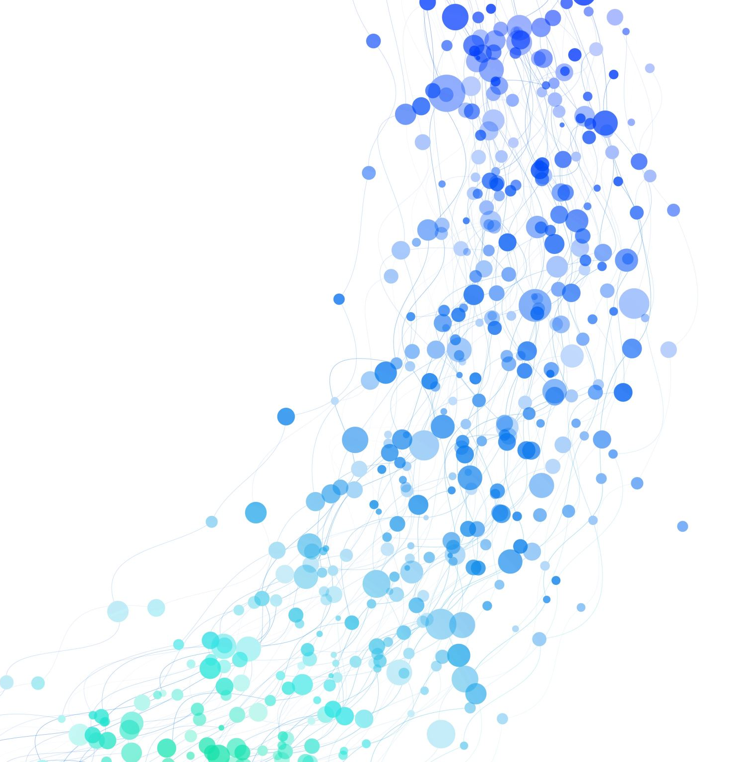
COS Autocare
By Trevor Kulczycki-McIntyre

Slide 2
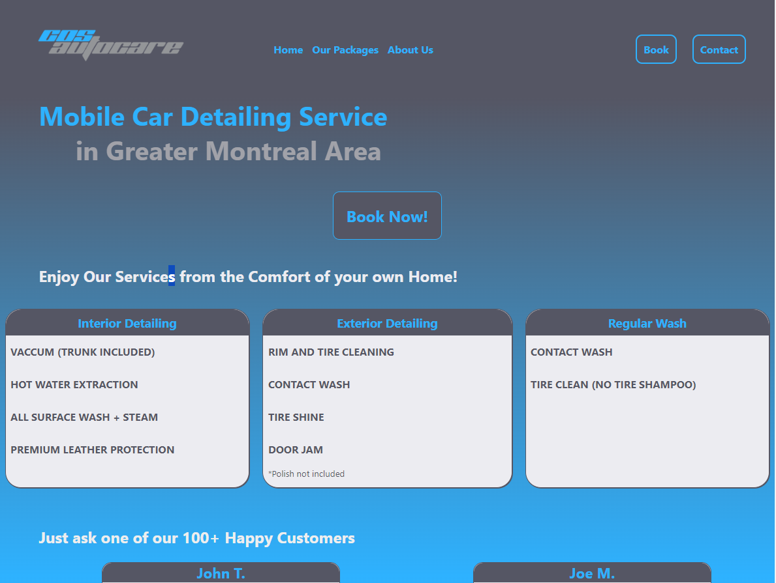
Index.html
Home page/Landing page prompting user to book now!

Slide 3
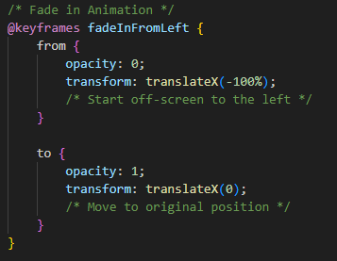
Index.html - Key features
Slide-in Header: I’ve developed a slide-in header using CSS animation and Keyframes

Slide 4
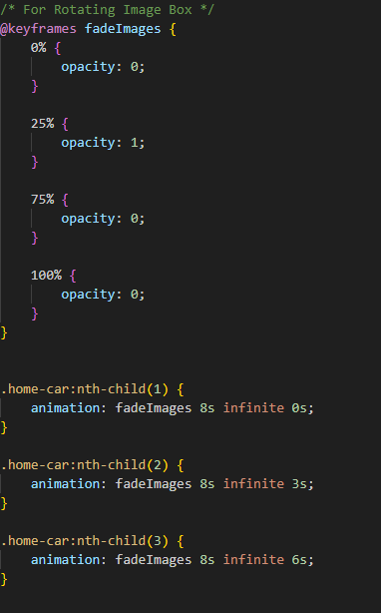
Index.html – Key Features cont.
Rotating image box: Images that fade in and fade out using CSS keyframes and nth-child(n)

Slide 5
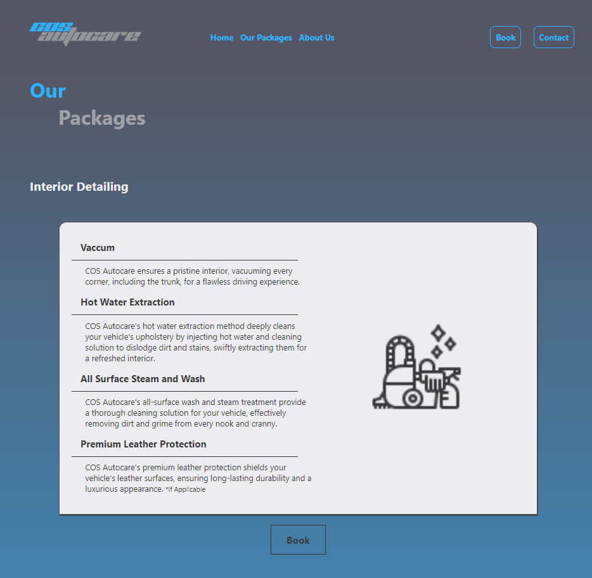
Our-packages.html
Package page featuring all of the different services we offer.

Slide 6
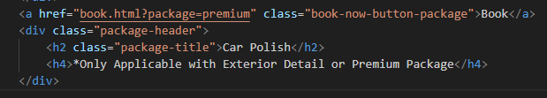
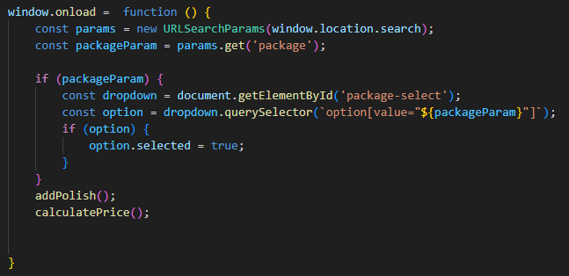
Our-packages.html – Key Features
Using JavaScript and HTML search params, clicking book on a package will auto-select in booking page

Slide 7
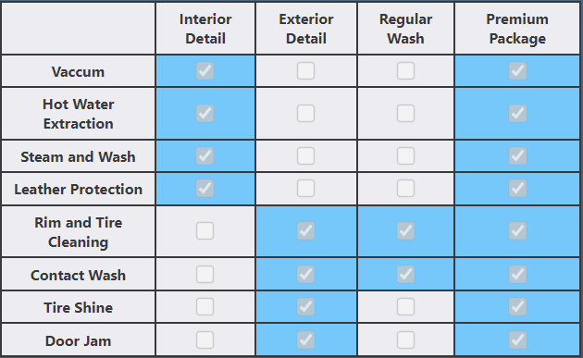
Our-packages.html – Key Features cont.
Absolutely stunning, gorgeous table featuring all of the information needed to determine which package is right for you

Slide 8
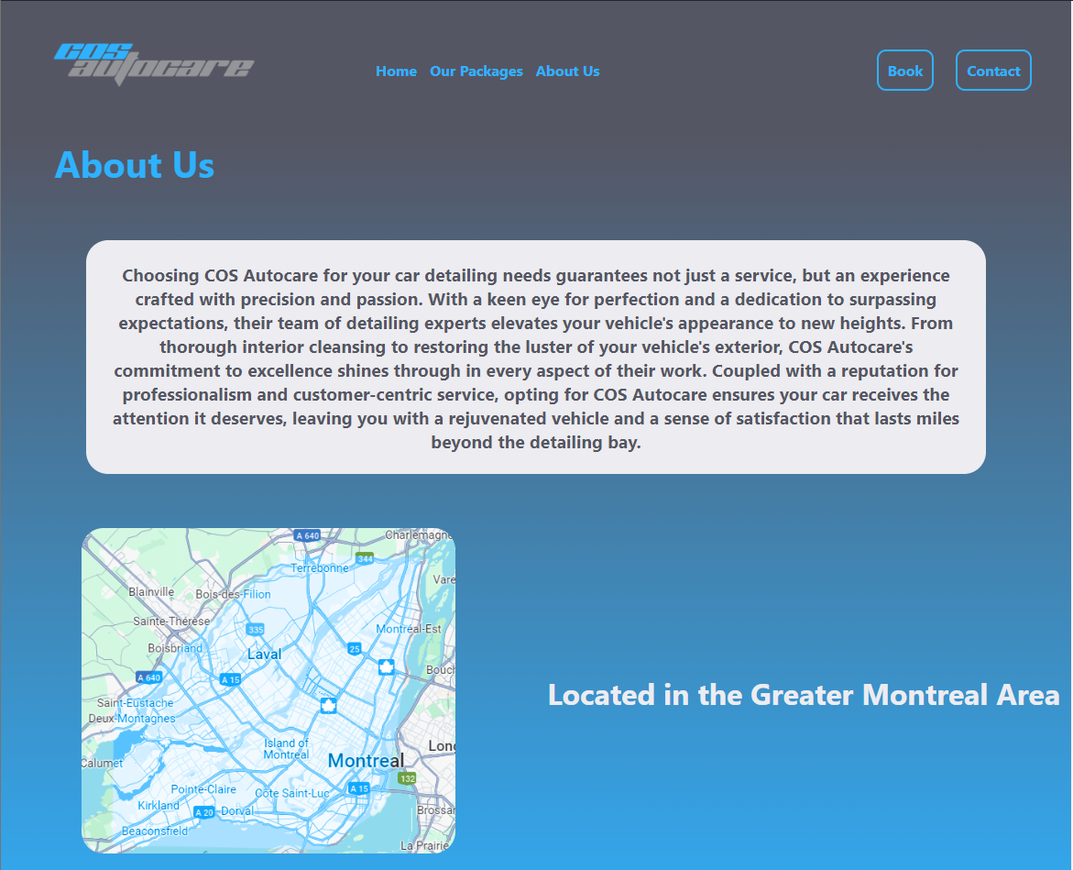
About-us.html
Page about company information

Slide 9
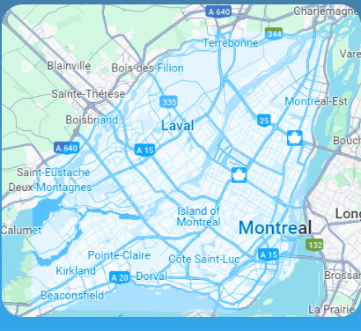
About-us.html – Key Features
A marvelous photo carefully and precisely edited in GIMP by yours truly.

Slide 10
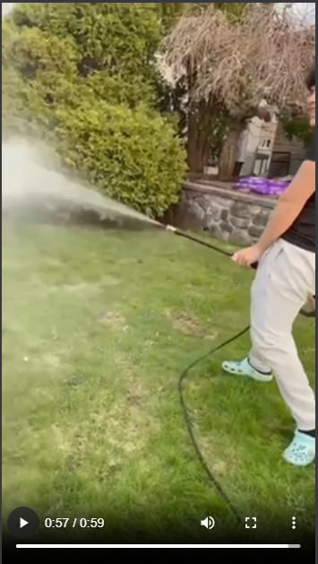
About-us.html Key Features cont.
A video featuring a REAL client and the work that we do at COS.

Slide 11
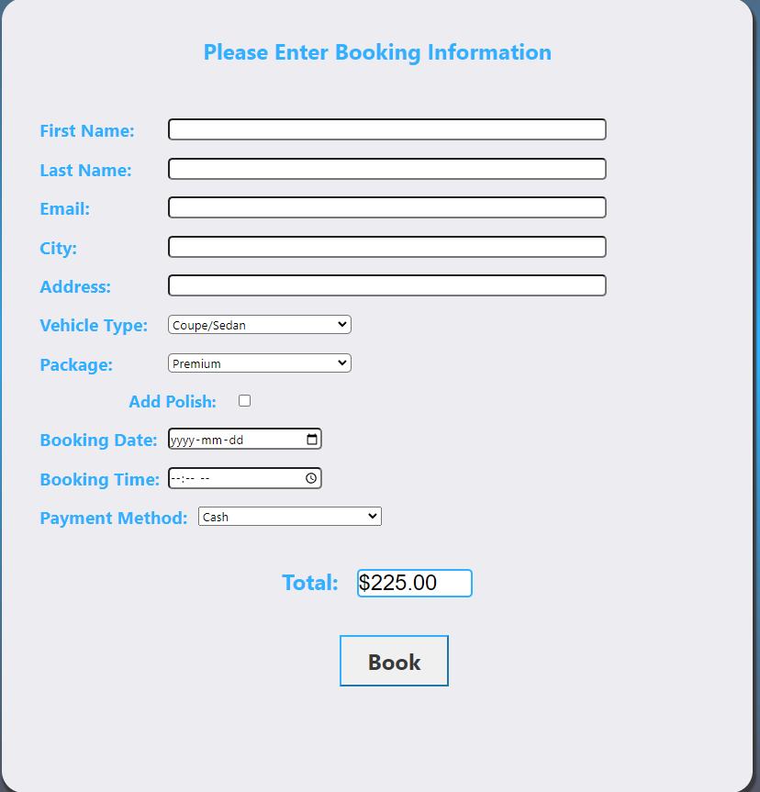
Book.html
The Booking page

Slide 12
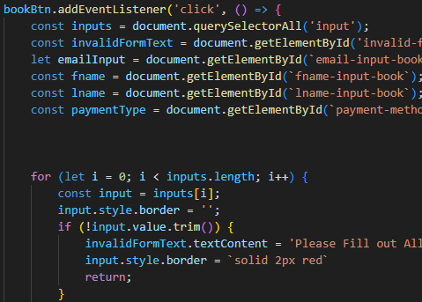
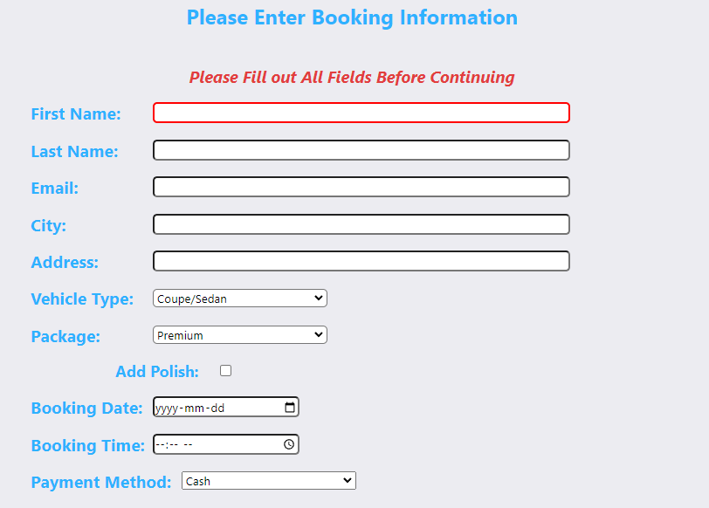
Book.html – Key Features
Form validation: The user must fill out all of the fields before continuing. I achieved this using the JS querySelectorAll method to target my inputs.

Slide 13
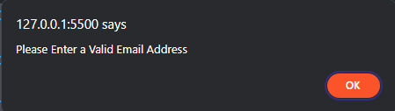
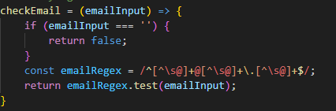
Book.html – Key Features cont.
Window.Alert if email address is unvalid using regular expressions

Slide 14
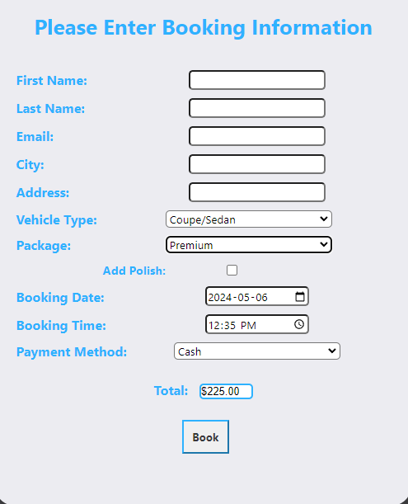
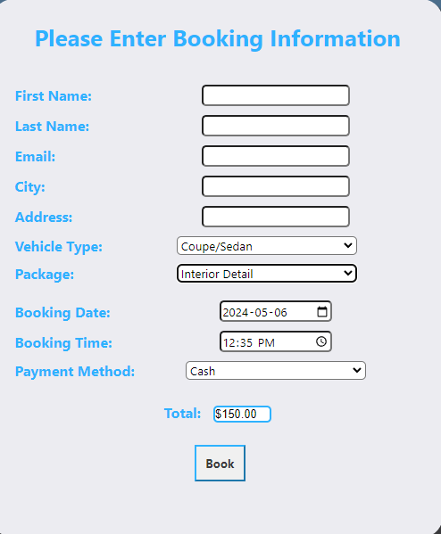
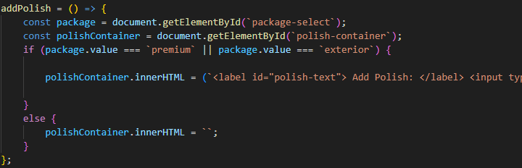
Book.html – Key Features cont.
Polish check using DOM
If the user chooses Premium or Exterior Detail package they are prompted to add polish

Slide 15
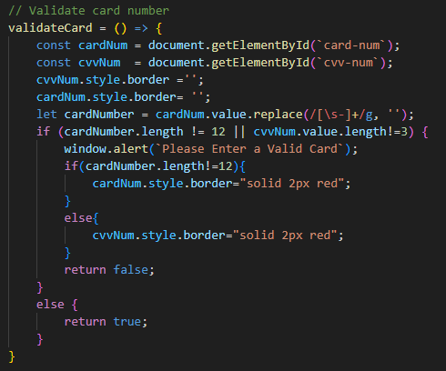
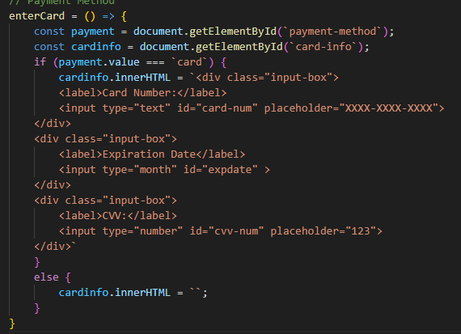
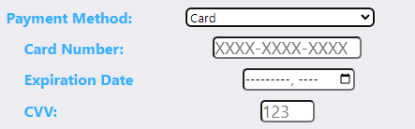
Book.html - Key Features cont.
If the user selects card as a payment, they are prompted to enter their card information, comes with its own form validation to ensure that the card number is 12 digits long and CVV number is 3
Using the JS replace() method allows the user to enter the number with spaces in it or ‘-’ notation

Slide 16
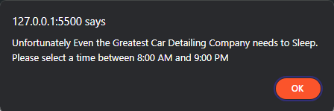
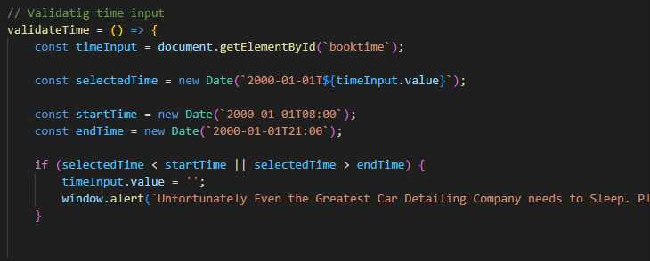
Book.html Key Features cont.
Time validation: If the user tries to book a time outside of traditional working hours (8:00 AM – 9:00 PM) then they are alerted and required to input a different time.
I achieved this by creating a start time and end time and ensuring the selected time is between them.

Slide 17
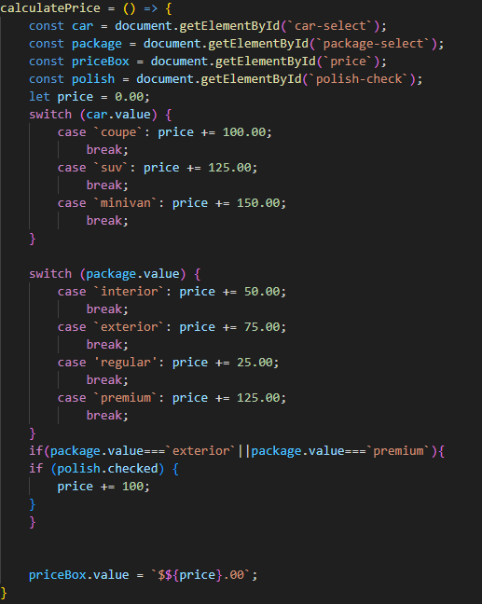
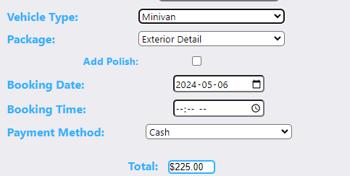
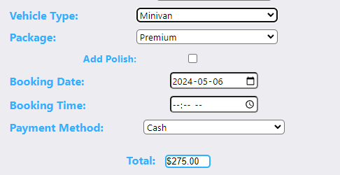
Book.html Key-Features cont.
Real Time Price Calculation: After the user selects a package and vehicle, the price automatically changes in the total box.

Slide 18
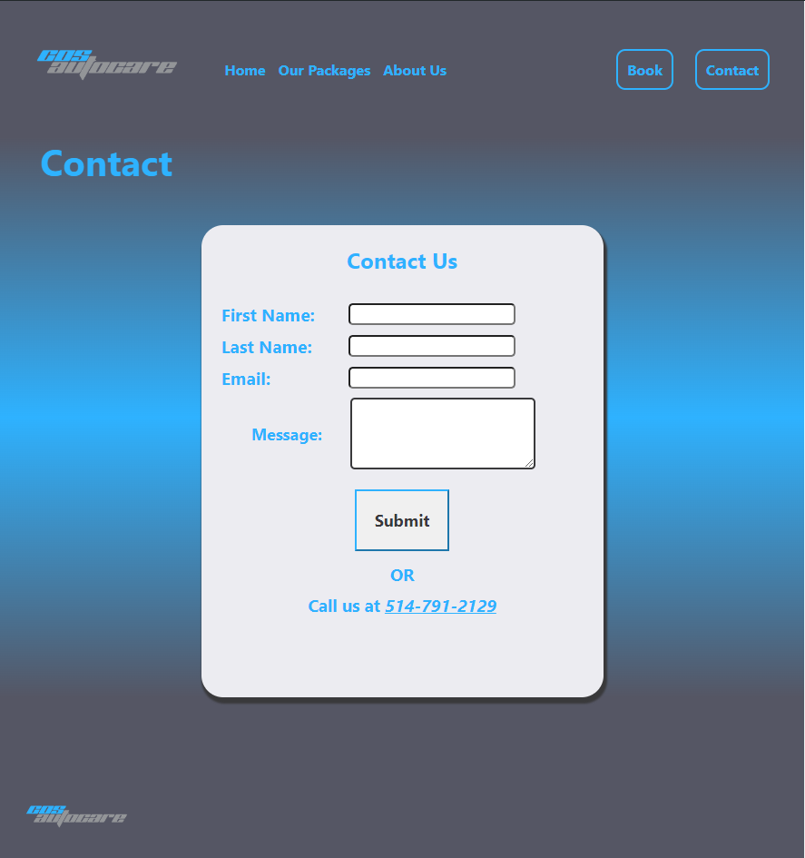
Contact.html
Contact page for user reviews/comments

Slide 19
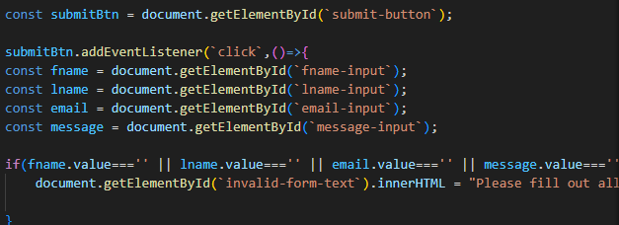
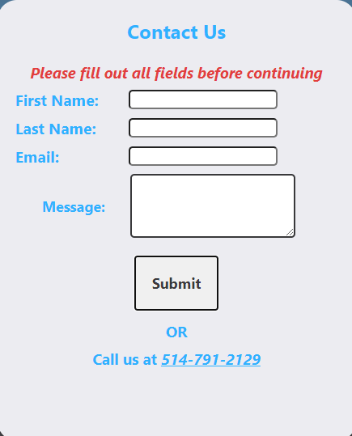
Contact.html - Key Features
Form validation: Ensures each field is filled out.
Also features the same email validation using regex as book page

Slide 20
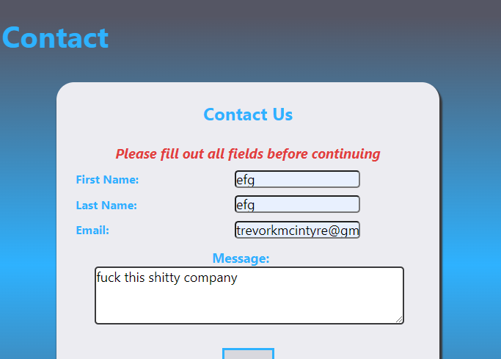
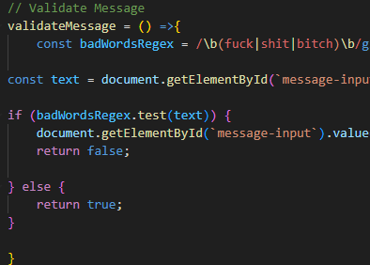
Contact.html - Key Features cont.
Verifies that the message being sent is family friendly using regular expressions.

Slide 21

Other Notable Features
Clicking on any of the logos in the page will bring you back to the main page

Slide 22
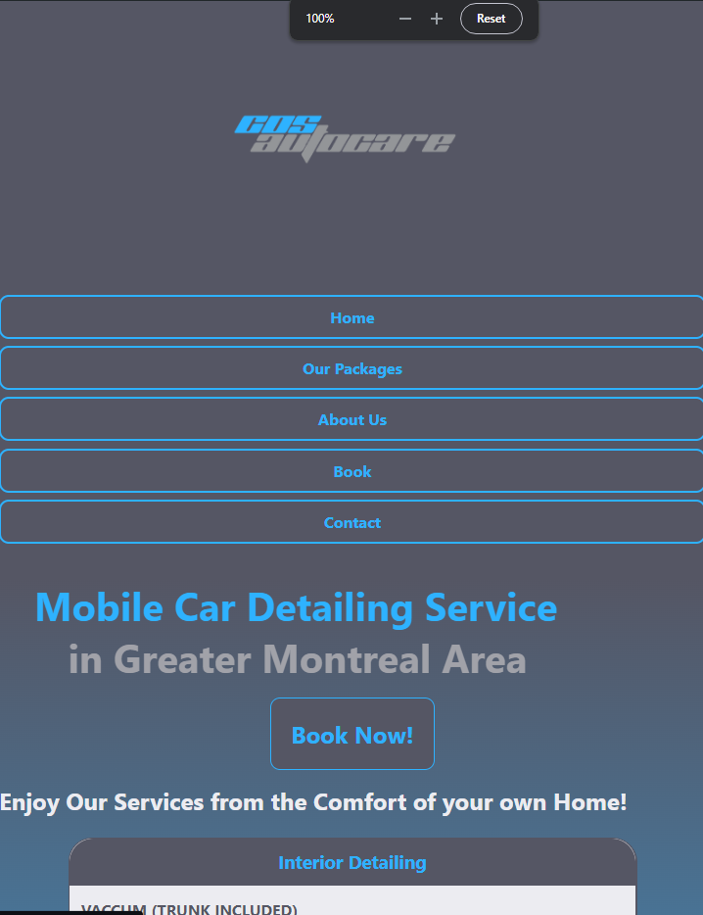
Other Notable Features cont.
Responsive Design: The webpages will change to fit your screen the best!

Slide 23

Future Implementation…
COS Autocare is a REAL company and will be washing cars in YOUR neighborhood this summer!
I plan to implement JSON file writing using Node.js and it’s express server.
I also plan to implement real time updates to reviews using JSON file reading, and writing from the contact page
Unfortunately I was unable to implement this for the project since Visual Studio’s live server does not support POST requests and Node.js would need to be installed on the school computers in order to access the server.

Slide 24

Thank you for your time!

