Slide 1

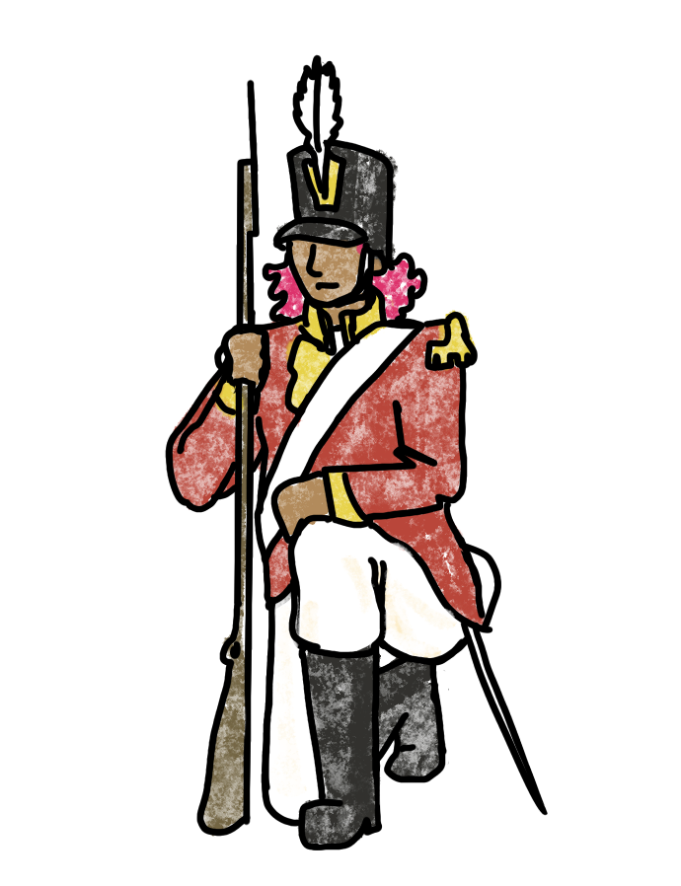
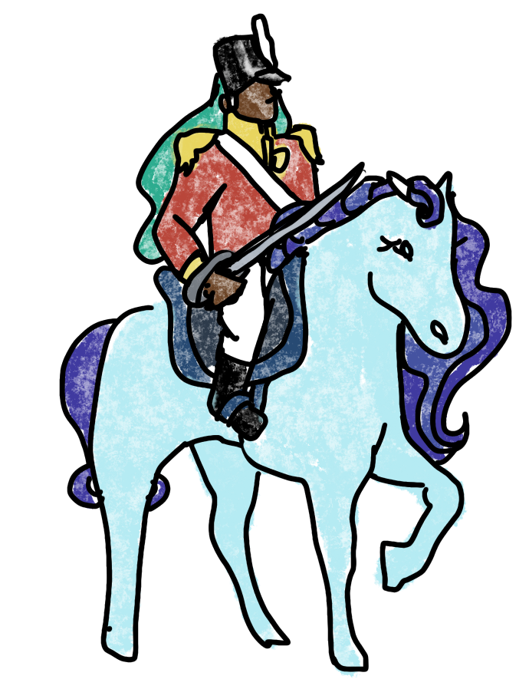
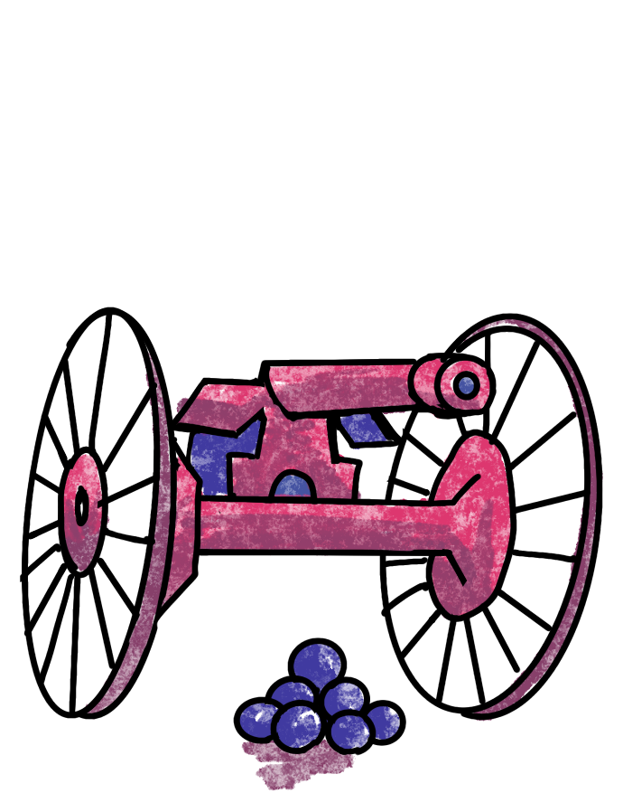
RISK
RL for Global Domination

Slide 2
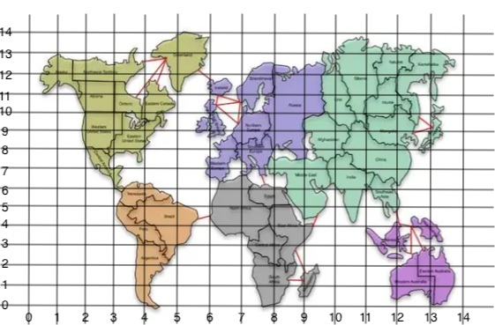
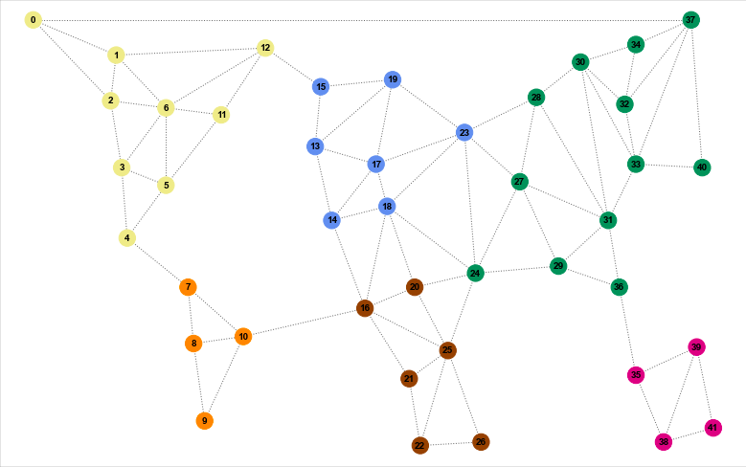
The board game map is not the best visualization for analysis
So, we turn it into a graph!

Slide 3
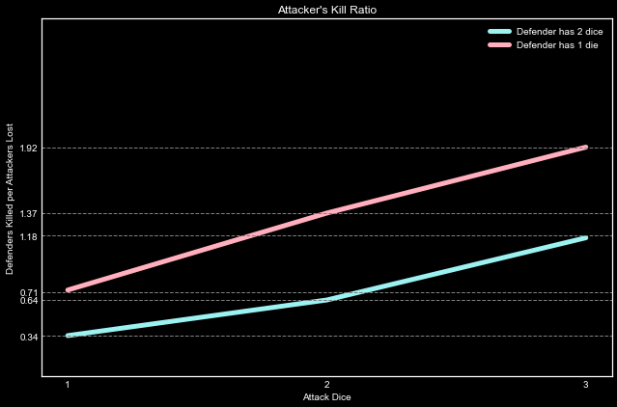
Battle Analysis
In small battles, the attacker is only at an advantage when outnumbering the defender

Slide 4
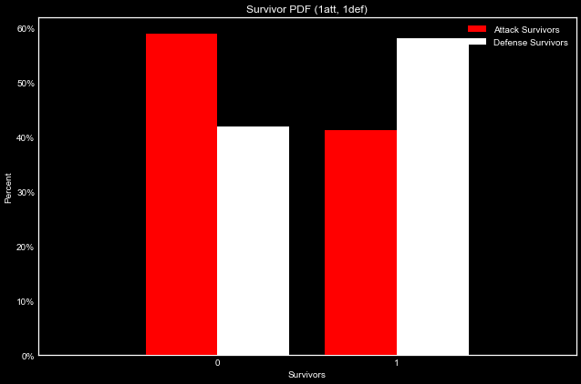
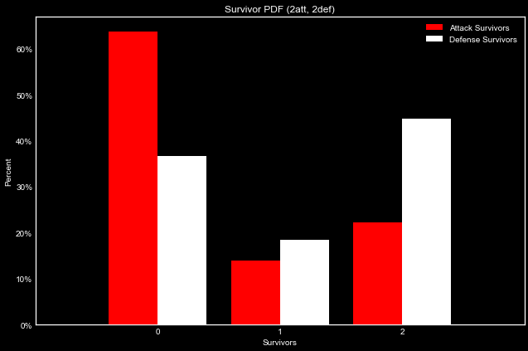
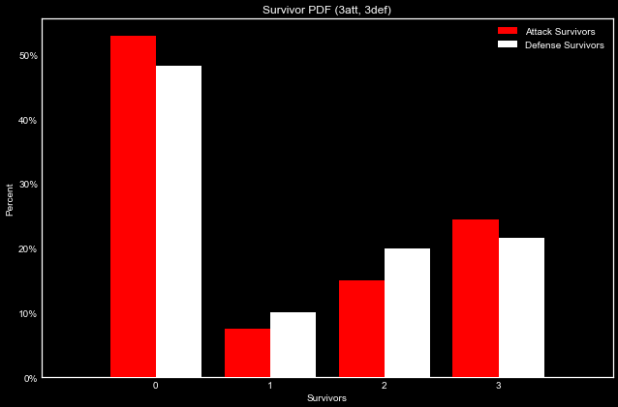
1 vs 1
2 vs 2
3 vs 3
Battle Analysis
Small battles have a high chance of the attacker losing a die to roll so they quickly lose any advantage

Slide 5
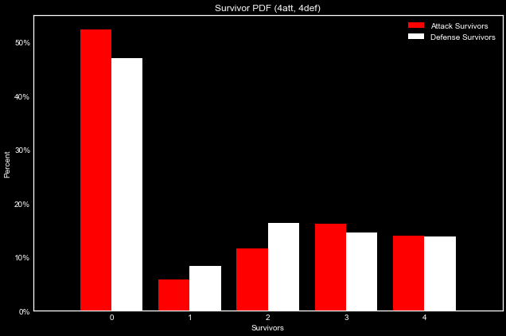
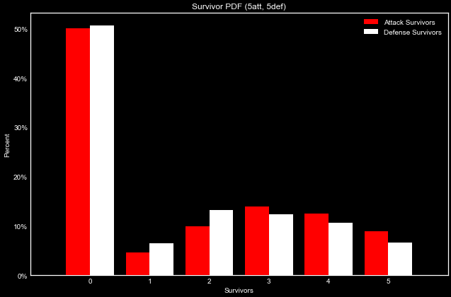
4 vs 4
5 vs 5
Battle Analysis
At 5 vs 5, the advantage of increased attack dice outweighs the tie going to the defender.

Slide 6
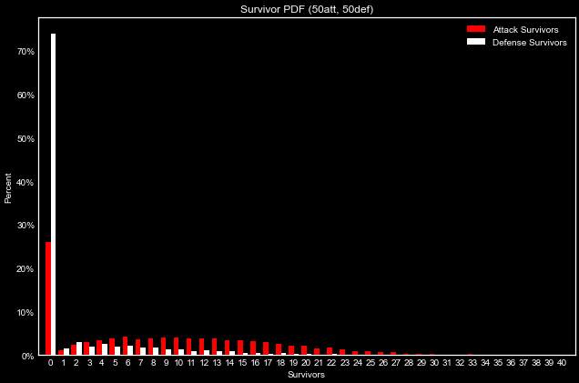
Battle Analysis
For very large battles, the kill ratio of 1.18 for 3 vs 2 dice gives the attacker a clear advantage.

Slide 7
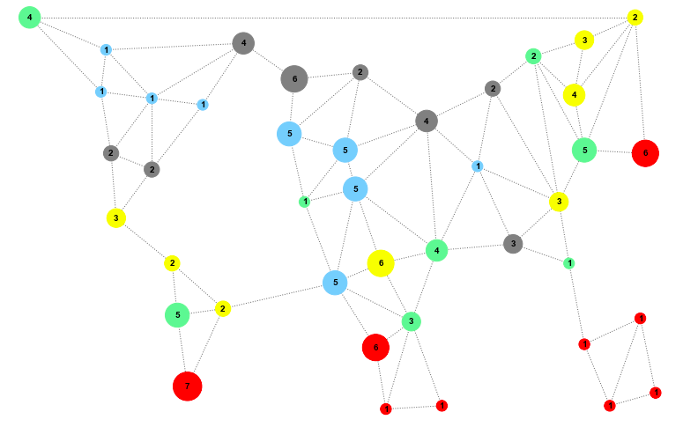
Simulation

Slide 8
Behaviors (Territory Selection)
Random
Isolationist
Network
Connecter
United States
South America
Pacific Islands
Africa
Europe
Middle East

Slide 9
Behaviors (Troop Placement)
Random
Aggressive
Defensive

Slide 10
Data Methods
5 Player Risk Simulations
Test behavior competes against 4 randomly selected behaviors
Run game simulation 100 times for each test behavior
track win/loss
turns to win
turns until eliminated
Compare strategies using t-tests
The data is IID!

Slide 11
Results
BEHAVIOR GAMES WON
“united states, random” 40%
“pacific islands, defensive” 30%
“isolationist, defensive” 20%
“random, random” 19%
“connecter, aggressive” 4%
“network, defensive” 6%

Slide 12
Future Steps
Set up a pure reinforcement framework for the game.
Evolutionary algorithms to determine the best strategy for general play.
Get this model online so people can see animations of their favorites strategies☺

