Slide 1
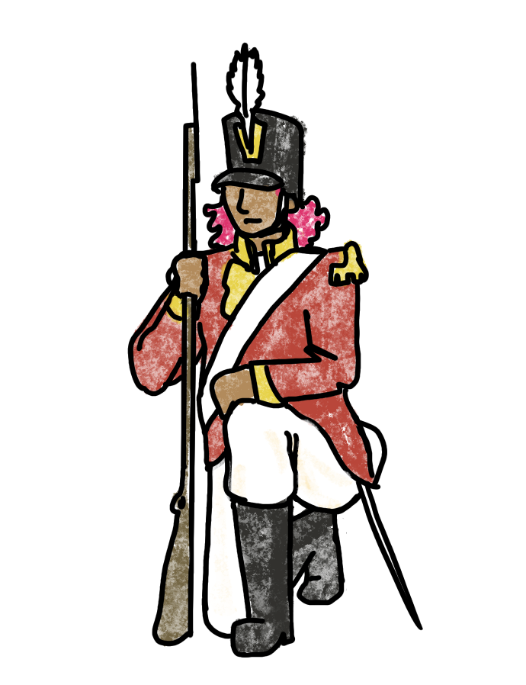
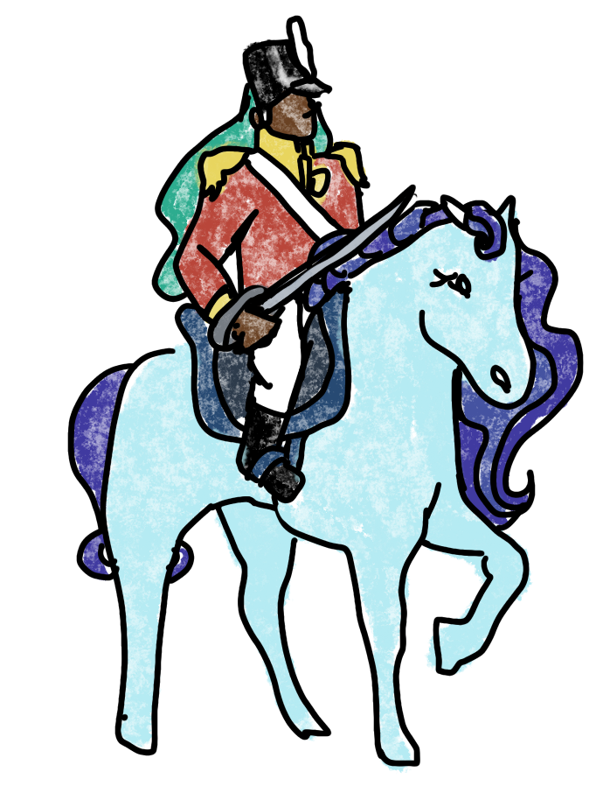
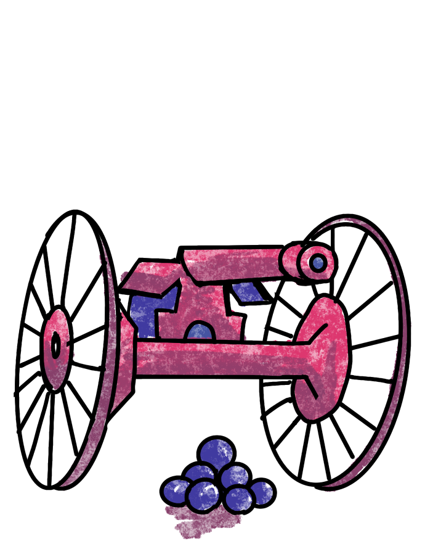
RISK
RL for Global Domination

Slide 2
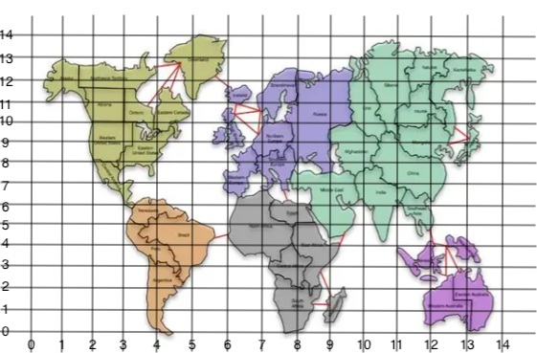
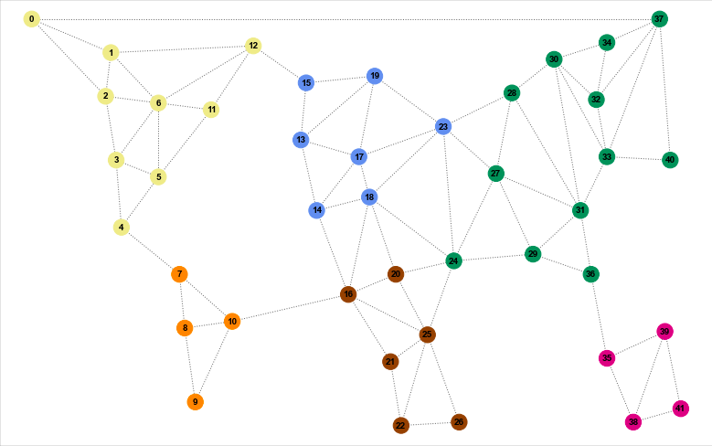
The board game map is not the best visualization for analysis
So, we turn it into a graph!

Slide 3
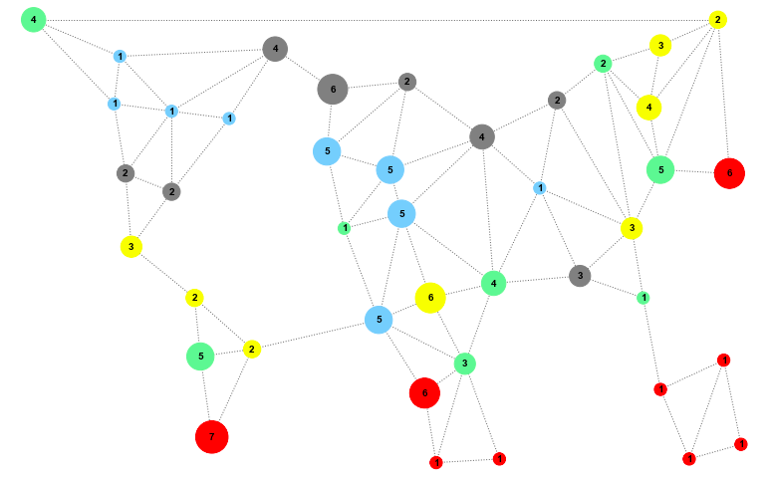
Simulation

Slide 4
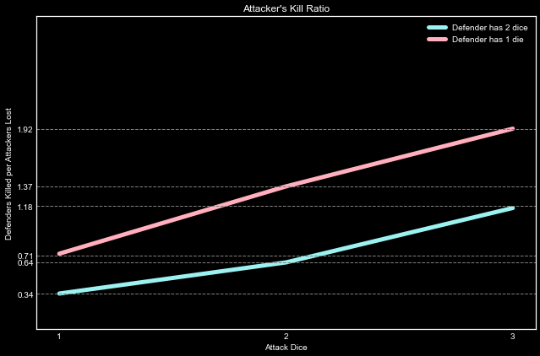
Battle Analysis
In small battles, the attacker is only at an advantage when outnumbering the defender

Slide 5
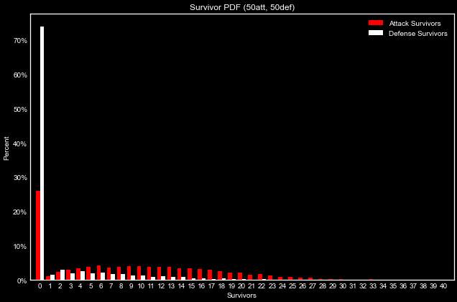
Battle Analysis
For very large battles, the kill ratio of 1.18 for 3 vs 2 dice gives the attacker a clear advantage.

Slide 6
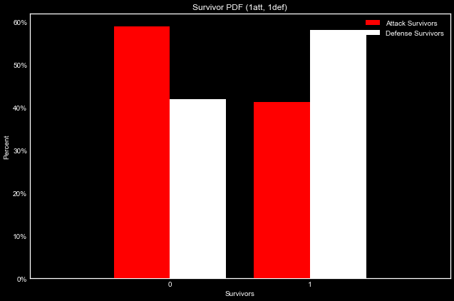
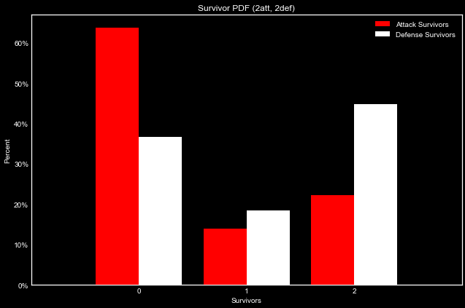
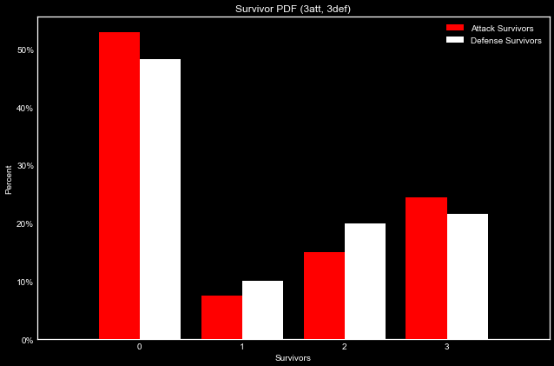
1 vs 1
2 vs 2
3 vs 3
Battle Analysis
Small battles have a high chance of the attacker losing a die to roll so they quickly lose any advantage

Slide 7
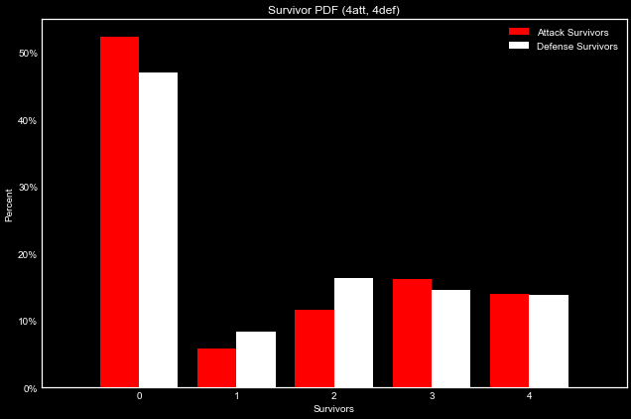
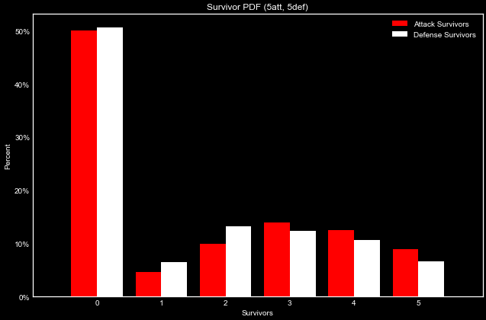
4 vs 4
5 vs 5
Battle Analysis
At 5 vs 5, the advantage of increased attack dice outweighs the tie going to the defender.

Slide 8
5 Player Risk Simulations
Test behavior competes against 4 randomly selected behaviors
Run game simulation 100 times for each test behavior
track win/loss
turns to win
turns until eliminated
Compare strategies
The data is IID!
Data Methods

Slide 9
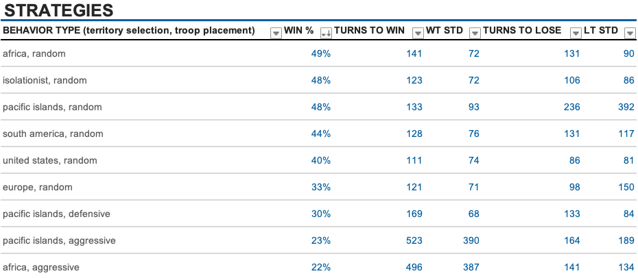
BEST

Slide 10
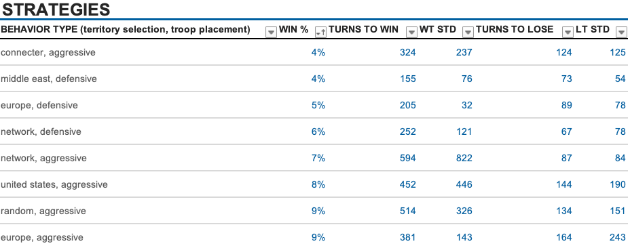
WORST

Slide 11
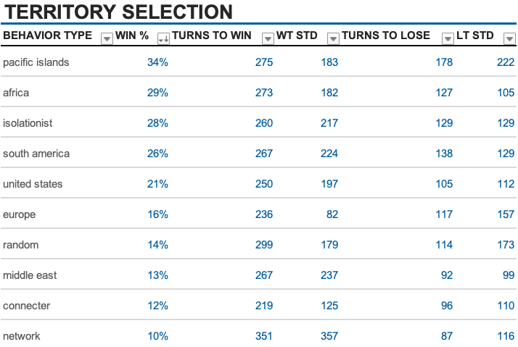
ISOLATING

Slide 12
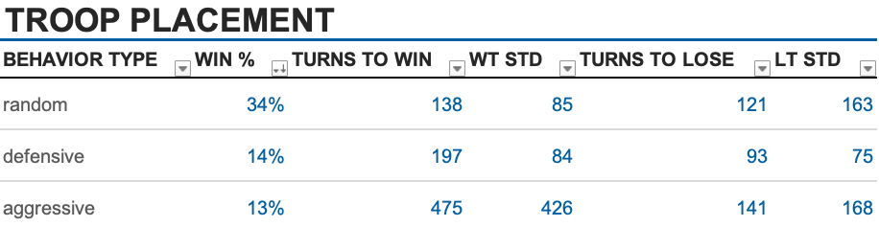
ISOLATING

Slide 13
Future Steps
Set up a pure reinforcement framework for the game.
Evolutionary algorithms to determine the best strategy for general play. Add variations of attack strategies.
Optimize speed (stuff like replacing battle simulation with a dictionary of probabilities of survivor distributions).
Get this model online so people can see animations of their favorites strategies.

Slide 14
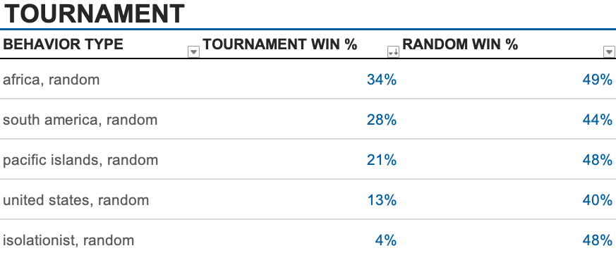
APPENDIX

Slide 15
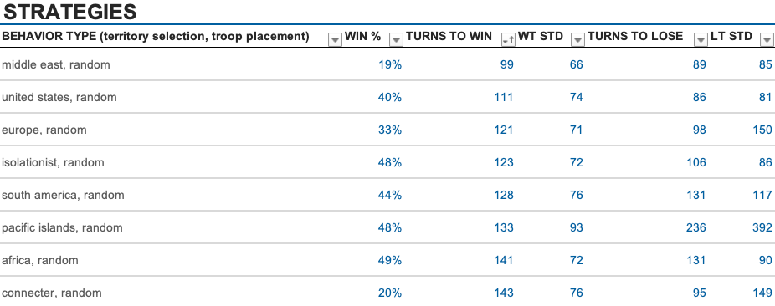
APPENDIX
FASTEST TO WIN

Slide 16
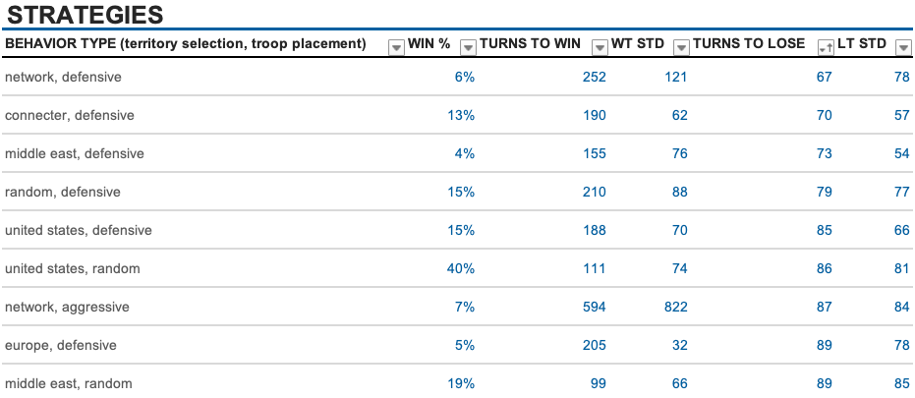
APPENDIX
FASTEST TO LOSE

