Slide 1
Using Graphs of Convex Sets (GCS) for
Point-Robot and Manipulation Planning
Adv Opt Project Final Presentation
Trevor Stack
04/23/26

Slide 2
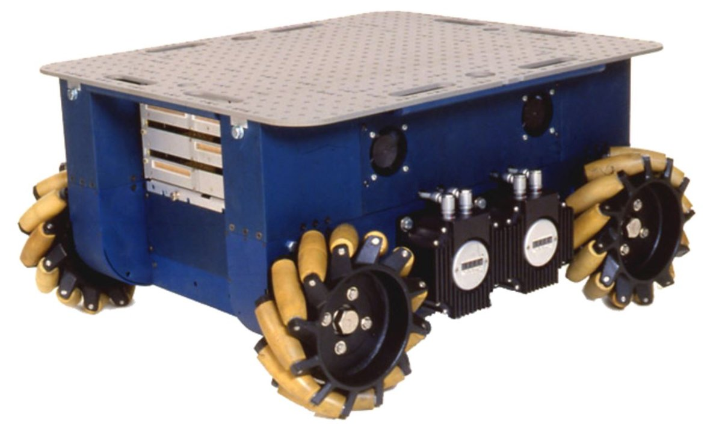
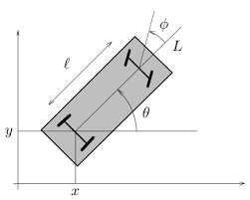
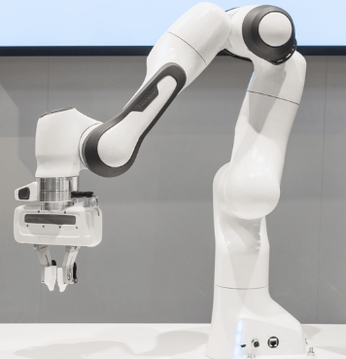
Background: Motion Planning
Process of computing path from a starting configuration to a goal configuration that:
Avoids obstacles
Satisfies the robotic platform’s kinematic and dynamic constraints
Holonomic Robot
No restriction on instantaneous velocity
Plan in (x,y)
Non-Holonomic Robot
Cannot move sideways
Plan in (x,y, θ)
Edges must satisfy robot’s kinematic constraints
Robot Arm
Higher DOF (7 for Panda)
Plan in c-space
(q_1, … , q_n)
Obstacle mapping to c-space is complex b/c of FK

Slide 3
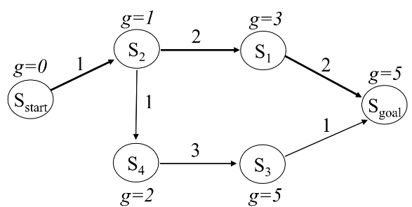
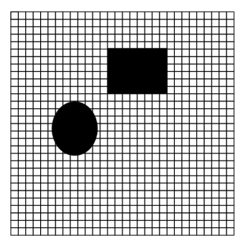
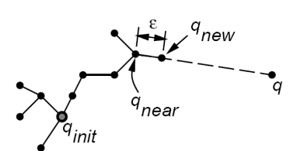
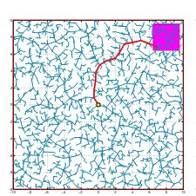
Related Work: Search and Sampling-Based Methods
Search-Based Method (A*)
Complete, optimal
Curse of dimensionality
Discretization of free-space impacts solution quality
Sampling-Based Method (RRT*)
Probabilistically complete, asymptotically optimal
May need a high number of samples to find paths through narrow passageways or to return a quality solution
Both typically require post-processing to produce smooth, kinematically feasible trajectories

Slide 4
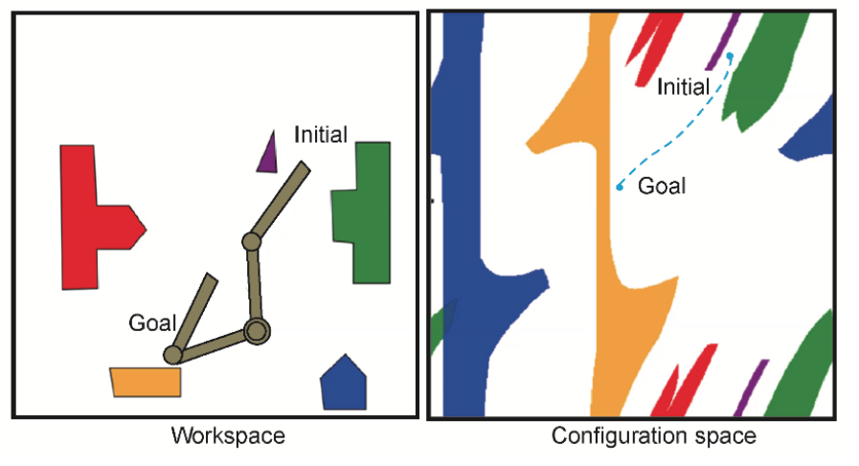
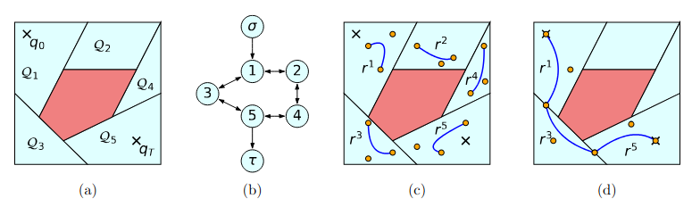
Motivation: Can we use convex optimization can be used to produce smooth, kinematically feasible trajectories?
Problem
C-Space can be non-convex
Solution: Graphs of Convex Sets [1]
Steps:
Decompose the free c-space into convex sets
Create the Graph
Solve a Mixed Integer Program
[1] T. Marcucci, M. Petersen, D. von Wrangel, and R. Tedrake, “Motion planning around obstacles with convex optimization,” 2022. [Online]. Available: https://arxiv.org/abs/2205.04422

Slide 5
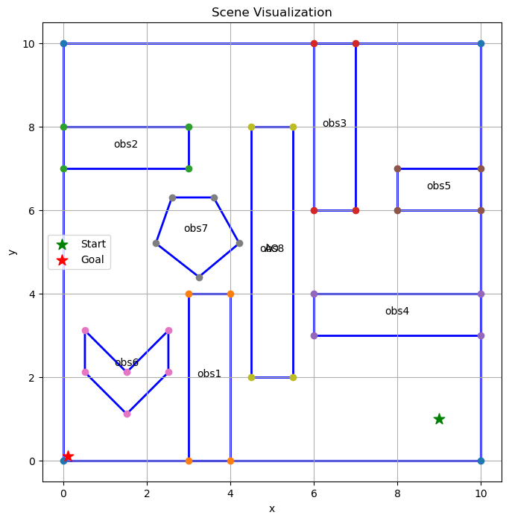
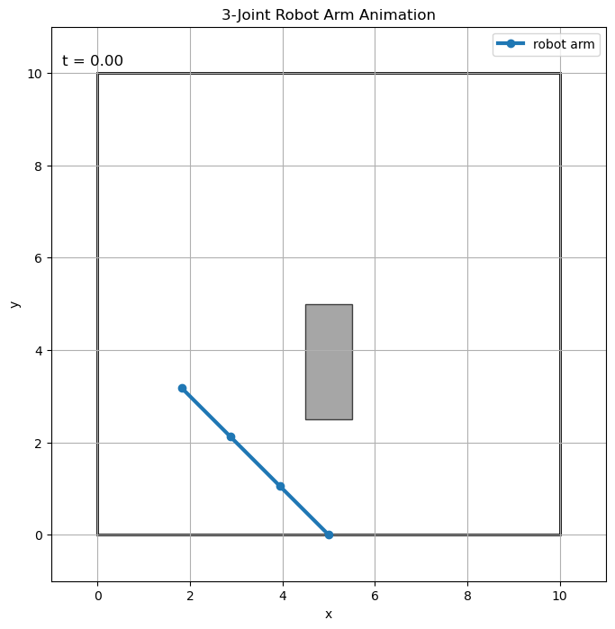
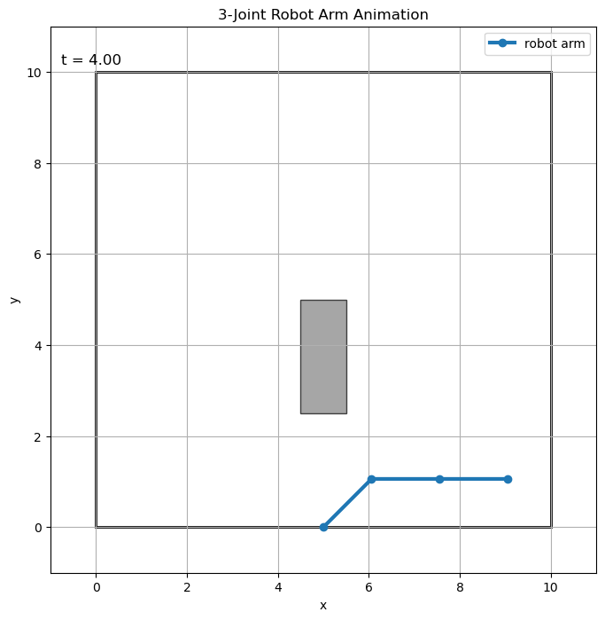
Problem Setup:
Point Robot
3-Joint Robot Arm

Slide 6
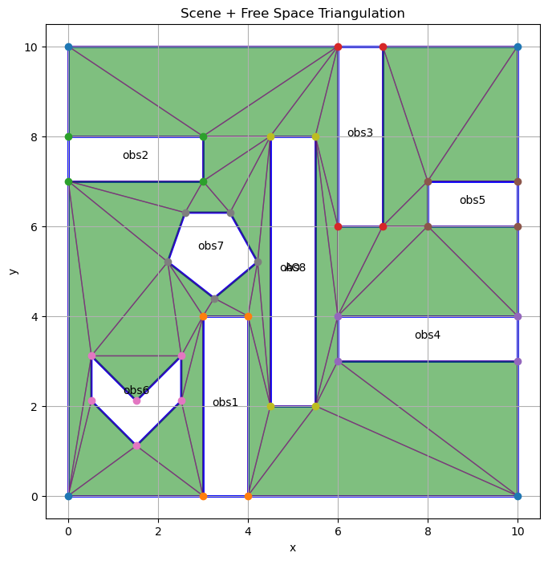
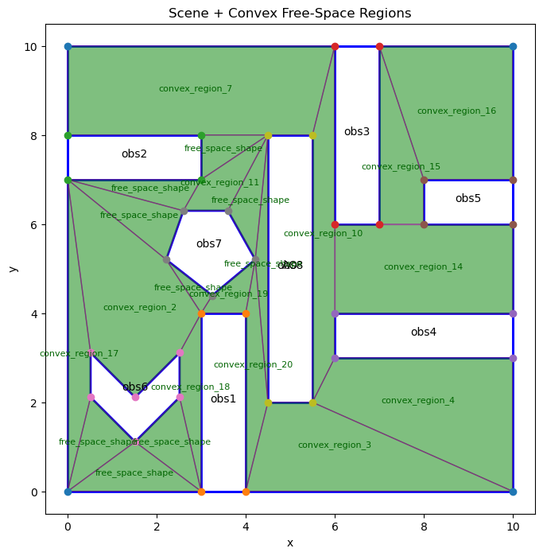
Step 1: Convex Decomposition of Point Robot’s C-Space
Constrained Delauney Triangulation [2]
Grouping Triangles into Convex Regions
[2] The CGAL Project, “CGAL: Computational geometry algorithms library,” https://www.cgal.org/, 2026, accessed: April 22, 2026.

Slide 7
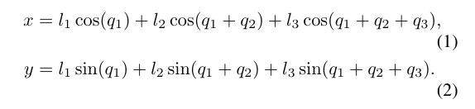
Step 1: Convex Decomposition of Robot Arm’s C-Space
Forward kinematics (FK) of robot arm is nonlinear:
Also, robot arms must avoid self collisions
Result: C-Space is 3D and non-convex with nonlinear boundaries
CDT is not feasible in this case

Slide 8
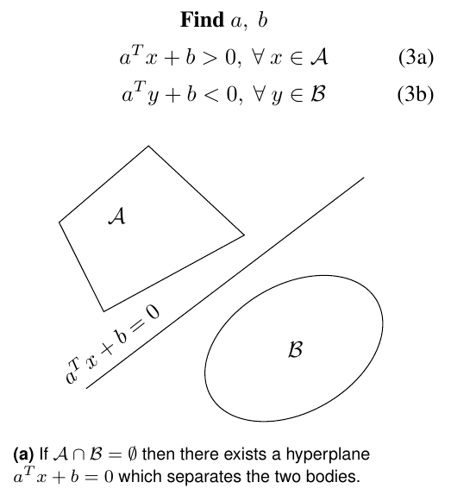
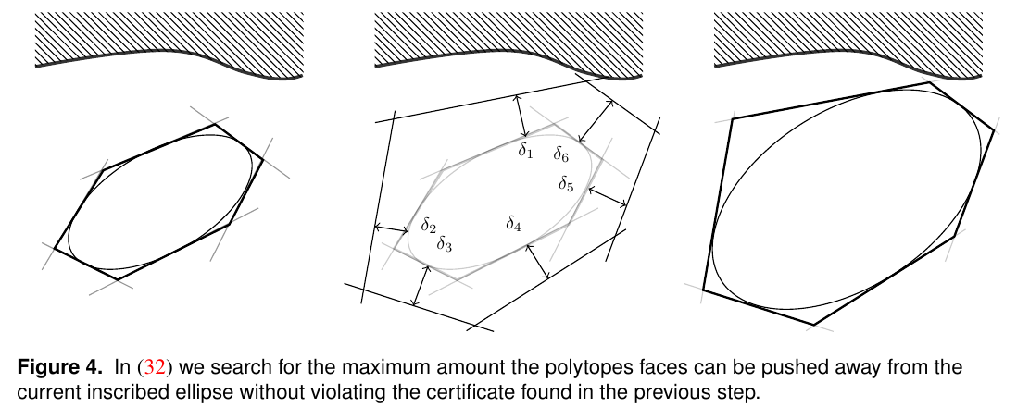
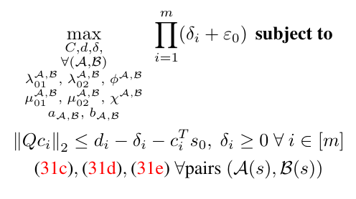
Step 1: Convex Decomposition of Robot Arm’s C-Space cont.
Solution: Configuration-space Iterative Regional Inflation by Semidefinite programming (C-IRIS)[3]
Sequentially solves 3 convex optimization problems:
Prove current convex region is not in collision
Measure the size of an ellipse that fits inside the convex region
Find hyperplanes between current region and obstacles, expand convex region
[3] H. Dai, A. Amice, P. Werner, A. Zhang, and R. Tedrake, “Certified polyhedral decompositions of collision-free configuration space,” 2023. [Online]. Available: https://arxiv.org/abs/2302.12219

Slide 9
Step 2: Create the Graph
Connect touching/intersecting convex regions
Connect the start and goal configurations to the convex regions they lie in
I used the Drake library for my implementation in code [4]
[4] Drake Development Team, “Drake: Model-based design and verification for robotics,” https://drake.mit.edu/, accessed: 2026-04-22.

Slide 10
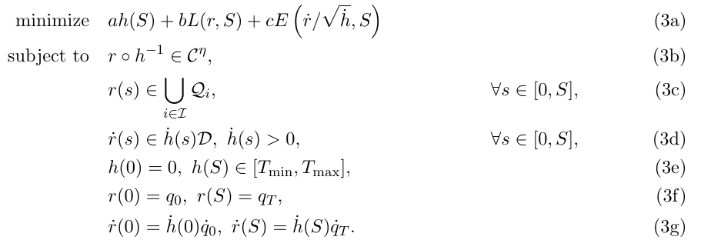
Step 3: Solve the MIP
Trajectory Time
Trajectory Length
Energy
3b: Continuity (Smoothness)
3c: Path stays in convex free space regions
3d: Velocity Constraint
3e: Time Constraint
3f: Path must start and end at the desired configs
3g: Start and end velocities
Path: can be parameterized by Bezier Curves

Slide 11
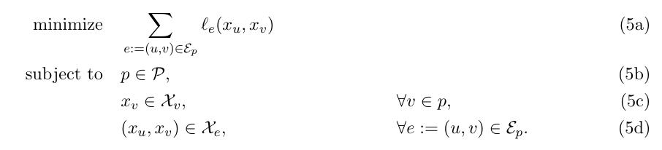



Convex Relaxation
5a. Re-formulation of objective
5b: Use only feasible edges
5c: Convex constraints w/in regions
5d: continuity between regions
5b constrains the problem to use only feasible paths. It introduces binary variables
For convex relaxation, 5b is removed and edges are weighted by a relaxed binary variable
This is equivalent to weighing edges by the probability they are a part of the optimal solution
Using these probabilities, sample candidate paths and pick the best

Slide 12
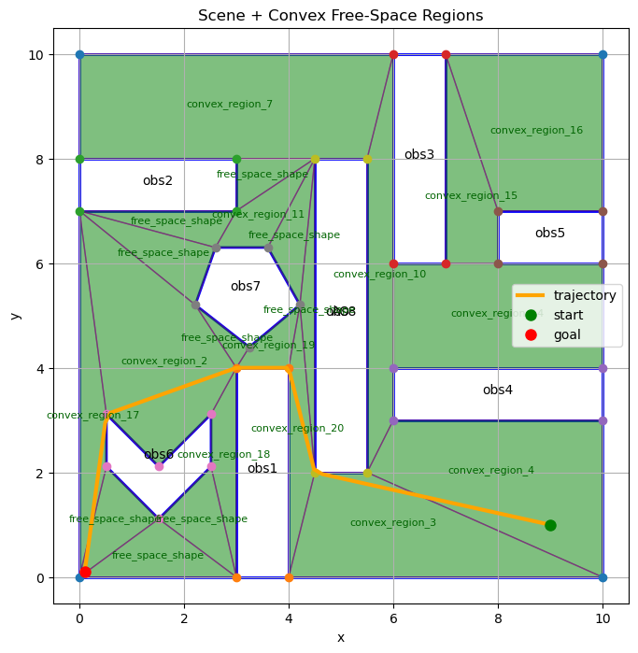
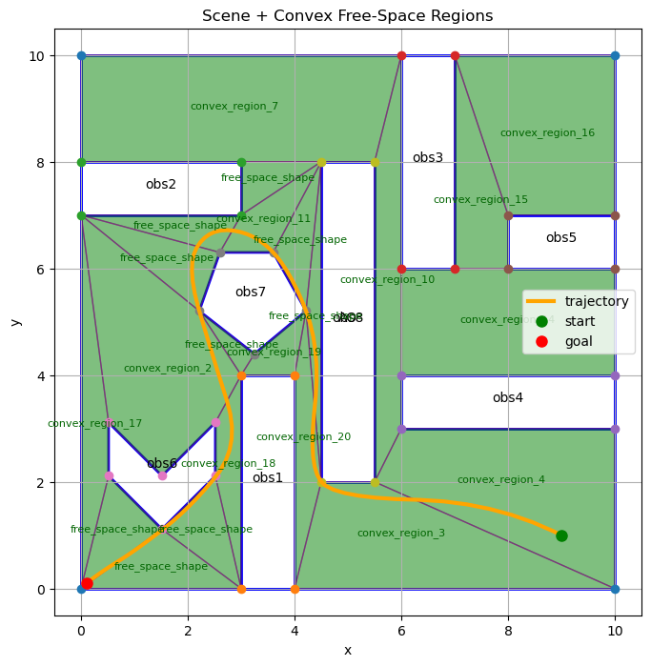
Results: Point Robot
Nonsmooth
Bezier order: 1
Continuity Order: 0
Path length weight: 1.0,
Path energy weight: 0.01,
Time weight: 1.0
Smooth:
Bezier order: 2
Continuity Order: 1
Path length weight: 0.1,
Path energy weight: 100.0,
Time weight: 0.1

Slide 13
Results: Robot Arm
Nonsmooth
Bezier order: 2
Continuity Order: 0
Path length weight: 1.0,
Path energy weight: .001,
Time weight: 1.0
Smooth
Bezier order: 2
Continuity Order: 1
Path length weight: 1.0,
Path energy weight: 1.0,
Time weight: 1.0

Slide 14
Other Results

Slide 15
Conclusion
GCS effectively enables you to explicitly define convex constraints on your trajectory
GCS can be applied to nonconvex, complex c-spaces using C-IRIS
Convex relaxation is tight, edges had probabilities of 0 or 1.
HOWEVER:
C-IRIS is slow. You do not want to repeatedly do C-IRIS every time the environment changes
Convex relaxation can return an infeasible path -> Need to explore further
Future work: Riemannian Manifold Optimization [5]
[5] T. Cohn, M. Petersen, M. Simchowitz, and R. Tedrake, “Non-euclidean motion planning with graphs of geodesically-convex sets,” 2023. [Online]. Available: https://arxiv.org/abs/2305.06341

Slide 16
Code Demo (if there’s time)

Slide 17
Questions?

Slide 18
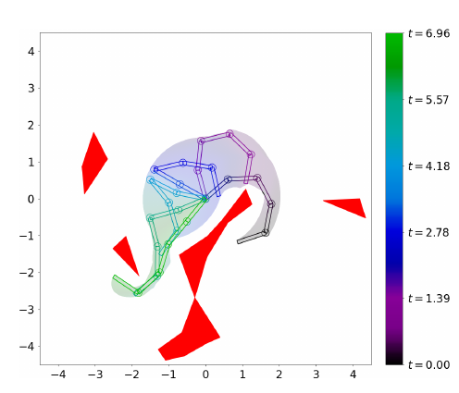
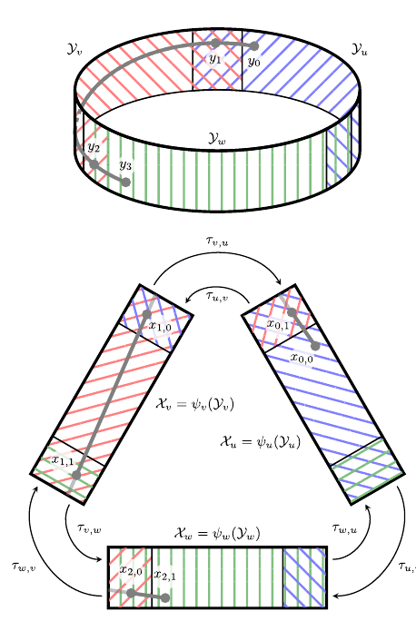
Path Forward:
Experiment with and understand Drake GCS settings, for example:
Bezier_order, continuity_order, time_weight, max_rounded_paths
Figure out convex relaxation for robot arm constraint:
x=l1​cos(q1)​+l2​cos(q1​+q2), y=l1sin(⁡q1)+l2sin⁡(q1+q2)
Understand how to model c-space as a Riemannian manifold and implement it in code

Slide 19
Sources
[1] T. Marcucci, M. Petersen, D. von Wrangel, and R. Tedrake, “Motion planning around obstacles with convex optimization,” 2022. [Online]. Available: https://arxiv.org/abs/2205.04422
[2] The CGAL Project, “CGAL: Computational geometry algorithms library,” https://www.cgal.org/, 2026, accessed: April 22, 2026.
[3] H. Dai, A. Amice, P. Werner, A. Zhang, and R. Tedrake, “Certified polyhedral decompositions of collision-free configuration space,” 2023. [Online]. Available: https://arxiv.org/abs/2302.12219
[4] Drake Development Team, “Drake: Model-based design and verification for robotics,” https://drake.mit.edu/, accessed: 2026-04-22.

Slide 20
Image Sources
https://automaticaddison.com/force-vector-diagrams-for-an-omni-directional-mobile-robot/
https://web2.qatar.cmu.edu/~gdicaro/16311-Fall17/slides/16311-4-Holonomy-WheeledRobots-Kinematics.pdf.
https://webflow.riders.ai/en-blog/what-is-panda-arm
https://lavalle.pl/rrt/papers.html
https://natanaso.github.io/ece276b2018/ref/ECE276B_5_ConfigurationSpace.pdf

