Slide 1

How Brazil Was Affected By Hosting The 2016 Summer Olympics
Presented By :
Galyna
Jasper
Trevor
Priya

Slide 2
Olympics 2016 impact on Brazil. Analysis from different perspectives
National Pride: Number of Medals
International Trade
Economic Health: GDP, Inflation and CPI, debt
Society: crime rates
Wellbeing for citizens: Happiness Rankings

Slide 3
National Pride: Number of Medals
Assumption
We assume that Athletes of hosting country have more familiarity with home field, receive greater support from home crowd, have easier qualification criteria, thus more participation is anticipated.
Considering all these factors we are expecting increase in number of Medals Brazil won in Rio 2016 comparing to the number of medals Brazil usually wins.
How hosting the Olympics impacted number of total medals and gold medals Brazil won that year.

Slide 4
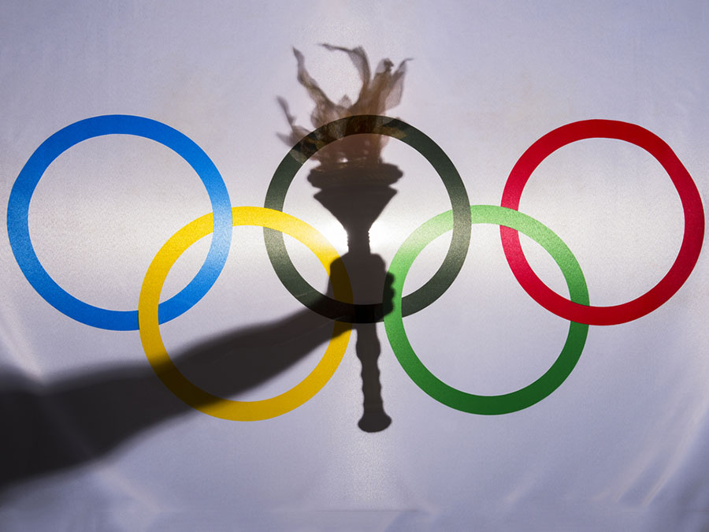
Data Source
Dataset on the modern Olympic Games, including all the Games from Athens 1896 to Rio 2016.
https://www.kaggle.com/heesoo37/120-years-of-olympic-history-athletes-and-results?select=noc_regions.csv
This dataset was scraped from www.sports-reference.com in May 2018.
The csv file contains 271116 rows and 15 columns. Each row corresponds to an individual athlete competing in an individual Olympic event.
World Bank's data API to get GDP data.
WBGAPI python package to work with data was installed and used.
https://pypi.org/project/wbgapi/
pip install wbgapi.

Slide 5
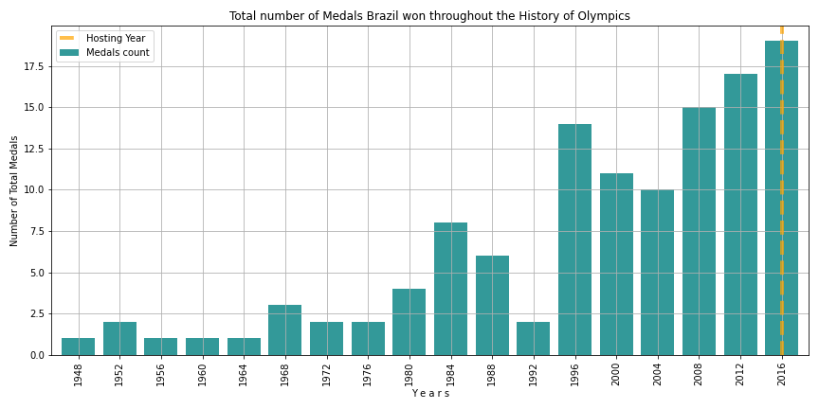
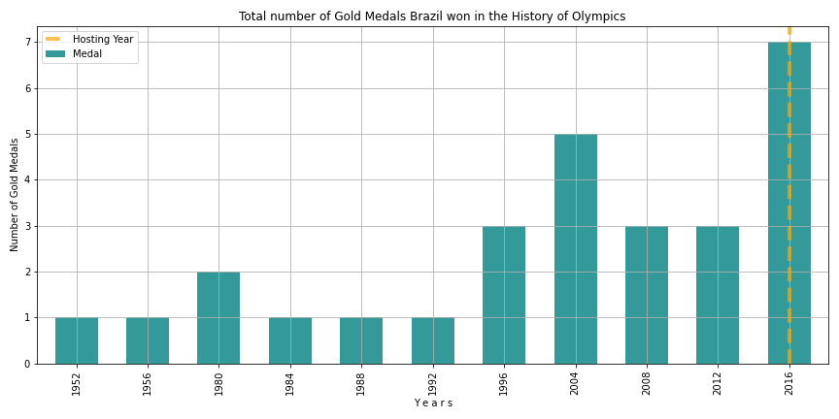
Total and Gold number of Medals Brazil won throughout the history of Olympics.
Hosting Year 2016:
Total number of Medals is higher than in any other previous games: 19 medals total.
The average for years with highest Medal Count (1996-2012) is 14.3;
The average for all other years (<1996) is 2.75 total medals.
Total number of Gold Medals is higher than in any other previous games: 7 gold medals.
The next highest number is 5 Gold Medals in 2004;
For all other games the average number is 1.7 gold medals.

Slide 6
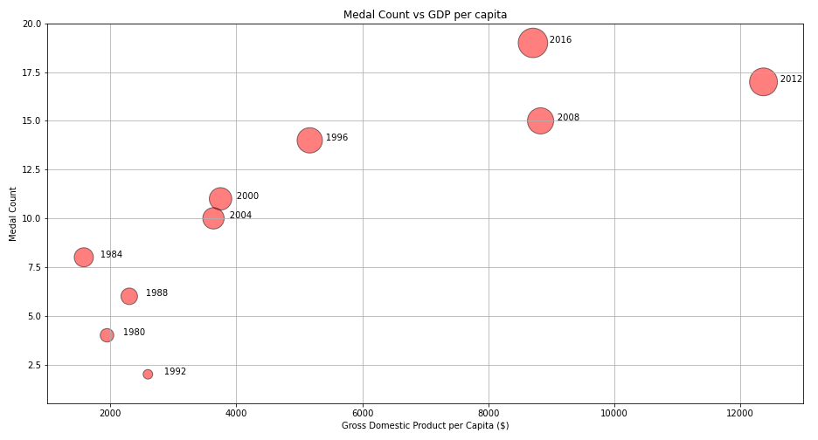
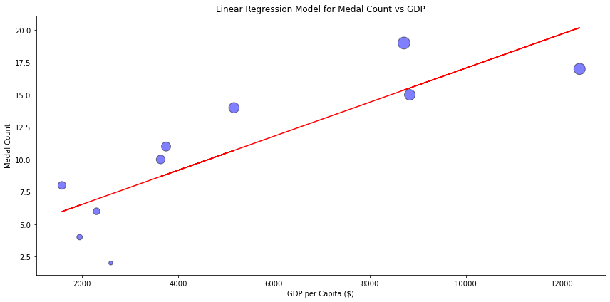
Investigating correlation between Number of Medals and GDP
A possible factor of Medal Count increase could be the increase of GDP (or GDP per capita)
Relationship between Total Medals vs GDP per capita and Linear Regression Model.
Linear Regression Model and R-value = 0.85 shows that there is a strong correlation between GDP per capita and Medals Count.
However, the GDP itself does not explain the highest number of Medals in 2016.

Slide 7
Conclusion
Our findings show that Brazil won its highest number of total and gold medals in the year of hosting the Olympics.
Linear Regression Model for Number of Medals and GDP over Olympics years revealed that there is a strong correlation between Number of Medals and GDP per capita.
However, GDP level in 2016 does not explain the highest Number of Medals Brazil won that year.
Thus, we can conclude that it's hosting the Olympics that caused Brazil to win more medals this year than in any other year before.

Slide 8
International Trade
Assumption
While bidding to host the Olympics, it is implied that country reduces restrictions on the international exchange of goods.
We are assuming that such strategy should lead to considerable positive change in Brazil international trade
How hosting the Olympics impacted Brazil international trade.

Slide 9



Data Source
World Integrated Trade Solution (WITS) API to get Trade Data.
In partnerships with
UNCTAD (United Nations Conference on Trade and Development);
World Bank;
WTO OMC.
Python package to work with WITS API
https://pypi.org/project/world-trade-data/
pip install world_trade_data

Slide 10
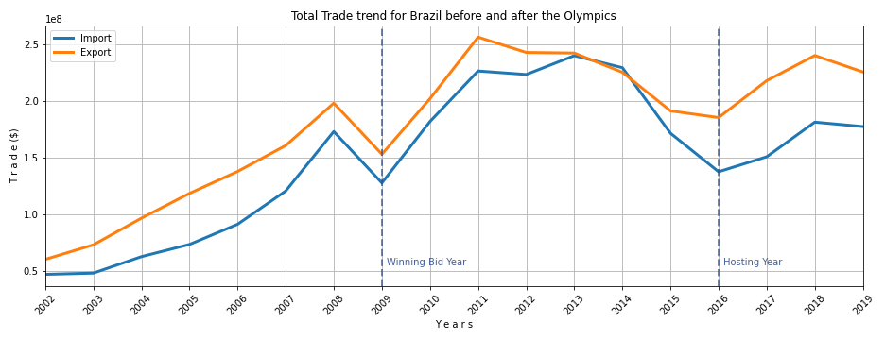
Yearly Export and Import Trend for Brazil.
Time period: from years preceding the year Brazil won the bid to host games to the most recent year with trade data available from WITS after hosting Olympics.
Trend tendency over time shows increase in Trade after year of winning the bid to host Olympics - 2009.

Slide 11
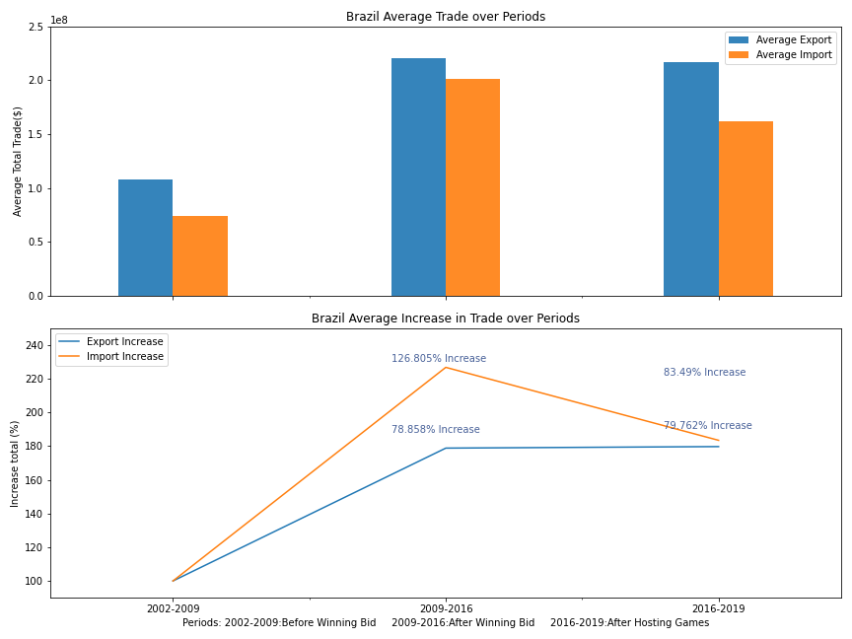
Investigate Trade Growth
Average Trade values were calculated to estimate the average increase in Trade:
In the period 2009-2016 Import increased by 126.8%, Export by 78.9% in comparison to 2002-2009.
In the period 2016-2019 Trade stays at the obtained increased levels: Import increased by 83.5%, Export by 79.8% comparing to the average Trade values before 2009.

Slide 12
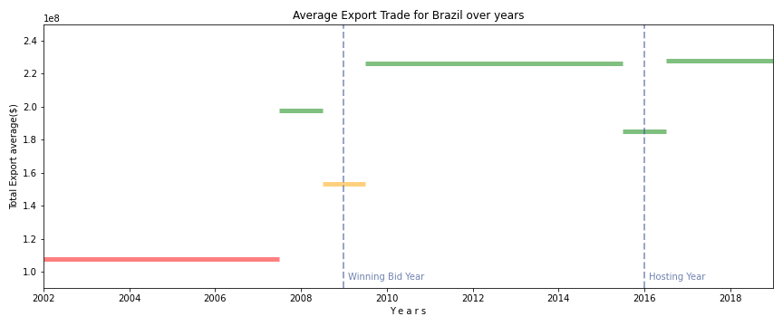
Average Export Trade over time including separate years
Chart shows in more details how hosting Olympics affects Export trade.
The year before winning the bid 2008 it jumps up, winning the bid year 2009 - goes down.
Significant permanent trade increase comparing to trade level before 2008 is seen after winning the bid.
Trade goes a little down at the year of hosting 2016 and stays at the obtained high level after hosting the Olympics.

Slide 13
Conclusion
From the available data we can see that Brazil experienced Trade Growth after hosting the Olympics.
To be more precise, Trade Growth starts from the time when Brazil was on the verge of winning the bid to host the Olympics - year 2008.
Average change in trade by periods shows Trade increase in 2009-2016 comparing to previous years and stays at the same high level after 2016.
It is not obvious from our analysis though what would happen to Trade tendency without actual hosting the Olympics. It might be that just bidding to host Olympics is enough for country to experience significant and permanent growth in Trade.

Slide 14
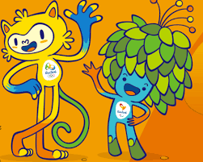
Questions considered about the 2016 Summer Olympics in Rio de Janeiro, Brazil.
Was Brazil’s economy affected by hosting the 2016 Summer Olympics in Rio de Janeiro?
Was Brazil’s economy better or worse from hosting the 2016 Summer Olympics in Rio de Janeiro?
In this study, we used economic data from two countries that hosted the Summer Olympics as controls: Greece (2004) and the United Kingdom (2012)

Slide 15
What is GDP and why is it an important metric?
Gross Domestic Product or GDP is an important metric that can help policy makers and economists determine the overall health of a nation’s production and growth.
Positive GDP growth in a country is a sign that unemployment is lower; wages are growing; and demand for products and services has increased.
Negative GDP growth means that the country is heading towards a slowing in their economy and that a recession is approaching.

Slide 16
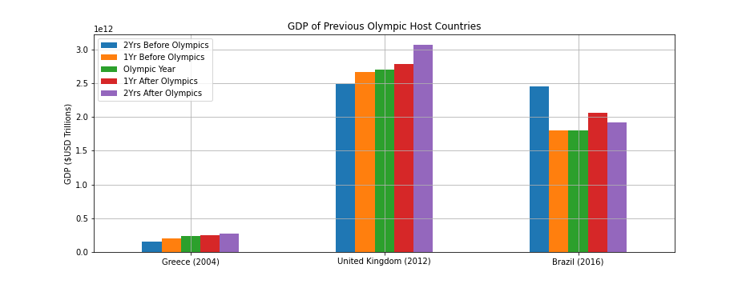
Annual GDP for Brazil
Control Countries: Greece and the United Kingdom (UK)
Greece and the UK trend upward in GDP pre and post Olympic
Brazil’s GDP dropped 26.6% in 2015, but increased 14.9% in 2017
Source: The World Bank API

Slide 17
What is GDP per capita?
Gross Domestic Product (GDP) per capita is equal to the country’s GDP divided by its overall population. This metric gauges the prosperity of the country based on its economic growth and often measured along with a country’s GDP.
GDP per capita shows how much each individual citizen contributes to the value of a country’s production (i.e. the production of goods and services).

Slide 18
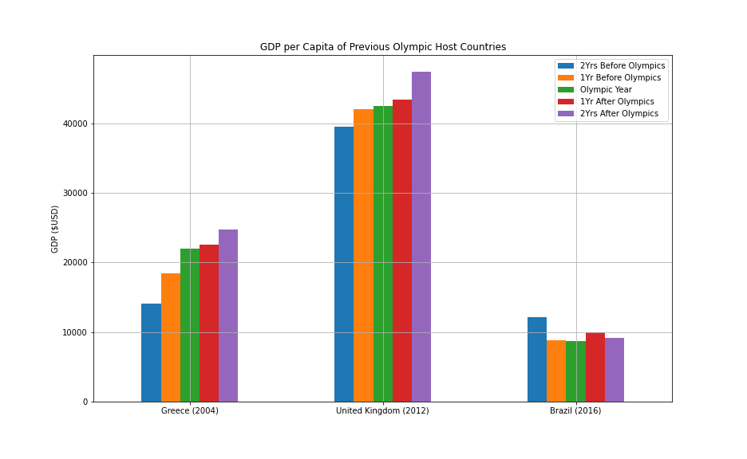
Annual GDP per Capita for Brazil
Brazil shows a decline of 27.2% in per capita GDP leading up to and after the Rio Summer Olympics, but increased 14% in 2017.
Other nations trends upwards in their per capita GDP after the Summer Olympics.
Source: The World Bank API

Slide 19
What is Consumer Price Inflation or Consumer Price Index (CPI)?
Consumer Price Inflation tracks the change in retail prices of goods and services that is consumed on a daily basis.
Consumer Price Inflation is used to identify periods of inflation and deflation. It is often compared to the Producer Price Index (PPI), but is a good metric to see how an individual’s purchasing power has increased or declined over time.
A general sense is that a rise in the level of prices may influence how the government of the country decides on their economic and monetary policies.

Slide 20
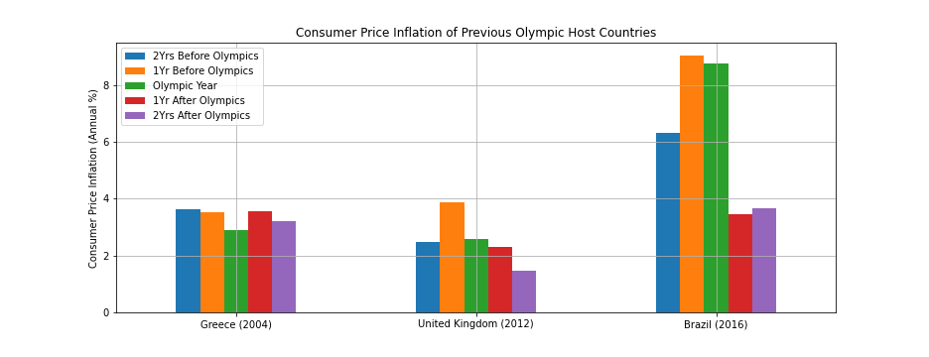
Consumer Price Inflation for Brazil
Inflation decreased for the fiscal year of each nation during the Summer Olympic games. Greece declined 0.63%; UK declined 1.28%; and Brazil declined 0.29%
Brazil had the most dramatic decrease in inflation the year after the Summer Olympic games at 5.29%
Source: The World Bank API

Slide 21
What is Industry Added Value?
Industry added value measures how much industry and a country’s government contribute to a country’s GDP.
Industry added value takes into account the overall cost of business (employee compensation, taxes, production costs, etc...) in the calculation of Industry Added Value.
An increase in the Industry Added Value helps economists and policy makers to measure the overall health business and governments are contributing to the economic health of a country. The data business and governments receive can help them make adjust or make policy changes.

Slide 22
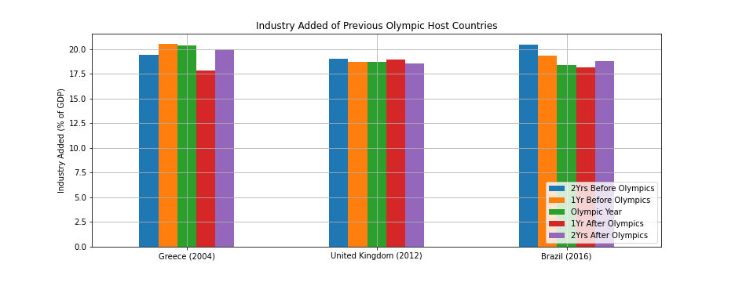
Industry Added Value for Brazil
All nations experienced some decline in added value from industry the year leading up to hosting the Summer Olympics.
Brazil experienced a decline in industry value added two years prior to the hosting the Summer Olympics (-1.11% in 2015 & -1.01% in 2016) and a year after hosting the Summer Olympics.
Source: The World Bank API

Slide 23
Analysis on how hosting the Summer Olympics affected Brazil.
The 2016 Summer Olympics in Rio de Janeiro had some positive effects on the overall economy in Brazil.
Brazil’s GDP improved dramatically the year after the Olympics. Other host countries saw modest gains in GDP.
Citizens of Brazil saw their personal wealth increase after the Summer Olympics in Rio, but the increase was temporary.
Brazil’s inflation was brought down during the Summer Olympics and saw a dramatic decrease in the year after the Olympics in Rio.
The industrial and government sector didn’t seem to add much value to the overall GDP of Brazil.
Overall, any positive economic effect from Brazil hosting the Summer Olympics was only temporary. Any lasting effects in the economy must come from fiscal and monetary policy decisions made by the Brazilian government. Hosting the Olympics plays a small and temporary effect in their economy.

Slide 24
How was Brazil’s Crime Rate affected by hosting the 2016 Rio Olympics?
Assumption:
I’m assuming that with the increase in population due to hosting the Olympics, I suspect that the opportunity for crime will rise and we will see an increase in occurrences up to the year of the Olympics.

Slide 25


My Data Sources:
Establishes a “Crime Index” which is “is an estimation of overall level of crime in a given city or a country.”
Data is collected by survey from people who live in that city/country
UNODC - United Nations Office of Drugs and Crime
“Data is collected from national authorities through the annual United Nations Crime Trends Survey (UN-CTS)”
The rates in the data represent police-recorded offences, per 100,000 population.

Slide 26
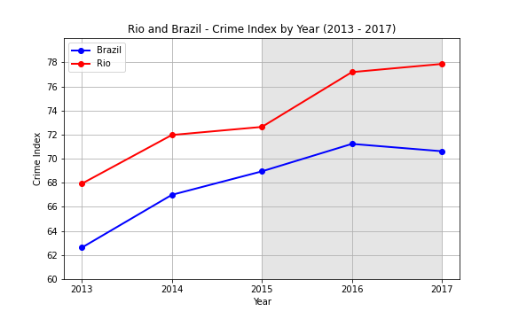
Brazil and Rio de Janeiro - Crime Index
The Blue line represents Brazil’s Crime Index and we can see a rise going until 2016 and a slight dip in 2017.
The Red line represents Rio and we can see that the Crime Index is higher and increases steadily over the 5 year period.
The highlighted area of the graph is 2015-2017 giving us an idea of a before, during, and after of hosting the Olympics.

Slide 27
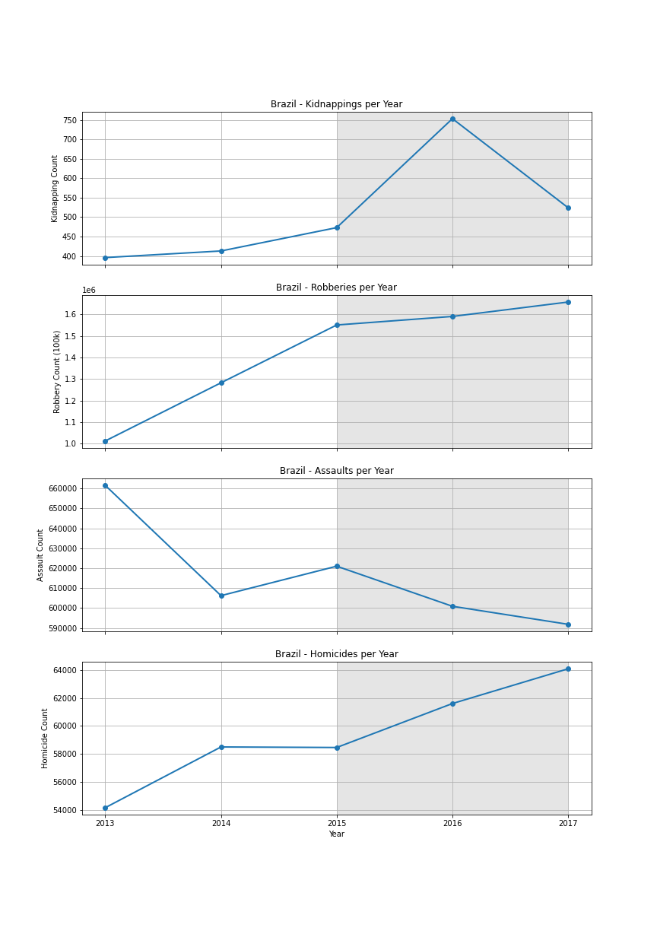
Brazil - Violent Crime Count
First graph shows Kidnappings. We can see a steady increase in occurrences up until 2016 when there was a big spike and then it went back down.
Second graph shows Robberies. There is a big increase in Robberies occurring and continues to increase before during and after the Olympics.
Third graph shows Assaults which is the only crime I looked at that had a downward trend that was consistent over the 5 years.
The final graph shows Homicides. The visualization shows how that Homicides flattened out from 2014 to 2015 then there was a big increase before during and after the Olympics.

Slide 28
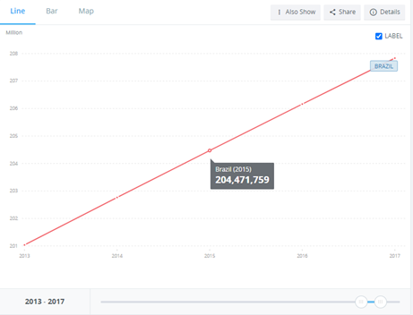
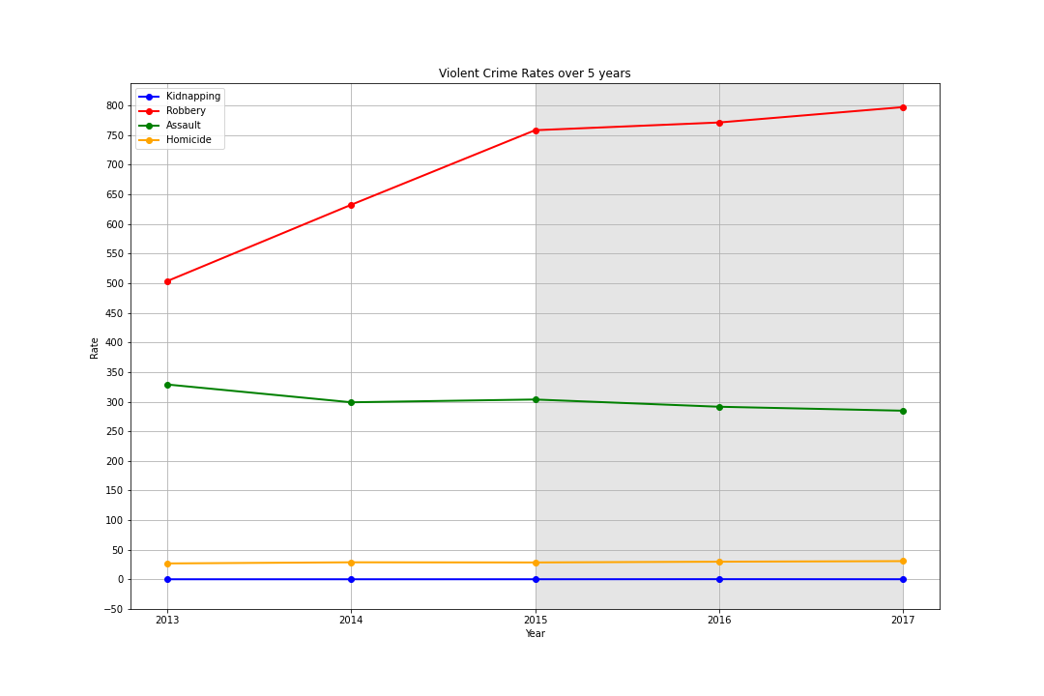
Brazil - Crime Rates
As you can see, you are very likely to be robbed in Brazil. The amount of Robberies that were happening were increasing as the population increased.
The green line shows Assaults which stayed relatively consistent as the population increased with a slight downwards trend
Yellow line is Homicide and Blue line is Kidnapping and as you can see they stayed relatively consistent as the population increased.

Slide 29
Conclusion - Brazil Crime Rates
Q: How was Brazil’s Crime Rate affected by hosting the 2016 Rio Olympics?
A:
When looking at the number of occurrences of violent crimes, 3 out of the 4 violent crimes that I looked at increased in the 3-year period around the Olympics representing before, during and after.
When we look at the rates of these crimes, it can be explained by the increasing population in Brazil. The only crime with a clear increase in Rate is Robbery. Robberies increased even as the population increased.
The other 3 violent crime rates stayed consistent as the population increased. Occurrences of the crimes increased relative to how much the population increased.

Slide 31
Source :The report primarily uses data from the Gallup World Poll and rankings of national happiness are based on a Cantril ladder survey. Each variable is measured on a scale running from 0 to 10
History :The first World Happiness Report was released on April 1, 2012, as a foundational text for the UN defining a New Economic Paradigm, drawing international attention. These factors include:
1. Social support
2. Health ( life expectancy )
3. Economy
4. Freedom to make life choices
5. Generosity
6. Trust (perceptions of corruption )
We tried to answer below questions :
1. Did hosting the Olympics in 2016 have an affect on the Happiness Score in Brazil?
2. How did the Happiness Score and its factors change before and after Olympics from 2015 to 2021 ?

Slide 32
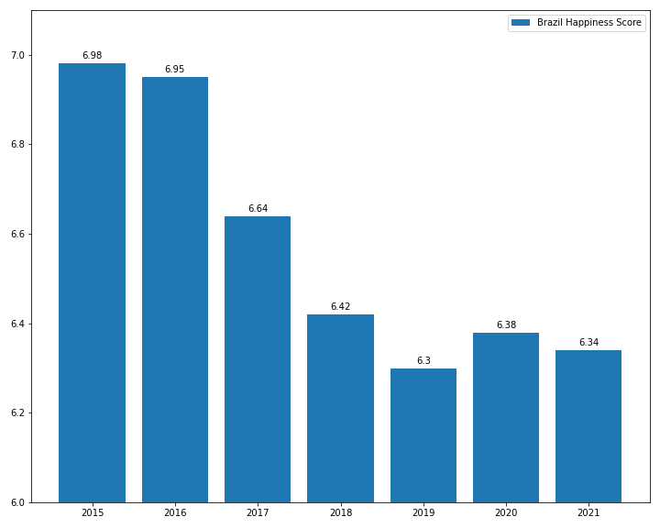
Brazil Happiness Score

Slide 33
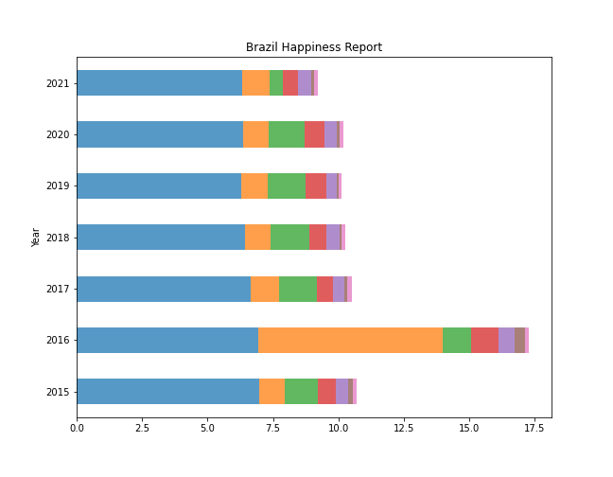
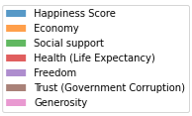
Factors Of Happiness

Slide 34
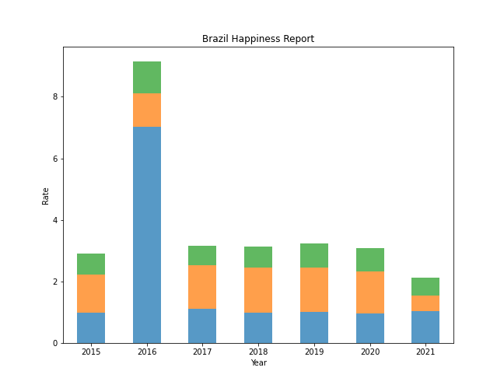

Economy, Social Support & Health

Slide 35
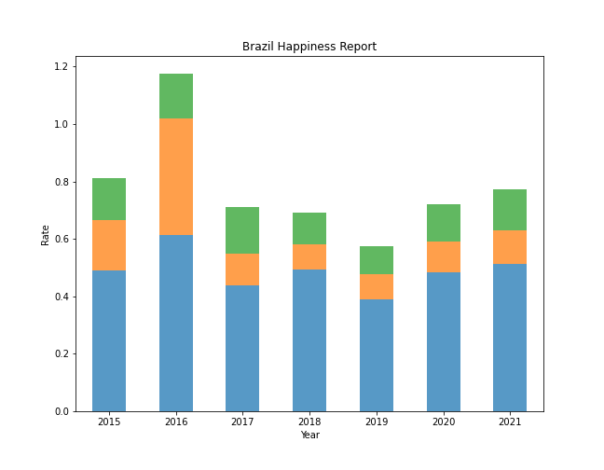

Freedom, Trust & Generosity

Slide 36
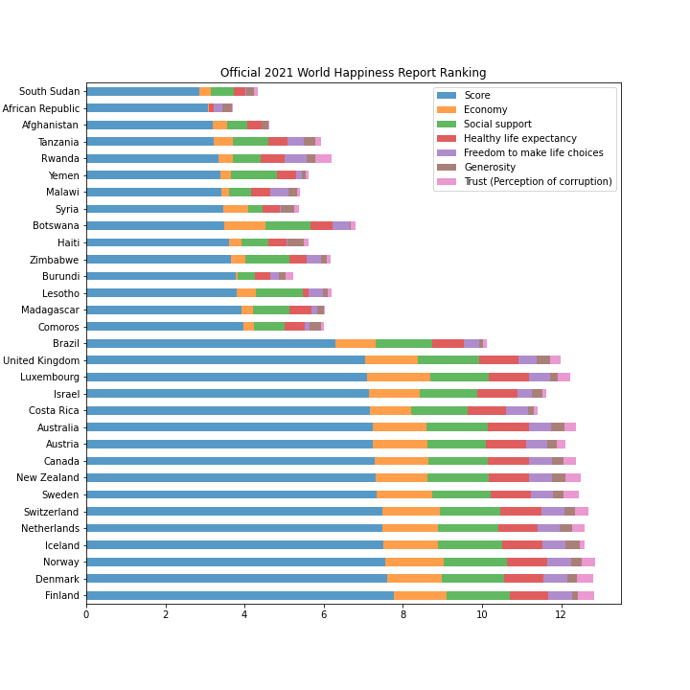

Slide 37
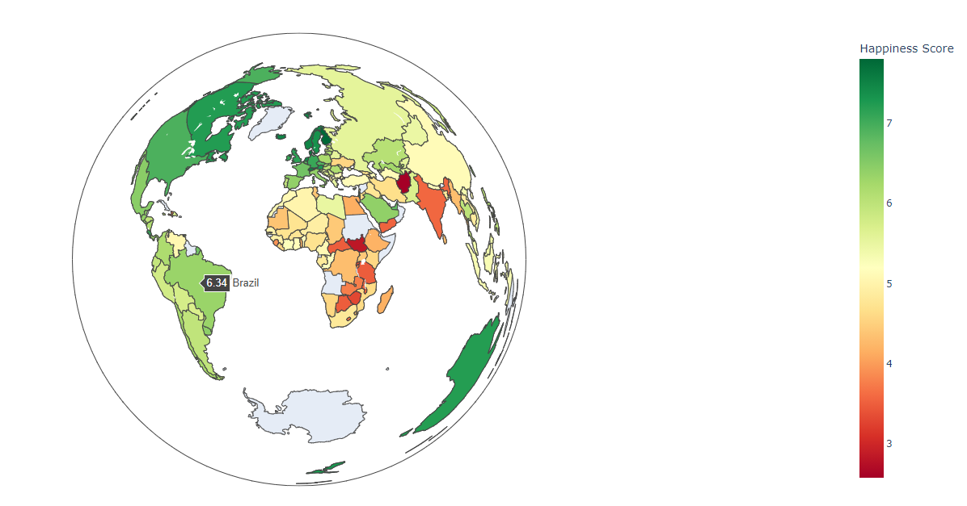
Geographical Visualization Of happiness Score

Slide 38
Conclusions
Question 1 :
Did hosting the Olympics in 2016 have an affect on the Happiness Score in Brazil?
Answer :
The Olympic Games are the most watched sports event in the world, and cities are paying significant amounts to host the event. Overall hosting the Olympics had a positive impact on subjective well-being in Brazil during the event. As per the poll data , factors like Economy , Freedom ,Trust on government and Generosity did increase in 2016 .
Question 2 :
How did the Happiness Score and its factors change before and after Olympics from 2015 to 2021 ?
Answer :
Olympics had positive impacts in 2016 did not last very long for factors like economy , health , Freedom and Trust on government . Corruption was widespread throughout the government and within businesses .also Brazil's happiness score went down after 2016 but on the other hand factors like social support and generosity did increase after 2016 which means that people were relying on each other, and citizens of Brazil were donating to the charity as well, but they didn’t receive much support from Brazil government . The 2016 Olympics cost the Brazilian government approximately $13.1 billion to host ($3.5 billion over budget), plus an additional $8.2 billion in infrastructure upgrades and renovations paid with a mix of public and private money. They hoped for economic benefit of hosting the games which did not occur in Rio. According to a report, government was late in paying teachers, hospital workers, and pensions .Also crime in the city has risen to almost record-breaking level.

Slide 39


