Slide 1
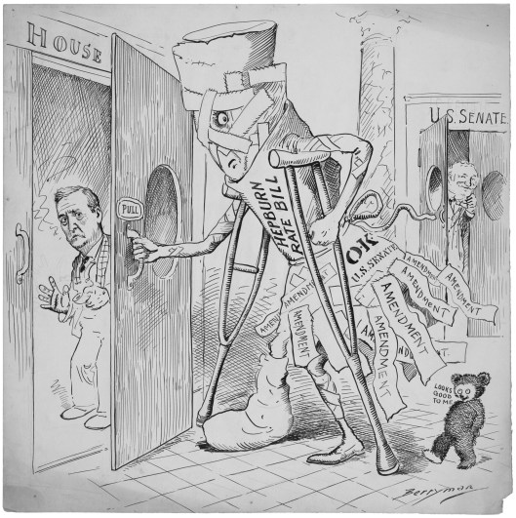
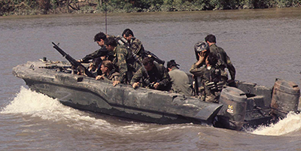
EDEL 522 | WEB-BASED INFORMAL PROFESSIONAL DEVELOPMENT
Primary sources that make history visible
A reflection on three National Archives educator webinars about the Constitution, Vietnam, and DocsTeach
Trevor Arcadipane
Summer 2026
National Archives educator resources
1
Notes:
For this informal professional development, I selected three recorded National Archives webinars about using primary sources in secondary U.S. history and government.

Slide 2
I changed plans to match the classroom I am entering
I originally planned to complete Code.org's AI 101. While continuing to explore options, I found the National Archives' free educator webinar archive and switched because it connects more directly to my new 7-12 social science assignment at Trona High School.
01
Make primary-source analysis manageable for grades 7-12.
02
Find ready-to-use material for U.S. history and government.
03
Evaluate DocsTeach as a practical, low-prep inquiry tool.
HOW I FOUND IT
A search for free, self-directed social studies PD led to the National Archives educator webinar page.
Source: National Archives Professional Development Webinars
2
Notes:
I first planned Code.org's AI 101, then found the National Archives' free educator webinar archive while searching for social studies professional development. I switched because it fits the five courses I will teach at Trona. My goals were to make source analysis manageable across grades seven through twelve, find ready-to-use U.S. history and government activities, and evaluate DocsTeach as a low-prep inquiry tool.

Slide 3
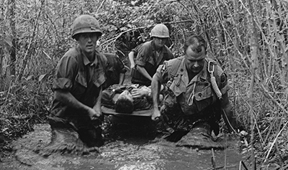
Three recorded webinars met the two-hour requirement
Expert presentations + guided document analysis + DocsTeach demonstrations
2:09:22 total
Teaching the Constitution
with Political Cartoons
Remembering Vietnam:
The Road to War
Remembering Vietnam:
The Road Through War
39:51
43:13
46:18
Open Constitution webinar
Open Road to War webinar
Open Road Through War webinar
Viewed asynchronously at normal speed; note-taking occurred during playback.
3
Notes:
At normal speed, the three recordings totaled two hours, nine minutes, and twenty-two seconds. National Archives and presidential-library educators combined expert presentation, guided analysis of specific records, and demonstrations of DocsTeach activities. I took notes and followed the prompts during playback, so the viewing exceeded the assignment's two-hour minimum.

Slide 4
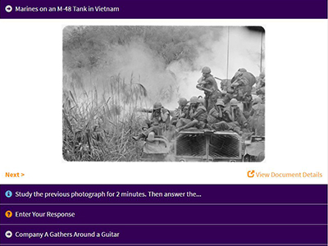
Recorded did not have to mean passive
I followed the presenters' questions instead of only listening.
Paused before explanations and answered the presenter prompts.
Used the four steps: meet, observe, make sense, and use as evidence.
Compared private or secret memos with public statements.
Matched political cartoons to Constitution clauses and principles.
Reviewed DocsTeach activities, worksheets, and teacher supports.
Example of the document-analysis activity format demonstrated in the webinars
Live-chat contributions were not applicable because I used the recordings.
Source: DocsTeach
4
Notes:
Live-chat participation was not possible with recordings. To stay active, I paused before explanations and answered the presenters' prompts. I used the Archives' four-step analysis framework, compared private memos with public statements, matched cartoons to constitutional language, and reviewed the teacher directions in DocsTeach.

Slide 5
The strongest lessons came from pairing sources
01
02
03
Visual sources clarify abstract ideas
Policy becomes a sequence of choices
Paired sources reveal purpose
Symbols, tone, and relationships in political cartoons made separation of powers and checks and balances visible rather than purely theoretical.
Documents from Truman through Ford showed that Vietnam policy developed through cumulative, contested decisions—not one simple turning point.
A secret memo beside a public speech gives students a concrete way to analyze audience, purpose, omissions, and competing perspectives.
Source: National Archives recorded educator webinars
5
Notes:
Three ideas stood out. Political cartoons make abstract constitutional principles visible. The Vietnam records showed policy developing through cumulative, contested choices across administrations. Pairing a private memo with a public statement also gives students a concrete way to analyze audience, purpose, omissions, and competing perspectives.

Slide 6
I can use this immediately in U.S. history and government
12th-grade Government
11th-grade U.S. History
Begin with a Berryman political-cartoon warm-up.
Have students infer the constitutional principle before reading the relevant clause.
Ask students to update or compare the cartoon to a current issue.
Build a Vietnam decision-point inquiry across administrations.
Let groups recommend the next step from one source before revealing the outcome.
End with an evidence-based reflection on continuity and change.
For 8th grade, I can use the novice analysis worksheet, fewer sources, and the same evidence-first structure.
Source: The War in Vietnam: A Story in Photographs
6
Notes:
In government, I can begin with a cartoon, ask students to infer a constitutional principle, and require evidence from the document. In U.S. history, students can recommend an action at a Vietnam decision point before learning the outcome. For eighth grade, I can use fewer sources and the novice worksheet.

Slide 7
Informal PD worked best when it stayed practical
Benefits
Challenges
Choice made the learning relevant to my actual courses.
On-demand viewing allowed pausing and replaying.
The resources were free and immediately usable.
Recorded sessions offered no live feedback or collaboration.
Self-directed learning can become passive without a plan.
The volume of resources can be difficult to narrow down.
FINAL REFLECTION
This experience reinforced my research project: effective technology PD is content-specific, practical, and connected to classroom implementation. What the recordings lacked was the ongoing support and peer feedback that can help teachers apply new ideas over time.
Source: National Archives educator PD and classroom resources
7
Notes:
The benefits were choice, flexibility, and immediate classroom relevance. Challenges included no live feedback, passive-viewing risk, and too many resources to sort through. Overall, the experience reinforced my research finding: effective technology professional development is content-specific, practical, and tied to implementation. The recordings lacked the ongoing collaboration and follow-up support that help teachers apply new ideas.

