Slide 1
Divide and Conquer

Slide 2
Divide and Conquer Algorithms
1. Partition task into sub-tasks which are smaller instances of the same task
2. Recursively solve the sub-tasks
Each sub-task often only solved outright when the bottom (threshold) of the recursion is reached
3. Appropriately combine the results
Why Divide and Conquer?
Can be an easier way to approach solving large problems
Can be faster - but not always
Critical point! Some examples coming

Slide 3
Divide and Conquer Structure
logn
depth
Depth log base depends on how we split and potential overlap in splits
O(n) splits – n-1 for full binary tree where n is # of elements in task
Do not always need to split all the way to one element per leaf, but often do
O(n) combines – may not need any (e.g. binary search)
Actual problem solving work may be done at split time, at the tree leaves, at combine time, or any combination of these three
Efficiency gains occur if the problem solving work can be simplified because of the split/merge paradigm

Slide 4
Grading n exams
logn
depth
Non DC time required?

Slide 5
Grading n exams
logn
depth
Non DC time required? – nG where G is time to grade 1 exam: O(n)
Divide and Conquer? – Feels more manageable, etc.
Any overall speed-up on exam grading?

Slide 6
Grading n exams
logn
depth
Non DC time required? – nG where G is time to grade 1 exam: O(n)
Divide and Conquer? – Feels more manageable, etc.
Any overall speed-up on exam grading?
No. Although note potential parallelism
Some overhead to split (dividing) and combine (re-stacking) the exams
n splits each being O(1) gives O(n) but splits are very fast operations compared to nG
Divide and conquer version still O(n)

Slide 7
Sorting n Integers
logn
depth
Non DC time required?

Slide 8
Sorting n Integers
logn
depth
Non DC time required? – n² using some bubble sort variation: O(n²)
Divide and Conquer?
Splitting is fast just like for grading exams
No work at leaves – Each leaf is an "ordered" list of length 1 to return
Now have n lists of length 1 at the leaves – Fast to do (O(n)) but was it worth it?

Slide 9
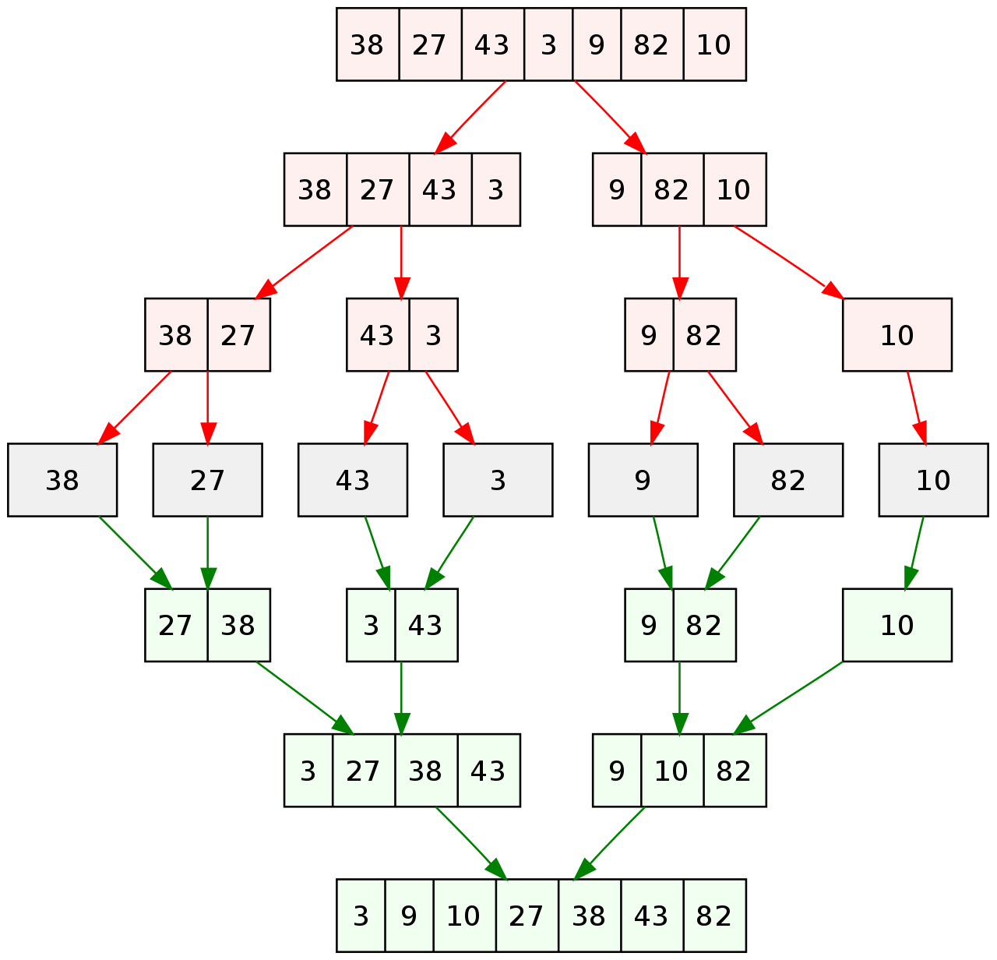
Mergesort Example

Slide 10
Sorting n Integers
logn
depth
Combining requires a merge of two ordered lists which is O(n) compared to the O(n²) required to sort one list directly. The key to the speedup!!
Note that at the first combination the lists are of length one so it is a O(1) merge, but there are n/2 of those merges at the level, which adds up to a total of O(n) work at that level
The lists double in size each level up, but the number of merges halves, so the work stays O(n)
Divide and conquer version is O(n) at each of the log(n) levels for total of O(nlog(n))
Notes:
Note if we just did bubble sort at each merge to get the sorted merged list, then total time would still be n^2
Tempted to think n^2logn, but not, we will show you why in a minute

Slide 11
DC Multiply – can we beat n²?
Assume x and y are n-bit numbers and n is a power of 2
power of 2 is not essential, just makes explanation easier
First split x and y into halves n/2 bits long: x_{L}, x_{R}, y_{L}, y_{R}
x · y = (2^{n/2}x_{L} + x_{R})(2^{n/2}y_{L} + y_{R}) =
2^{n} x_{L}y_{L} + 2^{n/2}(x_{L}y_{R} + x_{R}y_{L}) + x_{R}y_{R}
Notes:
a^logb(n) = a^(logan)(logba) = n^logba

Slide 12
DC (Divide and Conquer) Multiply
x · y = 2^{n} x_{L}y_{L} + 2^{n/2}(x_{L}y_{R} + x_{R}y_{L}) + x_{R}y_{R}
x · y = 10^{n} x_{L}y_{L} + 10^{n/2}(x_{L}y_{R} + x_{R}y_{L}) + x_{R}y_{R}
5218 * 4376
52 * 43
52 * 76
18 * 43
18 * 76
5 * 4
5 * 3
2 * 4
2 * 3

Slide 13
DC (Divide and Conquer) Multiply
x · y = 2^{n} x_{L}y_{L} + 2^{n/2}(x_{L}y_{R} + x_{R}y_{L}) + x_{R}y_{R}
x · y = 10^{n} x_{L}y_{L} + 10^{n/2}(x_{L}y_{R} + x_{R}y_{L}) + x_{R}y_{R}
5218 * 4376
52 * 43= 2236
2000+150+80+6=2236
52 * 43
52 * 76
18 * 43
18 * 76
20
15
8
6
5 * 4
5 * 3
2 * 4
2 * 3

Slide 14
DC Multiply
Assume x and y are n-bit numbers and n is a power of 2
power of 2 is not essential, just makes explanation easier
First split x and y into halves n/2 bits long: x_{L}, x_{R}, y_{L}, y_{R}
x · y = (2^{n/2}x_{L} + x_{R})(2^{n/2}y_{L} + y_{R}) =
2^{n} x_{L}y_{L} + 2^{n/2}(x_{L}y_{R} + x_{R}y_{L}) + x_{R}y_{R}
The 4 multiplies dominate the complexity, shifts and adds are O(n)
T(n) = 4T(n/2) + O(n) (Recurrence Relation)
Each multiply just a recursive call until leaves are reached
Since branching factor is 4, the # of leaf nodes is
4^{depth} = 4^{log2n} = 4^{(log4n)(log24)} = n^{log24} = n² (a^{logbn} = n^{logba} )
Complexity at leaf level?
Notes:
Note time difference equation
leaf level n^2 nodes each with complexity O(1) for total of n^2 at that level
Top level is O(n) – just the adds
a^logb(n) = a^(logan)(logba) = n^logb(a)

Slide 15
DC Multiply
Assume x and y are n-bit numbers and n is a power of 2
power of 2 is not essential, just makes explanation easier
First split x and y into halves n/2 bits long: x_{L}, x_{R}, y_{L}, y_{R}
x · y = (2^{n/2}x_{L} + x_{R})(2^{n/2}y_{L} + y_{R}) =
2^{n} x_{L}y_{L} + 2^{n/2}(x_{L}y_{R} + x_{R}y_{L}) + x_{R}y_{R}
The 4 multiplies dominate the complexity, shifts and adds are O(n)
T(n) = 4T(n/2) + O(n) (Recurrence Relation)
Each multiply just a recursive call until leaves are reached
Since branching factor is 4, the # of leaf nodes is
4^{depth} = 4^{log2n} = 4^{(log4n)(log24)} = n^{log24} = n² (a^{logbn} = n^{logba} )
Complexity at leaf level? n=1, Just do the O(1) multiply getting 1 or 0
n² leaf nodes each with O(1) complexity gives a leaf level complexity of O(n²)
What is complexity at next level up? n²/4 nodes doing 2 bit adds and shifts
Notes:
No multiplies as we go up. All has been changed to adds and shifts which are O(n). What is total complexity?
No gains. Same as before.
leaf level n^2 nodes each with complexity O(1) for total of n^2 at that level
Top level is O(n) – just the adds
a^logb(n) = a^(logan)(logba) = n^logba

Slide 16
DC Multiply
Assume x and y are n-bit numbers and n is a power of 2
power of 2 is not essential, just makes explanation easier
First split x and y into halves n/2 bits long: x_{L}, x_{R}, y_{L}, y_{R}
x · y = (2^{n/2}x_{L} + x_{R})(2^{n/2}y_{L} + y_{R}) =
2^{n} x_{L}y_{L} + 2^{n/2}(x_{L}y_{R} + x_{R}y_{L}) + x_{R}y_{R}
The 4 multiplies dominate the complexity, shifts and adds are O(n)
T(n) = 4T(n/2) + O(n) (Recurrence Relation)
Each multiply just a recursive call until leaves are reached
Since branching factor is 4, the # of leaf nodes is
4^{depth} = 4^{log2n} = 4^{(log4n)(log24)} = n^{log24} = n² (a^{logbn} = n^{logba} )
Complexity at leaf level? n=1, Just do the O(1) multiply getting 1 or 0
n² leaf nodes each with O(1) complexity gives a leaf level complexity of O(n²)
What is complexity at next level up? n²/4 nodes doing 2 bit adds and shifts
Total work decreases by ½ at each level up
What is root level Complexity? What is total complexity?
Notes:
Go to next slide after root complexity.
In terms of the exact work one level up it is not super obvious as adds/shifts are a function of n, but small n close to leaves. Master theorem settles result.
Intuition of nY^2 dropping to n at top is key.
Then ¼, 1/8, etc. All internal work adds to n2 + leafs for total of 2n2. No gain, maybe little constant factor loss
No multiplies as we go up. All has been changed to adds and shifts which are O(n).
No gains. Same as before.
leaf level n^2 nodes each with complexity O(1) for total of n^2 at that level
Top level is O(n) – just the adds and shifts
a^log_{b}n = a^log_{a}nlog_{b}a = n^log_{b}a
Since log_{b}n = log_{a}n/log_{a}b = log_{a}nlog_{b}a
Haven’t gained any speed yet. Simple DC doesn’t.

Slide 17
DC Multiply Complexity
Leaf level complexity is n² and complexity decreases by ½ at each level up until n at root
Total complexity is n² + n²/2 + n²/4 + n²/8 …. + n²/n < 2n²
Total complexity of all the internal nodes of the tree is less than the leaf level in this case
Thus, complexity is a geometric series from n to n² which increases by a factor of 2 at each level (ratio = 2) and the complexity is equal to that of the leaf level, O(n²).

Slide 18
Intuition: Geometric Series Review
Why isn't complexity n³ or n²logn? Important concept here!
Geometric series (HW# 0.2) for c > 0
f(n) = 1 + c + c² + ... + c^{n} = (c^{n+1} - 1)/(c-1)
if c < 1 then each term gets smaller and f = Θ(1), the first term
Since, 1 < f(n) = (1-c^{n+1})/(1-c) < 1/(1-c)
example: if c=.5, then 1 + 1/2 + 1/4 + ... + 1/2^{n} < 2
if c > 1 then f = Θ(c^{n}), which is the last term
Since, (1/(c-1))·c^{n} < c^{n} < (c/(c-1))·c^{n}
example: if c=2, then 1 + 2 + 4 + 8 + … + 2^{n} < 2·2^{n} and is Θ(2^{n})
if c = 1 then f = Θ(n), why?
Divide and Conquer tree analogy with complexity at levels
For geometric series (c is the geometric ratio)
If decreasing (ratio < 1) then complexity is Θ(first term/root)
If increasing (ratio > 1) then complexity is Θ(last term/leaves)
If unchanging (ratio = 1) then complexity is Θ(n = number of terms/levels of tree
Notes:
Skip, but here if you want Is complexity increasing, decreasing, or the same.
Isn't it n^2 at each level times number of levels? No and here is why. One level dominates in this case.
Look at it for our mult example with c=4 where f(n) is total nodes in tree and each term is total nodes at level of tree.
last term is 4^{depth} = 4^{log2n} = 4^{(log4n)(log24)} = n^{log24} = n²
f(n) = 4^{log2n+1} = 4*4^{log2n} = 4n²= cn²

Slide 19
Key Takeaway
logn
depth
Assume C(k) is the complexity (amount or work) at level k
Rate of increase/decrease in work at each level is the geometric ratio
If starting from top level C(k) is decreasing (ratio < 1), then the total asymptotic work will be equal to that done at the top level, since all the other work done at lower levels is within a constant factor of the top level
If C(k) increases with depth k then the total asymptotic work will be equal to that done at the leaf (bottom) level, since all the other work done at higher levels is within a constant factor of the leaf level
If C(k) is the same at each level, then total work is # of levels *C(k)
# of levels is logn for divide and conquer, thus logn *C(k)
Notes:
Just 3 cases
Our multiply case is increasing, thus leaf level dominates
Tempted to just do root node if decreasing? NO! the root speed up often only happening because of the DC and need the work below which is a constant factor of work at root.

Slide 20
Divide and Conquer Example
Faster multiplication algorithm
The product of 2 complex numbers is
(a+bi)(c+di) = ac - bd + (bc+ad)i
which requires 4 multiplications
Carl Freidrich Gauss noted that this could be done with 3 multiplications (but a few more adds) because
bc + ad = (a+b)(c+d) - ac - bd
While this is just a constant time improvement for one multiplication, the savings becomes significant when applied recursively in a divide and conquer scheme
Notes:
Remember, can't just add a+bi, get a single result, and multiply by c+di, because the real and imaginary parts cannot be combined.

Slide 21
Faster Multiply
Let's use Gauss's trick:
xy = 2^{n} x_{L}y_{L} + 2^{n/2}(x_{L}y_{R} + x_{R}y_{L}) + x_{R}y_{R}
x_{L}y_{R} + x_{R}y_{L} = (x_{L} + x_{R})(y_{L} + y_{R}) - x_{L}y_{L} - x_{R}y_{R}
xy = 2^{n} x_{L}y_{L} + 2^{n/2}((x_{L} + x_{R})(y_{L} + y_{R}) - x_{L}y_{L} - x_{R}y_{R}) + x_{R}y_{R}
Now have 3 multiplies and T(n) = 3T(n/2) + O(n)
But this savings happens at every branch of the recursion tree, 4-ary vs a 3-ary tree – Key to speed-up in this case
# of leaf nodes is 3^{log2n} = n^{log23} = n^{1.59}
Thus time in the tree is a geometric series from n to n^{1.59} increasing by 3/2 (ratio) at each level with the last term (leaf nodes) again dominating the complexity
Complexity is O(n^{1.59})
Improved complexity class – Because we combined DC with Gauss trick to decrease tree arity
Can we do an even faster multiply? - Yes - FFT
Notes:
How did DC do it? - We got it into a halving form that allowed us to take advantage of Gauss's trick

Slide 22
Master Theorem
The Master Theorem gives us a convenient way to look at a divide and conquer problem and quickly get the complexity
We cast the problem as a recurrence relation and the master theorem decides whether the complexity at each level is:
Increasing: leaf level gives complexity and it will just be the number of leaf nodes since n=1 at the leaves, and thus each leaf node always has O(1) complexity
Decreasing: root node gives complexity
Same at each level: work at each level * number of levels

Slide 23
Master Theorem
Given:
Where a > 0, b > 1, d ≥ 0 and
a = number of sub-tasks that must be solved
n = original task size (variable)
n/b = size of sub-instances
d = polynomial order of work at each node (leaf/partitioning/recombining)
Then:
This theorem gives big O complexity for most common DC algorithms
Notes:
So what is a/b^d? Geometric ratio of how work changes as we go down the tree!
If top node dominates then don’t do DC? No, n^d is work done at that node given than we are doing DC and a constant factor amount of work going down the tree. Might not be that fast otherwise. We will see examples.
d does not show up in leaf complexity. Why?, n=1 one there and 1^d is always 1.
no base in nlogn because same big theta

Slide 24
Master Theorem Examples
What is complexity of our 2 multiplication algorithms?
First write recurrence relation, then apply master theorem
Notes:
Do examples: First mult (d=1: adds and shifts), Reg Mult, Gauss Mult, then their challenge question
multiply d=0 going down, but d=1 going up

Slide 25
Master Theorem Examples
What is complexity of our 2 multiplication algorithms?
First write recurrence relation, then apply master theorem
T(n) = 4T(n/2) + O(n), a/b^{d} = 4/2¹ = 2
Notes:
Do examples: First mult (d=1: adds and shifts), Reg Mult, Gauss Mult, then their challenge question
multiply d=0 going down, but d=1 going up

Slide 26
Master Theorem Examples
What is complexity of our 2 multiplication algorithms?
First write recurrence relation, then apply master theorem
T(n) = 4T(n/2) + O(n), a/b^{d} = 4/2¹ = 2, O(n^{log}bª) O(n^{log}2⁴) = n²
T(n) =
Notes:
Do examples: First mult (d=1: adds and shifts), Reg Mult, Gauss Mult, then their challenge question
multiply d=0 going down, but d=1 going up

Slide 27
Master Theorem Examples
What is complexity of our 2 multiplication algorithms?
First write recurrence relation, then apply master theorem
T(n) = 4T(n/2) + O(n), a/b^{d} = 4/2¹ = 2, O(n^{log}bª) O(n^{log}2⁴) = n²
T(n) = 3T(n/2) + O(n), a/b^{d} = 3/2¹ = 1.5, O(n^{log}bª) = O(n^{log}2³) = n^{1.59}
Notes:
Do examples: First mult (d=1: adds and shifts), Reg Mult, Gauss Mult, then their challenge question
multiply d=0 going down, but d=1 going up

Slide 28
Master Theorem Examples
What is complexity of our 2 multiplication algorithms?
First write recurrence relation, then apply master theorem
T(n) = 4T(n/2) + O(n), a/b^{d} = 4/2¹ = 2, O(n^{log}bª) O(n^{log}2⁴) = n²
T(n) = 3T(n/2) + O(n), a/b^{d} = 3/2¹ = 1.5, O(n^{log}bª) = O(n^{log}2³) = n^{1.59}
Key to speed-up in divide and conquer is to find short-cuts during partition/merge that can be taken because of the divide and conquer approach
Notes:
Do examples: First mult (d=1: adds and shifts), Reg Mult, Gauss Mult, then their challenge question
multiply d=0 going down, but d=1 going up

Slide 29
**Challenge Question** - Master Theorem
Use the master theorem to give the big-O complexity of
T(n) = 5T(n/3) + O(n³)
T(n) = 4T(n/2) + O(n²)
Binary Search

Slide 30
Proof/Intuition of the Master Theorem
For simplicity assume n is a power of b (only a constant factor difference from any n)
Height of the recursion tree is log_{b}n
Branching factor is a, thus there are a^{k} subtasks at the (k^{th}) level of the tree, each task of size n/b^{k}
Total work at k^{th} level is thus a^{k}·O(n/b^{k})^{d} (#tasks·(task size)^{d})
= O(n^{d})·(a/b^{d})^{k} Work/level·(geometric ratio)^{k}
Note that (a/b^{d})^{k} as k goes from 0 (root) to leaf (log_{b}n) is a geometric series with ratio a/b^{d}.
The geometric ratio a/b^{d} shows to what extent work is increasing/decreasing at each level. The big-O sum of such a series is
The first term of the series if the ratio is less than 1
k (number of terms in the series) if the ratio is 1
The last term of the series if the ratio is greater than 1
Notes:
Skip this and next slide – they can review
First draw a tree on the board with n=4, a=4, b=2, d = (1, 2, and 3 to show each case) - d does not change tree
Table of a^k , size n/b^k, work size^d, total work = a^k * size^d = n^d* (a/b^d)^k (with all 3 cases of d)
*** Add optional slide with table and tree stuff above (Don't do it on the board)
Geometric series: 1 + c + c^2 + ... + c^n

Slide 31
Master Theorem Example/Intuition
Assume n = 4, a = 4, b =2
We'll consider d = 1, 2, and 3
total combining/pre-partitioning work at each node is O(n), O(n²), or O(n³)
Total work at k^{th} level is a^{k}·O(n/b^{k})^{d} = #tasks·(task size)^{d}
= O(n^{d})·(a/b^{d})^{k} = Work/level·(geometric ratio)^{k}
Level | Number of tasks a^{k} | Task size n/b^{k} | Total work at level k for d = 1 a/b^{d} = 2 | Total work at level k for d = 2 a/b^{d} = 1 | Total work at level k for d = 3 a/b^{d} = .5
0 | 1 | 4 | 4 = 1·4¹ n^{d} | 16 = 1·4² | 64 = 1·4³
1 | 4 | 2 | 8 = 4·2¹ | 16 = 4·2² | 32 = 4·2³
2 = log_{b}n | 16 | 1 | 16 = 16·1¹ | 16 = 16·1² | 16 = 16·1³
 |  |  | O(n^{log}bª) = n² # of leaf nodes work/leaf = n^{d} = 1^{d} | O(n^{d}logn) = n²logn (work/level) · #levels | O(n^{d}) = n³ Main complexity at root node
Notes:
Draw tree on board
Do this slide as the main intuition/proof of the master theorem
If a had been two then just had 4 tasks at leaf level
# of leaf nodes options independent of d because n=1 at that level and n^d is always one
*So just do root node with no divide and conquer when root dominates? No!, because lower O(n^d) approach at root, is often only available because of total DC approach even though most work is done at the root node. n^d is work per node given the DC, not what it would be without. Example coming – Selection/Median

Slide 32
Proof/Intuition of the Master Theorem
Total work at level k is a^{k}·O(n/b^{k})^{d} = O(n^{d})·(a/b^{d})^{k}
If a/b^{d} < 1 (i.e. a < b^{d}) then complexity is dominated by root node: O(n^{d})
a/b^{d} =.5: n^{d} + n^{d}/2 + n^{d}/4 ... n^{d}/2^{logbn} = n^{d} (1 + 1/2 + 1/4 + ... + 1/2^{logbn}) < 2n^{d}
If a/b^{d} = 1 then all log_{b}n levels of tree take equal time O(n^{d}) giving a total complexity of O(n^{d}logn)
if a/b^{d} > 1 then complexity is dominated by the leaf level: n^{d}·(a/b^{d})^{logbn}
Notes:
Use this slide as the general review and proof. Could skip.

Slide 33
Divide and Conquer - Mergesort
Sorting is a natural divide and conquer algorithm
Merge Sort
Recursively split list in halves
Merge together
Real work happens in merge - O(n) merge for sorted lists compared to the O(n²) required for merging unordered lists
Tree depth log_{b}n
What is complexity of recurrence relation?
Master theorem
2-way vs 3-way vs b-way split?
Notes:
Review first part quick, since already discussed merge sort earlier
t(n) = 2T(n/2) + n
Note 3 way merge requires more tests to see which one goes into ordered list
Would if split into n – back to bubble sort

Slide 34
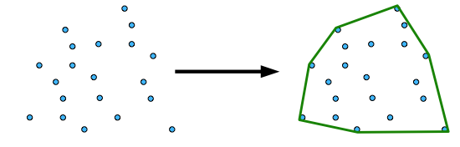
Convex Hull
The convex hull of a set of Q points is the smallest convex polygon P for which each point is either on the boundary of P or in its interior.
Notes:
Put one on the board and walk through brute force algorithm.

Slide 35
Convex Hull
Basic Algorithm
n points
n² possible edges (possible parts of hull)
Notes:
Convex Hull – Brute Force n^3 (each edge n^2 tested against n points)
Mention that test assumes edges extend infinitely
ask questions
y = mx + b,
Just plug in (x,y) points to see if y is =, <, or > x. If always x >= y or x<=y, then is a hull edge.

Slide 36
Convex Hull
Basic Algorithm
n points
n² possible edges (possible parts of hull)
Test for each edge
Total brute force time?
Can we do better?
Notes:
Convex Hull – Brute Force n^3 (each edge n^2 tested against n points)

Slide 37
Convex Hull – Divide and Conquer
Sort all points by x-coordinate – nlogn
Divide and Conquer
Find the convex hull of the left half of points
Find the convex hull of the right half of points
Merge the two hulls into one
All the work happens at the merge and that is where we have to be smart
Notes:
If time, better to do this right before matrix multiply

Slide 38
Convex Hull
If divide and conquer
How much work at merge
Can just pass back Hull and can drop internal nodes at each step, thus saving a large constant factor in time. (but not sufficient for project)
Hull can still have O(n) points.
At merge can test all edges made just from hull points to see which edges are part of the new merged hull
Complexity? Do relation and master theorem.
Notes:
Convex Hull – Brute Force n^3 (each edge n^2 tested against n points) – note new hull will contain 2 edges which are not part of the current hulls, and thus can't just compare current edges for brute force approach)
If recurse and merge step is still n^3, then overall is still n^3 – why not n^3logn (because top step in tree dominates – see proof of master theorem)

Slide 39
Master Theorem
Given:
Where a > 0, b > 1, d ≥ 0 and
a = number of sub-tasks that must be solved
n = original task size (variable)
n/b = size of sub-instances
d = polynomial order of work at each node (leaf/partitioning/recombining)
Then:
This theorem gives big O complexity for most common DC algorithms
Notes:
For convex hull d is still 3, thus n^3

Slide 40
Convex Hull
If divide and conquer
How much work at merge
Can just pass back Hull and can drop internal nodes at each step, thus saving a large constant factor in time. (but not sufficient for project)
Hull can still have O(n) points.
At merge can test all hull points to see which points/edges are part of the new merged hull
Complexity? Still O(n³). But get a big constant factor improvement by dropping internal nodes.
Notes:
Convex Hull – Brute Force n^3 (each edge n^2 tested against n points) – note new hull will contain 2 edges which are not part of the current hulls, and thus can't just compare current edges for brute force approach)
If recurse and merge step is still n^3, then overall is still n^3 – why not n^3logn (because top step in tree dominates – see proof of master theorem)

Slide 41
Convex Hull
If divide and conquer
How much work at merge
Can just pass back Hull and can drop internal nodes at each step, thus saving a large constant factor in time. (but not sufficient for project)
Hull can still have O(n) points.
At merge can test all hull points to see which points/edges are part of the new merged hull
Complexity? Still O(n³). But get a big constant factor improvement by dropping internal nodes
Notes:
Drop internals. Assume that for now on.

Slide 42
Convex Hull
Can we merge faster?
Note new hull will be a subset of the old hull edges plus 2 new edges
An improved approach is to just consider current hull edges. This is O(n) edges rather than testing all possible edges which is O(n²).
All (and only) current edges still legal with opposite hull
Complexity of this step?
Notes:
Ask which ones we would keep?
Could do n^2 by just testing current hull edges (n) against points from opposite hull (n) (total n^2) to see which are in, leaving 4 points which must be on the tangent lines (e.g. left hull edges with right hull points, first one that does not pass contains one of the 4 points –
If keep hull ordering can stop testing of edges a little early, but still O(n) for that part
Can do better

Slide 43
Convex Hull
Can we merge faster?
Note new hull will be a subset of the old hull edges plus 2 new edges
An improved approach is to just consider current hull edges. This is O(n) edges rather than testing all possible edges which is O(n²).
All (and only) current edges still legal with opposite hull will remain
Complexity of this step? - O(n²)
Leaving 4 points which must be end-points of tangent lines to create the merged convex hull.
Notes:
Could do n^2 by just testing current hull edges (n) against points from opposite hull (n) (total n^2) to see which are in, leaving 4 points which must be on the tangent lines (e.g. left hull edges with right hull points, first one that does not pass contains one of the 4 points –
If keep hull ordering can stop testing of edges a little early, but still O(n) for that part
Can do better

Slide 44
Convex Hull
Then just appropriately connect the 4 points, adding the 2 needed edges for the merge – complexity of this part?
Total complexity? Do relation and master theorem.
Notes:
First step n^2. Could do n^2 by just testing current hull edges (n) against points from opposite hull (n) (total n^2) to see which are in, leaving 4 points which must be on the tangent lines (e.g. left hull edges with right hull points, first one that does not pass contains one of the 4 points –
If keep hull ordering can stop testing of edges a little early, but testing still O(n)
Can do better

Slide 45
Convex Hull
Can we do even a smarter merge to get even faster?
Notes:
Thus, need to be smarter in merge step. If can do merge step in n then overall will be nlogn

Slide 46
Convex Hull – Divide and Conquer
Hint: Keep the hulls ordered clockwise or counter clockwise
Merging ordered hulls can be faster (like with merge sort)
From one point (e.g. left-most) to each other point, clockwise order will be by decreasing slopes

Slide 47
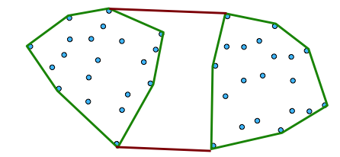
Merging Hulls
First find the edges which are upper and lower tangent
A common tangent of two simple convex polygons is a line segment in the exterior of both polygons intersecting each polygon at a single vertex
Then remove hull points and edges that are cut off
Other internal points should already have been removed by this time

Slide 48
Finding Tangent Lines
Start with the rightmost point of the left hull and the leftmost point of the right hull (maintain sorting)
While the edge is not upper tangent to both left and right
While the edge is not upper tangent to the left, move counter clockwise to the next point on the left hull
Notes:
Or O(n) to just find the right most point of the left hull. Can keep track of it as the merge goes up if you just keep track of the rightmost at the very bottom of the recursion.
We could test if upper tangent to left by checking against all points in left hull but then we will be back to n^2 overall for the merge

Slide 49
Finding Tangent Lines
Start with the rightmost point of the left hull and the leftmost point of the right hull (maintain sorting)
While the edge is not upper tangent to both left and right
While the edge is not upper tangent to the left, move counter clockwise to the next point on the left hull
Hint: Note that line is not upper tangent to the left if moving it up to the next point(s) on the left hull decreases slope of the tangent line
While the edge is not upper tangent to the right, move clockwise to the next point on the right hull
Notes:
Or O(n) to just find the right most point of the left hull. Can keep track of it as the merge goes up if you just keep track of the rightmost at the very bottom of the recursion.

Slide 50
Finding Tangent Lines
Start with the rightmost point of the left hull and the leftmost point of the right hull
While the edge is not upper tangent to both left and right
While the edge is not upper tangent to the left, move counter clockwise to the next point on the left hull
Hint: Note that line is not upper tangent to the left if moving it up to the next point(s) on the left hull decreases slope of the tangent line
While the edge is not upper tangent to the right, move clockwise to the next point on the right hull

Slide 51
Finding Tangent Lines
Start with the rightmost point of the left hull and the leftmost point of the right hull
While the edge is not upper tangent to both left and right
While the edge is not upper tangent to the left, move counter clockwise to the next point on the left hull
Hint: Note that line is not upper tangent to the left if moving it up to the next point(s) on the left hull decreases slope of the tangent line
While the edge is not upper tangent to the right, move clockwise to the next point on the right hull

Slide 52
Finding Tangent Lines
Start with the rightmost point of the left hull and the leftmost point of the right hull
While the edge is not upper tangent to both left and right
While the edge is not upper tangent to the left, move counter clockwise to the next point on the left hull
Hint: Note that line is not upper tangent to the left if moving it up to the next point(s) on the left hull decreases slope of the tangent line
While the edge is not upper tangent to the right, move clockwise to the next point on the right hull
Notes:
O(n) now for the merge rather than the previous n^3 and n^2

Slide 53
Finding Tangent Lines
Start with the rightmost point of the left hull and the leftmost point of the right hull
While the edge is not upper tangent to both left and right
While the edge is not upper tangent to the left, move counter clockwise to the next point on the left hull
Hint: Note that line is not upper tangent to the left if moving it up to the next point(s) on the left hull decreases slope of the tangent line
While the edge is not upper tangent to the right, move clockwise to the next point on the right hull – What is complexity of merge and total alg - master
Notes:
O(n) now for the merge rather than the previous n^3 and n^2

Slide 54
Some Hints
Maintain clockwise (or counter clockwise) ordering when merging (natural if start that way).
Handle the base cases (n < 4) properly
Get started with appropriately ordered hulls
Need to be careful when accessing your hull data structure since it is really a circular list. If using an array then make sure indexes properly change between the 0 element and the last element when you are moving either clockwise or counterclockwise through the array.
Review Project Description
Theoretical vs Empirical graph and proportionality constant
Notes:
Do demo?

