Slide 1
Quicksort
Mergesort is Θ(nlogn), but inconvenient for implementation with arrays since we need space to merge
Quicksort sorts in place, using partitioning
Example: Pivot about a random element (e.g. first element (3))
Starting next to pivot, swap the first element from left that is > pivot with first element from right that is ≤ pivot
For last step swap pivot with last swapped digit ≤ pivot
3 1 4 1 5 9 2 6 5 3 5 8 9 --- Initial list
3 1 3 1 2 9 5 6 5 4 5 8 9 --- After the O(n) swaps
2 1 3 1 3 9 5 6 5 4 5 8 9 --- Last step – swap the pivot
Pivot element ends up in it’s final position
No element left or right of pivot will flip sides again
Next, recursively Quicksort each side of pivot
Divide and Conquer approach
Complexity of Quicksort? How much work at each level?
How many levels?
Notes:
better constant factors than merge – note merge has to move all n each time, while QS swaps on average about half. Yet quicksort depth >= merge. Balance…
Master Theorem – But what is b? Must consider worst side of calling tree. On average? ¾ the size of original, thus b=4/3, master theorem gives nlogn average, but worst case?
CAN'T use master theorem because even b=4/3 is only one side of the tree.
Quicksort does O(n) work at each level of the tree regardless of split. Thus n*#levels where # levels between n and logn but usually logn thus average total is nlogn
Next call, just pass array indexes (1,4), (6,13)

Slide 2
Quicksort
Recurse around a random pivot
Pros and Cons
Speed depends on how well the random pivot splits the data
Random, First as pivot?, median of first middle and last…
Worst case is ?
Notes:
For quicksort there is no combine step. Array is sorted once you hit the bottom.
Will do empirical comparison of mergesort and quicksort later in semester

Slide 3
Quicksort
Recurse around a random pivot
Pros and Cons
Speed depends on how well the random pivot splits the data
Random, First as pivot?, median of first middle and last…
Worst case is O(n²)
Average case complexity is still O(nlogn) and has better constant factors than mergesort – On average swaps only n/2 total elements vs merge which moves all n with each merge, but deeper depth…
Empirical Analysis later
Can we apply master theorem directly?
In place algorithm - do not need extra memory
For Quicksort the work happens at partition time before the recursive call (O(n) at each level to pivot around one value), while for mergesort the work happens at merge time after the recursive calls. The last term in the master theorem recurrence includes both partition and combining work.
Notes:
For quicksort there is no combine step. Array is sorted once you hit the bottom.
Will do empirical comparison of mergesort and quicksort later in semester
Can we apply master theorem directly? Yes in average case, will show with Selection

Slide 4
Selection and Finding the Median
Median is the 50th percentile of a list
The middle number
If even number, then take the average of the 2 middle numbers
Book suggests taking the smallest of the two
Median vs Mean
Summarizing a list of numbers with just one number
Median is resistant to outliers - Is this good or bad?
Algorithm to find median?
Notes:
S(1) is min

Slide 5
Selection and Finding the Median
Median is the 50th percentile of a list
The middle number
If even number, then take the average of the 2 middle numbers
Book suggests taking the smallest of the two
Median vs Mean
Summarizing a list of numbers with just one number
Median is resistant to outliers - Is this good or bad?
Algorithm to find median
Sort list S and then return the middle number - nlogn
Faster approach: Use a more general algorithm: Selection(S,k)
Finds the k^{th} smallest element of a list S of size n
Median: Selection(S, floor(n/2))
How would you find Max or Min using Selection?
Notes:
S(1) is min

Slide 6
Selection Algorithm
S = {2, 36, 5, 21, 8, 13, 15, 11, 20, 5, 4, 1}
To find Median call Selection(S,floor(|S|/2)) = Selection(S,6)
Let initial random pivot be v = 5
How do we pick the pivot? - more on that in a minute
Compute 3-way split which is O(?) (like a pivot in Quicksort):
S_{L} = {
S_{v} = {
S_{R} = {
Notes:
Show 3 way split on board – O(n), but then only go down 1 of the splits!
Just create lists L to R
For this example, what is k on the next call? (1), The minimum element of the remaining list

Slide 7
Selection Algorithm
S = {2, 36, 5, 21, 8, 13, 15, 11, 20, 5, 4, 1}
To find Median call Selection(S,floor(|S|/2)) = Selection(S,6)
Let initial random pivot be v = 5
How do we pick the pivot? - more on that in a minute
Compute 3-way split which is O(n) (like a pivot in Quicksort):
S_{L} = {2, 4, 1}
S_{v} = {5, 5}
S_{R} = {36, 21, 8, 13, 15, 11, 20}
Notes:
Show 3 way split on board – O(n), but then only go down 1 of the splits!
Just create lists L to R
For this example, what is k on the next call? (1), The minimum element of the remaining list

Slide 8
**Challenge Question** Selection Algorithm (Median)
Same S = {2, 36, 5, 21, 8, 13, 15, 11, 20, 5, 4, 1}
To find Median call Selection(S,floor(|S|/2)) = Selection(S,6)
This time, Let the initial random pivot be v = 13. At the next level use the most appropriate of 8 or 20 as the pivot, and you choose for any later levels. Go through each recursion of the algorithm, until it returns the median.
What is the trick which gives us the speed-up?
What is the complexity of the algorithm?
What would you do if you wanted an in-place algorithm?
Notes:
Show SL, SV, and SR for pivot of 13 SL = 2,5,8,11,5,4,1, v=13, SR = 36,21,15,20
If wanted an in place algorithm? Swap
Speedup key? – Only follow one branch (ala binary search)

Slide 9
Selection Algorithm
S = {2, 36, 5, 21, 8, 13, 15, 11, 20, 5, 4, 1}, k=6, v=13
S_{L} = {2, 5, 8, 11, 5, 4, 1}
S_{v} = {13}
S_{R} = {36, 21, 15, 20}
S = {2, 5, 8, 11, 5, 4, 1}, k=6, v=8
S_{L} = {2, 5, 5, 4, 1}
S_{v} = {8} - Done
S_{R} = {11}
S = {2, 5, 8, 11, 5, 4, 1}, k=6, If v had been 5
S_{L} = {2, 4, 1}
S_{v} = {5, 5}
S_{R} = {8, 11} Next call would be S({8, 11},1) with v=8 or 11, both returning to 8, with an additional call required if v=11
Notes:
Go back to quicksort slide to show in-place, exact same, except recursively call just one side

Slide 10
Best Case Selection Complexity
Best case
Pick the median value as the pivot (or close to it) each time so that we cut the list in half at each level of the recursion
Of course if we could really pick the median value then we wouldn't need selection to find the median
If we can split the list close to half each time, then:
T(n) = T(n/2) + O(n)
a = 1 since we just recurse down 1 branch each time (the trick)
Note that just like quicksort, O(n) work is done before the recursive call and that no combining work need be done after the recursion threshold. Just the opposite of mergesort, etc.
By master theorem best case complexity is O(n) because time dominated by root node
But only because we do full divide & conquer! Can't stop at root
Notes:
Total work below is (usually) less than work at root node. (1 + ½ + ¼ + ….) < 2
So just do root node with no divide in conquer? No!, because no O(n) approach to do it just at root, the total DC approach allows the O(n) work approach even though most is done at the root node. Otherwise probably n^2 with bubble sort at root.

Slide 11
Master Theorem
Given:
Where a > 0, b > 1, d ≥ 0 and
a = number of sub-tasks that must be solved
n = original task size (variable)
n/b = size of sub-instances
d = polynomial order of partitioning/recombining cost
Then:
This theorem gives big O complexity for most common DC algorithms

Slide 12
Average/Worst Case Complexity
But can we pick the Median?
Pick Random instead (Could pick a few and take middle)
Best case - Always pick somewhat close to the median - O(n)
Worst case complexity
Always happen to pick smallest or largest element in list
Then the next list to check is of size n-1 with an overall depth of n
n + (n-1) + (n-2) + ... = O(n²)
Exact same issue as with Quicksort

Slide 13
Average Case Complexity
Average case complexity
Assume a good pivot is one between the 25th and 75th percentile, these divide the space by at least 25%
Chance of choosing a good pivot is 50% - coin flip
On average "heads" will occur within 2 flips
Thus, on average we divide the list by 3/4ths rather than the optimal 1/2
T(n) = T(3n/4) + O(n)
Complexity?
Notes:
Go to next slide to answer geometric progression bound question
1/(c-1) = 1/(.75-1) = 1/.25 = 4

Slide 14
Average Case Complexity
Average case complexity
Assume a good pivot is one between the 25th and 75th percentile, these divide the space by at least 25%
Chance of choosing a good pivot is 50% - coin flip
On average "heads" will occur within 2 flips
Thus, on average we divide the list by 3/4ths rather than the optimal 1/2
T(n) = T(3n/4) + O(n)
Complexity?
This is still O(n), b = 4/3
Note that as long as a=1, b>1 and d=1, then work is decreasing, and the complexity will be dominated by the work at the root node which for this case is O(n)
Notes:
half the time better than ¾ ths, half the time worse
c = ¾ = .75
Go to next slide to answer geometric progression bound question
1/1-c) = 1/(1-.75) = 1/.25 = 4
But why not same argument for Quicksort? NOT ¾ down BOTH branches. Still n work at each level with ~logn levels
Could also pick the middle of x (odd numbers) to make it closer to ½ at the cost of checking then extras numbers

Slide 15
Matrix Multiplication
One of the most common time-intensive operations in numerical algorithms
Thus any improvement is valuable
What is complexity of the standard approach?
1 2
3 4
·
5 6
7 8
=
(1·5 + 2·7) (1·6 + 2·8)
(3·5 + 4·7) (3·6 + 4·8)
=
19 22
43 50
Notes:
Skip? – Books explanation suffices?

Slide 16
Matrix Multiplication
One of the most common time-intensive operations in numerical algorithms
Thus any improvement is valuable
What is complexity of the standard approach?
An n by n matrix has n² elements and each element of the product of 2 matrices requires n multiplies
O(n³)
1 2
3 4
·
5 6
7 8
=
(1·5 + 2·7) (1·6 + 2·8)
(3·5 + 4·7) (3·6 + 4·8)
=
19 22
43 50
Notes:
Adds and multiplies both order 1 since max size of number is constant (but n adds/mults for each of the n^2 final elements

Slide 17
Divide and Conquer Matrix Multiplication
A B
C D
E F
G H
=
AE + BG AF + BH
CE + DG CF + DH
X·Y =
·
A thru H are sub-block matrices
This subdivides the initial matrix multiply into 8 matrix multiplies each of half the original size

Slide 18
Divide and Conquer Matrix Multiplication
A B
C D
E F
G H
=
AE + BG AF + BH
CE + DG CF + DH
X·Y =
·
A thru H are sub-block matrices
This subdivides the initial matrix multiply into 8 matrix multiplies each of half the original size
T(n) = 8T(n/2) + O(n²) - The O(n²) term covers the matrix additions of the sub-matrices when recombining
Complexity for this recurrence is: O(n^{log28}) = O(n³)
However, we can use a trick similar to the Gauss multiply trick in our divide and conquer scheme
Notes:
No actual multiplies ever take place, since just start adding once we get to the bottom. Basic adds and multiplies are O(1) each as we assume elements are bounded

Slide 19
Strassen's Algorithm
In 1969 Volkler Strassen discovered that:
a b
c d
e f
g h
=
m₂+m₃ m₁+m₂+m₅+m₆
m₁+m₂+m₄-m₇ m₁+m₂+m₄+m₅
·
m₁ = (c + d - a) · (h – f + e)
m₂ = (a · e)
m₃ = (b · g)
m₄ = (a - c) · (h - f)
m₅ = (c + d) · (f - e)
m₆ = (b - c + a - d) · h
m₇ = d · (e + h – f - g)
Now we have 7 matrix multiplies rather than 8
T(n) = 7T(n/2) + O(n²) which gives O(n^{log27}) ≈ O(n^{2.81})
Even faster similar approaches have recently been shown
Notes:
Adding/subtracting matrices is just n^2

Slide 20
Divide and Conquer Applications
What are some more natural Divide and Conquer applications?
Top down parser
Mail delivery (divide by country/state/zip/etc.)
20-questions – like binary search (only 1 sub-task)
FFT (Fast Fourier Transform) – hugely important/beneficial
Polynomial multiplication is nlogn with DC
FFT also transforms between time and frequency domains (speech, signal processing, etc.)
Two closest points in a 2-d graph?
Brute force O(n²), Divide and Conquer is O(nlogn)
Divide and Conquer is also natural for parallelism
Notes:
Let them offer some DC possibilities
Brute force nearest neighbor – n^2
sort points along x axis
Divide at x axis into two parts with equal number points…

Slide 21
Divide and Conquer Speed-up
Speed-up happens when we can find short-cuts during partition/merge that can be taken because of the divide and conquer
Don't just use same approach that could have been done at the top level
Sort: fast merge with already sorted sub-lists
Convex Hull: fast merge of ordered sub-hulls (and dropping internal points while merging)
Multiply/Matrix Multiply: can use the "less multiplies trick" at each level of merge
Quicksort: Partitioning is only O(n) at each level and leads to final sorted list
Binary Search/Selection: can discard ~half of the data at each level (i.e. just one subtask)
Master Theorem tells us the complexity
Notes:
Let them offer some DC possibilities
Brute force nearest neighbor – n^2
sort points along x axis
Divide at x axis into two parts with equal number points…

Slide 22
Multiplication of Polynomials
Key foundation to signal processing
A(x) = 1 + 3x + 2x²
Degree d=2 - highest power of x
Coefficents a₀ = 1, a₁ = 3, a_{d=2} = 2
B(x) = 2 + 4x + x²
A(x)·B(x) = (1 + 3x + 2x²)(2 + 4x + x²) =
Polynomial of degree 2d
Coefficients c₀, c₁, ..., c_{2d}

Slide 23
Multiplication of Polynomials
More generally
A(x) = a₀ + a₁x + a₂x² + ... + a_{d}x^{d}
B(x) = b₀ + b₁x + b₂x² + ... + b_{d}x^{d}
C(x) = A(x)·B(x) = c₀ + c₁x + c₂x² + ... + c_{2d}x^{2d}
Just need to calculate coefficients c_{k} for multiplication
c_{k} = a₀b_{k} + a₁b_{k-1} + ... + a_{k}b₀ = where a_{j},b_{m} = 0 for j,m>d
Convolution
Common operation in signal processing, etc.
Complexity
each c_{k} = O(k) = O(d)
2d coefficients for total O(d²)
Can we do better?

Slide 24
Convolution
A(x)·B(x) = (1 + 3x + 2x²)(2 + 4x + x²)
c₀ = 1·2 = 2
1 3 2
1 4 2
c₁ = 1·4 + 3·2 = 10
1 3 2
1 4 2
c₂ = 1·1 + 3·4 + 2·2 = 17
1 3 2
1 4 2
c₃ = 3·1 + 2·4 = 11
1 3 2
1 4 2
c₄ = 2·1 = 2
1 3 2
1 4 2

Slide 25
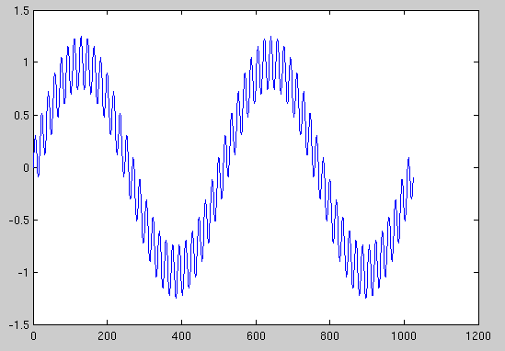
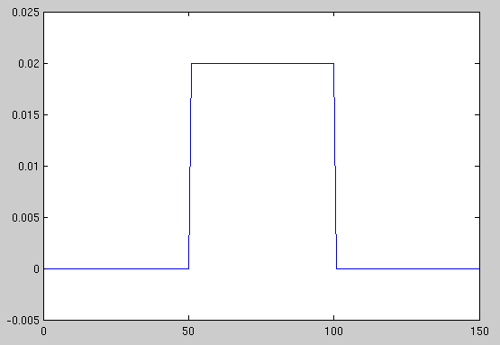
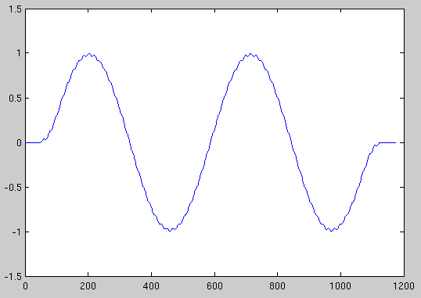
1-D Convolution
∗
Smoothing (noise removal)
=

Slide 26
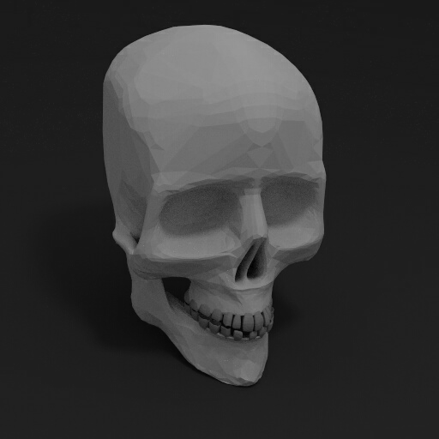

2-D Convolution
A 2-D signal (an Image) is convolved with a second Image (the filter, or convolution “Kernel”).
f(x,y) g(x,y) h(x,y)=f(x,y)*g(x,y)
-1 0 1
-1 0 1
-1 0 1
∗
=

Slide 27
Faster Multiplication of Polynomials
A degree-d polynomial is uniquely characterized by its values at any d+1 distinct points
line, parabola, etc.
Gives us two different ways to represent a polynomial A(x) = a₀ + a₁x + a₂x² + ... + a_{d}x^{d}
The coefficients a₀, a₁, .... , a_{d}
The values A(x₁), A(x₂), ... , A(x_{d}), for any distinct x_{i}
C(x) = A(x)·B(x) can be represented by the values of 2d+1 distinct points, where each point C(z) = A(x)·B(x)
Thus in the Value Representation multiplication of polynomials takes 2d+1 multiplies and is O(d)
Assumes we already have the values of A(z) and B(z) for 2d+1 distinct values
Notes:
Show a simple line A(x) = 2x+1
vs
A(0), A(2)
B(x) = x-2
assume B(0) and B(2)
C- need 3 points since C will be order 2
A(1), B(1)
C(X) = ...

Slide 28
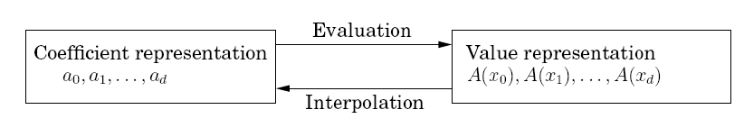
Changing Representations
We can get the value representation by evaluating the polynomial at distinct points using the original coefficient representation
What is complexity? Each evaluation takes d multiplies. Thus to evaluate d points is O(d²)
Interpolation - We'll discuss in a minute

Slide 29
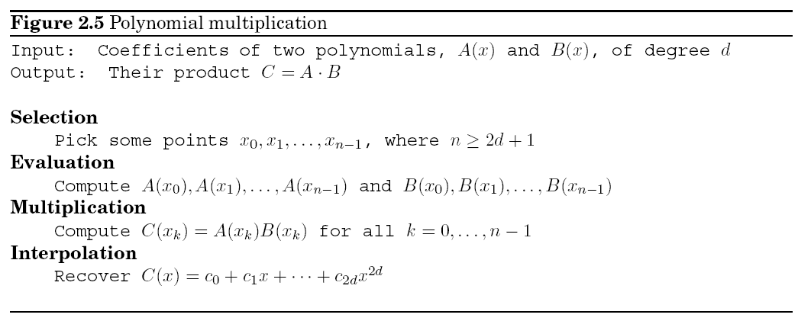
An Algorithm
Selection and Multiplication are O(d)
What have we gained?
But would if we could do evaluation and interpolation faster than O(d²)

Slide 30
Divide and Conquer Evaluation
To put a polynomial of degree n-1 into the value representation we need to evaluate it at n distinct points
If we choose our points cleverly we can use divide and conquer to get better than O(n²) complexity
Choose positive-negative pairs : ±x₀, ±x₁, ... , ±x_{n/2-1}
Computations for A(x_{i}) and A(-x_{i}) overlap a lot since even powers of x_{i} coincide with those of -x_{i}
3 + 4x + 9x² - x³ +5x⁴ + 2x⁵ = (3 + 9x² +5x⁴) + x(4 - x² + 2x⁴)
A(x_{i}) = A_{e}(x_{i}²) + x_{i}A_{o}(x_{i}²)
A(x) = 3 + 4x + 9x² - x³ +5x⁴ + 2x⁵ = A_{e}(x²) + xA_{o}(x²) where
A_{e}(x) = (3 + 9x² +5x⁴)
A_{e}(x²) = (3 + 9x +5x²)

Slide 31
Worked out Example
3 + 4x + 9x² - x³ +5x⁴ + 2x⁵ = (3 + 9x² +5x⁴) + x(4 - x² + 2x⁴)
A(x_{i}) = A_{e}(x_{i}²) + x_{i}A_{o}(x_{i}²)
A(-x_{i}) = A_{e}(x_{i}²) - x_{i}A_{o}(x_{i}²)
A(x) = 3 + 4x + 9x² - x³ +5x⁴ + 2x⁵ = A_{e}(x²) + xA_{o}(x²) where
A_{e}(x²) = (3 + 9x +5x²) and A_{o}(x²) = (4 - x + 2x²) half the size and half the degree
Try x = 2 and x = -2 and evaluate both ways
3 + 4x + 9x² - x³ +5x⁴ + 2x⁵ = 3 + 4(2) + 9(4) - (8) +5(16) + 2(32) = 183
3 + 4(-2) + 9(4) - (-8) +5(16) + 2(-32) = 55
A(2) = A_{e}(2²) + 2A_{o}(2²) = 3 + 9(4) +5(16) + 2(4 - 4 + 2(16)) = 183
A(-2) = A_{e}(-2²) - 2A_{o}(-2²) = 3 + 9(4) +5(16) - 2(4 - 4 + 2(16)) = 55

Slide 32
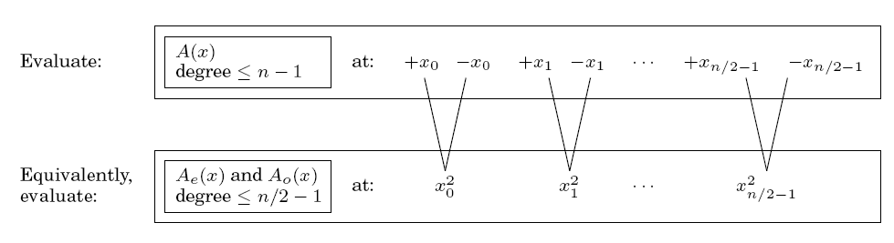
Divide and Conquer Approach
We divide the task into two sub-tasks each with half the size and with some linear time arithmetic required to combine. If we do this just once we cut the task in half but it is still O(n²)
If we continue the recursion we have t(n) = 2t(n/2) + O(n) which gives us the big improvement to O(nlogn)
However, next level of positive-negative pairs? Negative squares?
Notes:
Draw the tree before you show it and fill out the 8th roots of unity and show the unit circle and how you can go on infinitely

Slide 33
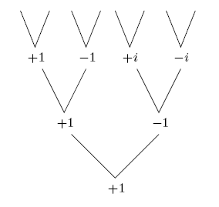
Complex n^{th} Roots of Unity
Assume final point in recursion is 1
Level above it must be its roots (1 and -1)
This must continue up to initial problem size n
The n complex solutions of z^{n} = 1
Complex n^{th} roots of unity
Notes:
(2^1/2)/2 + (2^1/2)i and -(2^1/2)/2 - (2^1/2)i : These squared = i
-(2^1/2)/2 + (2^1/2)i and (2^1/2)/2 - (2^1/2)i : These squared = -i
Show unit circle from there

Slide 34
8th Roots of Unity
To make sure we get the positive-negative pairs we will use powers of 2 such that at each level k there are 2^{k} equally spaced points on the unit circle.
These are not all the roots of unity
But we just want points which have opposite points (differ by π) so that they are positive-negative pairs
Notes:
Show circle up on the board

Slide 35
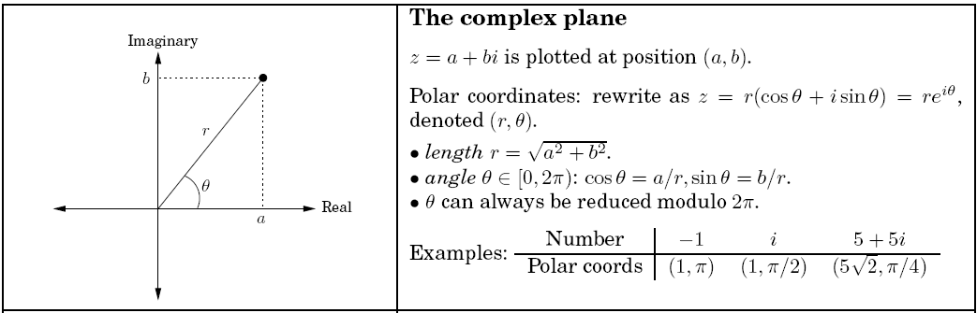
Complex Numbers Review
Transformations between the complex plane and polar coordinates
Notes:
z = a + bi = r(a/r +ib/r) = r(cosΘ + isinΘ)=re^iΘ

Slide 36
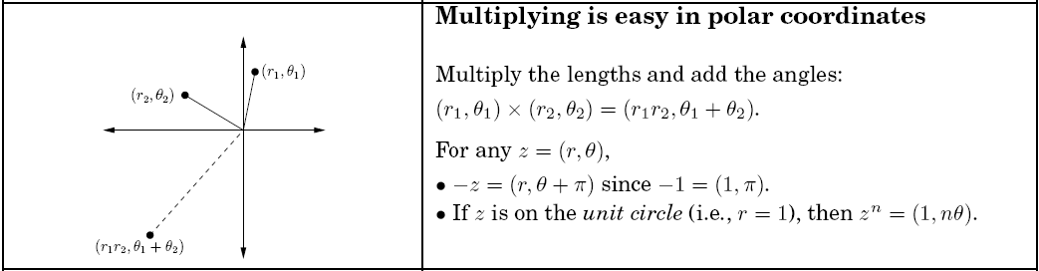
Complex Numbers Review
e^{π/4i} is an 8th root of unity

Slide 37
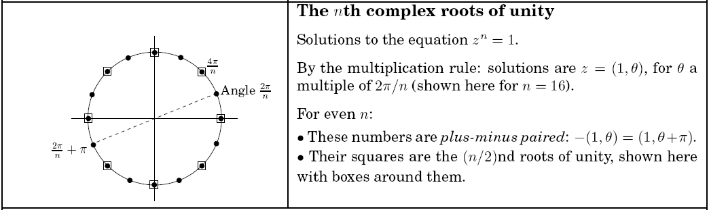
n^{th} roots of unity are 1, ω, ω², ..., ω^{n-1}, where ω = e^{2πi/n}
Note that the 3rd roots of unity are 1, e^{2πi/3}, and e^{4πi/3}, but they aren't plus-minus paired
We'll use n values which are powers of 2 so that they stay plus-minus paired (even) through the entire recursion
 | 0 | 1 | 2 | 3 | 4 | 5 | 6 | 7
Polar | (e^{2πi/8})⁰ = e⁰ (1,0) | (e^{2πi/8})¹ = e^{π/4} (1, π/4) | (e^{2πi/8})² = e^{π/2} (1, π/2) | (e^{2πi/8})³ = e^{3π/4} (1, 3π/4) | (e^{2πi/8})⁴ = e^{π} (1, π) | (e^{2πi/8})⁵ = e^{5π/4} (1, 5π/4) | (e^{2πi/8})⁶ = e^{3π/2} (1, 3π/2) | (e^{2πi/8})⁷ = e^{7π/4} (1, 7π/4)
Cartesian | 1 |  | i |  | -1 |  | -i
Value squared | 1 | i | -1 | -i | 1 | i | -1 | -i
Notes:
If I take any of these values to the 8th = 1

Slide 38
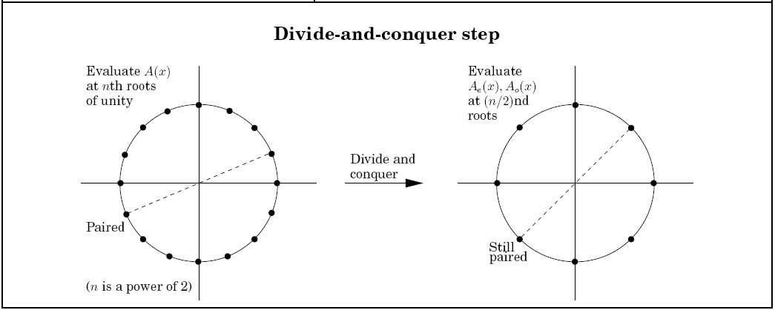
Each step cuts work in half
2 subtasks per step
Just linear set of adds and multiplies at each level
t(n) = 2t(n/2) + O(n)
Θ(nlogn)!!

Slide 39
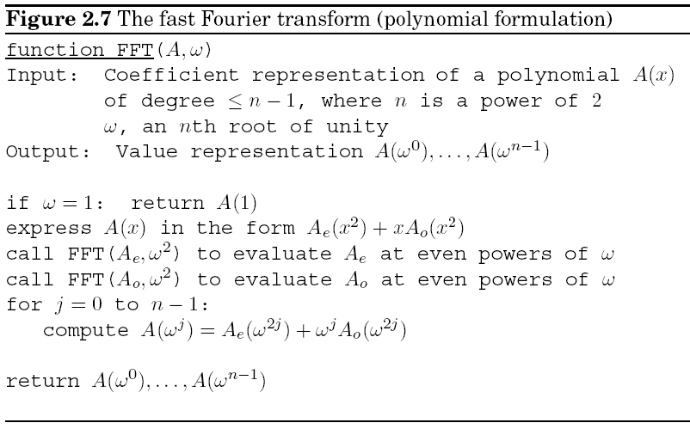
FFT Algorithm
Notes:
Begin a problem A(x) = x³ - 2x² + 3x + 1

Slide 40
A(1) = 1-2+3+1 = 3
A(-1) = -1-2-3+1 = 5
A(i) = -i+2+3i+1 = 3+2i
A(-i) = i+2-3i+1 = 3-2i
ω = e^{2πi/4} = i
ω = e^{2πi/2} = -1
ω = e^{2πi/1} = 1
A(x) = x³ - 2x² + 3x + 1 = (-2x² + 1) + x(x² + 3)
A(x) = -2x + 1 = (1) + x(-2) A(x) = (x + 3) = (3) + x(1)
A(x) = 1 A(x) = -2 A(x) = 3 A(x) = 1
A(1) =1 A(1) = -2 A(1) = 3 A(1) = 1
A(ω⁰) = 1 + -2 = -1 A(ω⁰) = 3 + 1 = 4
A(ω¹) = 1 + (-1)(-2) = 3 A(ω¹) = 3 + (-1)(1) = 2
A(ω⁰) = -1 + (1)4 A(ω¹) = -1 + (-1)4 A(ω²) = 3 + (i)2 A(ω³) = 3 + (-i)2
= 3 = -5 = 3 + 2i = 3 – 2i
Notes:
Note on bottom that the pos/neg pair does a + then a – of the second term

Slide 41
A(1) = 1-2+4+3+1 = 7
A(-1) = 1+2+4-3+1 = 5
A(i) = 1+2i-4+3i+1 = -2+5i
A(-i) = 1-2i-4-3i+1 = -2-5i
ω = e^{2πi/4} = i
ω = e^{2πi/2} = -1
ω = e^{2πi/1} = 1
A(x) = x⁴ - 2x³ + 4x² + 3x + 1 = (x⁴ + 4x² + 1) + x(-2x² + 3)
A(x) = x² +4x + 1 = (x² + 1) + x(4) A(x) = (-2x + 3) = (3) + x(-2)
A(x) = x + 1 A(x) = 4 A(x) = 3 A(x) = -2
A(1) =A(ω⁰)=2 A(1) = 4 A(1) = 3 A(1) = -2
A(ω⁰) = 2 + (1)(4) = 6 A(ω⁰) = 3 + (1)(-2) = 1
A(ω¹) = 2 + (-1)(4) = -2 A(ω¹) = 3 + (-1)(-2) = 5
A(ω⁰) = 6+1=7 A(ω¹) = 6-1=5 A(ω²) = -2+5i A(ω³) = -2-5i
Notes:
Should start this with 8th roots of unity. I cheated because I evaluate x+1 at the 3 rd level which should really pass one more down

Slide 42
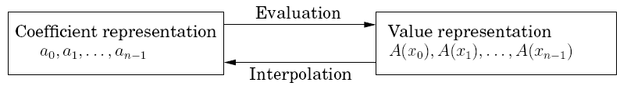
Review
Selection and Evaluation O(n)
Now have Evaluation of O(nlogn)
What about Interpolation?

Slide 43
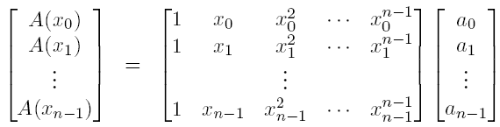
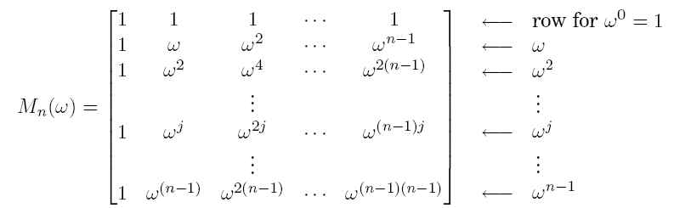
For any distinct set of points, evaluation is just the following Matrix Multiply
This is a Vandermonde Matrix - given n distinct points it is always invertible
Evaluation: A = M·a Interpolation: a = M⁻¹·A
However, still O(n²) for both operations for an arbitrary choice of points
But, we can choose any points we want
Fourier matrix is a Vandermonde matrix with n^{th} roots of unity (with n a power of 2)
Allows Evaluation in O(nlogn) due to its divide and conquer efficiencies
Evaluation: Values = FFT(Coefficients, ω)
ω⁻¹ is an nth root of unity so interpolation can also be done with the FFT function: nlogn!
Interpolation: Coefficients = 1/n·FFT(Values , ω⁻¹)
Notes:
Need to be in matrix form to do this interpolation

Slide 44
Fast Fourier Transform
Full polynomial multiplication is O(nlogn) with FFT
FFT allows transformation between coefficient and value domain in an efficient manner
Also transforms between time and frequency domains
Other critical applications
One of the most influential of all algorithms

Slide 45
Recurrence Relations
Time complexity for Recursive Algorithms
Can be more difficult to solve than for standard algorithms because we need to know complexity for the sub-recursions of decreasing size
Recurrence relations give us a powerful tool for calculating exact time complexities including constant factors
A Recurrence relation is a function t(n) defined in terms of previous values of n
For discrete time steps
When time is continuous we use differential equations (another course)
t(n) = a·t(n-1)
Also use notation t_{n} = at_{n-1} or t(n+1) = at(n)
Want to derive closed form (equation that does not refer to other t_{i})
Notes:
vs Master Theorem which just gives big-O

Slide 46
Factorial Example
Factorial(n)
if n=0 return 1
else return Factorial(n-1)·n
Complexity recurrence relation:
C(n) = C(n-1) + 3
n is a number with a max, not length, assume order 1 multiply
What is the generated complexity sequence
Must know the initial condition: C(0) = 1
Could build a sequence or table of the values
How long to compute C(n) from sequence
Better if we can find a closed form equation rather than a recurrence
Which would be what in this case?
Notes:
n is not length of the number , but just the number itself
We will then assume multiply is 1 operation (have a test, a subtract, and a mult)
Build table starting from 0,1,2,3
closed form C(n) =3n+1

Slide 47
Towers of Hanoi Example
Example: Tower of Hanoi, move all disks to third peg without ever placing a larger disk on a smaller one.
Use a strategy to decide time complexity without having to work out all the algorithmic details

Slide 48
Towers of Hanoi Example
Example: Tower of Hanoi, move all disks to third peg without ever placing a larger disk on a smaller one.
C(n) = C(n-1) + ...

Slide 49
Towers of Hanoi Example
Example: Tower of Hanoi, move all disks to third peg without ever placing a larger disk on a smaller one.
C(n) = C(n-1) + 1 + ...

Slide 50
Towers of Hanoi Example
Example: Tower of Hanoi, move all disks to third peg without ever placing a larger disk on a smaller one.
C(n) = C(n-1) + 1 + C(n-1)

Slide 51
Towers of Hanoi Example
Example: Tower of Hanoi, move all disks to third peg without ever placing a larger disk on a smaller one.
C(n) = C(n-1) + 1 + C(n-1)
C(n) = 2C(n-1) + 1
C(1) = 1

Slide 52
Tower of Hanoi Example
Given C(n) = 2C(n-1) + 1 and the initial condition C(1) = 1
What is the complexity for an arbitrary value of n (i.e., a closed form)?
Could build a table and see if we can recognize a pattern
For more complex problems we will not be able to find the closed form by simple examination and we will thus need our solution techniques for recurrence relations
Note that we can get basic complexity without having yet figured out all the details of the algorithm
Notes:
Do table 1,3, 7. 15… 2^n -1

Slide 53
Recurrence Relations
Example Recurrence Relation: End of day growth in a savings account
In terms of interest, deposits, and withdrawals
Notes:
y(n+1) = [i+1]y(n) + D(n) -W(n)
match form above
y(n+1) - [i+1]y(n) = g(n) = D(n) -W(n)

Slide 54
Recurrence Relations
Most general form for our purposes
t(n) + f(t(n-1), t(n-2),..., t(n-k)) = g(n)
or t(n+k) + f(t(n+k-1), t(n+k-2),..., t(n)) = g(n+k)
A recurrence relation is said to have order k when t(n) depends on up to the k previous values of n in the sequence
We will work with the linear form which is
a₀t(n) + a₁t(n-1) + ... + a_{k}t(n-k) = g(n)
a_{i} are the coefficients of the linear equation
Coefficients could vary with time: a_{i}(n)
g(n) is the forcing function
Notes:
y(n+1) = [i+1]y(n) + D(n) -W(n)
match form above
y(n+1) - [i+1]y(n) = g(n) = D(n) -W(n)

Slide 55
Recurrence Order
What are the orders and differences between the following?
a₀t(n) = a₁t(n-1) + a₂t(n-2)
a₀t(n+2) - a₁t(n+1) – a₂t(n) = 0
b₀y(w) – b₂y(w-2) = b₁y(w-1)
Change of variables: let n = w and t = y and a = b
What are the order of these?
t(n) = a₁t(n-1) + a₃t(n-3)
0 valued coefficients
t(n) = a₁t(n-1) + a₃t(n-3) + g(n)
Order is independent of forcing function
t(n-1) = a₁t(n-2) + a₃t(n-4)
Notes:
top all the same – order 2
3,3,3 (coefficients of 0)

Slide 56
Homogeneous Linear Recurrence Relations with Constant Coefficients
If coefficients do not depend on time (n) they are constant coefficients
When linear these are also called LTI (Linear time invariant)
If the forcing term/function is 0 the equation is homogenous
This is what we will work with first (Homogenous LTI)
a₀t(n) + a₁t(n-1) + ... + a_{k}t(n-k) = 0
A solution of a recurrence relation is a function t(n) only in terms of the current n that satisfies the recurrence relation
Notes:
remember tower of hanoi example T(n) = 2t(n-1) + 1, closed form 2^n -1
Refer back to Bank interest RR as an example

Slide 57
Fundamental Theorem of Algebra
For every polynomial of degree n, there are exactly n roots
You spent much of high school solving these where you set the equation to zero and solved the equation by finding the roots
Roots may not be unique

Slide 58
Solving Homogenous LTI RRs
Assume RR: t_{n} - 5t_{n-1} + 6t_{n-2} = 0
Do temporary change of variables: t_{n} = r^{n} for r ≠ 0
This gives us the Characteristic Equation
r^{n} - 5r^{n-1} + 6r^{n-2} = 0
Multiply by r^{n-2}/r^{n-2} to get r^{n-2}(r²-5r+6) = 0
Since r ≠ 0 we can divide out the r^{n-k} term. Thus could just initially divide by r^{n-k} where k is the order of the homogenous equation
(r²-5r+6) = 0 = (r-2)(r-3), This gives us roots of 2 and 3
Substituting back t_{n} = r^{n} gives solutions of 2^{n} or 3^{n}
Show that 3^{n} is a solution (root) for the recurrence relation
Notes:
Intuition of original equation
First glance at calling tree – will it be exponential?
(Proof/Intuition of why change of variables is beyond current scope)
3*3^n-1 - 5*3^n-1 + 2*3^n-1 = 0
Note that t_{n} = r^{n} is a solution to the RR if r is a root

Slide 59
Solving Homogenous LTI RRs
Assume RR: t_{n} - 5t_{n-1} + 6t_{n-2} = 0
Do temporary change of variables: t_{n} = r^{n} for r ≠ 0
This gives us the Characteristic Equation
r^{n} - 5r^{n-1} + 6r^{n-2} = 0
Multiply by r^{n-2}/r^{n-2} to get r^{n-2}(r²-5r+6) = 0
Since r ≠ 0 we can divide out the r^{n-k} term. Thus could just initially divide by r^{n-k} where k is the order of the homogenous equation
(r²-5r+6) = 0 = (r-2)(r-3), This gives us roots of 2 and 3
Substituting back t_{n} = r^{n} gives solutions of 2^{n} or 3^{n}
The general solution is all linear combinations of these solutions
Thus the general solution is t_{n} = c₁3^{n} + c₂2^{n}
Any of these combinations is a solution. You will show this in your homework
Notes:
(Proof/Intuition of why change of variables is beyond current scope)
General: Would 2(3^n) have been a solution?
It remains to be proven that such an r exists. It also remains to be proven that replacing the nth term of t with the nth power of r results in the same solution to the recurrence relation. There are two ways to argue that replacing tn with rn gives a correct solution to the recurrence relation. First, we don't have to know beforehand that tn = rn is going to work. After we find the roots of the characteristic function, we can verify that the substitution worked by testing the solution on some values. Second, we can prove that this substitution will work in general for any linear constant-coefficient homogeneous recurrence relation. That deeper answer is beyond the scope of the class but if you are interested, we recommend the text by Luenberger

Slide 60
Specific Solutions
The general solution represents the infinite set of possible solutions, one for each set of initial conditions
Given a general solution such as t_{n} = c₁3^{n} + c₂2^{n} the specific solution with specific values for c₁ and c₂ depends on the specific initial conditions
Existence and Uniqueness: There is one and only one solution for each setting of the initial conditions
Since the original recurrence was 2nd order we need initial values for t₀ and t₁
Given these we can solve m equations with m unknowns to solve for the coefficients c₁ and c₂
If t₀ = 2 and t₁ = 3 what is the specific solution for
t_{n} - 5t_{n-1} + 6t_{n-2} = 0
Notes:
Solve the system of equations
t0 = 2 = c1*3^0 + c2*2^0
t1 = 3 = c1*3^1 + c2*2^1
2 = c1 + c2
3 = 3c1 + 2c2
c1 = -1, c2 = 3
tn =- 3^n+3*2^n = 3*2^n – 3^n

Slide 61
Roots of Multiplicity
Assume a situation where the characteristic function has solution
(r-1)(r-3)² = 0
The equation has a root r (=3) of multiplicity 2
To maintain linear independence of terms, for each root with multiplicity j we add the following terms to the general solution
t_{n} = r^{n}, t_{n} = nr^{n}, t_{n} = n²r^{n}, ... , t_{n} = n^{j-1}r^{n}
General solution to (r-1)(r-3)² = 0 is t_{n} = c₁1^{n} + c₂3^{n} + nc₃3^{n}
Notes:
Do another full example"
t(n)+4t(n-2)=3t(n-1)
t(0) = 1, t(1) = 2?

Slide 62
Solving Homogenous LTI RRs
Set t_{n} = r^{n} for r ≠ 0 to get the Characteristic Equation
Divide by r^{n-k}
Solve for roots
Substitute back t_{n} = r^{n} to get solutions
The general solution is all linear combinations of these solutions
Use initial conditions to get the exact solution
t_{n} - 5t_{n-2} = -4t_{n-1}
Initial Conditions: t₀ = 1 and t₁ = 2
Notes:
Do another full example:

Slide 63
Solving Homogenous LTI RRs
t_{n} + 4t_{n-1} - 5t_{n-2} = 0
Initial Conditions: If t₀ = 1 and t₁ = 2
Solutions are (-5)^{n} and 1^{n}
General solution is t_{n} = c₁ + c₂(-5)^{n}
Exact solution is t_{n} = 7/6+ -1/6(-5)^{n}
Notes:
could show -5^n solution as HW prep (though did this a few slides back for 3^n example)
-5(-5)^n-1 + 4(-5)^n-1 + -5(-5)^n+1/-5 = 0
Can solve any HLTI RR, but note that this one would NOT correspond to the time complexity of an alg since it can be negative, since Tn = -4t(n-1)!!

Slide 64
Solutions to Non-Homogeneous LTI RRs
General form - no general solution
a₀t(n) + a₁t(n-1) + ... + a_{k}t(n-k) = g(n)
We will solve a particular and common form with a geometric forcing function
a₀t(n) + a₁t(n-1) + ... + a_{k}t(n-k) = b^{n}p(n)
How to solve
Brute force - manipulate it until it is a homogeneous recurrence relation and then solve for the roots as we have just discussed
Use a convenient shortcut which we will introduce
Example: t_{n} - 3t_{n-1} = 4^{n} (note b = 4 and p(n) = 1)

Slide 65
Brute Force Example
t_{n} - 3t_{n-1} = 4^{n}
To become homogenous, all terms must be in terms of t. Can get rid of 4^{n} term by finding two versions equal to 4^{n-1}
t_{n-1} - 3t_{n-2} = 4^{n-1} (change of variable, replaced n with n-1)
t_{n}/4 - 3/4t_{n-1} = 4^{n-1} (start from initial RR and divide by 4)
t_{n-1} - 3t_{n-2} = t_{n}/4 - 3/4t_{n-1} (set them equal)
t_{n}/4 - 7/4t_{n-1} + 3t_{n-2} = 0 (Homogeneous RR)
r^{n}/4 - 7/4r^{n-1} + 3r^{n-2} = 0 (Characteristic function)
r²/4 - 7/4r + 3 = 0 (Divide by r^{n-2} - remember r ≠ 0)
r² - 7r + 12 = 0 (Multiply both sides by 4)
(r -3)(r-4) = 0
t_{n} = c₁3^{n} + c₂4^{n} (General solution to the recurrence)

Slide 66
An Easier Way: Shortcut Rule
a₀t_{n} + a₁t_{n-1} + ... + a_{k}t_{n-k} = b^{n}p(n)
can be transformed to
(a₀r^{k} + a₁r^{k-1} + ... + a_{k})(r - b)^{d+1} = 0
which is a homogeneous RR where d is the order of polynomial p(n) and k is the order of the recurrence relation
Same example: t_{n} - 3t_{n-1} = 4^{n}
using rule where d = 0 and k = 1, RR is transformed to
(r¹ - 3)(r - 4)¹ = 0
t_{n} = c₁3^{n} + c₂4^{n} (Same general solution to the recurrence)
Notes:
Note: Why are these exponential – start at base, but then keep increasing by ak times at each level, with depth n

Slide 67
Example using Shortcut Rule
a₀t_{n} + a₁t_{n-1} + ... + a_{k}t_{n-k} = b^{n}p(n) can be transformed to
(a₀r^{k} + a₁r^{k-1} + ... + a_{k})(r - b)^{d+1} = 0
where d is the order of polynomial p(n)
Another example: t_{n} - 3t_{n-1} = 4^{n}(2n + 1)

Slide 68
More on Shortcut Rule
a₀t_{n} + a₁t_{n-1} + ... + a_{k}t_{n-k} = b^{n}p(n) can be transformed to
(a₀r^{k} + a₁r^{k-1} + ... + a_{k})(r - b)^{d+1} = 0
Another example: t_{n} - 3t_{n-1} = 4^{n}(2n + 1)
using rule where d = 1 and k = 1, RR is transformed to
(r¹ - 3)(r - 4)² = 0
4 is a root of multiplicity 2
t_{n} = c₁3^{n} + c₂4^{n} + c₃n4^{n} (general solution to the recurrence)
Need three initial values to find a specific solution - why?
Would if we're only given one initial value (i.e. t₀ = 0), which is probable since the original RR is order 1
Can pump RR for as many subsequent initial values as we need:
t₁ = ?, t₂ = ?

Slide 69
More on Shortcut Rule
a₀t_{n} + a₁t_{n-1} + ... + a_{k}t_{n-k} = b^{n}p(n) can be transformed to
(a₀r^{k} + a₁r^{k-1} + ... + a_{k})(r - b)^{d+1} = 0
Another example: t_{n} - 3t_{n-1} = 4^{n}(2n + 1)
using rule where d = 1 and k = 1, RR is transformed to
(r¹ - 3)(r - 4)² = 0
4 is a root of multiplicity 2
t_{n} = c₁3^{n} + c₂4^{n} + c₃n4^{n} (general solution to the recurrence)
Need three initial values to find a specific solution - why?
Would if we're only given one initial value (i.e. t₀ = 0), which is probable since the original RR is order 1
Can pump RR for as many subsequent initial values as we need:
t₁ = 12, t₂ = 116
Another example: 2t_{n} - 3t_{n-1} + t_{n-2} = n² + 1
Notes:
Just do general solution for last example
roots +1 4 times, and 1/2 (not exponential)

Slide 70
Tower of Hanoi Revisited
t(n) = 2t(n-1) + 1
t(1) = 1
Solve the Recurrence Relation
What kind of RR is it?
Notes:
t(n) - 2t(n-1) = 1^{n}n⁰
d=0, b=1. k=1
(r-2)(r-1)
t(n) = c₁2^{n} + c₂1^{n}
t(2) = 3
1 = c1*2 + c2
3 = c1*4 + c2
c1 = 1, c2 = -1

Slide 71
Tower of Hanoi Revisited
t(n) = 2t(n-1) + 1
t(1) = 1
Solve the Recurrence Relation
a₀t_{n} + a₁t_{n-1} + ... + a_{k}t_{n-k} = b^{n}p(n)
can be transformed to
(a₀r^{k} + a₁r^{k-1} + ... + a_{k})(r - b)^{d+1} = 0
which is a homogeneous RR where d is the order of polynomial p(n) and k is the order of the recurrence relation
Notes:
t(n) - 2t(n-1) = 1^{n}n⁰
d=0, b=1. k=1
(r-2)(r-1)
t(n) = c₁2^{n} + c₂1^{n}
t(2) = 3
1 = c1*2 + c2
3 = c1*4 + c2
c1 = 1, c2 = -1

Slide 72
Divide and Conquer Recurrence Relations and Change of Variables
Most divide and conquer recurrence relations are of the form t(n) = a·t(n/b) + g(n)
These are not recurrence relations like we have been solving because they are not of finite order
Not just dependent on a predictable set of t(n-1) ... t(n-k), but the arbitrarily large difference t(n/b) with a variable degree log_{b}n
We can often use a change of variables to translate these into the finite order form which we know how to deal with

Slide 73
Change of Variables - Binary Search Example
Example (binary search): T(n) = T(n/2) + 1 and T(1) = 1
Replace n with 2^{k} (i.e. Set 2^{k} = n)
Can do this since we assume n is a power of 2
Thus k = log₂n
In general replace n with b^{k} assuming n is a power of b and thus k = log_{b}n
With change of variable: T(2^{k}) = T(2^{k}/2) + 1 = T(2^{k-1}) + 1
One more change of variable: Replace T(b^{k}) with t_{k}
Then: T(2^{k}) = T(2^{k-1}) + 1 becomes t_{k} = t_{k-1} + 1
Now we have a non-homogeneous linear recurrence which we know how to solve

Slide 74
Change of Variables Continued
t_{k} = t_{k-1} + 1 transforms to t_{k} - t_{k-1} = 1^{k}·k⁰
by non-homogeneous formula (with b=1 and d=0) transforms to
(r-1)(r-1)
root 1 of multiplicity 2
t_{k} = c₁1^{k} + k·c₂1^{k} = c₁ + c₂k
General solution under change of variables
First, re-substitute T(b^{k}) for t_{k}
T(2^{k}) = c₁ + c₂k
Second, re-substitute n for b^{k} and log_{b}n for k
T(n) = c₁ + c₂log₂n
General solution under original variables

Slide 75
Change of Variables Completed
T(n) = c₁ + c₂log₂n
Need specific solution with T(1) = 1 a given
Pump another initial condition from original recurrence relation T(n) = T(n/2) + 1 which is T(2) = T(2/2) + 1 = 2
1 = c₁ + c₂log₂1 = c₁ + c₂·0
2 = c₁ + c₂log₂2 = c₁ + c₂·1
c₁ = c₂ = 1
T(n) = log₂n + 1
Specific solution
T(n) = O(log₂n) = O(logn)

Slide 76
Change of Variables Summary
To solve recurrences of the form T(n) = T(n/b) + g(n)
Replace n with b^{k} (assuming n is a power of b)
Replace T(b^{k}) with t_{k}
Solve as a non-homogenous recurrence (e.g. shortcut rule)
In the resulting general solution change the variables back
Replace t_{k} with T(b^{k})
Replace b^{k} with n and replace k with log_{b}n
Using this finalized general solution, use the initial values to solve for constants to obtain specific solution
Remember values of n must be powers of b
Note unfortunate overloaded use of b and k in the shortcut
In initial recurrence, b is task size divider, and k is the order index
In shortcut, b is the base of the forcing function, and k is the order of the transformed recurrence

Slide 77
Change of Variables Summary
To solve recurrences of the form T(n) = T(n/b) + g(n)
Replace n with b^{k} (assuming n is a power of b)
Replace T(b^{k}) with t_{k}
Solve as a non-homogenous recurrence (e.g. shortcut rule)
In the resulting general solution change the variables back
Replace t_{k} with T(b^{k})
Replace b^{k} with n and replace k with log_{b}n
Using this finalized general solution, use the initial values to solve for constants to obtain specific solution
Remember values of n must be powers of b
Do example: T(n) = 10T(n/5) + n² with T(1) = 0
where n is a power of 5 (1, 5, 25 …)
Notes:
replace n with 5^k
define T(5^k) as t sub k
when using shortcut 5^(2k) = 25^k (where k is fine to put in as n in the shortcut rule)
when pumping all values must be powers of b

Slide 78
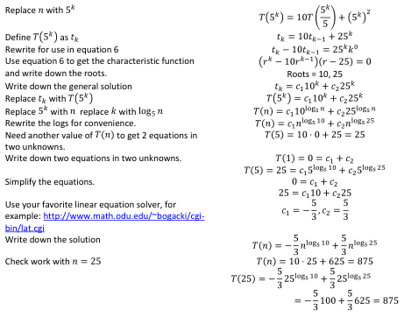
Note that is not necessary to “Rewrite the logs for convenience.” It is just as easy (perhaps easier) to leave
them as they are in doing the steps, leading to an equivalent final solution of –(5/3)10^{log}5^{n} + (5/3)25^{log}5^{n}

Slide 79
More Change of Variables
Change of variables can be used in other contexts to transform a recurrence
nT(n) = (n-1)T(n-1) + 3 for n > 0
Not time invariant since after dividing by n the second coefficient is (n-1)/n
Can do a change of variables and replace nT(n) with t_{n}
Get t_{n} = t_{n-1} + 3
Now it is a simple non-homogenous RR which we can solve and then change back the variables
You get to do one like this for your homework

