Slide 1
Graph Algorithms
Many problems are naturally represented as graphs
Networks, Maps, Possible paths, Resource Flow, etc.
Ch. 3 focuses on algorithms to find connectivity in graphs
Ch. 4 focuses on algorithms to find shortest paths within graphs
G = (V,E)
V is a set of vertices (nodes)
E is a set of edges between vertices, can be directed or undirected
Undirected: e = {x,y}
Directed: e = (x,y)
Degree of a node is the number of impinging edges
Nodes in a directed graph have an in-degree and an out-degree
WWW is a graph
Directed or undirected?
Notes:
Put up example on board and use it for representations in next slides

Slide 2
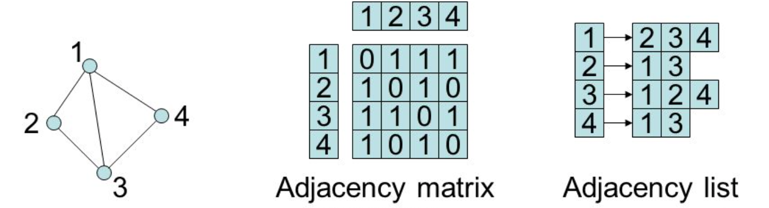
Adjacency Matrix vs Adjacency List
Two common ways to represent graphs
Space complexity?
Time complexity to know if two nodes are directly connected?
Which is Best?

Slide 3
Graph Representation – Adjacency Matrix
n = |V| for vertices v₁, v₂, …, v_{n}
Adjacency Matrix A is n ✕ n with
A is symmetric if it is undirected
One step lookup to see if an edge exists between nodes
n² size is wasteful if A is sparse (i.e. not highly connected)
If densely connected then |E| ≈ |V|²
Notes:
Put up a sample graph and show it in both representations

Slide 4
Graph Representation – Adjacency List
Adjacency List: n lists, one for each vertex
Linked list for a vertex u contains the vertices to which u has an outgoing edge
For directed graphs each edge appears in just one list
For undirected graph each edge appears in both vertex lists
Size is O(|V|+|E|)
Finding if two vertices are directly connected is no longer constant time

Slide 5
Graph Representation – Adjacency List
Adjacency List: n lists, one for each vertex
Linked list for a vertex u contains the vertices to which u has an outgoing edge
For directed graphs each edge appears in just one list
For undirected graph each edge appears in both vertex lists
Size is O(|V|+|E|)
Finding if two vertices are directly connected is no longer constant time
Which representation is best?
Depends on type of graph applications
If dense connectivity, Matrix is usually best
If sparse, then List is often best
Notes:
If out degree is guaranteed small (common) then could consider it constant time look-up

Slide 6
Depth-First Search of Undirected Graphs
What parts of the graph are reachable from a given vertex
Reachable if there is a path between the vertices
Note that in our 2 representations the computer only knows which are the neighbors of a specific vertex
Deciding reachability is like exploring a labyrinth
If we are not careful, we could miss paths, explore paths more than once, etc.
What algorithm do you use if you are at a cave entrance and want to find a cave exit on the other side?
Chalk and string is sufficient
Recursive stack will be our string, and visited(v)=true our chalk
Why not just "left/right-most" with no chalk/visited?
Depth first vs Breadth first?
Notes:
With cave example:
Draw a starting node (and neighbors) on the board.
Draw a final node (and neighbors) on the board.
What Algorithm would we use to find if we can get to final node?
Could just use left-most with no chalk if a tree, but if there are cycles you would loop
Breadth first more memory (especially tough in a cave), but can give shortest path (next chapter) – you getting out once, vs finding best path for future travellers

Slide 7
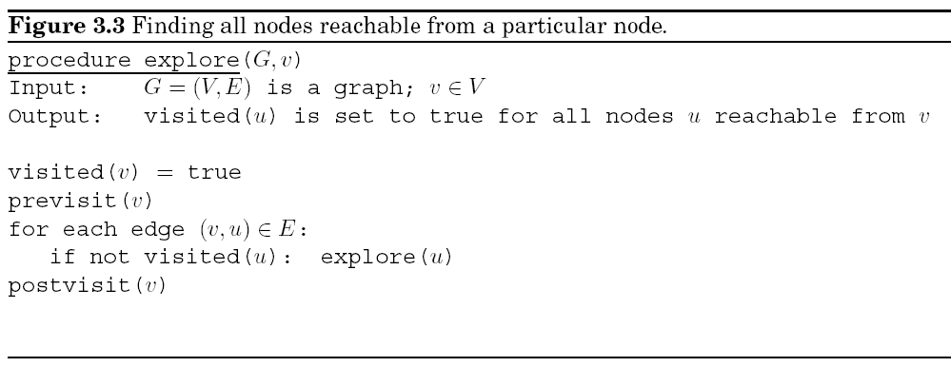
Explore Procedure
Algorithm to find which nodes are reachable from an initial node v
previsit(v) and postvisit(v) are optional updating procedures
Complexity?
Notes:
Is a depth first search algorithm. Alg doesn't show initializing visited to false – must do to be useful, but saving that for DFS, else would redo each time in explore.
If want to know which are reachable and which are not, must initialize visited to false for all V nodes, thus at least O(V)

Slide 8
Explore Procedure
Algorithm to find which nodes are reachable from an initial node v
previsit(v) and postvisit(v) are optional updating procedures
Complexity
Each reachable edge e_{r} checked exactly once (twice if undirected)
O(|E_{r}| + |V_{r}|) – If want non-reachable nodes marked false, then must initialize all visited flags to false, then complexity is O(|E_{r}| + |V|)

Slide 9
Data Structures Matter
Note explore is O(|E| + |V|) (linear in number of nodes and edges) if using adjacency list, but is O(|V|²) if using adjacency matrix. Why?
If the graph is dense then matrix is reasonable since in that case |E| ≈ |V|² anyways
Notes:
for each edge (v,u) line

Slide 10
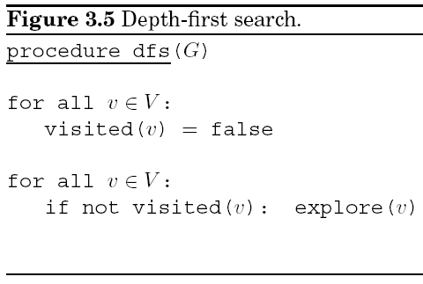
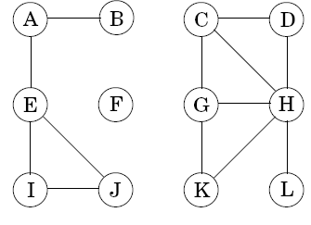
Visiting Entire Graph - DFS
An undirected graph is connected if there is a path between any pair of nodes
Otherwise the graph is made up of disjoint connected components
Visiting entire graph is O(|V| + |E|) – Note this is the amount of time it would take just to scan through the adjacency list
Why not just say O(|E|) since |V| is usually smaller than |E|?
What do we accomplish by visiting entire graph?
Notes:
This time they initialize (probably didn't want to do it twice or drop from explore which never stated that others would be false!?)
Don't do DFS tree yet
Because |E| could be small if very disconnected graph
What have we accomplished? Not much (all nodes have visited flag now as true) - Pre and post visit orderings

Slide 11
Previsit and Postvisit Orderings – Each pre and post visit is an ordered event
Account for all edges – Tree edges (solid: actually traversed with explore)
and Back edges (dashed: looking down edge reveals a node already visited)
Notes:
Account for all edges – Tree edges solid, Do the orderings for this graph (dash edge for edges checked but to nodes already visited)
As part of the previsit call
Also, show a connected component id
How would we store the previsit and postvisit event number
Would if we changed node order, different tree, but SAME relative results
Each node have a number for its unique component?
In DFS inc global counter just before explore call after the successful if. Set id in either pre or post visit.

Slide 12
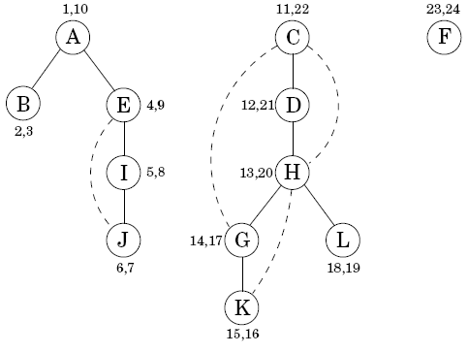
Previsit and Postvisit Orders
DFS yields a forest (disjoint trees) when there are disjoint components in the graph
Can use pre/post visit numbers to detect properties of graphs
Account for all edges: Tree edges (solid) and back edges (dashed)
Back edges detect cycles
Uniquely label each connected component
Properties still there even if explored in a different order (i.e. start with F, then J)
Notes:
Can use these numbers to detect properties of graphs
For example: Cycles - Is there a backedge – How do you tell? Anytime reach a visited node
Would if explored in a different order, F first then J – Just start it but don't walk through all of it

Slide 13
**Challenge Question** Previsit and Postvisit Orderings – This time decide amongst options reverse alphabetically
Account for all edges – Tree edges and Back edges
Notes:
Account for all edges - Do the orderings for this graph (dash edge for edges checked but to nodes already visited)
As part of the previsit call
How would we store the previsit and postvisit event number
Would if we changed node order, different tree, but SAME relative results
Each node have a number for its unique component?
In DFS inc global counter just before explore call after the successful if. Set id in either pre or post visit.

Slide 14
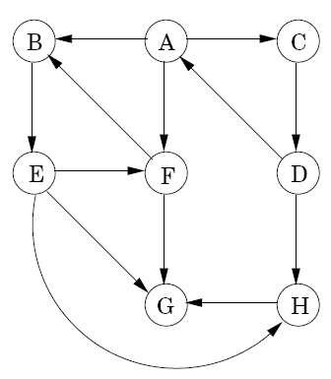
Depth-First Search in Directed Graphs
Can use the same DFS algorithm as before, but only traverse edges in the prescribed direction
Thus, each edge just considered once (not twice like undirected)
Ancestor relationships in DFS tree, not used for original graph
Introduce two new types of dashed edges
Cross edges lead to neither descendant nor ancestor in DFS tree
Forward edges lead from a node to a nonchild descendant
Notes:
Do the DFS tree including the tree, back, forward, and cross edges
Ancestor relationships not part of original graph, just DFS tree,
Don't do connected components here as it is not the same directed graphs. Save that for SCC

Slide 15
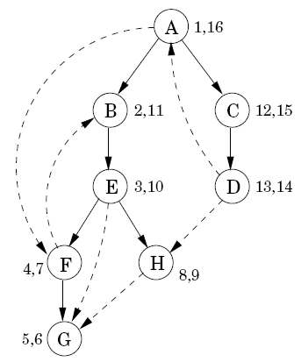
Depth-First Search in Directed Graphs
Tree edges and back edges (2 below) the same as before
Added terminology for DFS Tree of a directed graph
Forward edges lead from a node to a nonchild descendant (2 below)
Cross edges lead to neither descendant or ancestor, lead to a node which has already had its postvisit (2 below)
Notes:
child, ancestor terminology is for the DFS tree, not the original graph
DON’T do the DFS example from arbitrary node here, wait until DAG
DON’T discuss post-ordering effect here, since it is best for DAGs
Remember, directed graphs do not necessarily have sources or sinks

Slide 16
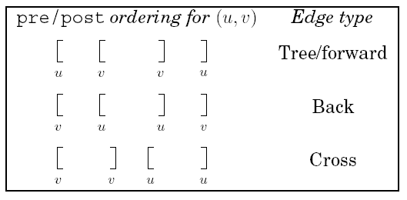
Back Edge Detection
Edge types can be read off directly from pre and post numbers of the DFS tree – just check nodes u (tail) and v (head) connected by each edge
Initial node of edge is u and final node is v
Tree/forward reads pre(u) < pre(v) < post(v) < post(u)
If G First?
Notes:
Look at edge examples in the right graph, pick one of each type form tree and show the orderings
DON’T do the DFS example from arbitrary node here, wait until DAG Note that post numbers suggest sequence in DAG - highest first, lowest last
DON’T discuss post-ordering effect here, since it is best for DAGs
Would if we had explored G first, still get same back edge relative values, post value ordering, etc. – go back 2 slides of the graph
Cross and Forward edges could be used to test robustness of a network in terms of bottlenecks, or how may ways to get between points, etc.

Slide 17
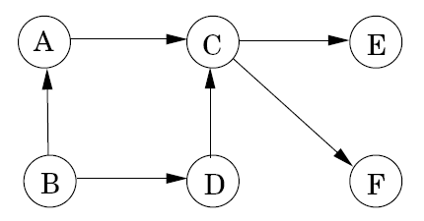
DAG – Directed Acyclic Graph
DAG – a directed graph with no cycles
Very common in applications
Ordering of a set of tasks. Must finish pre-tasks before another task can be done
How do we test if a directed graph is acyclic in linear time?

Slide 18
DAG – Directed Acyclic Graph
DAG – a directed graph with no cycles
Very common in applications
Ordering of a set of tasks. Must finish pre-tasks before another task can be done
How do we test if a directed graph is acyclic in linear time?
Property: A directed graph has a cycle iff DFS reveals a back edge
Just do DFS and see if there are any back edges
How do we check DFS for back edges and what is complexity?

Slide 19
DAG – Directed Acyclic Graph
DAG – a directed graph with no cycles
Very common in applications
Ordering of a set of tasks. Must finish pre-tasks before another task can be done
How do we test if a directed graph is acyclic in linear time?
Property: A directed graph has a cycle iff DFS reveals a back edge
Just do DFS and see if there are any back edges
How do we check DFS for back edges and what is complexity?
O(|E|) – for edge check pre/post values of nodes
Could test while building the DFS tree and stop early
Notes:
And just return as soon as find backedge if all you care about is if it is a DAG

Slide 20
DAG Properties
Every DAG can be linearized
More than one linearization usually possible
Notes:
Post orderings – look back 3 slides at the example G and DFS
Do some linearizations
Do DFS? With what initial node. Do A, (show all links accounted for, including cross links), then Try F first
What are sources and sinks?
DAG never a connected graph, would require cycles
DFS does both DAG test and linearization at the same time.

Slide 21
DAG Properties
Every DAG can be linearized
More than one linearization usually possible
Algorithm to linearize
Property: In a DAG, every edge leads to a node with lower post number
Do DFS, then linearize by choosing nodes by decreasing post number
Other linearizations usually possible – Sort by posts after?
Which node do we start DFS at? Makes no difference, B will always have largest post (Try A and F)
Notes:
Post orderings – look back 3 slides at the example G and DFS
Do some linearizations
Don’t sort postorders after as that would be nlogn. Just add into a linear list each time you do a postvisit. Then you have your linearization in linear time all done when dfs finishes. Or just output linearization as you go if that is all you want.
Do DFS With what initial node. Do A, (show all links accounted for, including cross links) and create list of postorders as we go!, then Try F (reverse alphabetical)first and see what linearization we get.
DFS does both DAG test and linearization at the same time.
What are sources and sinks?
DAG never a connected graph, would require cycles

Slide 22
DAG Properties
Every DAG can be linearized
More than one linearization usually possible
Algorithm to linearize
Property: In a DAG, every edge leads to a node with lower post number
Do DFS, then linearize by choosing nodes by decreasing post number
Other linearizations usually possible – Sort posts after?
Which node do we start DFS at? Makes no difference, B will always have largest post (Try A and F)
Another property: Every DAG has at least one source and at least one sink
Source has no input edges – If multiple sources, linearization can start with any of them
Sink has no output edges
Is the above directed graph connected?
Notes:
Post orderings – look back 3 slides at the example G and DFS
Do some linearizations
Do DFS? With what initial node. Do A, (show all links accounted for, including cross links), then Try F first
DFS does both DAG test and linearization at the same time.
What are sources and sinks?
DAG never a connected graph, would require cycles
Don’t sort postorders after as that would be nlogn. Just add into a linear list each time you do a postvisit. Then you have your linearization in linear time all done when dfs finishes.
A digraph (directed graph) is strongly connected if every vertex is reachable from every other following the directions of the arcs. I.e., for every pair of distinct vertices 𝑢u and 𝑣v there exists a directed path from 𝑢u to 𝑣v.
A digraph is weakly connected if when considering it as an undirected graph it is connected. I.e., for every pair of distinct vertices 𝑢u and 𝑣v there exists an undirected path (potentially running opposite the direction on an edge) from 𝑢u to 𝑣v.

Slide 23
DAG Properties
Every DAG can be linearized
More than one linearization usually possible
Algorithm to linearize
Property: In a DAG, every edge leads to a node with lower post number
Do DFS, then linearize by choosing nodes by decreasing post number
Other linearizations usually possible – Sort posts after?
Which node do we start DFS at? Makes no difference, B will always have largest post (Try A and F)
Another property: Every DAG has at least one source and at least one sink
Source has no input edges – If multiple sources, linearization can start with any of them
Sink has no output edges
Is the above directed graph connected – looks like it if it were undirected (i.e. weakly connected), a DAG is never a strongly connected graph
Notes:
Post orderings – look back 3 slides at the example G and DFS
Do some linearizations
Do DFS? With what initial node. Do A, (show all links accounted for, including cross links), then Try F first
DFS does both DAG test and linearization at the same time.
What are sources and sinks?
DAG never a connected graph, would require cycles
Don’t sort postorders after as that would be nlogn. Just add into a linear list each time you do a postvisit. Then you have your linearization in linear time all done when dfs finishes.
Better to say DAG is never strong connecgted graph, strongly connect graph only when all needs can get to all other nodes

Slide 24
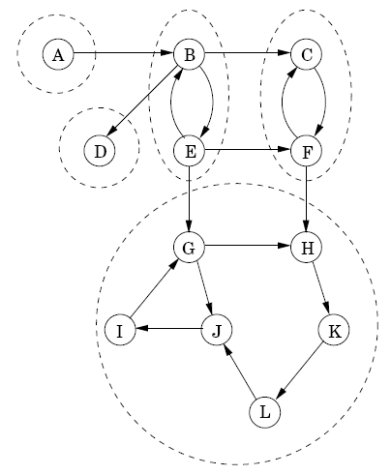
Strongly Connected Components
Two nodes u and v in a directed graph (digraph) are connected if there is a path from u to v and a path from v to u
The disjoint subsets of a directed graph which are connected are called strongly connected components
How could we make the entire graph strongly connected?
Notes:
Can a DAG have a non-singleton SCC? No! Requires a cycle.
How could we make the whole graph strongly connected? Connect from any node in each sink SCC to any node in each source SCC

Slide 25
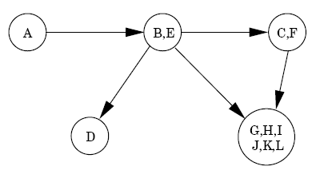
Meta-Graphs
EVERY directed graph is a DAG of its strongly connected components
This meta-graph decomposition is
very useful in many applications
(e.g. a high level flow of the task with
subtasks abstracted)

Slide 26
Algorithm to Decompose a Directed Graph into its Strongly Connected Components
explore(G,v) terminates precisely when all nodes reachable from v have been visited
If we could pick any v from any sink meta-node, then call explore. It would explore that complete SCC, marking all nodes in it as a SCC, and not reach any other nodes
Then remove SCC from the graph (or just use visited flags), and repeat
How do we detect if a node is in a meta-sink SCC?
How about starting from the node with the lowest post-visit value
Doesn't work with arbitrary graphs (with cycles) which are what we are dealing with. B below could have a lower post order than C even though it is not a sink
A
B
C
Notes:
Note that B could have a lower post order than c even though it is not a sink
Used highest post in DAG to detect source node
Note we are looking for a post-visit value on a particular node of the original graph, not a meta-node

Slide 27
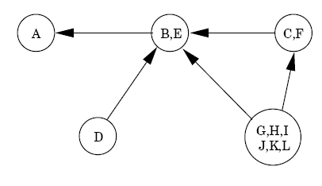
Algorithm to Decompose a Directed Graph into its Strongly Connected Components
explore(G,v) terminates precisely when all nodes reachable from v have been visited
If we could pick any v from any sink meta-node, then call explore. It would explore that complete SCC, marking all nodes in it as a SCC, and not reach any other nodes
Then remove SCC from the graph (or just use visited flags), and repeat
How do we detect if a node is in a meta-sink?
Property: Node with the highest post in a DFS search must lie in a source SCC
Just temporarily reverse the edges in the graph and do a DFS on G^{R} to get post ordering
Then node with highest post in DFS of G^{R}, which will be in a source SCC of G^{R}, must be in a sink SCC in G
Repeat until graph is empty: Pick node with highest remaining post score (from DFS on G^{R}), explore and mark that SCC in G, and then prune that SCC
Notes:
Show initial algorithm (without reversal) at a high level with top DAG
But how can we now if a node is in a sink SCC – can't directly, but can know a node in a source SCC.
Every node in bottom two sources has a post higher than all remaining nodes
Example next slide

Slide 28
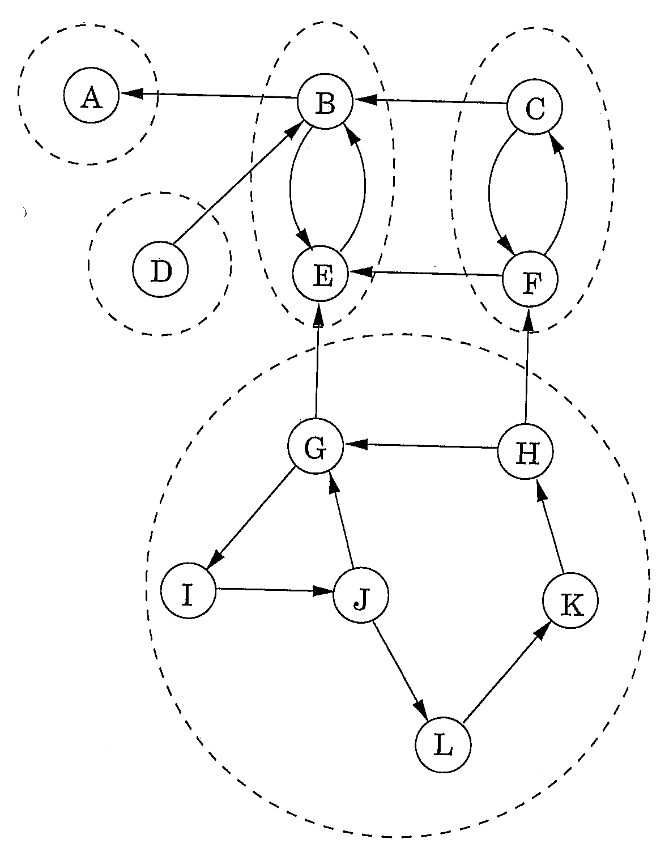
Example
Create G^{R} by reversing graph G
Do DFS on G^{R}
Repeat until graph G is empty:
Pick unvisited node with highest remaining post score (from DFS tree on G^{R}), and explore starting from that node in G, marking each as member of a particular number SCC
That will discover one sink SCC in G
Prune all nodes in that SCC from G (or just use the fact that they have been visited)
G
G^{R}
Notes:
First could start with D or any element of bottom SCC. After pruning MUST do the next in line. Assume big bottom prunes first. Next must be either D or top right SCC. Then deterministic after that.
All components of alg are O(|E|) or O(|V|+|E|) –

Slide 29
**Challenge Question** Complexity
We know complexity of DFS is linear O(|V| + |E|)
Is our new algorithm still linear? Only if our new requirements are linear
Order vertices of G by decreasing post values
Create G^{R}
Propose a linear time method for each of these when using an adjacency list
Think about how you would handle the reversal if using an adjacency matrix, which we might do if the graph is dense (i.e. |E| ≈ |V|²)
G
G^{R}
Notes:
First could start with D or an element of bottom SCC. After pruning MUST do the next in line. Assume big bottom prunes first. Next must be either D or top right SCC. Then deterministic after that.
All components of alg are O(|E|) or O(|V|+|E|) –
How do you make sure Picking highest remaining node is O(|E|)
Created postorder ranked list as you do dfs just like for linearization. Then just keep scanning down the O(V) list to the next unvisited/undeleted node to start with.
Creating adjacency list GR is O(|V|+|E|) from the initial adjacency list: For each edge (x,y) in G adjacency list, append x to end of GR y list (to avoid traversing y list each time keep a ptr to current end of each y list)
Could do it even easier for matrix. Might postulate to ust set every A[i,j] in GR with A[j,i] in G matrix, but that is n^2 time. Just use original matrix and whenever we would look up a(i,j), look up a(j,i) instead.

Slide 30
**Challenge Question** Complexity
We know complexity of DFS is linear - O(|V| + |E|)
Is our new algorithm still linear? Only if our new requirements are linear.
Order vertices of G by decreasing post values
Create postorder ranked list as you do DFS just like for linearization (note list will be in reverse order). After each sink SCC removal, scan down the O(V) list to the next unvisited/undeleted node.
Create G^{R}
Adjacency List: Creating adjacency list G^{R} is O(|V| + |E|) from the initial adjacency list. For each edge (x,y) in G adjacency list, append x to the end of G^{R} y list. To avoid traversing y list each time maintain a pointer to the current end of each y list during creation.
Adjacency Matrix: Could just create a new G^{R} matrix by setting A[i,j] in G^{R} to A[j,i] in G matrix, but that is V² time (all right since DFS is V² anyways with matrix). Faster to just use the original G matrix and whenever we would look up A[i,j] during G^{R} DFS, use A[j,i] instead.
Notes:
First could start with D or an element of bottom SCC. After pruning MUST do the next in line. Assume big bottom prunes first. Next must be either D or top right SCC. Then deterministic after that.
All components of alg are O(|E|) or O(|V|+|E|) –
How do you make sure Picking highest remaining node is O(|E|)
Created postorder ranked list as you do dfs just like for linearization. Then just keep scanning down the O(V) list to the next unvisited/undeleted node to start with.
Creating adjacency list GR is O(|V|+|E|) from the initial adjacency list: For each edge (x,y) in G adjacency list, append x to end of GR y list (to avoid traversing y list each time keep a ptr to current end of each y list)
Could do it even easier for matrix. Might postulate to ust set every A[i,j] in GR with A[j,i] in G matrix, but that is n^2 time. Just use original matrix and whenever we would look up a(i,j), look up a(j,i) instead.

Slide 31
Graph Connectedness Conclusion
By doing one linear time, O(|V|+|E|), depth-first search (DFS), we can efficiently gather lots of important information about arbitrary undirected or directed graphs
Cycles
Connectivity
Finding and labeling Connected Components
Finding and labeling Strongly Connected Components
Linearizations
Finding source and sink nodes and meta-nodes
etc.

