Slide 1
Shortest Paths
Distance is the length of the shortest path between two nodes
Breadth-first search (BFS) creates one BFS tree rooted at the initial node
Just one tree since we only care about nodes connected to the initial node. The rest have infinite distance.
BFS tree is a shortest path tree
Distance is the tree depth where each node resides
Complexity? – Examine algorithm
Notes:
First draw a little BFS tree for a graph showing all level 1 nodes distance 1, etc. Later use that picture to show that if a node reached later will be bigger path, thus only updates once

Slide 2
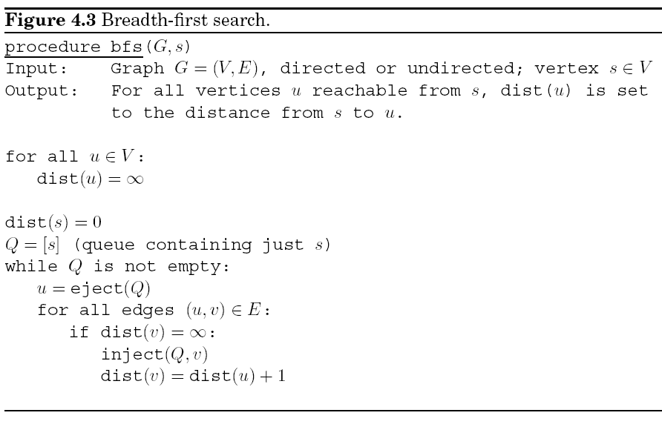
Notes:
Order – any node on shortest frontier and we'll use a Queue to manage the order
Queue – pop from front, push onto end (FIFO), key to making sure shortest paths are looked at first
BFS tree example (with cycles) next slide

Slide 3
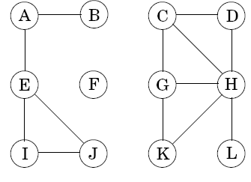
Notes:
Queue – pop from front, push onto end (FIFO) – order important overall
Do a BFS tree example (with cycles) to find shortest path between two nodes in a graph – Start from A as our s, show Q, do E next and not B!, so they see why don't keep going depth first
Walk through complexity together before going to next slides

Slide 4
Careful look at BFS Complexity
Initialization step is O(|V|)
Complexity of main section?
Each v considered exactly twice (one eject and one inject)
Must consider what the complexity is of eject and inject
For each v, each edge is considered exactly once for directed graphs and twice for undirected graphs
O(|V|*complexity(inject) + |V|*complexity(eject) + (1 or 2)*|E|) = ?
Notes:
First draw a little BFS tree for a graph showing all level 1 nodes distance 1, etc. Later use that picture to show that if a node reached later will be bigger path, thus only updates once
No easy way around initialization step even if enqueueing as we go, since must initialize notes to infinity or not visited somehow.

Slide 5
Careful look at BFS Complexity
Complexity of main section?
Each v considered exactly once (one eject and one inject)
Must consider what the complexity is of eject and inject
For each v, each edge is considered exactly once for directed graphs and twice for undirected graphs
O(|V|*complexity(inject) + |V|*complexity(eject) + (1 or 2)*|E|) = ?
For a simple queue the complexity of inject and eject are O(1)
Note that since we start at just one node and consider all reachable nodes V_{r}, the number of unique reachable edges E_{r} lies between V_{r}-1 and 2V_{r}² and thus E_{r} = Ω(V_{r}) (i.e. in complexity sense E_{r} ≥ V_{r})
O(|E_{r}|) = O(|E|)
Thus total main section complexity is O(|E|)
Total overall is O(|V|+|E|)
Notes:
First draw a little BFS tree for a graph showing all level 1 nodes distance 1, etc. Later use that picture to show that if a node reached later will be bigger path, thus only updates once
I think book is leaving the V in there since later (e.g. Dykstras) the queue operations will not be order 1 and we will look at the V cases
E ≥ V in cases where we will look at all v in the graph (since could be disconnected)
2V^2 for dense undirected graph

Slide 6
DFS and BFS Comparisons
DFS (e.g. Explore(G,v)) goes as deep as it can before backtracking for other options
Typically will not find shortest path
Could find a goal deep in the search tree relatively fast
Only need memory equal to stack depth
Infinitely deep paths can get you stuck
BFS
Guaranteed to find shortest path
Is that always important?
Memory will be as wide as the search tree
Long search if goal is deep in the search tree
“Best” First Search/Intelligent Search - Later
Notes:
Use a search tree example
Explore is dfs variation of book BFS. Book DFS searches entire graph
DFS and BFS are examples of exhaustive search – try em all

Slide 7
Lengths on Edges
Often edges will correspond to different lengths
Map
Path cost, time, distance, reward, negative values, etc.
Each e ∈ E has l_{e}, also written for u,v as l(u,v) or l_{uv}
How do we find shortest path in this case
Assume positive edge lengths for the moment
Dijkstra’s algorithm
Replace BFS simple queue with a Priority Queue
Priority queue keeps node with smallest current distance at front
Rest of the queue need not be ordered in any particular way
Update appropriate distances after a new node is opened
Arriving at a visited node may actually shorten the path
You will use Dijkstra’s in your “Network Routing” project
6
a
s
1
b
2

Slide 8
Priority Queue Operations
Maintains a set of elements each with an associated numeric key (e.g. distance)
We will review complexity details in a bit
Following are four operations which we will consider
Operation | Description
Insert | Add a new element to the set (also: “Enqueue”)
Decrease-key | Accommodate the decrease in key value of a particular element
Delete-min | Return the element with the smallest key, and remove it from the set (also: “Dequeue”)
Make-queue | Build a priority queue out of the given elements, with the given key values In many implementations, this is significantly faster than inserting the elements one by one
Notes:
You will implement a priority queue for the project

Slide 9
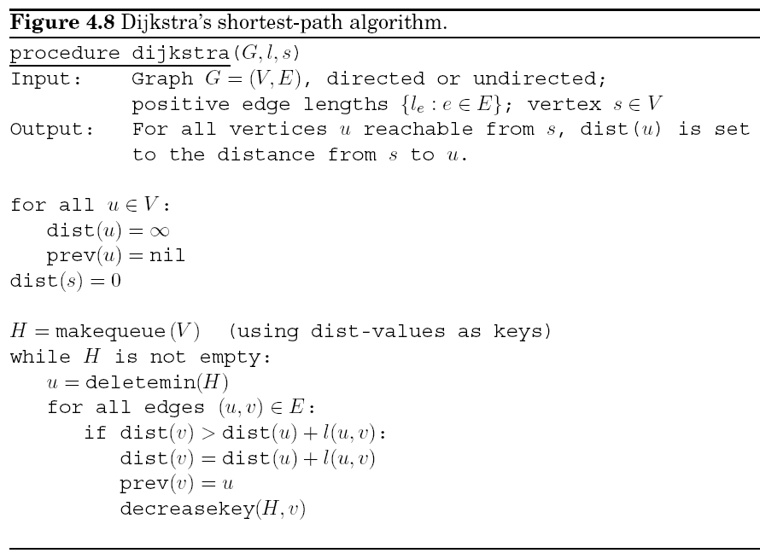
Dijkstra’s Algorithm
6
a
s
1
b
2
Notes:
Show with example on right, edges in ANY order
Why Prev? – so that we can backtrack to reconstruct the path from s to any connected node, show example with node a initally pointing back to s, then changed to b
don't actually have to initiate prev, since if dist stays infinite then never will access it
l is list of lengths, often just part of E
Initial Queue order

Slide 10
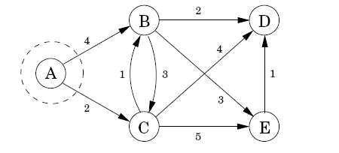
Dijkstra Example
Length of shortest paths:
A: 0
B: ∞
C: ∞
D: ∞
E: ∞
H = makequeue(V)
Priority Queue H: A:0, B:∞, C:∞, D:∞, E:∞
Notes:
Don't draw BFS tree on board since is implicit in graph, and edges do swap. Update queue with B and C before going to next slide
Which edge to explore first when expanding node? Arbitrary and makes no difference, since same deletemin will happen in next iteration regardless

Slide 11
Dijkstra Example
Length of shortest paths:
A: 0
B: 4
C: 2
D: ∞
E: ∞
Pull A off of H
Priority Queue H: C:2, B:4, D:∞, E:∞
Notes:
Look ahead to what will happen when C is pulled off before going to next slide,
Does H have to be ordered. No. Just min at front., D could be before B at the moment

Slide 12
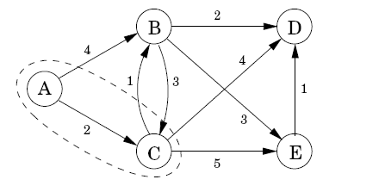
Dijkstra Example
Length of shortest paths:
A: 0
B: 3
C: 2
D: 6
E: 7
Pull C off of H and update
Priority Queue H: B:3, D:6, E:7
B changes it prev pointer from A to C
Note that once you dequeue a node (deletemin) you are guaranteed that that there is no shorter path to that node. Why?
Notes:
B checks C but not smaller
If there had been a shorter path we would have already gotten there
Could there be a shorter path to C. NO!! Because all paths on Q >= to path to C and l >= 0 for each edge. Once dequeued, IS the shortest path.
Note that edges on queue may still be decreased but never below value of a dequeued node, since it was the shortest POSSIBLE path from s when dequeued

Slide 13
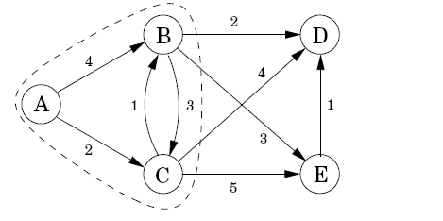
Dijkstra Example
Length of shortest paths:
A: 0
B: 3
C: 2
D: 5
E: 6
Pull B off of H and update
Priority Queue H: D:5, E:6
Note that decreasekey just works on the frontier, ordering which are the best next nodes to expand, but never undermining an already expanded path

Slide 14
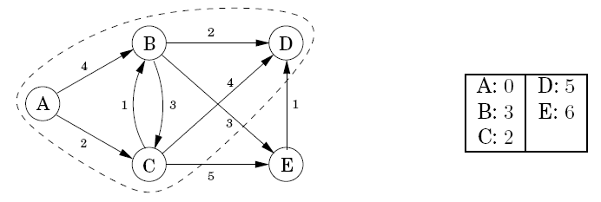
Dijkstra Example
Length of shortest paths:
A: 0
B: 3
C: 2
D: 5
E: 6
Pull D off of H and update and then E off of H
Priority Queue H: E:6

Slide 15
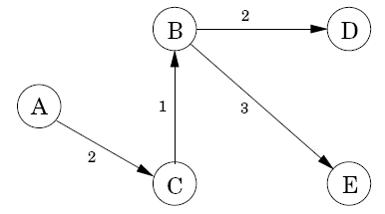
Dijkstra Example
A: 0
B: 3
C: 2
D: 5
E: 6
Final Shortest Path Tree
Constructed using prev(u)

Slide 16
**Challenge** Dijkstra’s Algorithm Complexity: Give complete complexity in terms of V, E, and queue operations – assume makequeue just uses insert
Notes:
Go over each part
insert*|V| + deletemin*|V| +
decreasekey*(|E|) = |V| * Eavg NOT V*E

Slide 17
Dijkstra Algorithm Complexity
Similar to BFS (O(|V| + |E|), but now we have a priority queue instead of a normal queue
Thus complexity will be O(|V|×(complexity of priority queue operations)+|E|×(complexity of priority queue operations))
Different priority queue implementations have different complexities
Basic operations are insert, make-queue, decrease-key, and delete-min
For Dijkstra’s algorithm make-queue is done just once and is at least O(|V|). Worst case is O(|V|×(complexity of insert))
delete-min is called once for every node |V|
decrease-key is called up to once for every edge |E| = |V|×E_{avg}
the overall complexity is:
O(|V|×(insert) + |V|×(delete-min) + |E|×(decrease-key))
Notes:
There is an O(V) for initializing nodes, but that is subsumed in the other ones

Slide 18
Priority Queue (PQ) Implementations
Array
An array of size |V|
Indexed by node number, the key is the array element value, distance for our current situation
Insert complexity is O(?)
Decrease-key complexity is O(?)
Delete-min is O(?)
Dykstra Complexity with array PQ?
O(|V|×(insert) + |V|×(delete-min) + |E|×(decrease-key))
Node | Key
1 | -1
2 | 8
3 | 3
4 | -1
5 | 5
6 | -1
Notes:
You will implement both for your project. -1 key represents node not in queue, could use a separate flag for that in general.
Thus array implementation is O( V^2) because of delete-min
MakeQueue is O(|V|)
Array will be V^2 * delete-min and binary heap is ElogV which is V^2logV for dense, thus array better for dense graphs

Slide 19
Priority Queue (PQ) Implementations
Array
Decrease-key/Insert complexity is O(1)
Delete-min is O(|V|) - since we need to search through entire array each time to find smallest key
Dykstra Complexity with array PQ?
O(|V| + |V|×|V| + |E|) = O(|V|²)
Can keep count of actual queue items to know when queue is empty, etc.
An optimal implementation when graph is dense
Dense graphs are less common for large applications
Can we do better if sparse?
Node | Key
1 | -1
2 | 8
3 | 3
4 | -1
5 | 5
6 | -1
Notes:
Thus array implementation is O( V^2) because of delete-min
MakeQueue is O(|V|)
Array will be V^2 * delete-min and binary heap is ElogV which is V^2logV for dense, thus array better for dense graphs

Slide 20
Priority Queue Implementations
D-ary Heap
Complete D-ary tree (binary common)
Special Constraint: The key value of any node of the tree is less than or equal to that of its children
Thus the minimum node is always at the top of the tree
Insert:
Notes:
insert x:7, dk e:1, dm
sift down – always swap with SMALLEST child
show binary heap example (put legal one on board and then try each operation) – With array of pointers pointing in. (Show node name and key value in picture)
d on deletemin to get smallest of d elements below to bring up. For binary heap d is constant 2. Once d is set, then overall decrease key is log(n)
stays balance since nodes can only be added by insert (and it goes to the right). delete-min can only swap, and does not add any leafs.

Slide 21
Priority Queue Implementations
D-ary Heap
Complete D-ary tree (binary common)
Special Constraint: The key value of any node of the tree is less than or equal to that of its children
Thus the minimum node is always at the top of the tree
Insert: Put new key at next available tree spot (bottom rightmost). Let it "bubble up" tree path, swapping with the node above, until it gets to its proper spot. log_{d}V time to "bubble up"
Delete-min:
Notes:
insert x:7, dk e:1, dm
sift down – always swap with SMALLEST child
show binary heap example (put legal one on board and then try each operation) – With array of pointers pointing in.
d on deletemin to get smallest of d elements below to bring up. For binary heap d is constant 2. Once d is set, then overall decrease key is log(n)
stays balance since nodes can only be added by insert (and it goes to the right). delete-min can only swap, and does not add any leafs.

Slide 22
Priority Queue Implementations
D-ary Heap
Complete D-ary tree (binary common)
Special Constraint: The key value of any node of the tree is less than or equal to that of its children
Thus the minimum node is always at the top of the tree
Insert: Put new key at next available tree spot (bottom rightmost). Let it "bubble up" tree path, swapping with the node above, until it gets to its proper spot. log_{d}V time to "bubble up"
Delete-min: Pulls off top and replaces it with last (rightmost) node of tree and then "sift down" (with smallest) to its proper spot – dlog_{d}V time to "sift down" since have to sort on d sub-nodes at each level to find min to bring up, note that total is O(logV) once we set d
Decrease-key:
Notes:
sift down – always swap with SMALLEST child
show binary heap example (put legal one on board and then try each operation) – With array of pointers pointing in.
d on deletemin to get smallest of d elements below to bring up. For binary heap d is constant 2. Once d is set, then overall decrease key is log(n)
stays balance since nodes can only be added by insert (and it goes to the right). delete-min can only swap, and does not add any leafs.

Slide 23
Priority Queue Implementations
D-ary Heap
Complete D-ary tree (binary common)
Special Constraint: The key value of any node of the tree is less than or equal to that of its children
Thus the minimum node is always at the top of the tree
Insert: Put new key at next available tree spot (bottom rightmost). Let it "bubble up" tree path, swapping with the node above, until it gets to its proper spot. log_{d}V time to "bubble up"
Delete-min: Pulls off top and replaces it with last (rightmost) node of tree and then "sift down" (with smallest) to its proper spot – dlog_{d}V time to "sift down" since have to sort on d sub-nodes at each level to find min to bring up, note that total is O(logV) once we set d
Decrease-key: same "bubble-up" as Insert, log_{d}(V) if maintain separate index into the heap to get to the right element, else O(V)
More on this in a second
Notes:
sift down – always swap with SMALLEST child
show binary heap example (put legal one on board and then try each operation) – With array of pointers pointing in.
d on deletemin to get smallest of d elements below to bring up. For binary heap d is constant 2. Once d is set, then overall decrease key is log(n)
stays balance since nodes can only be added by insert (and it goes to the right). delete-min can only swap, and does not add any leafs.

Slide 24
Priority Queue Implementations
Binary Heap Implementation notes (can use for project)
Can implement the D-ary heap with an array
Note this is not an array implementation of a priority queue
A balanced binary tree has a simple fast array indexing scheme
Notes:
Show binary tree numbered from 1 and figure out together how to get child and parent values – now have fast traversal alg.
It is an array implementation of the D-ary heap version of a PQ
Need # of nodes counter to know next open space in array implementation of tree.
show binary heap example (put legal one on board and then try each operation)
d on deletemin to get smallest of d elements below to bring up. For binary heap d is constant 2. Once d is set, then overall decrease key is log(n)
stays balance since nodes can only be added by insert (and it goes to the right). delete-min can only swap, and does not add any leafs.

Slide 25
Priority Queue Implementations
Binary Heap Implementation notes (can use for project)
Can implement the binary heap with an array
Note this is not an array implementation of a priority queue
A balanced binary tree has a simple fast array indexing scheme
node j has parent floor(j/2)
node j has children 2j and 2j+1
How do you find an arbitrary node to do decrease_key? – As is, it would be O(|V|) to find the node, thus messing up overall complexity
Can keep a separate array of size |V| which points into the binary heap for each node, thus allowing O(1) lookup of an arbitrary node
Each time you do a binary heap operation with a change in the heap, you need to adjust the pointers in the pointer array.
Notes:
Show binary tree numbered from 1 and figure out together how to get child and parent values – now have fast traversal alg.
Need # of nodes counter to know next open space in array implementation of tree.
show binary heap example (put legal one on board and then try each operation)
d on deletemin to get smallest of d elements below to bring up. For binary heap d is constant 2. Once d is set, then overall decrease key is log(n)
stays balanced since nodes can only be added by insert (and it goes to the right). delete-min can only swap, and does not add any leafs.

Slide 26
PQ Implementation Example
4
7
1
2
1
2
3
3
6
5
4
5
6
7
Note the indexes in the graph and tree are different
Assume we insert nodes 2-6 into the PQ all with initial key of ∞ – what will it look like?
Pointer Array
Binary Heap Array
1 | -1
2 | -1
3 | -1
4 | -1
5 | -1
6 | -1
7 | -1
1 | nil
2 | nil
3 | nil
4 | nil
5 | nil
6 | nil
7 | nil
Notes:
Call them graph nodes and tree nodes
This is showing the heap implemented with an array, thus all allocated to start. Could implement with a link list and then use pointers into it from the pointer array.
Assume all nodes have initial key of infinite (ala Dykstra) Draw actual Heap with Key values on the board
For insert (just set pointer to HC+1 in PA, then do bubble up (including swapping of pointers)
For DM, Standard sift down for Heap, in pointer array we just set the pointer to nil (-1)
For standard Dykstra would put all in the PQ with initial infinites values. Then set s to 0 and bubble it to the top.

Slide 27
PQ Implementation Example
4
2:∞
7
1
2
3:∞
4:∞
1
2
3
3
6
5:∞
6:∞
nil
nil
5
4
5
6
7
Note the indexes in the graph and tree are different
Assume we insert nodes 2-6 into the PQ – what will it look like?
What happens if we call DecreaseKey(3,12)?
Pointer Array
Binary Heap Array
1 | -1
2 | 1
3 | 2
4 | 3
5 | 4
6 | 5
7 | -1
1 | 2:∞
2 | 3:∞
3 | 4:∞
4 | 5:∞
5 | 6:∞
6 | nil
7 | nil
HC: 5
Notes:
Heap could have been in a different order
Assume all nodes have initial key of infinite (ala Dykstra) Draw actual Heap with Key values on the board
For insert (just set pointer to HC+1 in PA, then do bubble up (including swapping of pointers)
For DM, Standard sift down for Heap, in pointer array we just set the pointer to nil (-1)
For standard Dykstra would put all in the PQ with initial infinites values. Then set s to 0 and bubble it to the top.
Could have put distance/other info in either array

Slide 28
PQ Implementation Example
4
3:12
7
1
2
2:∞
4:∞
1
2
3
3
6
5:∞
6:∞
nil
nil
5
4
5
6
7
Note the indexes in the graph and tree are different
Assume we insert nodes 2-6 into the PQ – what will it look like?
What happens if we call DecreaseKey(3,12)?
What about Insert(1,15)?
Pointer Array
Binary Heap Array
1 | -1
2 | 1
3 | 2
4 | 3
5 | 4
6 | 5
7 | -1
1 | -1
2 | 2
3 | 1
4 | 3
5 | 4
6 | 5
7 | -1
1 | 2:∞
2 | 3:∞
3 | 4:∞
4 | 5:∞
5 | 6:∞
6 | nil
7 | nil
1 | 3:12
2 | 2:∞
3 | 4:∞
4 | 5:∞
5 | 6:∞
6 | nil
7 | nil
HC: 5
Notes:
Orange for things that change.
Heap nodes1 and 2 swap

Slide 29
PQ Implementation Example
4
3:12
7
1
2
2:∞
1:15
1
2
3
3
6
5:∞
6:∞
4:∞
nil
5
4
5
6
7
Note the indexes in the graph and tree are different
Assume we insert nodes 2-6 into the PQ – what will it look like?
What happens if we call DecreaseKey(3,12)?
What about Insert(1,15)?
What about DM()?
Pointer Array
Binary Heap Array
1 | -1
2 | 2
3 | 1
4 | 3
5 | 4
6 | 5
7 | -1
1 | 3
2 | 2
3 | 1
4 | 6
5 | 4
6 | 5
7 | -1
1 | 3:12
2 | 2:∞
3 | 4:∞
4 | 5:∞
5 | 6:∞
6 | nil
7 | nil
1 | 3:12
2 | 2:∞
3 | 1:15
4 | 5:∞
5 | 6:∞
6 | 4:∞
7 | nil
HC: 6
Notes:
Insert (1,15), pointer array from 1 initially to 6.
then swap with 3

Slide 30
PQ Implementation Example
4
1:15
7
1
2
2:∞
4:∞
1
2
3
3
6
5:∞
6:∞
nil
nil
5
4
5
6
7
Note the indexes in the graph and tree are different
Assume we insert nodes 2-6 into the PQ – what will it look like?
What happens if we call DecreaseKey(3,12)?
What about Insert(1,15)?
What about DM()?
Pointer Array
Binary Heap Array
1 | 3
2 | 2
3 | 1
4 | 6
5 | 4
6 | 5
7 | -1
1 | 1
2 | 2
3 | -1
4 | 3
5 | 4
6 | 5
7 | -1
1 | 3:12
2 | 2:∞
3 | 1:15
4 | 5:∞
5 | 6:∞
6 | 4:∞
7 | nil
1 | 1:15
2 | 2:∞
3 | 4:∞
4 | 5:∞
5 | 6:∞
6 | nil
7 | nil
HC: 5
Notes:
Return 3:12
Swap tree 6 into tree 1
then swap tree 1 with tree 3

Slide 31
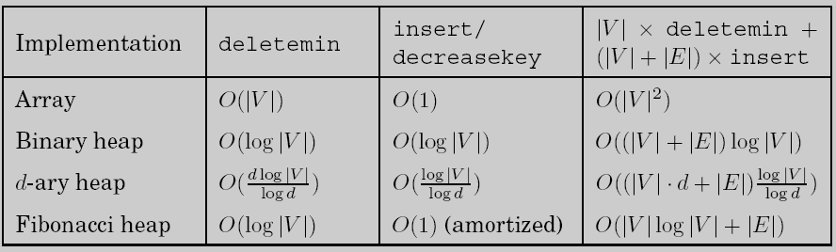
Dijkstra Algorithm Complexity
If dense then unsorted array implementation is best – why?
Binary heap better as soon as |E| < |V|²/log|V|
D-ary heap – depth of heap is log_{d}|V|
constant factor improvement (log₂d on depth), though deletemin is bit longer, since have to sort on d sub-nodes at each level to find min to bring up
Optimal balance is d ≈ |E|/|V| the average degree of the graph
Fibonacci heap – complex data structure makes this less appealing
O(1) (amortized) means over course of the algorithm average is O(1)
Data Structures Matter!
Notes:
recreate the first two rows of this graph (Do Dykstra complexity for both Array and binary heap) on board before turning to this slide
array e = v^2
In top right can replace insert with decreasekey since shown equivalent in preceding column
In binary heap column above vlogv is for the makequeue and elogv is for the decrease key operations

Slide 32
Network Routing Project
Interface, etc. is supplied. You will implement Dijkstra's with two different priority queue implementations: Array and D-ary Heap
binary is fine for the heap if you want
Hint: Implement and test first with the simpler array PQ implementation
Network routing uses Dijkstra’s algorithm to find the optimal (least-cost) path between a source and all other nodes
You select number of nodes and seed, and a random cost matrix is generated.
You will always find the distance from source to every node in the graph
In real life, once you have generated the full routing table at a node you do not need to re-calculate paths each time
However, since networks are constantly changing (new nodes, outages, etc.) you could still recalculate each time
Just finding the best path from the source to the destination can be more efficient than finding them all, though same Big-O complexity
We used to have you do All-paths and One-path
Notes:
n is appropriate for PQ var. For rras, will plug in V or E depending on the operation
Show demo and interface, and project description

Slide 33
Dijkstra Flow with Insert and Goal
If graph is large we do not need to start with all nodes in the queue
This is just a variant (subset) of the algorithm in the text
All-Paths vs One-path (my names)
All distances initially set to ∞ (which is also a flag for not yet queued)
Yellow: in the Queue
Red: removed from the Queue
While Queue not empty
u = deletemin()
if u = g then break()
for each edge (u,v)
if dist(v) = ∞ (i.e. not visited )
insert(v, dist(u)+len(u,v))
prev(v) = u
else if dist(v) > dist(u) + len(u,v)
dist(v) = dist(u) + len(u,v)
decreasekey(v, dist(u) + len(u,v))
prev(v) = u
g
s
Notes:
Quick version. Want just to get to goal in shortest and don't need distance to all reachable nodes.
Same big O, but smaller constant factors
First do an example graph search on the board showing that once deleted from queue, there cannot be a shorter path from the entire frontier (queue)
adding all edges from u also called node expansion
Note that you could check to see if a node has been dequeued at initial for loop (one test) avoiding 1 or 2 tests inside loop – at best small savings (need a dequeued flag)

Slide 34
Dijkstra Flow with Insert and Goal
Yellow: in the Queue
Red node: removed from Queue
Red lines: current backpointers which create the cheapest path tree, they can only be created/updated with a just removed node
While Queue not empty
u = deletemin()
if u = g then break()
for each edge (u,v)
if dist(v) = ∞ (i.e. not visited )
insert(v, dist(u)+len(u,v))
prev(v) = u
else if dist(v) > dist(u) + len(u,v)
dist(v) = dist(u) + len(u,v)
decreasekey(v, dist(u) + len(u,v))
prev(v) = u
g
s
Notes:
Red is current shortest path from s (i.e. pre pointer)
Current front of queue has cloud around it
Can't see which direction g is in, spreads out in all directions

Slide 35
Dijkstra Flow with Insert and Goal
Next deletemin is minimal yellow node (those queued)
No sense of direction towards g, just pushes out the shortest/cheapest frontier until g is finally reached
decreasekey only an option when a removed node has an edge to a node already on the queue
While Queue not empty
u = deletemin()
if u = g then break()
for each edge (u,v)
if dist(v) = ∞ (i.e. not visited )
insert(v, dist(u)+len(u,v))
prev(v) = u
else if dist(v) > dist(u) + len(u,v)
dist(v) = dist(u) + len(u,v)
decreasekey(v, dist(u) + len(u,v))
prev(v) = u
g
s
Updated w/
decreasekey
Notes:
Note bottom right node is updated w decrease key with new shortest red path
Show shortest/cheapest frontier on the board

Slide 36
Dijkstra Flow with Insert and Goal
Why don't we need to revisit a note if it has been removed?
If it is removed it is already on the least cost path and can never be modified. A later node could have an edge to a removed node but it would have to be a longer path (unless there were negative paths)
While Queue not empty
u = deletemin()
if u = g then break()
for each edge (u,v)
if dist(v) = ∞ (i.e. not visited )
insert(v, dist(u)+len(u,v))
prev(v) = u
else if dist(v) > dist(u) + len(u,v)
dist(v) = dist(u) + len(u,v)
decreasekey(v, dist(u) + len(u,v))
prev(v) = u
g
s
Notes:
This is because we a node was removed because we have a shortest path to it.
A later node could have a path to the removed node but it would have to be longer (unless there were negative paths)

Slide 37
Dijkstra Flow with Insert and Goal
We can't terminate just when g gets on the queue, but as soon as g is removed, then we know we have the shortest path
While Queue not empty
u = deletemin()
if u = g then break()
for each edge (u,v)
if dist(v) = ∞ (i.e. not visited )
insert(v, dist(u)+len(u,v))
prev(v) = u
else if dist(v) > dist(u) + len(u,v)
dist(v) = dist(u) + len(u,v)
decreasekey(v, dist(u) + len(u,v))
prev(v) = u
g
s

Slide 38
Dijkstra Flow with Insert and Goal
Another decreasekey example
While Queue not empty
u = deletemin()
if u = g then break()
for each edge (u,v)
if dist(v) = ∞ (i.e. not visited )
insert(v, dist(u)+len(u,v))
prev(v) = u
else if dist(v) > dist(u) + len(u,v)
dist(v) = dist(u) + len(u,v)
decreasekey(v, dist(u) + len(u,v))
prev(v) = u
g
s

Slide 39
Dijkstra Flow with Insert and Goal
Since g had the minimal key it is removed and we can terminate
Note the red edges are the cheapest path tree from s
Could continue and fill out the entire reachable graph, but not necessary since we reached the goal node
While Queue not empty
u = deletemin()
if u = g then break()
for each edge (u,v)
if dist(v) = ∞ (i.e. not visited )
insert(v, dist(u)+len(u,v))
prev(v) = u
else if dist(v) > dist(u) + len(u,v)
dist(v) = dist(u) + len(u,v)
decreasekey(v, dist(u) + len(u,v))
prev(v) = u
g
s
Notes:
Complexity?

Slide 40
Complexity for One-path Dijkstra
Same as standard Dijkstra complexity? For typical cases
O(|V|×(insert) + |V|×(delete-min) + |E|×(decrease-key)) = O((|V|+|E|)log|V|)
Which should have better constants?
However,
In the main body of One-Path O(|V|) ≤ O(|E|) since it only considers reachable nodes, thus the main body is O(|E|log|V|)
Which is also the case for All-paths
One-path does not need to insert all nodes like All-paths, thus not needing the separate O(|V|log|V|) complexity (which can dominate in the rare cases where there are many nodes with 0 degree – no edges). Note we could just do all-paths and break when g is dequeued, which is an improvement, but still requires full queue creation. Note that if the break statement were dropped from One-path, the result would be the same as All-paths.
One-path still needs to initiate all node distances to ∞ but that is O(1) for each v leading to a full complexity of O(|V|+|E|log|V|)
All-paths also has to initiate node distances to ∞, but that O|V|) complexity is subsumed by the O(|V|log|V|) insert complexity.
Notes:
Note One-path does not have to initiate prev pointers, since only used for non infinite nodes, but that is just a constant factor

Slide 41
Negative Edges
3
a
s
-2
b
4
With negative edges we can't keep a guaranteed cheapest frontier, since each time we encounter a negative edge we would have to propagate back decreased costs
We won’t use a priority queue since we can’t guarantee the true shortest path is at the front anyway
Note that the maximum edges in a cheapest path is |V|-1, assuming there are no negative cycles
Just update all nodes |V|-1 times (max possible path length), each time for a path one longer than before
Gives opportunity for all negative edges in path to have a chance to improve the distance to each node
Notes:
No guarantee that dequeued nodes really have a shortest distance, since negative edges coming into that node could decrease distance
If negative cycles then no solution since shortest path would be negative infinity

Slide 42
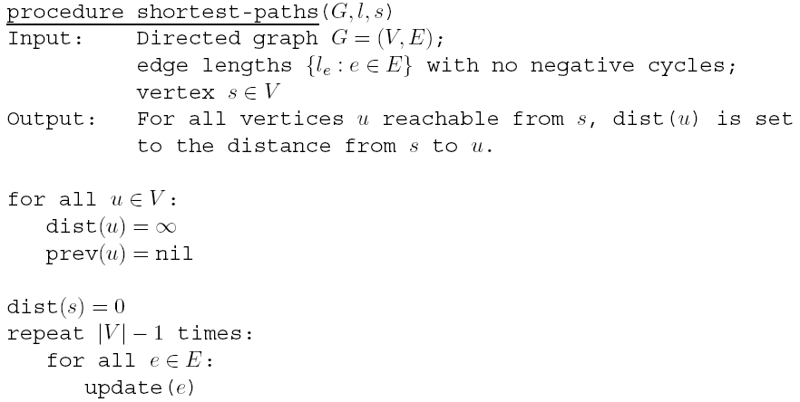
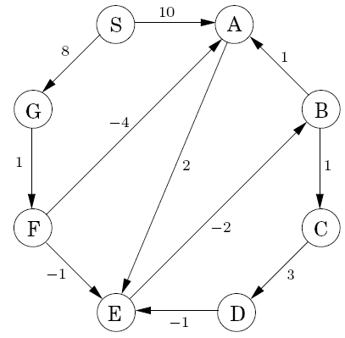
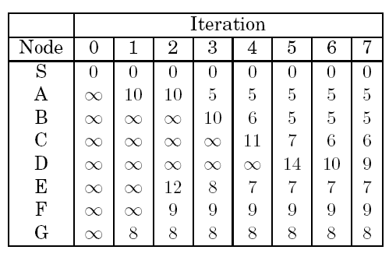
Column c contains the shortest path lengths from S to node x comprising ≤ c edges
Notes:
Note that column #2 shows shortest paths from S to node x comprising 2 steps
Note how path lengths monotonically decrease
Consider path length to A up to iteration 3– First is of length 1 (SA), when get to length 3 (GFA) improves, if incoming nodes ever get better, then SA will shorten, once past n-1 steps, no use looking longer
edges come into A from (S,F,B), note B gets down to 5 and F to 9 – not enough
Note SC is always SB+1
Prev needed to reconstruct paths
Example calculate from previous column, do column 6 from column 5
*Note it would suffice to only check outgoing edges of node that had a change last round. If none, then done., More efficient, but same big O

Slide 43
**Challenge **
Fill out rest of the table
Complexity?
Propose any shortcuts that would make the alg faster
Do the shortcuts improve big-O?
Column c contains the shortest path lengths from S to node x comprising ≤ c edges
Notes:
Note that column #2 shows shortest paths from S to node x comprising 2 steps
Note how path lengths monotonically decrease
Consider path length to A up to iteration 3– First is of length 1 (SA), when get to length 3 (GFA) improves, if incoming nodes ever get better, then SA will shorten, once past n-1 steps, no use looking longer
edges come into A from (S,F,B), note B gets down to 5 and F to 9 – not enough
Note SC is always SB+1
Prev needed to reconstruct paths
Example calculate from previous column, do column 6 from column 5
*Note it would suffice to only check outgoing edges of node that had a change last round. If none, then done., More efficient, but same big O

Slide 44
**Challenge **
Fill out rest of the table
Complexity?
Propose any shortcuts that would make the alg faster
Do the shortcuts improve big-O?
Column c contains the shortest path lengths from S to node x comprising ≤ c edges
Notes:
Complexity is |V|·|E|
It would suffice to only check outgoing edges of nodes that had a change (can only be a decrease) last round. If none, then done. Same big O.

Slide 45
Known as the Bellman-Ford Algorithm
Complexity is |V|·|E|
Notes:
Note could use distances from previous column (order independent) or some updated distances from current column (table would be order dependent), but final results the same either way. For HW use distances from previous column.

Slide 46
Negative Cycles
When there are negative cycles then by definition cheapest paths do not exist.
Notes:
What is best path of from E to C of length 2 steps?
What is best path of from E to C of length n steps?
Note, that if there is no change at any column you can stop early and no there are no negative cycles.

Slide 47
Negative Cycles
When there are negative cycles then by definition cheapest paths do not exist.
Run Bellman-Ford one more iteration (|V| times total). There is a negative cycle iff any cheapest path (distance value) decreases again.
Notes:
What is best path of from E to C of length 2 steps?
What is best path of from E to C of length n steps?
Note, that if there is no change at any column you can stop early and no there are no negative cycles.

Slide 48
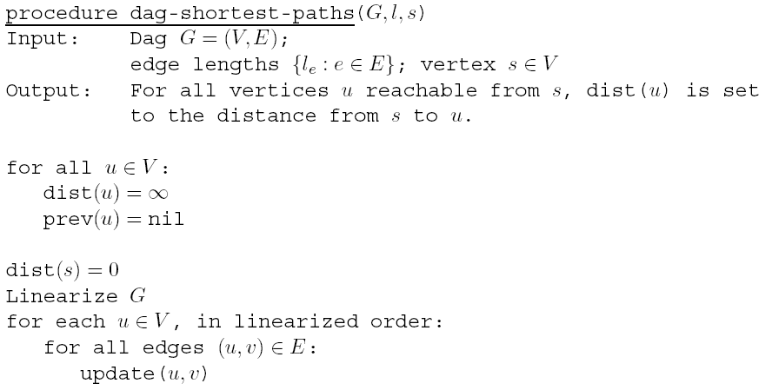
Shortest Path with DAGs
c
4
a
-3
2
s
2
d
6
b
-1
Negative paths are all right since there are no cycles and linearization will give an appropriate ordering
Complexity?
Notes:
Start with s and do alg, All but s have infinite init distance
Give a reasonable postorder possibility c:10, s:8 …
Walk through example C S A B D (only legal linearization in this case)
Linearize – dfs E+V, rest (E+V) or, O(E) since E>V , total E+V

Slide 49
Graph Paths Conclusion
With Breadth First Search (bfs) algorithms we have found efficient ways to find shortest paths in different types of directed and undirected graphs
Non-weighted edges – simple bfs
Weighted edges – Dijkstra's
Negative edges – Bellman-Ford
DAGs – Dag-shortest-path()
Efficiency for some of these can be strongly affected by choice of data structure implementation

