Slide 1

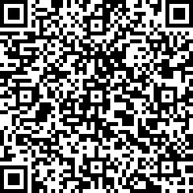
RYAN
ROGERS
RESUME
MOBILE: 512-934-0813
E-MAIL: mail@rynrogers.org
WEBSITE: www.ryanrogers.org
GITHUB: ENTER URL HERE
LINKEDIN ENTER URL
CODECADMEY: ENTER URL
ABOUT ME
EDUCATION: EDUCATION The University of Texas at Arlington Arlington, TX Bachelor of Science in Computer Science, 3.7 Major GPA Expected Graduation 2017 Minor in Biology
Computer Organization & Assembly Language
Object-Oriented Programming (Java)
Intermediate Programming – (Data Structures & C)
Introduction to Computers & Programming (Python)
Computer Literacy
Introduction to Computer Science & Engineering (Game Maker)
Introduction to Engineering
(Led an interdisciplinary Engineering team of five in creating a bridge)
Business & Professional Communication
MS Word, Excel, PowerPoint
InkScape
Microsoft Visual Studio
Cloud 9
Object Oriented Design
Setup mobile wifi.
Setup website.
Learned and implemented SEO and got website to first on Google for business name.
Managed large excel documents and generated reports.
Balanced income and expenses for multiple users and accounts.
Created successful customized marketing campaigns and materials and tracked results.
Computer Organization
Intermediate Programming
Intro to Computers and Programming
Object Oriented Programming
Assembly Language Programming

