Slide 1


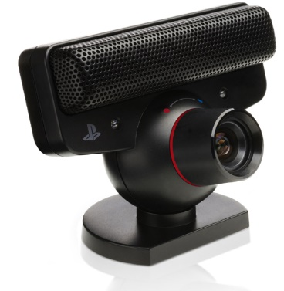


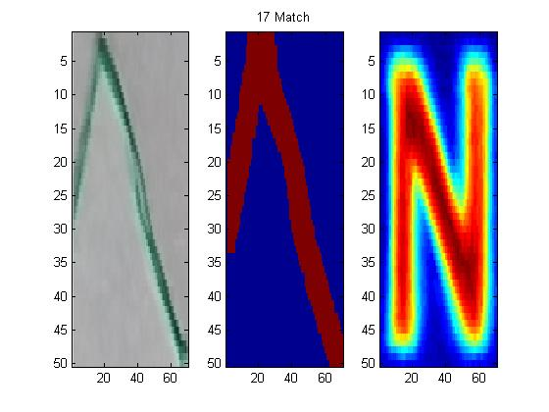
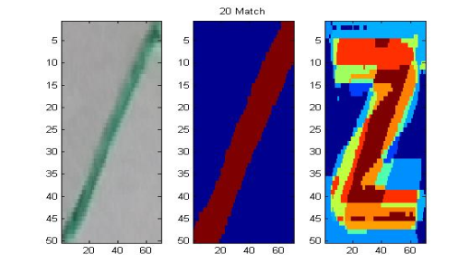
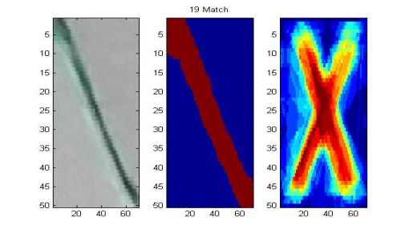
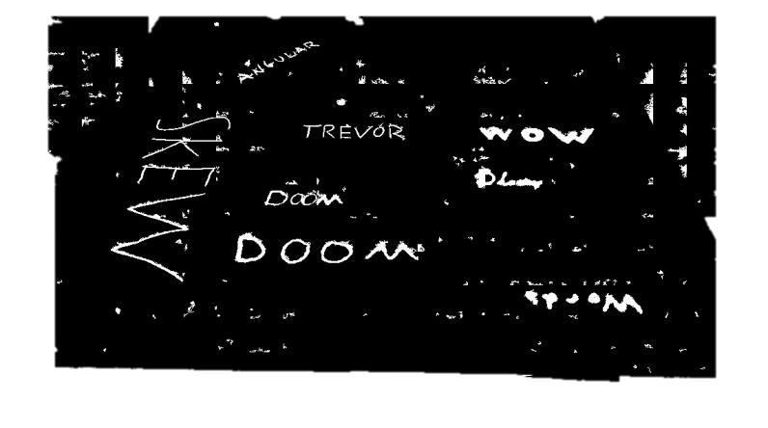
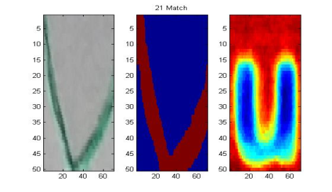
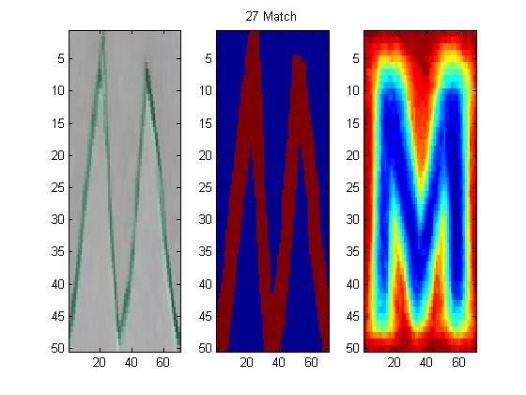
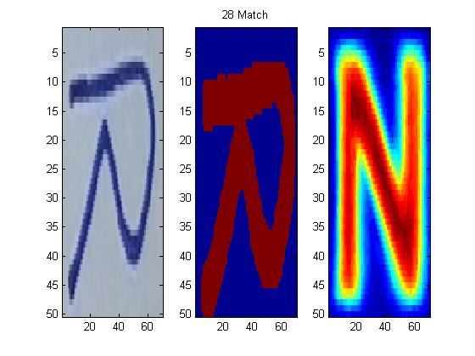
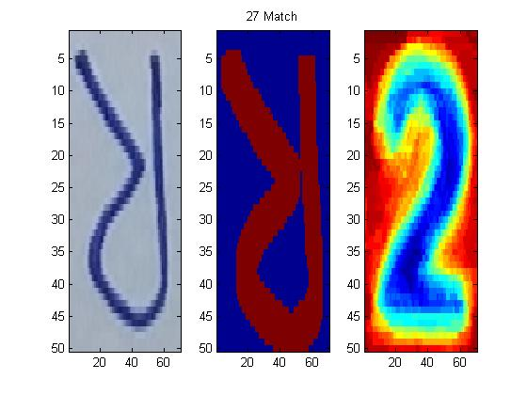
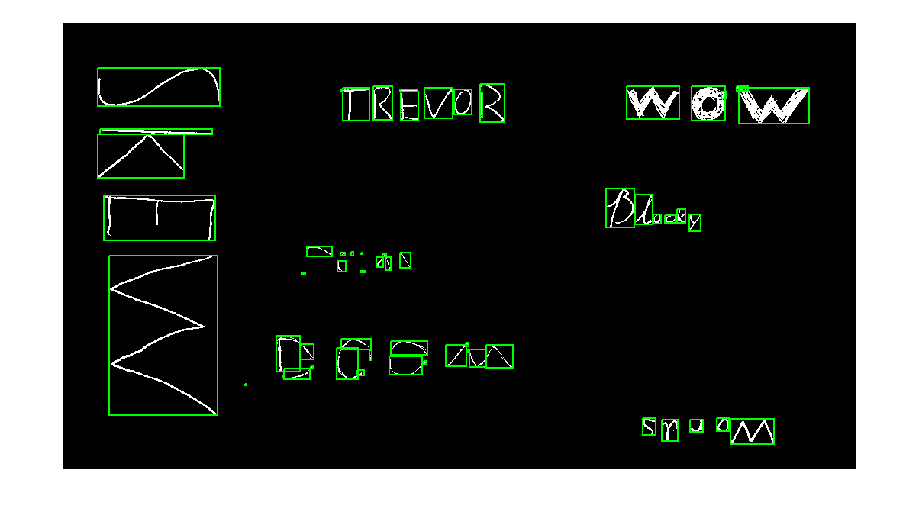
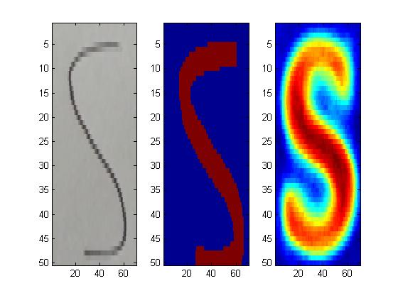
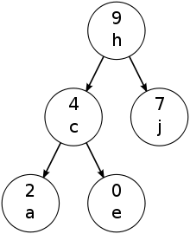
SKEW
WORDS
By Sarah Tan, Phil Bailey, and Trevor Decker
Introduction
System Overview
Multi Hypothesis Letter Combination
Skew Words goal is to detect and read text from an image. The goal of this paper is to create a robust approach to text detection in inconsistent environments. We intend to be able to read text oriented arbitrary whether it is on a STOP sign, CPU, or just written on paper.
Threasholding
Produce an eigen-character for each label
Project each image onto each eigen-character
Try to combine nearby letter segments
pass all detections to the next step
Rotation Invariance
Segment
Results
During segmentation we make initial guess of each letter, to get rid of rotation dependence we rotate each. Choosing the rotation which minimize the amount of non letter in the letters bounding box
Our results our forthcoming but seem promising …
Identify
Group
We combine letters near each with Multi Hypothesis Letter Combination
Training
References
For training we used a large free OCR character database including A-Z, a-z and 0-9. In order to classify, we took each set of letters, an split them by their labels. We then thresholded the images and inverted them if necessary to keep them uniform. Using these sets we then calculated the first eigen-character for each label.
Uses Dynamic Programing Spellchecker library to fix errors
Chen, Huizhong, Sam S. Tsai, Georg Schroth, David M. Chen, Radek Grzeszczuk, and Bernd Girod. "ROBUST TEXT DETECTION IN NATURAL IMAGES WITH EDGE-ENHANCED MAXIMALLY STABLE EXTREMAL REGIONS.“
Koo,, Hyung Il, and Duck Hoon Kim,. "Scene Text Detection via Connected Component Clustering and Nontext Filtering."
Yin, Xu-Cheng, Xuwang Yin, Kaizhu Huang, and Hong-Wei Hao. "Robust Text Detection in Natural Scene Images
Output Text

