Slide 1
missionB

Slide 2
Motivation -
Every two second, someone in the world is in need of blood. In India, there is a need of 5 crore blood units every year out of which only 2.5 crore unit requirements are met. A single car accident victim may require as many as 100 blood units. According to WHO, a single unit of blood can help save the lives of nearly 3 people. In such situations the application might be very helpful in meeting the requirements of blood units by the people who might be willing to donate blood.

Slide 3
Problem Statement -
Blood being the most important element for humans to survive, developing an application to interconnect blood requesters and donors might help save lives during emergency. Making such an application which is user friendly as well as has more features for serving the people better, we are proposing a model in which we are going to connect the blood donor and requester together in a unique way.

Slide 4
Existing System –
People who are in need of blood at emergency situations try to contact their relatives and friends or share the details on WhatsApp which doesn’t really help them much if there are no donors which match the criteria. They can contact only people they know and not strangers who might be willing to help them.

Slide 5
Proposed System –
Requests updated in the application will be plotted in the Maps using Google Maps API. Any person using the application can easily see the nearest blood request and choose to help. Requester can also notify people within the city if they are willing to donate blood. Requests can be made through twitter with a unique hashtag. Blood banks/hospital can organize blood camps and notify people. Automatic deletion of posts after the expiration time. Validation of every user through Aadhar API or manually done to ensure they are genuine. Reports can be generated based on the data for internal use of the government.

Slide 6
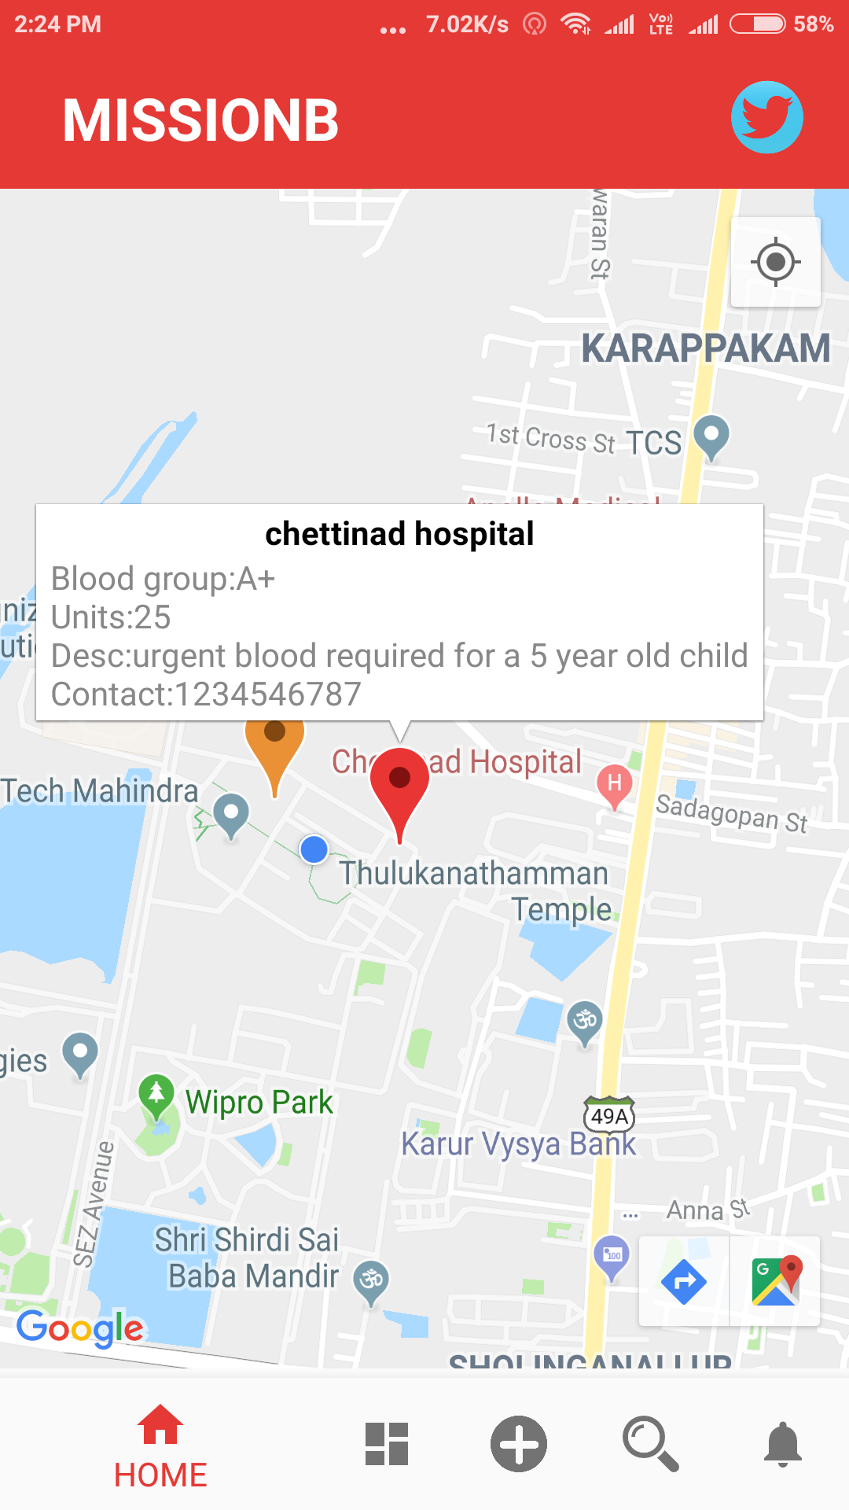
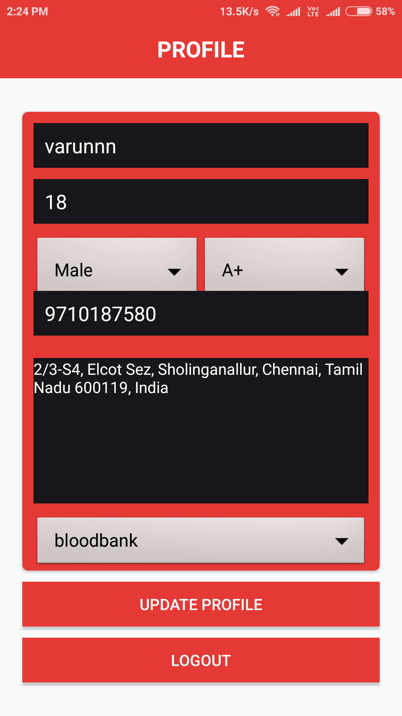
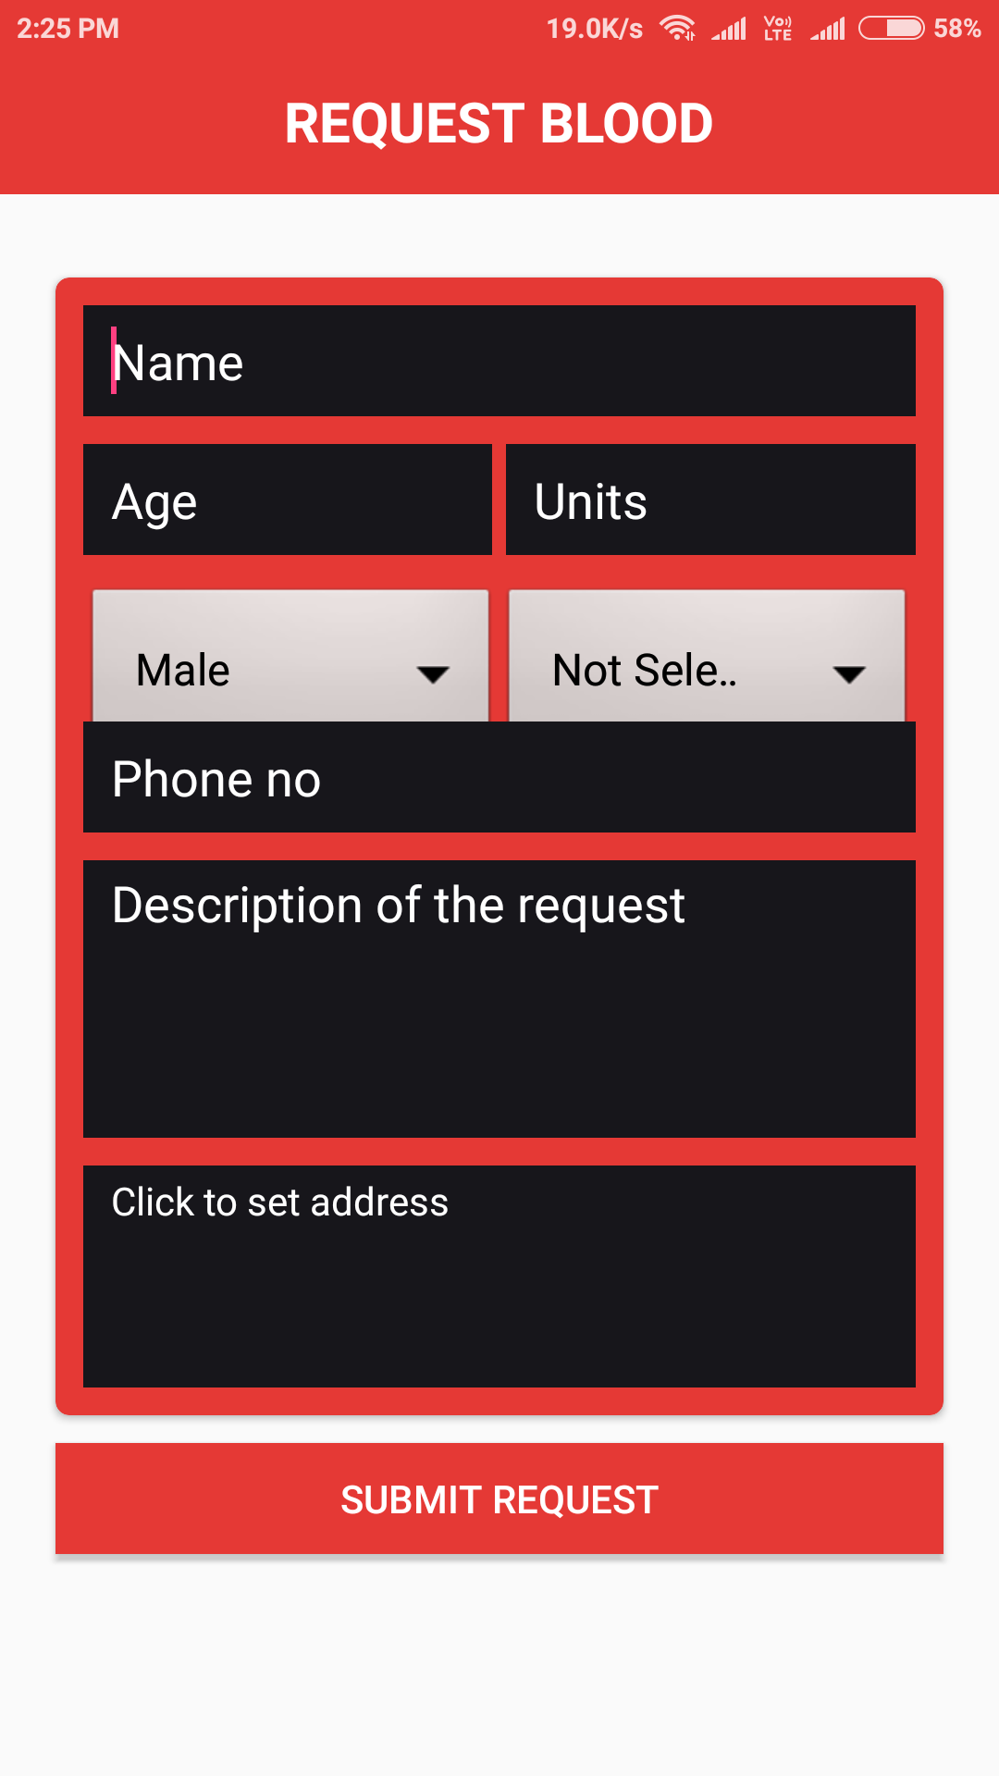
Implementation -

Slide 7
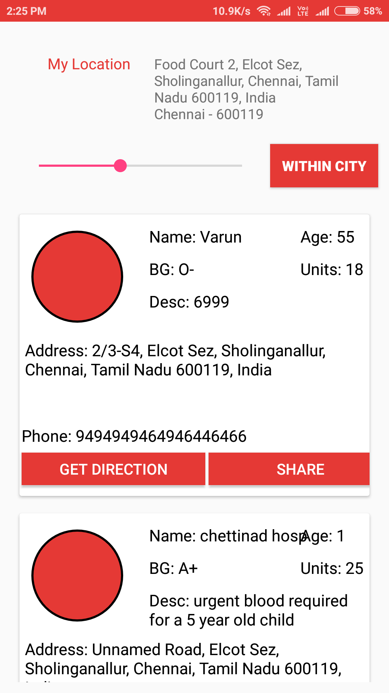
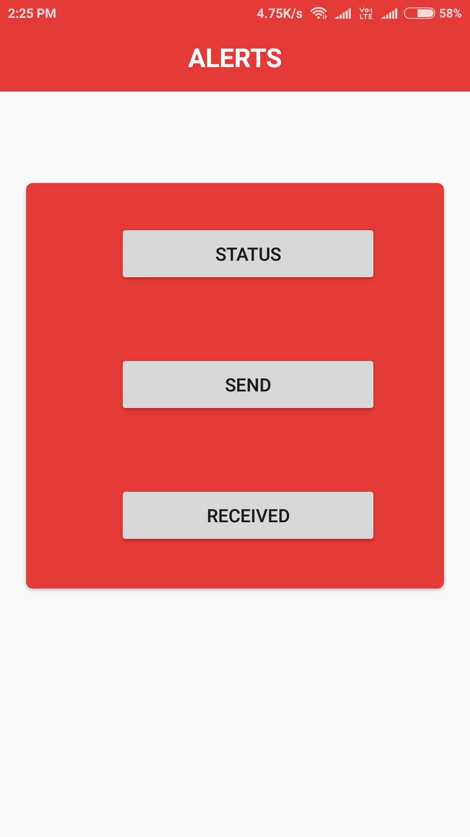
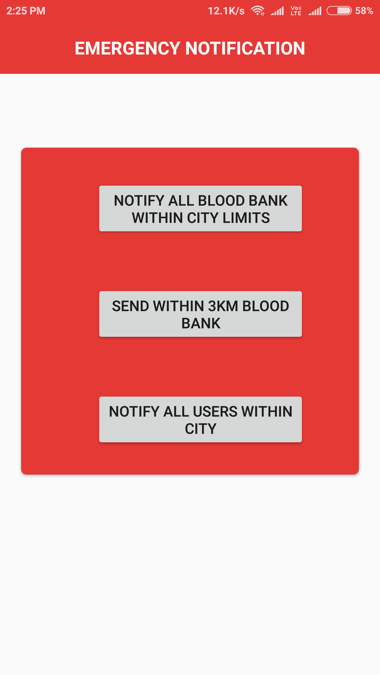
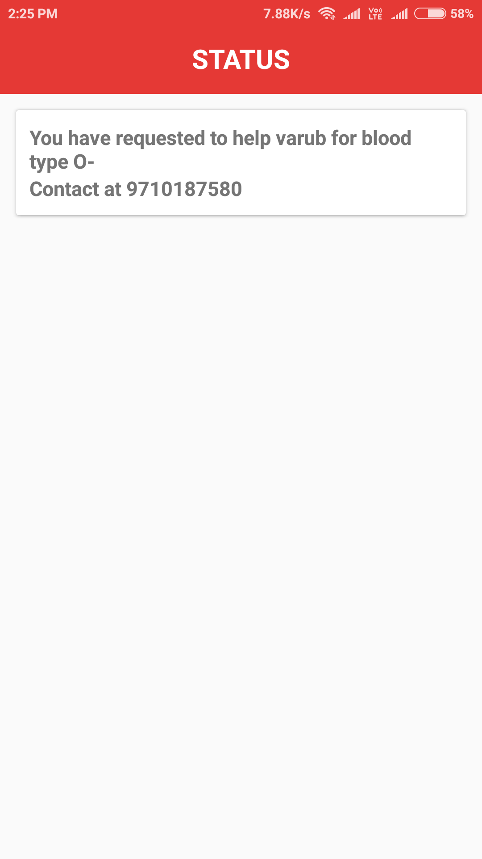
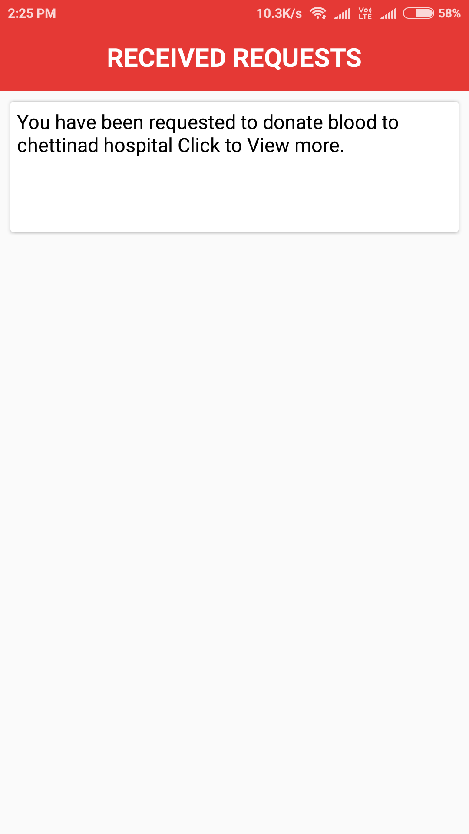
Implementation -

Slide 8
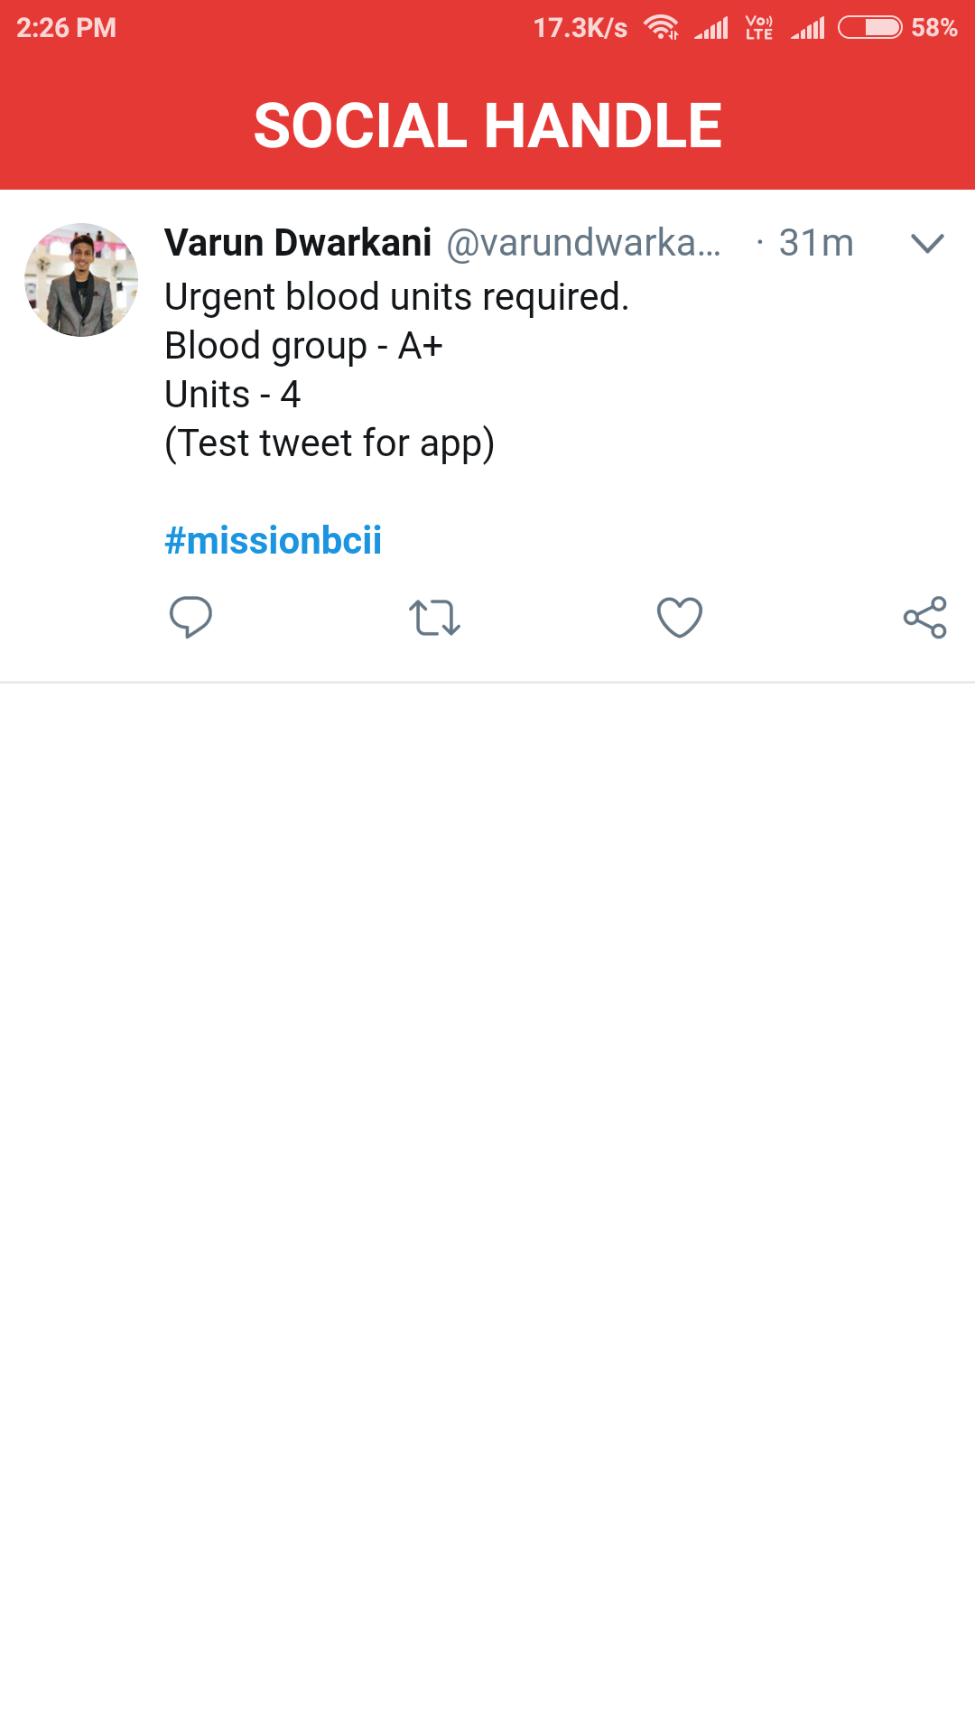
#missionbcii

Slide 9
<How will your product influence the world ?>
Blood is one of the requirements which is always immediate.
We can never predict when a person might end up in an
accident and require blood. Our application will definitely help
interconnecting all the blood requesters with people who are
willing to donate blood in the world.
Social impact :
Connecting all the blood needy ones with blood donors can
help to create a big change over saving lives.
IMPACT OF THE PRODUCT

