Slide 2
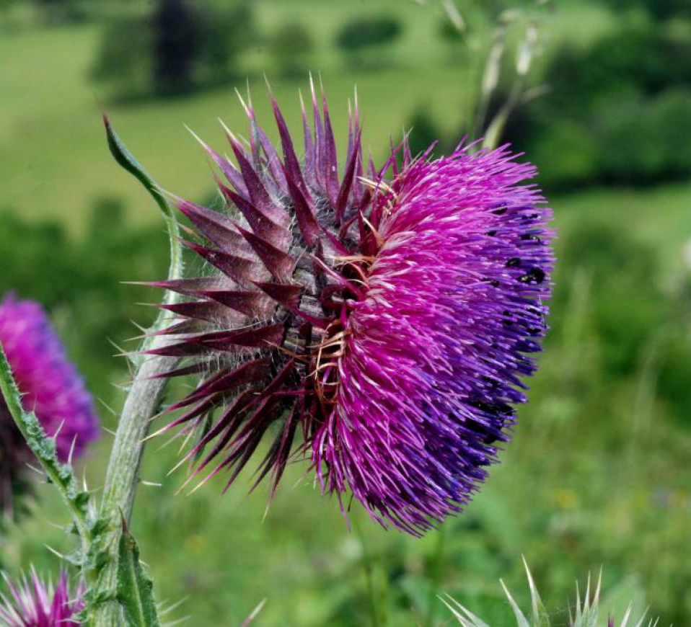
Study Species: Carduus Nutans
Invasive weed in US
Causes severe decrease in agricultural productivity
Managed with
Mowing
Biological control (weevil)
Warming shown to accelerate thistle phenology
brc.ac.uk

Slide 3
Experimental Design
Block 1-10
Plot 1: Ambient
Plot 2:
Warmed
Testing seed drop time (proxy for dispersal distance)
2 Warming Treatments
Ambient
Warmed
3 Mowing Treatments
No Mowing
Early
Late
Treatments Randomly Assigned
Pos. 1: No Mow
Pos. 1: No Mow
Pos. 2: Early Mow
Pos. 2: Early Mow
Pos. 3: Late Mow
Pos. 3: Late Mow
10 seeds planted per position

Slide 4
Research Questions
Is seed terminal velocity predicted by seed shape parameters?
To what extent does warming and mowing treatments change seed terminal velocity?
Can changes in terminal velocity by treatment be explained by changes in seed shape parameters?

Slide 5
Effect of treatments on TV

Slide 6
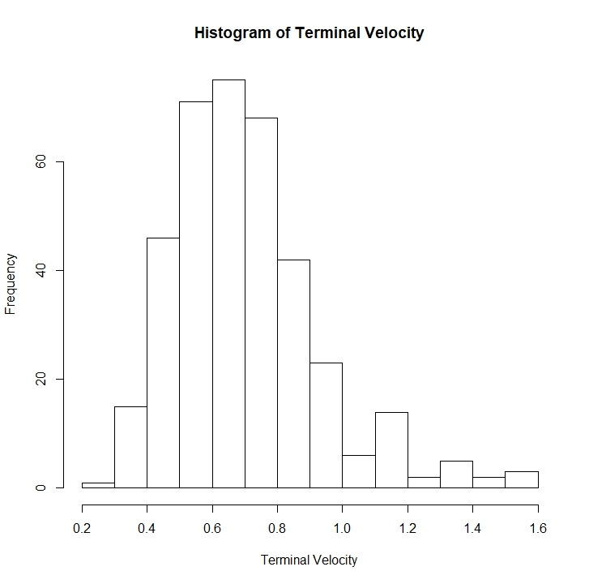
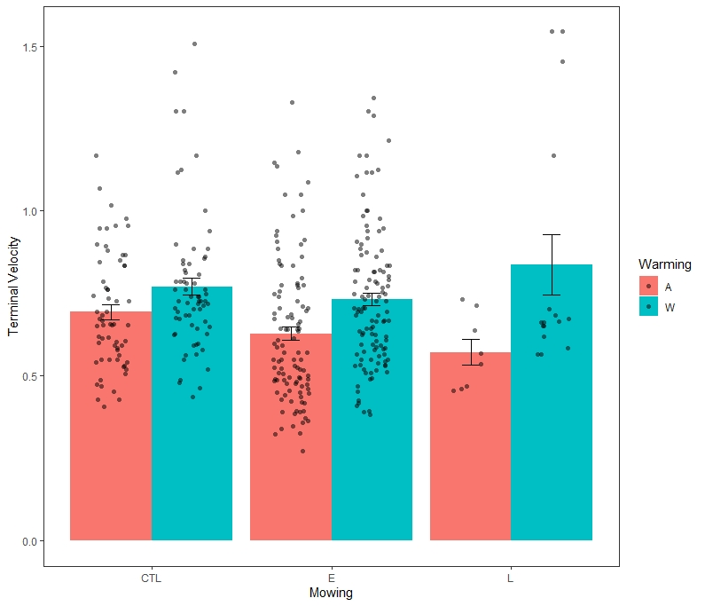
Preliminary Data Analysis

Slide 7
ANOVA for Warming and Mowing
Warming Alone
 | Estimate
Ambient | 0.6489***
Warmed | 0.1051***
Mowing and Warming
 | Estimate
Ambient Control | 0.6796***
Early Mow | -0.5130*
Late Mow | -0.0005
Warmed | 0.1040***
Mowing Alone
 | Estimate
Control | 0.7333***
Early | -0.5124*
Late | 0.0152
Significance Codes 0 *** 0.001 ** 0.05 * 0.1 .

Slide 8
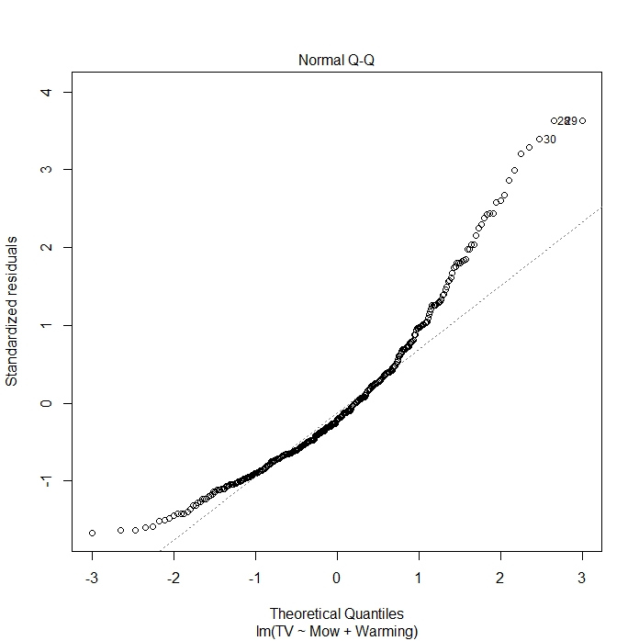
ANOVA for Warming and Mowing
Warming Alone
 | Estimate
Ambient | 0.6489***
Warmed | 0.1051***
Mowing and Warming
 | Estimate
Ambient Control | 0.6796***
Early Mow | -0.5130*
Late Mow | -0.0005
Warmed | 0.1040***
Mowing Alone
 | Estimate
Control | 0.7333***
Early | -0.5124*
Late | 0.0152
Significance Codes 0 *** 0.001 ** 0.05 * 0.1 .

Slide 9
ANOVA for Warming and Mowing Log – Transform Terminal Velocity
Warming Alone
 | Estimate
Ambient | -0.4783***
Warmed | 0.1558***
Mowing and Warming
 | Estimate
Ambient Control | -0.423***
Early Mow | -0.089**
Late Mow | -0.038
Warmed | 0.155***
Mowing Alone
 | Estimate
Control | -0.343***
Early | -0.892**
Late | -0.015
Significance Codes 0 *** 0.001 ** 0.05 * 0.1 .

Slide 10
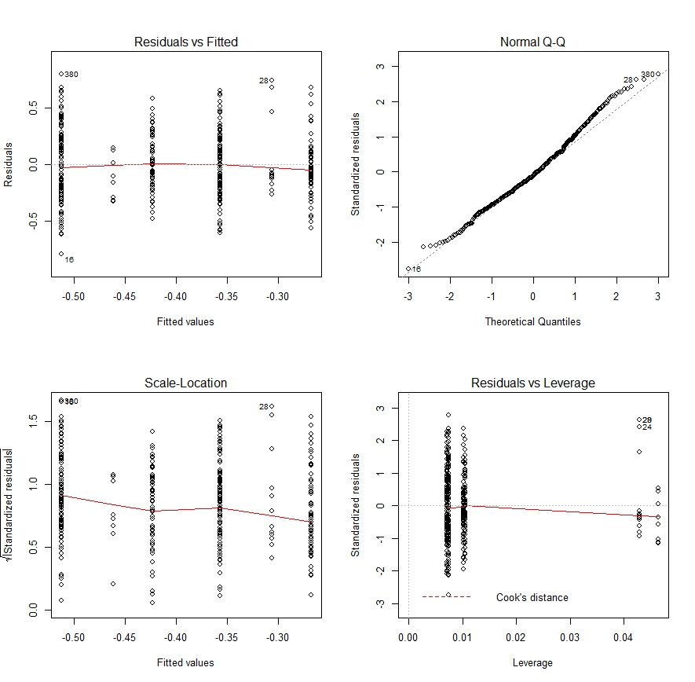
ANOVA for Warming and Mowing Log – Transform Terminal Velocity
Warming Alone
 | Estimate
Ambient | -0.4783***
Warmed | 0.1558***
Mowing and Warming
 | Estimate
Ambient Control | -0.423***
Early Mow | -0.089**
Late Mow | -0.038
Warmed | 0.155***
Mowing Alone
 | Estimate
Control | -0.343***
Early | -0.892**
Late | -0.015
Significance Codes 0 *** 0.001 ** 0.05 * 0.1 .

Slide 11
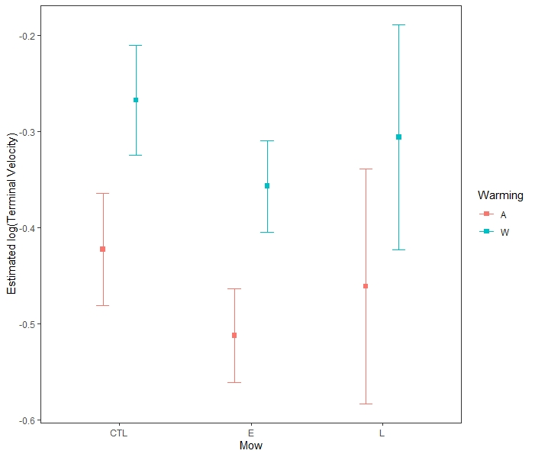
ANOVA for Warming and Mowing Log – Transform Terminal Velocity
Model | P-value
Warming only
Warming and Mowing | 0.019*
Interaction | 0.216

Slide 12
Effect of physical properties on TV
Both warming and mowing affect TV
Warming increases TV
Early mowing decreases TV, but not enough to compensate for increases due to warming
Model | P-value
Warming only
Warming and Mowing | 0.019*
Interaction | 0.216

Slide 13
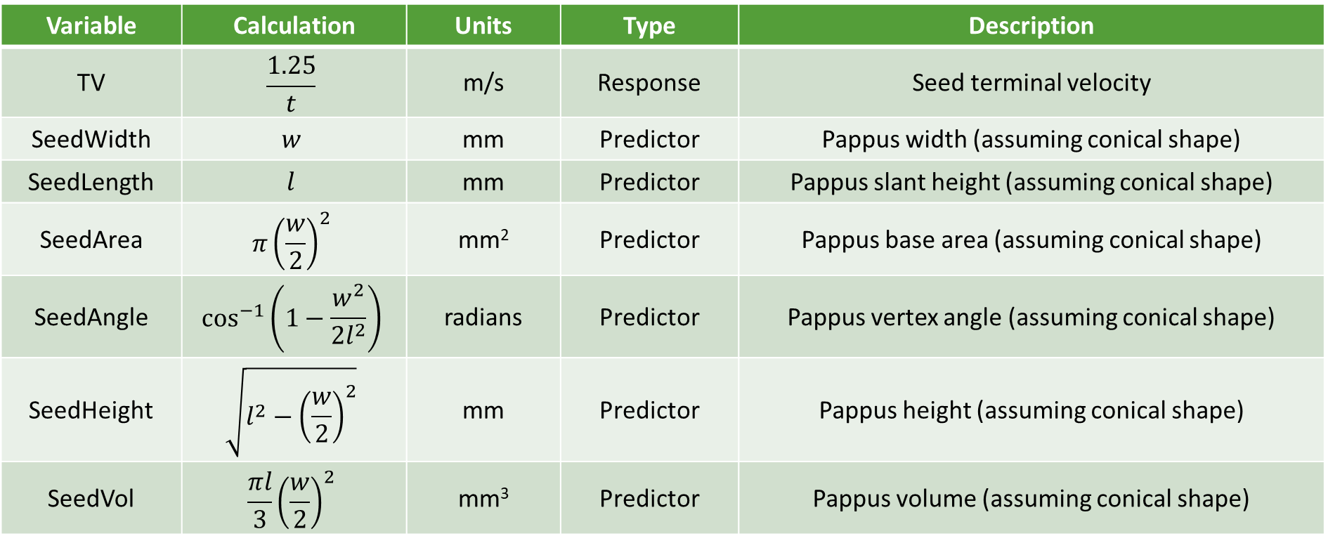
Regression variables
Variable | Calculation | Units | Type | Description
TV | $$\frac{1.25}{t}$$ | m/s | Response | Seed terminal velocity
SeedWidth | $$w$$ | mm | Predictor | Pappus width (assuming conical shape)
SeedLength | $$l$$ | mm | Predictor | Pappus slant height (assuming conical shape)
SeedArea | $$π{\left(\frac{w}{2}\right)}^{2}$$ | mm² | Predictor | Pappus base area (assuming conical shape)
SeedAngle | $$\cos^{−1}\left(1−\frac{w^{2}}{2l^{2}}\right)$$ | radians | Predictor | Pappus vertex angle (assuming conical shape)
SeedHeight | $$\sqrt{l^{2}−{\left(\frac{w}{2}\right)}^{2}}$$ | mm | Predictor | Pappus height (assuming conical shape)
SeedVol | $$\frac{πl}{3}{\left(\frac{w}{2}\right)}^{2}$$ | mm³ | Predictor | Pappus volume (assuming conical shape)

Slide 14
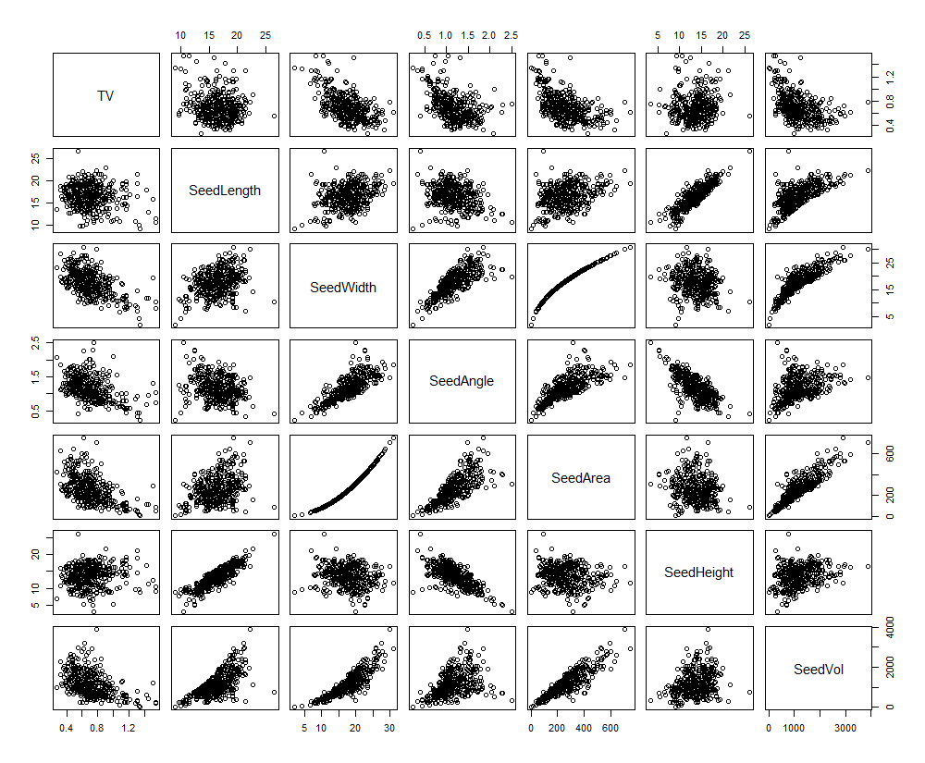
Correlations between variables
Some predictor variables are highly correlated
Occurs because some variables are calculated from other variables
Will cause multicollinearity issues
Response variable is clearly correlated with several predictors (e.g. SeedWidth, SeedAngle, SeedVol)

Slide 15
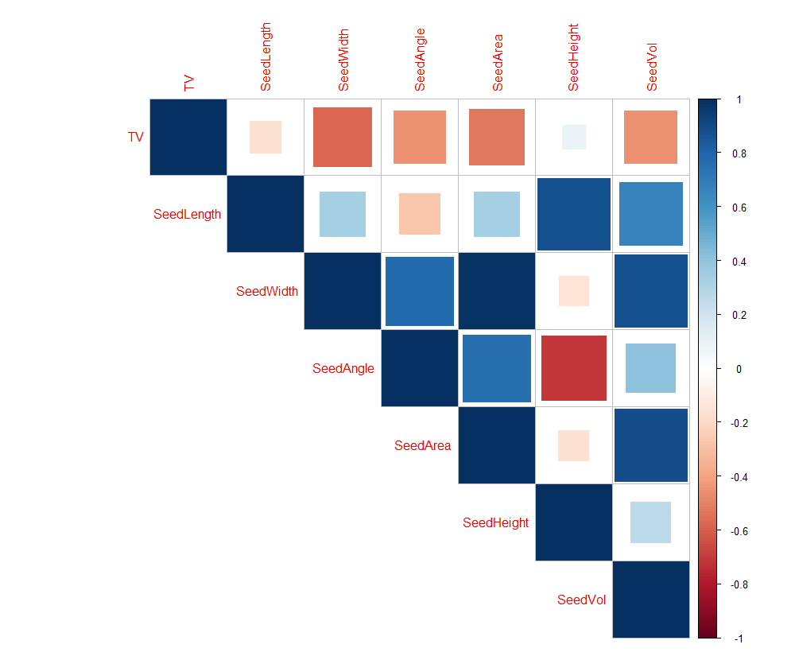
Correlations between variables
Some predictor variables are highly correlated
Occurs because some variables are calculated from other variables
Will cause multicollinearity issues
Response variable is clearly correlated with several predictors (e.g. SeedWidth, SeedAngle, SeedVol)

Slide 16
Variable selection
Variable | Estimate | Standard Error | P | Significance | VIF
(Intercept) | 1.7939155 | 0.2871889 | < 0.0001 | ***
SeedWidth | -0.0901834 | 0.0294440 | 0.00236 | ** | 232
SeedLength | 0.2323392 | 0.1394278 | 0.09650 | . | 1673
SeedArea | -0.0012359 | 0.0020885 | 0.55438 |  | 918
SeedAngle | -0.2098880 | 0.4396778 | 0.63339 |  | 291
SeedHeight | -0.2336151 | 0.1535504 | 0.12902 |  | 2709
SeedVol | 0.0003648 | 0.0001638 | 0.02653 | * | 128
Fit model using all predictors with no transformations such that:
TV ~ SeedWidth + SeedLength + SeedArea + SeedAngle + SeedHeight + SeedVol

Slide 17
Variable selection
Variable | Backward selection | Backward selection (AIC) | Bi-directional selection (AIC) | Forward selection (AIC)
(Intercept) | 1.6698759 | 1.6698759 | 1.6698759 | 1.6694531
SeedWidth | -0.1027270 | -0.1027270 | -0.1027270 | -0.0865305
SeedLength | 0.1536113 | 0.1536113 | 0.1536113 | -
SeedArea | - | - | - | 0.0021475
SeedAngle | - | - | - | -
SeedHeight | -0.1470827 | -0.1470827 | -0.1470827 | -
SeedVol | 0.0002749 | 0.0002749 | 0.0002749 | -
AIC | - | -1293.6 | -1293.6 | -1288.4
R² | 0.3921 | 0.3921 | 0.3921 | 0.3803
All coefficient estimates are highly significant at p < 0.001 (***)

Slide 18
Variable selection
Model 1
Model 2
Variable | Backward selection | Backward selection (AIC) | Bi-directional selection (AIC) | Forward selection (AIC)
(Intercept) | 1.6698759 | 1.6698759 | 1.6698759 | 1.6694531
SeedWidth | -0.1027270 | -0.1027270 | -0.1027270 | -0.0865305
SeedLength | 0.1536113 | 0.1536113 | 0.1536113 | -
SeedArea | - | - | - | 0.0021475
SeedAngle | - | - | - | -
SeedHeight | -0.1470827 | -0.1470827 | -0.1470827 | -
SeedVol | 0.0002749 | 0.0002749 | 0.0002749 | -
AIC | - | -1293.6 | -1293.6 | -1288.4
R² | 0.3921 | 0.3921 | 0.3921 | 0.3803
All coefficient estimates are highly significant at p < 0.001 (***)

Slide 19
Model selection
Both models have high multicollinearity
Worse in model 1 than in model 2
If we were to choose based on VIF alone, model 2 would be a better selection
Variable | Model 1 VIF | Model 2 VIF
(Intercept) | - | -
SeedWidth | 37 | 30
SeedLength | 70 | -
SeedArea | - | 30
SeedAngle | - | -
SeedHeight | 72 | -
SeedVol | 15 | -

Slide 20
Model selection
Model 2
Model 1
Variable | 1 | 2 | 3 | 4 | 5 | 6
SeedWidth | * | * | * | * | * | *
SeedLength |  |  | * | * | * | *
SeedArea |  | * | * |  | * | *
SeedAngle |  |  |  |  |  | *
SeedHeight |  |  |  | * | * | *
SeedVol |  |  |  | * | * | *
R² | 0.3292141 | 0.3836799 | 0.3845918 | 0.3987089 | 0.3989259 | 0.3993030
If we can only choose two variables, we should select SeedWidth and SeedArea.
Model 2 seems like the better choice because it yields a large decrease in multicollinearity for only a small decrease in R².

Slide 21

Model selection
If SeedArea is calculated only from SeedWidth as ${π\left(\frac{w}{2}\right)}^{2}$, then why not use a single-variable polynomial regression instead of two variables?
Furthermore, is the quadratic term even necessary?
Variable | Model 2 VIF
(Intercept) | -
SeedWidth | 30
SeedLength | -
SeedArea | 30
SeedAngle | -
SeedHeight | -
SeedVol | -
Model 3: TV ~ SeedWidth
Model 4: TV ~ SeedWidth + I(SeedWidth^2)

Slide 22
Model selection
All terms are highly significant
Addition of the quadratic term reduces the amount of unexplained variance
Model 4 is likely the better choice, but we should check the model diagnostics to make sure
Value | Model 3 | Model 4
Intercept p-value | < 0.0001 | < 0.0001
SeedWidth p-value | < 0.0001 | < 0.0001
I(SeedWidth^2) p-value | - | < 0.0001
AIC | -1259.1 | -1288.4
R² | 0.3274 | 0.3803

Slide 23
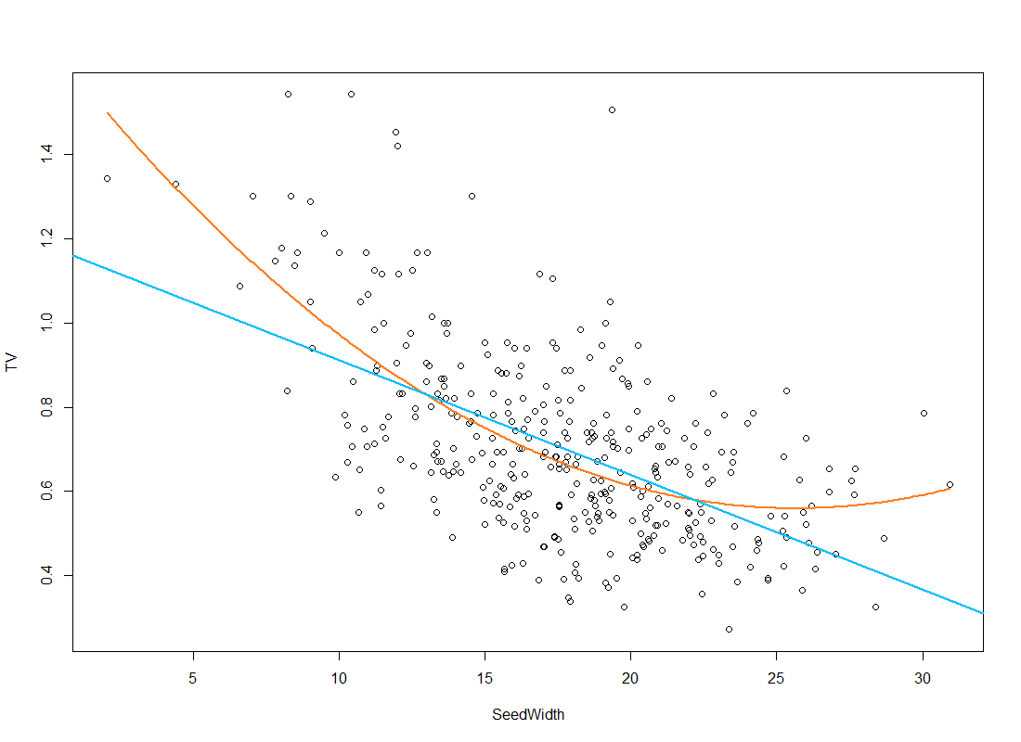
Model diagnostics
Clear pattern of curvature in the data
Polynomial model (model 4) seems to fit better than strictly linear model (model 3)
Model 4
Model 3

Slide 24
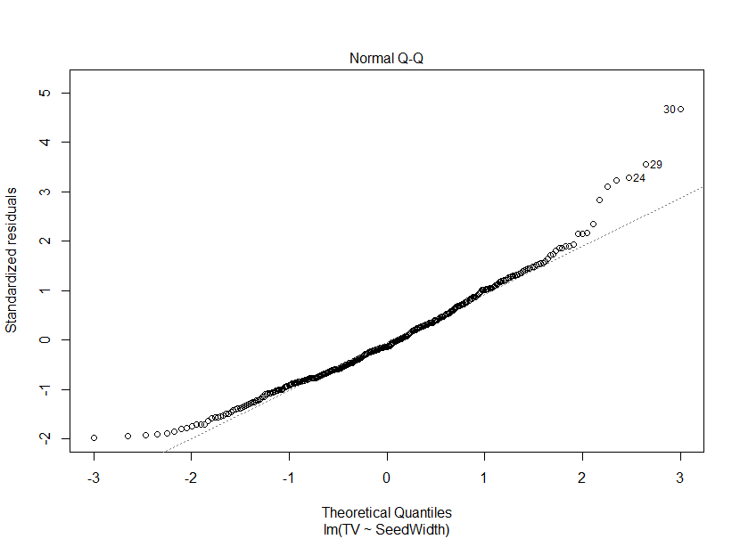
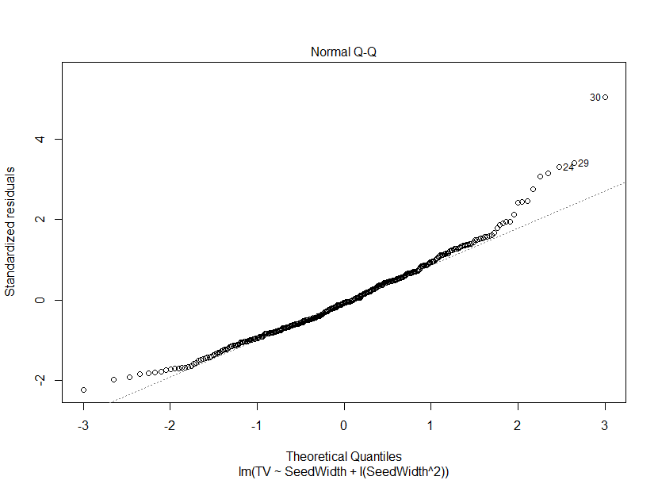
Model diagnostics
Model 3
Model 4
Normality of residuals is approximately the same, with slight deviations at tails

Slide 25
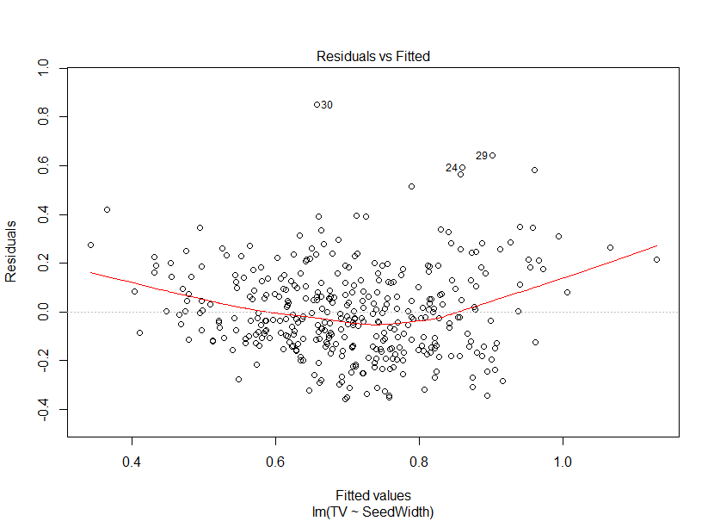
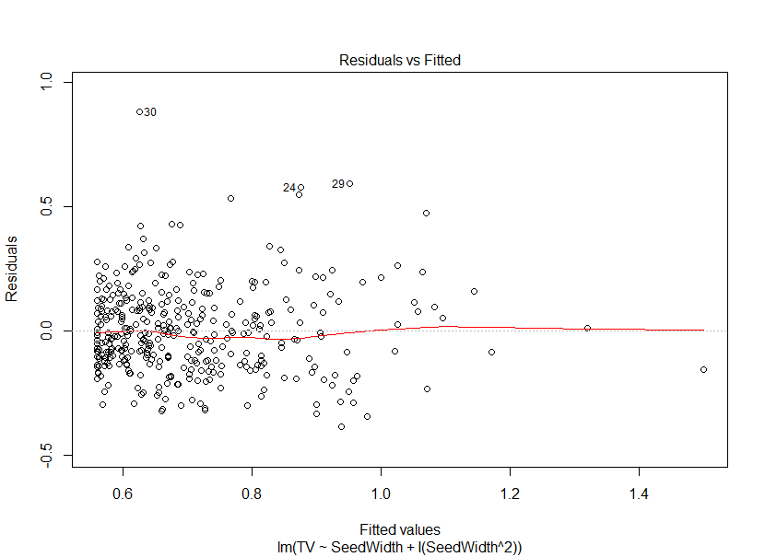
Model diagnostics
Model 3
Model 4
Curvature of residuals in model 3, but no obvious pattern in model 4

Slide 26
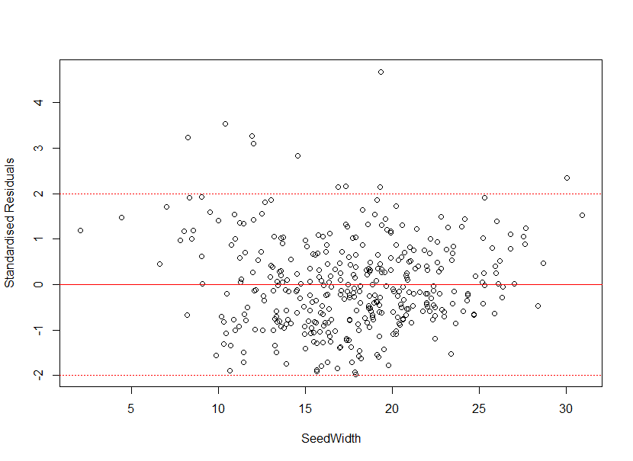
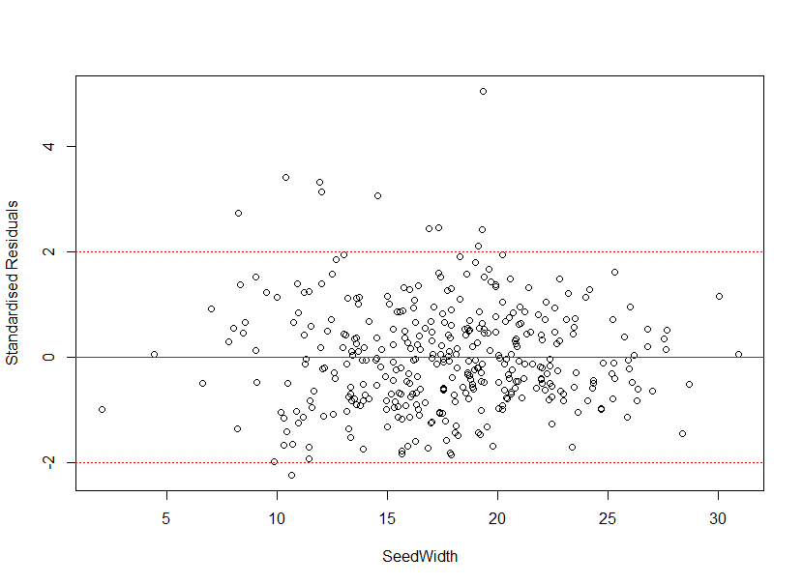
Model diagnostics
Model 3
Model 4
Curvature of residuals in model 3, but no obvious pattern in model 4

Slide 27
Conclusions
Width of the seed pappus is the best estimator of terminal velocity
As pappus width increases, terminal velocity decreases
Other predictors such as pappus height and volume add explanatory power, but not much
This is due to high multicollinearity

Slide 28
Effect of treatments on physical properties

