Slide 2
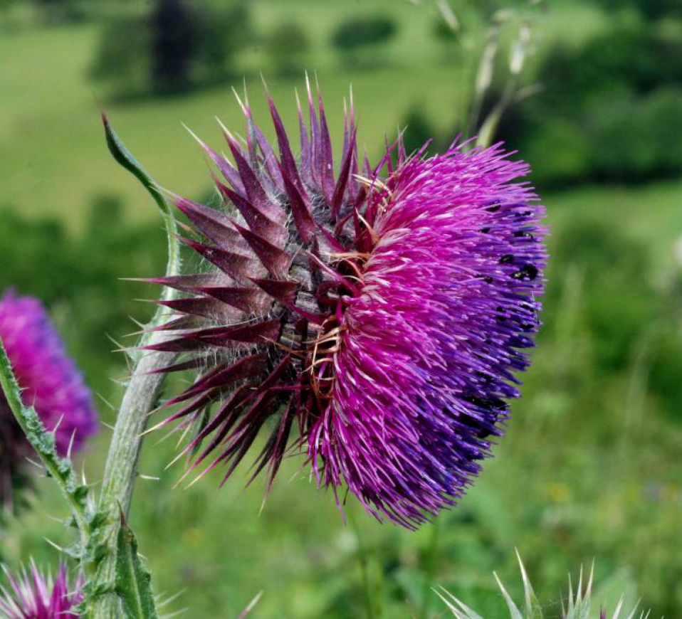
Study Species: Carduus Nutans
Invasive weed in US
Causes severe decrease in agricultural productivity
Managed with
Mowing
Biological control (weevil)
Warming shown to accelerate thistle phenology
brc.ac.uk

Slide 3
Experimental Design
Block 1-10
Plot 1: Ambient
Plot 2:
Warmed
Testing seed drop time (proxy for dispersal distance)
2 Warming Treatments
Ambient
Warmed
3 Mowing Treatments
No Mowing
Early
Late
Treatments Randomly Assigned
Pos. 1: No Mow
Pos. 1: No Mow
Pos. 2: Early Mow
Pos. 2: Early Mow
Pos. 3: Late Mow
Pos. 3: Late Mow
10 seeds planted per position

Slide 4
Effect of treatments on TV

Slide 5
Effect of physical properties on TV

Slide 6
Effect of treatments on physical properties

