Slide 1
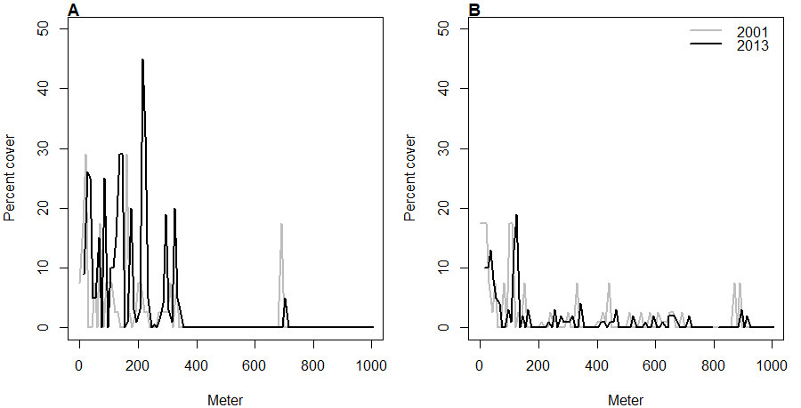
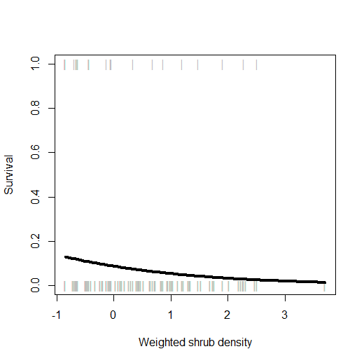
…This is not because grasslands are resisting shrub invasion. In fact, a transplant experiment showed that shrubs do best as grassland invaders. However, recruitment is very low across the board, and we think this is what limits wave expansion. Increasing climate variability is likely to create favorable windows of opportunity that may lead to pulses of shrub expansion (MVE).
Along permanent transects, there has been virtually no advance of the creosote wave for over a decade….
Grass
Ecotone
Shrub

Slide 2
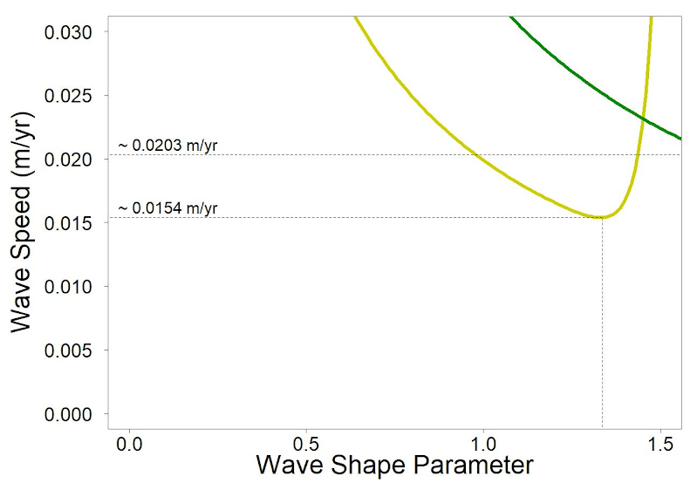
(Wet year)
(Average year)

