Slide 1

Introduction to AquaticAlgorithms
STEP-UP Internship Program Summer 2023
Day 1
July 24, 2023

Slide 2
Outline
AquaticAlgorithms
About me
Program goals
Schedule
Resources:
GitHub
Google Colab
Case Study Overview

Slide 3
About Me: Trevor
AquaticAlgorithms

Slide 4
Program Goals
AquaticAlgorithms
Learn about the complexity of climate, hydrology, and their interactions with the human environment.
Learn about the role of water resource engineers, data science, and environmental modeling in the environmental management.
Become comfortable with basic coding practices and concepts; be able to interpret, run, and write beginner-level Python code.
Gain familiarity with probability and statistics concepts, how they can be used in environmental studies, and how to use code to measure them.
Complete a case study for a student-chosen location of interest, focused on the unique interactions between the hydrology and the human system.

Slide 5
Program Goals
AquaticAlgorithms
Learn about the complexity of climate, hydrology, and their interactions with the human environment.
Learn about the role of water resource engineers, data science, and environmental modeling in the environmental management.
Become comfortable with basic coding practices and concepts; be able to interpret, run, and write beginner-level Python code.
Gain familiarity with probability and statistics concepts, how they can be used in environmental studies, and how to use code to measure them.
Complete a case study for a student-chosen location of interest, focused on the unique interactions between the hydrology and the human system.

Slide 6
Program Goals
AquaticAlgorithms
Learn about the complexity of climate, hydrology, and their interactions with the human environment.
Learn about the role of water resource engineers, data science, and environmental modeling in the environmental management.
Become comfortable with basic coding practices and concepts; be able to interpret, run, and write beginner-level Python code.
Gain familiarity with probability and statistics concepts, how they can be used in environmental studies, and how to use code to measure them.
Complete a case study for a student-chosen location of interest, focused on the unique interactions between the hydrology and the human system.

Slide 7
Program Goals
AquaticAlgorithms
Learn about the complexity of climate, hydrology, and their interactions with the human environment.
Learn about the role of water resource engineers, data science, and environmental modeling in the environmental management.
Become comfortable with basic coding practices and concepts; be able to interpret, run, and write beginner-level Python code.
Gain familiarity with probability and statistics concepts, how they can be used in environmental studies, and how to use code to measure them.
Complete a case study for a student-chosen location of interest, focused on the unique interactions between the hydrology and the human system.

Slide 8
Program Goals
AquaticAlgorithms
Learn about the complexity of climate, hydrology, and their interactions with the human environment.
Learn about the role of water resource engineers, data science, and environmental modeling in the environmental management.
Become comfortable with basic coding practices and concepts; be able to interpret, run, and write beginner-level Python code.
Gain familiarity with probability and statistics concepts, how they can be used in environmental studies, and how to use code to measure them.
Complete a case study for a student-chosen location of interest, focused on the unique interactions between the hydrology and the human system.

Slide 9
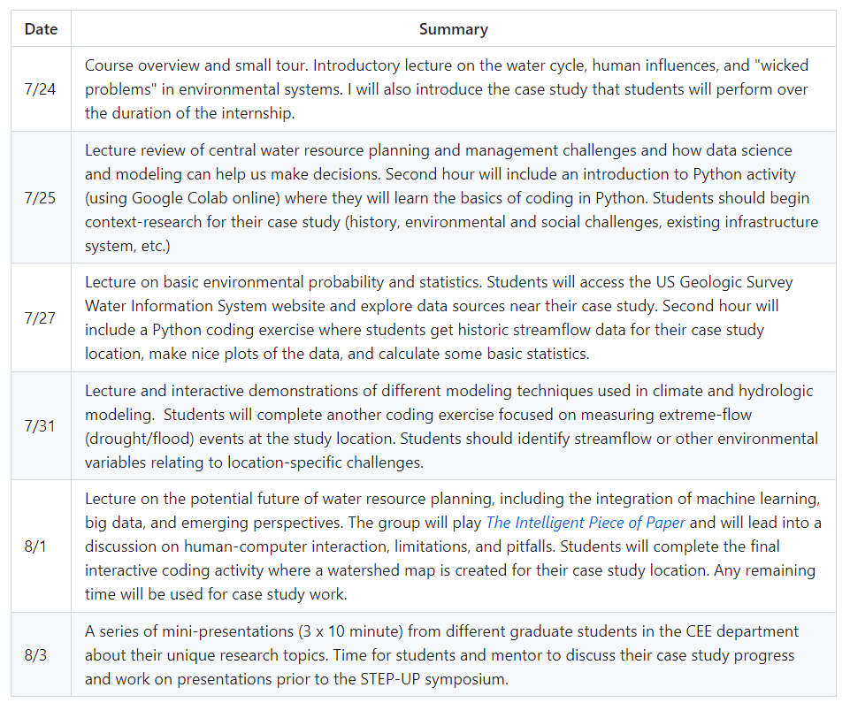
Schedule
AquaticAlgorithms
Overview, wicked problems, and choosing a case study location.
Water resource infrastructure planning
Probability and stats
Modeling basics
Future of water resource planning
Presentations and completing activities

Slide 10
GitHub
AquaticAlgorithms
What is GitHub?
GitHub is a code hosting platform for version control and collaboration. It lets you and others work together on projects from anywhere.

Slide 11





GitHub
AquaticAlgorithms
What is GitHub? Version Control

Slide 12
GitHub
AquaticAlgorithms
What is GitHub? The home-base for this program
https://github.com/TrevorJA/AquaticAlgorithms

Slide 13
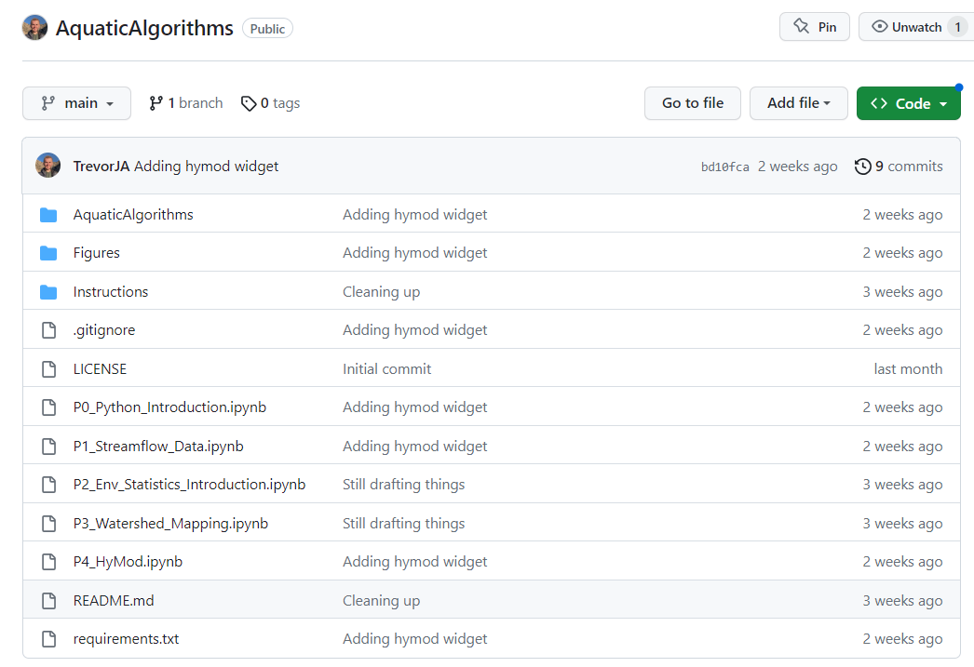
GitHub
AquaticAlgorithms
What is GitHub? The home-base for this program
All files: code, presentations, etc.

Slide 14
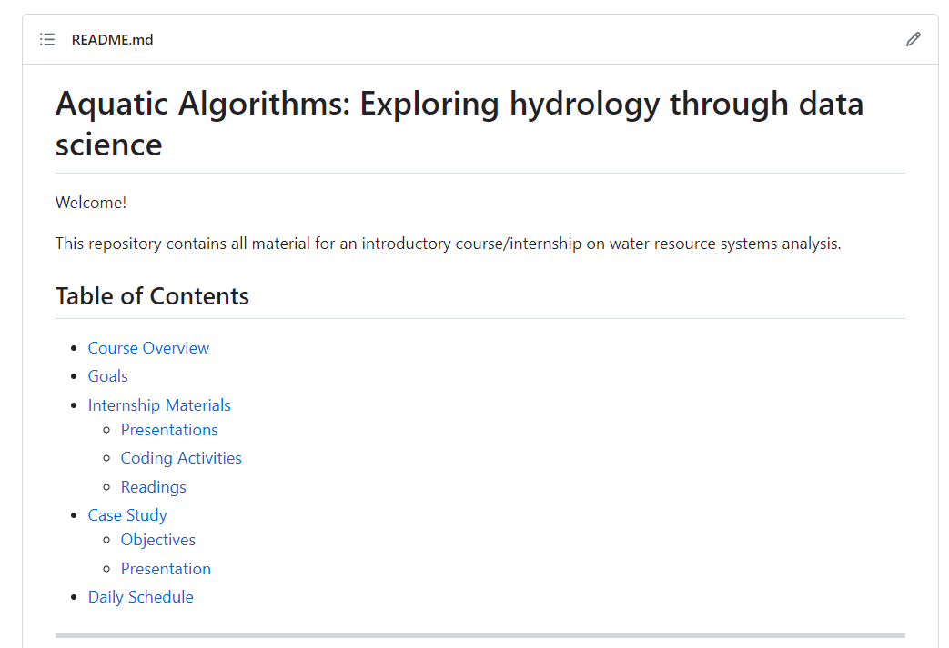
GitHub
AquaticAlgorithms
What is GitHub? The home-base for this program
Program outline, schedule, and resources

Slide 15
GitHub
AquaticAlgorithms
What is GitHub? “Repository”

Slide 16
GitHub
AquaticAlgorithms
What is GitHub? “Repository”
Repositories have files called “README.md”
These are markdown files (.md)
README files give instructions

Slide 17
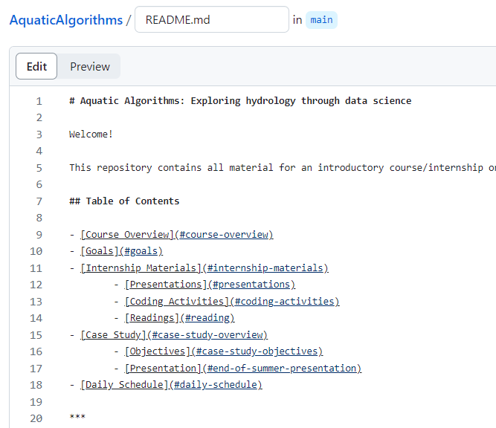
GitHub
AquaticAlgorithms
What is GitHub? “Repository”

Slide 18
Google Colab
AquaticAlgorithms
This is how we are going to do all our coding!

Slide 19
Google Colab
AquaticAlgorithms
This is how we are going to do all our coding!
Benefits:
No need to install Python or any other software
It’s easy to use
Your work can be saved on Google Drive
It’s free

Slide 20
Next Time
AquaticAlgorithms
Let’s talk about hydrology!

